Slide 1

TACHYONSYS ASSIGNMENT
- K.SAMYUKTHA
B.Sc. MATHEMATICS.

Slide 2
1.DIFFERENT TYPE OF GRAPHS & CHARTS
BAR GRAPH
“William Playfair” , inventor of bar chart.
A “bar graph or bar chart” is the one which represents limited or possible data with rectangular bars with heights or lengths corresponding to the values they represent.
In other words, it’s the pictorial representation of grouped data in form of vertical or horizontal rectangular bars.
Here the length of bars are equal to the measure of data.
Below is the simple representation of bar graph or bar chart.

Slide 4
LINE GRAPH
“William Playfair” , inventor of line graph.
Line graph is the graphical representation where we find how the value changes.
In other words, it’s a type of chart used to show information that changes over time.
Below is the simple representation of line graph or line chart.

Slide 5
SCATTER PLOT
A graph plotted with points that have relationship between two sets of data. It’s used to plot graphically with help of dots.
The dots represent the values of individual data points.
Below is the simple representation of scatter plot.

Slide 6
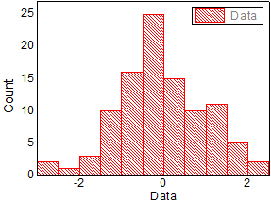
HISTOGRAM
Histogram first introduced by “Karl Pearson”.
It’s the representation of frequency distribution by means of rectangles whose width represents the class intervals and areas are proportional to the corresponding frequencies.
In other words, it is used to summarize continuous data that are measured on an interval scale.
Below is the simple representation of histogram.

Slide 7
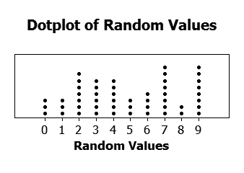
DOT PLOT
Introduced by “Gibbs and McIntyre”.
A dot plot or dot chart or strip plot, is the representation of data in form of dots or small circles. These are used to represent small amount of data.
Below is the simple representation of dot plot.

Slide 8
PIE CHART
“William Playfair”, introduced pie chart.
Pie chart is the type of graph in which circle is divided into segments to illustrate the data or numerical proportions.
It’s also called as “circle graph”.
Below is the simple representation of pie chart.

Slide 9
AREA CHART
An “area chart or area graph” represents graphically quantitative data. It’s based on line chart.
Commonly, it’s the comparison between two or more quantities with an area chart.
Below is the simple representation of area chart.

Slide 10
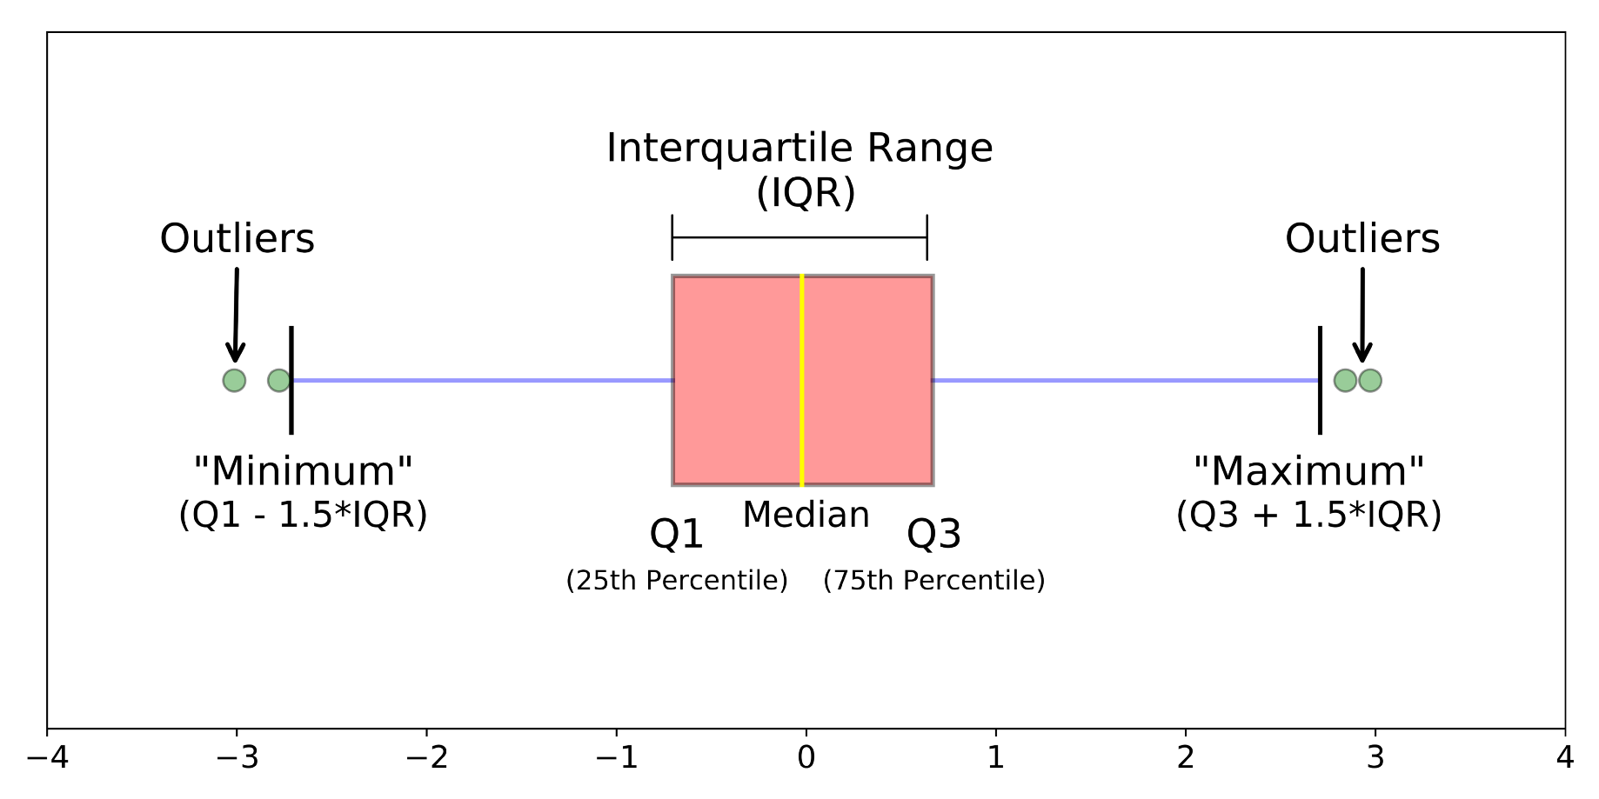
BOX PLOT
Invented by “John Wilder Turkey”.
It’s the graphical representation of data in which rectangle is used to represent the second and the third quartiles and vertical line inside to represent the median value.
The upper and lower quartiles are shown as the horizontal lines as either sides of the rectangle.
Below is the simple representation of box plot.

Slide 11
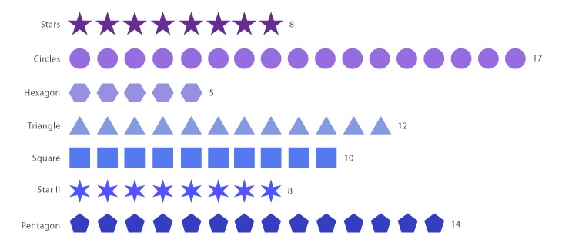
PICTOGRAM
A pictogram is a chart or graph which is used to represent data in a simple way by using pictures.
Also known as “pictograph or picto”.
Below is the simple representation of pictogram.

Slide 12
BUBBLE CHART
Introduced by “Fernanda Viegas and Martin Wattenberg”.
It’s simply a variation of scatter chart.
In scatter chart, data is represented as points whereas in bubble chart, they’re represented as bubbles.
Below is the simple representation of bubble chart.

Slide 13
2. PRACTICAL USES OF GRAPHS AND CHARTS
In businesses, we can use both “bar graphs and pie charts” to represent any information. For example, we can use sales information to depict to customers as well to employees.
Line graph is used to trace the heartbeat. As of now, it is used to represent the statistical changes of people affected by covid.
Histograms are commonly used for large data which gives out median. For example, when we want to calculate the normal body temperature, we have to take the median of all set of people, which is a large data set.
Pictograms are commonly used everywhere in schools, traffic signs, etc.
Scatter plot chart is used to plot data having large variance and the normal one. It is used to track performance against a target in businesses.
In World Wide Web , web pages have vertices which is the use of directed graph.
Google maps is also the example of practical use of graphs, where the roads are the connecting vertices.

Slide 14
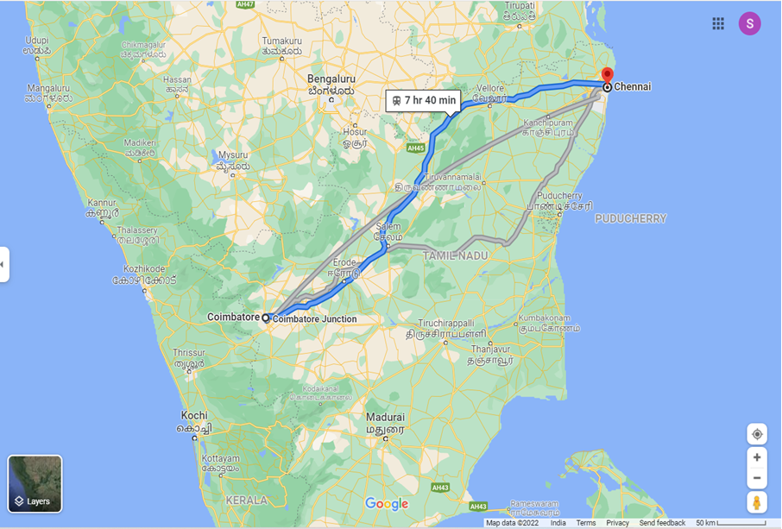
Below is image of google maps which is like a graph having end to end vertices ,

Slide 15
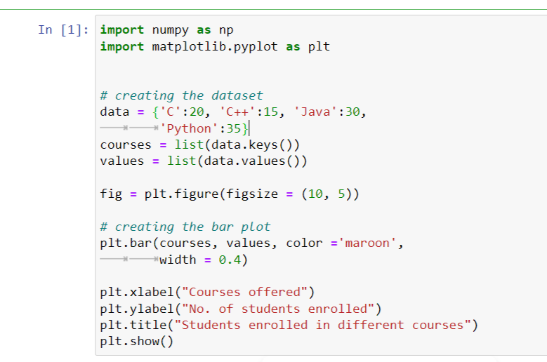
3. GRAPHS & CHARTS USING PYTHON LIBRARY MATPLOTLIB
BAR GRAPH
Screenshot of python code for bar graph :

Slide 16
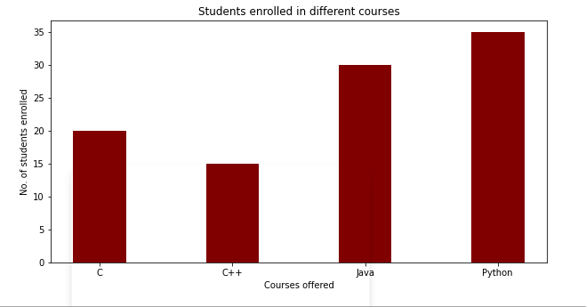
Screenshot of output:

Slide 17
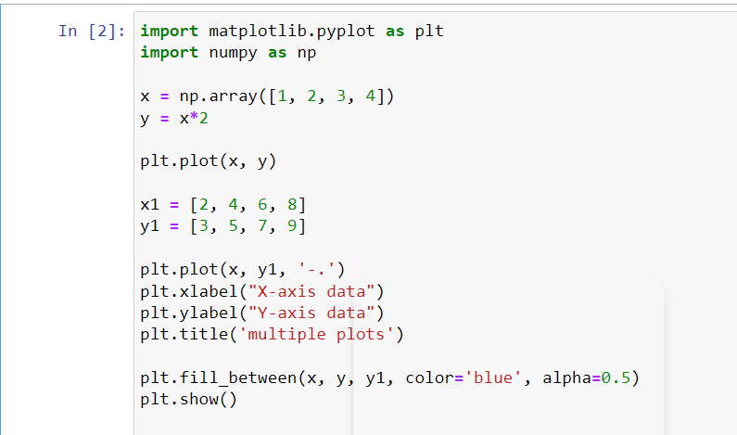
LINE GRAPH
Screenshot of python code for line graph :

Slide 18
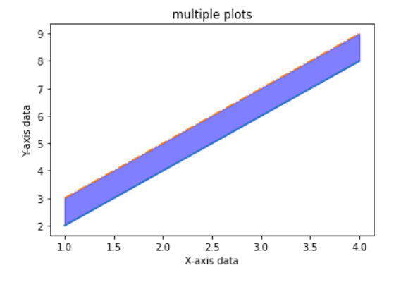
Screenshot of output :

Slide 19
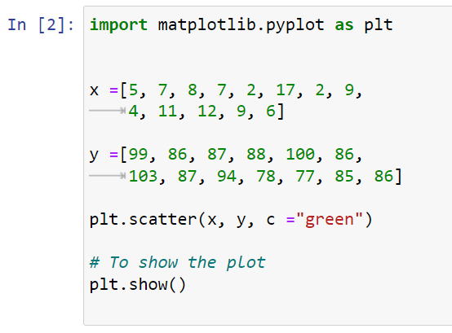
SACTTER PLOT
Screenshot of python code for scatter plot :

Slide 20
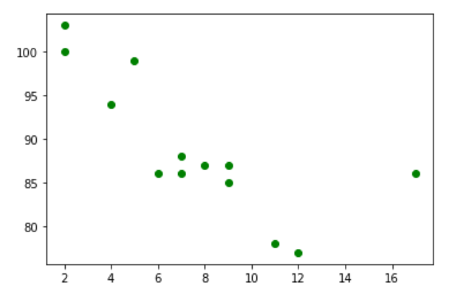
Screenshot of output :

Slide 21
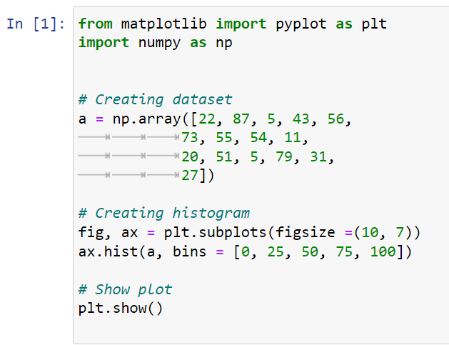
HISTOGRAM
Screenshot of python code for histogram :

Slide 22
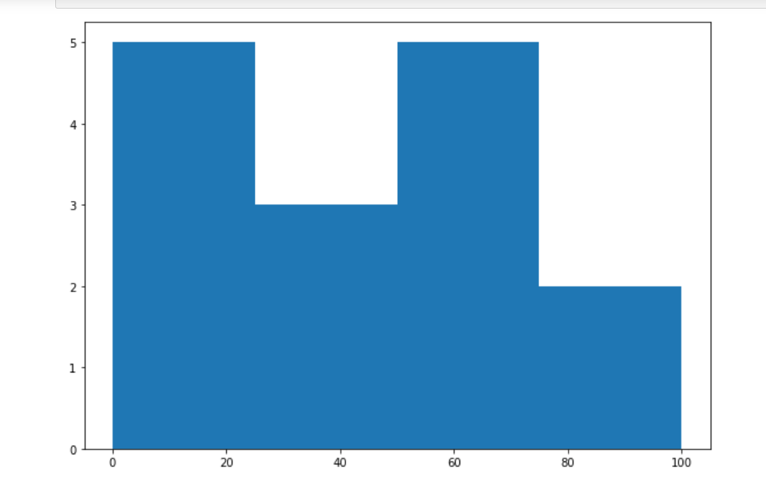
Screenshot of output :

Slide 23
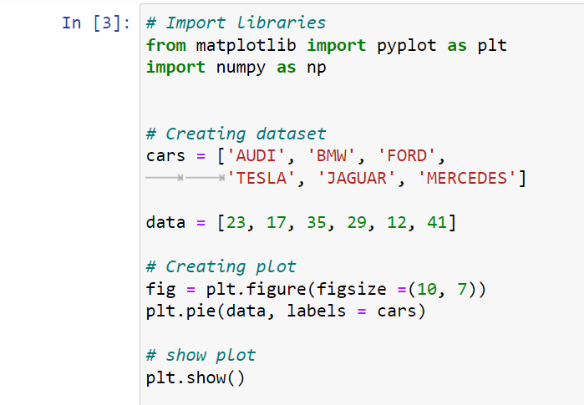
PIE CHART
Screenshot of python code for pie chart :

Slide 24
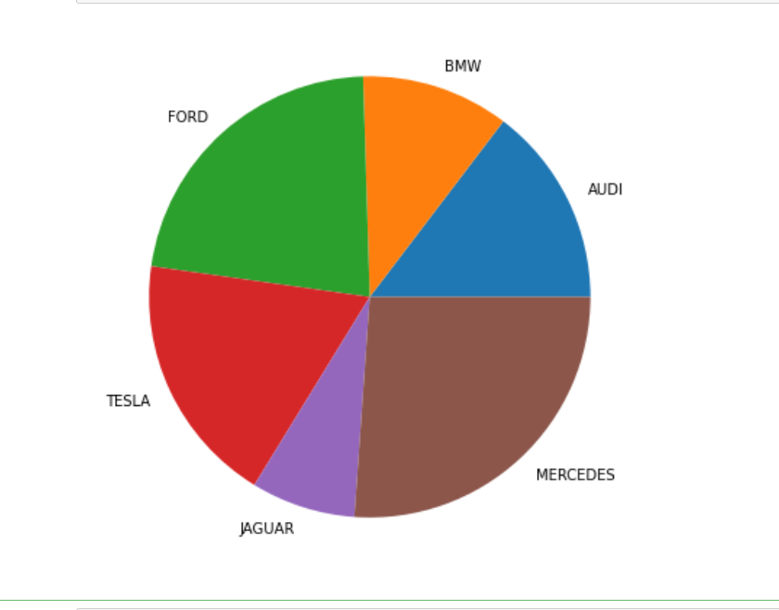
Screenshot of output :

Slide 25
4. LINEAR REGRESSION WITH PRACTICAL EXAMPLE
LINEAR REGRESSION
Generally, regression is used when we try to find the relationship between variables.
Linear regression uses the relationship between the data points to draw the straight line through all them.
This line can be used to predict future values.
Now , in the next slide, we will see the screenshot of the python code for the linear regression and the screenshot of output in the succeeding slide, which is the practical example i.e. the average mark scored by the student from year 2012 to 2021.
That shows the relationship between the average mark to the corresponding years.

Slide 26
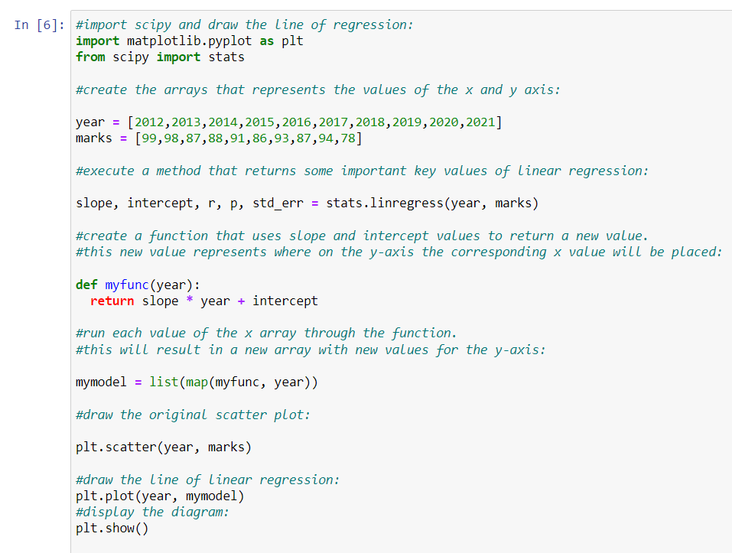
Screenshot of python code for linear regression :

Slide 27
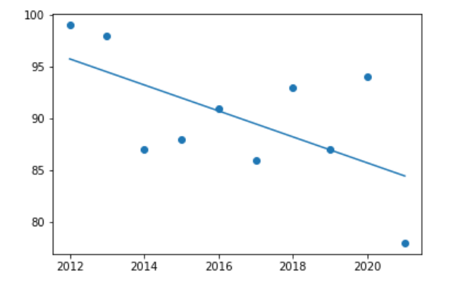
Screenshot of the output :

Slide 28
5. LOGISTIC REGRESSION WITH PRACTICAL EXAMPLE
LOGISTIC REGRESSION
Logistic regression is a simple machine learning method that we can use to predict the value of a numeric categorical variable based on its relationship with predicted values.
Logistic Regression Use Cases
Purchase propensity vs. Ad spend analysis
Customer chum prediction
Employee attrition modelling
Hazardous event prediction

Slide 29
Logistic Regression Assumptions
Data is free of missing values.
The predictant variable is binary (only accepts two values) or ordinal (a categorical variable with ordered values).
All predictors are independent of each other.
There are at least 50 observations per predictor variable (to ensure reliable results).
Now, we will demonstrate the logistic regression with the example.

Slide 30
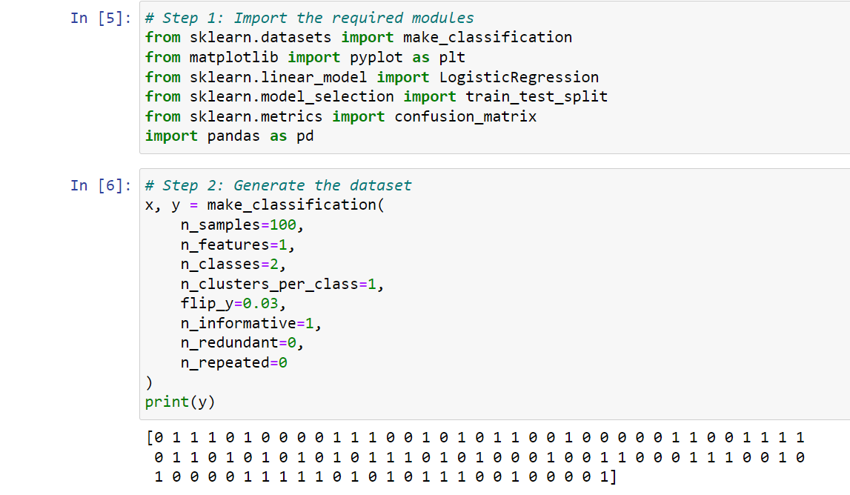
Screenshot of python code for logistic regression :

Slide 31
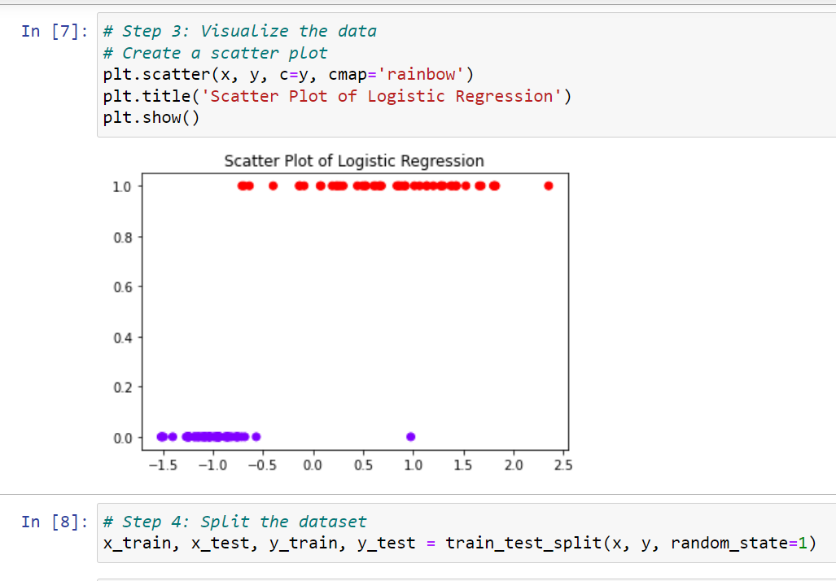

Slide 32
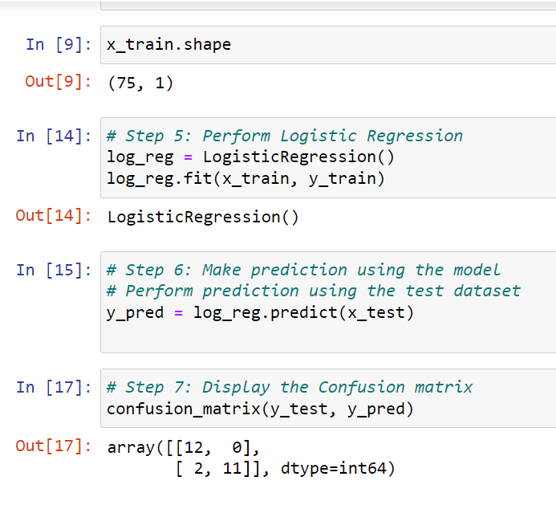

Slide 33
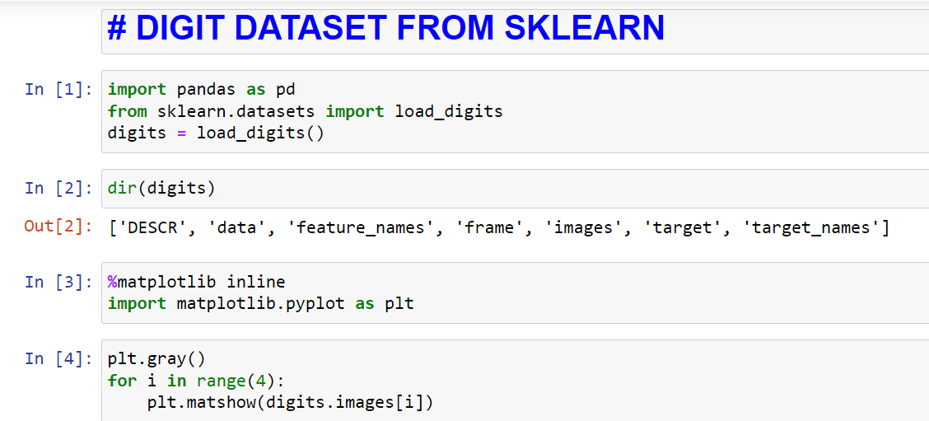
6. RANDOM FOREST WITH PRACTICAL EXAMPLE
RANDOM FOREST
Random forest is a classification algorithm consisting of many decision trees.
It uses bagging and feature randomness when building each individual tree to try to create an uncorrelated forest of trees whose prediction by committee is more accurate that of any individual tree.
Now, we will see the practical example.

Slide 34
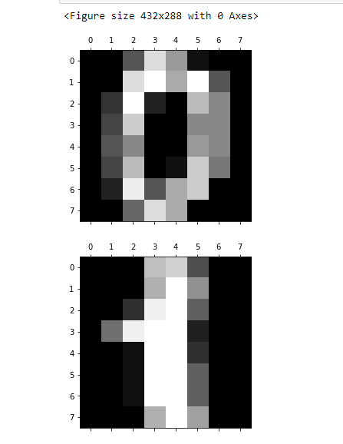

Slide 35
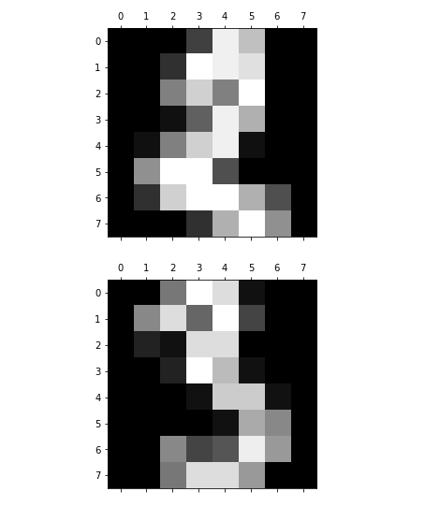

Slide 36
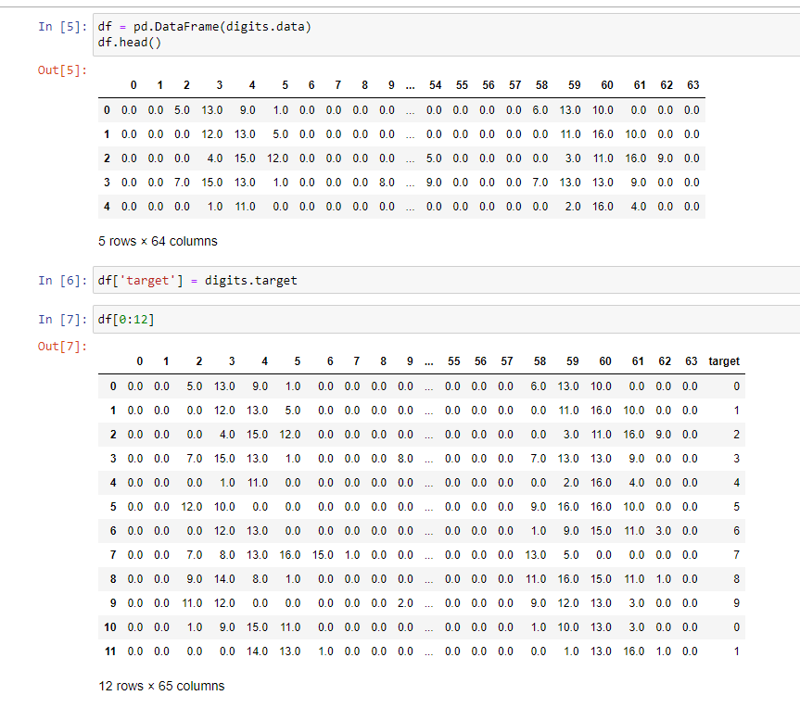

Slide 37
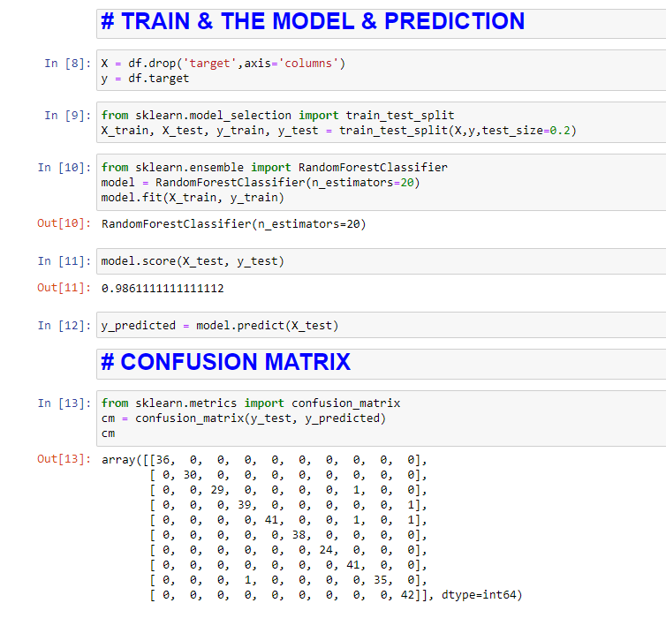

Slide 38
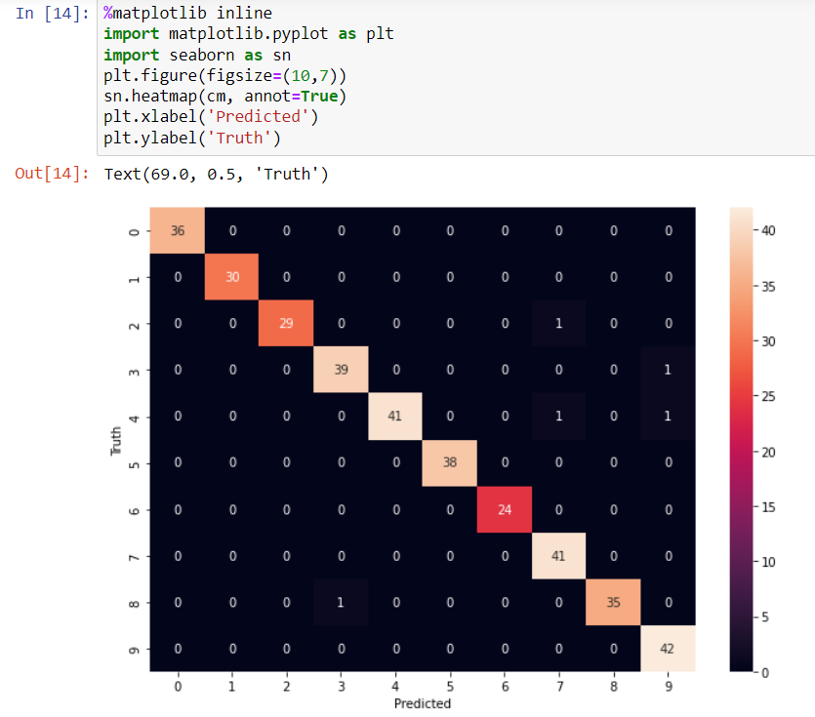

Slide 39
7. NAIVE BAYES CLASSIFIER WITH PRACTICAL EXAMPLE
NAIVE BAYES CLASSIFIER
Naive Bayes is a machine learning method we can use to predict the likelihood that an event will occur given evidence that’s present in our data.
It’s also called “conditional probability” in the world of statistics.
Three types of Naive Bayes Model
Multinomial – good for when our features describe discrete frequency counts.
Bernoulli – good for making predictions for binary features.
Gaussian – good for making predictions from normally distributed features.

Slide 40
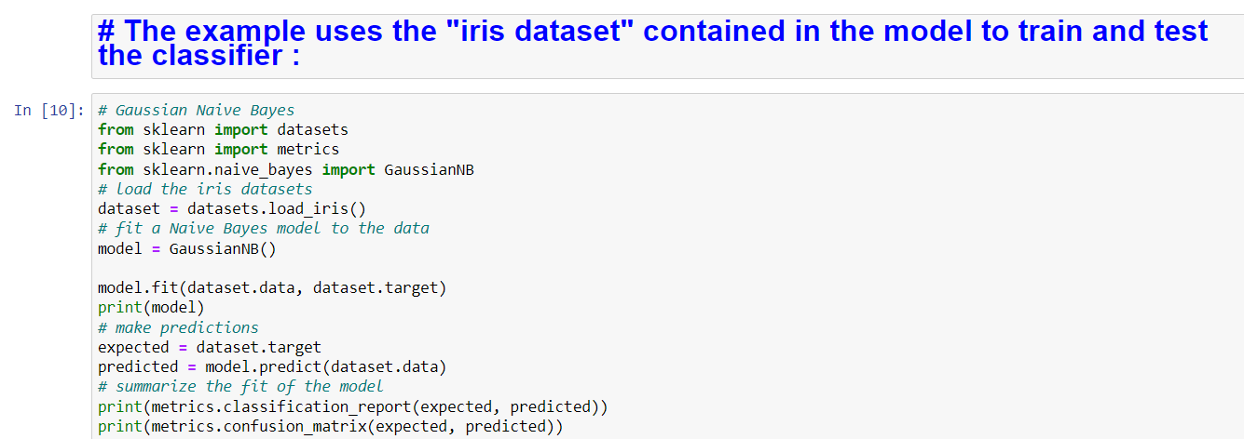
Naive Bayes Assumption
Predictors are independent of each other.
A prior assumption : this is an assumption that the past conditions still hold true. When we make predictions from historical values, we will get incorrect results if present circumstances have changed.
All regression models maintain an a prior assumption as well.

Slide 41
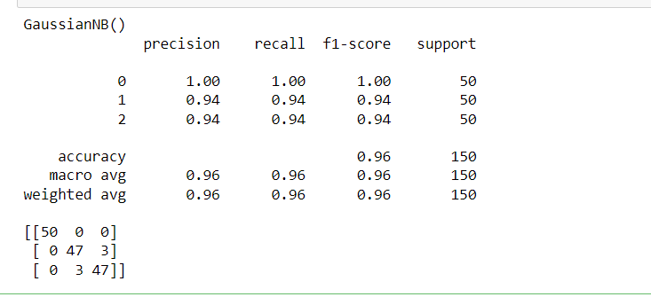
Output :

Slide 42
8. K-MEANS CLUSTERING WITH PRACTICAL EXAMPLE
K-MEANS CLUSTERING
The K-means clustering algorithm is a simple “unsupervised” algorithm that is used for quick prediction of groupings from within an unlabeled dataset.
Predictions are based on
The number of cluster centres present [K]
Nearest mean values [ measured in Euclidian distance between observations ]
K-means use cases
Market price & casting model
Customer segmentation
Insurance claim fraud detetction
Hedge fund classification

Slide 43
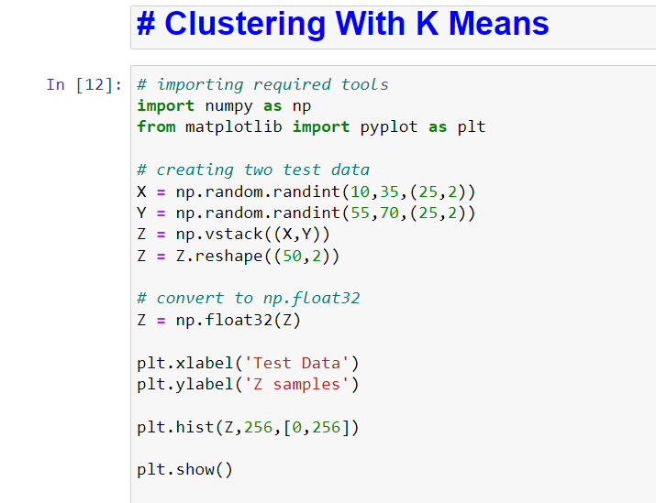

Slide 44
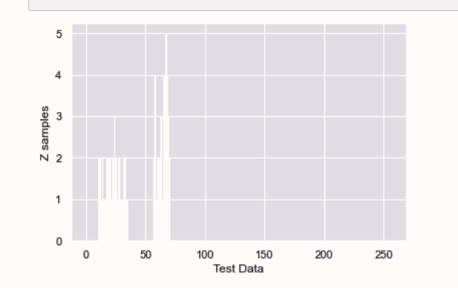

Slide 45
JUST TRIED MY LEVEL BEST
THANKYOU SHAN

