Slide 1
MULTITHREADING
Sona ES
Samyuktha ES
Athulya Vijayan
Naznin Shafeek

Slide 2
INTRODUCTION
Multithreading refers to a process of executing two or more threads simultaneously for maximum utilization of the CPU.
A thread in Java is a lightweight process requiring fewer resources to create and share the process resources.
Multithreading and Multiprocessing are used for multitasking in Java, but we prefer multithreading over multiprocessing.
This is because the threads use a shared memory area which helps to save memory, and also, the content-switching between the threads is a bit faster than the process.

Slide 3
Advantages of Multithreading
Multithreading saves time as you can perform multiple operations together.
The threads are independent, so it does not block the user to perform multiple operations at the same time
and also, if an exception occurs in a single thread, it does not affect other threads.
Improved performance and concurrency
Reduced number of required servers

Slide 4
Disadvantages of Multithreading
Difficulty of writing code Multithreaded and multicontexted applications are not easy to write.
Difficulty of managing concurrency
Difficulty of testing.
Difficulty of porting existing code

Slide 5
Life Cycle of a Thread
There are five states a thread has to go through in its life cycle. This life cycle is controlled by JVM (Java Virtual Machine). These states are:
New
Runnable
Running
Non-Runnable (Blocked)
Terminate

Slide 6
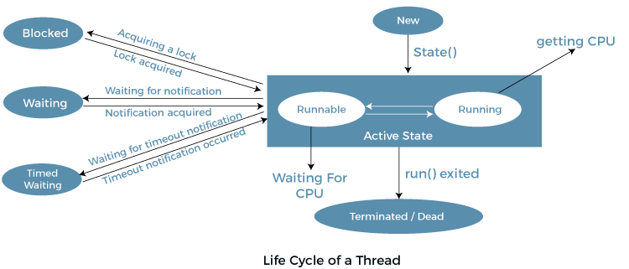

Slide 7
1. New
In this state, a new thread begins its life cycle. This is also called a born thread. The thread is in the new state if you create an instance of Thread class but before the invocation of the start() method.
2. Runnable
A thread becomes runnable after a newly born thread is started. In this state, a thread would be executing its task.
3. Running
When the thread scheduler selects the thread then, that thread would be in a running state.

Slide 8
4. Non-Runnable (Blocked)
The thread is still alive in this state, but currently, it is not eligible to run
5. Terminated
A thread is terminated due to the following reasons:-
Either its run() method exists normally, i.e., the thread’s code has executed the program.Or due to some unusual errors like segmentation fault or an unhandled exception.A thread that is in a terminated state does not consume ant cycle of the CPU.

Slide 9
Deadlock
Deadlock in Java is a condition where two or more threads are blocked forever, waiting for each other.
This usually happens when multiple threads need the same locks but obtain them in different orders. Multithreaded Programming in Java suffers from the deadlock situation because of the synchronized keyword.
It causes the executing thread to block while waiting for the lock, or monitor, associated with the specified object.

Slide 10
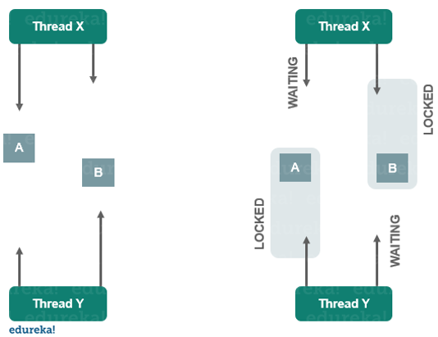

Slide 11
How To Avoid Deadlock in Java?
Although it is not completely possible to avoid deadlock condition, but we can follow certain measures or pointers to avoid them
Avoid Nested Locks – You must avoid giving locks to multiple threads, this is the main reason for a deadlock condition. It normally happens when you give locks to multiple threads.
Avoid Unnecessary Locks – The locks should be given to the important threads. Giving locks to the unnecessary threads that cause the deadlock condition.

Slide 12
Using Thread Join – A deadlock usually happens when one thread is waiting for the other to finish. In this case, we can use Thread.join with a maximum time that a thread will take.

Slide 13
Thread Creation
While multithreading in Java, you can create a thread using two ways:
By extending Thread class
By implementing the Runnable interface

Slide 14
What is a Thread Class
Thread class provides the methods and constructors to create and perform operations on a thread. Thread class extends Object class and implements the Runnable interface.
Various constructors are used in a Thread class, but the commonly used constructors are:
Thread()
Thread(String name)
Thread(Runnable r)
Thread(Runnable r,String name)
Also, as discussed earlier, there are various thread methods that are used for different purposes and tasks.
So, these constructors and methods are provided by the Thread class to perform various operations on a thread

Slide 15
Java Thread Methods :
These are the methods that are available in the Thread class:
1. public void start()
It starts the execution of the thread and then calls the run() on this Thread object.
2. public final void resume()
This method is used to resume the suspended thread. It is only used with the suspend() method.

Slide 16
3.public void run()
This thread is used to do an action for a thread. The run() method is instantiated if the thread was constructed using a separate Runnable object.
4.Java thread wait and notify()
Java Object class contains three methods to communicate the lock status of a resource. Learn with example usage of these Object class methods in a simple Wait-Notify implementation.

Slide 17
5. public static Thread currentThread()
It returns a reference to the currently running thread.
6. Java Exception in Thread()
JVM creates the first thread using the main method. This post explains some common exceptions we see in daily life and what is the root cause of them and how to fix them
7. public static void sleep()
This blocks the currently running thread for the specified amount of time.

Slide 18
8.public void interrupt()
This method of a thread is used to interrupt the currently executing thread. This method can only be called when the thread is in sleeping or waiting state.
9.public void destroy()
This thread method destroys the thread group as well as its subgroups.
10.public final String getName()
This method of thread class is used to return the name of the thread. We cannot override this method in our program, as this method is final.

Slide 19
What is a Runnable Interface?
Runnable Interface is implemented whose instances are intended to be executed by a thread. It has only one method run().
public void run() – This is used to perform an action for a thread.
Starting a Thread
While multithreading in Java, to start a newly created thread, the start() method is used.
A new thread starts(with a new callstack).
The thread moves from the New state to the Runnable state.
When the thread gets a chance to execute, its target run() method will run.

Slide 20
Thread Scheduler
A component of Java that decides which thread to run or execute and which thread to wait is called a thread scheduler in Java
There are two factors for scheduling a thread i.e. Priority and Time of arrival.

Slide 21
Priority
Priority of each thread lies between 1 to 10. If a thread has a higher priority, it means that thread has got a better chance of getting picked up by the thread scheduler.Default priority of a thread is 5 (NORM_PRIORITY). The value of MIN_PRIORITY is 1 and the value of MAX_PRIORITY is 10.
Time of Arrival
Suppose two threads of the same priority enter the runnable state, then priority cannot be the factor to pick a thread from these two threads. In such a case, arrival time of thread is considered by the thread scheduler. A thread that arrived first gets the preference over the other threads.

Slide 22
Working Of Thread Scheduler
Suppose, there are five threads that have different arrival times and different priorities
Now, it is the responsibility of the thread scheduler to decide which thread will get the CPU first.
The thread scheduler selects the thread that has the highest priority, and the thread begins the execution of the job.

Slide 23
If a thread is already in runnable state and another thread (that has higher priority) reaches in the runnable state, then the current thread is pre-empted from the processor, and the arrived thread with higher priority gets the CPU time.
When two threads (Thread 2 and Thread 3) having the same priorities and arrival time, the scheduling will be decided on the basis of FCFS algorithm. Thus, the thread that arrives first gets the opportunity to execute first.

Slide 24
Synchronization
It is the capability to control the access of multiple threads to any shared resource.
Java Synchronization is better option where we want to allow only one thread to access the shared resource.
It is implemented in the program by using ‘synchronized‘ keyword.
Why use Synchronization?
To prevent thread interference.
To prevent consistency problem.

Slide 25
Disadvantage
Performance issues will arise as during the execution of one thread all the other threads are put to a blocking state and do note they are not in waiting state. This causes a performance drop if the time taken for one thread is too long.

Slide 26
Types of Thread Synchronization
There are two types of thread synchronization mutual exclusive and inter-thread communication.
Mutual Exclusive-helps keep threads from interfering with one another while sharing data.
Synchronized method.
Synchronized block.
Static synchronization.
Cooperation (Inter-thread communication in java)

Slide 27
Synchronized Method
If you declare any method as synchronized, it is known as synchronized method.
Synchronized method is used to lock an object for any shared resource.
When a thread invokes a synchronized method, it automatically acquires the lock for that object and releases it when the thread completes its task.

Slide 28
Synchronized block
Synchronized block can be used to perform synchronization on any specific resource of the method.If we put all the codes of the method in the synchronized block, it will work same as the synchronized method.
Synchronized block is used to lock an object for any shared resource.
Scope of synchronized block is smaller than the method.
A Java synchronized block doesn't allow more than one JVM, to provide access control to a shared resource.
The system performance may degrade because of the slower working of synchronized keyword.

Slide 29
Static Synchronization
If you make any static method as synchronized, the lock will be on the class not on object.
To maintain the Synchronized behavior, we need a class-level lock rather than an instance-level lock such that only one thread can act on the static synchronized method.

Slide 30
Inter thread Communication
Cooperation is a mechanism in which a thread is paused running in its critical section and another thread is allowed to enter (or lock) in the same critical section to be executed.It is implemented by following methods of Object class:
wait()-It tells the calling thread to give up the lock and go to sleep until some other thread enters the same monitor and calls notify().
notify()-It wakes up one single thread called wait() on the same object. It should be noted that calling notify() does not give up a lock on a resource.
notifyAll()-It wakes up all the threads called wait() on the same object.

Slide 31
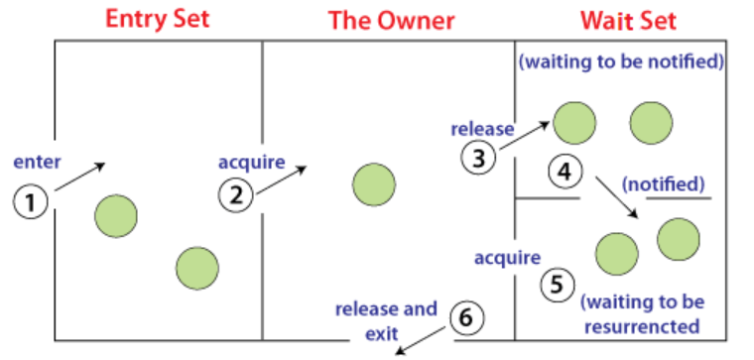

Slide 32
Threads enter to acquire lock.
Lock is acquired by on thread.
Now thread goes to waiting state if you call wait() method on the object. Otherwise it releases the lock and exits.
If you call notify() or notifyAll() method, thread moves to the notified state (runnable state).
Now thread is available to acquire lock.
After completion of the task, thread releases the lock and exits the monitor state of the object.

Slide 33
THANK YOU

