Slide 1
OpenAI ChatGPT APIs in Spring Boot
Samyuktha ES
245106

Slide 2
ChatGPT
ChatGPT is a pre-trained language model developed by OpenAI.
It is based on the GPT (Generative Pre-trained Transformer) architecture and is trained on a large dataset of conversational text.
It is designed to generate human-like text in response to prompts and can be fine-tuned for various language tasks such as question answering, text completion, and dialogue generation.
It is considered one of the most powerful language models currently available, with the ability to generate human-like text, complete tasks like translation, summarization and more.

Slide 3
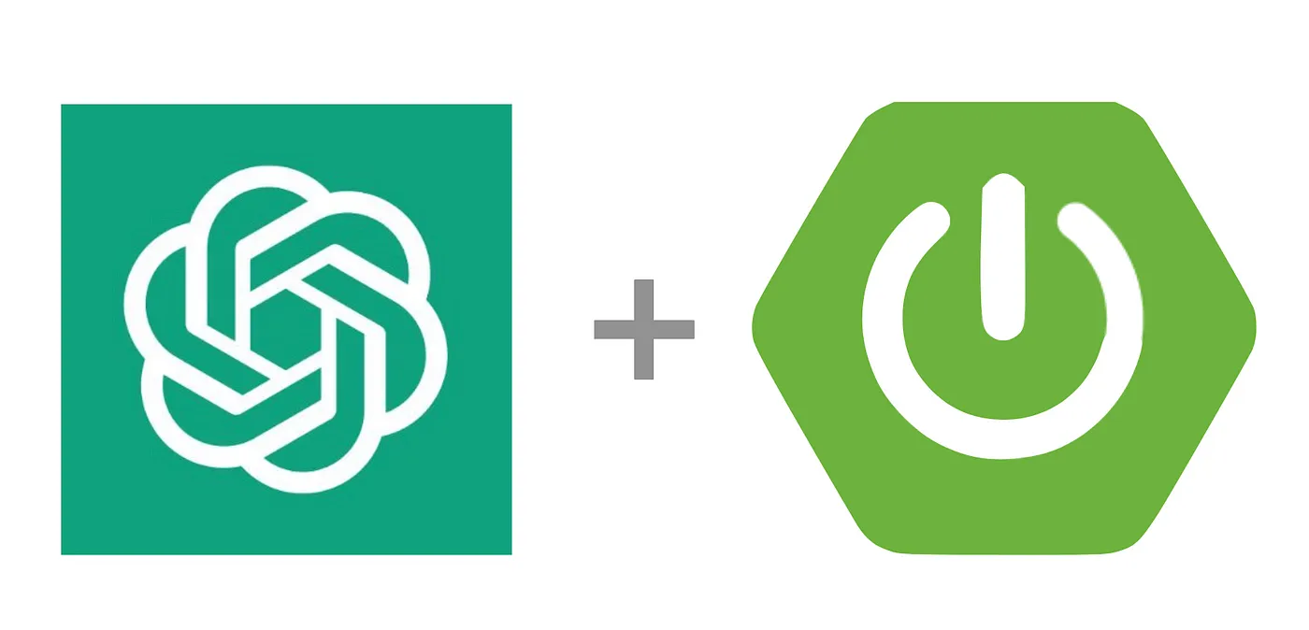
How to use OpenAI with Spring Boot ?

Slide 4
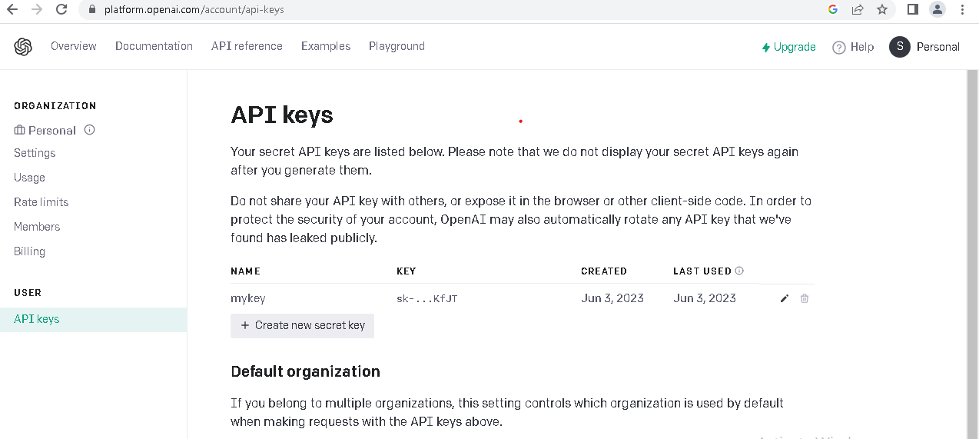
API Key Generation

Slide 5
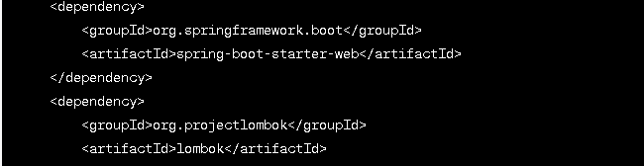
Required Dependencies

Slide 6
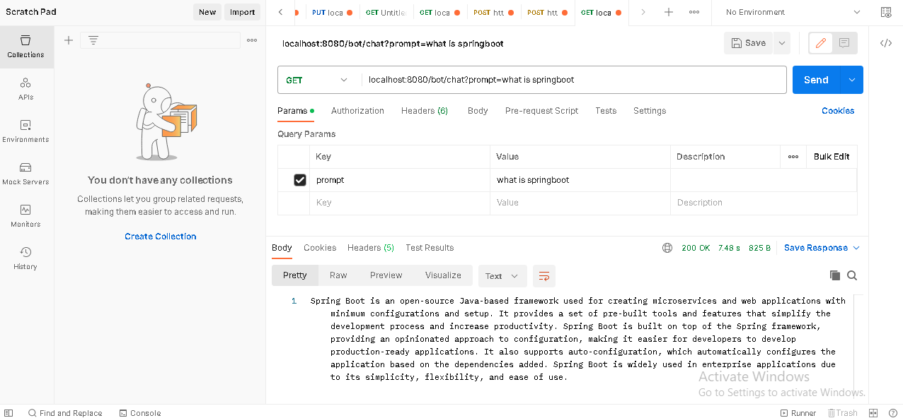
Final Output

Slide 7
Benefits
Enhanced user experience: Integrating Spring Boot with ChatGPT allows for real-time, interactive conversations with users, providing them with a seamless and dynamic experience.
Scalability and performance: Spring Boot's lightweight and modular design, combined with ChatGPT's ability to handle multiple concurrent conversations, enables efficient scaling to accommodate a large number of users and maintain high performance.
Natural language understanding: ChatGPT's advanced natural language processing abilities enable it to understand and interpret user queries and responses, allowing for intelligent and context-aware conversations.
Security and authentication: Spring Boot provides robust security features, including authentication and authorization mechanisms, which can be leveraged to ensure secure access to the chatbot and protect user data.

Slide 8
References
https://www.baeldung.com/spring-boot-chatgpt-api-openai
https://www.javastackflow.com/2023/01/how-to-use-chatgpt-with-spring-boot.html
https://youtu.be/HlDkuFy8xRM
https://github.com/samyukthaes/springboot-chatgpt.git

