Slide 1

smartJacket
First Step towards developing
A SmartJacket
Project Guide: Prof. Srikanth H.R
Team Members:
Nikitha Nagaraj 1PI11CS109
Prerana K 1PI11CS123
Samyukta Rao 1PI11CS148
Dept. of CSE

Slide 2
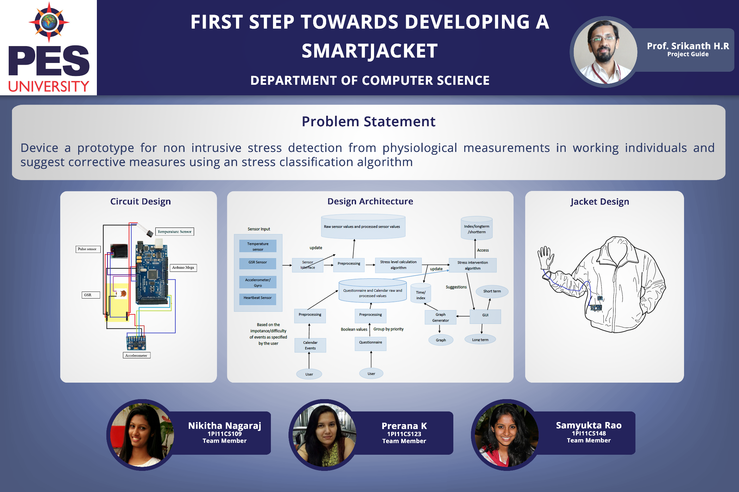

Slide 3
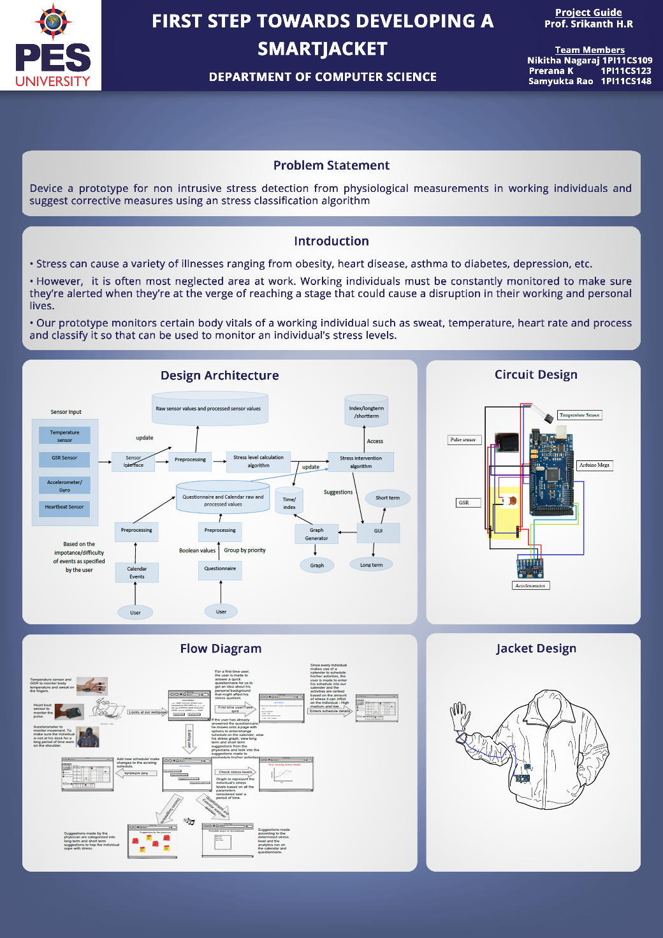

Slide 4
smartJacket
PROBLEM STATEMENT
Device a prototype for non intrusive stress detection from physiological measurements in working individuals and suggest corrective measures using an stress classification algorithm.
Dept. of CSE

Slide 5
smartJacket
INTRODUCTION
There are a lot of statistics that prove that most illnesses in today’s working class is due to stress. It is a major factor determining the health of a person.
Studies in the UK show that 59% of the working class succumbed to stress related illnesses.
Stress can cause a variety of illnesses ranging from obesity, heart disease, asthma to diabetes, depression, etc.
However, it is often most neglected area at work. Working individuals must be constantly monitored to make sure they’re alerted when they’re at the verge of reaching a stage that could cause a disruption in their working and personal lives.
Our prototype monitors certain body vitals of a working individual such as sweat, temperature, heart rate and process and classify it so that can be used to monitor an individual’s stress levels.
Dept. of CSE

Slide 6
smartJacket
Experts Approached
Physicians
  Dr. A.L Nagaraj ESI, Rajajinagar
  Dr. Satish Rao Mallya Hospital
  Dr. Pratibha ESI, Rajajinagar
  Dr. Prakash Victoria Hospital
  Dr. G.R Gopal Fortis
  Dr. Kanakalakshmi Fortis
  Dr. Seenappa Shanbhag Nursing Home
  Dr Faridaa Khan Yoga & Naturopathy expert
Dept. of CSE

Slide 7
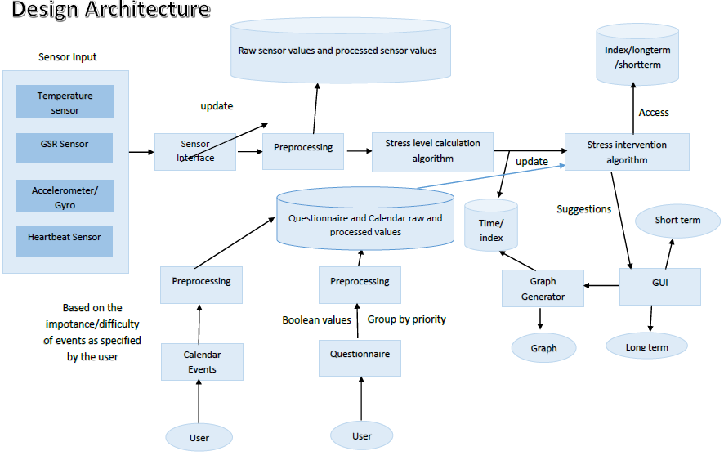
smartJacket
Dept. of CSE

Slide 8
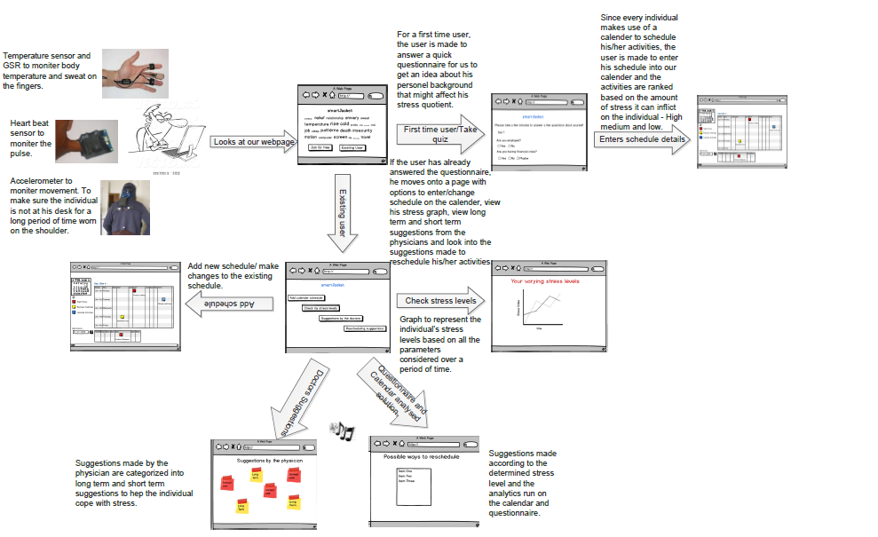
smartJacket
Flowdiagram
Dept. of CSE

Slide 9
smartJacket
Technologies Used
Accessing Values from hardware
1.Arduino
2.Chart.js
TestData Generation
1.Java
2.Python
Web Application:Client Side
1.HTML,CSS
2.Javascript,Jquery
3. Bootstrap
Web Application: Server Side
1.Python
2. PHP
Database
1.MySQL
Dept. of CSE

Slide 10
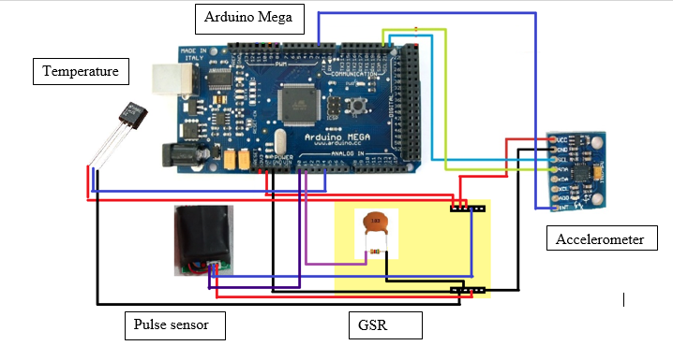
smartJacket
CIRCUIT DESIGNS
Dept. of CSE

Slide 11
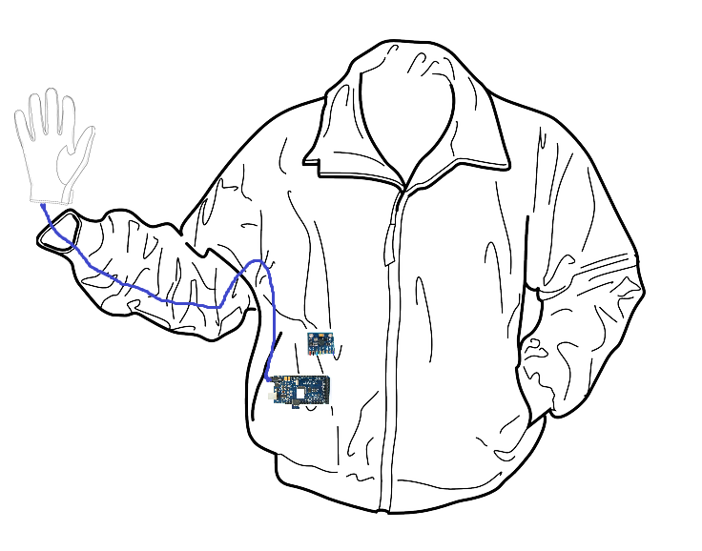
smartJacket
JACKET DESIGN
Dept. of CSE

Slide 12
smartJacket-A Prototype
Thank you
Dept. of CSE

