Slide 1

STOCK TREND AI
STOCK MARKET
FORECASTING MODEL
Presented by Kanakamedala Samyutha

Slide 2
INTRODUCTION
Stock market prediction is a complex task due to highly dynamic financial data.
This project uses deep learning and time-series analysis to forecast stock price trends.
The system analyzes historical data to predict future market movements.

Slide 3
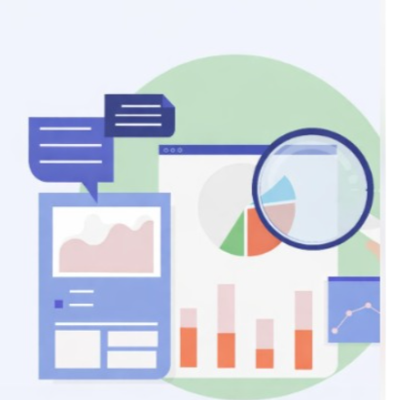
PROBLEM STATEMENT
Stock market prices fluctuate due to economic, financial, and market factors.
Traditional prediction methods often fail to capture complex temporal patterns.
An intelligent AI-based system is required for more reliable stock trend forecasting.

Slide 4
ABSTRACT
1
StockTrendAI is a forecasting system that uses LSTM deep learning models to predict stock prices.
Historical Apple stock data is analyzed and preprocessed for model training.
The system predicts the next-day stock trend and visualizes prediction results.
2

Slide 5
SOLUTION
The project applies Long Short-Term Memory (LSTM) networks to learn time-series patterns.
The model analyzes historical stock prices and predicts future price movements.
An interactive dashboard visualizes trends and prediction insights.

Slide 6

TECHNOLOGY STACK
Programming Language: Python
Libraries: TensorFlow, Keras, Pandas, NumPy, Scikit-Learn
Visualization & Dashboard: Matplotlib, Plotly, Streamlit

Slide 7
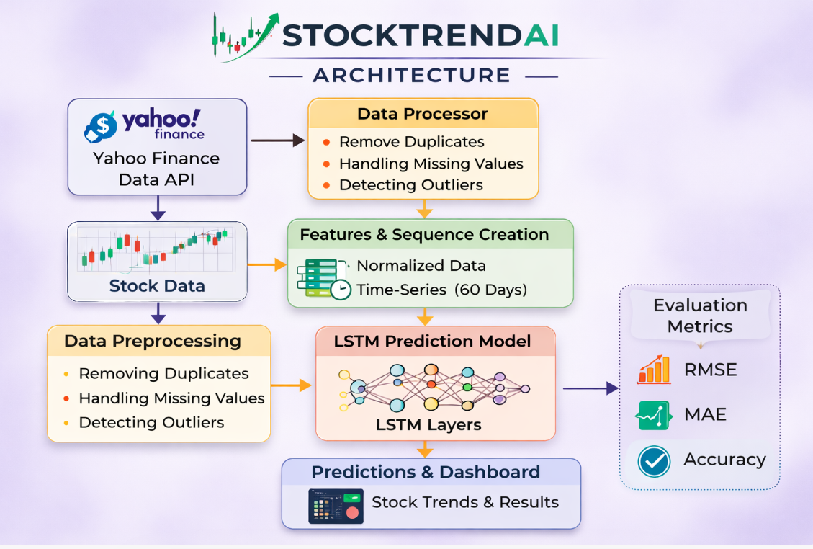
ARCHITECTURE DIAGRAM

Slide 8
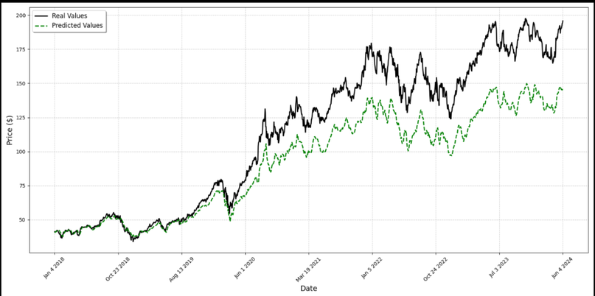
UNIQUE
The project uniquely combines time-series analysis and deep learning (LSTM) to forecast stock price trends from historical data.
It also integrates an interactive dashboard that visualizes predictions, stock trends, and performance metrics for better interpretation.

Slide 9
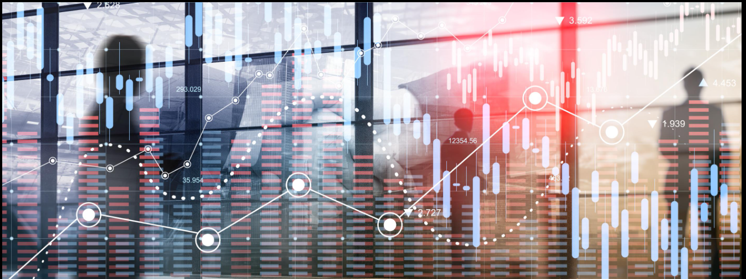
DATA
Historical stock price data of Apple Inc. (AAPL) was collected using the Yahoo Finance API.
The dataset includes attributes such as Open, High, Low, Close, and Volume, which are used for training the prediction model.

Slide 10
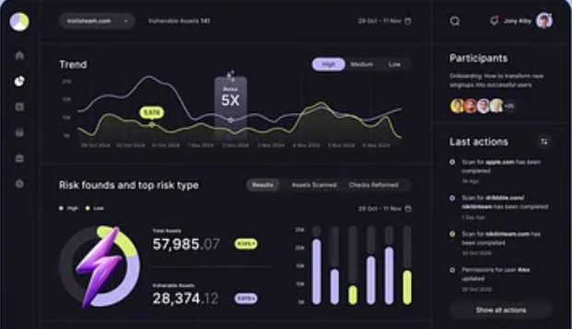
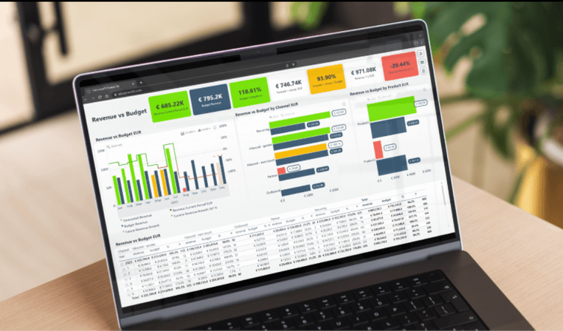
USER DETAILS
Users can access the interactive dashboard to explore stock trends, prediction results, and evaluation metrics.
The system provides insights that help investors and analysts understand potential market movements and make informed decisions

Slide 11

FEATURE ENHANCEMENT
Improved Data Cleaning
Advanced Outlier Detection
Interactive Dashboard

Slide 12
ADVANTAGES
Deep learning models can capture complex stock price patterns.
The system provides data-driven insights for investors and analysts.
Interactive dashboards improve usability and visualization.

Slide 13
CORE MODULES
Data Preprocessing Module – Handles missing values, removes outliers, and normalizes the dataset.
Prediction Module – Implements an LSTM deep learning model to forecast future stock price trends.
Visualization Module – Displays stock trends, prediction graphs, and evaluation metrics through an interactive dashboard.

Slide 14
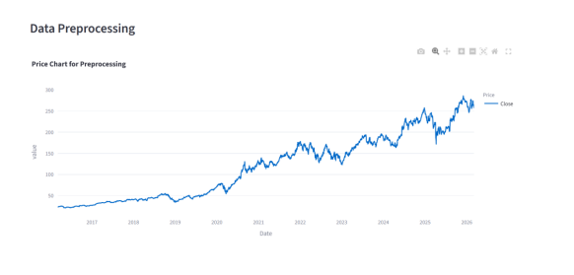
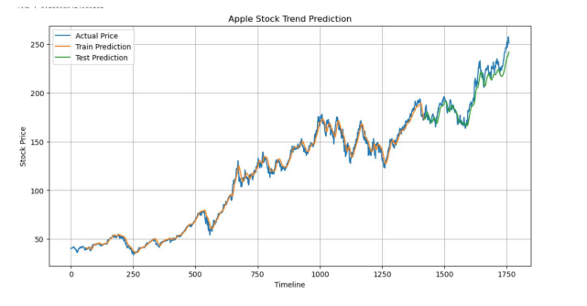
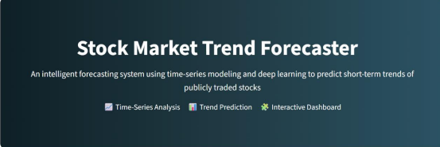
Data preprocessing
Visualization
DashBoard

Slide 15
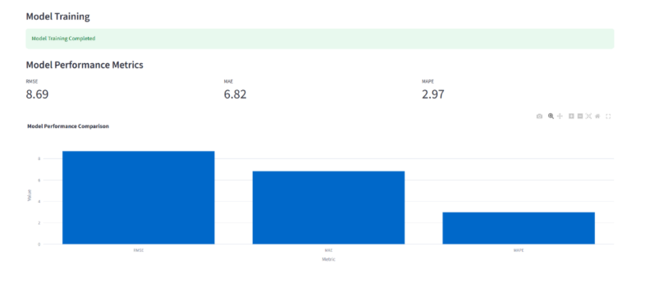
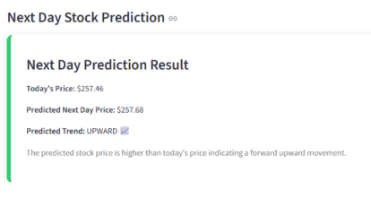
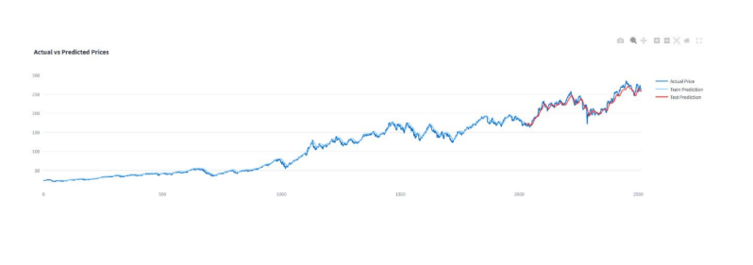
Performance
Predictions

Slide 16
CONCLUSION
The project demonstrates how deep learning can forecast stock trends.
LSTM models effectively learn time-series dependencies in financial data.
The system provides meaningful predictions and visual insights.

Slide 17


