Slide 1
Finding the best location for new business
Data Science Project Report
By Sam Zhang 2019-08-09

Slide 2
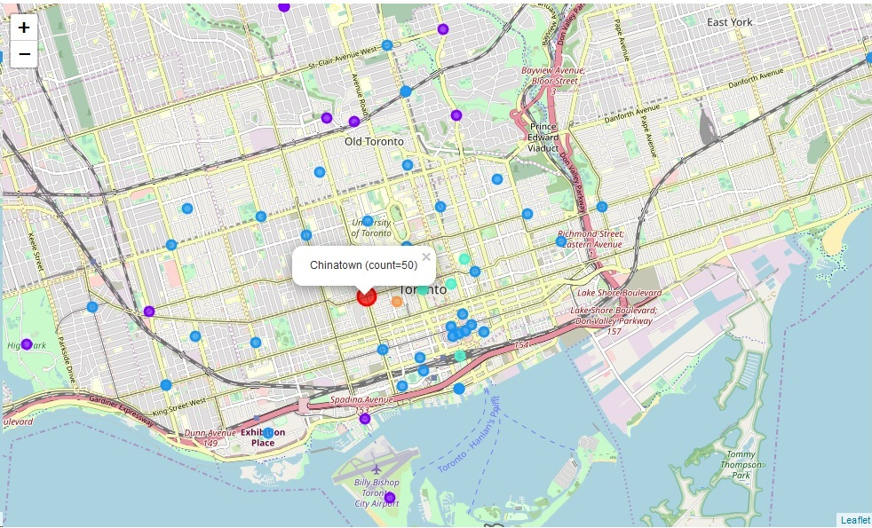
The Question
Question: Where in Toronto?
How to find
the best location
for your
new business?

Slide 3
The Data
Hot Area Finder
Collect Data on Chinese Restaurants by Area
Calculate Density by Area
Recommend the Top Density Area
Collect Neighborhood List.
Scrape with BeautifulSoup
web site https://en.wikipedia.org/wiki/List_of_postal_codes_of_Canada:_M
Find Geo-location for Each Neighborhood
geopy.geocoders
Find List of Chinese Restaurants in Each Neighborhood
Foursquare Venue service API for listing – keep Venue ID.
Find Open Date of Each Chinese Restaurant
Foursquare Venue Detail service API – keep “createdAt”

Slide 4
The Methodology
Hot Area Finder
Collect Data on Chinese Restaurants by Area
Calculate Density by Area
Recommend the Top Density Area
Start with Neighborhood Dataframe
Reduce Columns to:
Neighborhood – name of neighborhood
Venue – name of the Chinese restaurant
df[["Neighborhood","Venue"]]
Calculate Venue Counts by Neighborhood
cnt_df=df[["Neighborhood","Venue"]]
.groupby("Neighborhood").count()

Slide 5
The Methodology
Hot Area Finder
Collect Data on Chinese Restaurants by Area
Calculate Density by Area
Recommend the Top Density Area
Find Max Density (Counts)
max_cnt=max(cnt_df["Venue"])
Filter to Get the Top Neighborhood(s)
tgt_df=cnt_df[cnt_df["Venue"]==max_cnt]
Recommend the Top Neighborhood
tgt_df.loc[0,"Neighborhood"]

Slide 6
The Methodology
Model Validation
Prepare Validation Cases
Recommendation on the Validation Case
Calculate Accuracy Score
Start with Dataframe
Columns: “Neighborhood”, “Venue ID”, “Venue CreatedAt”
ev_df=df[["Neighborhood", "Venue", "Venue CreatedAt"]]
Find Max CreatedAt
max_createdAt=max(ev_df["Venue CreatedAt"])
Find Y of the Case
The Y of the validation case is the neighborhood with the max_createdAt.
tgt_df=ev_df[ev_df["Venue CreatedAt"]==max_createdAt]
Y[i]=tgt_df.loc[0,"Neighborhood"]
Find X of the Case
ev_df=ev_df[ev_df["Venue CreatedAt"]<max_createdAt]

Slide 7
The Methodology
Model Validation
Prepare Validation Cases
Recommendation on the Validation Case
Calculate Accuracy Score
Start with Dataframe
Columns: “Neighborhood”, “Venue ID”, “Venue CreatedAt”
ev_df=df[["Neighborhood", "Venue", "Venue CreatedAt"]]
Find Max CreatedAt
max_createdAt=max(ev_df["Venue CreatedAt"])
Find Y of the Case
The Y of the validation case is the neighborhood with the max_createdAt.
tgt_df=ev_df[ev_df["Venue CreatedAt"]==max_createdAt]
Y[i]=tgt_df.loc[0,"Neighborhood"]
Find X of the Case
ev_df=ev_df[ev_df["Venue CreatedAt"]<max_createdAt]
Find y of the Case
ev_cnt_df=ev_df[["Neighborhood","Venue"]].groupby("Neighborhood").count()
ev_cnt_df.reset_index(inplace=True)
# recommended location
max_cnt=max(ev_cnt_df["Venue"])
ev_tgt_df=ev_cnt_df[ev_cnt_df["Venue"]==max_cnt]
ev_tgt_df.reset_index(inplace=True)
y[i]=ev_tgt_df.loc[0,"Neighborhood"]

Slide 8
The Methodology
Model Validation
Prepare Validation Cases
Recommendation on the Validation Case
Calculate Accuracy Score
Start with Dataframe
Columns: “Neighborhood”, “Venue ID”, “Venue CreatedAt”
ev_df=df[["Neighborhood", "Venue", "Venue CreatedAt"]]
Find Max CreatedAt
max_createdAt=max(ev_df["Venue CreatedAt"])
Find Y of the Case
The Y of the validation case is the neighborhood with the max_createdAt.
tgt_df=ev_df[ev_df["Venue CreatedAt"]==max_createdAt]
Y[i]=tgt_df.loc[0,"Neighborhood"]
Find X of the Case
ev_df=ev_df[ev_df["Venue CreatedAt"]<max_createdAt]
Find y of the Case
ev_cnt_df=ev_df[["Neighborhood","Venue"]].groupby("Neighborhood").count()
ev_cnt_df.reset_index(inplace=True)
# recommended location
max_cnt=max(ev_cnt_df["Venue"])
ev_tgt_df=ev_cnt_df[ev_cnt_df["Venue"]==max_cnt]
ev_tgt_df.reset_index(inplace=True)
y[i]=ev_tgt_df.loc[0,"Neighborhood"]
Compare each Y and y
Repeat Steps 2-6
Accumulate towards an overall model accuracy score

Slide 9

The Result & After Thoughts
The accuracy score over 200 validation cases is 12%
The recommendation for my new Chinese restaurant location is China Town.
Accuracy Score - 12% - is quite low, this model definitely needs improvement.
First may need to double check data issue (some venue could have been counted in multiple neighborhoods, but lack of neighborhood polygon is a problem)
Second, more likely need more features in addition to simple venue counts.
China Town, hot!

Slide 10
Conclusion
Achievements:
Exercise AI practice to Answer real world questions
China Town as the recommended location sounds right.
Needs Improvements:
More and better data
Improved model

Slide 11
Thank You!
Questions?
Ideas?
Share Codes?
Feel Free to contact me:
samzhang98@hotmail.com

