Slide 1

Are Top Universities More Attractive To Tech Startups?

Slide 2
Introduction
Do we see more tech startups around the top Universities in the UK? There is evidence that tech startups cluster together and become incubators for innovation but does that also correlate with where certain Universities are located?
The purpose of this project is to find out if certain Universities have a higher proportion of tech startups in close proximity and the similarities between those Universities

Slide 3
The Data
To look at this problem we are going to need two data sets:
A list of UK universities with ranking data
A count of tech startups in close proximity to each University
For the university ranking data we will use The Times Higher Education World Rankings data
To get tech startup proximity data we will use the FourSquare API

Slide 4
University Ranking Data
The data is not easy to scrape from the THE website, luckily this data has already been collected by a contributor on kaggle
The data can be found in https://www.kaggle.com/joeshamen/world-university-rankings-2020/download
Credit must be given to THE for producing this data and Joe Shamen for making it available in this form.
To make the data useful for our purposes we drop columns we are not interested in. Remove the rank field because we will use the index instead.
The data is formatted and then scaled by dividing each number by 100 so we can compare them later on

Slide 5
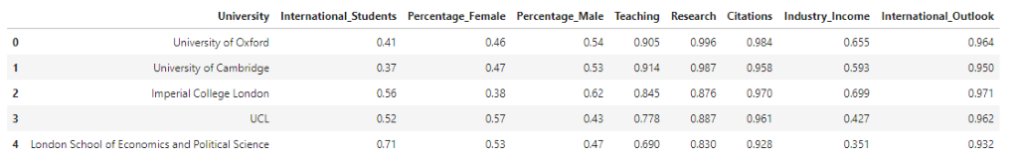
University Ranking Data

Slide 6
Location Data
To use the Four Square API to find Tech Startups near a University we first need the University locations
For that we used the geopy package and the Nominatim geocoder
To ensure the location data is valid, two levels of validation were performed.
First we check if any rows have null data for location, and that was found. The missing data was entered manually.
Secondly we validate the locations are correct by presenting the Universities on a folium map.

Slide 7
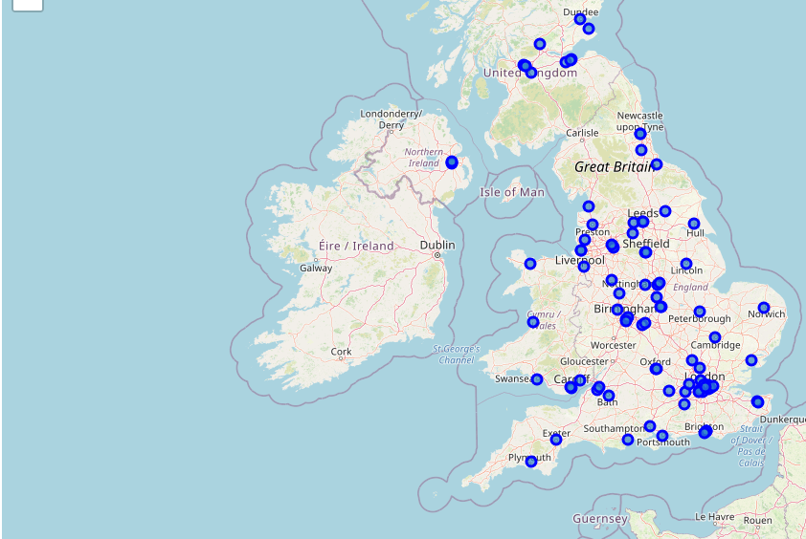
Universities Map

Slide 8
Tech Startup Count
Using the location data, we use the FourSquare search API to find tech startups within a kilometre of each University. Any Universities that returned an empty venues list were updated with a count of 0.

Slide 9
Methodology
The data will be analysed from two perspectives.
One is by looking at the correlation between the number of tech startups and attributes of each University. For this we will look for linear relationships between the values and their significance through statistical measures such as pearson correlation coefficient.
Secondly the Universities will be clustered using kmeans clustering from there we will look if there is a relationship.

Slide 10
Correlation Analysis
Each data point in this section is correlated against number of tech startups to understand the relationship between the two variables.
We visually check for correlation and then check mathematically using pearson correlation coefficient.

Slide 11
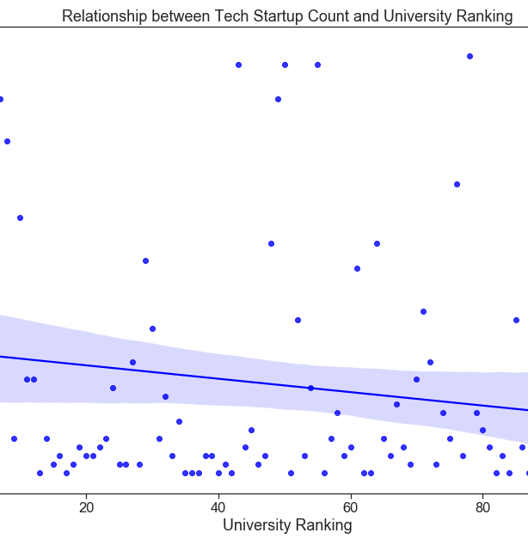
Ranking vs Tech Startup Count
Does University rank correlate with the number of tech startups?
There doesn’t appear to be a relationship here.
This is confirmed by pearson correlation coefficient which gives us
Correlation:: -0.15989384537789045
Significance:: 0.11204284425635871

Slide 12
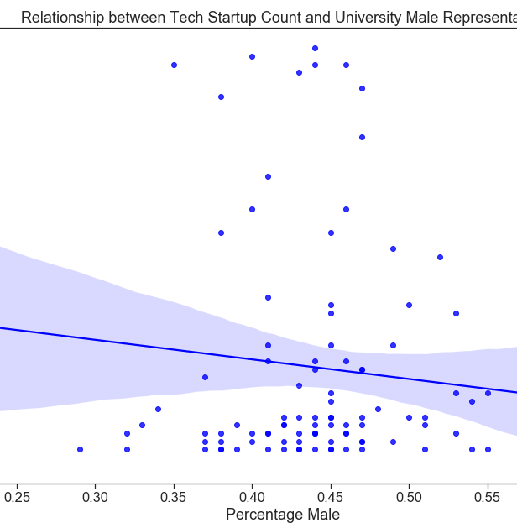
Male Representation vs Tech Startup Count
Do we see male bias when it comes to tech startups?
Again there doesn’t appear to be a relationship here.
This is confirmed by pearson correlation coefficient which gives us
Correlation:: -0.10689824071206178
Significance:: 0.2897913801355428

Slide 13
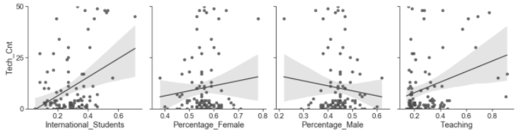
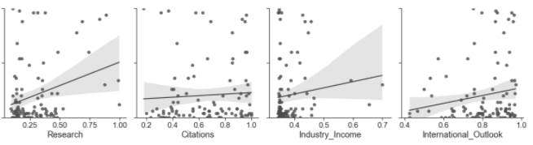
Multiple value correlation

Slide 14
Multiple Variable Correlation
Looking at the graphs the strongest correlations appear to be:
International Students
Correlation:: 0.3725851074495698
Significance:: 0.00013485931494028897
Teaching
Correlation:: 0.29666362220215314
Significance:: 0.00272546569137422
Research
Correlation:: 0.2987968924629771
Significance:: 0.002530209708622019
International Outlook
Correlation:: 0.16969820209989445
Significance:: 0.09142801878333925
All of the correlations are quite weak. P values under 0.05 indicates statistical significance so all have significance except International Outlook.

Slide 15
Cluster Analysis
Lets cluster the universities based on there attributes and lets see if particular clusters have a higher number of tech startups
We are going to use kmeans as our clustering algorithm. We will start with a k of 4 and then go from there.
For us to be able to get a good set of clusters we need drop the following variables when fitting the data:
Ranking – Unique, continuous value so it would distort the similarity tests
University – Dropped as this text field cannot be used in the distance calculation
Location – This will lead to noise in the data. We are not interested In this data for this report
Tech Count – This is the variable that we want to check the clusters against later on

Slide 16
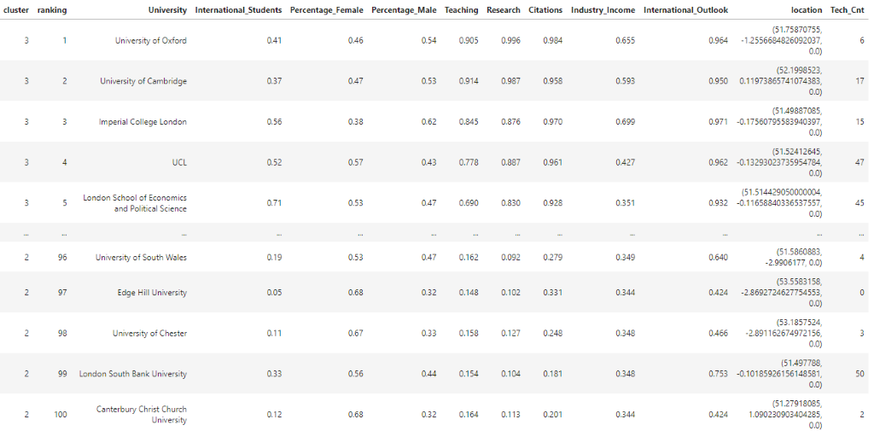
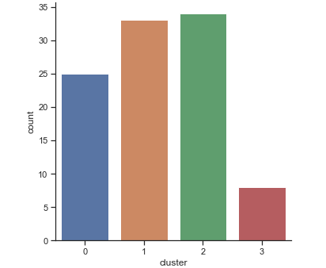
KMeans Cluster (K = 4)
Arbitrarily start with k = 4

Slide 17
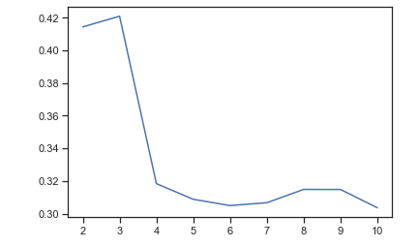
Find best k for k means
We arbitrarily took 4 as a starting point for kmeans but lets now take a more methodical approach before going further.
There are several methods available to iteratively run kmeans to find the best value for k.
One of those is the silhouette method which uses a score based on how similar the points are in each cluster and dissimilar to other clusters. The score is between –1 and +1, the highest score for a given range of k will give us the best k to use.
The results of the analysis are shown. We can see that k = 3 is the optimal value

Slide 18
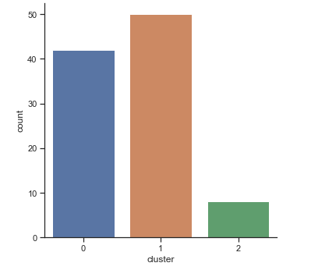
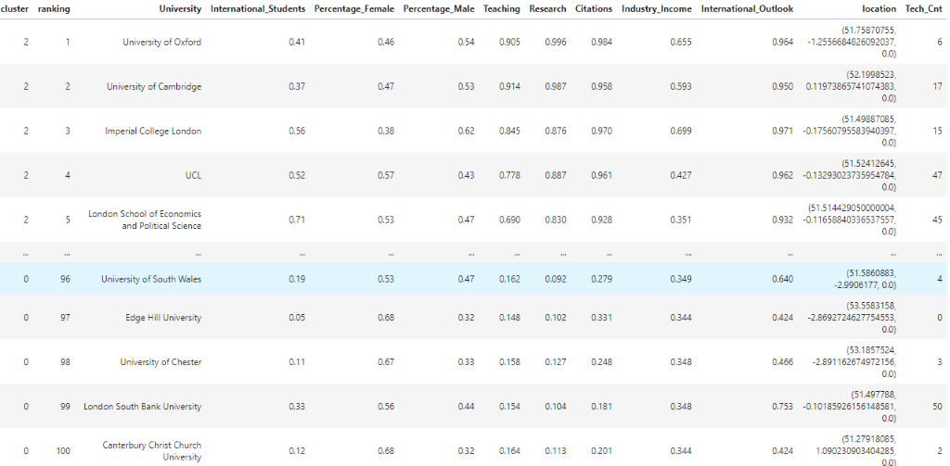
KMeans with new optimal k

Slide 19
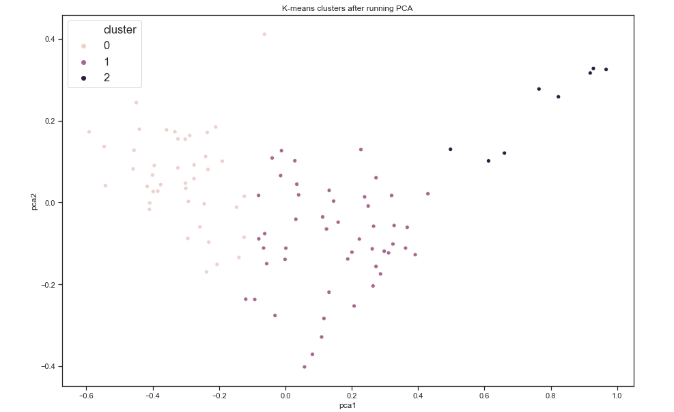
Visualised Cluster

Slide 20
Cluster Data Analysis
Field | Cluster | Min | Max | Mean
Ranking | 0 | 55 | 100 | 79.24
 | 1 | 9 | 62 | 33.72
 | 2 | 1 | 8 | 4.50
International Students | 0 | 0.05 | 0.53 | 0.22
 | 1 | 0.14 | 0.51 | 0.30
 | 2 | 0.37 | 0.71 | 0.48
Percentage Female | 0 | 0.47 | 0.71 | 0.58
 | 1 | 0.40 | 0.78 | 0.54
 | 2 | 0.38 | 0.62 | 0.52
Percentage Male | 0 | 0.29 | 0.53 | 0.42
 | 1 | 0.22 | 0.60 | 0.45
 | 2 | 0.38 | 0.62 | 0.48
Teaching | 0 | 0.15 | 0.41 | 0.19
 | 1 | 0.14 | 0.47 | 0.30
 | 2 | 0.57 | 0.91 | 0.75
Field | Cluster | Min | Max | Mean
Research | 0 | 0.09 | 0.38 | 0.15
 | 1 | 0.14 | 0.53 | 0.32
 | 2 | 0.64 | 1.00 | 0.83
Citations | 0 | 0.18 | 0.68 | 0.42
 | 1 | 0.52 | 1.00 | 0.80
 | 2 | 0.85 | 0.98 | 0.95
Industry Income | 0 | 0.34 | 0.37 | 0.35
 | 1 | 0.34 | 0.47 | 0.38
 | 2 | 0.35 | 0.70 | 0.50
International Outlook | 0 | 0.42 | 0.89 | 0.69
 | 1 | 0.72 | 0.97 | 0.88
 | 2 | 0.91 | 0.97 | 0.95
Tech Count | 0 | 0 | 50 | 8.71
 | 1 | 0 | 48 | 8.22
 | 2 | 6 | 47 | 30.38

Slide 21
Cluster Data Analysis
We can see that on average the Universities in cluster 2 have more tech startups near them.
These are also the same Universities that have higher values for the features that we saw earlier which had a weak correlation to tech startup count.

Slide 22
Results and Discussion
The analysis has shown that there is some correlation between clusters of Universities and the number of tech startups.
What we found was that individual features did not have a strong correlation but a combination did seem to have an effect. The top Universities clustered together, as an average had a higher tech startup count and interestingly at an average they had higher values for:
Ratio of International Students
Teaching Score
Research Score
During the analysis we found that these features individually had a weak correlation to the number of tech startups but the correlation was statistically significant.
While there does appear to be a correlation we cannot be sure it is causation. Other areas to look at is location, from the data we could see that the tech startup count was higher around particular cities so this is an area for more investigation.

Slide 23
Conclusions
The purpose of this report is to help understand the relationship between Universities and tech startups. We have found a correlation with the top Universities but there are data points such as location that should be investigated further.
Hopefully this will be helpful for tech startups trying to find the best location to start their business.

