Slide 1




ELEVATE LABS
DAY-2 TASK-2

Slide 2
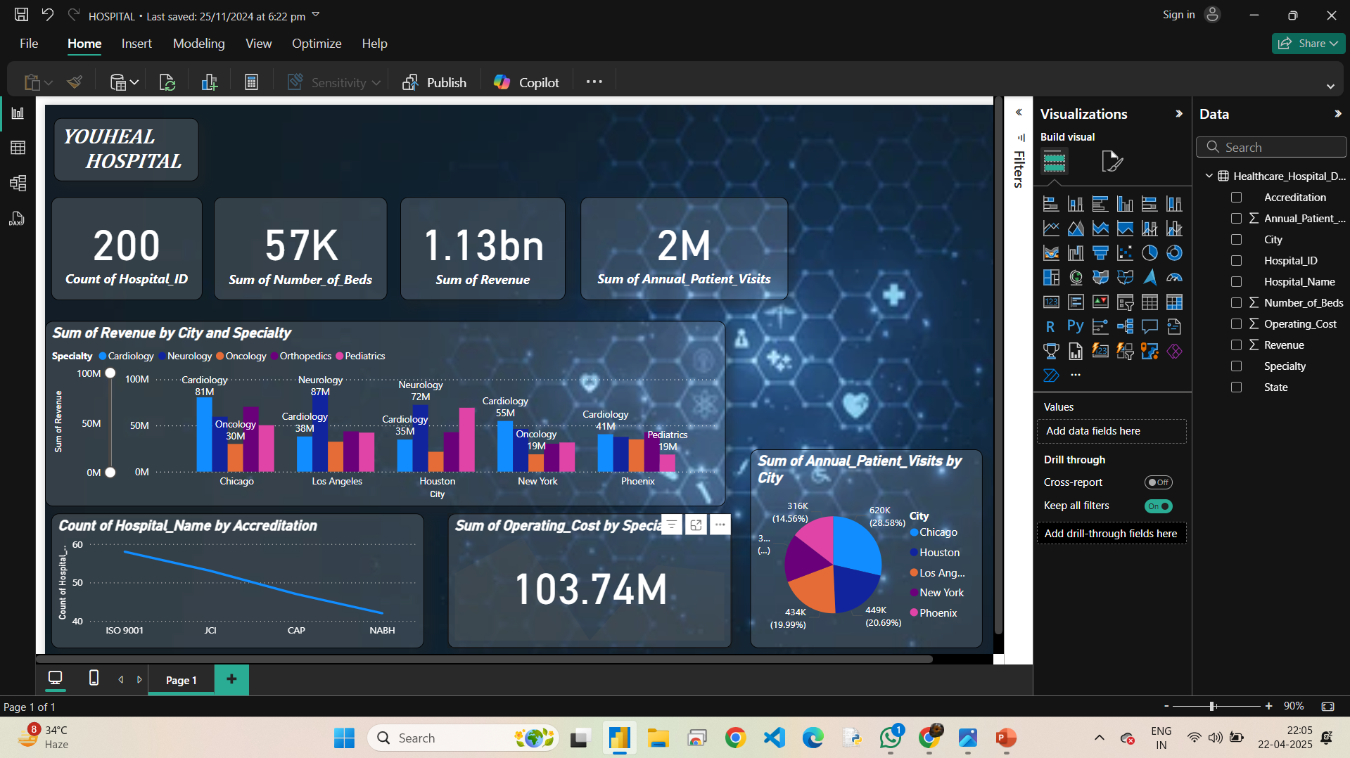
HOSPITAL’S DATASET CONVERTED INTO VISUALS USING POWER BI TOOL

Slide 3
YOUHEAL Hospital Insights
Power BI Dashboard Summary

Slide 4
Key Metrics
- Total Hospitals: 200
- Total Beds: 57,000
- Total Revenue: 1.13 Billion
- Annual Patient Visits: 2 Million

Slide 5
Revenue by City and Specialty
- Chicago: Cardiology (81M), Oncology (30M)
- Los Angeles: Neurology (87M), Cardiology (35M)
- Houston: Neurology (72M), Cardiology (30M)
- New York: Cardiology (55M), Oncology (19M)
- Phoenix: Cardiology (41M), Pediatrics (19M)

Slide 6
Annual Patient Visits by City
- Chicago: 620K visits (28.58%)
- Phoenix: 449K (20.69%)
- Los Angeles: 434K (19.99%)
- New York: 316K (14.56%)
- Others grouped under '3...'

Slide 7
Operating Cost by Specialty
- Total Operating Cost across specialties: 103.74 Million

Slide 8
Hospital Accreditation
- ISO 9001 is the most widely held accreditation.
- Other accreditations include:
- JCI
- CAP
- NABH
- Fewer hospitals have NABH compared to ISO 9001.

