Slide 1
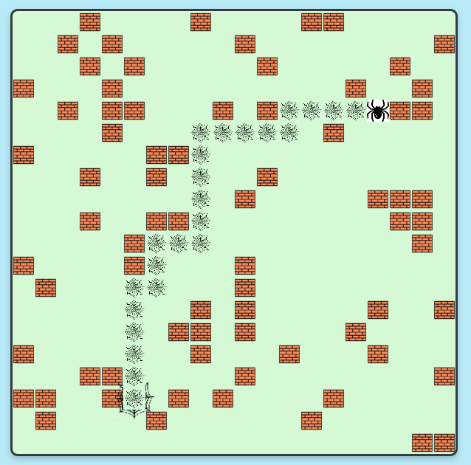
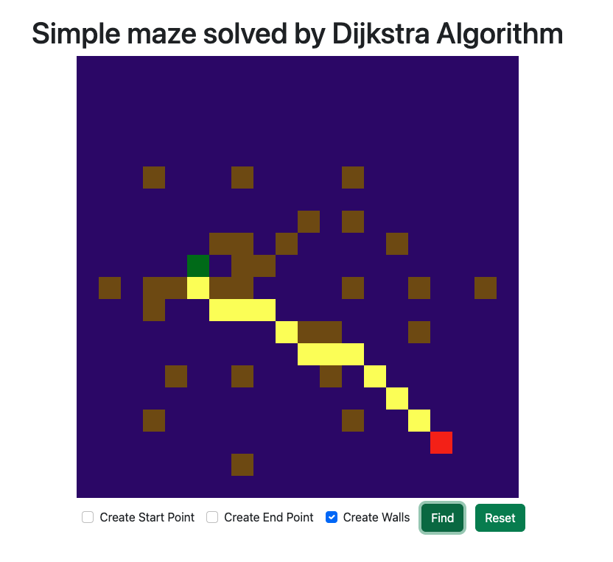
Title: Maze Solving with Dijkstra’s algorithm.
Authors:
Durgesh Singh, Swarn Singh Warshaneyan.

Slide 2
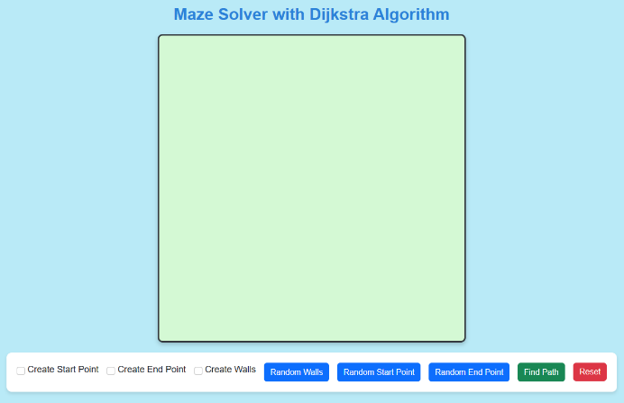
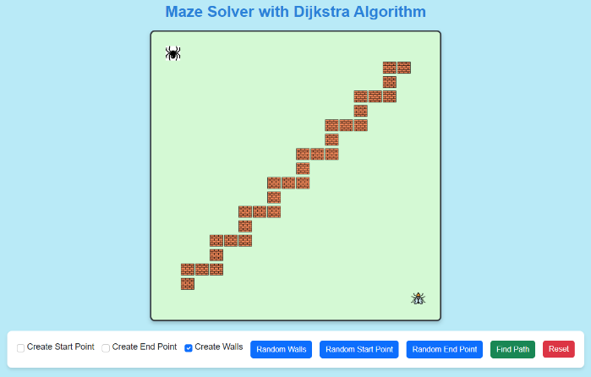
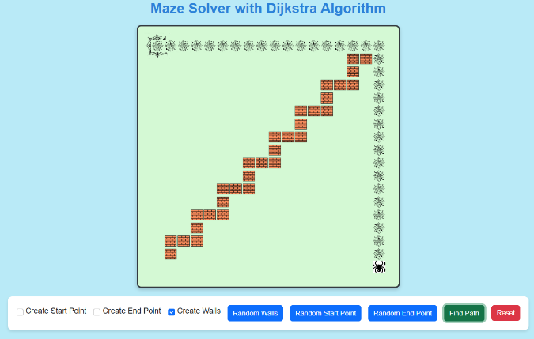
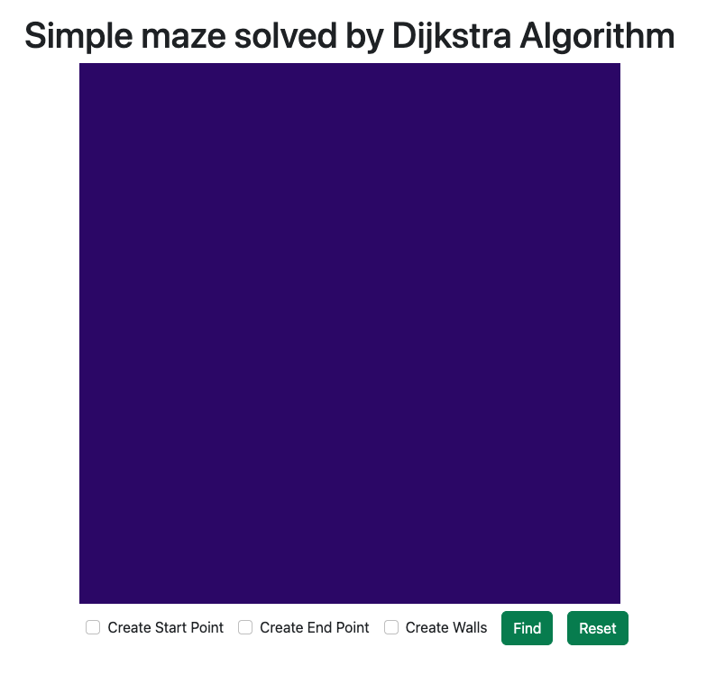
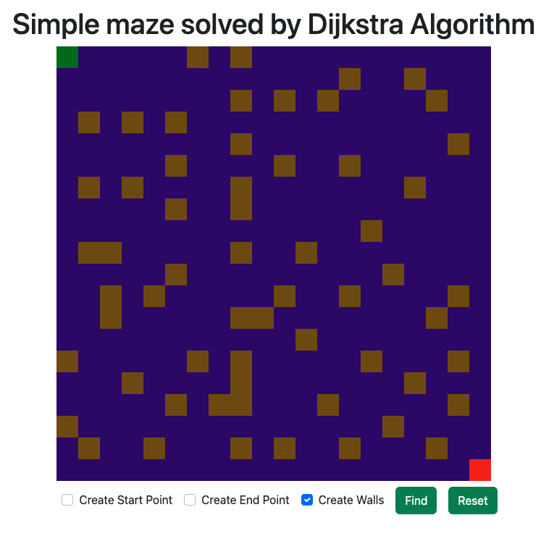
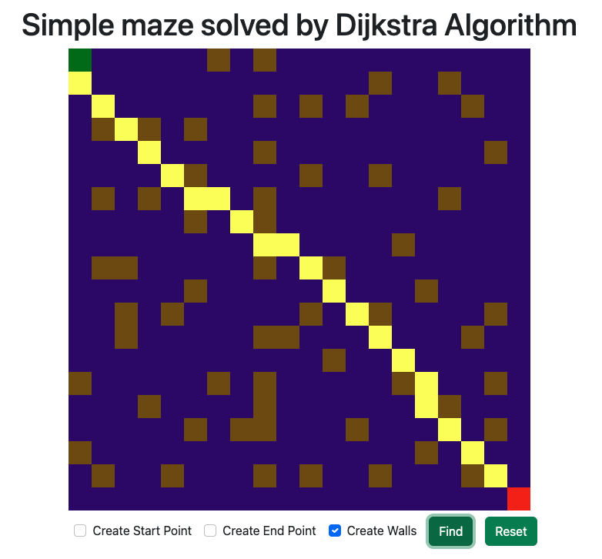
Introduction.
In this project, a pathfinding algorithm in a grid-based environment is visualised. The primary elements are a visual aid canvas, an environment-representing grid, and multiple images/colors to differentiate between various elements (such as walls, start/end points, and the shortest path found by Drijkstra’s Algorithm).
The theme of a spider catching bugs is used for visuals.

Slide 3



Introduction (continued).
The core algorithm & functionality work is handled by Durgesh Singh, who has web development experience.
The core design & interactivity work is handled by Swarn Singh Warshaneyan, who has game development experience.
The application was made through pair-programming, so both participants contributed in all aspects.

Slide 4
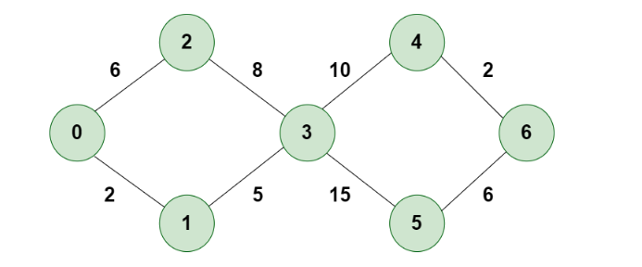
What is Dijkstra Algorithm?
Dijkstra's algorithm is a method to find the shortest paths between nodes (vertices) in a graph. The example image represents nodes & edges with numbers.
The algorithm maintains a set of visited vertices and a set of unvisited vertices. It starts at the source vertex and iteratively selects the unvisited vertex with the smallest tentative distance from the source. It then visits the neighbors of this vertex and updates their tentative distances if a shorter path is found. This process continues until the destination vertex is reached, or all reachable vertices have been visited.

Slide 5
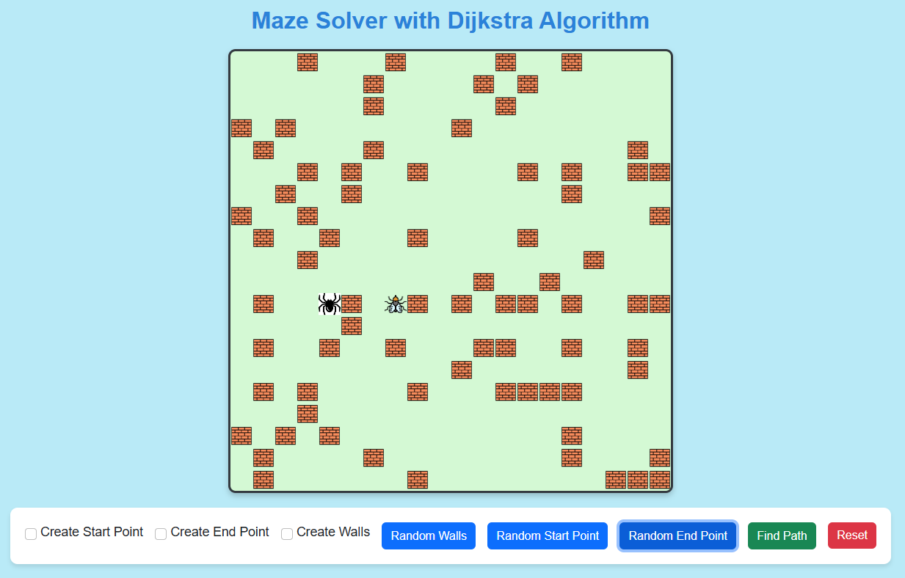
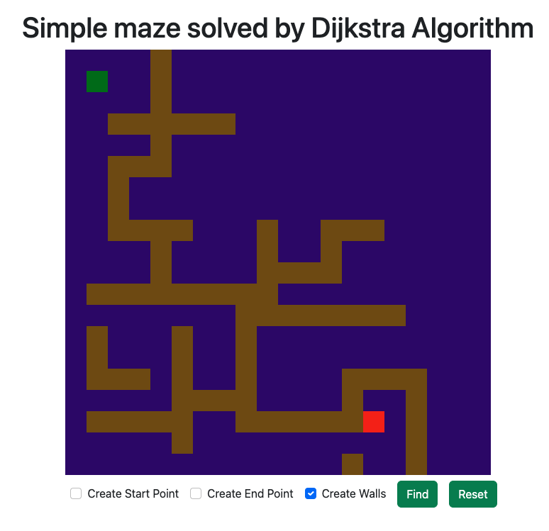
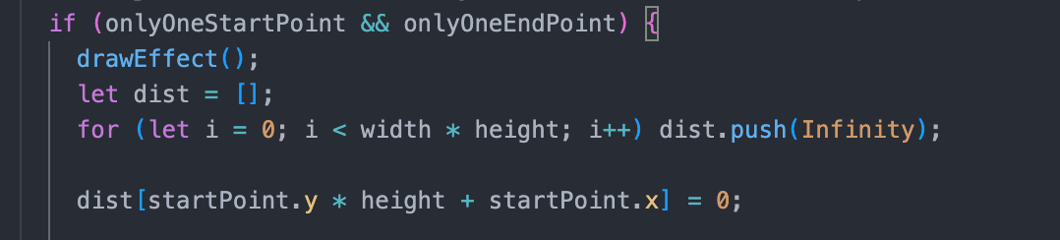
Implementation in maze solving.
Distance Initialization: The "dist" array is initialized to represent the minimum distance from the start point to each cell. All distances are initially set to "Infinity" except the start point, which is set to "0".

Slide 6
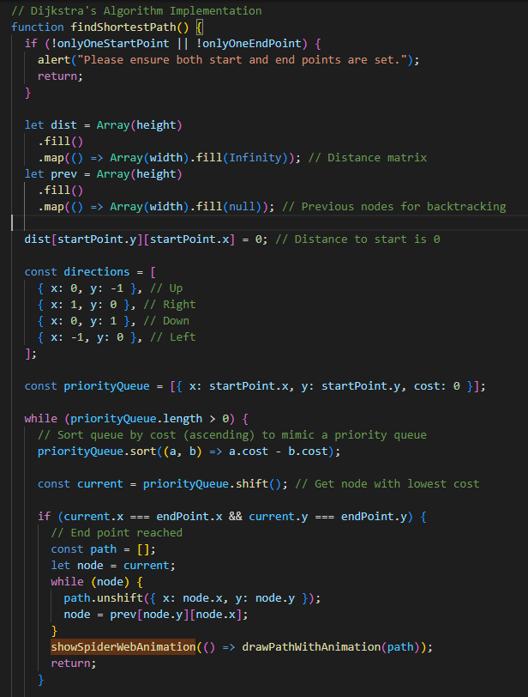
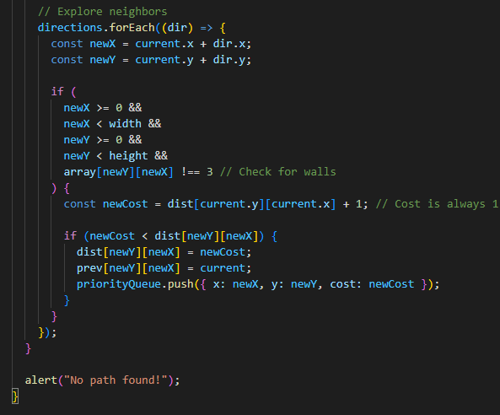
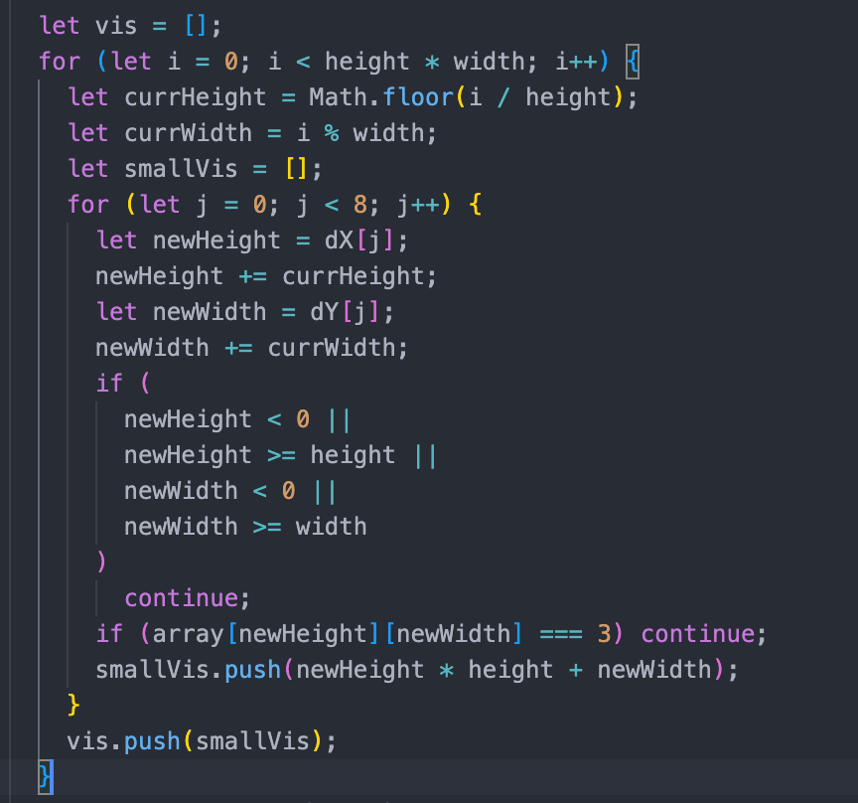
Implementation in maze solving (continued).
Neighbour Initialisation: The array is initialized to store neighbours for each cell. It checks the eight possible neighbours and excludes cells with walls (the value "3" is given to indicate a wall to ensure algorithm does not consider walls as valid cells to move to).

Slide 7
Implementation in maze solving (continued).
Queue Initialisation: The algorithm uses a priority queue to keep track of the cells to be explored. It starts with the start point and its distance. It calculates a unique index for the starting point in a linear representation of the 2D grid. As the algorithm progresses, cells are dequeued from the priority queue in order of their minimum distance. The neighbours of each cell are then processed, and their distances are updated. This continues until either the destination is reached or all reachable cells are explored.

Slide 8
Implementation in maze solving (continued).
Backtracking Loop: After the algorithm finds the destination, the Prev array is used to backtrack from the destination to the start point, forming the optimal path. The "if (reach)" condition checks whether the destination has been reached. If so, the algorithm proceeds to reconstruct the optimal path.

Slide 9
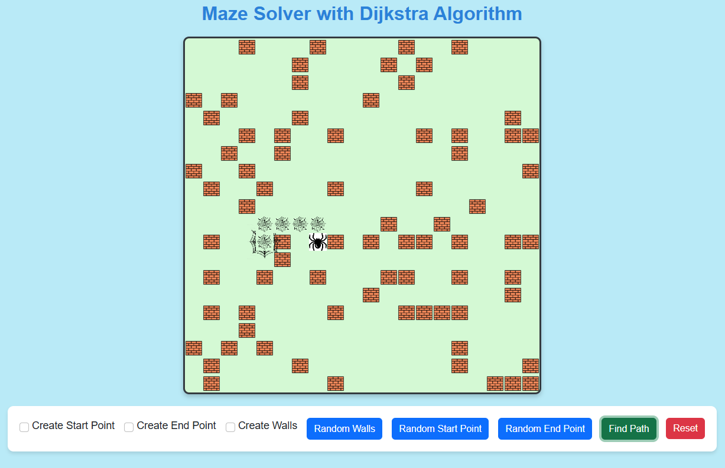
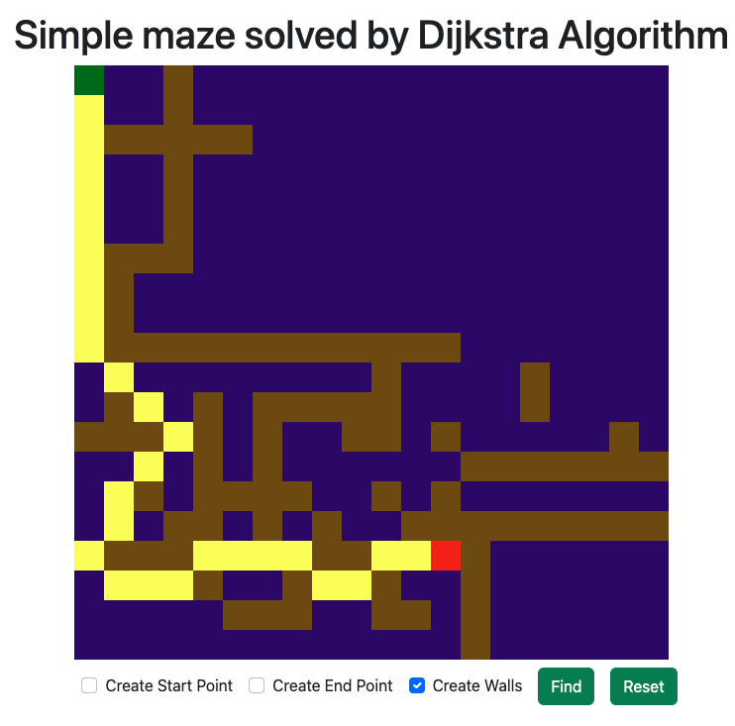
Implementation in maze solving (continued).
Path Visualisation: If a valid path is found ("reach" is "true"), the optimal path is visualised on the canvas with a time delay between each step, so that our eyes can follow the changes.

Slide 10
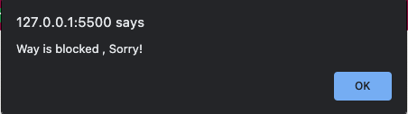
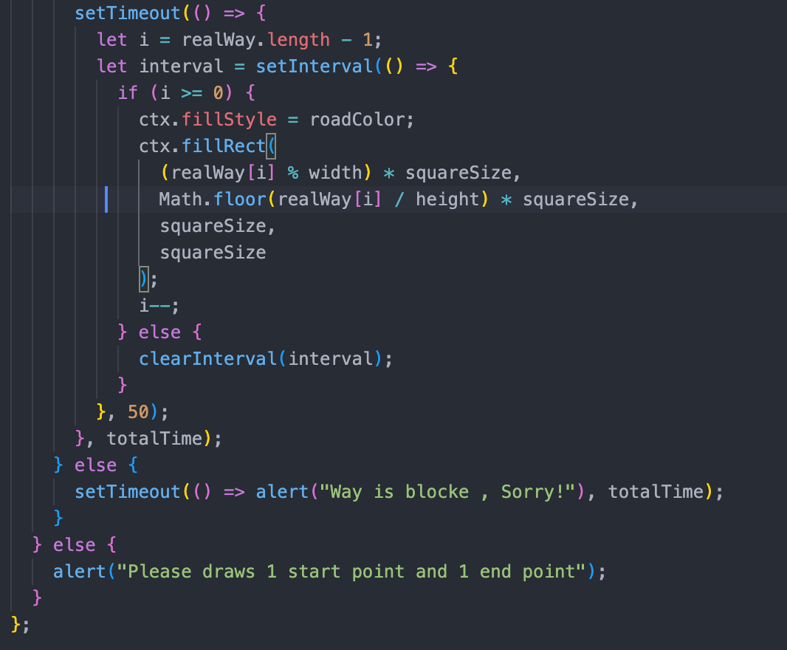
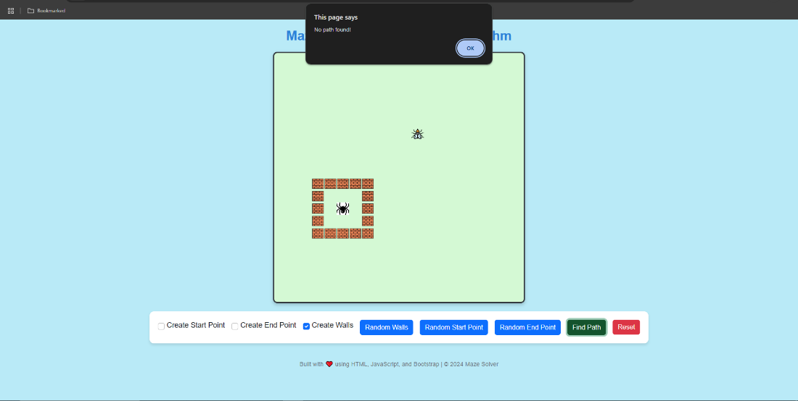
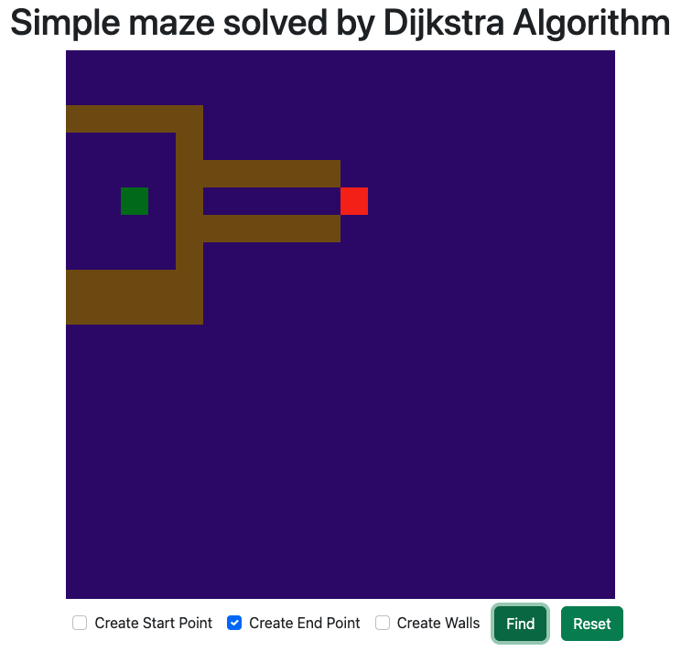
Implementation in maze solving (continued).
Blocked Path handling: If no valid path is found ("reach" is "false"), an alert is shown after the animation, indicating that the way is blocked.

Slide 11
Thank you!

