Slide 1

OLA Ride Insights
DOMAIN: Ride-Sharing & Mobility Analytics
A Data-Driven View of Customer Behavior & Ride Dynamics
By [Sanjana Agarwal]

Slide 2
PROBLEM STATEMENT
Ride-sharing platforms like OLA have revolutionized urban transportation.
OLA generates large volumes of data on rides, drivers, payments, and customer behavior.
Business needs: Enhance efficiency, improve customer satisfaction, and optimize decision-making.
Goal: Analyze OLA ride data using SQL, Power BI, and Streamlit to uncover key patterns.
Deliverables: Cleaned dataset, data visualizations, interactive dashboard, and web app with insights.

Slide 3
BUSINESS USECASES
Identifying peak demand hours and optimizing driver allocation.
Analyzing customer behavior for personalized marketing strategies.
Understanding pricing patterns and surge pricing effectiveness.
Detecting anomalies or fraudulent activities in ride data.

Slide 4
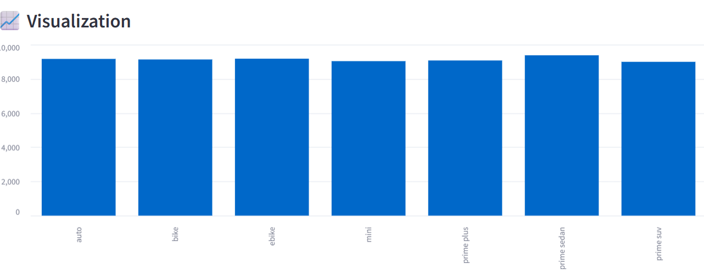
SUCCESFUL BOOKINGS
Filtered all rides with Booking status = 'Success'.
Insight: High number of successful rides indicates
operational reliability.
“PRIME SEDAN” – having high number of successful Bookings.

Slide 5
AVERAGE RIDE DISTANCE BY VEHICLE TYPE
Calculated average ride distance grouped by vehicle type.
Insight: Top five vehicles having longest average ride distance are:
1. Prime Sedan
2. Bike
3. Prime SUV
4. eBike
5. mini

Slide 6
CUSTOMER CANCELLATION
Total cancelled rides by customers extracted.
Insight: Cancellation reasons can help improve booking interface and communicationn.
Total rides cancelled by customers are-
count : ( 10499 )
Common in metro cities, peak hours
Suggests pain points: ETA, pricing, driver availability

Slide 7
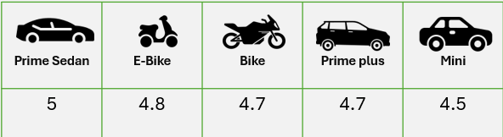
DRIVER RATING DISTRIBUTION
Prime Sedan driver ratings range: 2.1 to 5.0
Shows high variance in service quality
Suggestion: Identify low performers, offer training or incentives

Slide 8
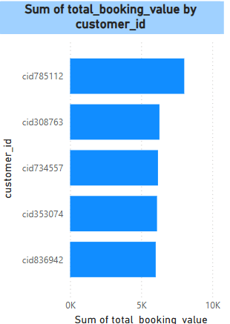
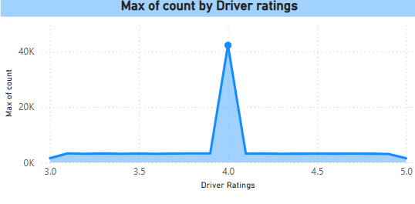
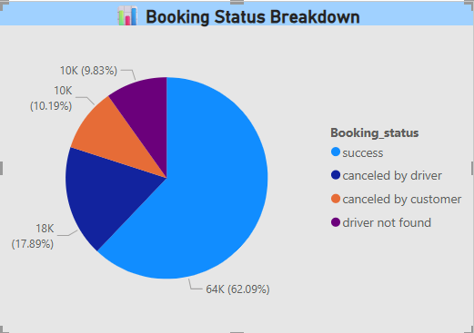
POWERBI DASHBOARD SNAPSHOTS

Slide 9
Key Insights – Ride Volume, Vehicle Type & Revenue
🕒 Ride Patterns
Ride Volume Over Time: Consistent ride activity with occasional peaks—suggests demand fluctuation based on time/day.
Booking Status Breakdown: Majority of rides are successful, but cancellations still contribute significantly.
🚗 Vehicle Type Trends
Top 5 Vehicle Types by Ride Distance: Prime Sedan and Mini lead in distance—preferred for longer rides.
💰 Revenue Insights
Revenue by Payment Method: UPI and Unknown payments dominate—cash usage is minimal.
Top 5 Customers by Booking Value: A few loyal customers contribute a significant share of revenue.
Ride Distance Distribution Per Day: Most rides fall within 5–10 km range—suggesting common short-distance usage.

Slide 10
Key Insights – Cancellations & Ratings
❌ Ride Cancellations
Customer Cancellations: Often due to long wait times or location mismatches.
Driver Cancellations: Largely due to personal reasons or vehicle issues—potential for operational intervention.
⭐ Ratings Analysis
Driver Ratings: Range varies between 3.5 to 5—Prime Sedan shows the highest driver quality.
Customer Ratings: Consistent across vehicle types—slightly higher for Prime services.

Slide 11
CONCLUSIONS & RECOMMENDATIONS
High success rate of bookings shows OLA's reliability.
Prime Sedans dominate long-distance rides, indicating premium preference for longer travel.
Customer loyalty is evident with a few users contributing high booking values.
Cancellations remain a concern, especially due to driver-side issues—opportunity to improve operations.
Digital payments (especially UPI) are widely adopted, reflecting modern customer preferences.
Ratings provide insights into service quality; scope exists to enhance both driver and customer satisfaction.
🎯 Business Impact
These insights can help OLA optimize fleet management, enhance customer experience, and target high-value users effectively.

Slide 12
THANK YOU!!!

