Slide 1
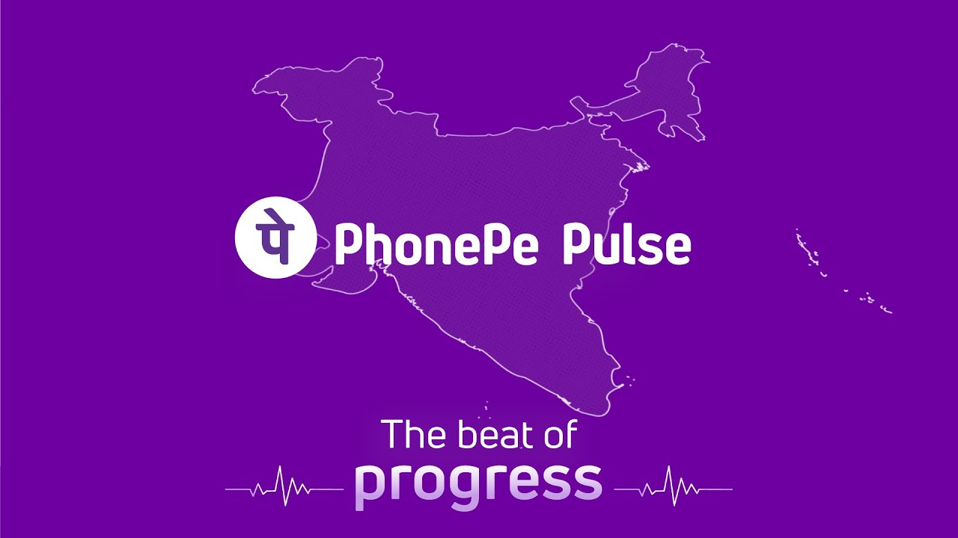
PhonePe Transaction Insights Domain: Finance/Payments system BY: SANJANA AGARWAL

Slide 2
Introduction
PhonePe is a leading digital payments platform in India.
PhonePe Pulse provides rich insights into transaction behaviors.
This project analyzes transaction data across various dimensions to understand usage trends.

Slide 3
Problem Statement
“With the increasing reliance on digital payment systems like PhonePe, understanding the dynamics of transactions, user engagement, and insurance-related data is crucial for improving services and targeting users effectively. “
This project aims to analyze and visualize aggregated values of payment categories, create maps for total values at state and district levels, and identify top-performing states, districts, and pin codes.

Slide 4
Objectives
Analyze transaction data across states and time.
Study user engagement and device usage.
Explore insurance uptake.
Provide actionable insights to PhonePe.
Total of 9 case studies examined.

Slide 5
Data Sources
PhonePe Pulse GitHub repository.
SQL queries on PostgreSQL.
Data extracted and transformed into CSV using Python.
CSV files used for analysis and visualization.

Slide 6
Tech Stack & Tools
Python
SQL: Data querying
Pandas: Data analysis
Matplotlib & Seaborn: Visualization
Streamlit: Dashboard development
VS Code: Development environment

Slide 7
Case Study 1: Decoding Transaction Dynamics
Scenario: PhonePe noticed inconsistent growth across different states and transaction categories. The goal is to understand state-wise and category-wise transaction patterns over time.
Key Insights:
Maharashtra, Karnataka, and Tamil Nadu consistently ranked among the top 5 states by transaction volume.
UPI payments were the dominant mode in every quarter, growing steadily YoY.
Recharge and bill payments showed a decline in some rural districts, possibly due to market saturation or seasonal demand.
Quarter 4 (Oct–Dec) consistently showed a spike across most transaction types — likely due to festival season and year-end offers.

Slide 8
Case Study 2: Device Dominance Analysis
Scenario: PhonePe is analyzing user engagement patterns based on device brands. The objective is to identify which devices have high registrations but low engagement and understand regional trends in device usage.
Key – Insights:
Xiaomi, Samsung, and Vivo dominated the user base across most regions.
Apple users, though smaller in number, showed higher app opens per user – indicating deeper engagement.
In Northeast India, devices like Infinix and Micromax had relatively high registrations but very low engagement.
Urban states like Maharashtra and Karnataka showed diverse device usage, while rural states were heavily skewed toward 2–3 brands

Slide 9
Case Study 3 & 4: Insurance & Market Expansion
Scenario:
By identifying high-performing and underpenetrated regions, the company can tailor strategies for marketing, partnerships, and expansion. The analysis focuses on transaction volumes, user behavior, and regional adoption trends. These insights will help prioritize areas for business growth and resource allocation.
Key – insights:
High insurance transactions are concentrated in a few urban states, while many rural or semi-urban states show low adoption, revealing untapped potential.
States like Maharashtra, Karnataka, and Tamil Nadu show consistent growth in both overall transactions and insurance-related services.
Northeastern and smaller states reflect low transaction density, indicating a need for awareness campaigns and strategic entry.

Slide 10
Case Study 5–9: Engagement & State Insights
Scenario:
PhonePe conducted a multi-dimensional analysis focusing on user engagement, registration trends, transaction activity, and insurance service adoption across various geographic and temporal segments. These insights aim to guide strategic growth, user targeting, and service optimization.
Insights:
States like Maharashtra, Karnataka, and Uttar Pradesh show consistently high user registration, app opens, and transaction volumes.
Tier-2 and Tier-3 cities are emerging as strong contributors to growth, especially in insurance transactions and new user sign-ups.
Insurance services are still underutilized in eastern and northeastern states, indicating potential for focused awareness campaigns.
Quarterly analysis reveals seasonal spikes in app engagement and insurance transactions, suggesting alignment with festive or financial planning cycles.

Slide 11
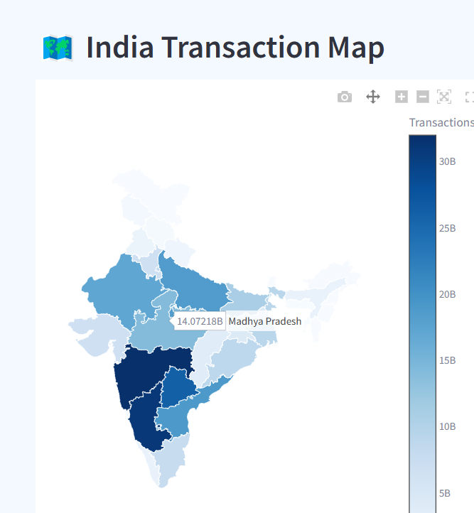
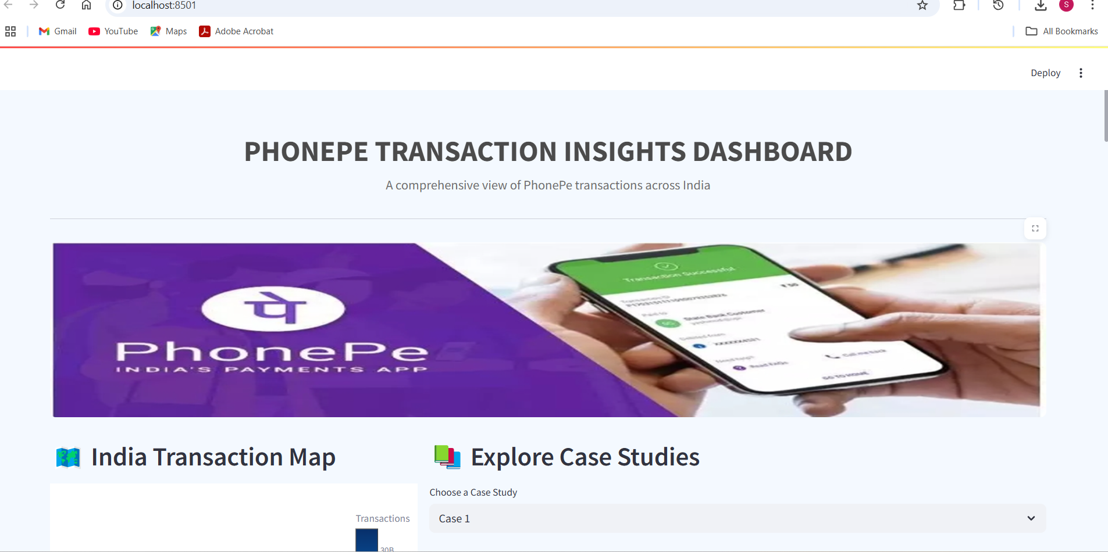
Dashboard Demo
Streamlit dashboard built to visualize insights interactively.
Includes filters for year, quarter, state.
Charts, maps, and tables for easy exploration.
Dashboard screenshots:

Slide 12
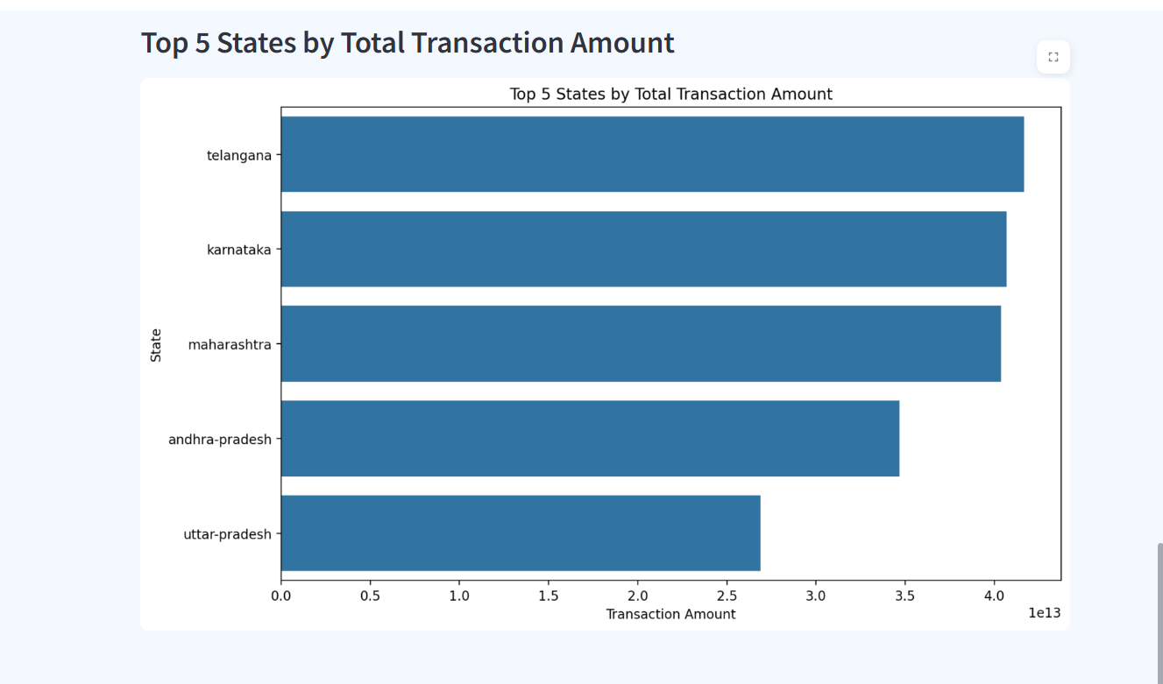
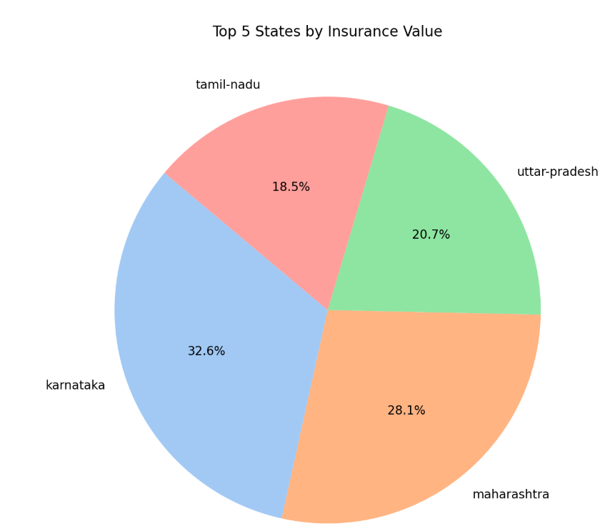
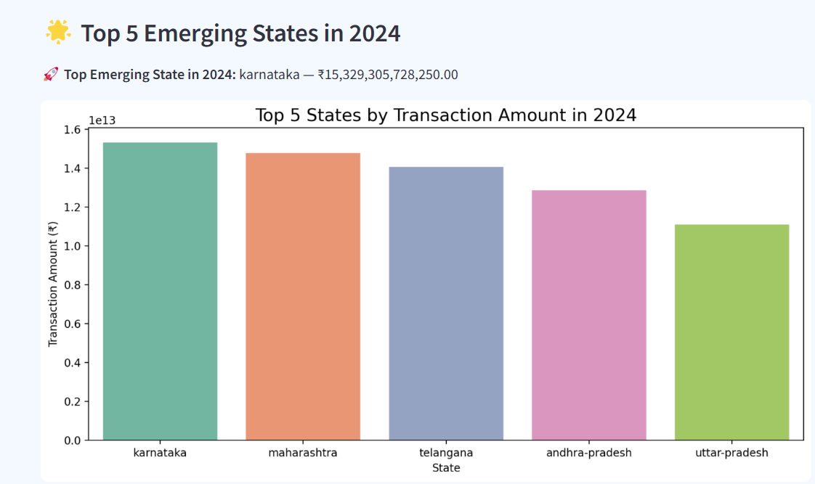
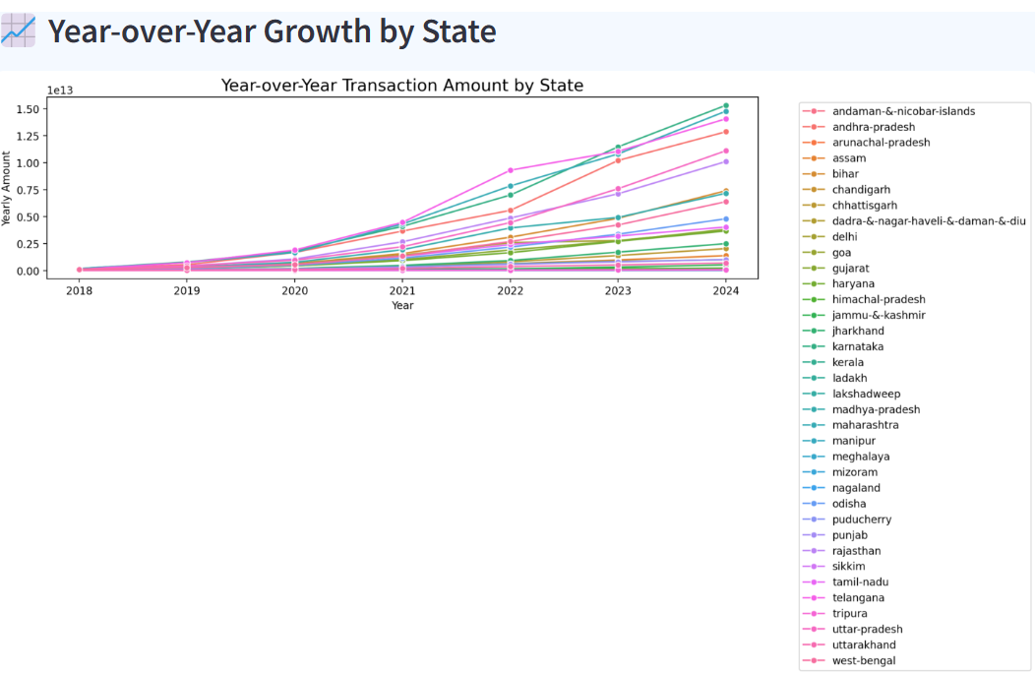

Slide 13
Key Insights
Certain states consistently outperform others in transactions.
Device usage significantly influences engagement.
Insurance services gaining momentum.
Dashboard makes insights accessible.

Slide 14
Recommendations
Focus marketing in underperforming but potential-rich states.
Improve app performance on top user devices.
Expand insurance services in low-penetration areas.
Use dashboard regularly for tracking.

Slide 15
Conclusion
This project delivers actionable insights through 9 detailed case studies, exploring user
behavior, transaction trends, and insurance adoption.
The analysis uncovers:
Strong urban engagement & growth in key districts
Untapped potential in insurance penetration
Region-specific device usage and registration patterns
Future Scope:
Real-time dashboard integration, user segmentation, and predictive modeling for proactive
business strategies.

