Slide 1





GROUP 2 | ATSA PROJECT
Intro
Data
Models
Results
Prophet Model Implementation
UPI Forecasting
With holiday and event effects
Group 2
Rohan Dedhia | Duncan D'lima | Sanaz Katpitia

Slide 2



GROUP 2 | ATSA PROJECT
Intro
Data
Models
Results
Why Forecast UPI?
Daily volume swings with the calendar
Festivals, paydays and sales cause spikes
Banks plan capacity from daily forecasts
790M
5.3x
per day, Aug 2026
growth since Jan 2022

Slide 3
GROUP 2 | ATSA PROJECT
Intro
Data
Models
Results
Our Questions
1
Do holidays and events improve forecasts?
3
Does Prophet beat SARIMAX?
2
Does Prophet recover the true effects?
4
Forecast volume to February 2027

Slide 4
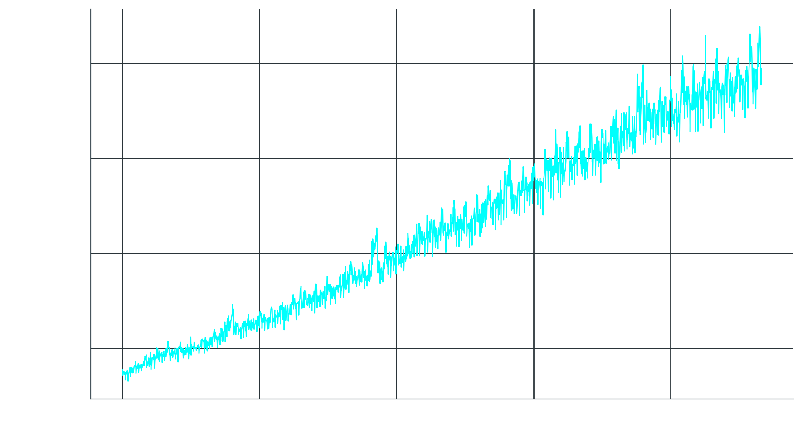






GROUP 2 | ATSA PROJECT
Intro
Data
Models
Results
Our Data
Real NPCI monthly UPI totals
January 2022 to August 2026
NPCI publishes no daily figures
So we built a daily series
Known effects let us check accuracy
56
1,704
months of data
daily values

Slide 5



GROUP 2 | ATSA PROJECT
Intro
Data
Models
Results
Holidays and Events
Festivals: Diwali, Holi, Eid, Raksha Bandhan
National holidays as single days
Events: sale, payday and month-end

Slide 6
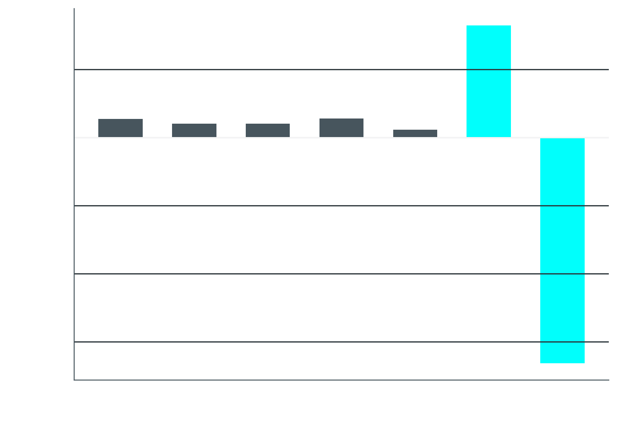
GROUP 2 | ATSA PROJECT
Intro
Data
Models
Results
What the Data Shows
Volume grew five times since 2022
Saturday highest, Sunday about 7% lower
Paydays lift volume about 4.5%
Festivals add bumps each October
One difference makes it stationary
Weekday effect vs 28-day average

Slide 7

GROUP 2 | ATSA PROJECT
Intro
Data
Models
Results
Our Models
Prophet
SARIMAX
Baseline: same weekday last week
Trend and seasonality
Plus holiday windows
Plus payday and sale
Order chosen by AIC
Same calendar inputs

Slide 8



GROUP 2 | ATSA PROJECT
Intro
Data
Models
Results
How We Tested
Rolling origin cross validation
Same 10 folds for every model
Scored by MAPE, MAE and RMSE
TRAIN ON TWO YEARS
FORECAST 90 DAYS
ROLL FORWARD, REPEAT

Slide 9
GROUP 2 | ATSA PROJECT
Intro
Data
Models
Results
Results at a Glance
Prophet with holidays and events best
SARIMAX trails every Prophet version
2.45%
5.54%
best model error
naive baseline error

Slide 10
GROUP 2 | ATSA PROJECT
Intro
Data
Models
Results
Where Error Drops
Holidays cut holiday-day error 30%
Events halve error on sale days
Paydays help ordinary days too

Slide 11



GROUP 2 | ATSA PROJECT
Intro
Data
Models
Results
Estimated vs True
Estimated +6.2%
True +6.0%
Estimated +9.8%
True +10.7%
Estimated +7.7%
True +9.1%
Payday
E-commerce sale
Diwali window
Almost exact
Close
Underestimated

Slide 12
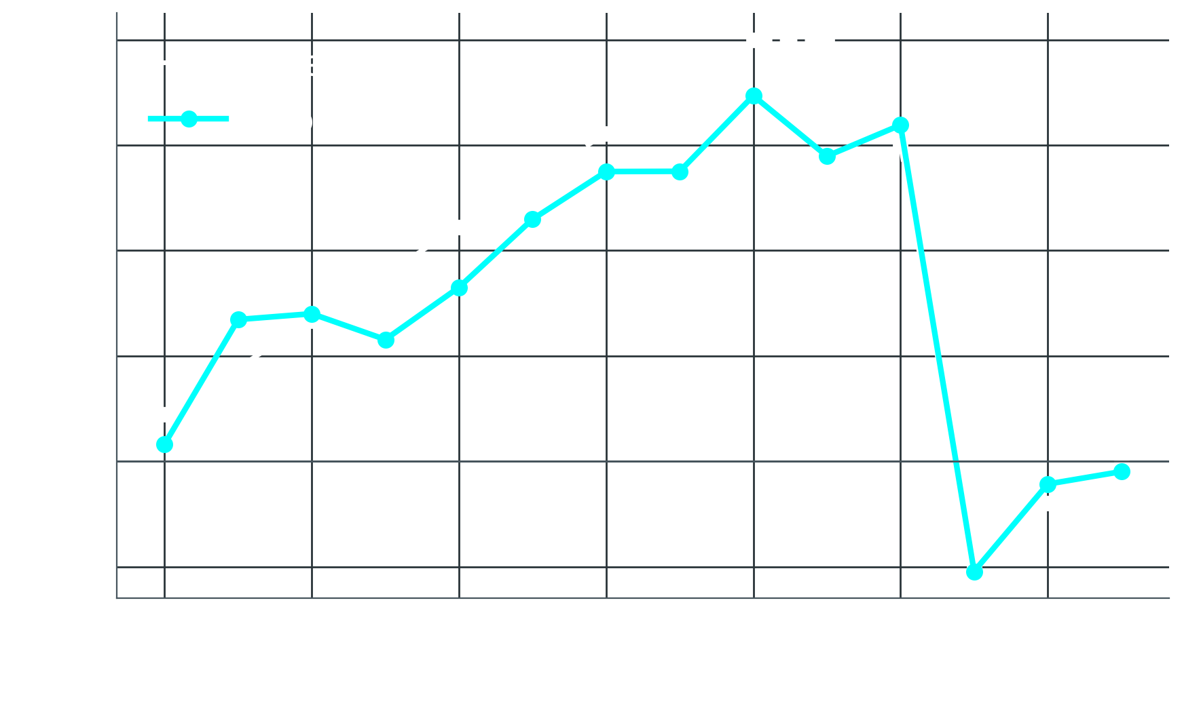
GROUP 2 | ATSA PROJECT
Intro
Data
Models
Results
The Diwali Effect
Ten-day ramp captured well
Peak estimated 17%, true 20%
Only four Diwalis to learn from
Yearly cycle absorbs some effect

Slide 13


GROUP 2 | ATSA PROJECT
Intro
Data
Models
Results
Model Checks
Why did SARIMAX lose?
Its errors grow over 90 days
It overshoots holiday days by 6%
Prophet errors still correlated
Error size changes over time

Slide 14
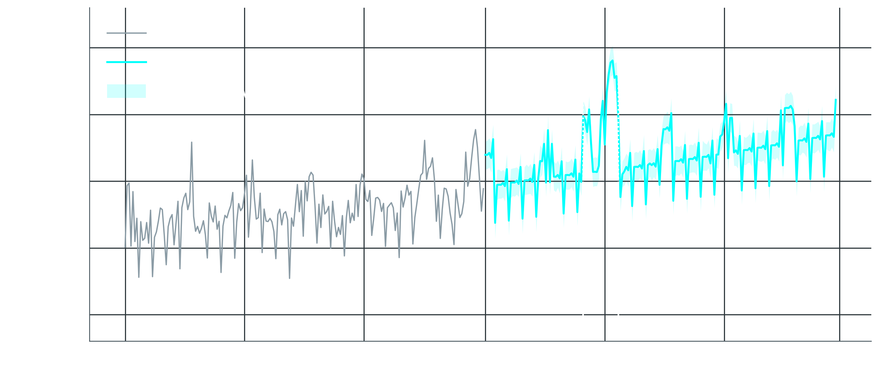
GROUP 2 | ATSA PROJECT
Intro
Data
Models
Results
Six Month Forecast
24 to 26 billion a month
Sale and Diwali peaks visible
Real range likely wider

Slide 15
GROUP 2 | ATSA PROJECT
Intro
Data
Models
Results
Conclusions
1
Holidays and events improve accuracy
3
Prophet beats SARIMAX out of sample
2
Prophet recovers most effects closely
4
Diwali size still underestimated

Slide 16
GROUP 2 | ATSA PROJECT
Intro
Data
Models
Results
Looking Ahead
Limitations
Future Work
Synthetic daily data
Only four Diwalis
Intervals too narrow
Real daily data
Prophet plus ARIMA
Compare with LSTM

Slide 17


GROUP 2 | ATSA PROJECT
Intro
Data
Models
Results
Thank You
Questions are welcome
Rohan Dedhia
Duncan D'lima
Sanaz Katpitia
E004
E026
E020

