Slide 1
Functional Languages
IT253
slide <number>

Slide 2
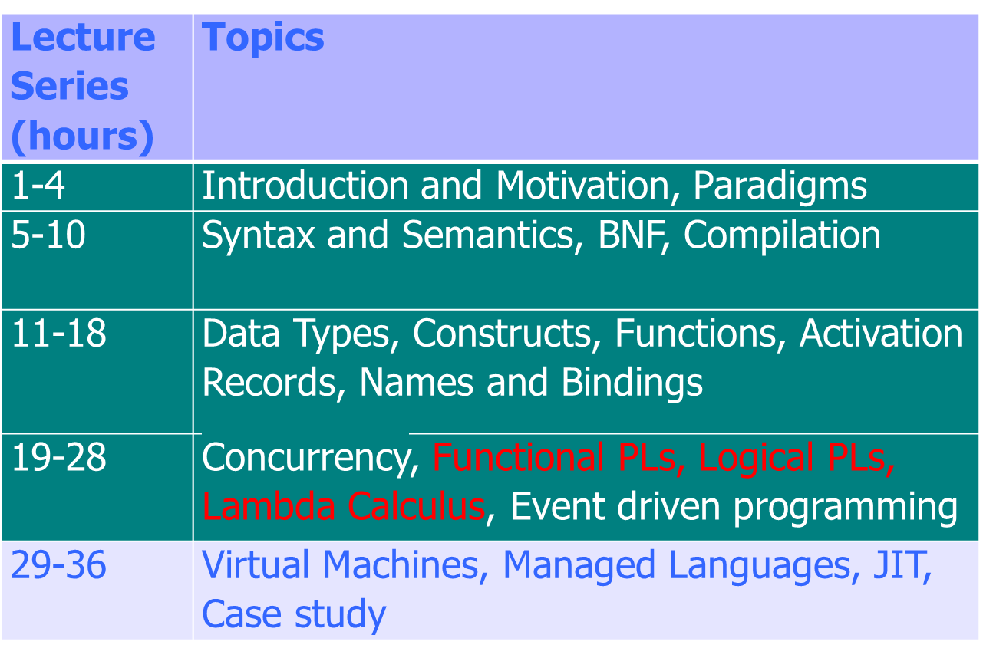
Syllabus
slide <number>

Slide 3
Lambda Expressions and Functions
Expressions
  x + y x + 2*y + z
Functions
  λx. (x+y) λz. (x + 2*y + z)
Application
  (λx. (x+y)) 3 = 3 + y
  (λz. (x + 2*y + z)) 5 = x + 2*y + 5
Parsing: λx. f (f x) = λx.( f (f (x)) )
slide <number>

Slide 4
Higher-Order Functions
Given function f, return function f ° f
  λf. λx. f (f x)
How does this work?
  (λf. λx. f (f x)) (λy. y+1)
  = λx. (λy. y+1) ((λy. y+1) x)
  = λx. (λy. y+1) (x+1)
  = λx. (x+1)+1
slide <number>

Slide 5
Same Procedure (JavaScript)
Given function f, return function f ° f
  function (f) { return function (x) { return f(f(x)); } ; }
How does this work?
  (function (f) { return function (x) { return f(f(x)); } ; })
  (function (y) { return y + 1; })
  function (x) { return (function (y) { return y + 1; })
  ((function (y) { return y + 1; }) (x)); }
  function (x) { return (function (y) { return y +1; }) (x + 1); }
  function (x) { return ((x + 1) + 1); }
slide <number>

Slide 6
Declarations as “Syntactic Sugar”
  function f(x) {
  return x+2;
  }
  f(5);
  (λf. f(5)) (λx. x+2)
block body
declared function
slide <number>

Slide 7
Free and Bound Variables
Bound variable is a “placeholder”
  Variable x is bound in λx. (x+y)
  Function λx. (x+y) is same function as λz. (z+y)
Compare
  ∫ x+y dx = ∫ z+y dz ∀x P(x) = ∀z P(z)
Name of free (i.e., unbound) variable matters!
  Variable y is free in λx. (x+y)
  Function λx. (x+y) is not same as λx. (x+z)
Occurrences
  y is free and bound in λx. ((λy. y+2) x) + y
slide <number>

Slide 8
Renaming Bound Variables
Function application
  (λf. λx. f (f x)) (λy. y+x)
apply twice
add x to argument
Substitute “blindly” – do you see the problem?
  λx. [(λy. y+x) ((λy. y+x) x)] = λx. x+x+x
Rename bound variables
  (λf. λz. f (f z)) (λy. y+x)
  = λz. [(λy. y+x) ((λy. y+x) z))] = λz. z+x+x
Easy rule: always rename variables to be distinct
slide <number>

Slide 9
Main Points About Lambda Calculus
λ captures the “essence” of variable binding
  Function parameters
  Declarations
  Bound variables can be renamed
Succinct function expressions
Simple symbolic evaluator via substitution
Can be extended with
  Types, various functions, stores and side effects…
slide <number>

Slide 10
What is a Functional Language?
“No side effects”
Pure functional language: a language with functions, but without side effects or other imperative features
slide <number>

Slide 11
No-Side-Effects Language Test
Within the scope of specific declarations of x₁,x₂, …, x_{n}, all occurrences of an expression e containing only variables x₁,x₂, …, x_{n}, must have the same value.
  begin
  integer x=3; integer y=4;
  5*(x+y)-3
  … // no new declaration of x or y //
  4*(x+y)+1
  end
slide <number>

Slide 12
Reasoning About Programs
To prove a program correct, must consider everything a program depends on
In functional programs, dependence on any data structure is explicit
Therefore, it’s easier to reason about functional programs
slide <number>

Slide 13
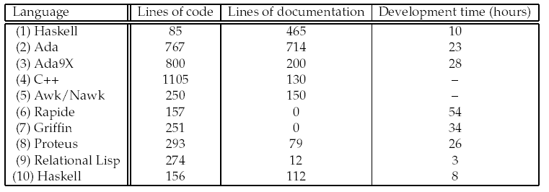
Case Study
[Hudak and Jones, Yale TR, 1994]
Naval Center programming experiment
  Separate teams worked on separate languages
  Some programs were incomplete or did not run
  Many evaluators didn’t understand, when shown the code, that the Haskell program was complete. They thought it was a high-level partial specification.
slide <number>

Slide 14
Von Neumann Bottleneck
Von Neumann
  Mathematician responsible for idea of stored program
Von Neumann bottleneck
  Backus’ term for limitation in CPU-memory transfer
Related to sequentiality of imperative languages
  Code must be executed in specific order
    function f(x) { if (x<y) then y = x; else x = y; }
    g( f(i), f(j) );
slide <number>

Slide 15
Eliminating VN Bottleneck
No side effects
  Evaluate subexpressions independently
    function f(x) { return x<y ? 1 : 2; }
    g(f(i), f(j), f(k), … );
Good idea but ...
  Too much parallelism
  Little help in allocation of processors to processes
  ...
Effective, easy concurrency is a hard problem
slide <number>

Slide 16
Introduction to Scheme
slide <number>

Slide 17
Scheme
Impure functional language
Dialect of Lisp
  Key idea: symbolic programming using
  list expressions and recursive functions
  Garbage-collected, heap-allocated
Some ideas from Algol
  Lexical scoping, block structure
Some imperative features
slide <number>

Slide 18
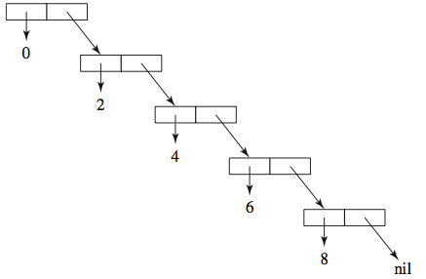
Expressions and Lists
Cambridge prefix notation: (f x1 x2 … xn)
  (+ 2 2)
  (+ (* 5 4) (- 6 2)) means 5*4 + (6-2)
List = series of expressions enclosed
in parentheses
  For example, (0 2 4 6 8) is a list of even numbers
  The empty list is written ()
Lists represent
both functions and data
slide <number>

Slide 19
Elementary Values
Numbers
  Integers, floats, rationals
Symbols
  Include special Boolean symbols #t and #f
Characters
Functions
Strings
  “Hello, world”
Predicate names end with ?
  (symbol? ‘(1 2 3)), (list? (1 2 3)), (string? “Yo!”)
slide <number>

Slide 20
Top-Level Bindings
define establishes a mapping from a symbolic name to a value in the current scope
  Think of a binding as a table: symbol → value
  (define size 2) ; size = 2
  (define sum (+ 1 2 3 4 5)) ; sum = (+ 1 2 3 4 5)
Lambda expressions
  Similar to “anonymous” functions
  Scheme: (define square (lambda (x) (* x x)))
slide <number>

Slide 21
Functions
( define ( name arguments ) function-body )
  (define (factorial n)
  (if (< n 1) 1 (* n (factorial (- n 1)))))
  (define (square x) (* x x))
  (define (sumsquares x y)
  (+ (square x) (square y)))
  (define abs (lambda (x) (if (< x 0) (- 0 x) x)))
Arguments are passed by value
  Eager evaluation: argument expressions are always evaluated, even if the function never uses them
  Alternative: lazy evaluation (e.g., in Haskell)
slide <number>

Slide 22
Expression Evaluation
Read-eval-print loop
Names are replaced by their current bindings
  x ; evaluates to 5
Lists are evaluated as function calls
  (+ (* x 4) (- 6 2)) ; evaluates to 24
Constants evaluate to themselves.
  ‘red ; evaluates to ‘red
Innermost expressions are evaluated first
  (define (square x) (* x x))
  (square (+ 1 2)) ⇒ (square 3) ⇒ (* 3 3) ⇒ 9
slide <number>

Slide 23
Equality Predicates
= - to check if two numbers are equal (if not numbers, error)
(= 2 3) => #f
(= 2.5 2.5) => #t
(= '() '()) => error
eq? - check whether its two parameters respresent the same object in memory
(define x '(2 3))
(define y '(2 3))
(eq? x y) => #f
(define y x)
(eq? x y) => #t
slide <number>

Slide 24
Equality Predicates
(eq? 2 2) => depends upon the implementation
(eq? "a" "a") => depends upon the implementation
eqv? – same as eq? except return #t for primitives
(eq? 2 2) => #t
(eq? "a" "a") => depends upon the implementation
equal? - are two values structurally equivalent? Works with list, vectors etc
  (equal “abc” “abc”) ⇒ #t
slide <number>

Slide 25
Operations on Lists
car, cdr, cons
  (define evens ‘(0 2 4 6 8))
  (car evens) ; gives 0
  (cdr evens) ; gives (2 4 6 8)
  (cons 1 (cdr evens)) ; gives (1 2 4 6 8)
Other operations on lists
  (null? ‘()) ; gives #t, or true
  (equal? 5 ‘(5)) ; gives #f, or false
  (append ‘(1 3 5) evens) ; gives (1 3 5 0 2 4 6 8)
  (cons ‘(1 3 5) evens) ; gives ((1 3 5) 0 2 4 6 8)
    Are the last two lists same or different?
slide <number>

Slide 26
Conditionals
General form
(cond (p1 e1) (p2 e2) … (pN eN))
  Evaluate p_{i} in order; each p_{i} evaluates to #t or #f
  Value = value of e_{i} for the first p_{i} that evaluates to #t or e_{N} if p_{N} is “else” and all p₁ … p_{N-1} evaluate to #f
  (cond ((> 3 3) 'greater)
  ((< 3 3) 'less)
  (else 'equal)) => equal
slide <number>

Slide 27
Conditionals
Simplified form
  (if (< x 0) (- 0 x)) ; if-then
  (if (< x y) x y) ; if-then-else
Boolean predicates:
(and (e1) … (eN)), (or (e1) … (eN)), (not e)
slide <number>

Slide 28
Other Control Flow Constructs
Case selection
  (case month
  ((sep apr jun nov) 30)
  ((feb) 28)
  (else 31)
  )
What about loops?
  Iteration ↔ Tail recursion
  Scheme implementations must implement tail-recursive functions as iteration
slide <number>

Slide 29
Delayed Evaluation
Bind the expression to the name as a literal…
  (define sum ‘(+ 1 2 3))
  sum ⇒ (+ 1 2 3)
    Evaluated as a symbol, not a function
Evaluate as a function
  (eval sum) ⇒ 6
No distinction between code (i.e., functions) and data – both are represented as lists!
slide <number>

Slide 30
Imperative Features
Scheme allows imperative changes to values of variable bindings
  (define x `(1 2 3))
  (set! x 5)
(define x 3)
(define (foo)
(define x 4)
x)
slide <number>

Slide 31
Imperative Features
(define (bar)
(set! x 4)
x)
(foo) ; returns 4
x ; still 3
(bar) ; returns 4
x ; is now 4
slide <number>

Slide 32
Let Expressions
Nested static scope
(let ((var1 exp1) … (varN expN)) body)
(define (subst y x alist)
(if (null? alist) ‘()
(let ((head (car alist)) (tail (cdr alist)))
(if (equal? x head)
(cons y (subst y x tail))
(cons head (subst y x tail)))))
slide <number>

Slide 33
Let*
(let* ((var1 exp1) … (varN expN)) body)
  Bindings are applied sequentially, so var_{i} is bound in exp_{i+1} … exp_{N}
This is also syntactic sugar for a (different) lambda application
  (lambda (var1) (
  (lambda (var2) ( … (
  (lambda (varN) (body)) expN) … ) exp1
slide <number>

Slide 34
Let and Let*
  (let ((x 10)
  (y (+ x 6))) ; error! unbound identifier in module in: x
  y)
  (let* ((x 10)
  (y (+ x 6))) ; works fine
  y)
  => 16
slide <number>

Slide 35
Functions as Arguments
F
(define (mapcar fun alist)
(if (null? alist) ‘()
(cons (fun (car alist))
(mapcar fun (cdr alist)))
))
(define (square x) (* x x))
What does (mapcar square ‘(2 3 5 7 9)) return?
(4 9 25 49 81)
slide <number>

Slide 36
Using Recursion
Compute length of the list recursively
  (define length
  (lambda(lst)
  (if (null? lst) 0 (+ 1 (length (cdr list))))))
slide <number>

Slide 37
Example Programs
(define (contains? item lst)
(cond
[(empty? lst) false]
[(= item (first lst)) true]
[else (contains? item (rest lst))]))
slide <number>

Slide 38
Key Features of Scheme
Scoping: static
Typing: dynamic
No distinction between code and data
  Both functions and data are represented as lists
  Lists are first-class objects
    Can be created dynamically, passed as arguments to functions, returned as results of functions and expressions
  This requires heap allocation and garbage collection
  Self-evolving programs
slide <number>

