Slide 1
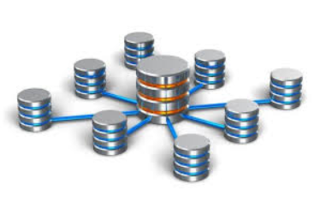
What is Data Base
A database is an organized collection of structured information, or data, typically stored electronically in a computer system. A database is usually controlled by a database management system (DBMS). Together, the data and the DBMS, along with the applications that are associated with them, are referred to as a database system, often shortened to just database.

Slide 2



Relational Data Base Management Systems (RDBMS)
Using RDBMS allows us to:
No Data redundancy
Data Consistency and Integrity
More flexibility than files
Examples of RDBMS’s
MySQL.
SQL Server
PostgreSQL

Slide 3
MySQL
My SQL is a relational database management system (RDBMS) developed by Oracle that is based on structured query language (SQL).
A database is a structured collection of data. It may be anything from a simple shopping list to a picture gallery or a place to hold the vast amounts of information in a corporate network.
.
Major Advantages of Using MySQL
Data Security
High Performance
The Flexibility Of Open Source
Disadvantages of MySQL:
MySQL is not very efficient in handling very large databases.
MySQL does not support SQL check constraints.
MySQL is prone to data corruption as it inefficient in handling transactions.

Slide 4
PostgreSQL
It is a highly stable database management system, backed by more than 20 years of community development which has contributed to its high levels of resilience, integrity, and correctness. PostgreSQL is used as the primary data store or data warehouse for many web, mobile, geospatial, and analytics applications. .
Major Advantages of Using PostegreSQL
Reduce costs
Security
Scalability
Disadvantages of PostegreSQL:
On performance metrics.
Postgres is not owned by one organization
Postgres has had trouble getting its name out there despite being fully featured

Slide 5
SQL Server
is a relational database management system (RDBMS) that supports a wide variety of transaction processing, business intelligence and analytics applications in corporate IT environments. Microsoft SQL Server is one of the three market-leading database technologies, along with Oracle Database and IBM's DB2
.
Major Advantages of Using SQL Server
Enhanced Performance
Highly Secure
Easy to Install
Disadvantages of SQL Server
Poor Interface
Cost Inefficient
Partial Control

Slide 6
SQL Server
SQL is one programming language that is used to extract data and process data in databases. Among others, SQL Server, Oracle, MySQL, and PostgreSQL are relational database management systems (RDBMS) that have their own SQL dialect for the reasons we previously exposed.
For novice or intermediate users, the differences can mainly be seen in the syntax, and for most of us (I would include myself here) the technical reasons behind such differences are rather obscure. However this will not prevent us from using SQL in the most relevant way!
.

Slide 7
