Slide 1

Computer Networks Assignment 2:
Simple Router
Tutorial: 02/17/2026
Due Date: March 13th, 2026

Slide 2
PART 1: ASSIGNMENT DESCRIPTION
Implementing a Simple Router

Slide 3
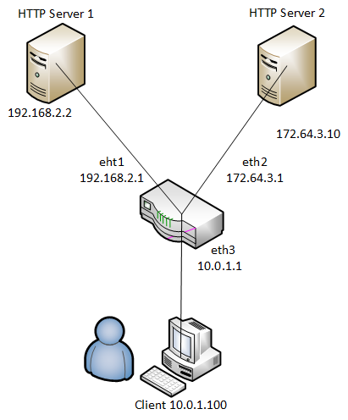
Overview
You will build a simplified router which will route packets from an emulated client to two emulated servers.
Emulation environment: Mininet
Four main parts to the assignment:
  Preparing the emulation environment
  Implementing IP forwarding
  Implementing ICMP protocol
  Handling address resolution (ARP)

Slide 4


Flow of a TCP/IP Transaction (HTTP Request)
Client Network Stack
Server Network Stack
HTTP Server
Browser
Router
10.10.1.2, Gateway: 10.10.1.1
10.10.1.1
192.168.1.1
192.168.1.4, Gateway: 192.168.1.1
App Data
ARP Request
1) GET 192.168.1.4 HTTP/1.1
2) WHO HAS 10.10.1.1?
ARP Response
3) 10.10.1.1 IS AT AB:CD:34:34:12:14
TCP SYN
4) TCP SYN from 10.10.1.2 to 192.168.1.4
5) WHO HAS 192.168.1.4?
6) 192.168.1.4 IS AT AB:CD:55:66:77:99
7) TCP SYN from 10.10.1.2 to 192.168.1.4
8,9) Is there an app listening to port 80?
YES!
10) WHO HAS 192.168.1.1?
11) 192.168.1.1 IS AT AB:CD:55:66:77:88
13) WHO HAS 10.10.1.2?
12) TCP ACK from 192.168.1.4 to 10.10.1.2
14) 10.10.1.2 IS AT AB:CD:55:66:11:CF
15) TCP ACK from 192.168.1.4 to 10.10.1.2
16) TCP SYN/ACK from 10.10.1.2 to 192.168.1.4
17) TCP SYN/ACK from 10.10.1.2 to 192.168.1.4
18) GET 192.168.1.4 HTTP/1.1, from 10.10.1.2 to 192.168.1.4
19) GET 192.168.1.4 HTTP/1.1, from 10.10.1.2 to 192.168.1.4
20) GET 192.168.1.4 HTTP/1.1
24) HTTP/1.1 200 OK
23) HTTP/1.1 200 OK
22) HTTP/1.1 200 OK
App Data
App Data
21) HTTP/1.1 200 OK

Slide 5
Raw Ethernet Frames
Your router will receive and send raw Ethernet frames.
PHYSICAL preamble | ETHERNET Header | Network Header IPv4, ARP, … | Transport Header ICMP, UDP, TCP, … | Payload | END of frame
Ethernet
DESTINATION MAC (6B) | SOURCE MAC (6B) | ETHERTYPE (2B) | DATA
IPv4
Ver-IHL (1B) | TOS (1B) | Total Length (2B) | Identification (2B) | F-Fragment Offset (2B) | TTL (1B) | PROTOCOL (1B) | CSUM (2B) | SOURCE ADDR (4B) | DEST ADDR (4B)
ARP
HTYPE (2B) | PTYPE (2B) | HLEN (1B) | OPCODE (2B) | SENDER MAC (6B) | SENDER IP (4B) | TARGET MAC (6B) | TARGET IP (4B)
ICMP
TYPE (1B) | CODE (1B) | CHECKSUM (2B) | ICMP DATA (4B)

Slide 6
Ethernet
Your router will receive and send raw Ethernet frames.
Ethernet frames have headers which contain source and destination MAC addresses.
  To forward a packet one hop, we must change the destination MAC address of the forwarded packet to the MAC address of the next hop’s incoming interface.
Your router must process packets & forward them to the correct interface.
When your router receives a packet
  First, identify the packet (IP, ARP)
  Then, extract appropriate header

Slide 7
Raw Ethernet Frames
Your router will receive and send raw Ethernet frames.
PHYSICAL preamble | ETHERNET Header | Network Header IPv4, ARP, … | Transport Header ICMP, UDP, TCP, … | Payload | END of frame
Ethernet
DESTINATION MAC (6B) | SOURCE MAC (6B) | ETHERTYPE (2B) | DATA
IPv4
Ver-IHL (1B) | TOS (1B) | Total Length (2B) | Identification (2B) | F-Fragment Offset (2B) | TTL (1B) | PROTOCOL (1B) | CSUM (2B) | SOURCE ADDR (4B) | DEST ADDR (4B)
ARP
HTYPE (2B) | PTYPE (2B) | HLEN (1B) | OPCODE (2B) | SENDER MAC (6B) | SENDER IP (4B) | TARGET MAC (6B) | TARGET IP (4B)
ICMP
TYPE (1B) | CODE (1B) | CHECKSUM (2B) | ICMP DATA (4B)

Slide 8
Address Resolution Protocol (ARP)
ARP determines the next-hop MAC that corresponds to the next-hop IP
Your router needs to generate and process ARP requests/replies.
  You are required to cache ARP replies that your router receives
  We handle the cache timeout for you
During the packet forwarding process, the router should first check the ARP cache for the MAC address before sending an ARP request

Slide 9
Address Resolution Protocol (ARP)
If your router receives an ARP packet:
Check if it’s an ARP request or ARP reply:
  If ARP request:
    Check if its target IP address is one of our router’s IP addresses.
      If yes, send ARP reply
      Else, drop it
  If ARP reply:
    Cache the ARP reply as long as the target IP address is one of your router’s IP addresses
    If there is an ARP request waiting on the reply
      Send IP packets waiting on this ARP reply
      Remove corresponding ARP request from queue

Slide 10
Raw Ethernet Frames
Your router will receive and send raw Ethernet frames.
PHYSICAL preamble | ETHERNET Header | Network Header IPv4, ARP, … | Transport Header ICMP, UDP, TCP, … | Payload | END of frame
Ethernet
DESTINATION MAC (6B) | SOURCE MAC (6B) | ETHERTYPE (2B) | DATA
IPv4
Ver-IHL (1B) | TOS (1B) | Total Length (2B) | Identification (2B) | F-Fragment Offset (2B) | TTL (1B) | PROTOCOL (1B) | CSUM (2B) | SOURCE ADDR (4B) | DEST ADDR (4B)
ARP
HTYPE (2B) | PTYPE (2B) | HLEN (1B) | OPCODE (2B) | SENDER MAC (6B) | SENDER IP (4B) | TARGET MAC (6B) | TARGET IP (4B)
ICMP
TYPE (1B) | CODE (1B) | CHECKSUM (2B) | ICMP DATA (4B)

Slide 11
Internet Protocol (IPv4)
If your router receives an IPv4 packet:
Perform basic checks
  Verify its checksum
  Check that it meets minimum length
Determine if it is destined for one of our interfaces:
  If yes, check that it is an ICMP echo request (type 8)
    If yes, send ICMP echo reply (type 0) back
    Else, drop it. If not even an ICMP packet, send ICMP port unreachable (type 3, code 3)
  If not destined for our interfaces, IPv4 packet must be forwarded.

Slide 12
IP Forwarding
If packet must be forwarded:
Decrement TTL by 1, recompute packet checksum
  If TTL is expired, send ICMP time exceeded (type 11)
Find match for the destination IP address in the routing table
  If no match, send ICMP destination net unreachable (type 3, code 0)
  If match, check ARP cache for next-hop MAC address corresponding to next-hop IP
    If ARP entry is found, send IP packet to its next hop
    If no ARP entry is found:
      Send ARP request for next-hop IP
      Put packet onto a queue as it waits for an ARP reply.
Notes:
When both a valid next hop IP address and a corresponding MAC address are found, send packet to its next hop

Slide 13
Raw Ethernet Frames
Your router will receive and send raw Ethernet frames.
PHYSICAL preamble | ETHERNET Header | Network Header IPv4, ARP, … | Transport Header ICMP, UDP, TCP, … | Payload | END of frame
Ethernet
DESTINATION MAC (6B) | SOURCE MAC (6B) | ETHERTYPE (2B) | DATA
IPv4
Ver-IHL (1B) | TOS (1B) | Total Length (2B) | Identification (2B) | F-Fragment Offset (2B) | TTL (1B) | PROTOCOL (1B) | CSUM (2B) | SOURCE ADDR (4B) | DEST ADDR (4B)
ARP
HTYPE (2B) | PTYPE (2B) | HLEN (1B) | OPCODE (2B) | SENDER MAC (6B) | SENDER IP (4B) | TARGET MAC (6B) | TARGET IP (4B)
ICMP
TYPE (1B) | CODE (1B) | CHECKSUM (2B) | ICMP DATA (4B)

Slide 14
ICMP
Use ICMP messages to send control information to host:
Echo reply (type 0)
  Send in response to echo request (type 8). Used for PING.
Destination net unreachable (type 3, code 0)
  Sent if there is a non-existent route to the destination IP.
Destination host unreachable (type 3, code 1)
  Sent if five ARP requests were sent to the next-hop IP without a response.
Port unreachable (type3, code 3)
  Sent if an IP packet containing a UDP or TCP payload is sent to one of the router’s interfaces.
Time exceeded (type 11, code 0)
  Sent if an IP packet is discarded because the TTL field is 0.

Slide 15
ICMP Unreachable Host Scenario
Client Network Stack
Server Network Stack
HTTP Server
Browser
Router
10.10.1.2, Gateway: 10.10.1.1
10.10.1.1
192.168.1.1
192.168.1.4, Gateway: 192.168.1.1
1) GET 192.168.1.6 HTTP/1.1
2) WHO HAS 10.10.1.1?
3) 10.10.1.1 IS AT AB:CD:34:34:12:14
4) TCP SYN from 10.10.1.2 to 192.168.1.6
5) WHO HAS 192.168.1.6?
6) WHO HAS 192.168.1.6?
…
2 tries
…
7) WHO HAS 192.168.1.6?
8) ICMP DESTINATION HOST UNREACHABLE!
9) Socket error: connect failed

Slide 16
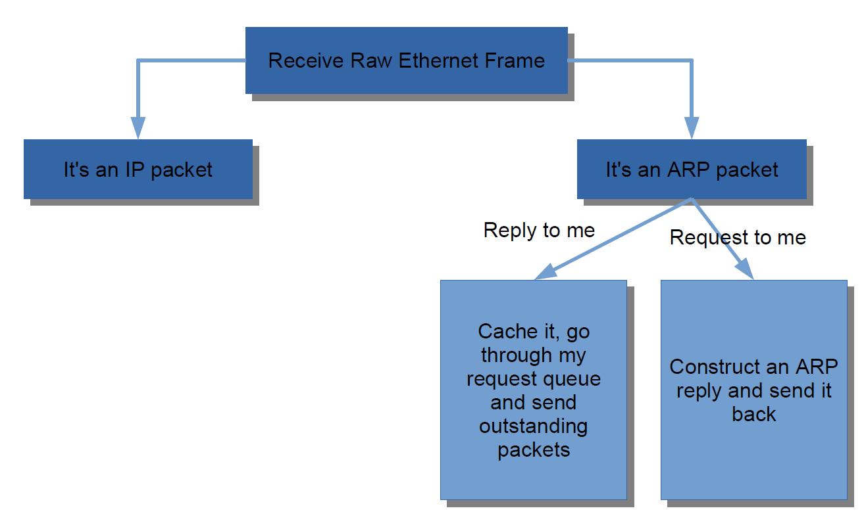
Summary: A Rough Flow Chart
Notes:
Please be aware there might be some other
There is no port number in ARP packet

Slide 17
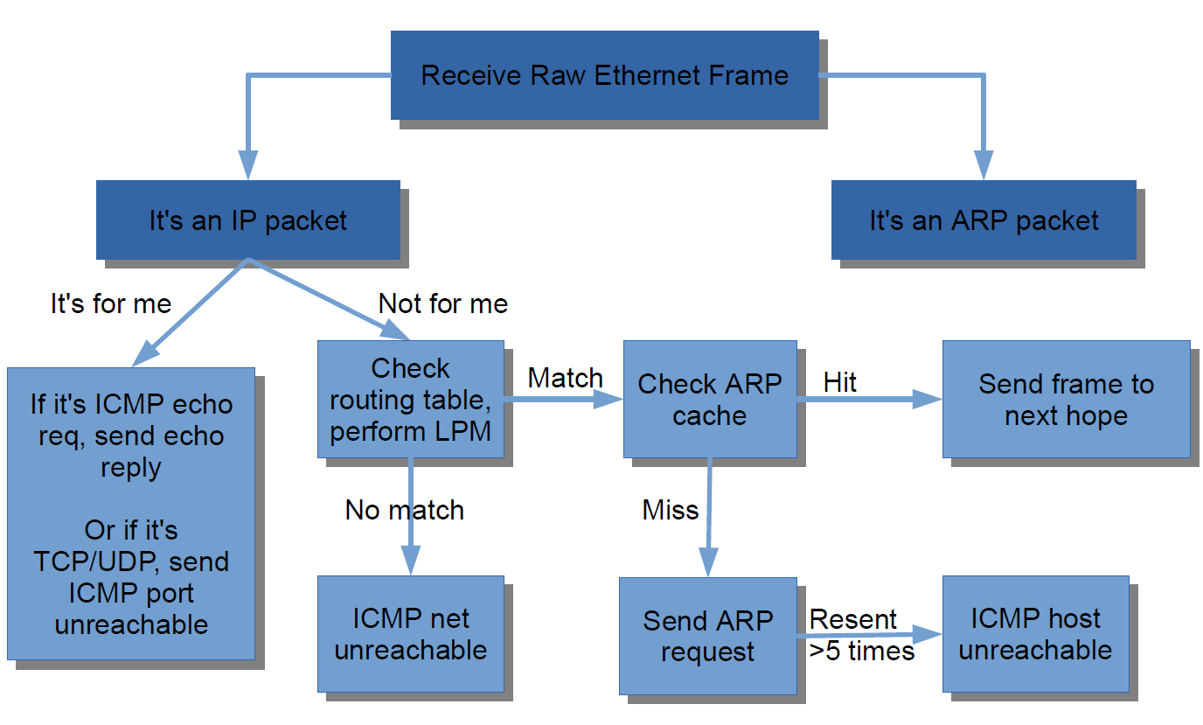
Summary: A Rough Flow Chart

Slide 18
END OF PART 1
Q&A

Slide 19
PART 2: TESTING ENVIRONMENT
Deploying Mininet using Multipass

Slide 20
Mininet VM Setup
Checkout the instructions in README-VM.md
Custom Multipass VM setup (cn-a2) → must use for this assignment!
Test connectivity using the reference binary provided.
  Do this BEFORE writing any code.
  Do this early so we can help resolve any setup issues.
  If there are any connectivity issues, you will not be able to test your implementation.
  No autograder on Gradescope, but exact requirements are provided.
Step-by-step instructions and requirements are in the README

Slide 21
Getting Started: sr_router.c
In sr_router.c:
void sr_handlepacket(struct sr_instance* sr, uint8_t * packet, unsigned int len, char* interface)
This method is called every time the router receives a raw Ethernet frame.
You will have to implement the logic to process the packets and send them to the correct interface.
  Tip: First check if it is an IP or an ARP packet using ethertype() method from sr_utils.c/h, then process accordingly
  Use helper methods!

Slide 22
Helper functions: sending a packet
In sr_vns_comm.c:
int sr_send_packet(struct sr_instance* sr, uint8_t* buf, unsigned int len, const char* iface)
Sends a packet of length len to the network out of iface
Your sr_router.c should call this method
You do not need to modify this method

Slide 23
Getting Started: sr_arpcache.c
In sr_arpcache.c:
void sr_arpcache_sweepreqs(struct sr_instance *sr)
Called once per second
You should add code to iterate through the ARP request queue and re-send outstanding requests
Fill in the helper method called e.g. handle_arpreq() to track of how many times the request has been sent
  If sent >= 5 times and no response, send ICMP destination host unreachable (type 3, code 1)
Tip: there is helpful pseudocode for this in sr_arpcache.h

Slide 24
Summary
Code to be written in sr_router.c:
  Handle IP packet
    Send ICMP echo replies
    Send (forward) IP packets
    Queue ARP requests
  Handle ARP packet
    Send ARP replies in response to requests
    Cache incoming ARP reply
    Send IP packets that are waiting on incoming ARP reply
    Remove corresponding ARP request from queue
  Send ICMP messages based on certain conditions
Code to be written in sr_arpcache.c:
  Iterate through ARP request queue
  Send and re-send ARP requests
  Check if we need to re-send or destroy ARP request
There are some helpful methods to look up interfaces in sr_if.c.
There are some generally helpful methods in sr_utils.c.
These are just my recommendations for where to place different functionality.
You may organize the functionality across the code base as you see fit.

Slide 25

Final Thoughts
Please start early.
  I repeat, start early.
Come to office hours
Ask questions on Piazza

Slide 26
Grading Checklist
Since we don’t have a Gradescope autograder we are providing visible test cases for grading
(numbers in parentheses are test-case points)
Note: This list is not exhaustive. There will be hidden test cases. You should ensure your solution is complete and handles all edge cases
Ping from client to server1 (5)
Ping from client to server2 (5)
Ping from client to eth1 (5)
Ping from client to eth2 (5)
Ping from client to eth3 (5)
Traceroute from client to server1 (7)
Traceroute from client to server2 (7)
Traceroute from client to eth1 (2)
Traceroute from client to eth2 (2)

Slide 27
Grading Checklist (continued)
Since we don’t have a Gradescope autograder for this assignment, please ensure these test cases succeed
Traceroute from client to eth3 (2)
Get HTTP content from server1 (10)
Get HTTP content from server2 (10)
Send a ping from client to server with TTL=1 (router should reject with TTL exceeded) (5)
README: Description of Code you wrote (5)

Slide 28
Additional Tips
Go over the files/classes in the router directory to understand the available functions that you can use during coding.
Be sure to correctly convert data from network format to local host format (ntohs/ntohl) and vice versa (whenever applicable).
Creating new packets: Use the file named “Tips for Packet Creation” in the main folder for reference.

