Slide 1





University of Prince Mugrin
College of Computer & Cyber Sciences
Department of Artificial Intelligence
Survey of 𝕏 Platform Sentiment Analysis Methods
AI 306 – Data Mining
Team Members:
Salwa Shamma – 4010405
Samah Shamma – 4010403
Sana Shamma – 4010404
Instructor:
Ms.Marwa Alrehili
Academic Year 2023 – 2024

Slide 2

Table of Contents
INTRODUCTION
RELATED WORK
DATASET AND DATA PREPROCESSING
METHODOLOGY
EXPERIMENTS & RESULTS
DISCUSSION
CONCLUSION
Page 02

Slide 3

Introduction
𝕏 Platform
It is a microblogging service.
Provides an opportunity to express the daily activities and thoughts in real-time.
It allow to user to express themselves not just via words but also through images and videos.
Page 03

Slide 4

Introduction
Sentiment analysis
It is a technique can be utilized to recognize emotions in 𝕏's posts.
It assesses whether a post conveys sentiments that are positive or negative or neutral.
Rely on the existence of English words (like, hate, and love).
Goal
An initial analysis that attempts to identify and analyses emotions in postings.
Page 04

Slide 5
Literature Review on Sentiment analysis
Author & year | Method | Dataset | Advantages
Cindo et al (2020) | Maximum Entropy (ME) | General opinions and Airline Reservation Tweets | Maximum Entropy (ME) outperforms Support Vector Machin (SVM)
Author & year | Method | Dataset | Advantages
Kumar et al.. (2021) | Support Vector Machin (SVM) | 1000 tweets | SVM linear grid outperformed the other type of SVM models
Author & year | Method | Dataset | Advantages
Rahat et al (2019) | Naive Bayes (NB) | 10,000 posts containing passenger reviews | They found that both (SVM) and (NB), algorithms yielded good results in the case of airline reviews on 𝕏 platform posts
Page 05

Slide 6
Literature Review on Sentiment analysis
Author & year | Method | Dataset | Advantages
Sanjay et al. (2021) | Random Forests (RF) | 1000 tweets | The Random Forests had the best accuracy in sentiment classification.
Author & year | Method | Dataset | Advantages
Ferdoshi et al (2023) | VADER | "Mendeley“ website | They found that VADER achieved higher results than Transformers-RoBERTa
Author & year | Method | Advantages
Cindo et al. (2020) | k-nearest neighbors (KNN) | They found that oversampling and using logistic regression, decision trees, and KNN, yielded strong classification results
Page 06

Slide 7
Literature Review on Sentiment analysis
Author & year | Method | Advantages
Popoola et al. (2024) | Term frequency-inverse document frequency (TF-IDF) | The algorithm aids sentiment analysis by analysing sentiment text corpora
Author & year | Method | Advantages
Abdur Rahman et al. (2021). | Adaptive Boosting (Adaboost) | Utilizing (SVM) and Adaboost with different functions and feature extraction techniques like Chi-square help to optimize sentiment classification models
Page 07

Slide 8

DATASET AND DATA
PREPROCESSING

Slide 9
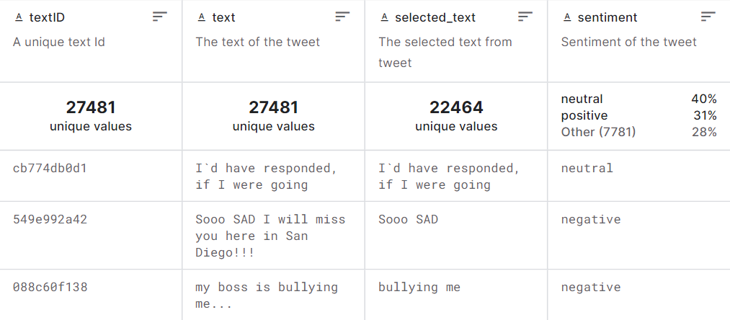
Dataset
Dataset: "Twitter Tweets Sentiment Dataset" from Kaggle.
Number of tweets: 27,226.
Data format: Raw form.
Features:
textID: Unique ID for each piece of text.
text: The text of the tweet.
selected_text: Subset of the text containing keywords from the tweet.
sentiment: General sentiment of the tweet (positive, negative, neutral).
Page 09

Slide 10
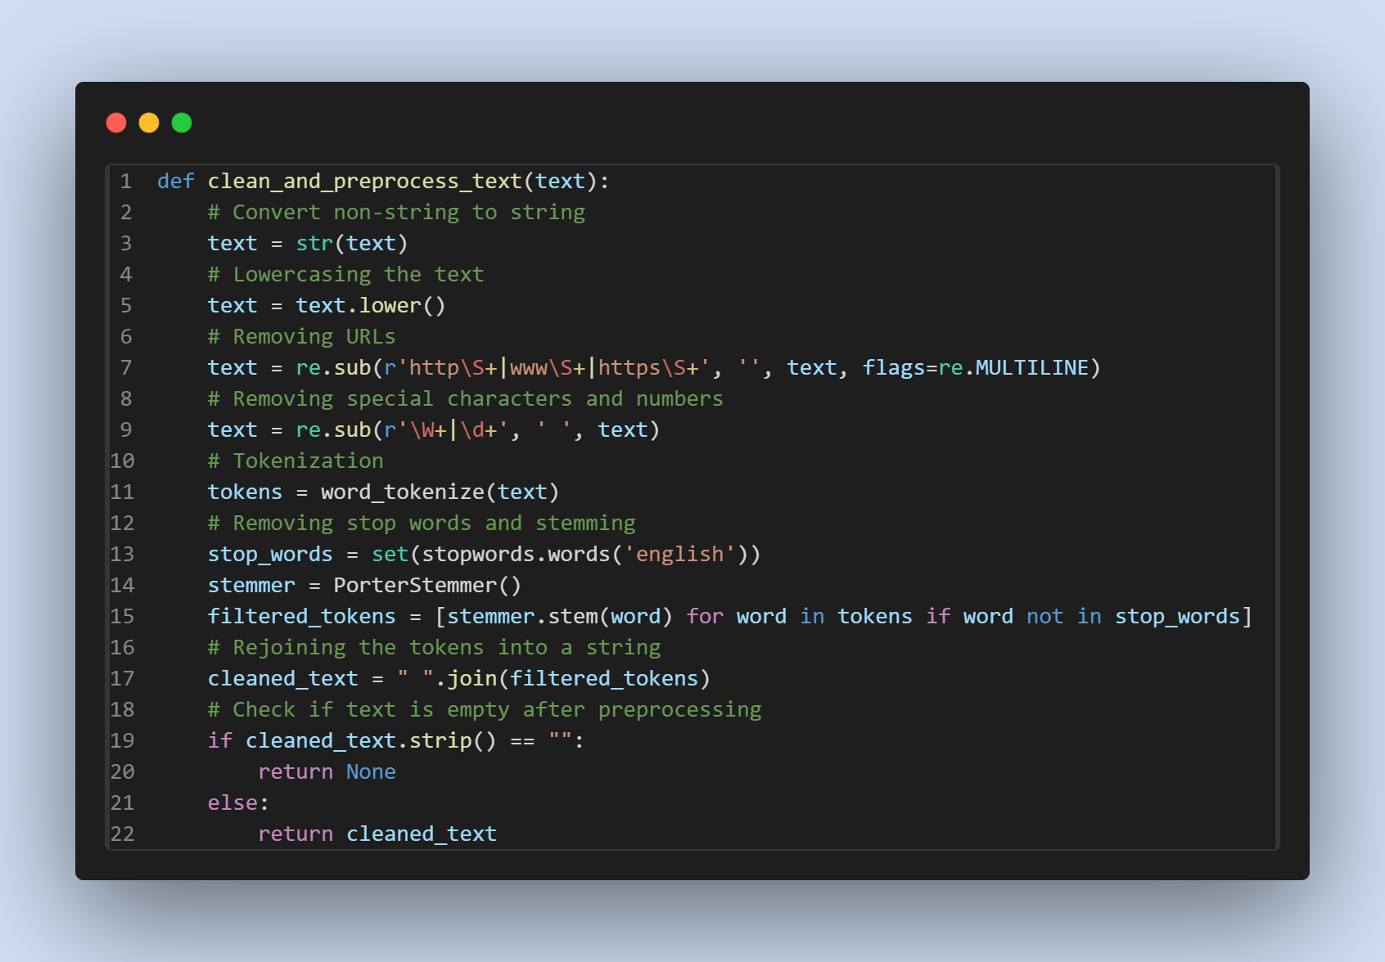
Data Preprocessing
Handling null values by drop the rows.
Converting text to lowercase.
Removing garbage words:
URLs,
special characters,
or punctuation marks.
Removing stop words:
articles,
prepositions, or
conjunctions.
Text stemming.
Encoding text.
Page 10

Slide 11


METHODOLOGY

Slide 12
Methodology
Goal
Understand the strengths and weaknesses of each technique in emotion detection in tweets.
Step1: Find a diverse and representative dataset for sentiment analysis.
Step2: Curate a dataset of 27,226 tweets using the Python programming language. (pre-processing )
Step3: Apply the Term Frequency-Inverse Document Frequency (TF-IDF) technique.
Step4: Evaluate the detection of emotions in tweets using seven distinct techniques:
Support Vector Machines (SVM)
Random Forest
K-Nearest Neighbors (KNN)
Valence Aware Dictionary and Sentiment Reasoner (VADER)
Naive Bayes (NB)
Adaboost
Maximum Entropy (ME)
Step5: Analysis and result.
Page 12

Slide 13
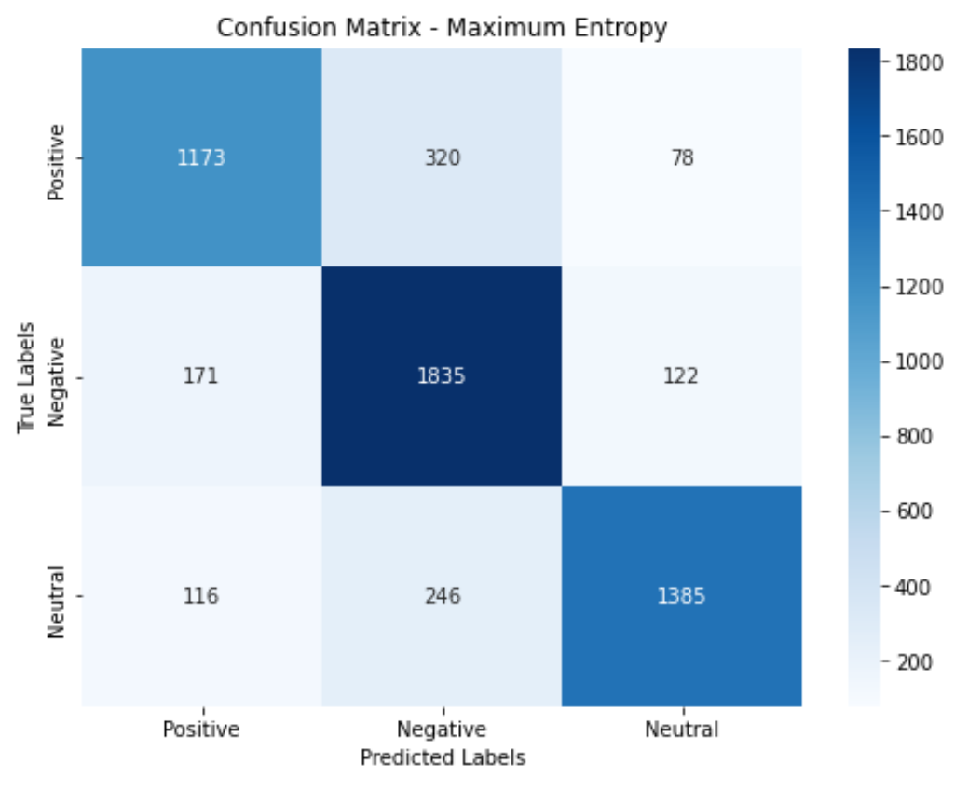

Experiments
Maximum Entropy (ME)
This model achieves an 81% accuracy in detecting sentiment in the "Twitter Tweets Sentiment Dataset."
Page 13

Slide 14
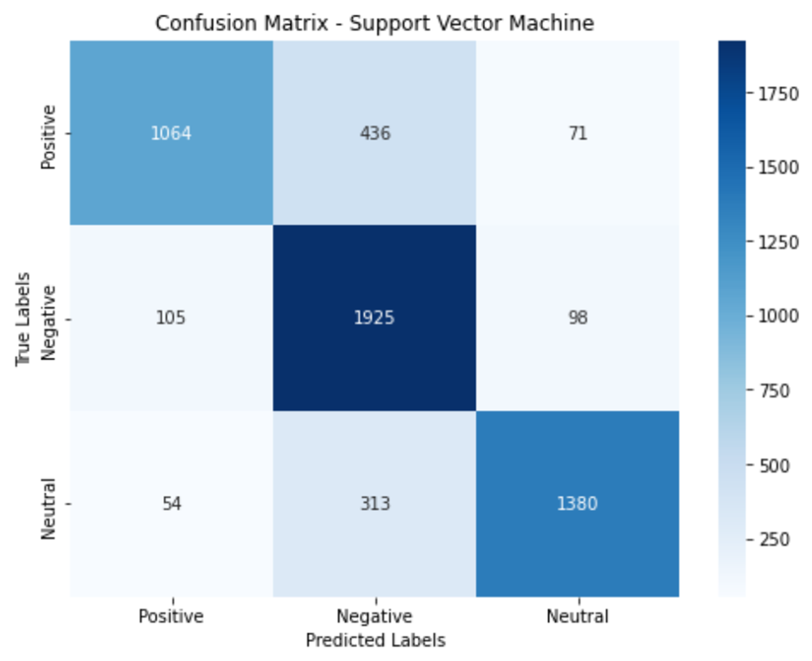
Experiments
Support Vector Machine (SVM)
This model achieves an 80% accuracy in detecting sentiment in the "Twitter Tweets Sentiment Dataset."
Page 14

Slide 15
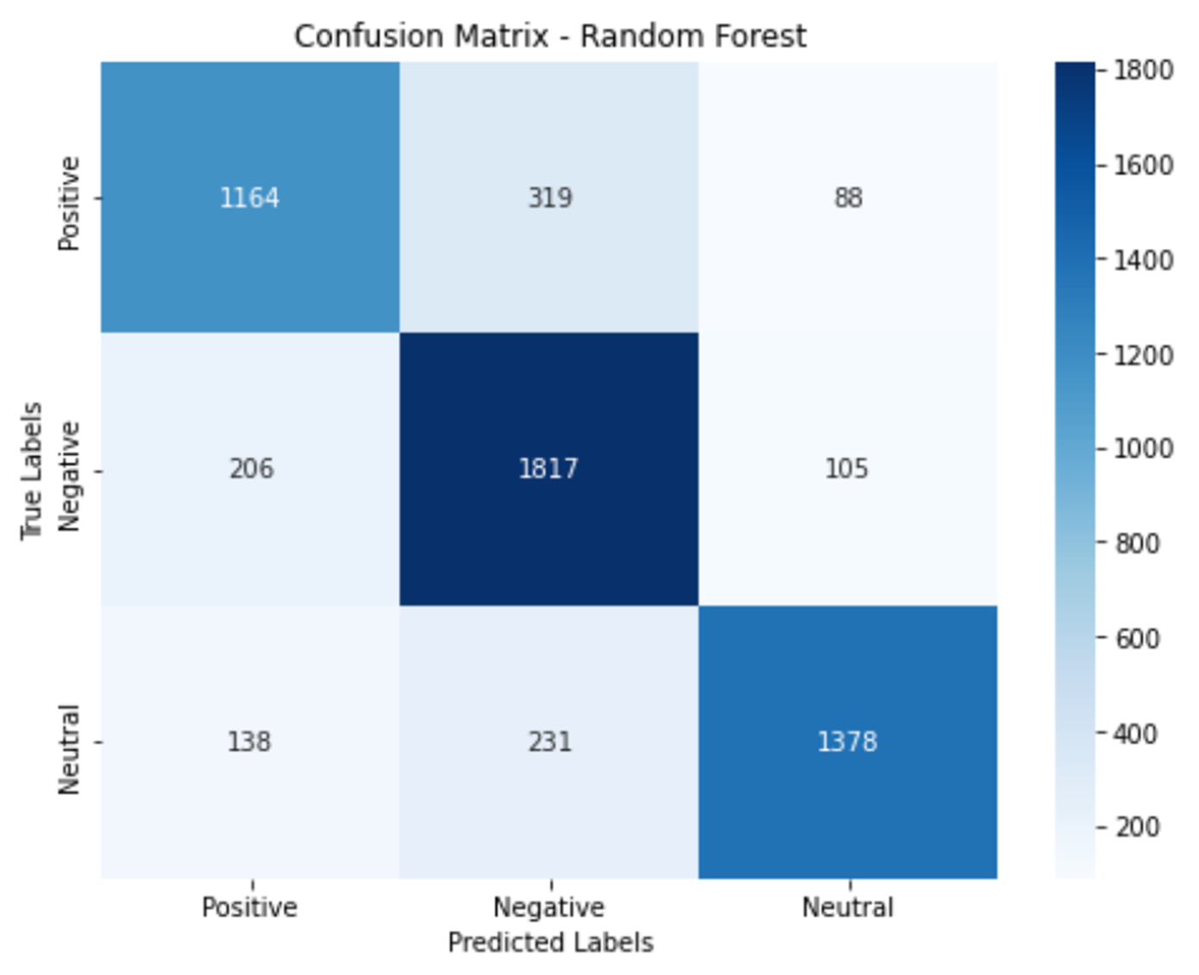
Experiments
Random Forest (RF)
This model achieves an 80% accuracy in detecting sentiment in the "Twitter Tweets Sentiment Dataset."
Page 15

Slide 16
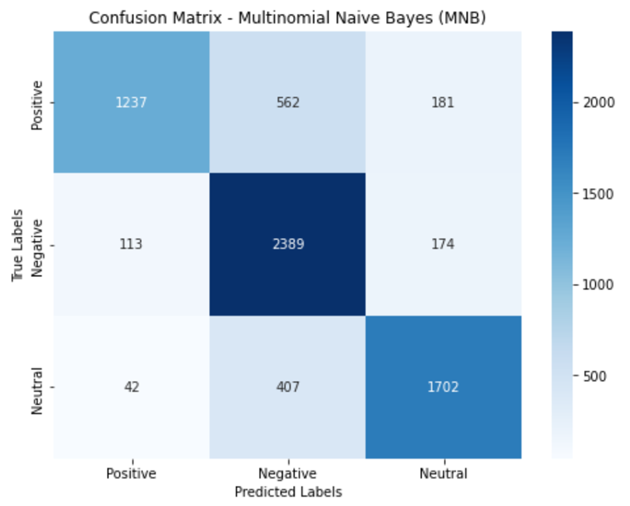
Experiments
Multinomial Naive Bayes (MNB)
This model achieves an 78% accuracy in detecting sentiment in the "Twitter Tweets Sentiment Dataset."
Page 16

Slide 17
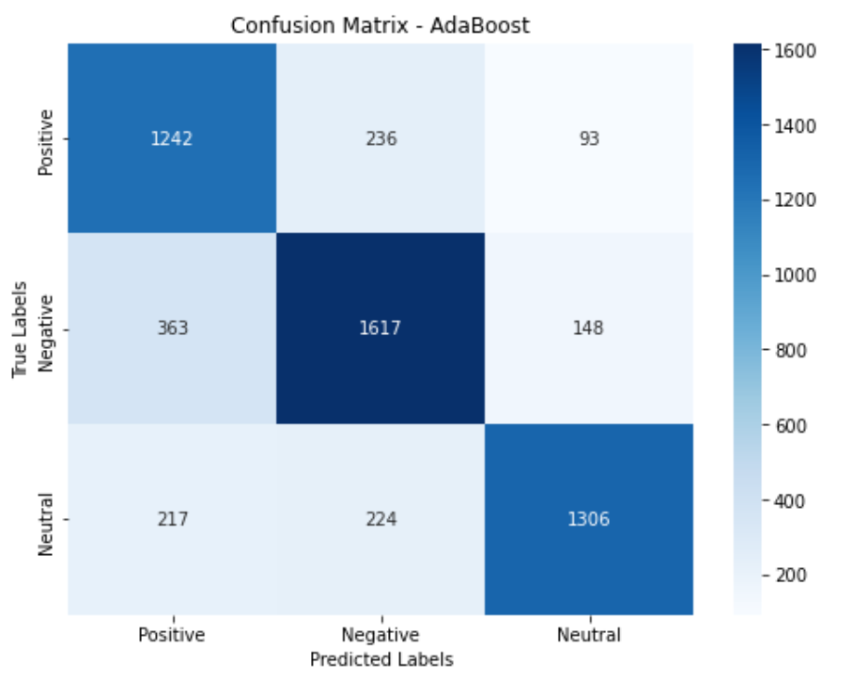
Experiments
AdaBoost
This model achieves an 77% accuracy in detecting sentiment in the "Twitter Tweets Sentiment Dataset."
Page 17

Slide 18
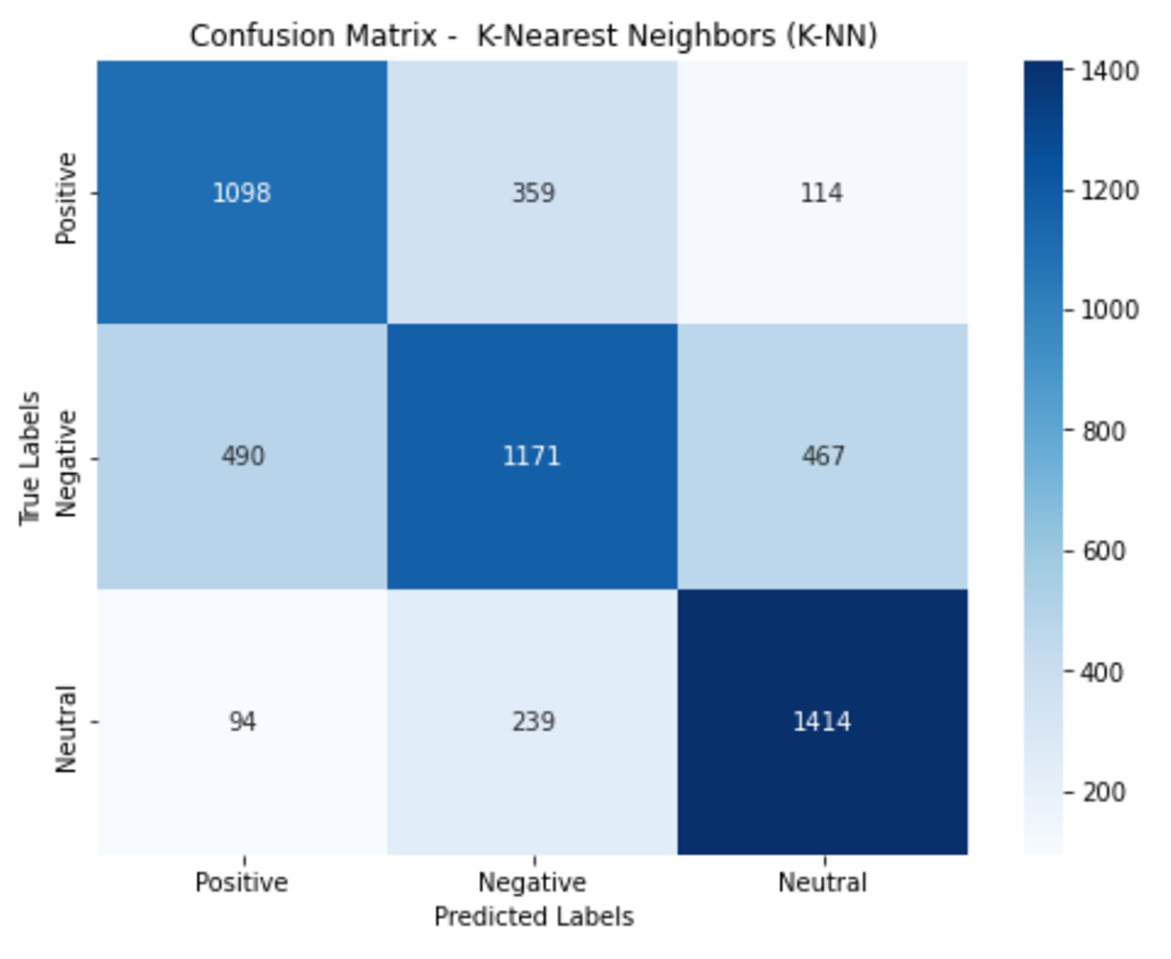
Experiments
K-Nearest Neighbors (K-NN)
This model achieves an 68% accuracy in detecting sentiment in the "Twitter Tweets Sentiment Dataset."
Page 18

Slide 19
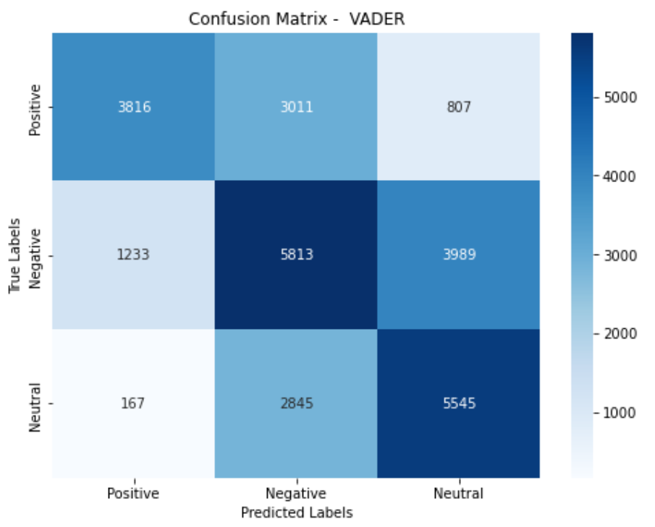
Experiments
Vader
This model achieves an 56% accuracy in detecting sentiment in the "Twitter Tweets Sentiment Dataset."
Page 19

Slide 20
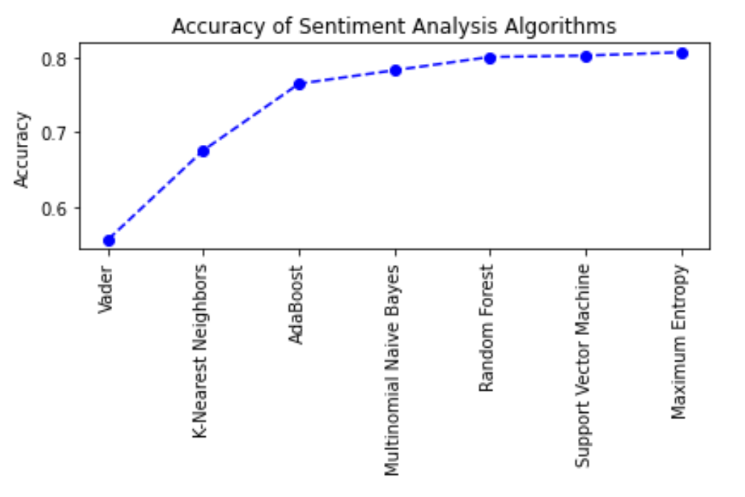
Result
Lowest Accuracy
Highest Accuracy
Maximum Entropy achieved the highest accuracy of 81%.
Vader exhibited the lowest accuracy at 56%.
Multinomial Naive Bayes (MNB) using TF-IDF vectorizer achieved the highest accuracy in detecting negative sentiment tweets, according to its confusion matrix.
K-Nearest Neighbors (K-NN) using TF-IDF achieved the highest accuracy in detecting natural tweets, according to its confusion matrix.
The remaining algorithms, namely Support Vector Machines (SVM), Random Forest, Adaboost, and Valence Aware Dictionary and Sentiment Reasoner (VADER), also outperformed in detecting negative sentiment. This suggests that detecting negative tweets is relatively easier. It is worth noting that none of the proposed models achieved the highest accuracy in detecting positive sentiment, making the detection of positive tweets more challenging.
Page 20

Slide 21
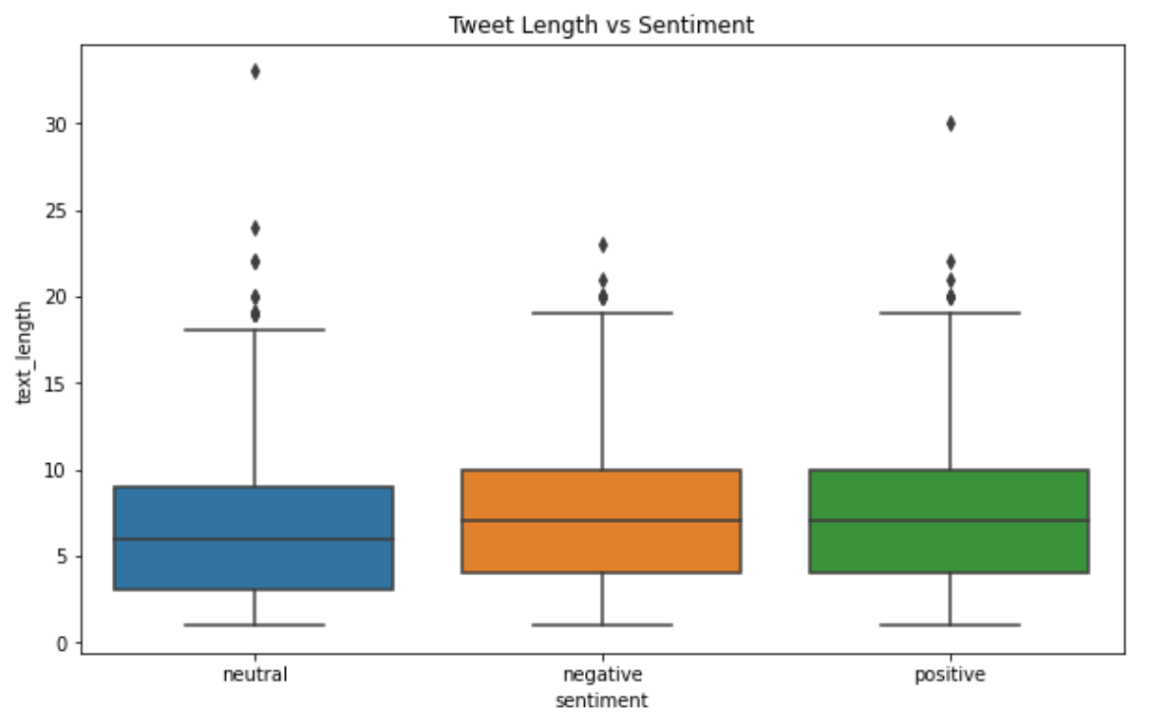
Data Mining
Boxplot Visualization
From the boxplot, we see that the median tweet length for neutral sentiments is slightly lower than that for positive and negative sentiments.
The spread for negative tweets appears to be larger than for the other two categories.
Outliers are present in all three sentiment categories, indicating that there are some tweets significantly longer than the average.
Page 21

Slide 22
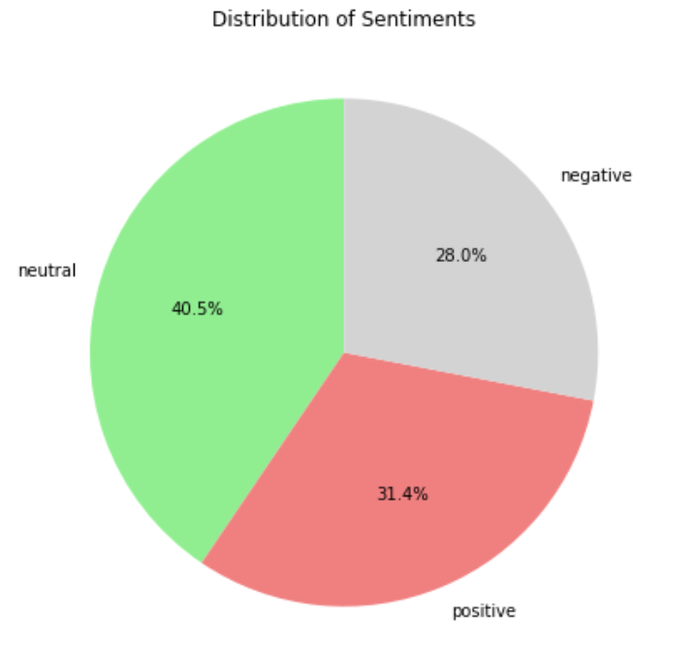
Data Mining
Pie Chart Visualization
The pie chart displays that neutral sentiments are the most prevalent in the dataset, followed by positive and then negative sentiments.
This could indicate that people tend to tweet in a neutral tone more frequently. The relatively balanced distribution between positive and negative sentiments shows somehow balanced.
Page 22

Slide 23
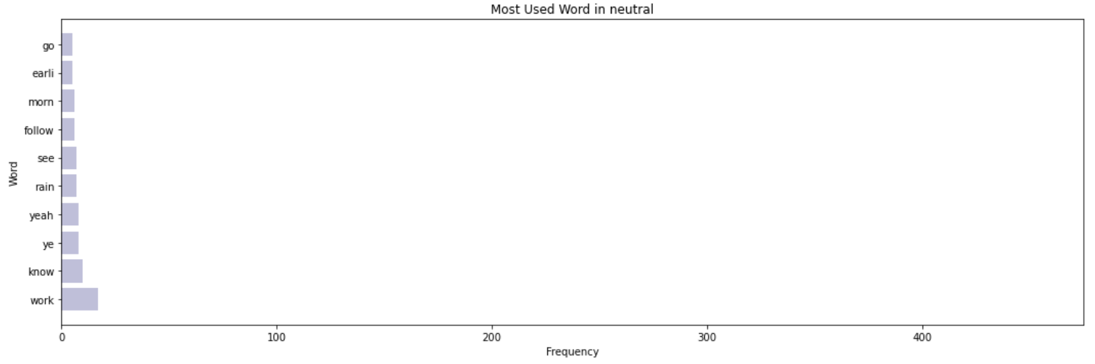
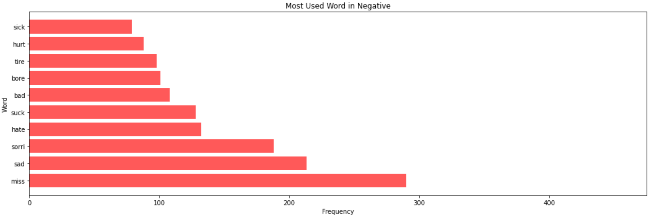
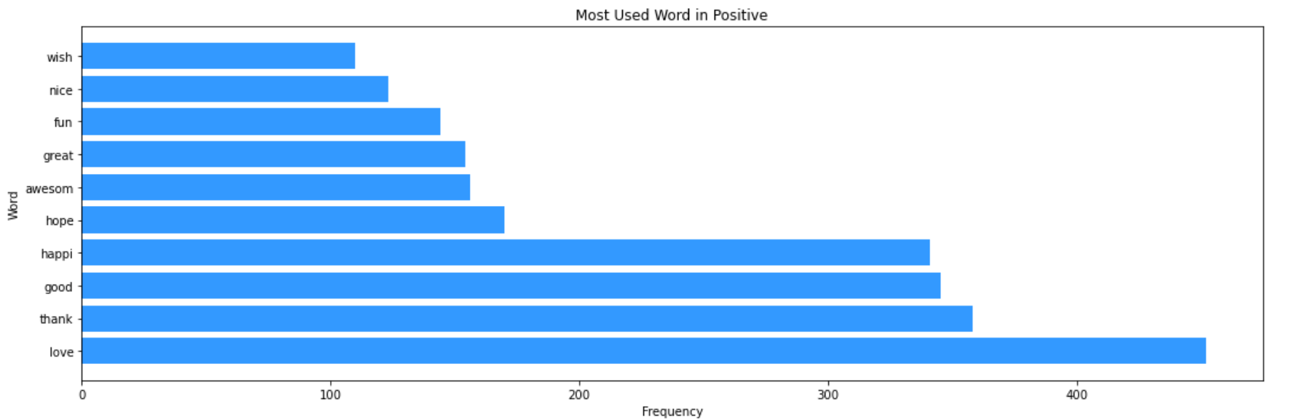
Data Mining
Bar Chart Visualization
As shown in the figure, the five most frequent words on the X platform are "love" which is a positive word, followed by "thank" which is also positive, then "good" another positive word, "happy" a positive word, and the fifth word is "miss," which is a negative word.

Slide 24
Discussion
01
02
The Maximum Entropy (ME) algorithm demonstrates its effectiveness compared to Random Forest, K-Nearest Neighbors (KNN), Support Vector Machines, Valence Aware Dictionary Sentiment Reasoner (VADER), Naive Bayes, and Adaboost in analyzing the sentiment of users on the 𝕏 platform.
This result can be generalized to apply to another platform that has the same nature as the 𝕏 platform, a microblogging service, such as Reddit or Threads, and it is expected to perform with the same efficiency.
Page 24

Slide 25
Conclusion
The Conclusion Of This Thesis
Maximum Entropy (ME) achieved the best result with an accuracy of 81% in identifying the sentiment of tweets in the "Twitter Tweets Sentiment Dataset."
Most algorithms yield good results when applied to pre-processed text containing words that clearly express user emotions. This indicates that the cleaner the data, the more accurate the results can be.
Page 25

Slide 26
Next Steps!
01
02
03
Apply the algorithm to an Arabic dataset and include a wider range of additional features such as time, location, and number of likes.
Spend more time on preprocessing steps to prepare and extract good feature vectors by using many techniques, such as the Bag of Words approach before applying the algorithm.
Try alternative techniques for sentiment analysis and compare between them.
Page 26

Slide 27
THANKS
FOR YOUR ATTENTION

