Slide 1

NIH Chest X-rays Image Enhancement AI 361 – Image Processing GroupTeam1 Team Member: Salwa Shamma | 4010405 Samah Shamma | 4010403 Sana Shamma | 4010404 UPM University Fall 2023
University of Prince Mugrin
College of Computer and Cyber Sciences
Department of Artificial Intelligence

Slide 2
Method
Preprocessing
Best Submission Steps
Challenges
Resizing
Normalization
Grouping Based on Brightness Ranges
1
Loading the images.
Resizing the images to (128 x 128).
Normalizing the images.
Grouping the images into 10 group based on the Mean Brightness.
Tonemapping by using Dragos Tonemapping Method.
Convert the image back to the suitable format.
Saving processed images.
Set Tonemapping Parameters.
Determining the Number of Groups.
2

Slide 3
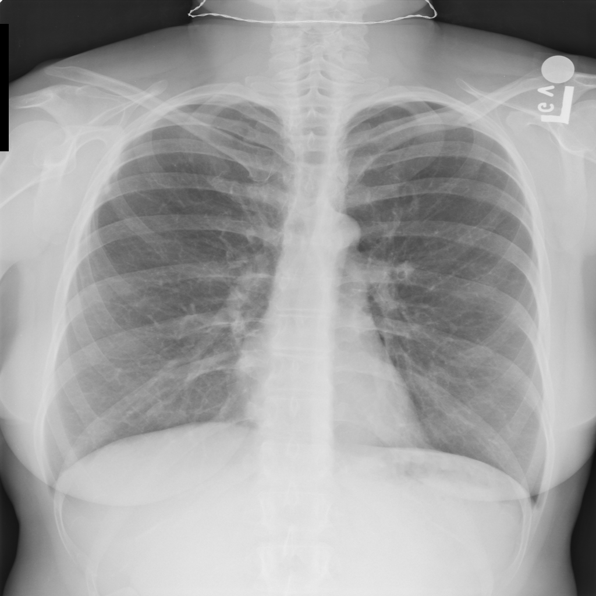
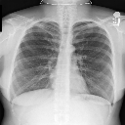
Samples
After
Before
3

Slide 4
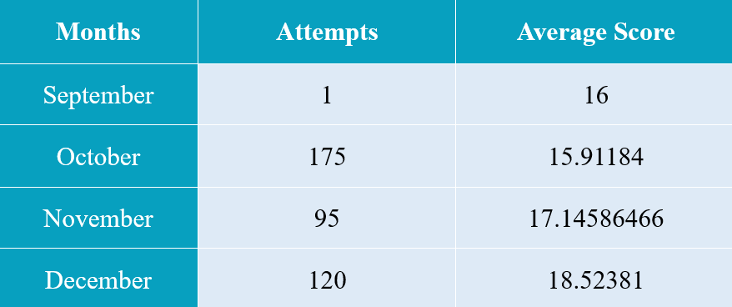
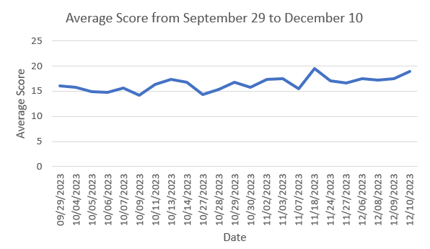
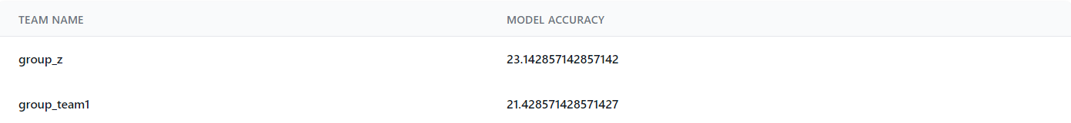
Results
Team Attempts:
Team Ranking:
4

Slide 5
Next Steps and Team Roles
Next Steps
Team Roles
In the future, if we have another chance, maybe what we will do is read more about the diseases and try to understand them better. In addition, we will look into similar fields projects and try to follow their best practices and approaches instead of starting from scratch. In addition, we will explore other possibilities for enhancing images, which are almost unlimited.
During the competition journey, Salwa aimed to find a suitable combination of image processing methods, including noise reduction, histogram equalization, tone mapping, morphological operations, and more. She also experimented with different types of these methods. For instance, in the best submission on the private leaderboard, she discovered that the Drago type of tone mapping yielded a good result.
Sana's focus was on categorizing the images into groups and determining a reasonable number of groups, which was set at 10. Additionally, she worked on finding the optimal image size for processing and was responsible for enhancing images in groups 8 to 10.
Samah's task involved enhancing the images in groups 0 to 7 and determining suitable parameters for the functions, in addition to searching for research papers that might be helpful.
5

Slide 6
Thank You

