Slide 1
Dashboard Summary - Sales Financial Dataset

Slide 2
Key Performance Indicators (KPIs)
Total Sales: 878,802.51

Slide 3
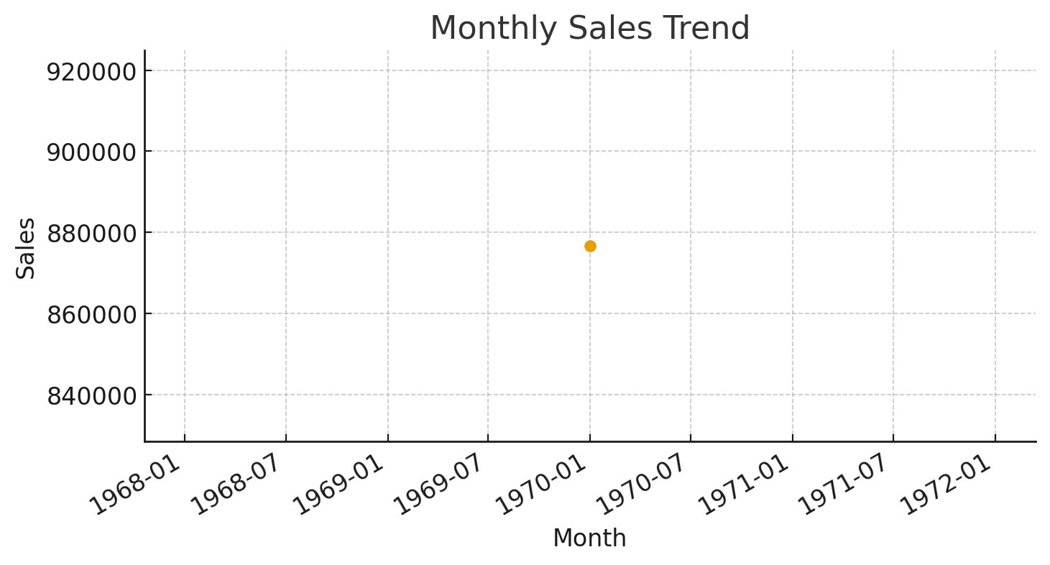
Monthly Sales

Slide 4
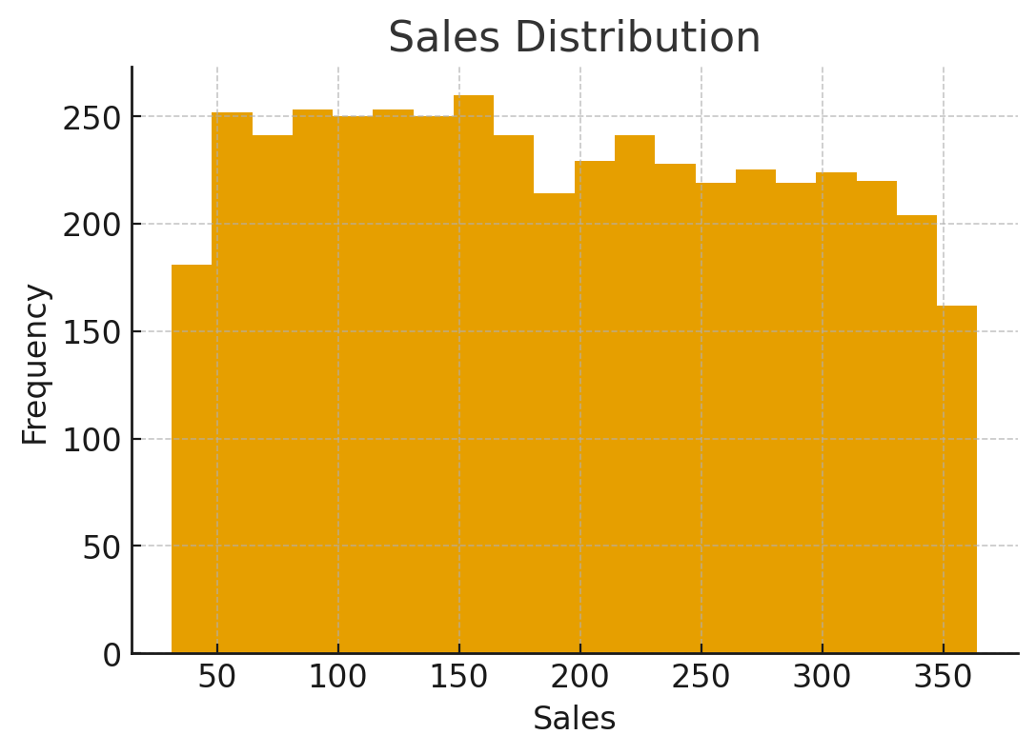
Sales Distribution

Slide 5
Recommendations
Quick recommendations to convert this into an interactive dashboard:
Choose KPIs: Total Sales, Total Profit, Profit Margin, Sales Growth
Add slicers/filters for Date, Region, Category, Product
Use time-series line chart with drill-down (year -> quarter -> month)
Add cards for totals and conditional formatting for alerts
Create navigation tabs: Overview, Sales, Profit, Products, Regions

