Slide 1
AI-POWERED EMERGENCY BLOOD COORDINATION SYSTEM · PAKISTAN
BloodBridge AI
Emergency blood coordination for Pakistan —
every drop, matched in seconds. Safely.
Verified staff · screened donors
Safety-first AI matching
Privacy by default
Live product: bloodbridge-ai-two.vercel.app · Source: github.com/sana1234-tech/bloodbridge-AI

Slide 2
THE PROBLEM · WHO IT AFFECTS
Finding blood in an emergency means hours of desperate phone calls.
1
Matching is slow and manual
Who lives this problem
Families call relatives, post on Facebook, and drive from bank to bank — while the patient’s clock runs out. There is no single place where a verified need meets willing, eligible donors.
Patients & families — emergencies, childbirth, surgery, accidents. Thalassemia & dialysis patients — Pakistan carries one of the world’s largest thalassemia burdens; many need a transfusion every 2–4 weeks, for life. Hospitals & blood banks — coordinating under time pressure with no forecasting. Voluntary donors — willing to help, but contacted chaotically and without eligibility checks.
2
Safety rules get ignored
Donors are contacted even when they are medically ineligible to donate again. Pakistan’s guideline requires a 90-day rest for men and 120 for women — informal networks don’t check.
3
Anyone can post anything
Unverified requests circulate publicly with patient names and donor phone numbers attached — no way to tell a genuine hospital need from spam, and privacy is traded away in the panic.

Slide 3
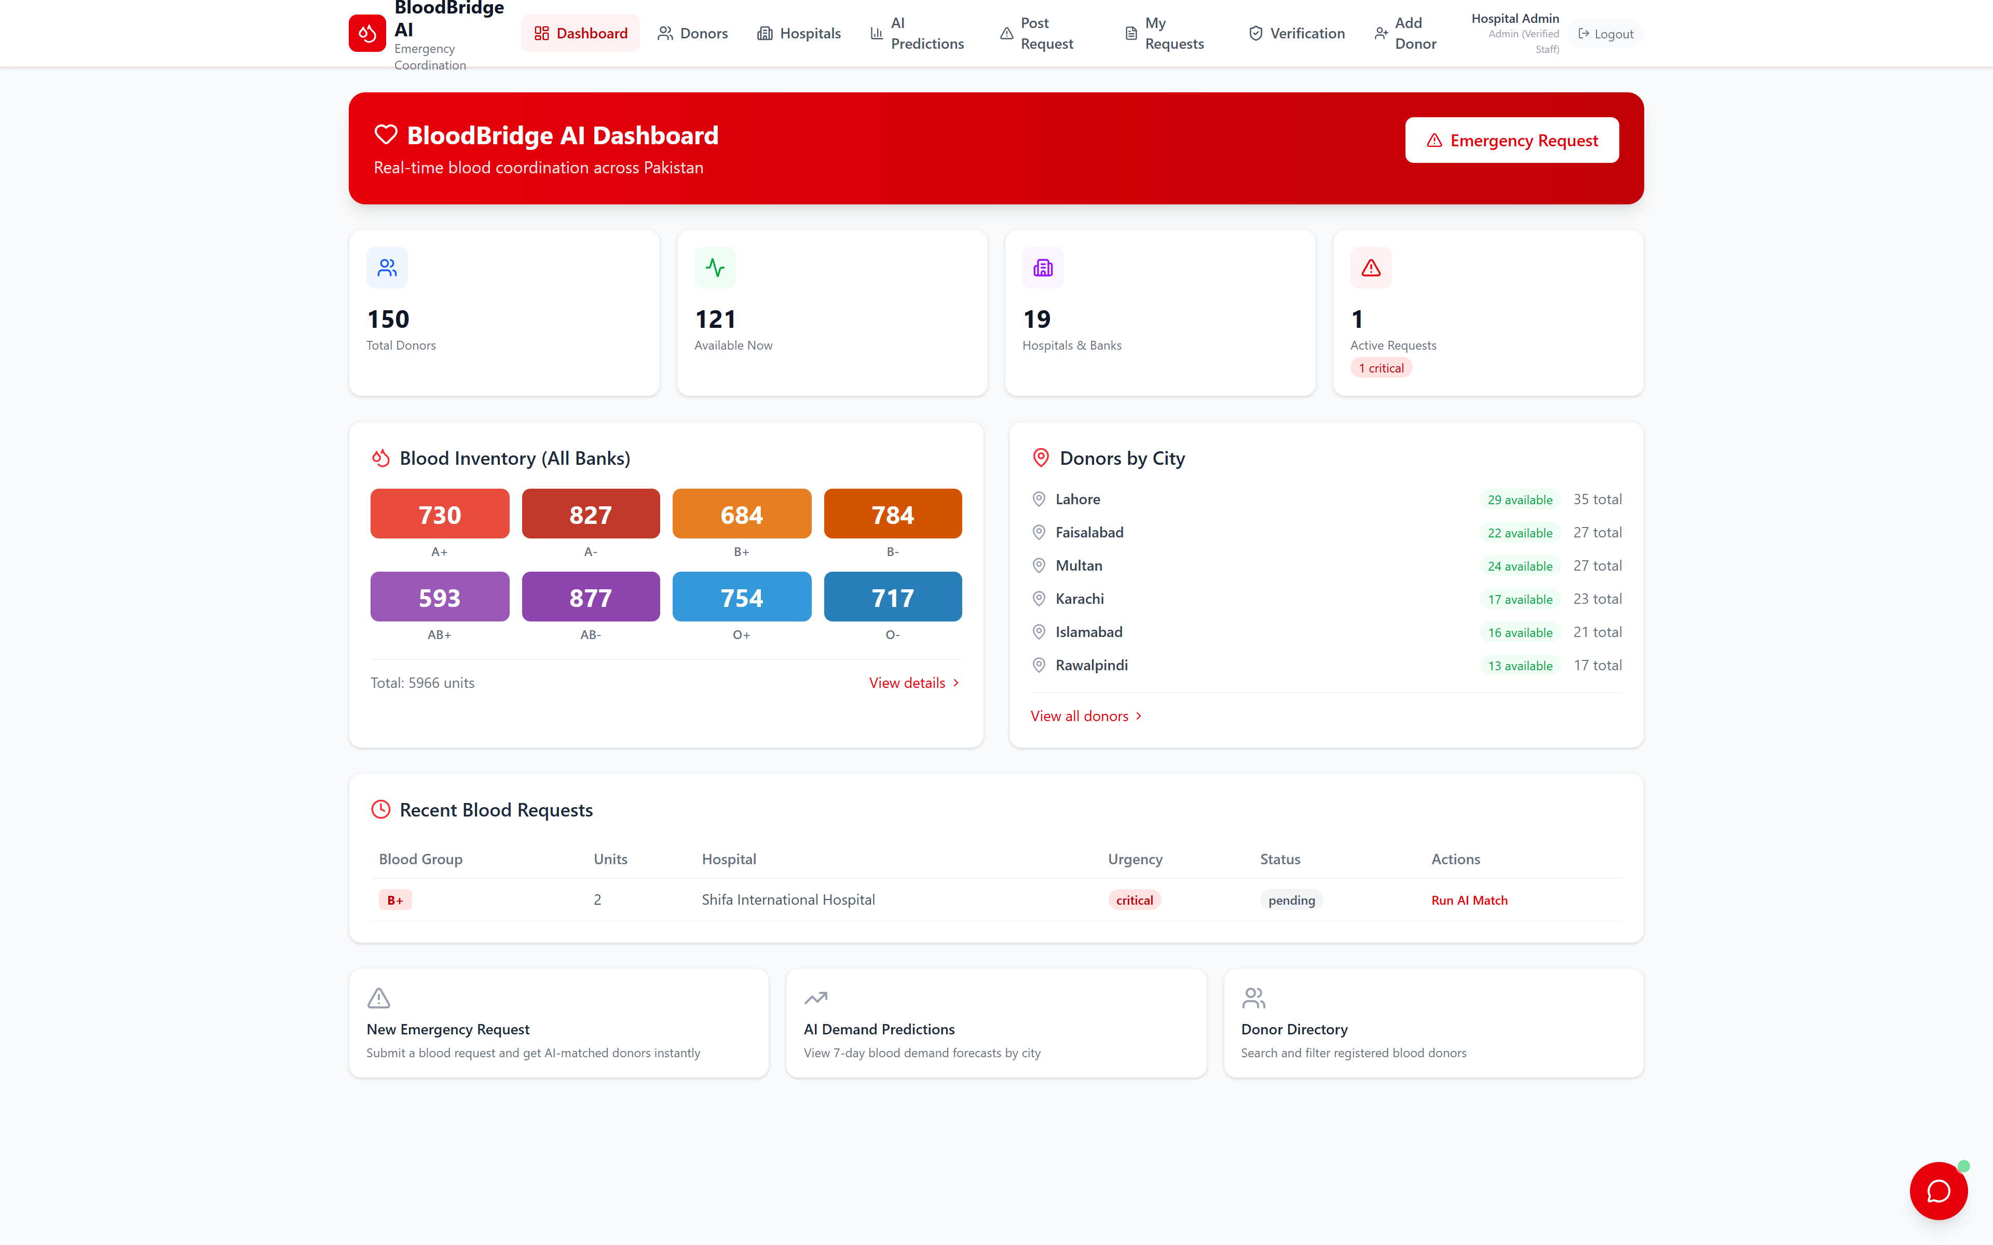
OUR SOLUTION · AND WHO IT SERVES
One platform, three coordinated systems.
1
Safety-first donor matching
Ranks compatible donors by blood type, distance, donation recency and reliability — hard-blocks anyone inside the mandatory resting window, and guarantees newly registered donors are visible immediately.
2
Self-verifying demand forecasts
7-day predictions per city & blood group — with backtested accuracy displayed live in the product, so the numbers are proven, not claimed.
3
Assistant chatbot
Live dashboard — inventory, donors by city, requests (patient names never shown)
Instant answers on compatibility, eligibility rules, live inventory and how requests work — staff-only posting is explained right in the chat.
Audience: verified hospital & blood-bank staff post requests · screened donors register and respond · admins approve institutions and plan stock.

Slide 4
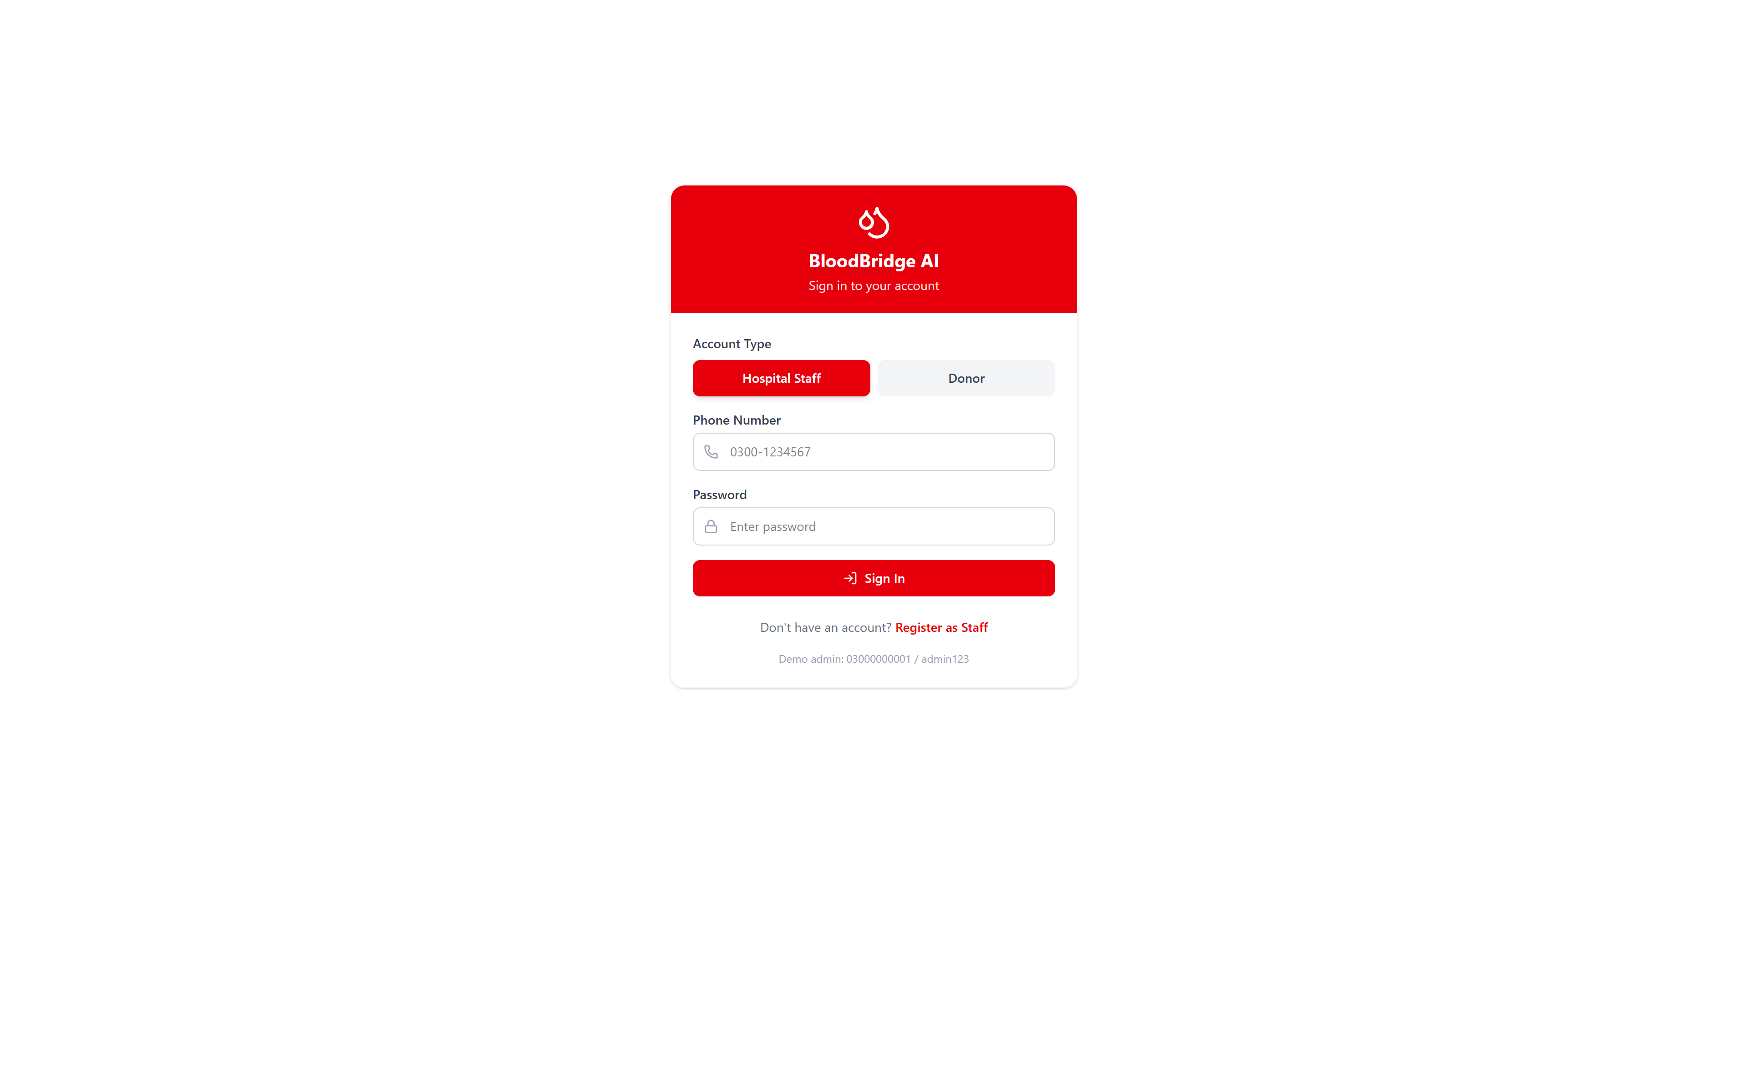
ACCESS CONTROL · WHO CAN DO WHAT
Two account types, verified before they can act.
Hospital / blood-bank staff
Register with institution name + license number → status PENDING. A verified admin approves or rejects them in the Verification Panel. Only approved staff can post requests; approved staff are the admins.
Donors — screened at signup
Open registration with an 8-question health pre-screening (fever, HIV, hepatitis, chronic conditions, medication, recent procedures, pregnancy, malaria travel). Answers become safety flags — visible to staff only, never to other donors.
Login — role selection (Hospital Staff / Donor)
Replacement donors
Verified staff register walk-in donors brought by a patient’s family — tagged with the institution — so they join the matched pool for future requests.

Slide 5
THE NEED · THE IMPACT IT MAKES
From a phone tree to a match in seconds — with safety enforced by design.
10
8
7 days
0
ranked, medically eligible donors surfaced instantly per request — plus every donor registered in the last 24h is guaranteed visible
health screening questions answered by every donor at signup — flags for staff, invisible to other donors
of demand forecast per city & blood group — accuracy backtested daily against real demand, shown live
patient names or donor phone numbers exposed in public views — privacy by default
Why it matters: every emergency that starts with a match instead of a phone tree saves the most expensive currency in medicine — time. Only verified institutions can ask for blood, every donor is health-screened before entering the pool, and every blocked ineligible donor is a complication that never happens. The system also gets smarter with use: real requests and fulfillments feed the forecast model.

Slide 6
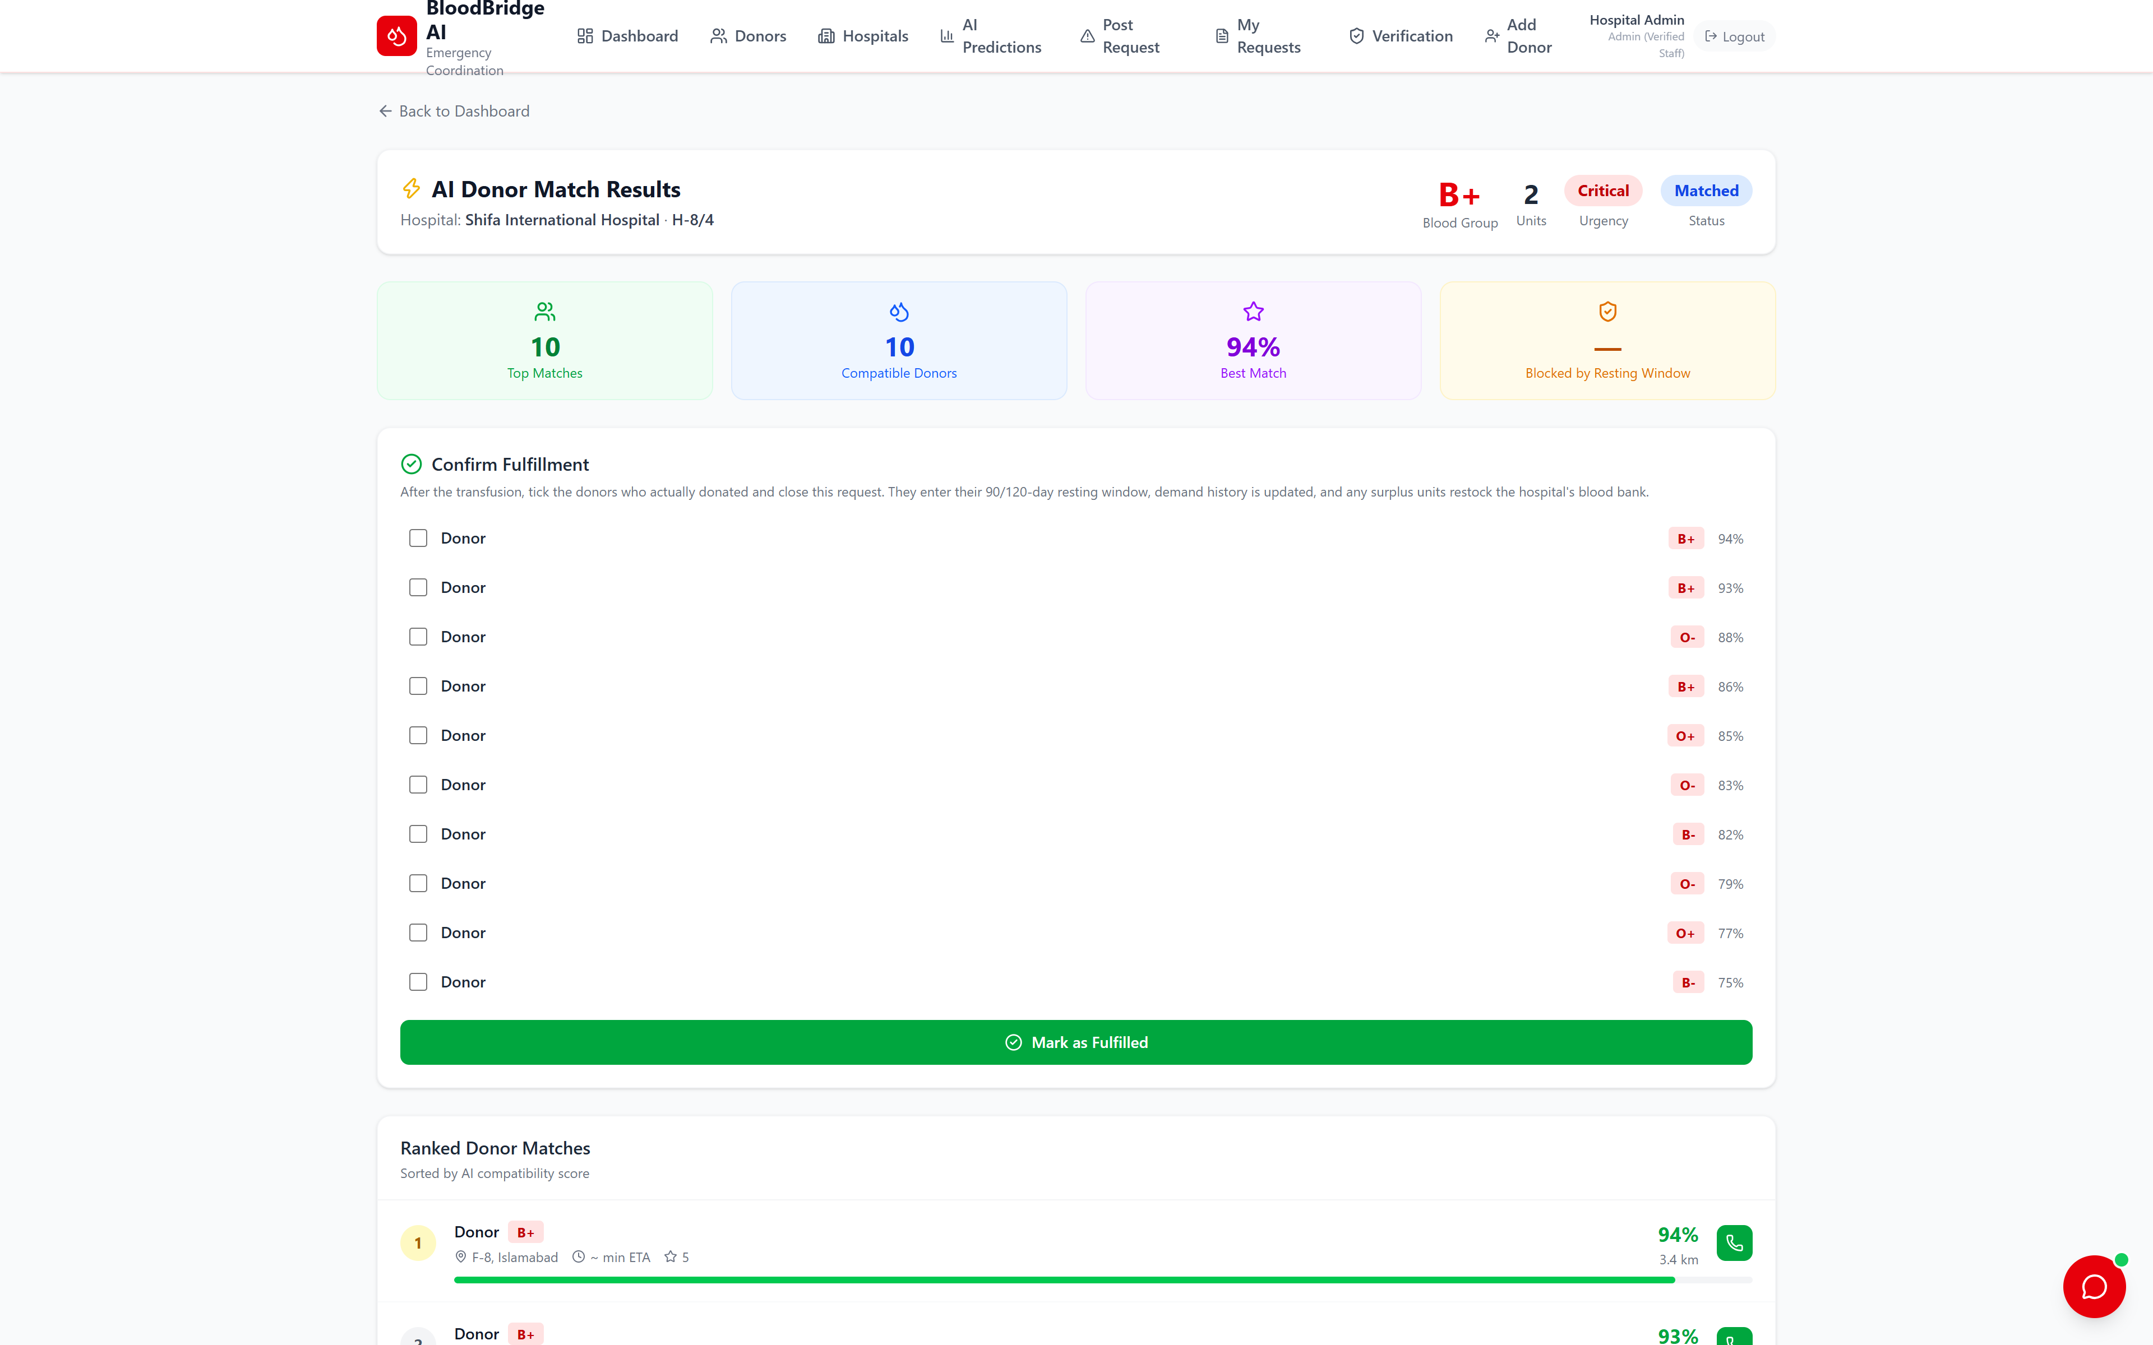
INNOVATION 1 · SAFETY-FIRST MATCHING
Matching that refuses to recommend ineligible donors.
Weighted compatibility score
Blood-type compatibility (40%) · haversine distance (30%) · donation recency (20%) · donor rating (10%). Critical requests re-weight toward distance. O- universal donors matched to every group.
The hard safety rule
Donors inside the 90-day (men) / 120-day (women) resting window are excluded entirely — never just ranked lower. The blocked count is shown live on every match.
New donors are never invisible
Anyone registered in the last 24h is guaranteed a place in results — beyond the top-10 if needed — badged “New Donor”. Results also re-rank live on every view, so a donor who signs up after a request is posted still appears.
Live AI match — ranked donors, blocked count, and no patient name anywhere

Slide 7
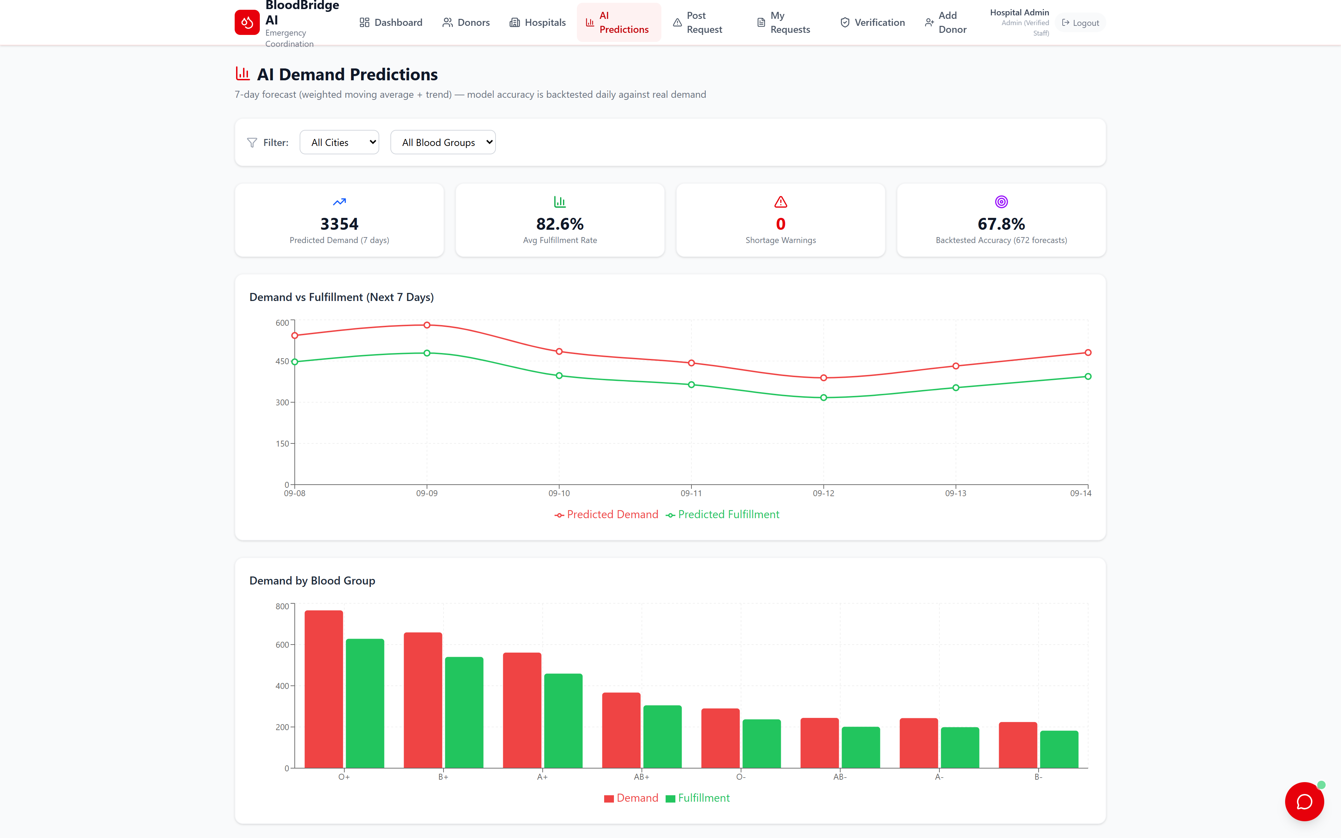
INNOVATION 2 · SELF-VERIFYING FORECASTS
Predictions that prove their own accuracy.
The model
Weighted 14-day moving average + linear-regression trend + weekday seasonality, per city and blood group — explainable by design.
Backtested, not just claimed
The model is re-run on past days using only prior history, then compared with what actually happened — accuracy across 672 backtested forecasts is displayed live in the product, per city and blood group.
Learns from reality
Every real request and fulfillment updates demand history — the forecast improves as the system is used, instead of living on seed data.
Analytics — 7-day forecast with live backtested accuracy card

Slide 8
INNOVATION 3 · CLOSED LOOP & PRIVACY
A data loop that keeps the system truthful — and privacy by default.
Verified request
AI match
Contact & response
Fulfillment confirmed
posted by approved staff only, with a private internal reference
→
eligible donors ranked; ineligible ones hard-blocked
→
donor contact visible only to the posting staff member
→
donors enter resting window · bank restocks · demand history updated
Privacy by default
Verified access — live in the product
✓ Patient names never leave the staff side — the public feed shows only blood group, units, hospital, city and urgency ✓ Donor phones masked in the directory: 0335••••••• — full contact revealed only to the staff who posted that request ✓ Health screening answers become staff-only flags — donors never see each other’s data ✓ All inputs validated at the API boundary — malformed or malicious data is rejected with clear errors
✓ JWT authentication with bcrypt-hashed passwords — two roles: staff and donor ✓ Institutions submit license numbers and stay pending until an admin approves — only then can they post requests ✓ Patient identity replaced by a private internal reference in the staff’s own records ✓ Walk-in replacement donors registered by staff, tagged with their institution

Slide 9
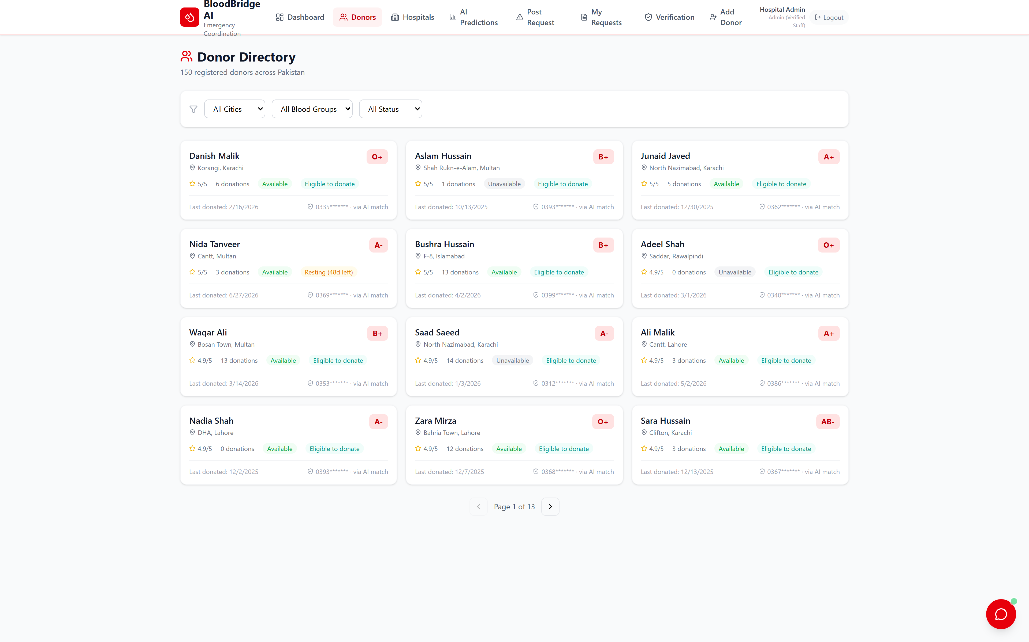
THE TECHNOLOGY
Simple stack, engineered honestly.
Architecture
React 19 + Vite + Tailwind + Recharts single-page app → Node.js / Express API → in-memory store with disk persistence (Mongoose-ready schemas for a MongoDB upgrade).
Security engineering
JWT authentication, bcrypt password hashing, and role-based guards on both server and client. Verification, masking, eligibility and validation rules live server-side — they cannot be bypassed from the browser.
Deployed & versioned
Donor directory — masked phones, live eligibility status per donor
Live on Vercel (serverless) at bloodbridge-ai-two.vercel.app · full source on GitHub (github.com/sana1234-tech/bloodbridge-AI) · one command ships a new production build. Realistic dataset: 150 donors, 19 real hospitals, 90 days of demand history across 6 cities.

Slide 10
FEASIBILITY · WHAT WE ACTUALLY BUILT
Everything in this deck runs today — live on the internet.
✓ Full working app, deployed — 12+ routes, 20+ API endpoints, chatbot, matching & forecasting — live on Vercel right now
Verify it in 2 minutes
1. Open bloodbridge-ai-two.vercel.app
✓ Complete verified lifecycle — admin login → post request → AI match → donor responds → staff see contacts & health flags → fulfillment → resting window
2. Login as admin: 03000000001 / admin123
✓ Tested end-to-end — automated API smoke tests for auth, signup, verification, matching (including the new-donor guarantee) and privacy redaction
3. Post an emergency request — watch the AI match
✓ Real bugs found & fixed in the field — negative resting countdowns, patient-name leakage, and new donors excluded from matching: all reproduced, fixed and re-verified on production
4. Register as a donor — 8-question screening
5. Browse the repo: github.com/sana1234-tech/bloodbridge-AI
✓ Honest scope — in-memory prototype storage; production needs a real database and SMS alerts. We say so in the README — and the roadmap is concrete.

Slide 11
ROADMAP & CLOSE
Next: MongoDB persistence, SMS/WhatsApp alerts,
map view, blood-unit expiry tracking.
Authentication, verification, health screening, privacy and the forecast loop already run in production — the roadmap builds on what runs today, not on promises.
Every drop, matched in seconds. Safely.
BloodBridge AI — Project Presentation · Live: bloodbridge-ai-two.vercel.app · GitHub: github.com/sana1234-tech/bloodbridge-AI · Thank you

