Slide 1
Outlier/Anomaly Detection
CS622 project by:
Sayyed Ahmad Naghavi Nozad
Abdul Tauqeer
Code and report available on GitHub
Recorded presentation available on GoogleDrive

Slide 2
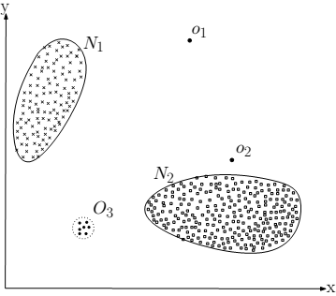
Introduction
What is an outlier?
Significantly deviates from the norm
Raise suspicions that there is an intention behind it
Exists in small numbers regarding the inliers count
Outliers variants:
Local outliers
Global outliers

Slide 3
Introduction
Outlier detection general categories:
Probabilistic methods
Proximity-based methods
Distance-based methods
Density-based methods
Clustering-based methods
Graph-based methods
Information-theoretic methods
Isolation-based methods
Our investigation:
LOF
kNN
iForest
HBOS

Slide 4
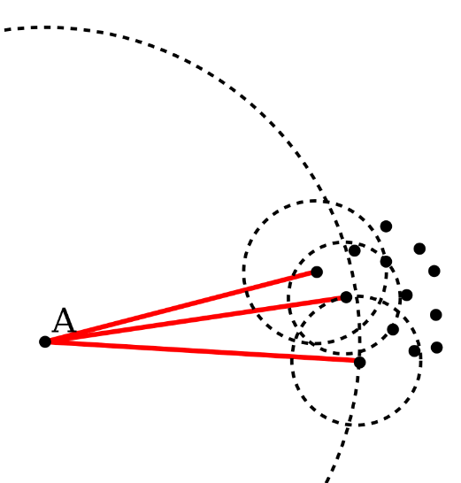
Competing methods Local Outlier Factor (LOF)
Computes the local density variation around every point
Based on k nearest neighbors of every point
Number of neighbors in the kNN set could be larger; more than one k-th nearest neighbor for a particular point
Regarding the kNN set, the local reachability distance of each point w.r.t. its vicinity is delineated
Utilizing the local reachability distances, the local reachability densities (lrd) are obtained

Slide 5
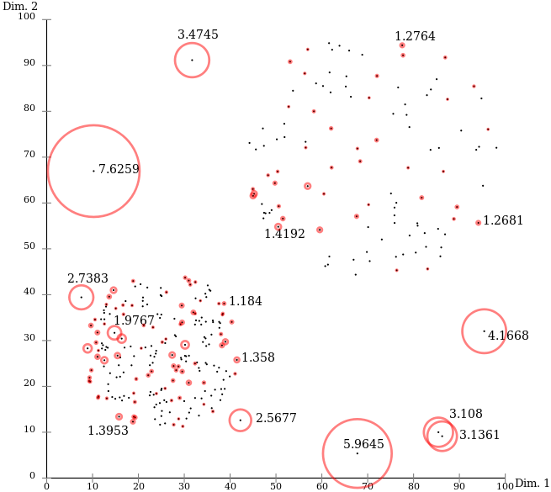
Competing methods Local Outlier Factor (LOF)
Local outlier factor for every point is drawn out of the ratio of neighboring lrd’s over the lrd of the point itself
The larger such ratio, the more probable the point is a potential outlier

Slide 6
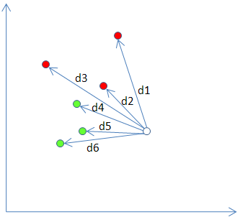
Competing methods k nearest neighbors (kNN)
Like LOF, it is based on finding the kNN set of every point in data
In some papers, efficient algorithms for locating the kNN set for every point are introduced
The distances in the kNN set are employed in various ways to define the corresponding outlier score:
Largest distance
Average distance
Median distance
Sum of distances

Slide 7
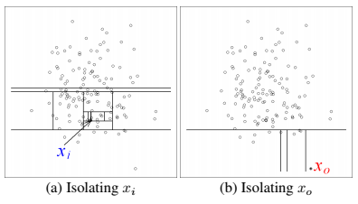
Competing methods isolation forest (iForest)
Isolation forest is a group of isolation trees
Each isolation tree is dragged out of a random sampling of the entire data
The only two input parameters of the algorithm are:
t, the number of isolation trees or the same base estimators
Ψ, size of the random sample to construct the isolation tree out of it
To build an isolation trees out of a random sample, at each node:
Choose an attribute at random
Choose a split point from a uniform distribution spanning from the min to max values in the selected attribute

Slide 8
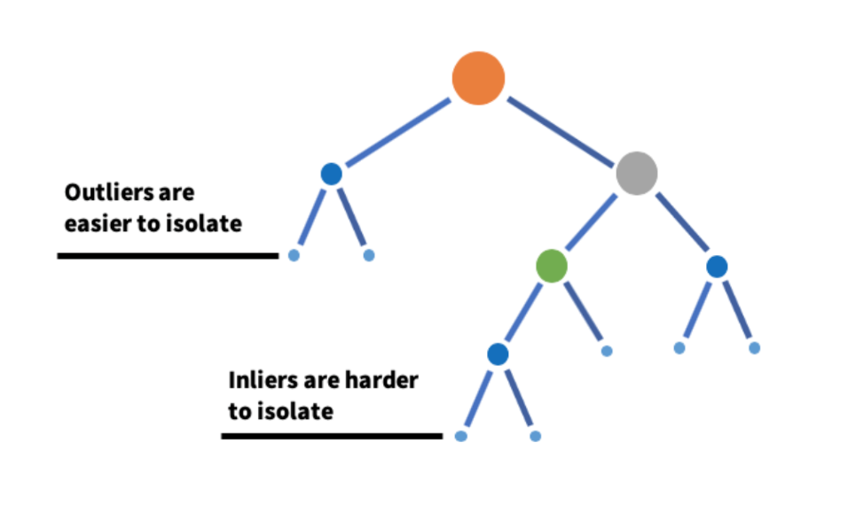
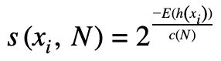
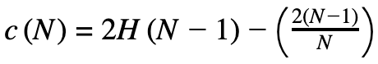
Competing methods isolation forest (iForest)
The tree growth is like what is happening in decision trees, though isolation trees are very like binary search trees
The nodes in the isolation trees are of two types:
External nodes: the same leaf nodes that contain only one data point or all the data points reached to this point are of the same value w.r.t. the selected random attribute for division
Internal nodes: those nodes that can still be broken to two daughter nodes
The interesting tip about outliers is that they need a remarkably shorter path to be isolated using the isolation trees
Finally, using Euler’s number and a specific formula, outlier scores are achieved
The higher the score, the more likely the point is an outlier
Harmonic number:
H(i) ≈ ln(i) + 0.5772156649

Slide 9
Competing methods Histogram-Based Outlier Score
An unsupervised outlier detection algorithm like previous methods
Capable of working on both categorical and numerical features at the same time, unlike previous ones
Linear time complexity and multiple times faster than distance- and clustering-based methods
The reason behind such speed is its strong assumption on the independence of the variables (features)
This assumption causes lower precision in general
Talking about histograms over the data variables, it incurs lower performance on detecting local outliers

Slide 10

Competing methods Histogram-Based Outlier Score
Two types of histogram building:
Static bin-width strategy
Dynamic bin-width strategy (more preferred)
Outliers are assumed to be residing among histogram gaps
With an unknown or long-tailed real distribution:
Static bin-width approach can cause many gaps
Such gaps may not be realistic and may be misleading
Employing the heights of the bins, the outlier scores are achieved

Slide 11
Experiment design metrics and datasets
Evaluation metrics:
Area Under Receiving Operating Characteristic/Curve (AUROC)
Average Precision (AP)
Precision at rank n (Prec@n)
Datasets from ODDS
Dataset | #n | #p | #o | %o
Arrhythmia | 452 | 274 | 66 | 14.6
Glass | 214 | 9 | 9 | 4.21
Ionosphere | 351 | 33 | 126 | 35.9
Lympho | 148 | 18 | 6 | 4.05
Pima | 768 | 8 | 268 | 34.9
Vertebral | 240 | 6 | 30 | 12.5
Vowels | 1456 | 12 | 50 | 3.43
WBC | 378 | 30 | 21 | 5.56
Wine | 129 | 13 | 10 | 7.75

Slide 12
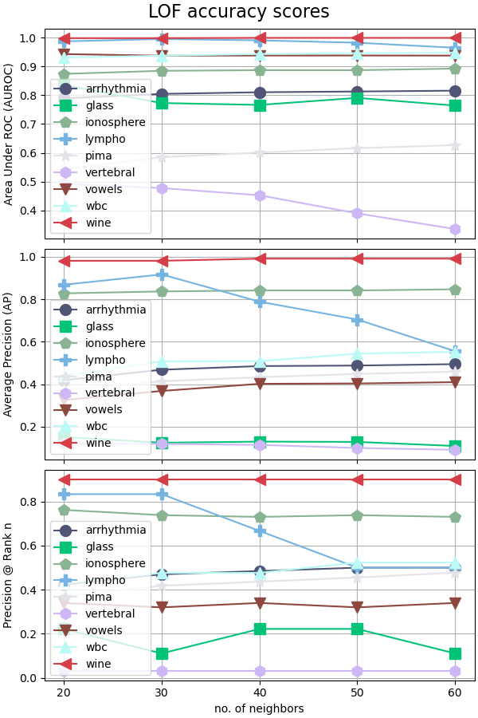
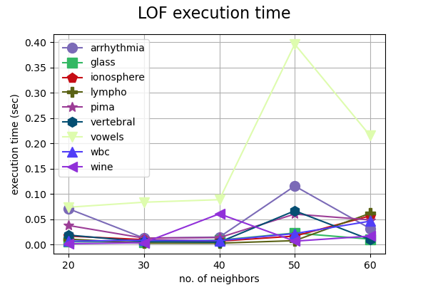
Experiment design parameterization LOF

Slide 13
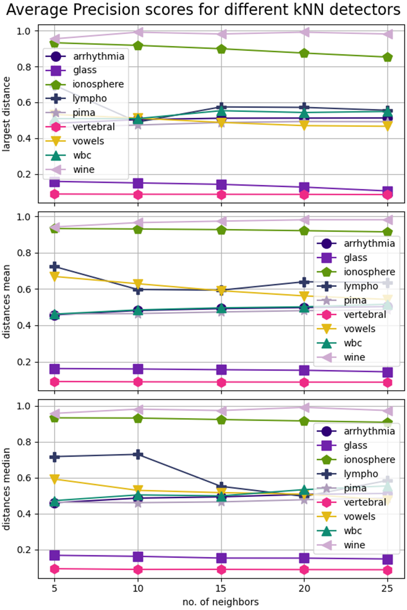
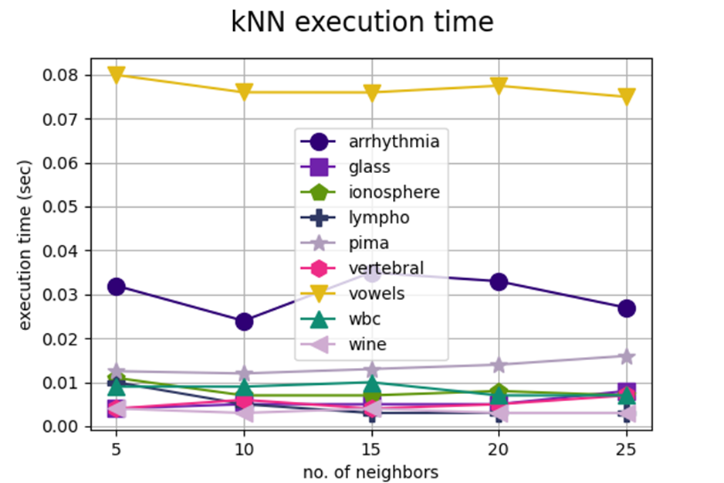
Experiment design parameterization kNN

Slide 14
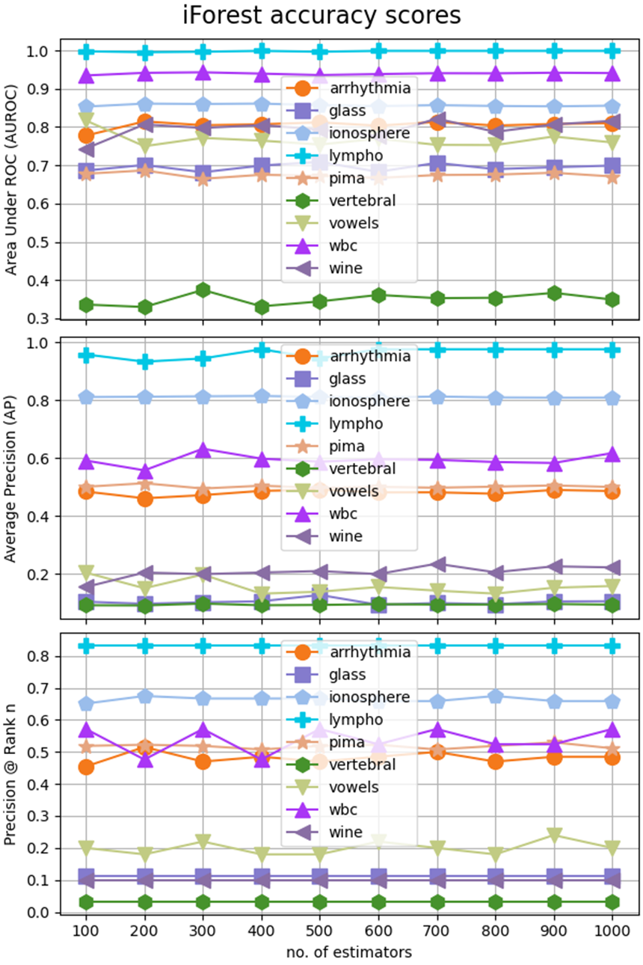
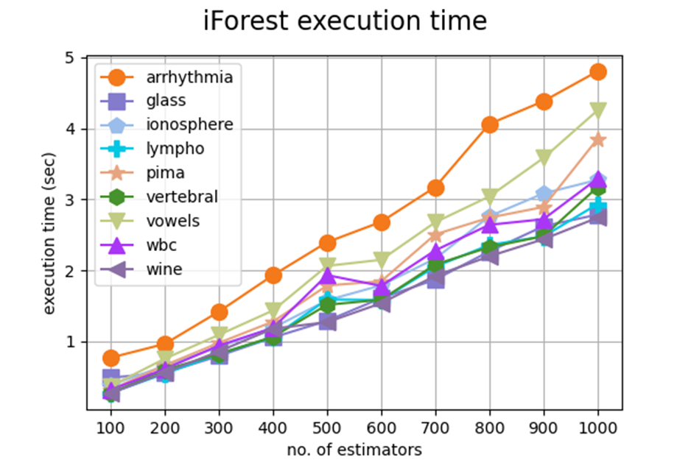
Experiment design parameterization iForest

Slide 15
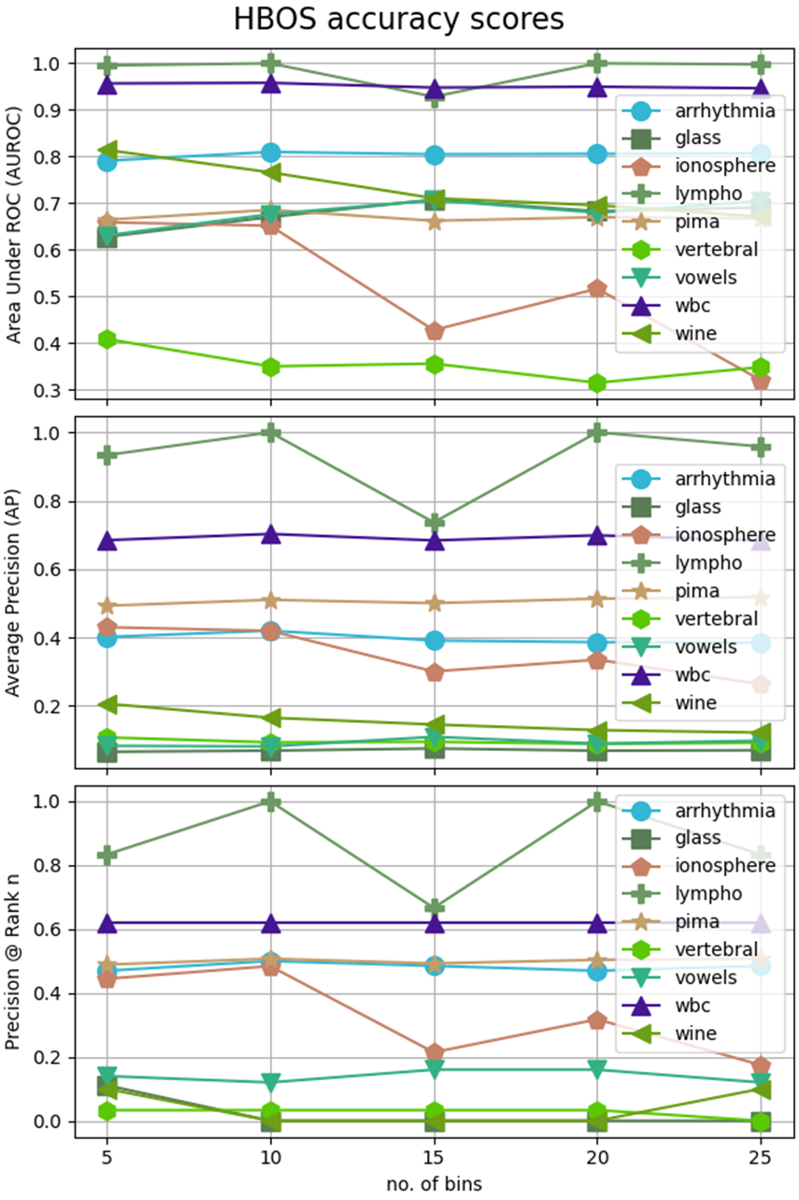
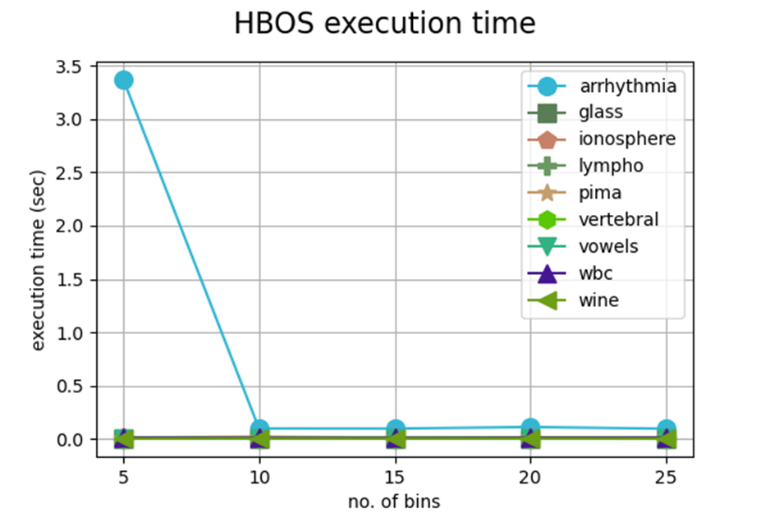
Experiment design parameterization HBOS

Slide 16
Experiment design overall analysis
K = 20
K = 5
t = 100, ψ = 256
n_bins = 10

Slide 17
Experiment design overall analysis

Slide 18
Thank you
For your Attention

