Slide 1
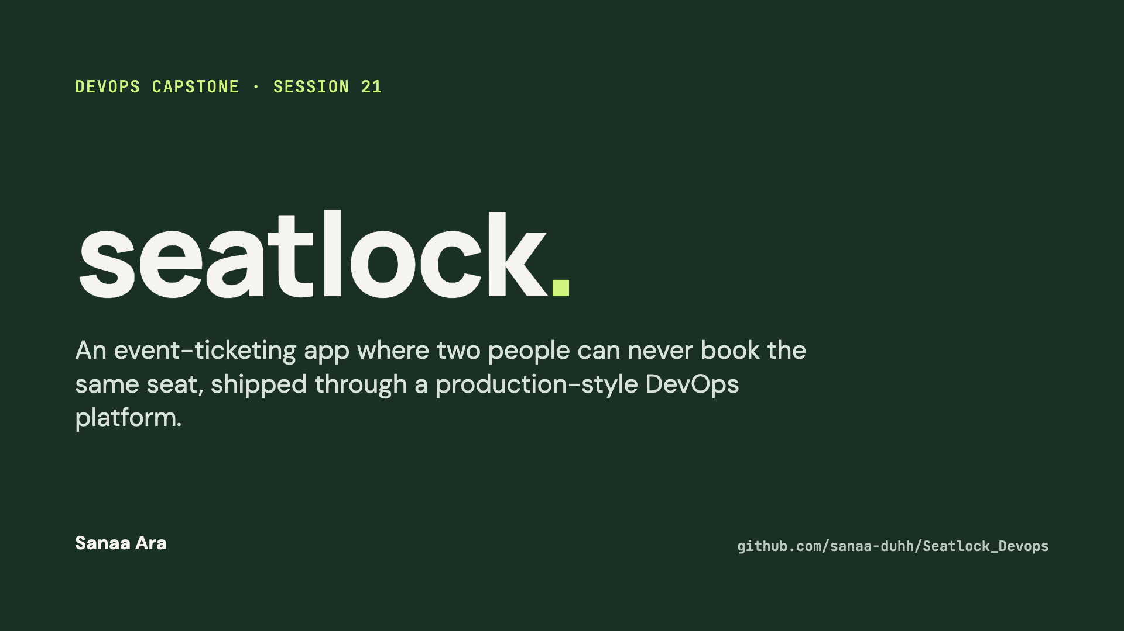
Notes:
Hi, I'm Sanaa. This is SeatLock, my DevOps capstone. It's an event-ticketing app built around one hard rule: two people can never book the same seat. Around it I built the full delivery platform: CI/CD with security gates, container images in GHCR, AWS infrastructure with Terraform, Kubernetes with Helm and Argo CD, and monitoring with Prometheus and Grafana.

Slide 2
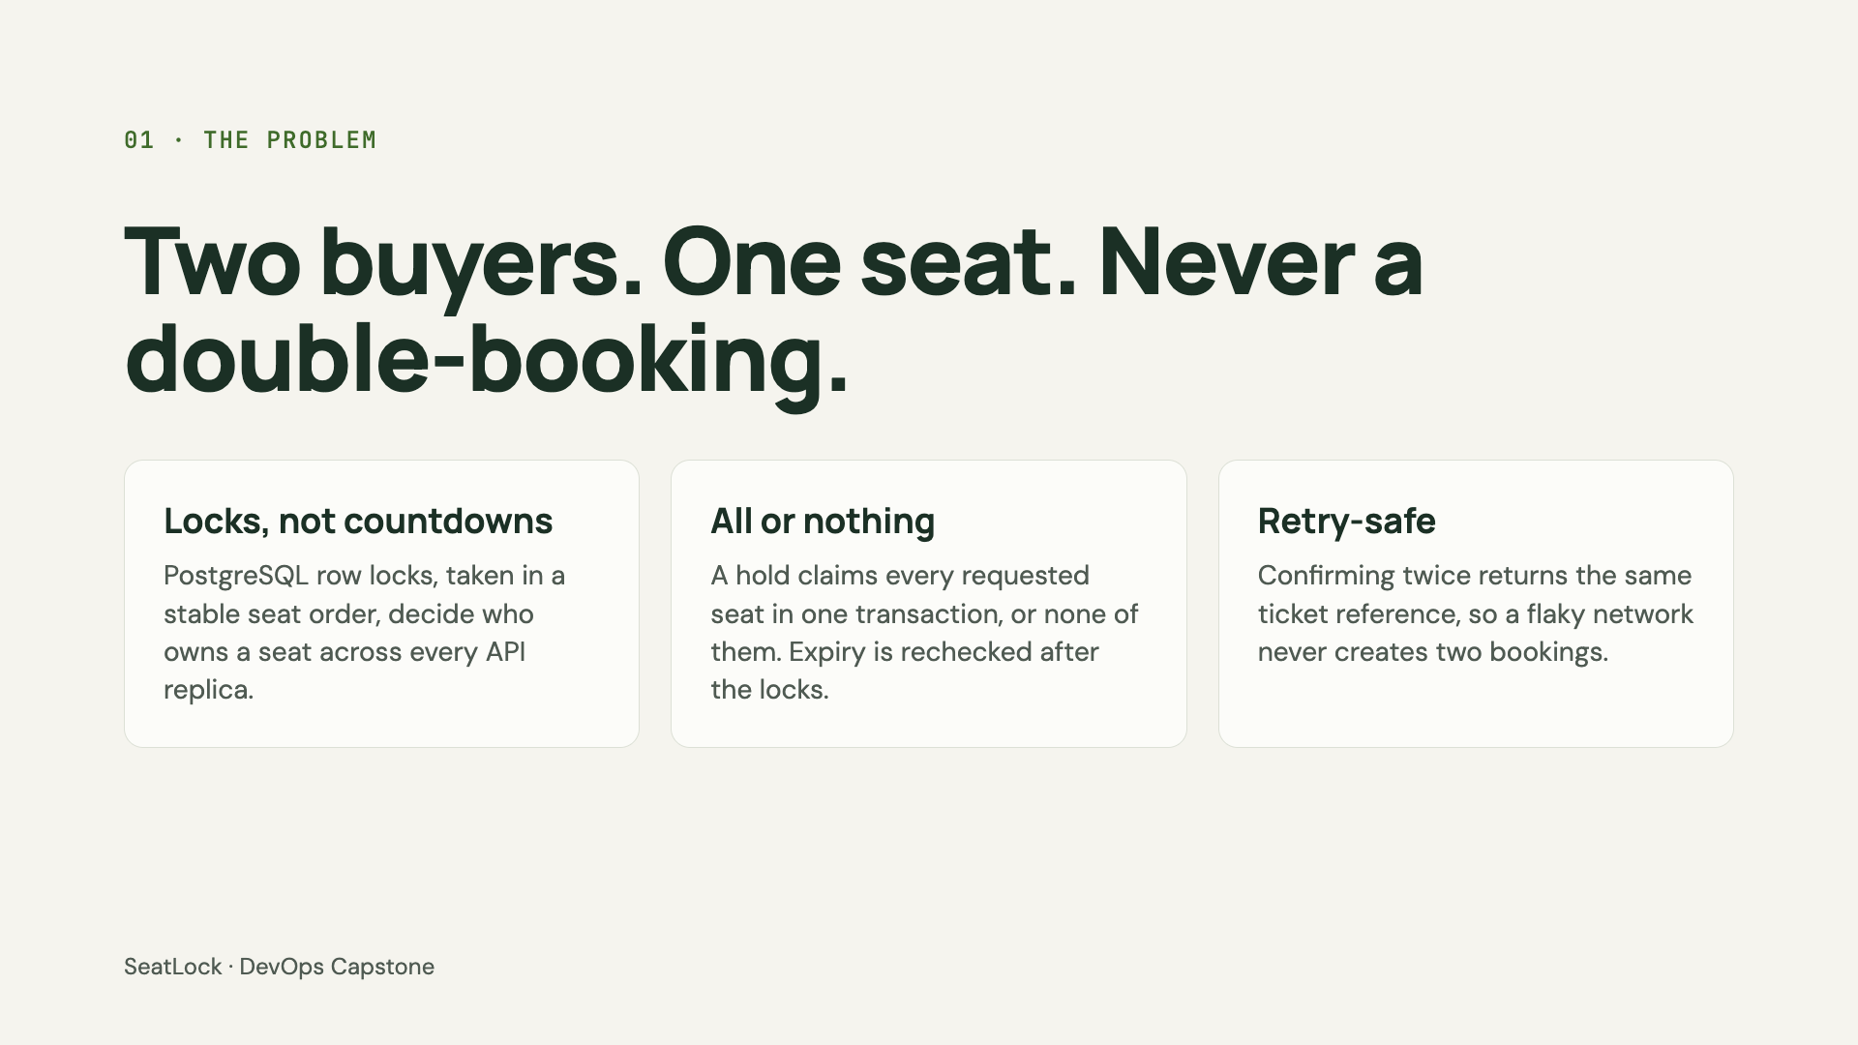
Notes:
Why this domain? Ticketing has a real correctness problem. If two people click the same seat at the same moment, on two different API replicas, only one may win. A client-side timer can't guarantee that; the database has to. So holds lock the seat rows in a stable order, they're all-or-nothing, expiry is checked after taking the locks, and confirmation is idempotent. The test suite runs real competing transactions to prove it. That matters for DevOps too: it means I can scale the API horizontally without breaking correctness.

Slide 3
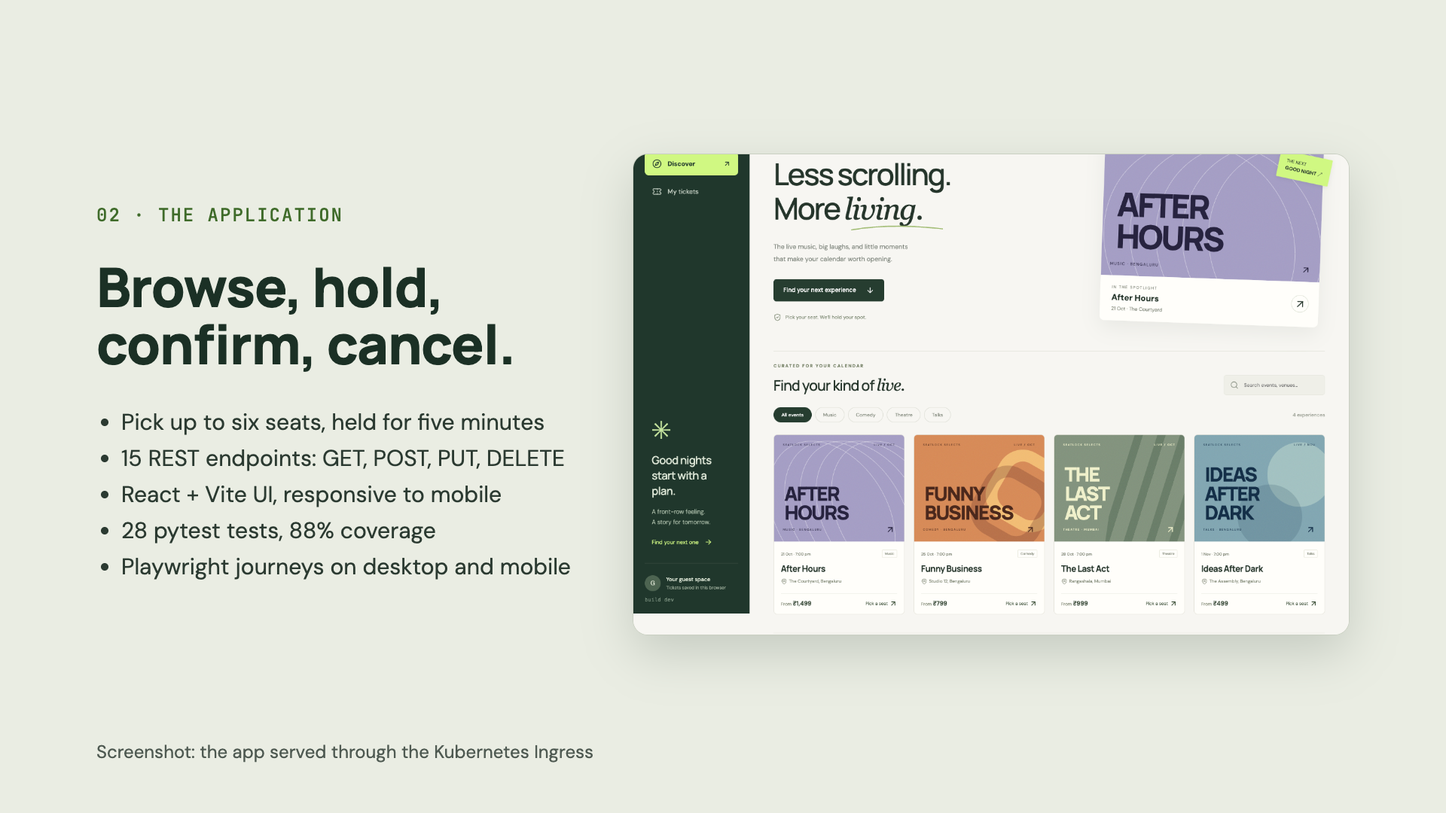
Notes:
This is the actual app. You browse events, pick up to six seats, and they're held for five minutes while you confirm. You can view your tickets and cancel. The backend is FastAPI with fifteen REST endpoints covering GET, POST, PUT and DELETE, plus health, readiness and Prometheus metrics. It's tested with twenty-eight pytest tests at eighty-eight percent coverage, against a real throwaway Postgres, and Playwright runs the full booking journey in a browser on desktop and mobile.

Slide 4
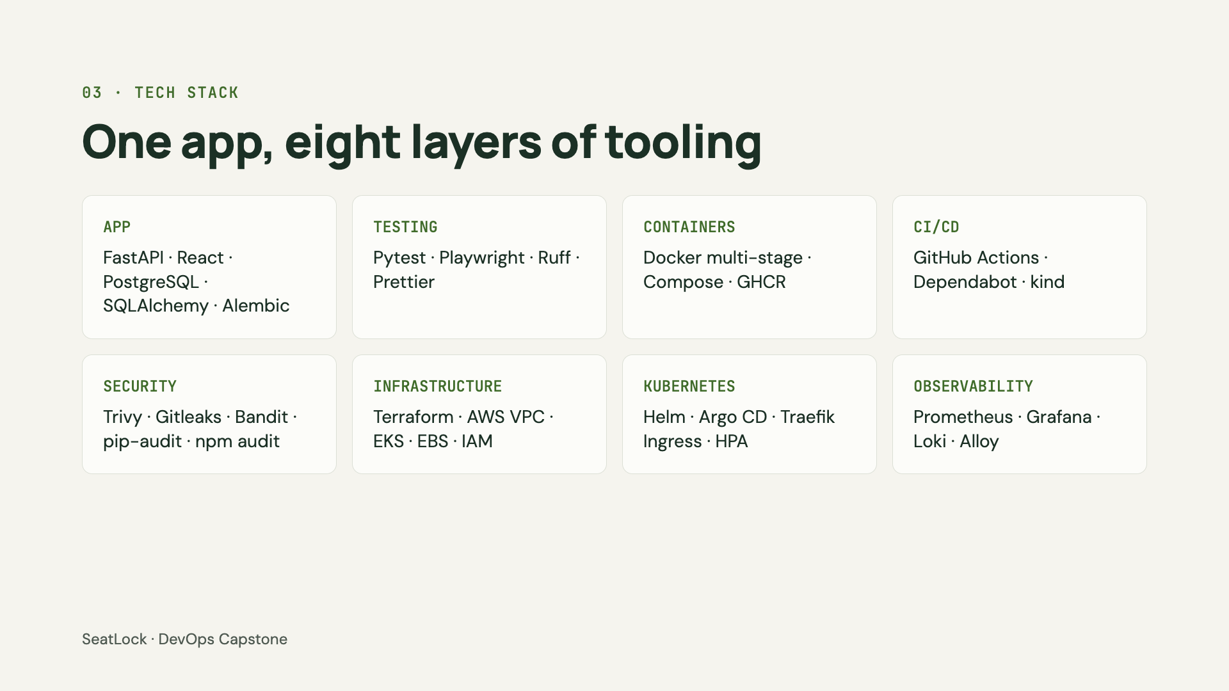
Notes:
Here's the stack by layer. The app is FastAPI, React and PostgreSQL, with Alembic migrations. Images are multi-stage Docker builds published to GitHub Container Registry. CI/CD is GitHub Actions, and it even spins up a throwaway kind cluster. Security scanning uses Trivy, Gitleaks, Bandit, pip-audit and npm audit. Infrastructure is Terraform on AWS: a VPC and an EKS cluster. On Kubernetes I use Helm for packaging, Argo CD for GitOps, Traefik for Ingress and an HPA for autoscaling. And Prometheus, Grafana, Loki and Alloy cover metrics and logs.

Slide 5
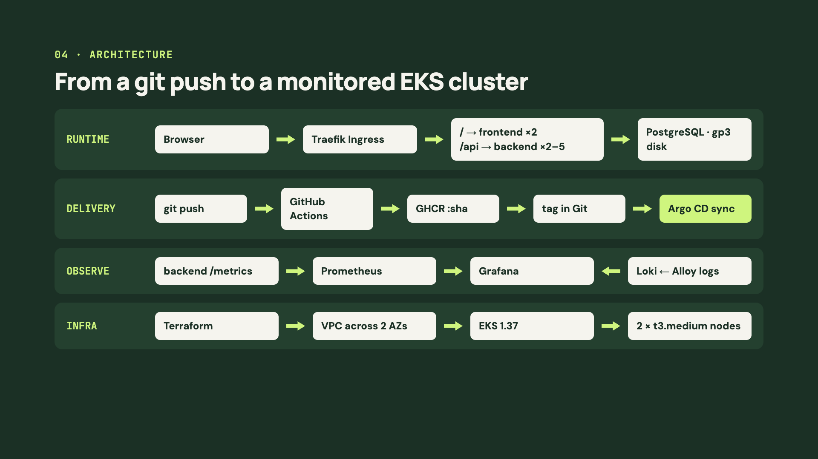
Notes:
Four lanes tell the whole story. Runtime: the browser hits the Traefik Ingress, which sends slash to the React frontend and slash-api to the FastAPI backend, which autoscales from two to five pods, and PostgreSQL keeps its data on an encrypted gp3 volume. Delivery: a git push runs GitHub Actions, the scanned images go to GHCR tagged with the commit SHA, the pipeline writes that tag into Git, and Argo CD in the cluster syncs it. Observe: Prometheus scrapes the backend's metrics, Alloy ships the logs to Loki, and Grafana shows both. Infra: Terraform builds the VPC, the EKS cluster and its two worker nodes.

Slide 6
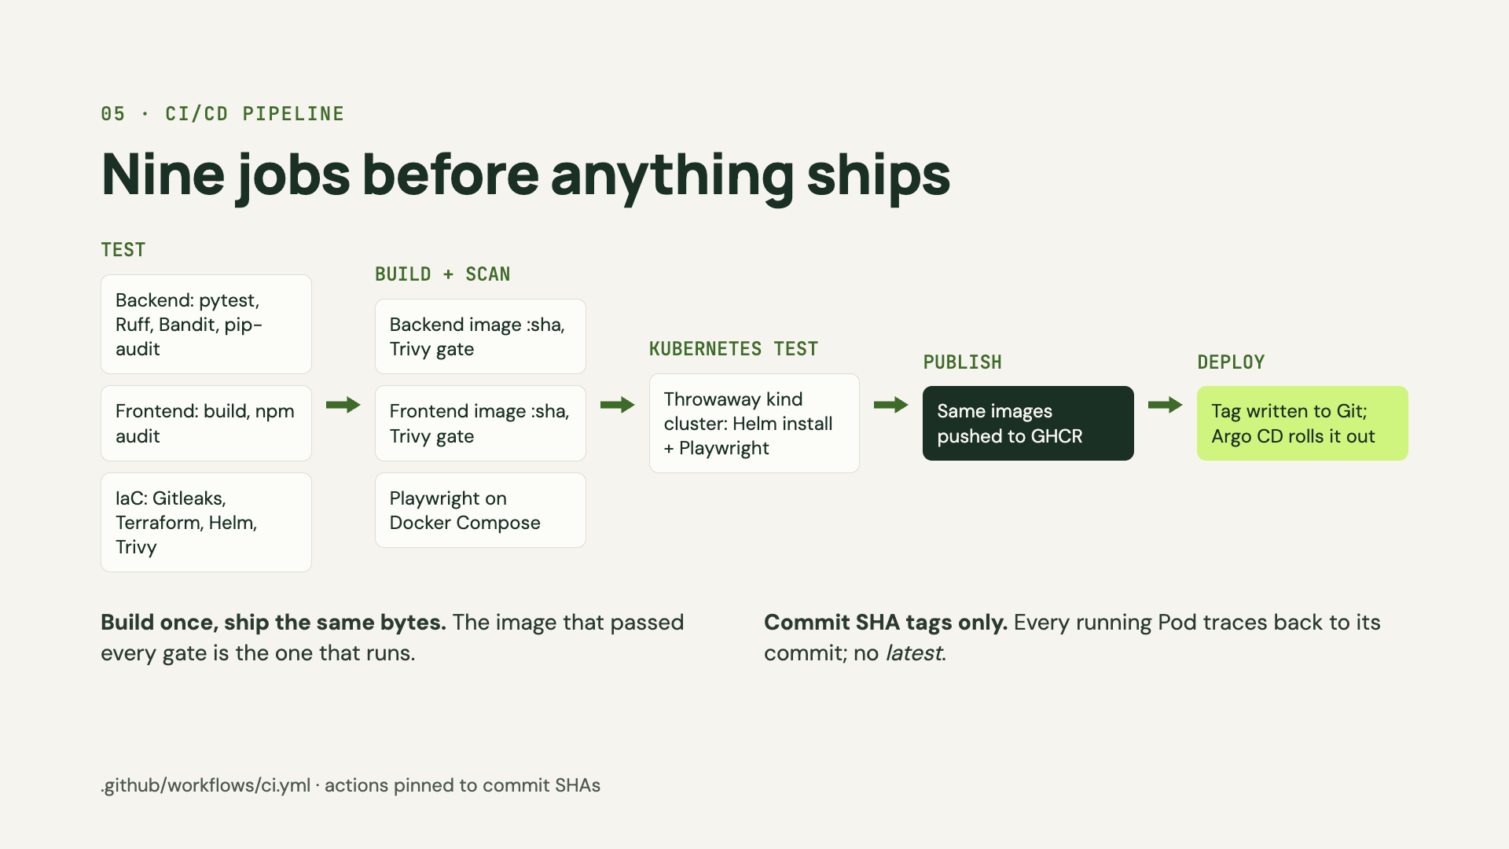
Notes:
The pipeline runs on every push and pull request. Stage one tests: pytest with coverage, linting, Bandit, dependency audits, the frontend build, a Gitleaks scan of the whole Git history, Terraform validate, Helm lint and a Trivy misconfiguration scan. Stage two builds both images once, tagged with the commit SHA, and Trivy blocks any HIGH or CRITICAL vulnerability, while Playwright tests the full stack on Docker Compose. Stage three installs the Helm chart on a throwaway kind cluster and runs the browser tests against Kubernetes. Only then are those same images pushed to GHCR, and the new tag is written to Git so Argo CD deploys it. Any failure stops everything, so a broken image never reaches the registry.

Slide 7
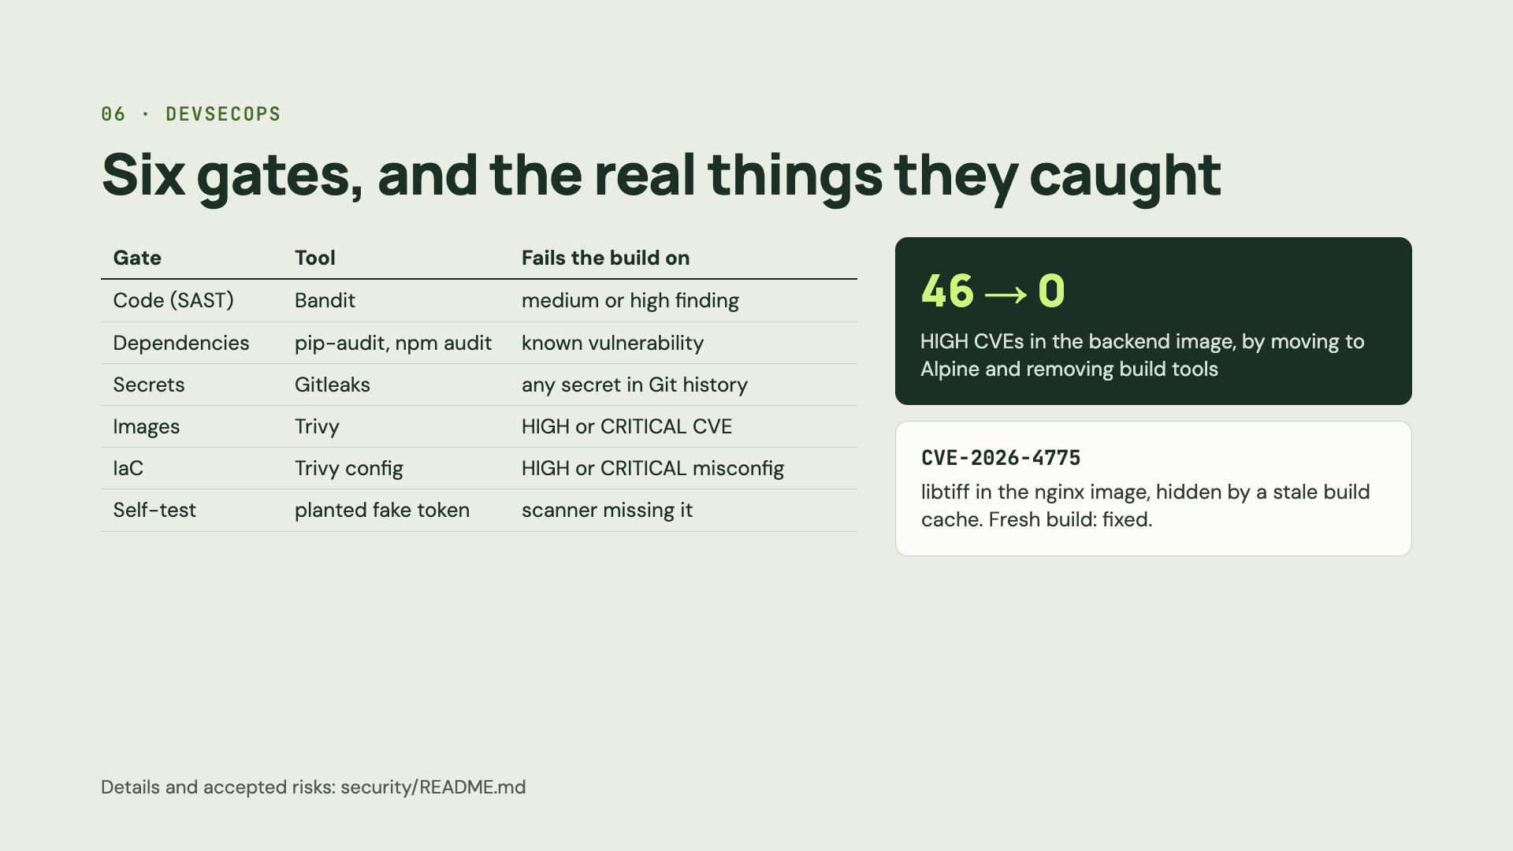
Notes:
Security is six automated gates, and each one fails the build. Bandit scans the Python code, pip-audit and npm audit check dependencies, Gitleaks scans the entire Git history for secrets, Trivy scans both images and blocks anything HIGH or CRITICAL, and Trivy's config scan checks Terraform, Helm and Dockerfiles. There's even a self-test that plants a fake token to prove the scanners still catch it. Two real findings: the first backend image had forty-six HIGH vulnerabilities, mostly Debian packages we never used, so I moved to Alpine and removed pip and wheel from the runtime, and it went to zero. And later Trivy caught CVE-2026-4775 in libtiff, which a cached build layer was hiding; a fresh build fixed it. The IaC scan also made me run every container with a read-only root filesystem.

Slide 8
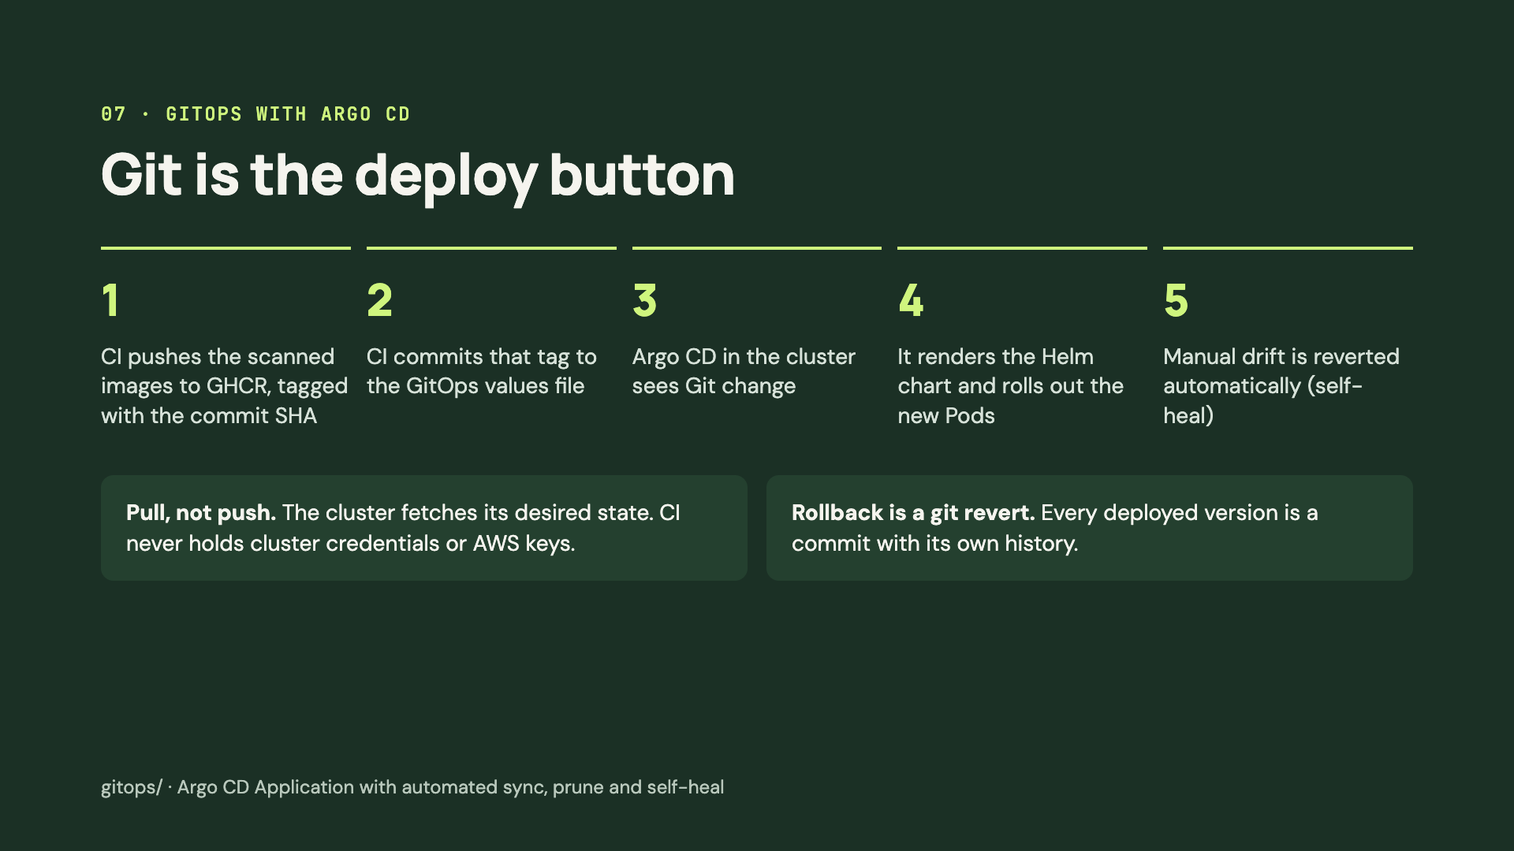
Notes:
Deployment is GitOps with Argo CD. When the pipeline passes, it pushes the images to GHCR and commits the new SHA tag into a values file in Git. Argo CD, running inside the cluster, notices the change, renders the Helm chart and rolls out the new pods. If someone edits the cluster by hand, Argo reverts it, which is called self-heal. The big benefit is that it's pull-based: GitHub Actions never needs cluster credentials or AWS keys, and rolling back is just a git revert.

Slide 9
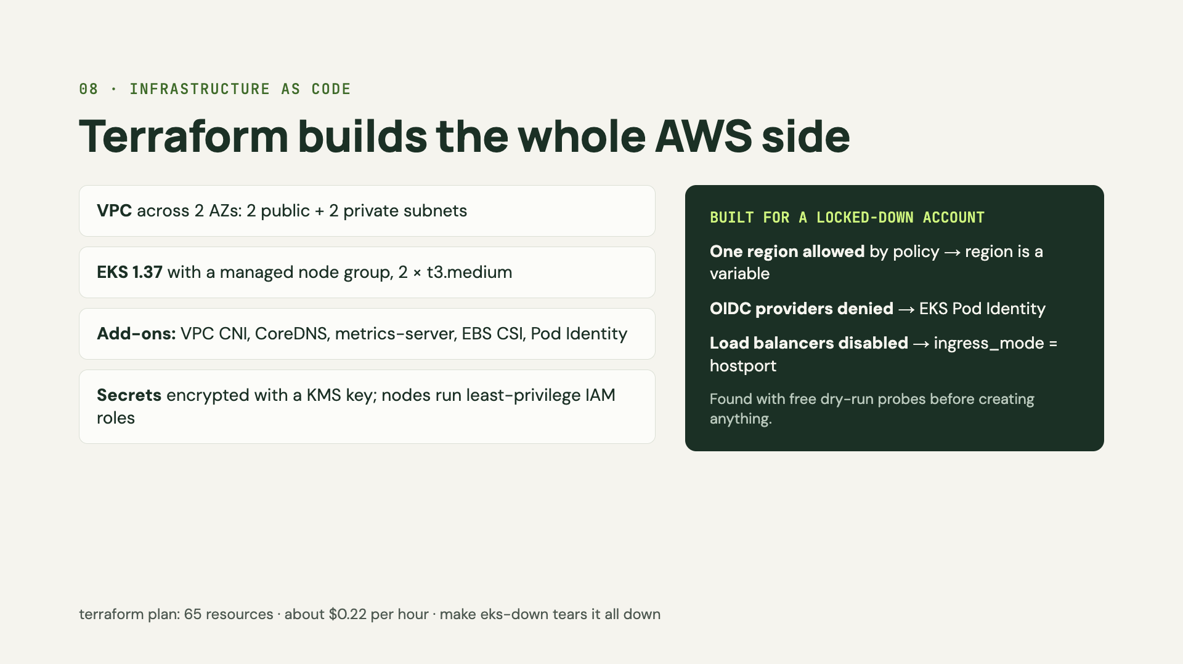
Notes:
All AWS infrastructure is Terraform, using the community VPC and EKS modules. It creates a VPC across two availability zones with public and private subnets, an EKS 1.37 cluster with a managed node group of two t3.medium instances, the add-ons for networking, DNS, autoscaling metrics and encrypted EBS storage, and a KMS key for Kubernetes secrets. The account I deployed to had guardrails: an organization policy allowing a single region, a deny on IAM OIDC providers, and load balancers not yet enabled. I found all three with free dry-run probes before creating anything, and made the code adapt with variables instead of hard-coding around one account. Teardown deletes Kubernetes-created resources first so terraform destroy never stalls.

Slide 10
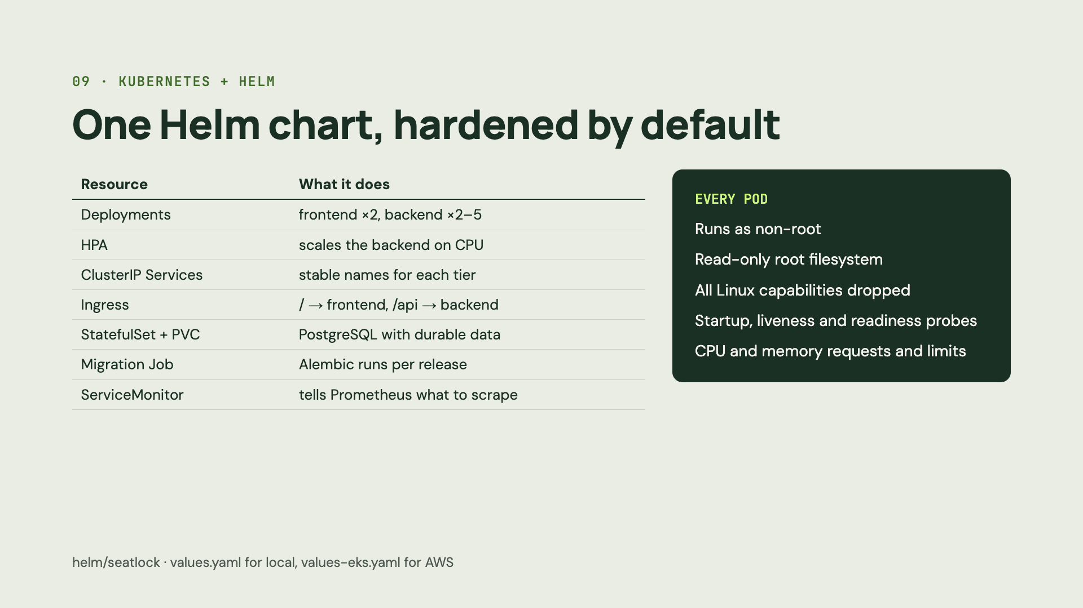
Notes:
Everything in the cluster comes from one Helm chart. Frontend and backend Deployments run at least two replicas each, and an HPA scales the backend on CPU. ClusterIP Services give each tier a stable name, and the Ingress routes slash to the frontend and slash-api to the backend. PostgreSQL runs as a StatefulSet with a persistent volume, and a Job runs the database migrations for each release. A ServiceMonitor tells Prometheus what to scrape. Every pod is hardened: non-root, read-only filesystem, no Linux capabilities, proper probes and resource limits. The same chart deploys to minikube, a CI kind cluster and EKS, just with different values files.

Slide 11
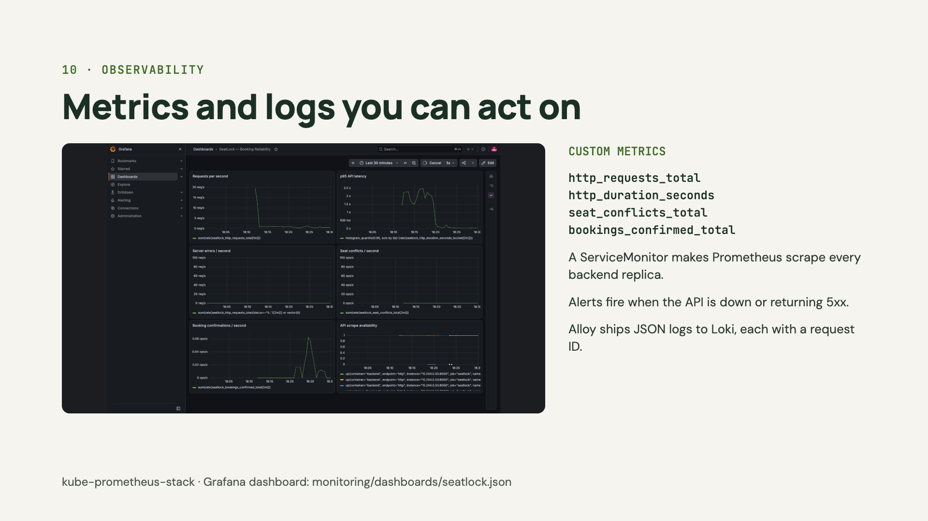
Notes:
Monitoring runs on kube-prometheus-stack. The backend exports its own metrics, all prefixed seatlock: request counts, a latency histogram, seat conflicts and confirmed bookings. A ServiceMonitor tells Prometheus to scrape every backend replica, and the Grafana dashboard shows requests per second, p95 latency, server errors, seat conflicts and confirmations. Alert rules fire when the API stops responding or starts returning server errors. For logs, Grafana Alloy collects each pod's JSON logs into Loki, and every log line carries the same request ID the API returns in its response header, so you can trace a single request.

Slide 12
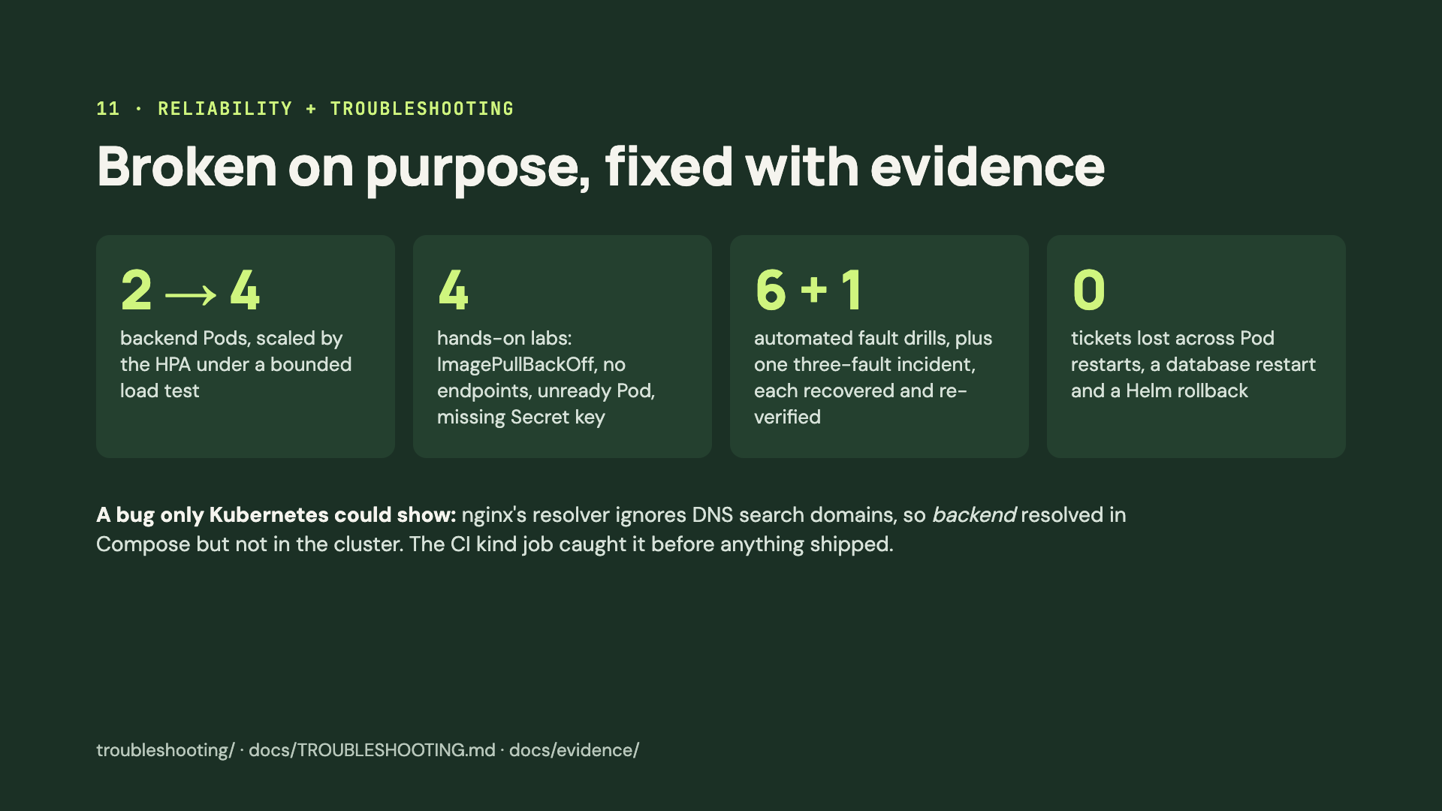
Notes:
I tested failure on purpose. Under a bounded load test, the HPA scaled the backend from two to four pods. The troubleshooting folder has four broken manifests, ImagePullBackOff, a Service with no endpoints, a pod that's running but never ready, and a missing Secret key, each with the diagnosis steps and fix. A script also injects six faults into a full release, plus a combined three-fault incident, and verifies a booking end to end after each recovery. A confirmed ticket survived pod restarts, a database pod restart and a Helm rollback. And the best catch was a real bug: nginx doesn't use Kubernetes DNS search domains, so the short name backend only worked in Docker Compose. The kind job in CI caught it before release.

Slide 13
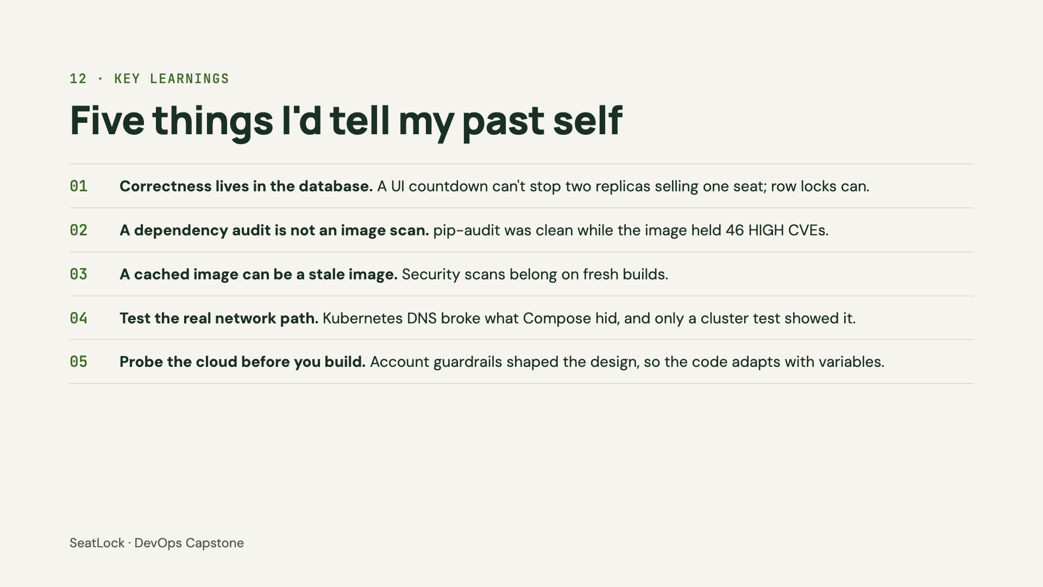
Notes:
Five lessons. One: correctness has to live in the database; a countdown in the browser can't stop two replicas from selling the same seat. Two: a dependency audit is not an image scan; pip-audit was clean while the image carried forty-six HIGH vulnerabilities in OS packages. Three: a cached image can be a stale image, so security scans should run on fresh builds. Four: test the real network path; Kubernetes DNS broke something Docker Compose hid. And five: probe the cloud account before you build; the guardrails I found shaped the whole infrastructure design.

Slide 14
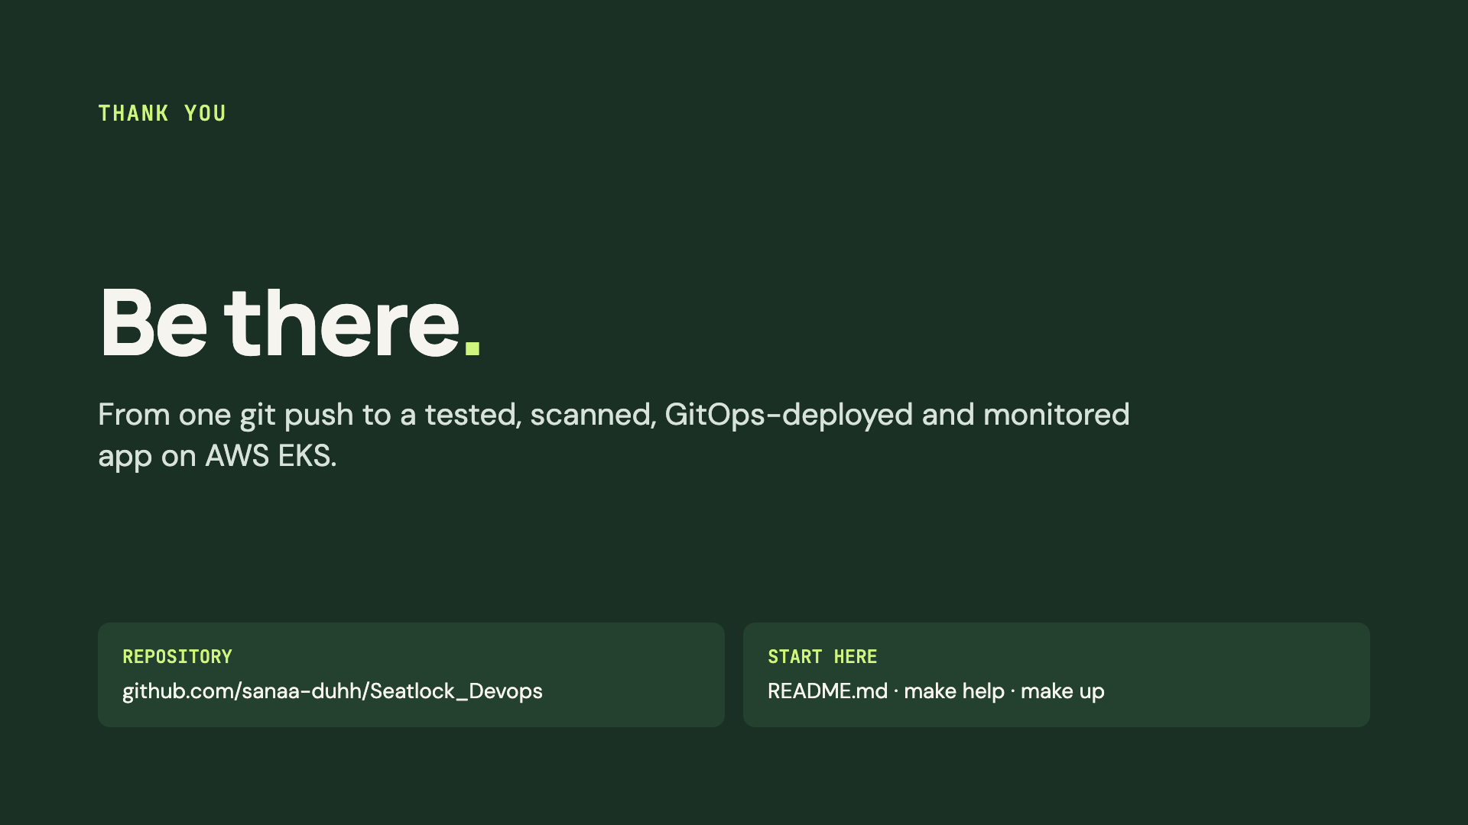
Notes:
That's SeatLock: one git push takes the code through tests and security gates, into a scanned image in GHCR, and out to EKS through Argo CD, with Prometheus and Grafana watching it. The repository has everything, and the README is the best place to start. Thank you.

