Slide 1
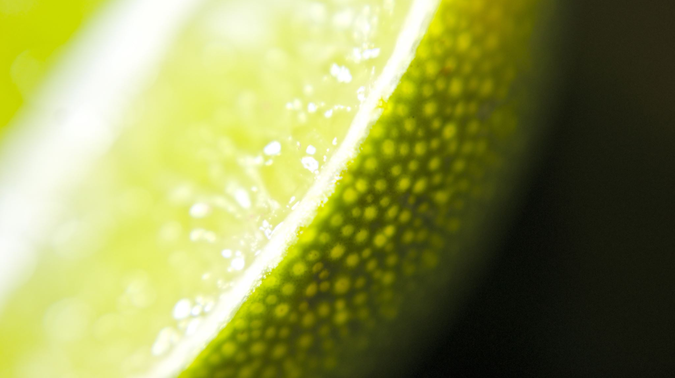
CAN hempcreate replace concrete?
By ayesha ali

Slide 2
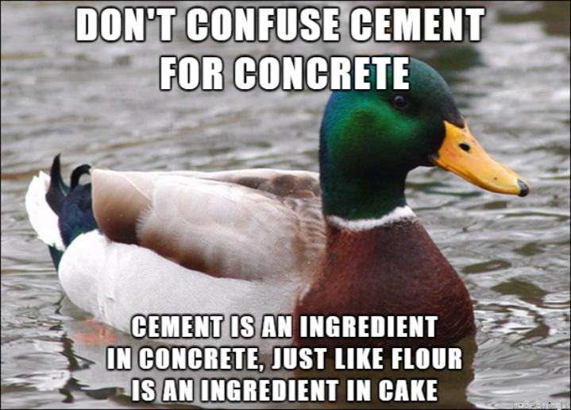
WHAT IS CONCRETE
Concrete is a substance used in building infrastucture
Cement is a binder ;it binds with sand and gravel (aggregate) to form concrete.

Slide 3
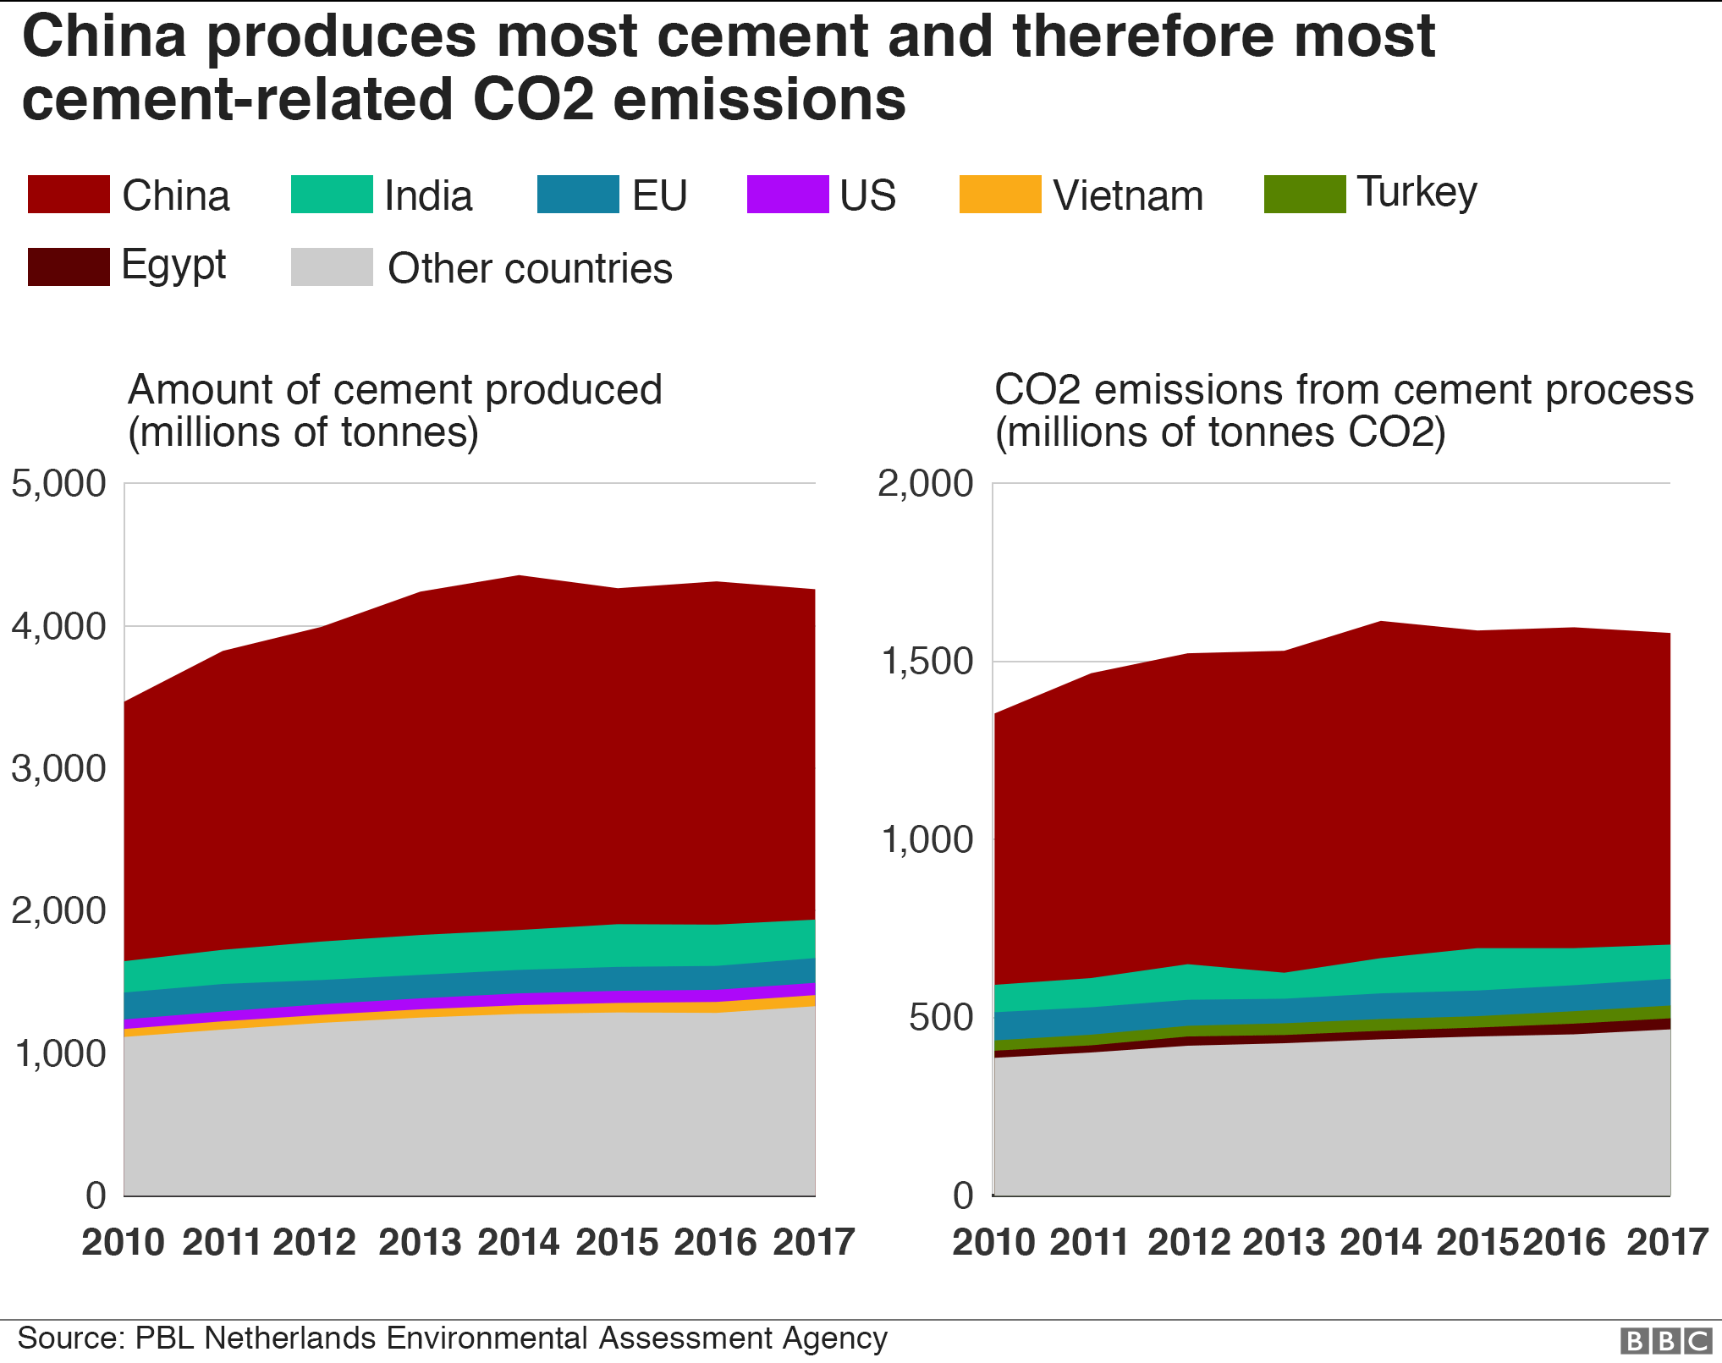
WHY REPLACE CONCRETE?
Air pollution-The industry's heavy dependence on coal leads to high discharges of CO2, nitrous oxide and sulphur oxide.
High energy dependence-Including direct fuel use for mining and transporting raw materials, about 1,758 kWh is released for every ton of cement.

Slide 4
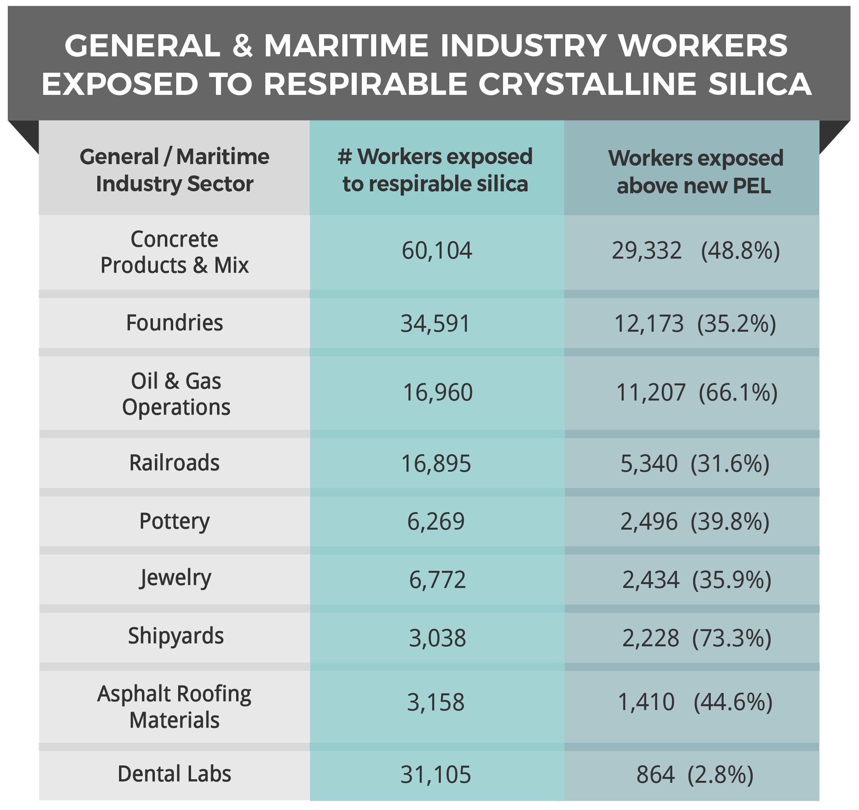
WHY REPLACE CONCRETE?
Water pollution-Water that encounters unset concrete or concrete dust quickly increases in basicity and will be highly toxic to aquatic life
Highly toxic to skin - Concrete or concrete dust can cause grave wounds by skin or eye contact or inhalation.
High wastage - Approximately 3-4% of concrete produced by concrete plants is wasted,accounting for a quarter of global waste.

Slide 5
Factors on which a substitute for concrete is found
Greenhouse Emissions
Mechanical Strength
Cost
Energy Consumption
Water Consumption
Biodegradability
Toxicity

Slide 6
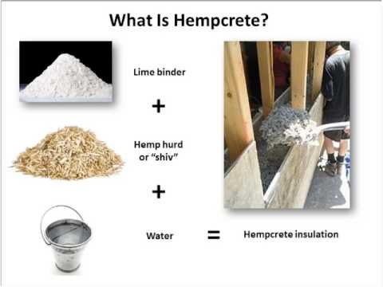
What is HEMPCRETE?
Hempcrete is a substance made of the fibres of the hemp plant mixed with a binder.
Advantages - Carbon negative material;during its growth it takes in CO2 from the atmosphere.
Decrease the risk of vapour condensation and increases insulation.
Pest-resistant due to reaction between the binder and hemp fibres.

Slide 7
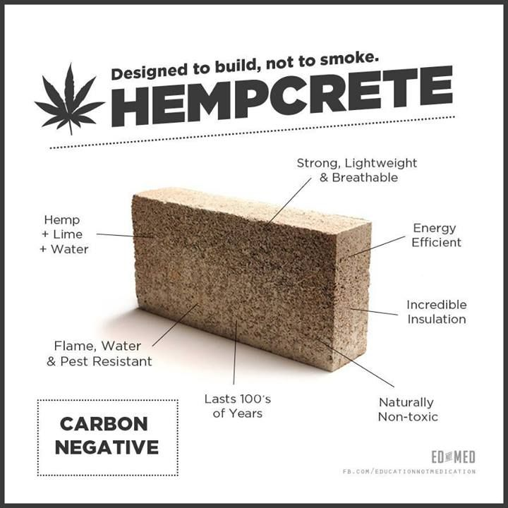
What is HEMPCRETE?
Lighter than concrete
Resistant to crack under movement and can be used in seismic zones.
Disadvantages-Costs more than conventional methods
Used as an infill material with timber only
Needs more scientific research in its material properties
Its cultivation is illegal in many places
Needs more water in producing it than concrete due to cultivation

Slide 8
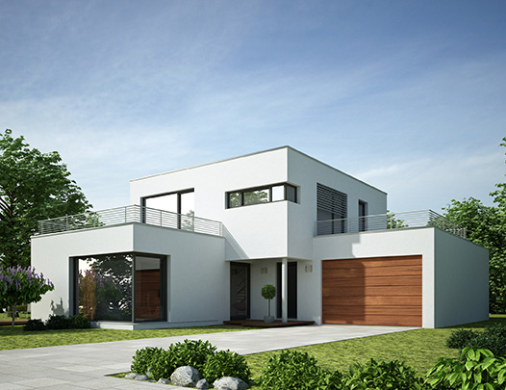
practical applications
In 2017, Western Australia had constructed its first hemp home in just eight months.
Canberra’s first hemp home had won the title of the 2018 HIA Australian GreenSmart Home.
About more than 24 hemp homes exist in Australia
Hundreds of buildings use hempcrete in Europe and Canada
A seven-story office tower in France, a Marks and Spencer department store in the United Kingdom, even a home built by Prince Charles
The material was developed in the 1980s in France, with its roots going back ages to homes as far away as Japan.

Slide 9
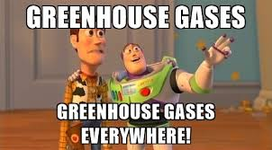
Conclusion
The cement industry is one of the largest producers of carbon dioxide
With the rise of greenhouse gases in the earth's atmosphere, an alternative to concrete has to be found
In terms of environmental impact, hempcrete is a better building material than concrete
But it is currently used as an in fill material with timber only
As cultivation of hemp plant illegal in many places it's expensive then concrete
Its gaining popularity as a building material
To make its mainstream, more research has to be done on its material properties
Its cultivation and use has to be made gradually legal globally

