Slide 1


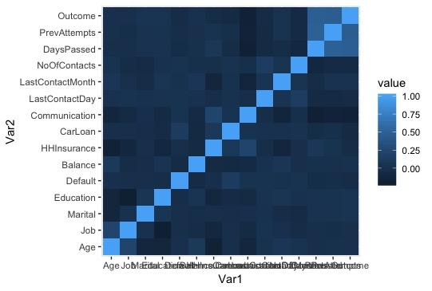



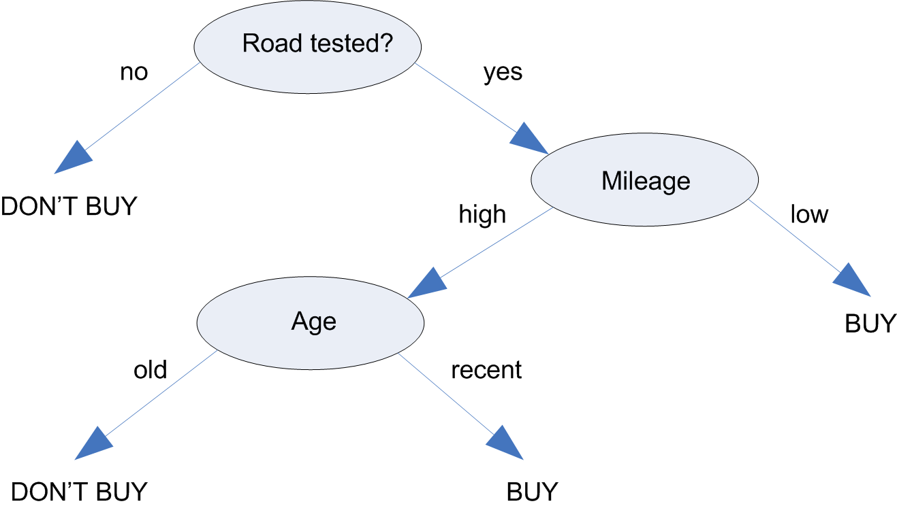
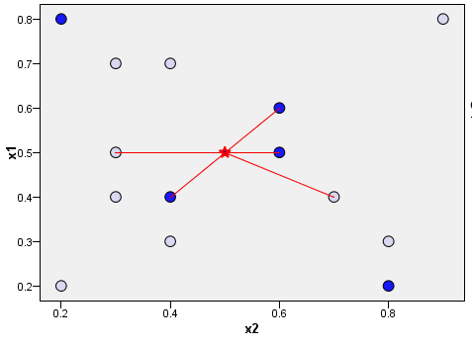
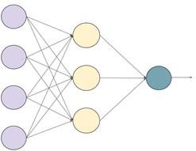


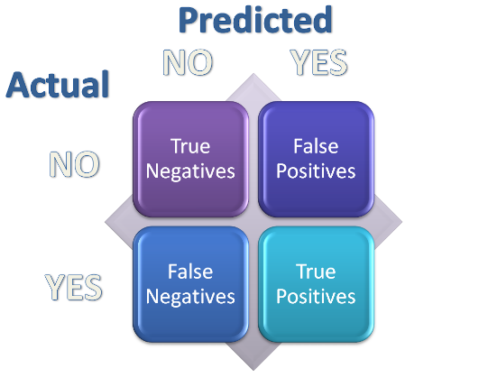


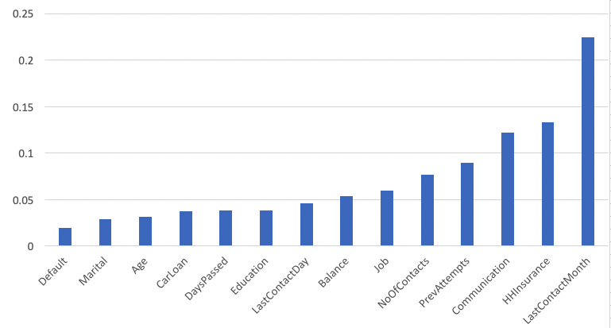


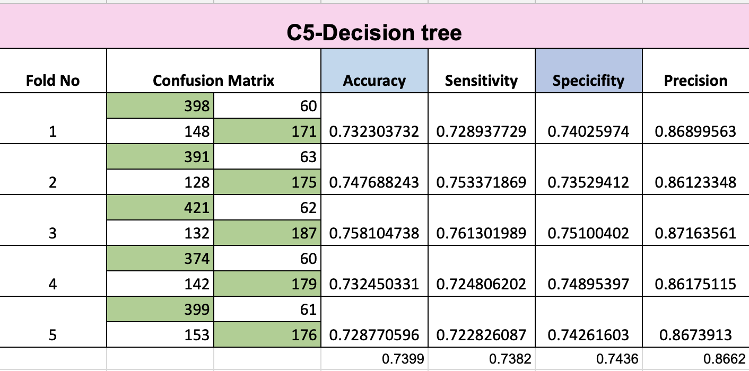
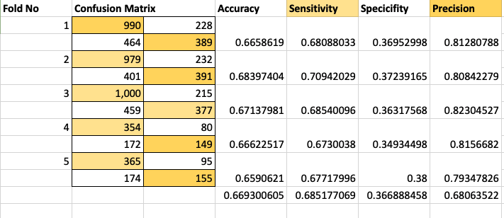
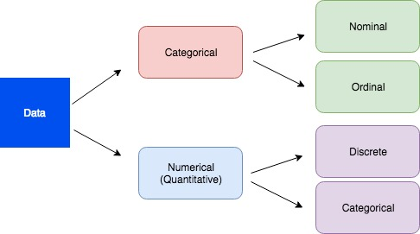
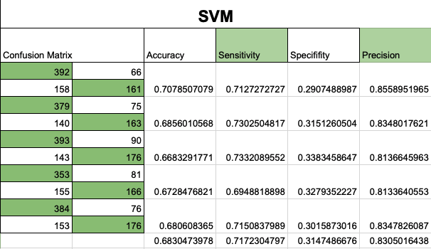
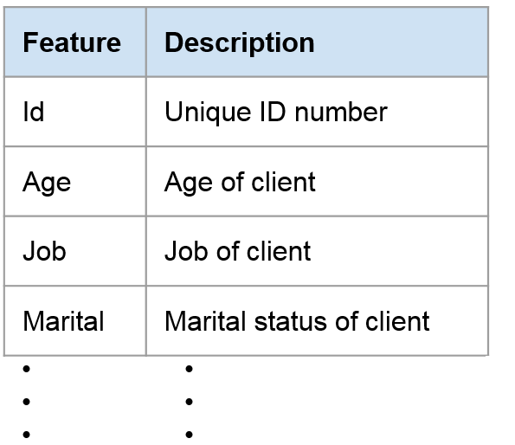
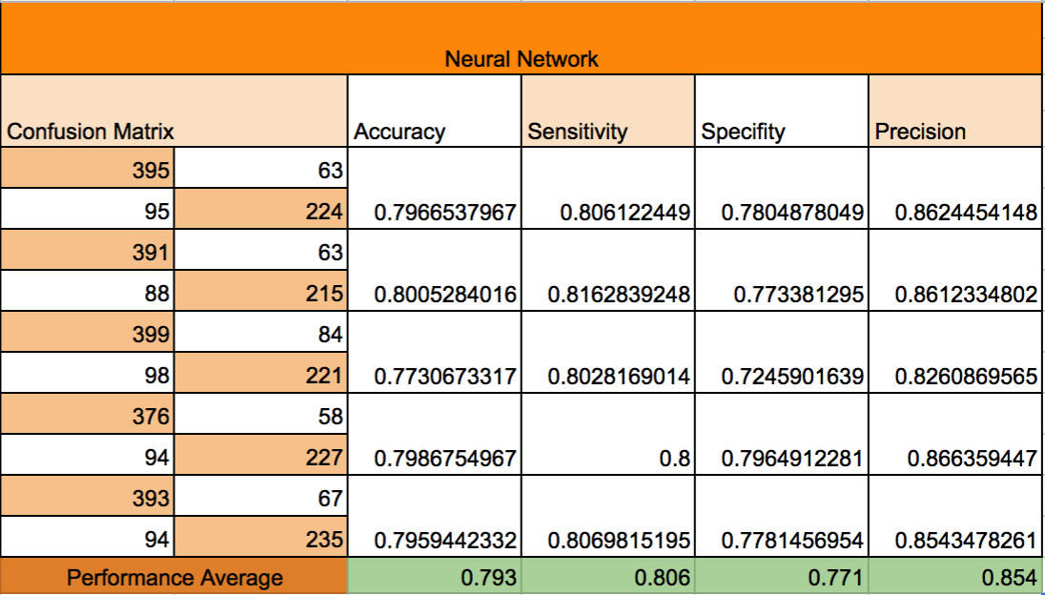
A Machine Learning Approach to Cold Call Insurance Prediction
Student: Sana Bahari
Engineering Management MSc Programs
Faculty Advisor: Dr. Asil Oztekin, Operations & Information Systems
MOTIVATION
Objective: Employ machine learning models to accurately predict whether a client will purchase car insurance or not
  Filter clients that are more likely to purchase car insurance
  Decrease cost and time for company
  Determining the best use of company’s resources
  Dataset is from bank, which also provides car insurance service
  Bank has possible customer information to call and advertise car insurance
  Bank wants to save money and time by forecasting customer’s action
Flowchart of the Data Analytic Methodology
RESULTS
RESULTS (cont’d)
Raw data
Variable Correlation
Data preprocessing
Performance Comparison
Data cleaning
Data correlation
Model | Accuracy | TPR | TRN | Precision
C5-Decision Tree | 73.99% | 73.82% | 74.36% | 86.62%
KNN | 66.93% | 68.51% | 36.68% | 68.06%
SVM | 68.30% | 71.72% | 31.47% | 83.05%
Neural Network | 79.3% | 80.6% | 77.1% | 85.4%
Data mining
Clean dataset
Data splitting
Decision tree
Modeling
KNN
Training
80%
Testing
20%
Accuracy of Classification Models
TP: true positive, FP: false positive
TN: true negative, FN: false negative
5-fold
Cross-validation
Neural Networks
SVM
APPROACH
Information-Fusion based Sensitivity Analysis
The steps that are followed in this project are based on six-step CRISP-DM methodology (see the flowchart).
The fourth step is modeling.
We use four supervised machine leaning models: K-nearest neighbors (KNN), support vector machine (SVM), neural networks, decision tree.
Our approach is to test several models based on appropriate metrics leading to finding new patterns in cold calls insurance prediction.
Generate confusion matrix
Model evaluation
Managerial implications
Model 1 - Decision Tree
Prediction results
Information fusion-based analysis
Data cleaning
  Ignore Id variable
  Define dummy variable for categorical predictors
  Find correlation between variables
Model 2 - KNN
CONCLUSIONS
Distinguishing data
The most important variables in making prediction models are:
  The month of last contact
  Is the household insured?
  Number of contacts performs before this campaign for the client
  Number of contacts performed during the campaign for the client
  Job of the customer
Four popular machine learning models are studied based on their performance metrics: accuracy, precision, sensitivity (TPR), and specificity (TNR).
Neural Network performed the best among all the prediction models
Future work includes the extension to other features, e.g. cost of insurance, brand of insurance, clients demographic.
SIGNIFICANCE OF YOUR RESULTS
Applications of comparative studies
  There is extensive appetite in business to use machine learning methods.
  However, the choice of the appropriate machine learning model is highly problem-dependent.
  Various models use different levels of sophistication and have different computational demands.
  Our research identify methods to compare across different models and identify the most suitable approach for the specific applications.
Target business:
  Banks and insurance companies
  Financial companies
Model 3 - SVM
Data understanding
  18 predictors
    9 Continuous
    5 Nominals
    1 Ordinals
    3 Flags
  1 Outcome
  Flag
Model 4 - Neural Networks

