Slide 1


Rain Prediction in Australia Using Machine Learning
By:
SaNa Bahari
Under the guidance of Prof. Amit deokar
Mist.6160: Advanced Data Mining

Slide 2
Problem Statement
Preprocess dataset
Making Classification Prediction model to estimate the likelihood of rain tomorrow
Finding the best Machin Learning model
Improve recall and precision by tuning the model

Slide 3
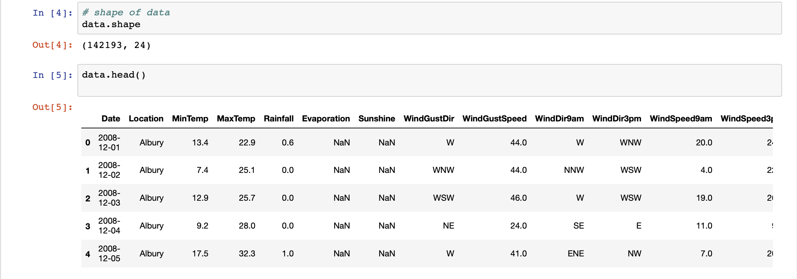
Data Understanding
Raw dataset has 150K records and 24 columns

Slide 4
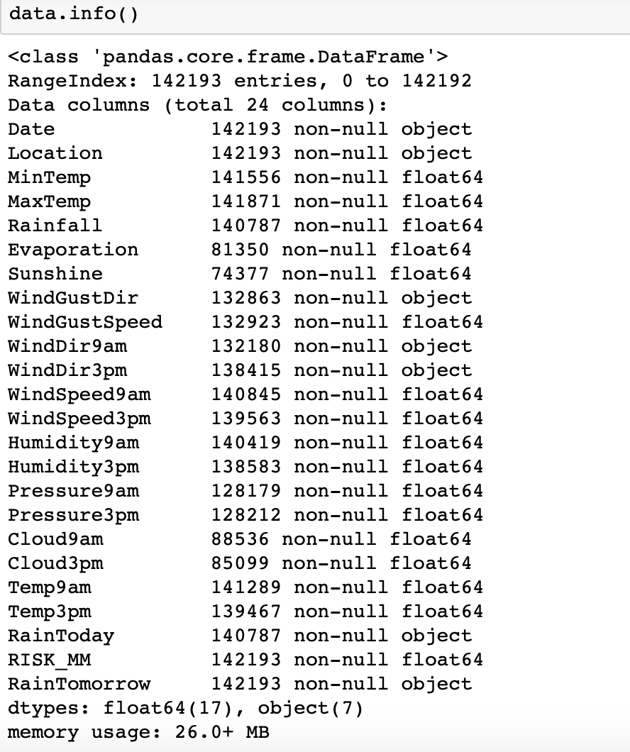
Data types

Slide 5
Data Prepration
15000 records out of 150K observation are randomly selected.
Index is reset, and null values are identified.
”backfill” method is used to refill null values.
‘Location’ , ‘Risk_mm’ and ‘date’ column are removed.
Converted all the column name to lowercase.
Replace ‘No’ with 0,and ‘Yes’ with 1

Slide 6
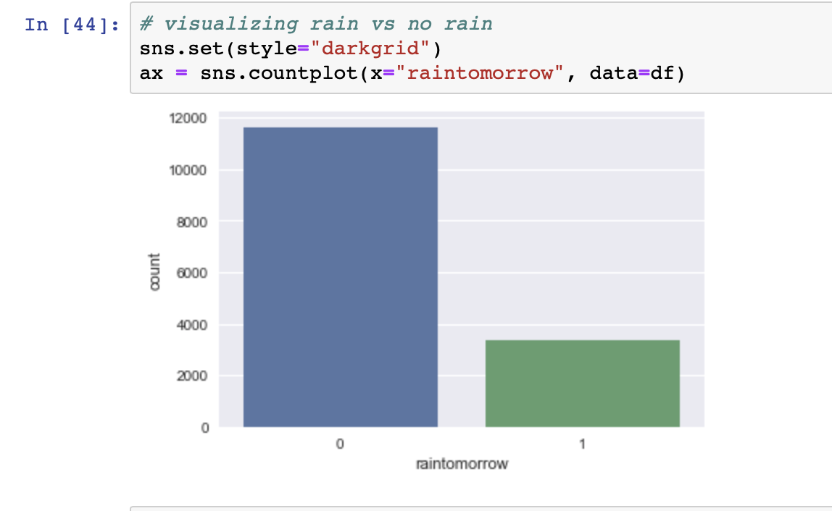
Distribution of target variable

Slide 7
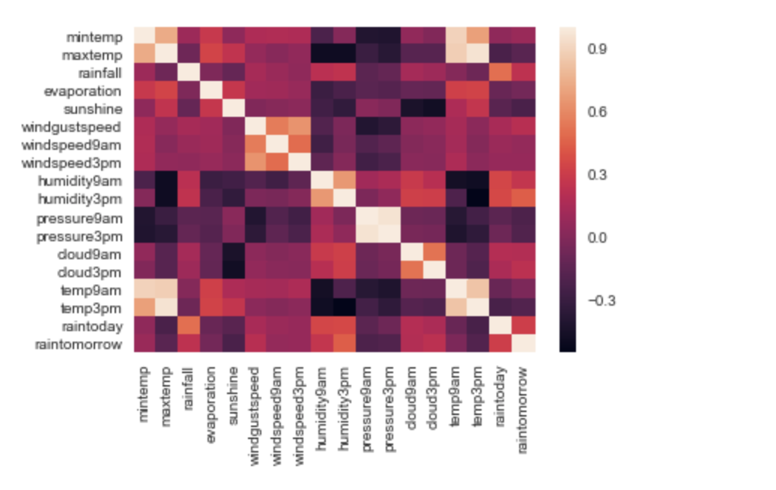
Correlation
Temp9am is highly correlated with temp3pm.
Pressure9am is highly correlated with pressure3pm.

Slide 8
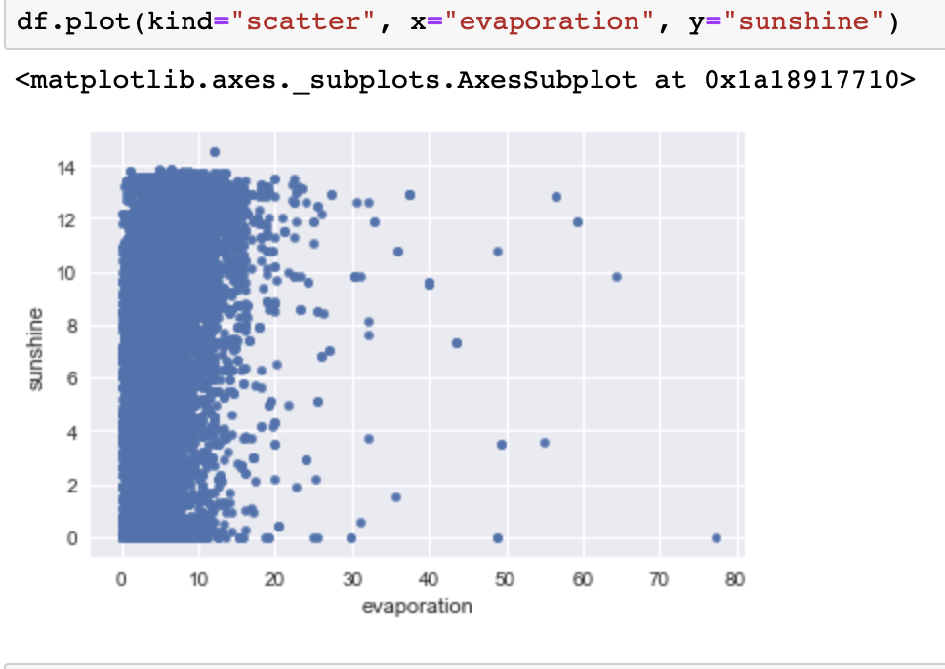
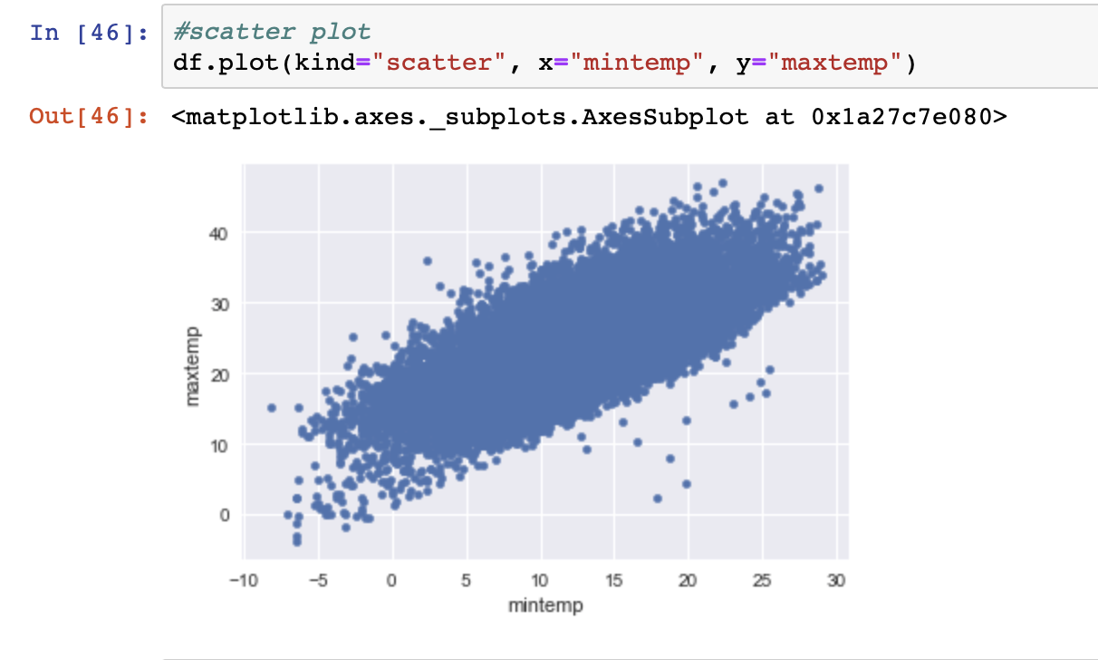
Scatter plots:

Slide 9
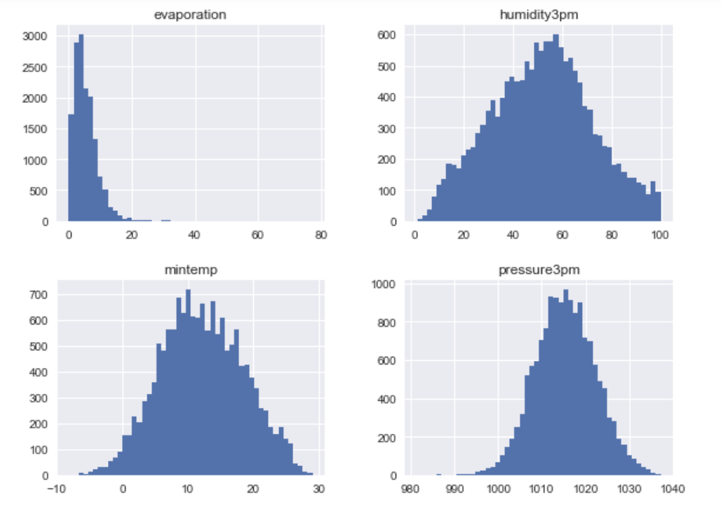
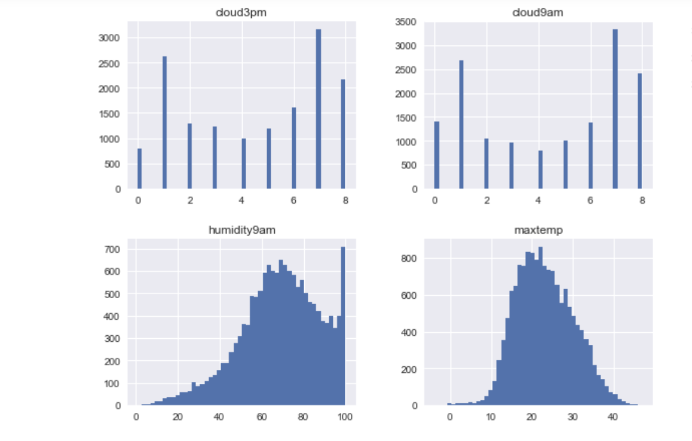
Visualization of columns:

Slide 10
Last steps for data preprocessing
Data is scaled with “Min Max Scaler” function.
Dummy variables are defined for categorical variables.
Removed highly corrolated variables

Slide 11
Studied Machin Learning Models:
K-Nearest-Neighbor (KNN)
Logistic Regression
Decision Tree
Support Vector Classifier (SVC)
Random Forest
Naive Bayes

Slide 12
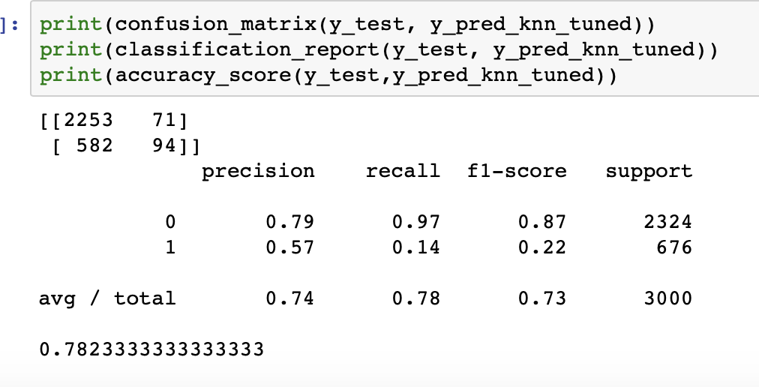
K-Nearest-Neighbor with Tunned parameters:
With Grid Search, and 10 fold cross-validation, the best parameter for n_neighbor is 8.
Model is trained and prediction is performed on a test set

Slide 13
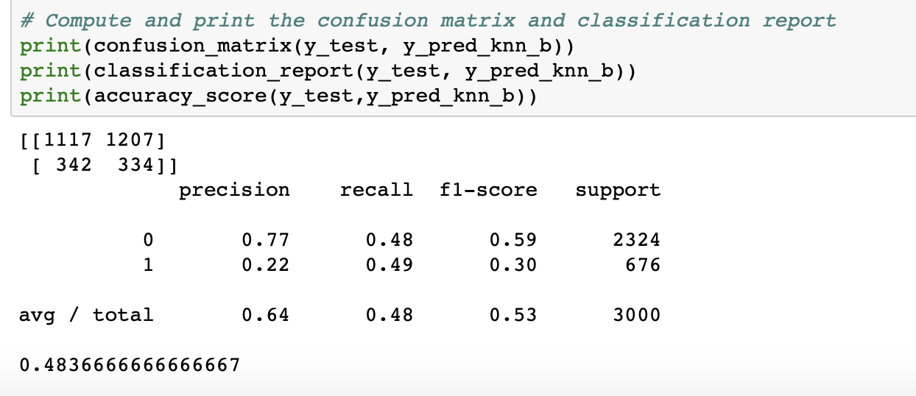
Balancing Train date for KNN model:
Train data is balance by up sampling method.
Model is trained on a balance data, and test on original test set
Recall is improved from 0.14 to 0.49
Precision and Accuracy is decreased.

Slide 14
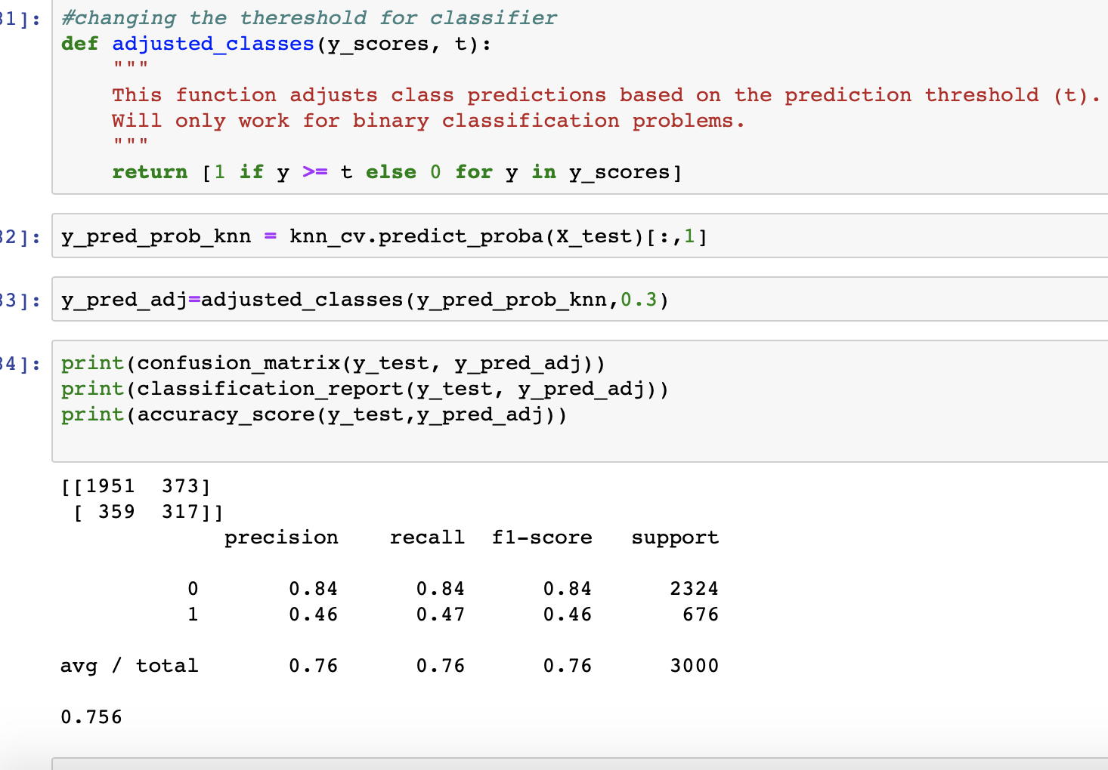
Changing threshold for KNN to 0.3
Recall is improved
Precision and Accuracy are decreased
Changing threshold makes better results than balancing train data

Slide 15
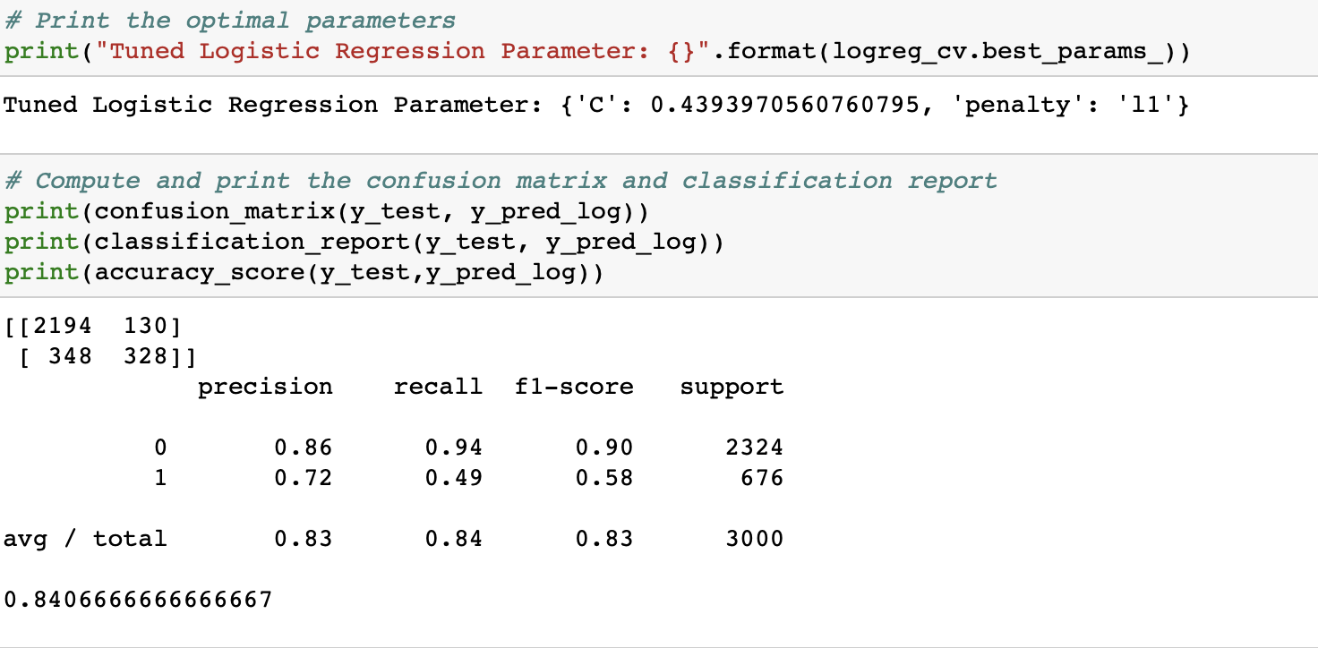
Tuned Logistic Regression:

Slide 16
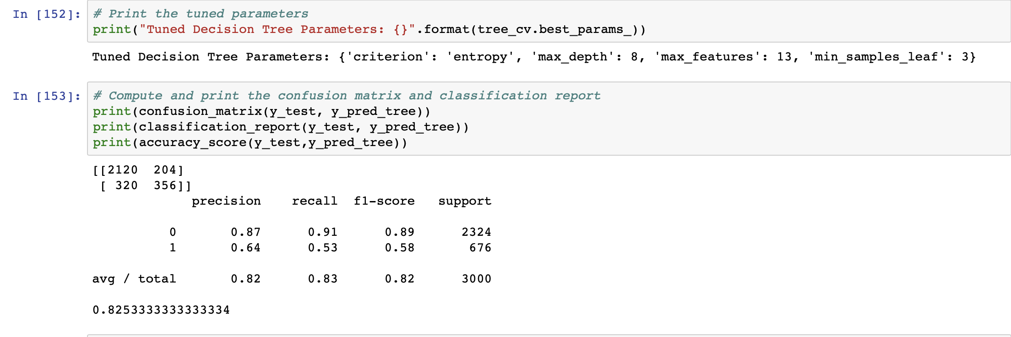
Tuned Decision Tree:

Slide 17
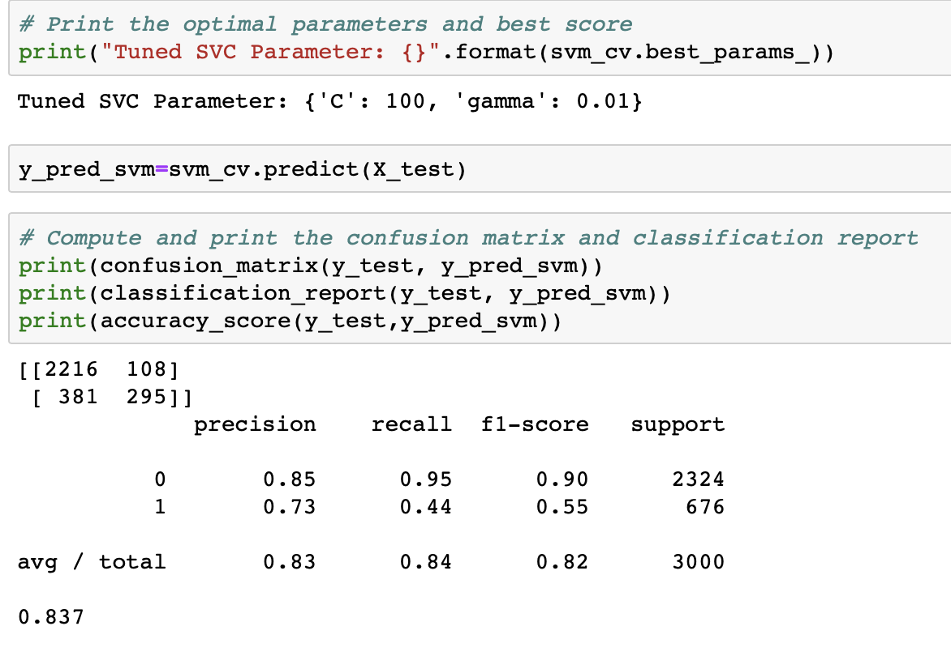
Tuned SVC:

Slide 18
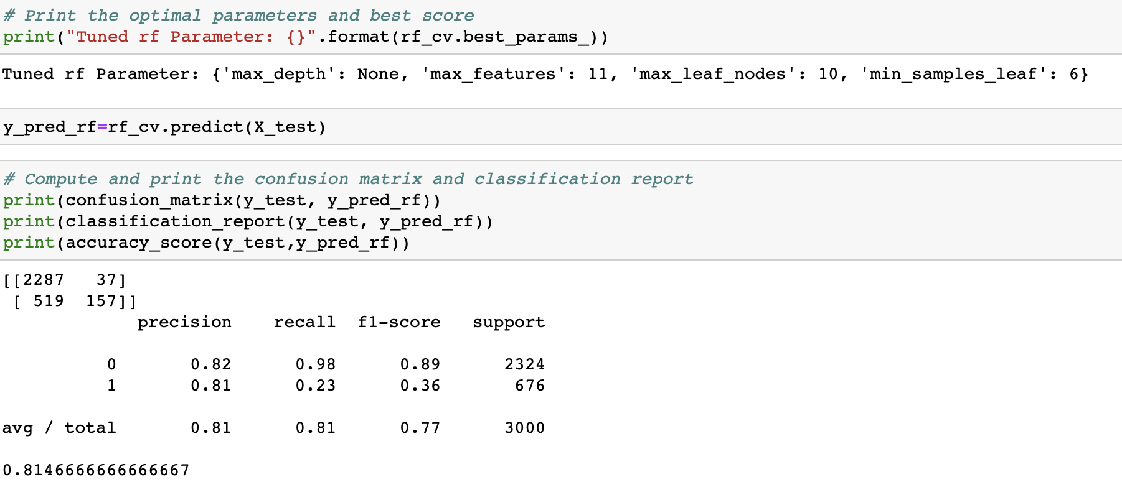
Tuned Random forest

Slide 19
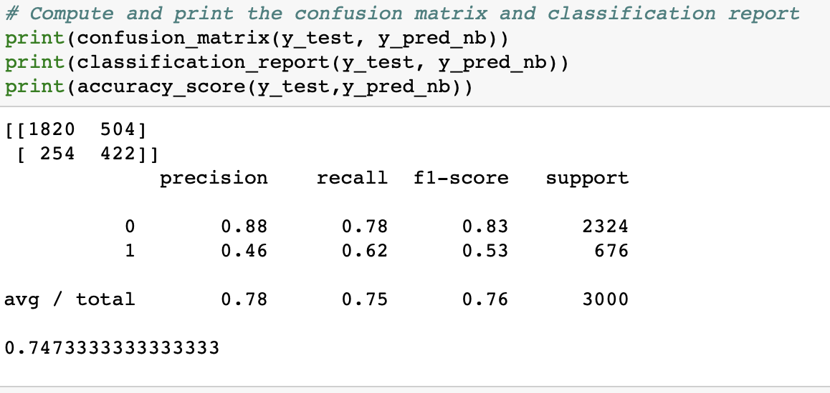
Naïve Bayes:

Slide 20
Comparing Model performance
 | K-Nearest-Neighbor | Logistic Regression | Decision Tree | SVC | Random Forest | Naive Bayes
Precision | 0.57 | 0.72 | 0.64 | 0.73 | 0.81 | 0.46
Recall | 0.14 | 0.49 | 0.53 | 0.44 | 0.23 | 0.62
F1-score | 0.22 | 0.58 | 0.58 | 0.55 | 0.36 | 0.53
Accuracy | 78% | 84% | 82% | 83% | 81% | 74%

Slide 21
Conclusion
Balancing train dataset does not always improve the results.
Larger dataset improves the result, but its computationally expensive
Changing threshold improve the recall but decrease the precision
Selecting assessment criteria depends on business policy
In term of recall Naïve Bayes performs best
Decision Tree and Logistic regression have identical f-1 Score

Slide 22
Thank You

