Slide 1
2
Introduction
to Java Applications
part2

Slide 2
2.5 Another Java Application: Adding Integers
Upcoming program
  Use Scanner to read two integers from user
  Use printf to display sum of the two values
  Use packages

Slide 3
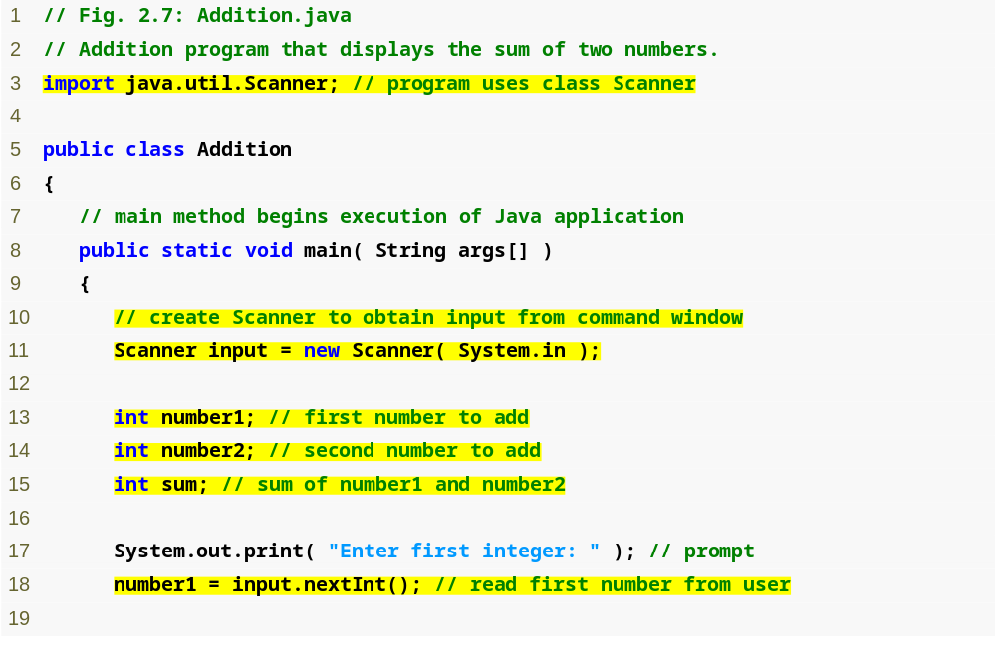
Outline
import declaration imports class Scanner from package java.util.
Addition.java
(1 of 2)
import declaration
Scanner
nextInt
Declare and initialize variable input, which is a Scanner.
Declare variables number1, number2 and sum.
Read an integer from the user and assign it to number1.

Slide 4
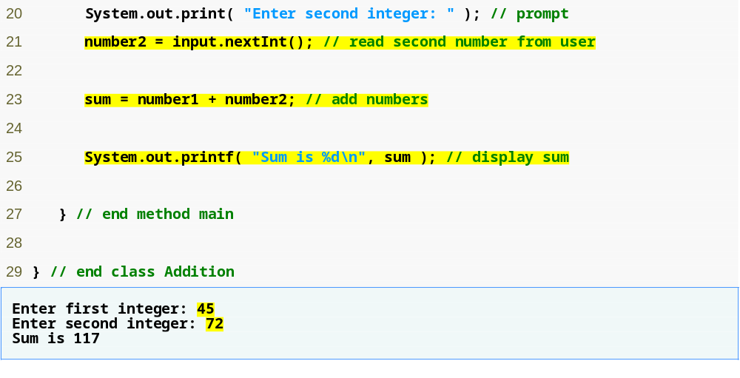
Outline
Read an integer from the user and assign it to number2.
Calculate the sum of the variables number1 and number2, assign result to sum.
Addition.java
(2 of 2)
4. Addition
5. printf
Display the sum using formatted output.
Two integers entered by the user.

Slide 5
2.5 Another Java Application: Adding Integers (Cont.)
  import declarations
    Used by compiler to identify and locate classes used in Java programs
    Tells compiler to load class Scanner from java.util package
  Begins public class Addition
    Recall that file name must be Addition.java
  Lines 8-9: begin main
3 import java.util.Scanner; // program uses class Scanner
5 public class Addition
6 {

Slide 6
2.5 Another Java Application: Adding Integers (Cont.)
  Variable Declaration Statement
  Variables
    Location in memory that stores a value
      Declare with name and type before use
    Input is of type Scanner
      Enables a program to read data for use
    Variable name: any valid identifier
  Declarations end with semicolons ;
  Initialize variable in its declaration
    Equal sign
    Standard input object
      System.in
10 // create Scanner to obtain input from command window
11 Scanner input = new Scanner( System.in );

Slide 7
2.5 Another Java Application: Adding Integers (Cont.)
13 int number1; // first number to add
14 int number2; // second number to add
15 int sum; // sum of number 1 and number 2
  Declare variable number1, number2 and sum of type int
    int holds integer values (whole numbers): i.e., 0, -4, 97
    Types float and double can hold decimal numbers
    Type char can hold a single character: i.e., x, $, \n, 7
    int, float, double and char are primitive types
  Can add comments to describe purpose of variables
  Can declare multiple variables of the same type in one declaration
  Use comma-separated list
int number1, // first number to add
number2, // second number to add
sum; // sum of number1 and number2

Slide 8
2.5 Another Java Application: Adding Integers (Cont.)
  Message called a prompt - directs user to perform an action
  Package java.lang
  Result of call to nextInt given to number1 using assignment operator =
    Assignment statement
    = binary operator - takes two operands
      Expression on right evaluated and assigned to variable on left
    Read as: number1 gets the value of input.nextInt()
17 System.out.print( "Enter first integer: " ); // prompt
18 number1 = input.nextInt(); // read first number from user

Slide 9
2.5 Another Java Application: Adding Integers (Cont.)
20 System.out.print( "Enter second integer: " ); // prompt
  Similar to previous statement
    Prompts the user to input the second integer
  Similar to previous statement
    Assign variable number2 to second integer input
  Assignment statement
    Calculates sum of number1 and number2 (right hand side)
    Uses assignment operator = to assign result to variable sum
    Read as: sum gets the value of number1 + number2
    number1 and number2 are operands
21 number2 = input.nextInt(); // read second number from user
23 sum = number1 + number2; // add numbers

Slide 10
2.5 Another Java Application: Adding Integers (Cont.)
  Use System.out.printf to display results
  Format specifier %d
    Placeholder for an int value
  Calculations can also be performed inside printf
  Parentheses around the expression number1 + number2 are not required
25 System.out.printf( "Sum is %d\n: " , sum ); // display sum
System.out.printf( "Sum is %d\n: " , ( number1 + number2 ) );

Slide 11
2.6 Memory Concepts
Variables
  Every variable has a name, a type, a size and a value
    Name corresponds to location in memory
  When new value is placed into a variable, replaces (and destroys) previous value
  Reading variables from memory does not change them

Slide 12
Fig. 2.8 | Memory location showing the name and value of variable number1.

Slide 13

Fig. 2.9 | Memory locations after storing values for number1 and number2.

Slide 14

Fig. 2.10 | Memory locations after calculating and storing the sum of number1 and number2.

Slide 15
2.7 Arithmetic
Arithmetic calculations used in most programs
  Usage
    * for multiplication
    / for division
    % for remainder
    +, -
  Integer division truncates remainder
    7 / 5 evaluates to 1
  Remainder operator % returns the remainder
    7 % 5 evaluates to 2

Slide 16
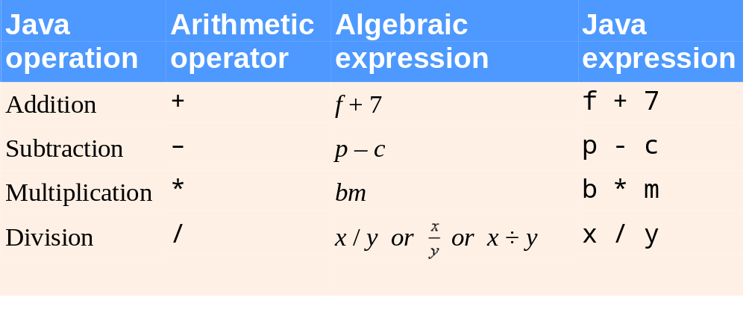
Fig. 2.11 | Arithmetic operators.

Slide 17
2.7 Arithmetic (Cont.)
Operator precedence
  Some arithmetic operators act before others (i.e., multiplication before addition)
    Use parenthesis when needed
  Example: Find the average of three variables a, b and c
    Do not use: a + b + c / 3
    Use: ( a + b + c ) / 3

Slide 18
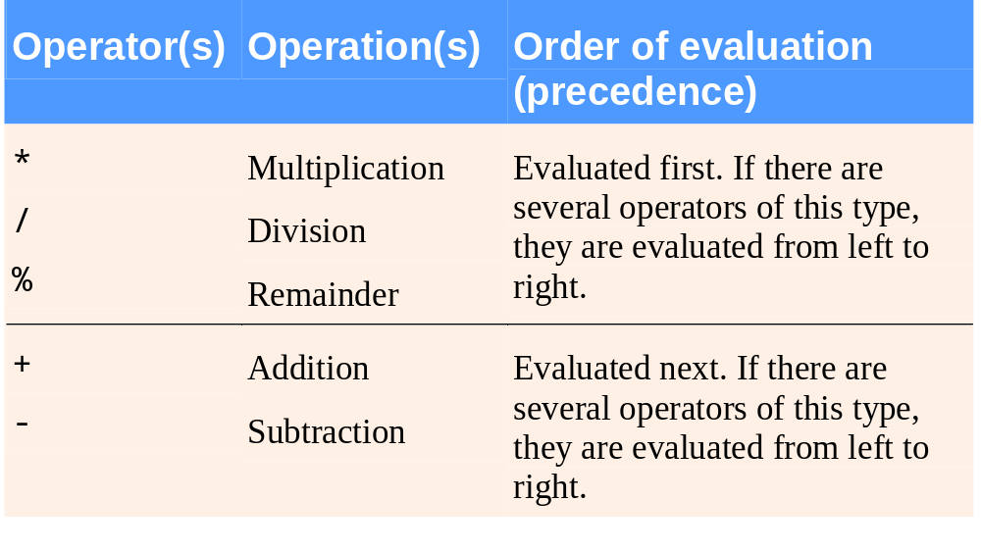
Fig. 2.12 | Precedence of arithmetic operators.

Slide 19
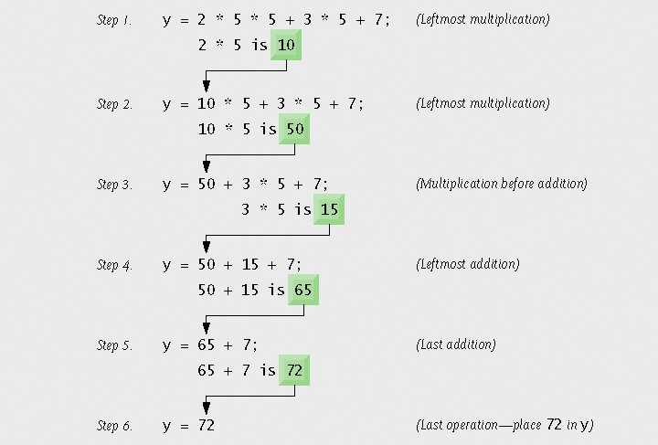
Fig. 2.13 | Order in which a second-degree polynomial is evaluated.

Slide 20
2.8 Decision Making: Equality and Relational Operators
Condition
  Expression can be either true or false
if statement
  Simple version in this section, more detail later
  If a condition is true, then the body of the if statement executed
  Control always resumes after the if statement
  Conditions in if statements can be formed using equality or relational operators (next slide)

Slide 21
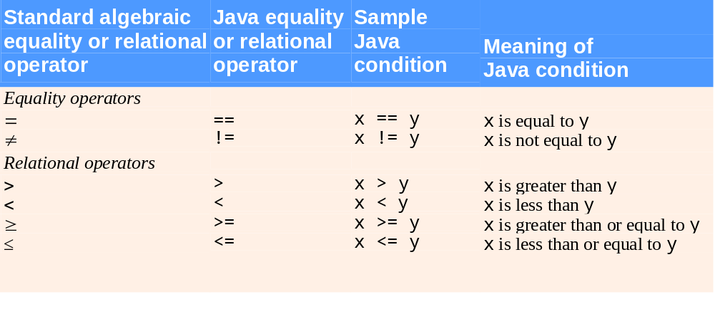
Fig. 2.14 | Equality and relational operators.

Slide 22
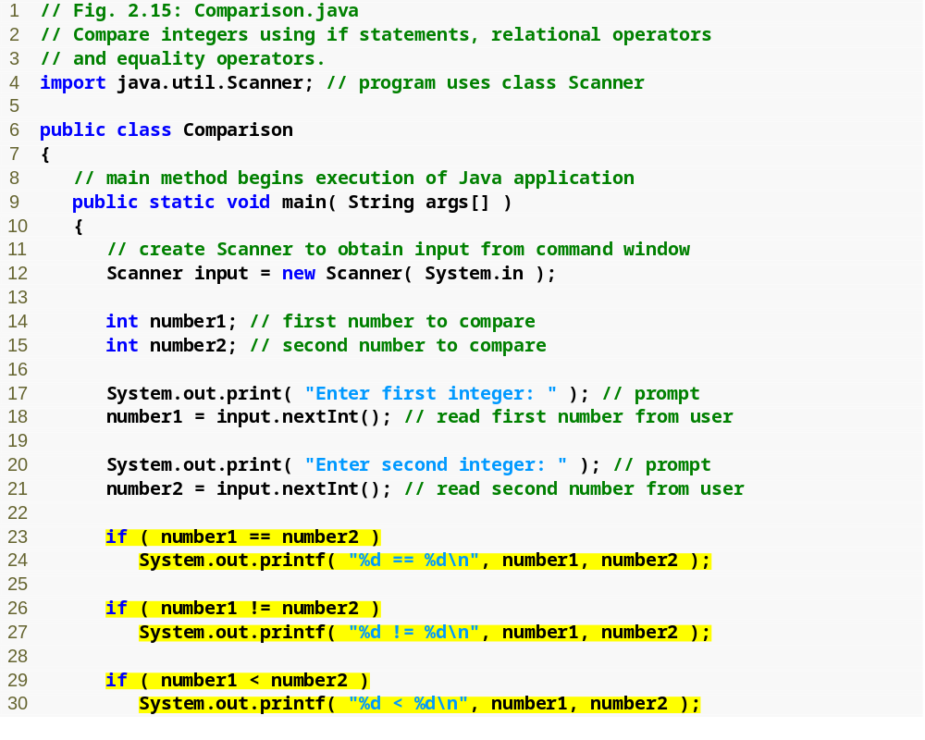
Outline
Comparison.java
(1 of 2)
1. Class Comparison
1.1 main
1.2 Declarations
1.3 Input data (nextInt)
1.4 Compare two inputs using if statements
Test for equality, display result using printf.
Compares two numbers using relational operator <.

Slide 23
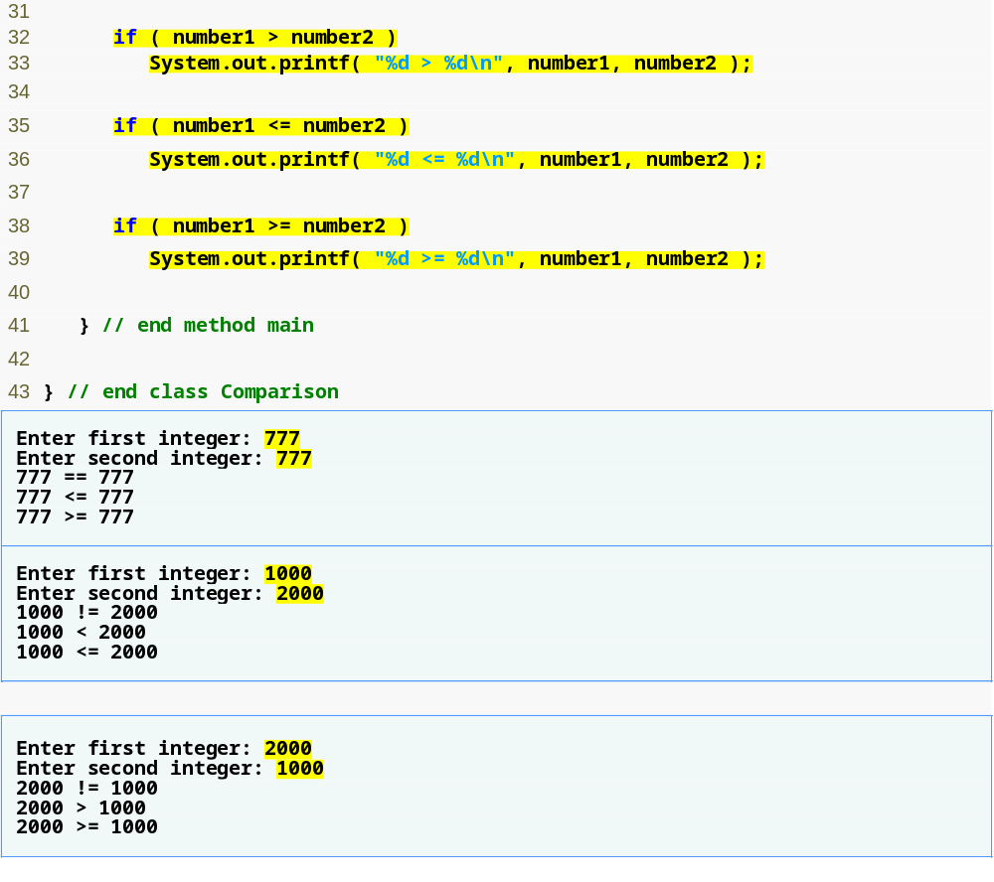
Outline
Compares two numbers using relational operators >, <= and >=.
Comparison.java
(2 of 2)
Program output

Slide 24
2.8 Decision Making: Equality and Relational Operators (Cont.)
  Line 6: begins class Comparison declaration
  Line 12: declares Scanner variable input and assigns it a Scanner that inputs data from the standard input
  Lines 14-15: declare int variables
  Lines 17-18: prompt the user to enter the first integer and input the value
  Lines 20-21: prompt the user to enter the second integer and input the value

Slide 25
2.8 Decision Making: Equality and Relational Operators (Cont.)
23 if ( number1 == number2 )
24 System.out.printf( "%d == %d\n", number1, number2 );
  if statement to test for equality using (==)
    If variables equal (condition true)
      Line 24 executes
    If variables not equal, statement skipped
    No semicolon at the end of line 23
    Empty statement
      No task is performed
  Lines 26-27, 29-30, 32-33, 35-36 and 38-39
    Compare number1 and number2 with the operators !=, <, >, <= and >=, respectively

