Slide 1
4
Control Statements: Part 1

Slide 2
Let’s all move one place on.
  Lewis Carroll
The wheel is come full circle.
  William Shakespeare
How many apples fell on Newton’s head before he took the hint!
  Robert Frost
All the evolution we know of proceeds from the vague to the definite.
  Charles Sanders Peirce

Slide 3
OBJECTIVES
In this chapter you will learn:
To use basic problem-solving techniques.
To develop algorithms through the process of top-down, stepwise refinement.
To use the if and if…else selection statements to choose among alternative actions.
To use the while repetition statement to execute statements in a program repeatedly.
To use counter-controlled repetition and sentinel-controlled repetition.
To use the assignment, increment and decrement operators.
The primitive data types.

Slide 4
4.1 Introduction
4.2 Algorithms
4.3 Pseudocode
4.4 Control Structures
4.5 if Single-Selection Statement
4.6 if…else Double-Selection Statement
4.7 while Repetition Statement
4.8 Formulating Algorithms: Counter-Controlled Repetition
4.9 Formulating Algorithms: Sentinel-Controlled Repetition
4.10 Formulating Algorithms: Nested Control Statements
4.11 Compound Assignment Operators
4.12 Increment and Decrement Operators
4.13 Primitive Types
4.14 (Optional) GUI and Graphics Case Study: Creating Simple Drawings
4.15 (Optional) Software Engineering Case Study: Identifying Class Attributes
4.16 Wrap-Up

Slide 5
4.2 Algorithms
Algorithms
  The actions to execute
  The order in which these actions execute
Program control
  Specifies the order in which actions execute in a program

Slide 6
4.3 Pseudocode
Pseudocode
  An informal language similar to English
  Helps programmers develop algorithms
  Does not run on computers
  Should contain input, output and calculation actions
  Should not contain variable declarations

Slide 7
4.4 Control Structures
Sequential execution
  Statements are normally executed one after the other in the order in which they are written
Transfer of control
  Specifying the next statement to execute that is not necessarily the next one in order
  Can be performed by the goto statement
    Structured programming eliminated goto statements

Slide 8
4.4 Control Structures (Cont.)
Bohm and Jacopini’s research
  Demonstrated that goto statements were unnecessary
  Demonstrated that all programs could be written with three control structures
    The sequence structure,
    The selection structure and
    The repetition structure

Slide 9
4.4 Control Structures (Cont.)
UML activity diagram (www.uml.org)
  Models the workflow (or activity) of a part of a software system
  Action-state symbols (rectangles with their sides replaced with outward-curving arcs)
    represent action expressions specifying actions to perform
  Diamonds
    Decision symbols (explained in Section 4.5)
    Merge symbols (explained in Section 4.7)

Slide 10
4.4 Control Structures (Cont.)
  Small circles
    Solid circle represents the activity’s initial state
    Solid circle surrounded by a hollow circle represents the activity’s final state
  Transition arrows
    Indicate the order in which actions are performed
  Notes (rectangles with the upper-right corners folded over)
    Explain the purposes of symbols (like comments in Java)
    Are connected to the symbols they describe by dotted lines

Slide 11
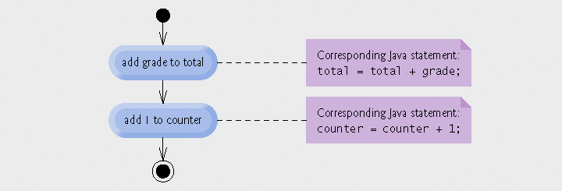
Fig. 4.1 | Sequence structure activity diagram.

Slide 12
4.4 Control Structures (Cont.)
Selection Statements
  if statement
    Single-selection statement
  if…else statement
    Double-selection statement
  switch statement
    Multiple-selection statement

Slide 13
4.4 Control Structures (Cont.)
Repetition statements
  Also known as looping statements
  Repeatedly performs an action while its loop-continuation condition remains true
  while statement
    Performs the actions in its body zero or more times
  do…while statement
    Performs the actions in its body one or more times
  for statement
    Performs the actions in its body zero or more times

Slide 14
4.4 Control Structures (Cont.)
Java has three kinds of control structures
  Sequence statement,
  Selection statements (three types) and
  Repetition statements (three types)
  All programs are composed of these control statements
    Control-statement stacking
      All control statements are single-entry/single-exit
    Control-statement nesting

Slide 15
4.5 if Single-Selection Statement
if statements
  Execute an action if the specified condition is true
  Can be represented by a decision symbol (diamond) in a UML activity diagram
    Transition arrows out of a decision symbol have guard conditions
      Workflow follows the transition arrow whose guard condition is true

Slide 16
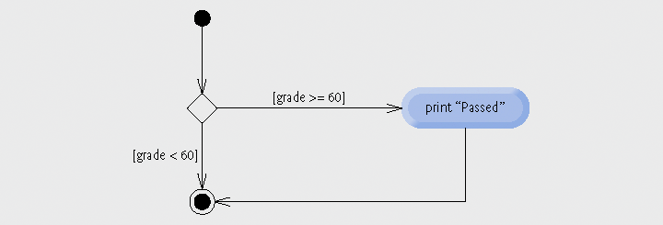
Fig. 4.2 | if single-selection statement UML activity diagram.

Slide 17
4.6 if…else Double-Selection Statement
if…else statement
  Executes one action if the specified condition is true or a different action if the specified condition is false
Conditional Operator ( ? : )
  Java’s only ternary operator (takes three operands)
  ? : and its three operands form a conditional expression
    Entire conditional expression evaluates to the second operand if the first operand is true
    Entire conditional expression evaluates to the third operand if the first operand is false

Slide 18
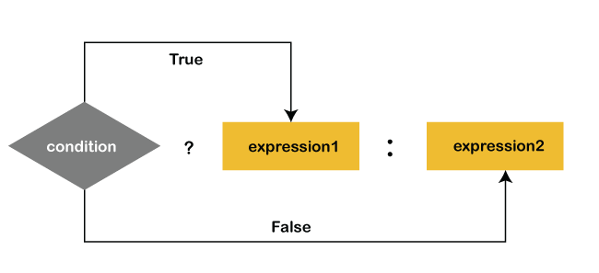
Conditional Operator

Slide 19
Good Programming Practice 4.2
If there are several levels of indentation, each level should be indented the same additional amount of space.

Slide 20
Good Programming Practice 4.3
Conditional expressions are more difficult to read than if…else statements and should be used to replace only simple if…else statements that choose between two values.

Slide 21
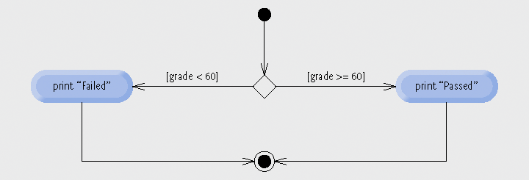
Fig. 4.3 | if…else double-selection statement UML activity diagram.

Slide 22
4.6 if…else Double-Selection Statement (Cont.)
Nested if…else statements
  if…else statements can be put inside other if…else statements
Dangling-else problem
  elses are always associated with the immediately preceding if unless otherwise specified by braces { }
Blocks
  Braces { } associate statements into blocks
  Blocks can replace individual statements as an if body

Slide 23
4.6 if…else Double-Selection Statement (Cont.)
Logic errors
  Fatal logic errors cause a program to fail and terminate prematurely
  Nonfatal logic errors cause a program to produce incorrect results
Empty statements
  Represented by placing a semicolon ( ; ) where a statement would normally be
  Can be used as an if body

Slide 24
Common Programming Error 4.1
Forgetting one or both of the braces that delimit a block can lead to syntax errors or logic errors in a program.

Slide 25
Good Programming Practice 4.4
Always using braces in an if...else (or other) statement helps prevent their accidental omission, especially when adding statements to the if-part or the else-part at a later time. To avoid omitting one or both of the braces, some programmers type the beginning and ending braces of blocks before typing the individual statements within the braces.

Slide 26
Common Programming Error 4.2
Placing a semicolon after the condition in an if or if...else statement leads to a logic error in single-selection if statements and a syntax error in double-selection if...else statements (when the if-part contains an actual body statement).

Slide 27
4.7 while Repetition Statement
while statement
  Repeats an action while its loop-continuation condition remains true
  Uses a merge symbol in its UML activity diagram
    Merges two or more workflows
    Represented by a diamond (like decision symbols) but has:
      Multiple incoming transition arrows,
      Only one outgoing transition arrow and
      No guard conditions on any transition arrows

Slide 28
Common Programming Error 4.3
Not providing, in the body of a while statement, an action that eventually causes the condition in the while to become false normally results in a logic error called an infinite loop, in which the loop never terminates.

Slide 29
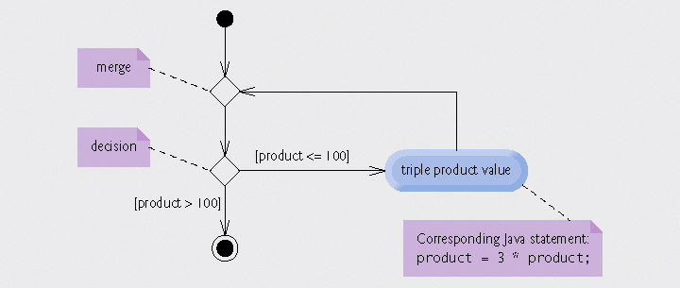
Fig. 4.4 | while repetition statement UML activity diagram.

Slide 30
4.8 Formulating Algorithms: Counter-Controlled Repetition
Counter-controlled repetition
  Use a counter variable to count the number of times a loop is iterated
Integer division
  The fractional part of an integer division calculation is truncated (thrown away)

Slide 31
Fig. 4.5 | Pseudocode algorithm that uses counter-controlled repetition to solve the class-average problem.
1 Set total to zero
2 Set grade counter to one
3
4 While grade counter is less than or equal to ten
5 Prompt the user to enter the next grade
6 Input the next grade
7 Add the grade into the total
8 Add one to the grade counter
9
10 Set the class average to the total divided by ten
11 Print the class average

Slide 32
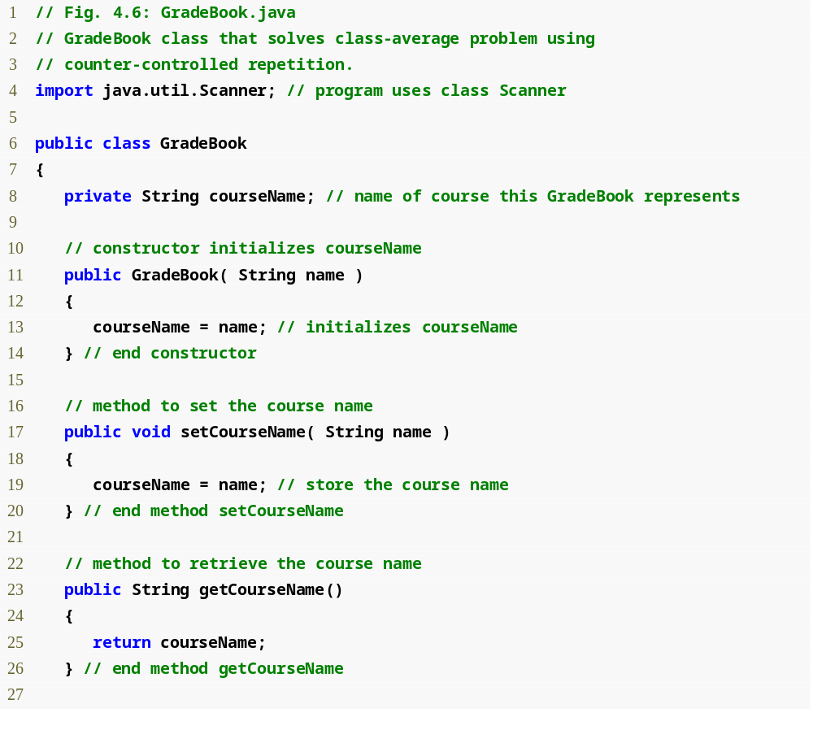
Outline
GradeBook.java (1 of 3)
Assign a value to instance variable courseName
Declare method setCourseName
Declare method getCourseName

Slide 33
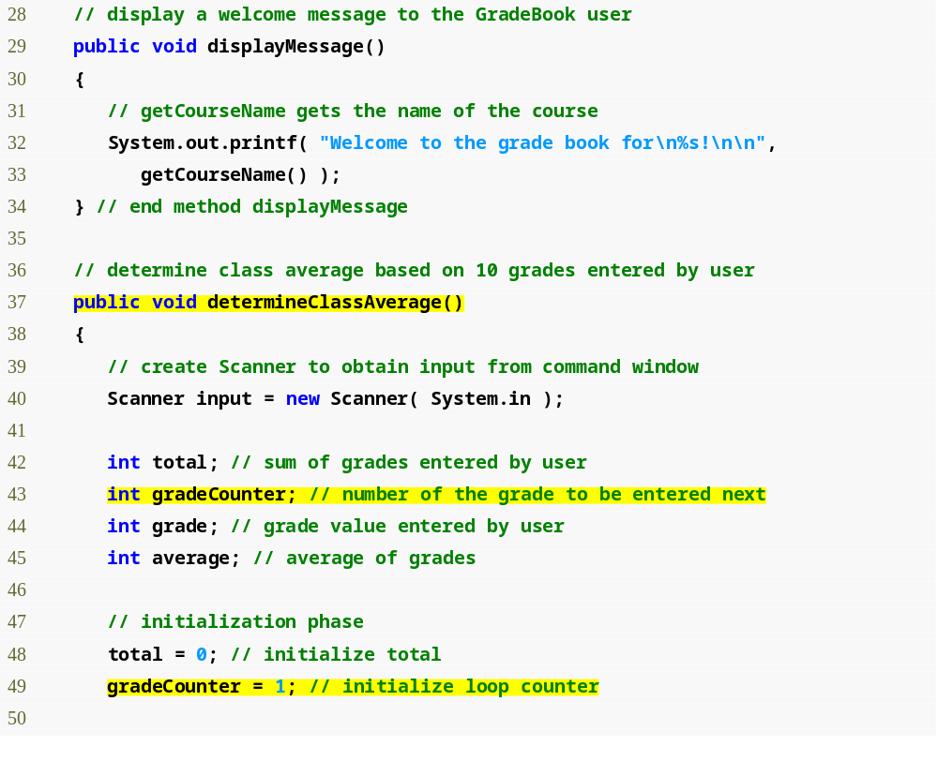
Outline
Declare method displayMessage
GradeBook.java (2 of 3)
Declare method determineClassAverage
Declare and initialize Scanner variable input
Declare local int variables total, gradeCounter, grade and average

Slide 34
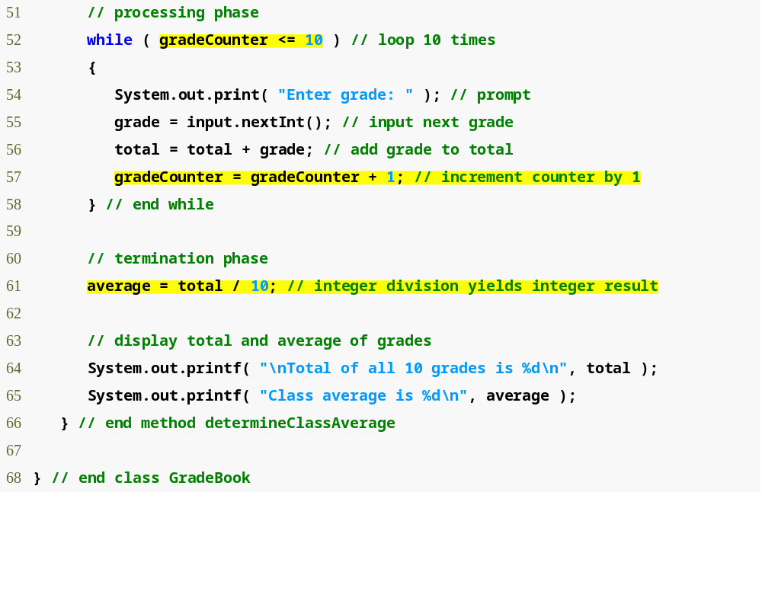
Outline
while loop iterates as long as gradeCounter <= 10
GradeBook.java (3 of 3)
Increment the counter variable gradeCounter
Calculate average grade
Display results

Slide 35
Good Programming Practice 4.5
Separate declarations from other statements in methods with a blank line for readability.

Slide 36
Software Engineering Observation 4.1
Experience has shown that the most difficult part of solving a problem on a computer is developing the algorithm for the solution. Once a correct algorithm has been specified, the process of producing a working Java program from the algorithm is normally straightforward.

Slide 37
Common Programming Error 4.4
Using the value of a local variable before it is initialized results in a compilation error. All local variables must be initialized before their values are used in expressions.

Slide 38
Error-Prevention Tip 4.1
Initialize each counter and total, either in its declaration or in an assignment statement. Totals are normally initialized to 0. Counters are normally initialized to 0 or 1, depending on how they are used (we will show examples of when to use 0 and when to use 1).

Slide 39
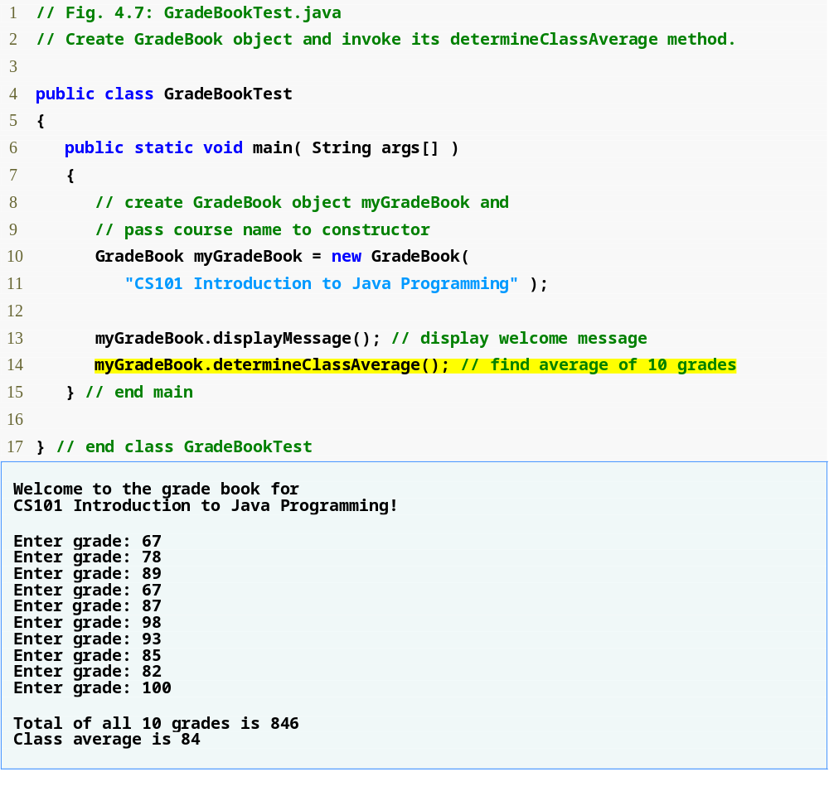
Outline
Create a new GradeBook object
GradeBookTest.java
Pass the course’s name to the GradeBook constructor as a string
Call GradeBook’s determineClassAverage method

Slide 40
Common Programming Error 4.5
Assuming that integer division rounds (rather than truncates) can lead to incorrect results. For example, 7 ÷ 4, which yields 1.75 in conventional arithmetic, truncates to 1 in integer arithmetic, rather than rounding to 2.

Slide 41
4.9 Formulating Algorithms: Sentinel-Controlled Repetition
Sentinel-controlled repetition
  Also known as indefinite repetition
  Use a sentinel value (also known as a signal, dummy or flag value)
    A sentinel value cannot also be a valid input value

Slide 42
4.9 Formulating Algorithms: Sentinel-Controlled Repetition (Cont.)
Top-down, stepwise refinement
  Top: a single statement that conveys the overall function of the program
  First refinement: multiple statements using only the sequence structure
  Second refinement: commit to specific variables, use specific control structures

Slide 43
Common Programming Error 4.6
Choosing a sentinel value that is also a legitimate data value is a logic error.

Slide 44
Software Engineering Observation 4.2
Each refinement, as well as the top itself, is a complete specification of the algorithm—only the level of detail varies.

Slide 45
Software Engineering Observation 4.3
Many programs can be divided logically into three phases: an initialization phase that initializes the variables; a processing phase that inputs data values and adjusts program variables (e.g., counters and totals) accordingly; and a termination phase that calculates and outputs the final results.

Slide 46
Error-Prevention Tip 4.2
When performing division by an expression whose value could be zero, explicitly test for this possibility and handle it appropriately in your program (e.g., by printing an error message) rather than allow the error to occur

Slide 47
Fig. 4.8 | Class-average problem pseudocode algorithm with sentinel-controlled repetition.
1 Initialize total to zero
2 Initialize counter to zero
3
4 Prompt the user to enter the first grade
5 Input the first grade (possibly the sentinel)
6
7 While the user has not yet entered the sentinel
8 Add this grade into the running total
9 Add one to the grade counter
10 Prompt the user to enter the next grade
11 Input the next grade (possibly the sentinel)
12
13 If the counter is not equal to zero
14 Set the average to the total divided by the counter
15 Print the average
16 else
17 Print “No grades were entered”

Slide 48
Software Engineering Observation 4.4
Terminate the top-down, stepwise refinement process when you have specified the pseudocode algorithm in sufficient detail for you to convert the pseudocode to Java. Normally, implementing the Java program is then straightforward.

Slide 49
Software Engineering Observation 4.5
Some experienced programmers write programs without ever using program-development tools like pseudocode. They feel that their ultimate goal is to solve the problem on a computer and that writing pseudocode merely delays the production of final outputs. Although this method may work for simple and familiar problems, it can lead to serious errors and delays in large, complex projects.

Slide 50
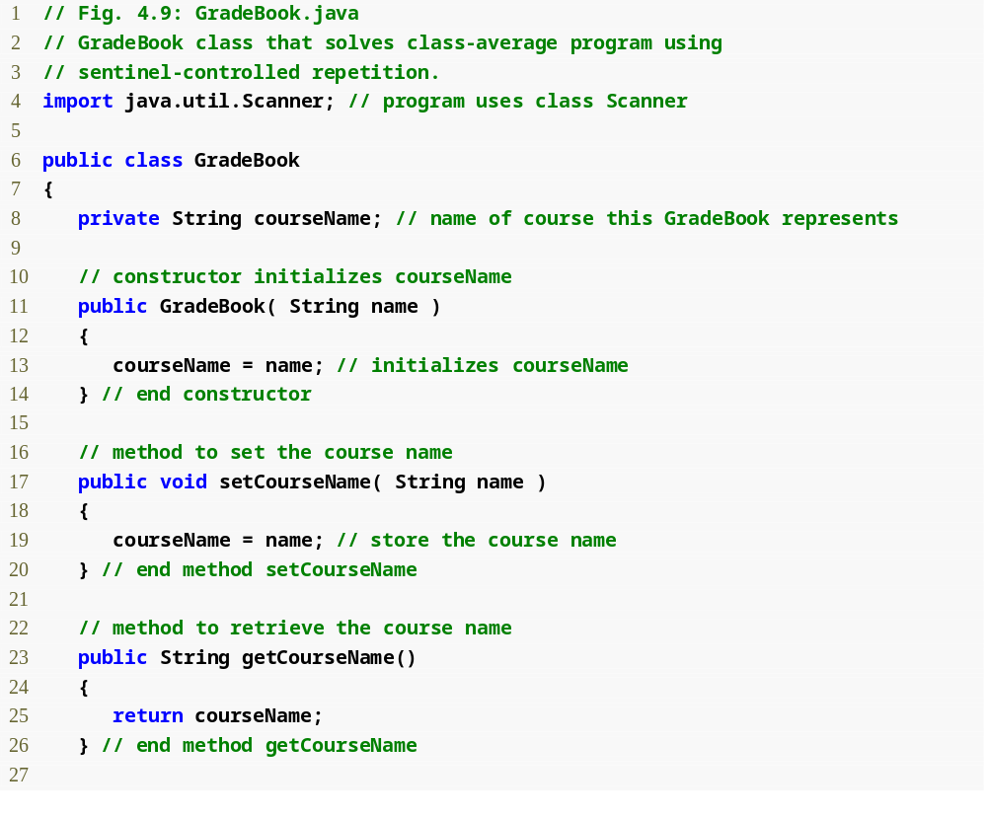
Outline
GradeBook.java (1 of 3)
Assign a value to instance variable courseName
Declare method setCourseName
Declare method getCourseName

Slide 51
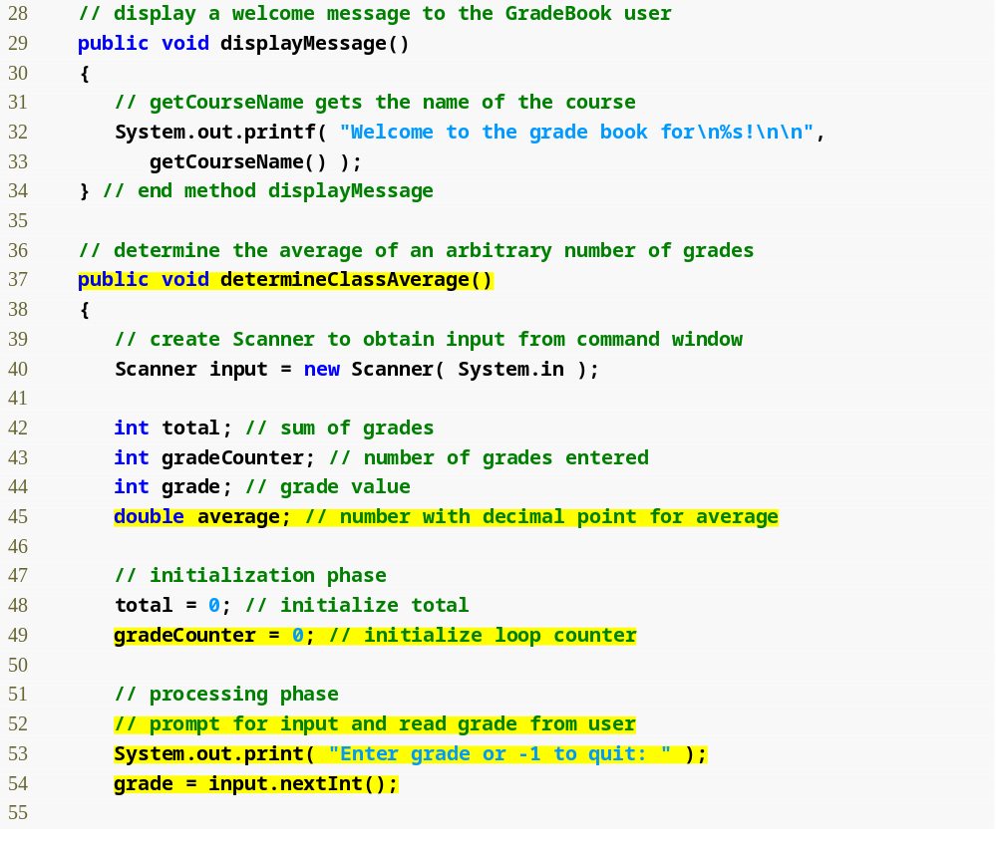
Outline
Declare method displayMessage
GradeBook.java (2 of 3)
Declare method determineClassAverage
Declare and initialize Scanner variable input
Declare local int variables total, gradeCounter and grade and double variable average

Slide 52
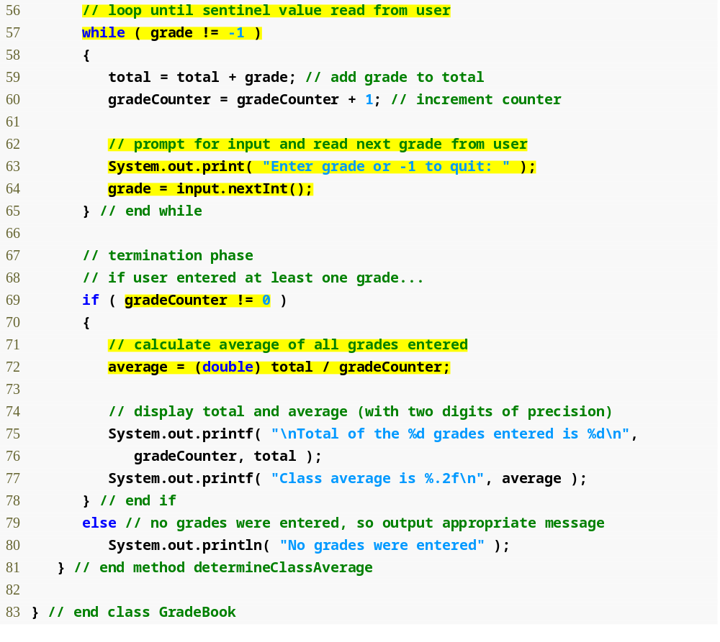
Outline
while loop iterates as long as grade != the sentinel value, -1
GradeBook.java (3 of 3)
Calculate average grade using (double) to perform explicit conversion
Display average grade
Display “No grades were entered” message

Slide 53
Good Programming Practice 4.6
In a sentinel-controlled loop, the prompts requesting data entry should explicitly remind the user of the sentinel value.

Slide 54
Common Programming Error 4.7
Omitting the braces that delimit a block can lead to logic errors, such as infinite loops. To prevent this problem, some programmers enclose the body of every control statement in braces even if the body contains only a single statement.

Slide 55
4.9 Formulating Algorithms: Sentinel-Controlled Repetition (Cont.)
Unary cast operator
  Creates a temporary copy of its operand with a different data type
    example: (double) will create a temporary floating-point copy of its operand
  Explicit conversion
Promotion
  Converting a value (e.g. int) to another data type (e.g. double) to perform a calculation
  Implicit conversion

Slide 56
Common Programming Error 4.8
The cast operator can be used to convert between primitive numeric types, such as int and double, and between related reference types (as we discuss in Chapter 10, Object-Oriented Programming: Polymorphism). Casting to the wrong type may cause compilation errors or runtime errors.

Slide 57
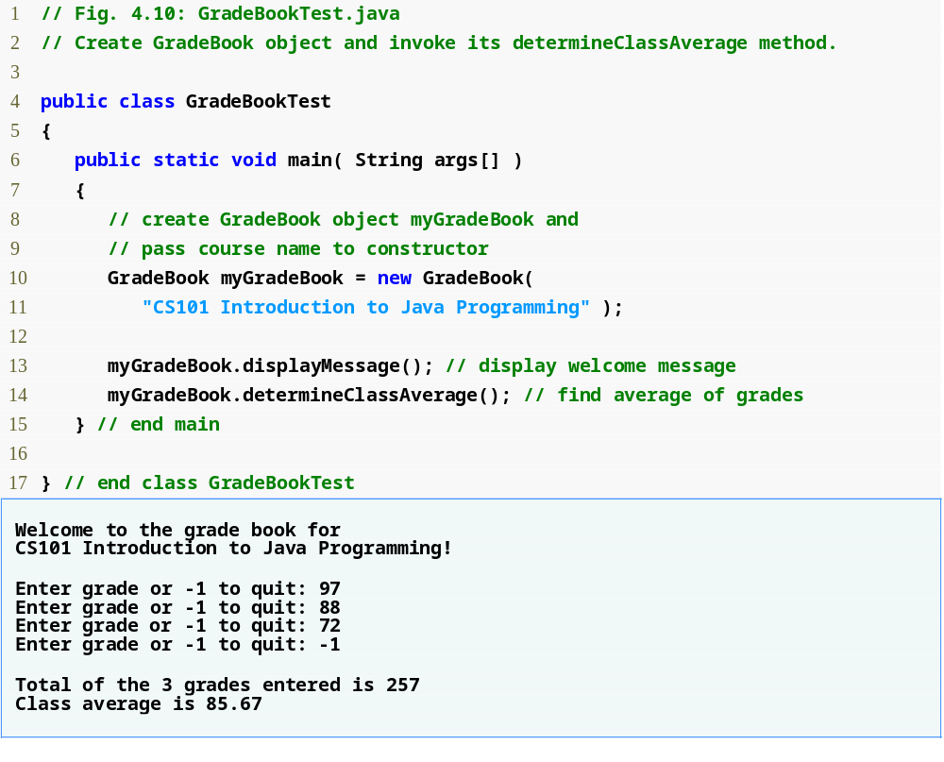
Outline
Create a new GradeBook object
GradeBookTest.java
Pass the course’s name to the GradeBook constructor as a string
Call GradeBook’s determineClassAverage method

Slide 58
4.10 Formulating Algorithms: Nested Control Statements
Control statements can be nested within one another
  Place one control statement inside the body of the other

Slide 59
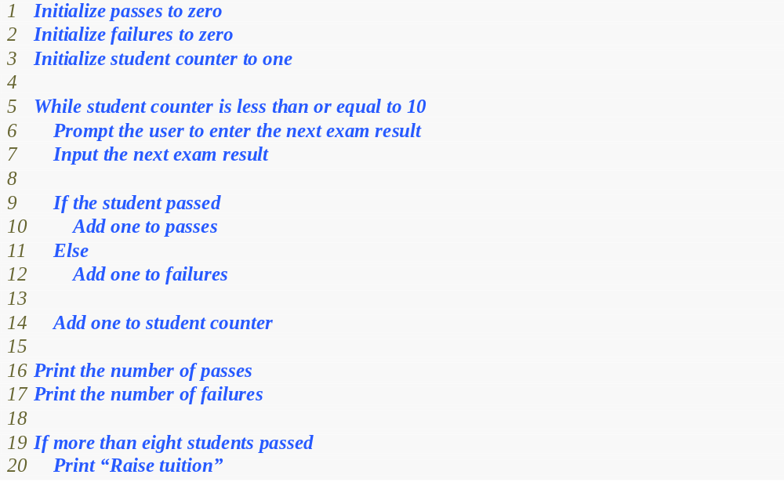
Fig. 4.11 | Pseudocode for examination-results problem.

Slide 60
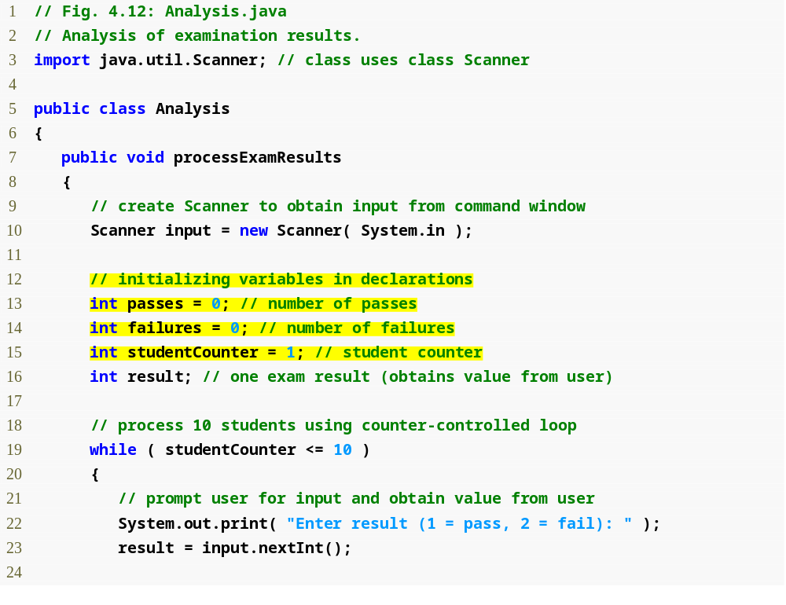
Outline
Declare processExamResults’ local variables
Analysis.java (1 of 2)
while loop iterates as long as studentCounter <= 10

Slide 61
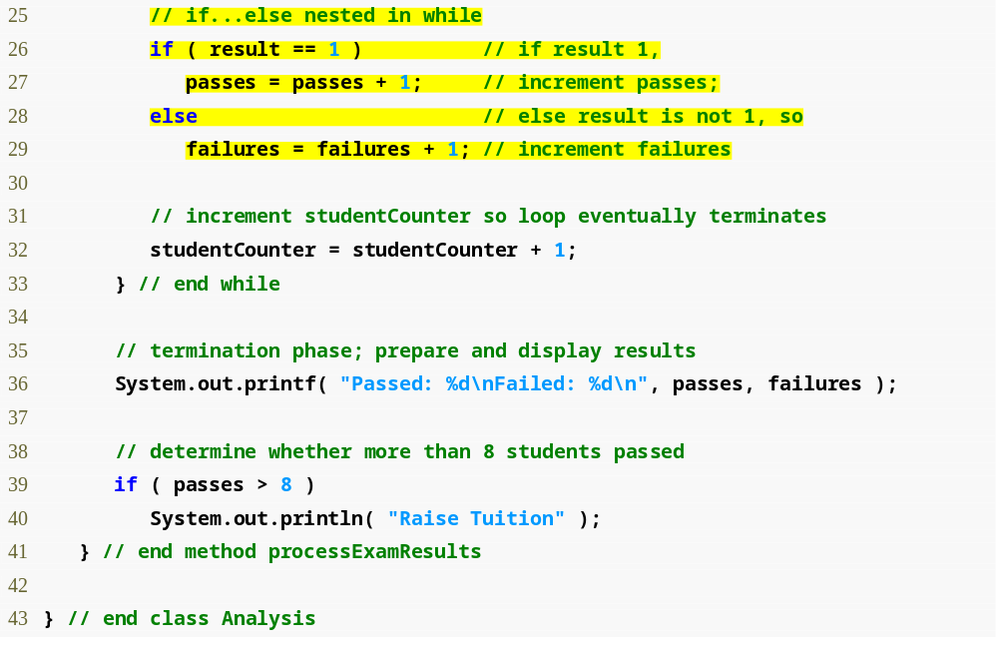
Outline
Determine whether this student passed or failed and increment the appropriate variable
Analysis.java (2 of 2)
Determine whether more than eight students passed the exam

Slide 62
Error-Prevention Tip 4.3
Initializing local variables when they are declared helps the programmer avoid any compilation errors that might arise from attempts to use uninitialized data. While Java does not require that local variable initializations be incorporated into declarations, it does require that local variables be initialized before their values are used in an expression.

Slide 63
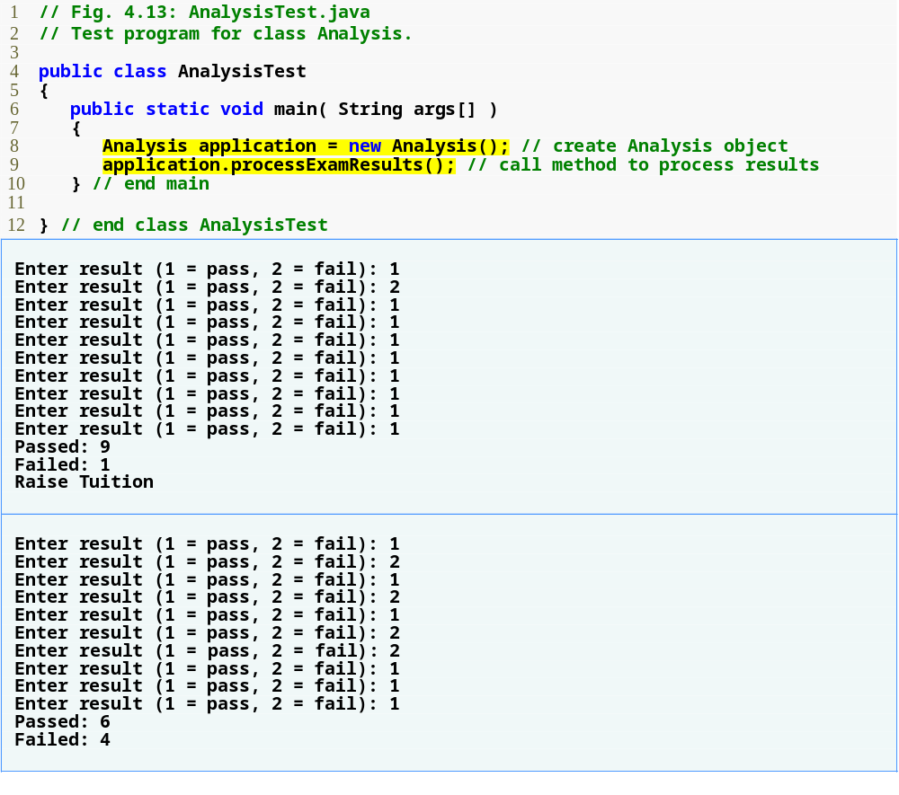
Outline
Create an Analysis object
AnalysisTest.java
More than 8 students passed the exam

Slide 64
4.11 Compound Assignment Operators
Compound assignment operators
  An assignment statement of the form:
  variable = variable operator expression;
  where operator is +, -, *, / or % can be written as:
  variable operator= expression;
  example: c = c + 3; can be written as c += 3;
    This statement adds 3 to the value in variable c and stores the result in variable c

Slide 65
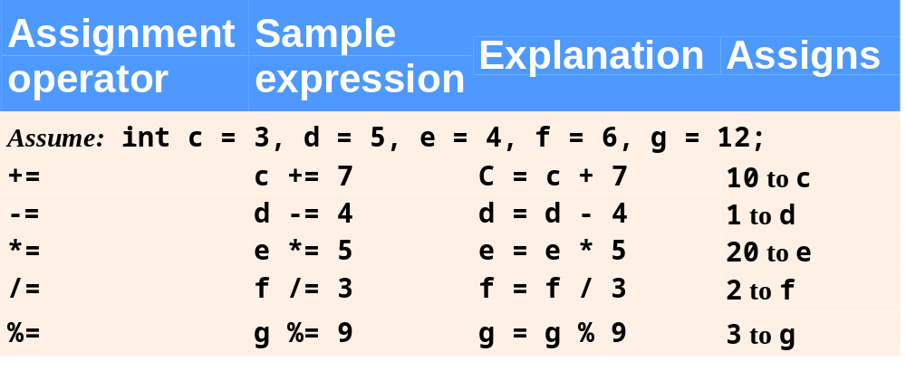
Fig. 4.14 | Arithmetic compound assignment operators.

Slide 66
4.12 Increment and Decrement Operators
Unary increment and decrement operators
  Unary increment operator (++) adds one to its operand
  Unary decrement operator (--) subtracts one from its operand
  Prefix increment (and decrement) operator
    Changes the value of its operand, then uses the new value of the operand in the expression in which the operation appears
  Postfix increment (and decrement) operator
    Uses the current value of its operand in the expression in which the operation appears, then changes the value of the operand

Slide 67
Good Programming Practice 4.7
Unlike binary operators, the unary increment and decrement operators should be placed next to their operands, with no intervening spaces.

Slide 68
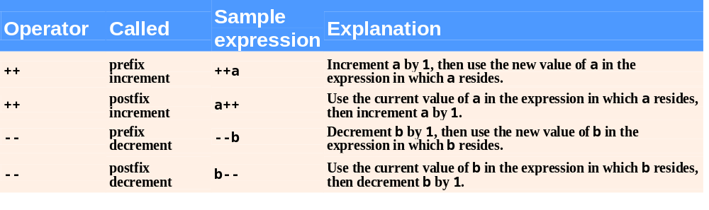
Fig. 4.15 | Increment and decrement operators.

Slide 69
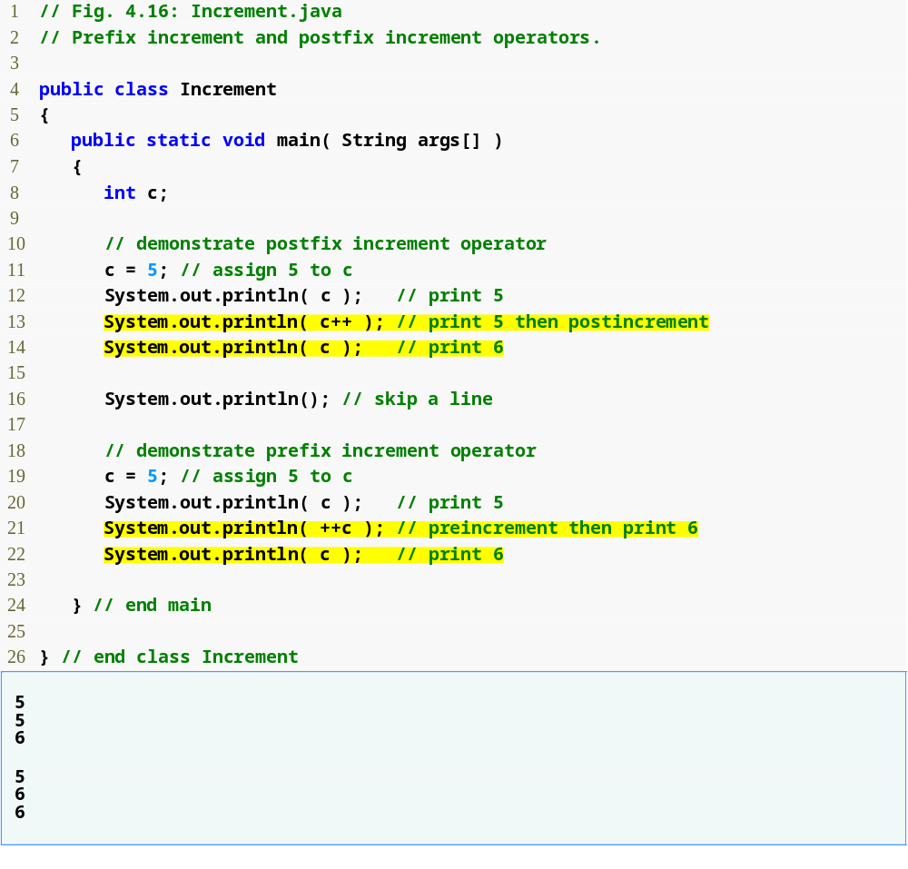
Outline
Increment.java
Postincrementing the c variable
Preincrementing the c variable

Slide 70
Common Programming Error 4.9
Attempting to use the increment or decrement operator on an expression other than one to which a value can be assigned is a syntax error. For example, writing ++(x + 1) is a syntax error because (x + 1) is not a variable.

Slide 71
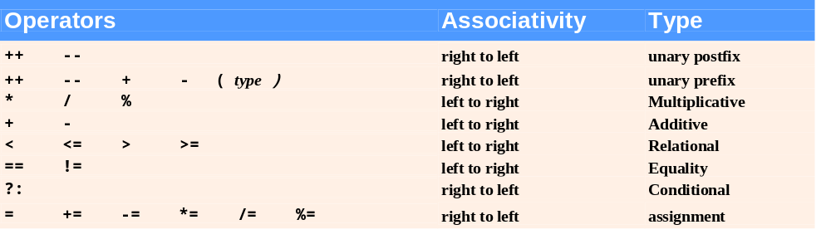
Fig. 4.17 | Precedence and associativity of the operators discussed so far.

Slide 72
4.13 Primitive Types
Java is a strongly typed language
  All variables have a type
Primitive types in Java are portable across all platforms that support Java

Slide 73
Portability Tip 4.1
Unlike C and C++, the primitive types in Java are portable across all computer platforms that support Java. Thanks to this and Java's many other portability features, a programmer can write a program once and be certain that it will execute on any computer platform that supports Java. This capability is sometimes referred to as WORA (Write Once, Run Anywhere).

Slide 74
4.14 (Optional) GUI and Graphics Case Study: Creating Simple Drawings
Java’s coordinate system
  Defined by x-coordinates and y-coordinates
    Also known as horizontal and vertical coordinates
    Are measured along the x-axis and y-axis
  Coordinate units are measured in pixels
Graphics class from the java.awt package
  Provides methods for drawing text and shapes
JPanel class from the javax.swing package
  Provides an area on which to draw

Slide 75
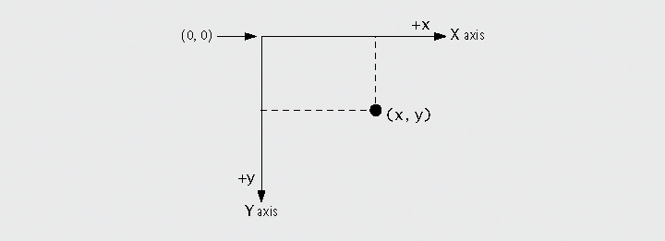
Fig. 4.18 | Java coordinate system. Units are measured in pixels.

Slide 76
4.14 (Optional) GUI and Graphics Case Study: Creating Simple Drawings (Cont.)
Inheriting
  extends keyword
  The subclass inherits from the superclass
    The subclass has the data and methods that the superclass has as well as any it defines for itself

Slide 77
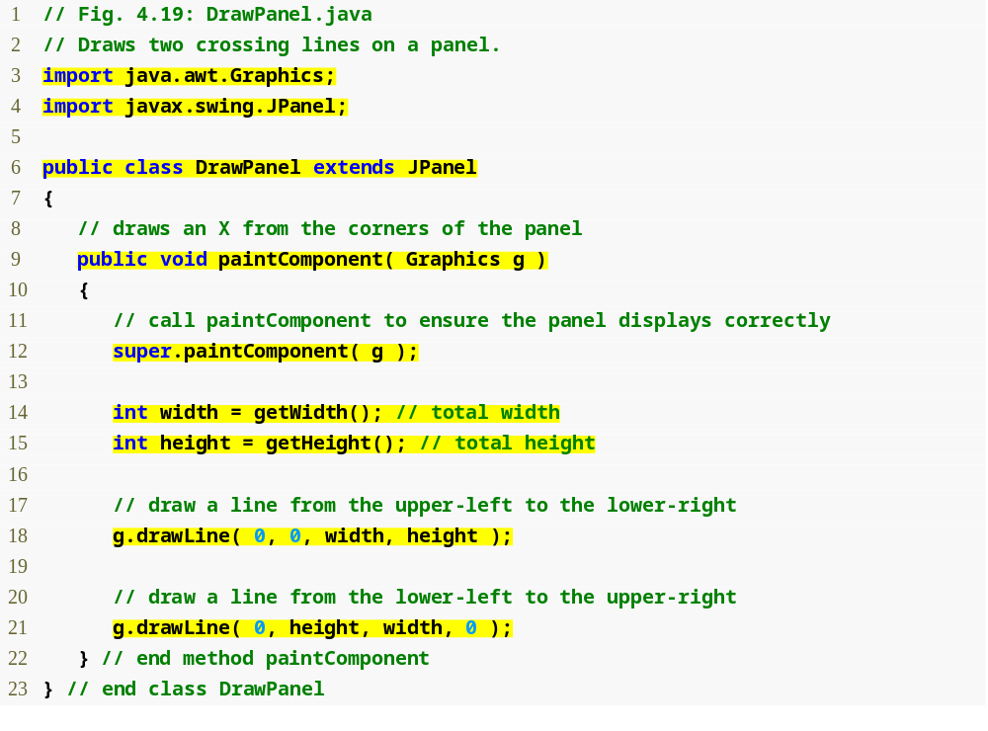
Outline
Import the java.awt.Graphics and the javax.swing.JPanel classes
The DrawPanel class extends the JPanel class
DrawPanel.java
Declare the paintComponent method
Retrieve the JPanel’s width and height
Draw the two lines

Slide 78
4.14 (Optional) GUI and Graphics Case Study: Creating Simple Drawings (Cont.)
The JPanel class
  Every JPanel has a paintComponent method
    paintComponent is called whenever the system needs to display the JPanel
  getWidth and getHeight methods
    Return the width and height of the JPanel, respectively
  drawLine method
    Draws a line from the coordinates defined by its first two arguments to the coordinates defined by its second two arguments

Slide 79
4.14 (Optional) GUI and Graphics Case Study: Creating Simple Drawings (Cont.)
JFrame class from the javax.swing package
  Allows the programmer to create a window
  setDefaultCloseOperation method
    Pass JFrame.EXIT_ON_CLOSE as its argument to set the application to terminate when the user closes the window
  add method
    Attaches a JPanel to the JFrame
  setSize method
    Sets the width (first argument) and height (second argument) of the JFrame

Slide 80
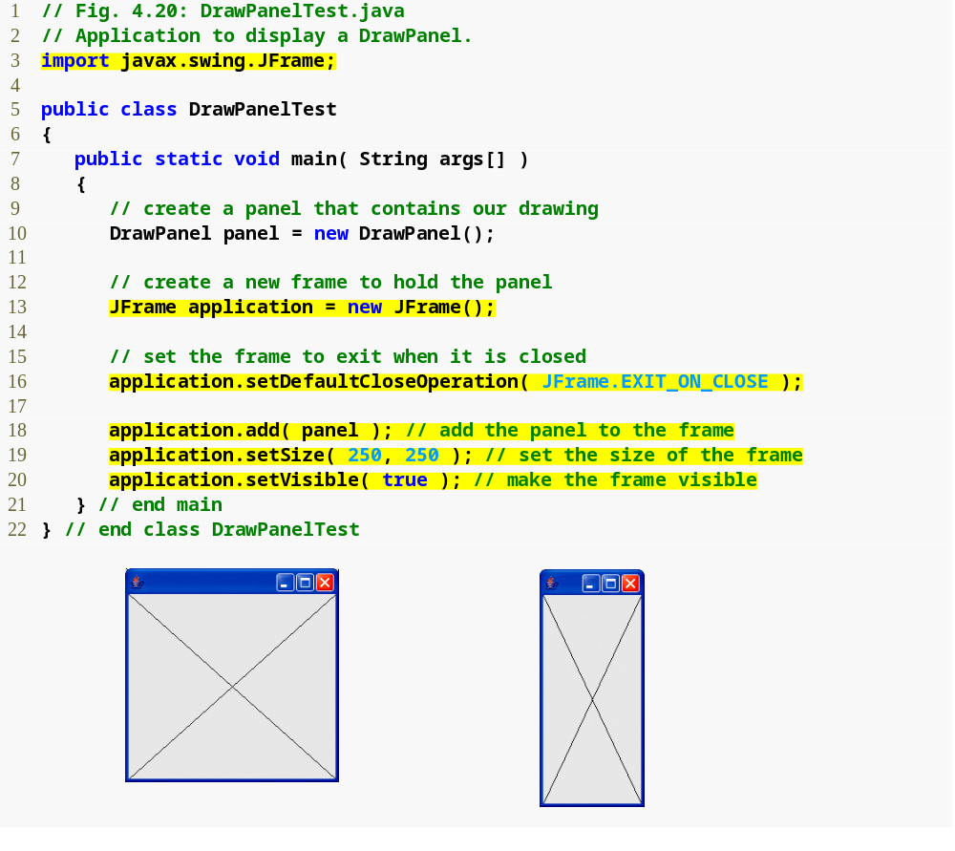
Outline
Import the JFrame class from the javax.swing package
DrawPanelTest.java
Create DrawPanel and JFrame objects
Set the application to terminate when the user closes the window
Add the DrawPanel to the JFrame
Set the size of and display the JFrame

Slide 81
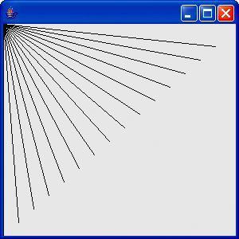
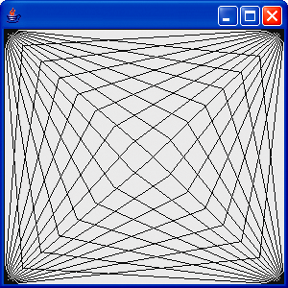
Fig. 4.21 | Lines fanning from a corner.

Slide 82
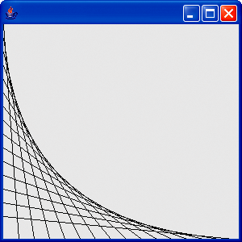
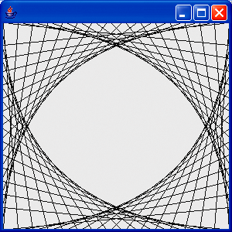
Fig. 4.22 | Line art with loops and drawLine.

Slide 83
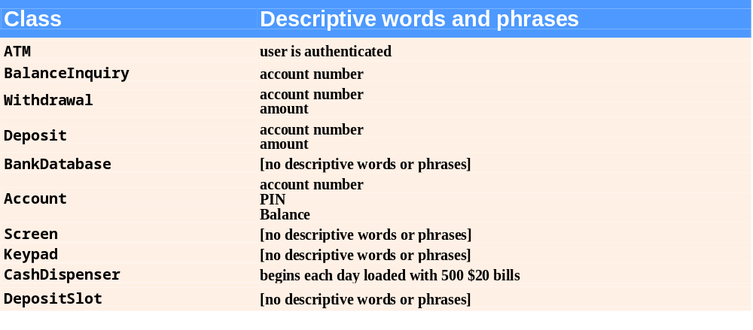
Fig. 4.23 | Descriptive words and phrases from the ATM requirements.

Slide 84
Software Engineering Observation 4.6
At early stages in the design process, classes often lack attributes (and operations). Such classes should not be eliminated, however, because attributes (and operations) may become evident in the later phases of design and implementation.

Slide 85
4.15
Identifying Class Attributes
Identifying attributes
  Look for descriptive words and phrases in the requirements document
  Create attributes and assign them to classes
  Each attribute is given an attribute type
  Some attributes may have an initial value
  Some classes may end up without any attributes
    Additional attributes may be added later on as the design and implementation process continues
  Reference-type attributes are modeled more clearly as associations

Slide 86
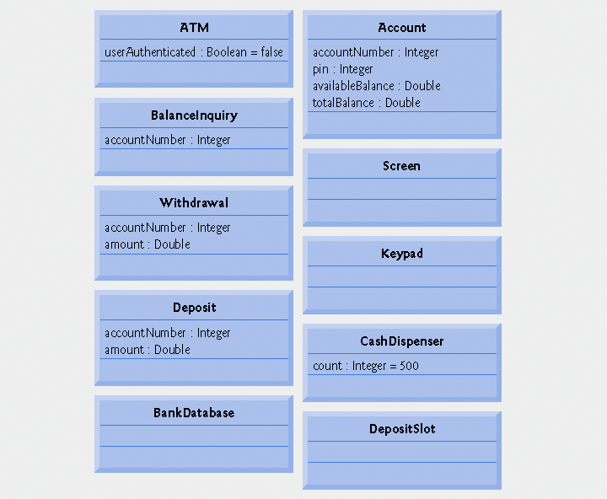
Fig. 4.24 | Classes with attributes.

