Slide 1

Programming 1
Mr. Sameh AbuHassira
First Semester 2022-2023
University of Palestine

Slide 2
Chapter 1
Intro to Computers and Programming

Slide 3
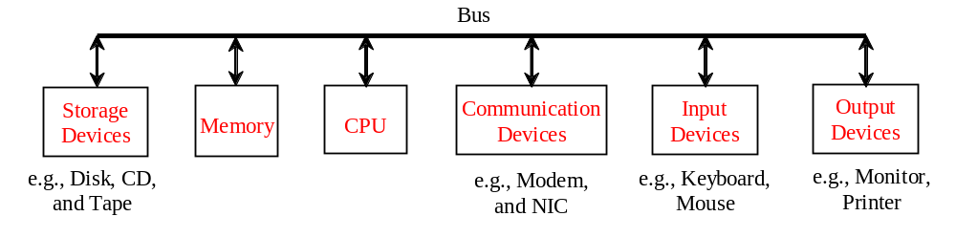
Computer Hardware

Slide 4

Hardware
Visible, physical elements of the computer
Main components:
  CPU
    retrieves instructions from memory and executes them
  Memory
    temporarily stores data and program instructions
  Storage Devices
    non-volatile storage; data remains after a power interruption
  Communication Devices
    devices that allow computers to communicate with each other
  Input and output devices
    devices that let the user communicate with the computer
Components are connected through a subsystem called a bus

Slide 5
Hardware
  Memory
    volatile = data is normally lost when power lost (reboot or power interruption)
    every location in memory has a numeric address
    all information is measured in bits
      a bit can be conceptualized as a switch that is either on or off
        values of single or multiple bits are represented as base 2 (binary) numbers
        can also be interpreted as true / false

Slide 6

Hardware
مش مطلوبة الحفظ

Slide 7
Base 2
مش مطلوبة الحفظ
Decimal | Binary
0 | 0
1 | 1
2 | 10
3 | 11
4 | 100
5 | 101
6 | 110
Decimal | Binary
7 | 111
8 | 1000
9 | 1001
15 | 1111
16 | 10000

Slide 8
Bits
المطلوب نعرف إنها وحدة قياس الجهاز
You do not have to become a whiz at base 2 arithmetic,
but you do need to develop basic familiarity with it
Base 2 math in this class is intended to
  make the point that programming is just a fancy way to flip billions of switches
  ease the learning curve for later courses in which you will need to understand binary
There will be a few questions on base 2 arithmetic on the quizzes and/ or exams. They won’t be much harder than the examples below.

Slide 9
Binary Arithmetic Rules
0 + 0 = 0
0 + 1 = 1
1 + 0 = 1
1 + 1 = 0 (carry 1)
1+1+1 = 1 (carry 1)

Slide 10
Binary Arithmetic
01 + 01 = 10
11 + 11 = 110
101 + 101 = 1010
1000 + 1 = 1001
1000 + 11 = 1011
1111 + 1 = 10000

Slide 11
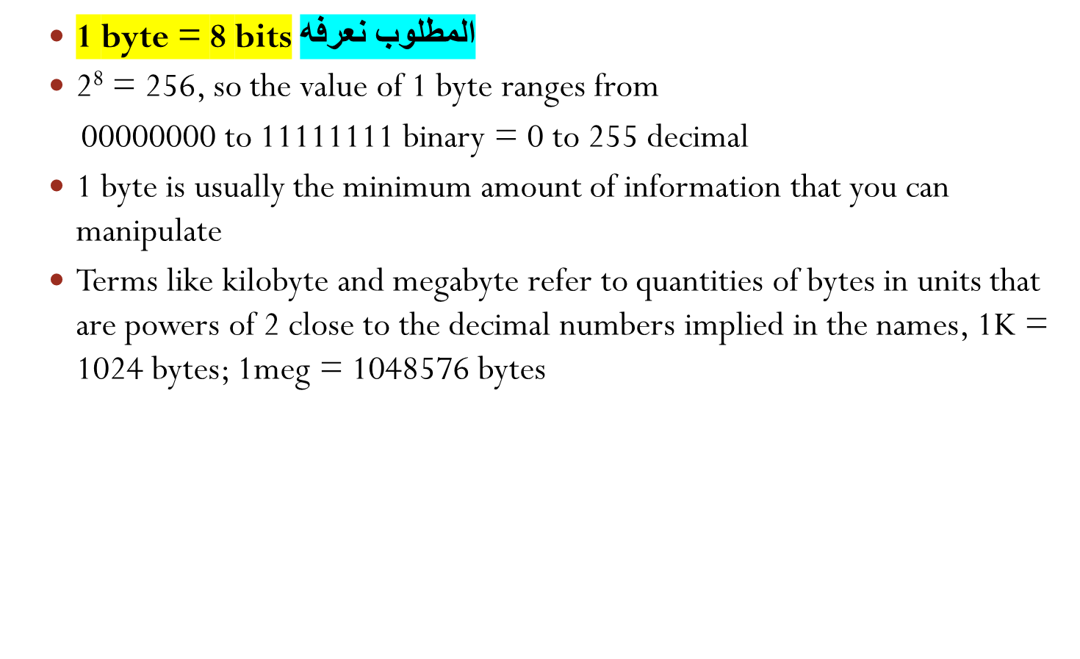
Bytes

Slide 12
Bytes
  Most of the time, the actual storage units are invisible to the programmer. For example, you will usually deal with an integer without worrying about the fact that the computer sees it as 4 bytes

Slide 13
Bytes
  However, storage affects the maximum possible value for a piece of data
    Java uses 4 bytes = 32 bits to store the value of an integer
    one byte stores the sign
    2³¹ = 2147483648
    a Java integer has possible values from -2147483648 to
    +2147483647
  2147483647 + 1 = garbage

Slide 14
Software
Software
  instructions that control the hardware and make it perform specific tasks
Program
  a set of instructions describing how a computer can perform a task
Algorithm
  a set of instructions that will solve a problem in a finite amount of time
A program normally implements one or more algorithms

Slide 15
Software
Programming
  the preparation of programs!
  requires a programming language
  Wikipedia:
    A programming language is an artificial language designed to express computations that can be performed by a machine, particularly a computer.

Slide 16
Programming
Computer executes machine code, also called machine language, which consists of instructions expressed as base 2 numbers
  different machine languages for different types of processors
  very few programmers can write machine language (I don’t know any!)
  some programming is done in assembly language, which is a human-understandable set of mnemonic codes that corresponds closely to machine instructions
    Different for different types of CPUs

Slide 17
Programming Languages
Assembly language requires manipulation of minute machine operations.
Over time, easier-to-use programming languages have evolved to allow greater programmer productivity
Low level language: few machine instructions per line of programming-language code.
  a more highfalutin way to put this: little abstraction from the machine operations
High level language: many machine instructions per line of code
  greater abstraction from machine operations
Because high-level languages do not directly manipulate machine operations, they can be standardized across different operating systems and hardware.

Slide 18
Low-level Vs. High-Level
Typical assembly language instruction:
  mov cx,digits
    Sets the value held in CPU register cx to the current value of a variable called “digits”
Typical high-level language statement:
  area = 5 * 5 * 3.1415;
    Sets the value of a variable called “area” to 5* 5 * pi
    would take many lines of assembly language to do this

Slide 19
Programming Languages
High level languages
  first widely-used ones were COBOL and FORTRAN, used for business and scientific applications.
  BASIC 1964 used for teaching programming
  Many others
  Ancestry of Java:
    ALGOL developed 1950s by a committee of professors
      mostly used to describe algorithms, not for actual programs
    C 1969 Bell Labs, drew on ALGOL
      relatively low level
      designed for operating systems but widely used for other software
    C++ 1979 Bell Labs
      superset of C, adding support for object-oriented programming

Slide 20
Java
Java 1995
  developed at Sun Microsystems
  simpler to use than C++ in many ways
  gives up C’s low-level capabilities
  currently approximately tied with C++ as the most widely used programming language
  Used in many web-based applications
  Widespread use in embedded systems (software that runs on computers included in appliances, cars, etc)
  Widely used for programming devices like video game consoles, BluRay players, smart phones, etc.
  Designed to allow identical code to produce the same results on many different platforms

Slide 21
Siblings of Java
C#
  Microsoft’s proprietary answer to Java
  proprietary = controlled by a company
Visual Basic
  Another MS proprietary language, descended from both C++ and BASIC
Objective C
  Apple proprietary language, used for Mac and iOS platform programming

Slide 22
Programming Language to Machine Instructions
source code = instructions written in a programming language
Assembly language is translated to machine code using an assembler
High level languages are translated using interpreters and or compilers
  interpreter translates into machine language at runtime; no need to store extra files
  compiler translates into machine language ahead of time and stores the executable file: faster at runtime than in interpreter

Slide 23
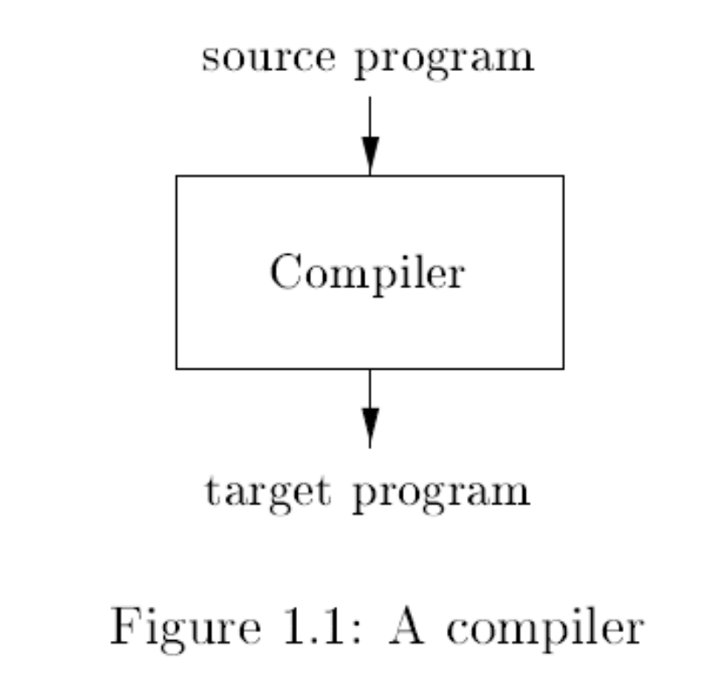
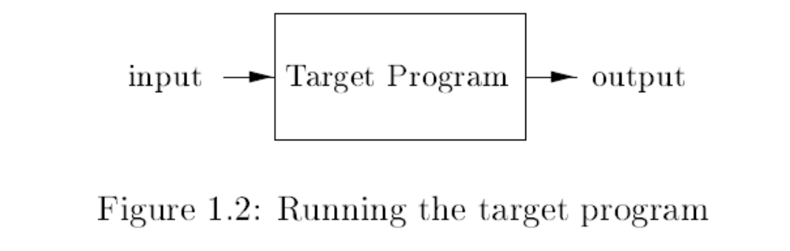

Slide 24
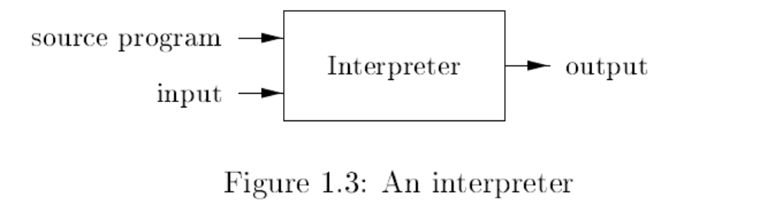

Slide 25
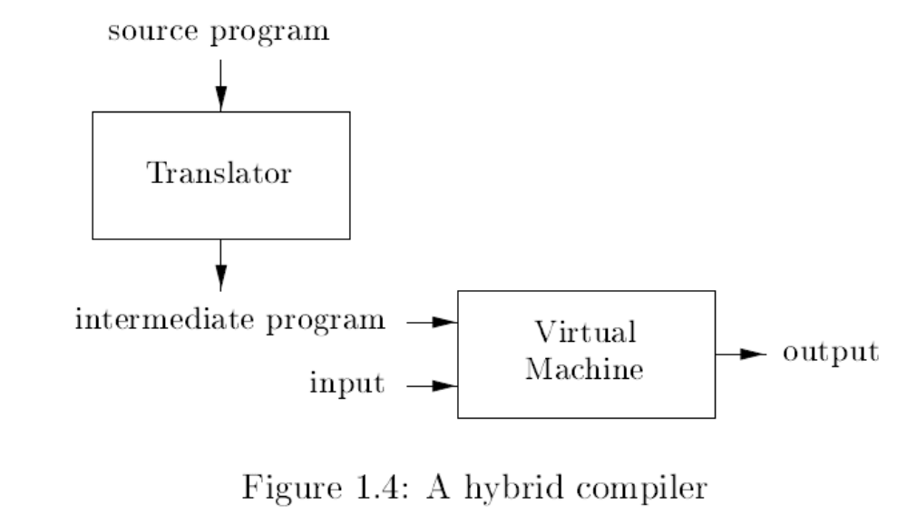

Slide 26
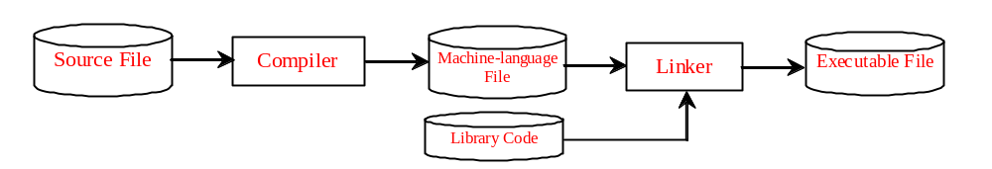
Programming Language to Machine Instructions

Slide 27
Programming Language to Machine Instructions
Traditional BASIC and JavaScript (language used for writing programs that run in your web browser) use interpreters
C uses compilers
Java uses both
  Java is compiled before runtime to an intermediate language called Java bytecode
  Java Virtual Machine interprets bytecode to machine language at runtime
  Each platform (operating system or hardware type) requires a different type of JVM, but all forms of JVM run the same bytecode
  Therefore, Java bytecode is analogous to an assembly language for the JVM

Slide 28
Pros and Cons of JVM
Main Advantage
  Java is highly platform-independent
    Write Once, Run Anywhere
      easy to run the same Java code in UNIX/OSX/Windows/ Android/Toaster/Antilock Brake System/Whatever
      reduces the amount of knowledge the programmer needs to have about the specific platform
    adds long-term robustness. Your Java code will still run in Windows 18.7 as long as there is a JVM.
Main Drawbacks:
  JVM itself uses some memory, CPU capacity, and other system resources
  Adds one extra step at runtime.
  Java code often runs more slowly and unevenly than compiled C++

Slide 29
Statements
A statement represents an action or a sequence of actions.
  System.out.println(“Hello, World!");
    prints the message “Hello, World!”
  Every statement in Java ends with a semicolon (;).

Slide 30
Variable and Constant Declarations
Programs often use variables and constants
You already know these concepts from algebra
You must tell the computer to set aside memory space for any variable or constant you use
int x = 0;
  finds space to store an integer, names it x, and sets the value to 0

Slide 31
Data
Each variable or constant has a specific data type
  The data type is used by the computer to determine how to store and handle values
You must always be conscious of the data type of any piece of information you use
  a character takes less space to store than an integer
  you can’t find the product of two variables unless they are both numbers
  If you divide one integer by another and store the quotient as an integer, you may lose information. It may not be good enough to say that 5 / 4 = 1

Slide 32
Comments
Ignored by the compiler and JVM
Used for documentation intended for programmers or other people involved in development

Slide 33
Comments
Line comment: A line comment is preceded by two slashes (//) in a line.
Paragraph comment: A paragraph comment is enclosed between /* and */ in one or multiple lines.
javadoc comment: javadoc comments begin with /** and end with */. They are used for documenting classes, data, and methods. They can be extracted into an HTML file using JDK's javadoc command.

Slide 34
Reserved Wordsكلمات محجوزة
Reserved words or keywords are words that have a specific meaning to the compiler and cannot be used for other purposes in the program.
For example, when the compiler sees the word class, it understands that the word after class is the name for the class.
Other reserved words in Listing 1.1 are public, static, and void. Their use will be introduced later.

Slide 35
Modifiers
Java uses certain reserved words called modifiers that specify the properties of the data, methods, and classes and how they can be used.
Examples of modifiers are public and static. Other modifiers are private, final, abstract, and protected. A public datum, method, or class can be accessed by other programs. A private datum or method cannot be accessed by other programs.

Slide 36

Blocks
A pair of braces in a program forms a block that groups components of a program.

Slide 37
Methods
Procedures for performing particular tasks
Java methods are equivalent to functions, subroutines, or procedures in other languages
public int get Product(int x, int y) {
  return x * y;
  }

Slide 38
Objects قال بدهش يحكي عنه للفصل الجاي نناخذه
An object is a self-contained entity that consists of both data and procedures to manipulate the data.
Objects often (not always) model real-world entities or abstractions that already exist outside the program
  A Ship object might have
    data items including weight, country of registration, and engine displacement
    procedures (methods/ functions/ subroutines) including accelerate, show speed, drop anchor, fire cannon, prepare to be boarded, sink
  A Rectangle object might have
    three (probably not four) data points that represent coordinates
    methods to calculate area and perimeter and to determine whether a given coordinate is inside the rectangle

Slide 39
Classes قال بدهش يحكي عنه للفصل الجاي نناخذه
A class is a template or blueprint for objects.
To program in Java, you must understand classes and be able to write and use them.
For now, understand that a program is defined by using one or more classes.

Slide 40
main Method
The main method provides the control of program flow. The Java interpreter executes the application by invoking the main method.
main often calls other methods, including ones that are in other classes
The main method looks like this:
public static void main(String[] args) {
// Statements;
}

Slide 41
System.out.println
The simplest way to show output
By default, prints to the command console
  System.out.println("Hello, World!");
    prints the message “Hello, World!”
  System.out.println(i)
    prints the value of a variable named i
  System.out.println("i = " + i);
    prints the literal text "i =" followed by the value of I
      if the value of i is 1 at the time the statement executes, prints “i = 1”

Slide 42
Math Operations
  Math operations are easy to understand
  x = 1; // sets x to 1
  x = x + 1; // adds 1 to x. Also x+=1, x++
  x = x * y; // multiplies x by y
  x = 100/9; // x should be a floating point // type, not an integer
  x = y + 100;

Slide 43
Math Operations
  x = 1 is an assignment that sets x to the value 1
  x == 1 is a test that is true if x is equal to 1, otherwise false.
    Usually used in a expression like
  if(x == 1)
  System.out.println(“x is equal to 1!”);

Slide 44
Skeleton Java class
public class Skeleton{
public static void main(String[] args){
// early in the course, all your code will go here, inside the main method
} // end main method
} // end class

