Slide 1
2
Introduction
to Java Applications
Part 1

Slide 2
2.1 Introduction
Java application programming
  Display messages
  Obtain information from the user
  Arithmetic calculations
  Decision-making fundamentals

Slide 3
2.2 First Program in Java: Printing a Line of Text
Application
  Executes when you use the java command to launch the Java Virtual Machine (JVM)
Sample program
  Displays a line of text
  Illustrates several important Java language features

Slide 4
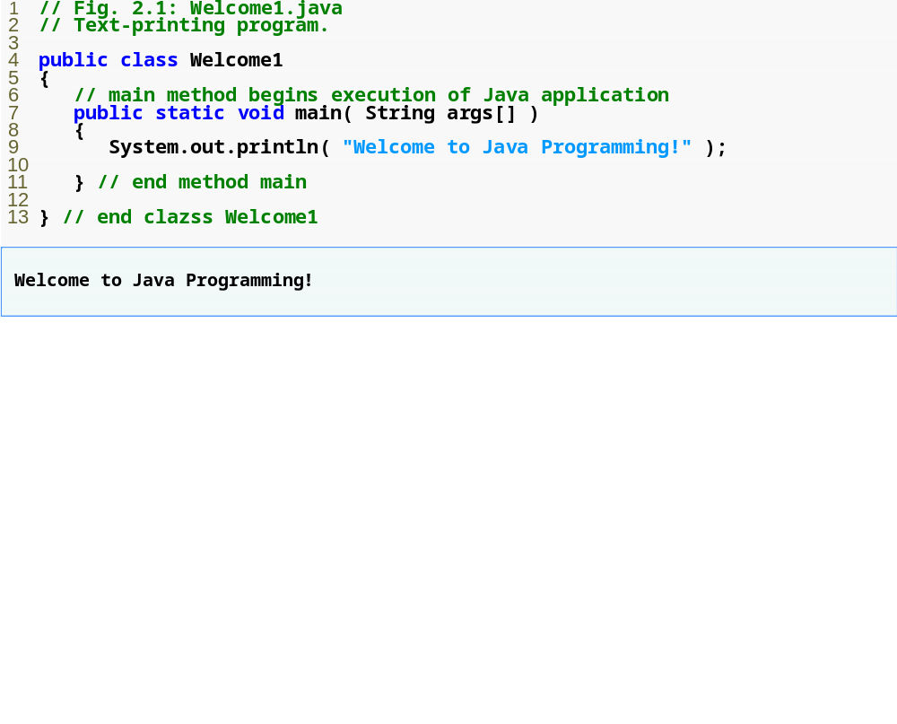
Outline
Welcome1.java

Slide 5
2.2 First Program in Java: Printing a Line of Text (Cont.)
  Comments start with: //
    Comments ignored during program execution
    Document and describe code
    Provides code readability
  Traditional comments: /* ... */
  /* This is a traditional
  comment. It can be
  split over many lines */
  Another line of comments
  Note: line numbers not part of program, added for reference
1 // Fig. 2.1: Welcome1.java
2 // Text-printing program.

Slide 6
2.2 First Program in Java: Printing a Line of Text (Cont.)
3
  Blank line
    Makes program more readable
    Blank lines, spaces, and tabs are white-space characters
      Ignored by compiler
  Begins class declaration for class Welcome1
    Every Java program has at least one user-defined class
    Keyword: words reserved for use by Java
      class keyword followed by class name
    Naming classes: capitalize every word
      SampleClassName
4 public class Welcome1

Slide 7
2.2 First Program in Java: Printing a Line of Text (Cont.)
  Java identifier
    Series of characters consisting of letters, digits,
    underscores ( _ ) and dollar signs ( $ )
    Does not begin with a digit, has no spaces
    Examples: Welcome1, $value, _value, button7
      7button is invalid
    Java is case sensitive (capitalization matters)
      a1 and A1 are different
  In chapters 2 to 7, start each class with public class
    Details of this covered later
4 public class Welcome1

Slide 8
2.2 First Program in Java: Printing a Line of Text (Cont.)
4 public class Welcome1
  Saving files
    File name must be class name with .java extension
    Welcome1.java
  Left brace {
    Begins body of every class
    Right brace ends declarations (line 13)
5 {

Slide 9
2.2 First Program in Java: Printing a Line of Text (Cont.)
  Part of every Java application
    Applications begin executing at main
      Parentheses indicate main is a method (Ch. 3 and 6)
      Java applications contain one or more methods
    Exactly one method must be called main
  Methods can perform tasks and return information
    void means main returns no information
    For now, mimic main's first line
  Left brace begins body of method declaration
    Ended by right brace } (line 11)
7 public static void main( String args[] )
8 {

Slide 10
2.2 First Program in Java: Printing a Line of Text (Cont.)
9 System.out.println( "Welcome to Java Programming!" );
  Instructs computer to perform an action
    Prints string of characters
      String – series of characters inside double quotes
    White-spaces in strings are not ignored by compiler
  System.out
    Standard output object
    Print to command window (i.e., MS-DOS prompt)
  Method System.out.println
    Displays line of text
  This line known as a statement
    Statements must end with semicolon ;

Slide 11
2.2 First Program in Java: Printing a Line of Text (Cont.)
  Ends method declaration
  Ends class declaration
  Can add comments to keep track of ending braces
11 } // end method main
13 } // end class Welcome1

Slide 12
2.2 First Program in Java: Printing a Line of Text (Cont.)
Compiling a program
  Open a command prompt window, go to directory where program is stored
  Type javac Welcome1.java
  If no syntax errors, Welcome1.class created
    Has bytecodes that represent application
    Bytecodes passed to JVM

Slide 13
2.2 First Program in Java: Printing a Line of Text (Cont.)
Executing a program
  Type java Welcome1
    Launches JVM
    JVM loads .class file for class Welcome1
    .class extension omitted from command
    JVM calls method main

Slide 14
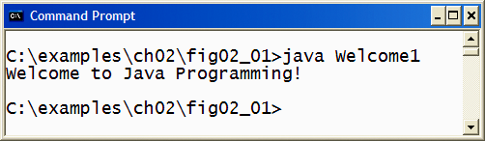
Fig. 2.2 | Executing Welcome1 in a Microsoft Windows XP Command Prompt window.
You type this command to execute
the application
The program outputs
Welcome to Java Programming!

Slide 15
2.3 Modifying Our First Java Program
Modify example in Fig. 2.1 to print same contents using different code

Slide 16
2.3 Modifying Our First Java Program (Cont.)
Modifying programs
  Welcome2.java (Fig. 2.3) produces same output as Welcome1.java (Fig. 2.1)
  Using different code
  Line 9 displays “Welcome to ” with cursor remaining on printed line
  Line 10 displays “Java Programming! ” on same line with cursor on next line
9 System.out.print( "Welcome to " );
10 System.out.println( "Java Programming!" );

Slide 17
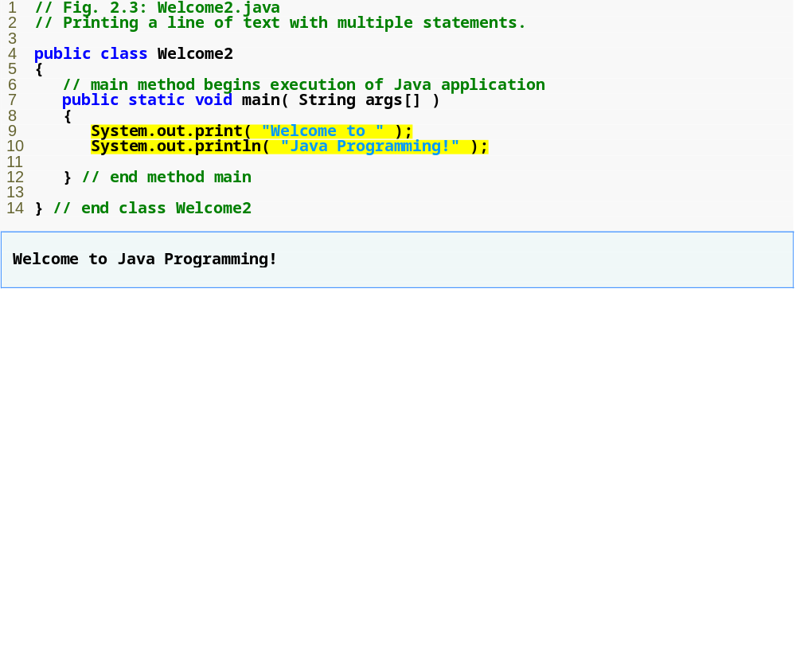
Outline
System.out.print keeps the cursor on the same line, so System.out.println continues on the same line.
Welcome2.java
1. Comments
2. Blank line
3. Begin class Welcome2
3.1 Method main
4. Method System.out.print
4.1 Method System.out.println
5. end main, Welcome2
Program Output

Slide 18
2.3 Modifying Our First Java Program (Cont.)
Escape characters
  Backslash ( \ )
  Indicates special characters to be output
Newline characters (\n)
  Interpreted as “special characters” by methods System.out.print and System.out.println
  Indicates cursor should be at the beginning of the next line
  Welcome3.java (Fig. 2.4)
  Line breaks at \n
9 System.out.println( "Welcome\nto\nJava\nProgramming!" );

Slide 19
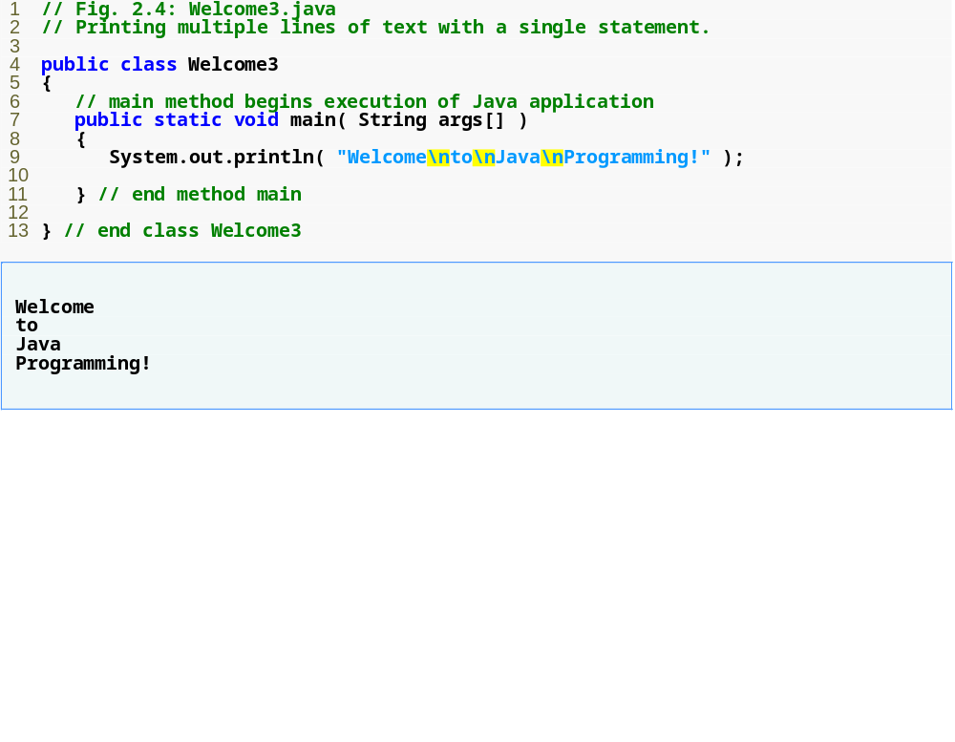
Outline
Welcome3.java
1. main
2. System.out.println (uses \n for new line)
Program Output
A new line begins after each \n escape sequence is output.

Slide 20
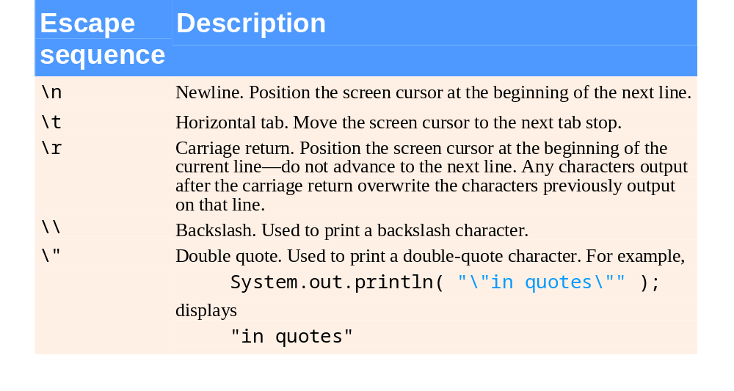
Fig. 2.5 | Some common escape sequences.

Slide 21
2.4 Displaying Text with printf
System.out.printf
  Feature added in Java SE 5.0
  Displays formatted data
  Format string
    Fixed text
    Format specifier – placeholder for a value
  Format specifier %s – placeholder for a string
9 System.out.printf( "%s\n%s\n",
10 "Welcome to", "Java Programming!" );

Slide 22
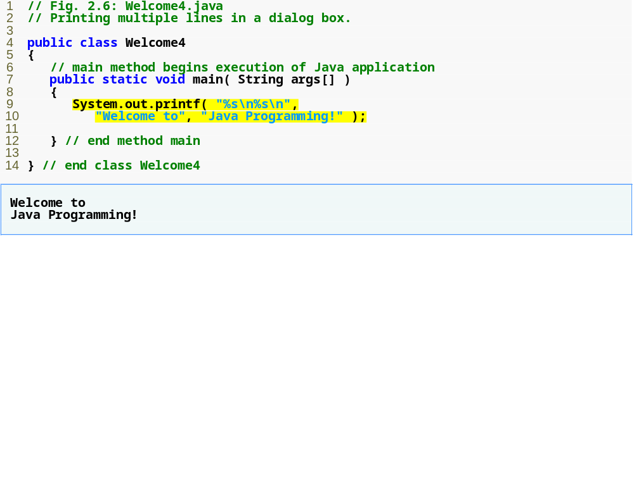
Outline
System.out.printf displays formatted data.
Welcome4.java
main
printf
Program output

