Slide 1
6
Methods: A Deeper Look

Slide 2
The greatest invention of the nineteenth century was the invention of the method of invention.
  Alfred North Whitehead
Call me Ishmael.
  Herman Melville
When you call me that, smile!
  Owen Wister

Slide 3
Answer me in one word.
  William Shakespeare
O! call back yesterday, bid time return.
  William Shakespeare
There is a point at which methods devour themselves.
  Frantz Fanon

Slide 4
OBJECTIVES
In this chapter you will learn:
How static methods and fields are associated with an entire class rather than specific instances of the class.
To use common Math methods available in the Java API.
To understand the mechanisms for passing information between methods.
How the method call/return mechanism is supported by the method call stack and activation records.
How packages group related classes.
How to use random-number generation to implement game-playing applications.
How the visibility of declarations is limited to specific regions of programs.
What method overloading is and how to create overloaded methods.

Slide 5
6.1 Introduction
6.2 Program Modules in Java
6.3 static Methods, static Fields and Class Math
6.4 Declaring Methods with Multiple Parameters
6.5 Notes on Declaring and Using Methods
6.6 Method Call Stack and Activation Records
6.7 Argument Promotion and Casting
6.8 Java API Packages
6.9 Case Study: Random-Number Generation
6.9.1 Generalized Scaling and Shifting of Random
Numbers
6.9.2 Random-Number Repeatability for
Testing and Debugging

Slide 6
6.10 Case Study: A Game of Chance (Introducing Enumerations)
6.11 Scope of Declarations
6.12 Method Overloading
6.13 (Optional) GUI and Graphics Case Study: Colors and Filled Shapes
6.14 (Optional) Software Engineering Case Study: Identifying Class Operations
6.15 Wrap-Up

Slide 7
6.1 Introduction
Divide and conquer technique
  Construct a large program from smaller pieces (or modules)
  Can be accomplished using methods
static methods can be called without the need for an object of the class
Random number generation
Constants

Slide 8
6.2 Program Modules in Java
Java Application Programming Interface (API)
  Also known as the Java Class Library
  Contains predefined methods and classes
    Related classes are organized into packages
    Includes methods for mathematics, string/character manipulations, input/output, databases, networking, file processing, error checking and more

Slide 9
Good Programming Practice 6.1
Familiarize yourself with the rich collection of classes and methods provided by the Java API (java.sun.com/javase/6/docs/api/). In Section 6.8, we present an overview of several common packages. In Appendix G, we explain how to navigate the Java API documentation.

Slide 10
Software Engineering Observation 6.1
Don’t try to reinvent the wheel. When possible, reuse Java API classes and methods. This reduces program development time and avoids introducing programming errors.

Slide 11
6.2 Program Modules in Java (Cont.)
Methods
  Called functions or procedures in some other languages
  Modularize programs by separating its tasks into self-contained units
  Enable a divide-and-conquer approach
  Are reusable in later programs
  Prevent repeating code

Slide 12
Software Engineering Observation 6.2
To promote software reusability, every method should be limited to performing a single, well-defined task, and the name of the method should express that task effectively. Such methods make programs easier to write, debug, maintain and modify.

Slide 13
Error-Prevention Tip 6.1
A small method that performs one task is easier to test and debug than a larger method that performs many tasks.

Slide 14
Software Engineering Observation 6.3
If you cannot choose a concise name that expresses a method’s task, your method might be attempting to perform too many diverse tasks. It is usually best to break such a method into several smaller method declarations.

Slide 15
6.3 static Methods, static Fields and Class Math
static method (or class method)
  Applies to the class as a whole instead of a specific object of the class
  Call a static method by using the method call:
  ClassName.methodName( arguments )
  All methods of the Math class are static
    example: Math.sqrt( 900.0 )

Slide 16
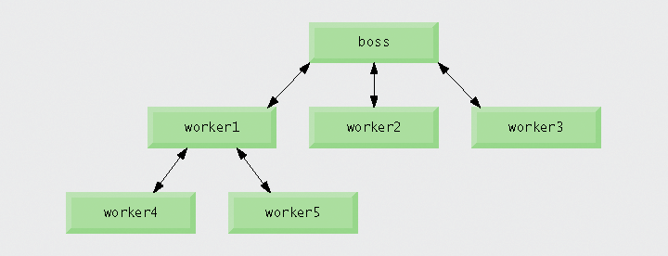
Fig. 6.1 | Hierarchical boss-method/worker-method relationship.

Slide 17
Software Engineering Observation 6.4
Class Math is part of the java.lang package, which is implicitly imported by the compiler, so it is not necessary to import class Math to use its methods.

Slide 18
6.3 static Methods, static Fields and Class Math (Cont.)
Constants
  Keyword final
  Cannot be changed after initialization
static fields (or class variables)
  Are fields where one copy of the variable is shared among all objects of the class
Math.PI and Math.E are final static fields of the Math class

Slide 19
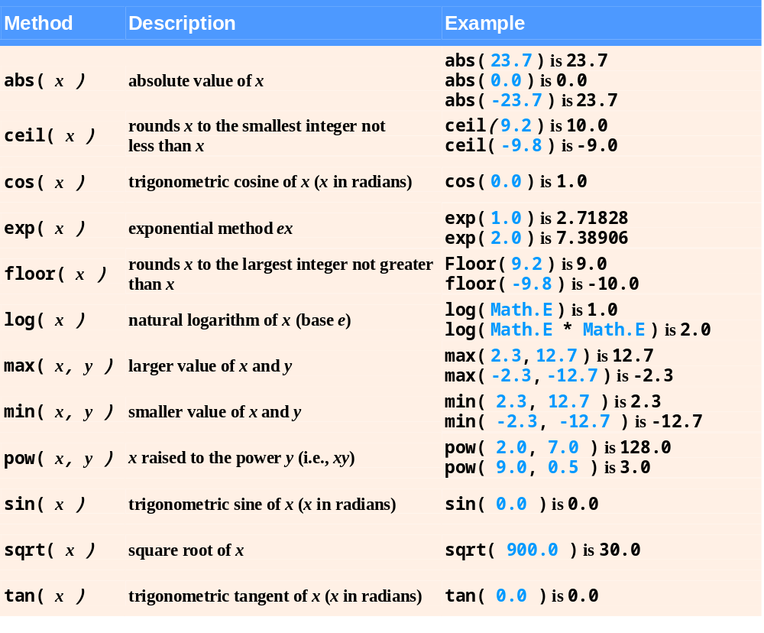
Fig. 6.2 | Math class methods.

Slide 20
6.3 static Methods, static Fields and Class Math (Cont.)
Method main
  main is declared static so it can be invoked without creating an object of the class containing main
  Any class can contain a main method
    The JVM invokes the main method belonging to the class specified by the first command-line argument to the java command

Slide 21
6.4 Declaring Methods with Multiple Parameters
Multiple parameters can be declared by specifying a comma-separated list.
  Arguments passed in a method call must be consistent with the number, types and order of the parameters
    Sometimes called formal parameters

Slide 22
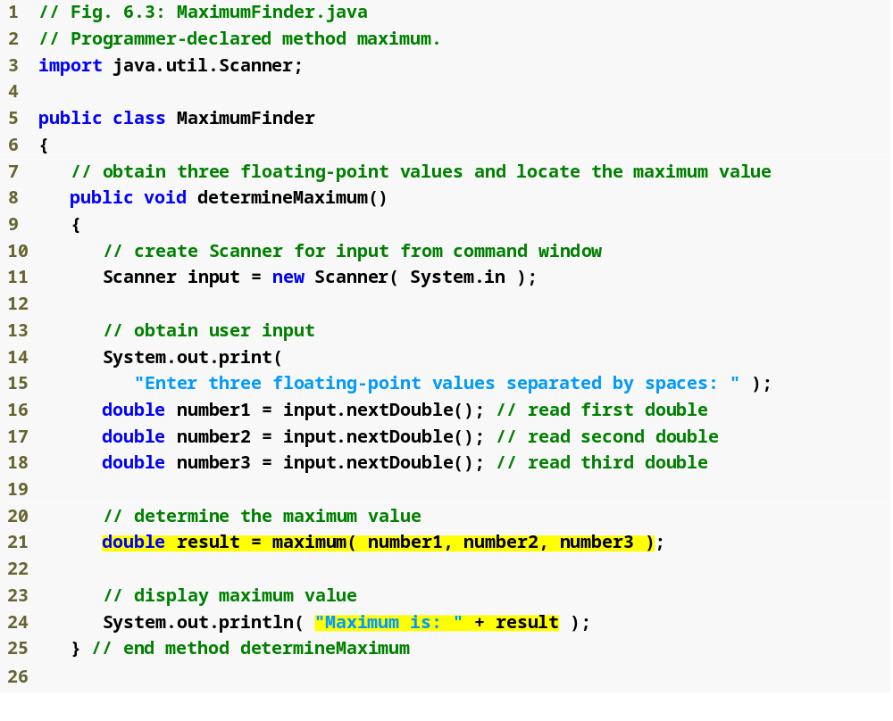
Outline
MaximumFinder.java
(1 of 2)
Call method maximum
Display maximum value

Slide 23
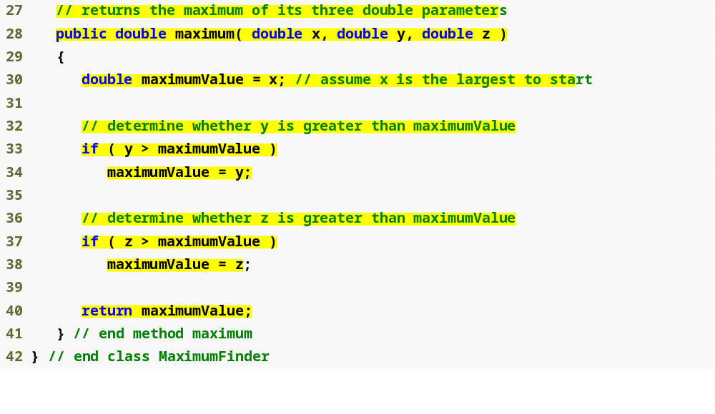
Outline
Declare the maximum method
MaximumFinder.java
(2 of 2)
Compare y and maximumValue
Compare z and maximumValue
Return the maximum value

Slide 24
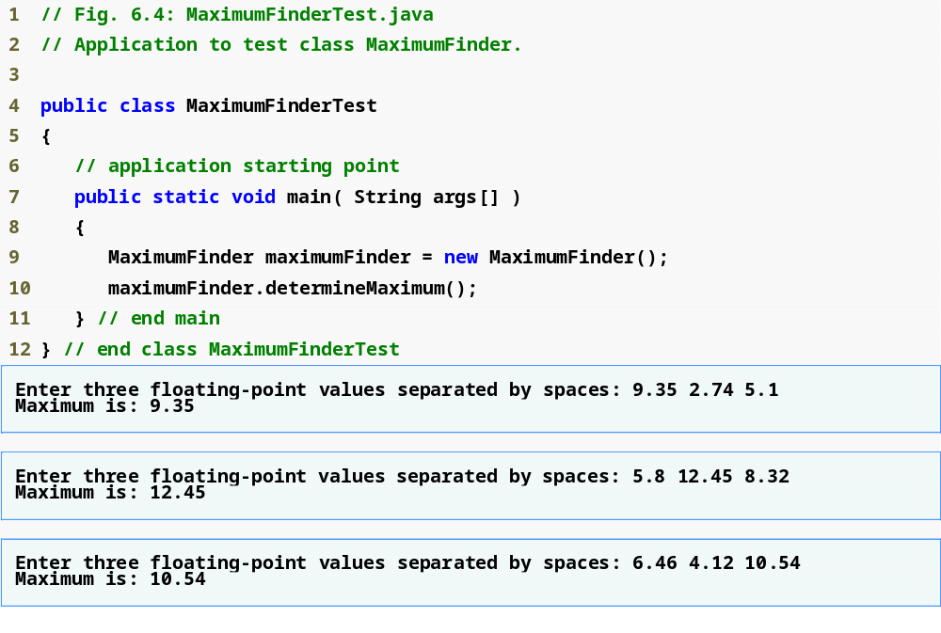
Outline
Create a MaximumFinder object
MaximumFinderTest
.java
Call the determineMaximum method

Slide 25
Common Programming Error 6.1
Declaring method parameters of the same type as float x, y instead of float x, float y is a syntax error-a type is required for each parameter in the parameter list.

Slide 26
Software Engineering Observation 6.5
A method that has many parameters may be performing too many tasks. Consider dividing the method into smaller methods that perform the separate tasks. As a guideline, try to fit the method header on one line if possible.

Slide 27
6.4 Declaring Methods with Multiple Parameters (Cont.)
Reusing method Math.max
  The expression Math.max( x, Math.max( y, z ) ) determines the maximum of y and z, and then determines the maximum of x and that value
String concatenation
  Using the + operator with two Strings concatenates them into a new String
  Using the + operator with a String and a value of another data type concatenates the String with a String representation of the other value
    When the other value is an object, its toString method is called to generate its String representation

Slide 28
Common Programming Error 6.2
It is a syntax error to break a String literal across multiple lines in a program. If a String does not fit on one line, split the String into several smaller Strings and use concatenation to form the desired String.

Slide 29
Common Programming Error 6.3
Confusing the + operator used for string concatenation with the + operator used for addition can lead to strange results. Java evaluates the operands of an operator from left to right. For example, if integer variable y has the value 5, the expression "y + 2 = " + y + 2 results in the string "y + 2 = 52", not "y + 2 = 7", because first the value of y (5) is concatenated with the string "y + 2 = ", then the value 2 is concatenated with the new larger string "y + 2 = 5". The expression "y + 2 = " + (y + 2) produces the desired result "y + 2 = 7".

Slide 30
6.5 Notes on Declaring and Using Methods
Three ways to call a method:
  Use a method name by itself to call another method of the same class
  Use a variable containing a reference to an object, followed by a dot (.) and the method name to call a method of the referenced object
  Use the class name and a dot (.) to call a static method of a class
static methods cannot call non-static methods of the same class directly

Slide 31
6.5 Notes on Declaring and Using Methods (Cont.)
Three ways to return control to the calling statement:
  If method does not return a result:
    Program flow reaches the method-ending right brace or
    Program executes the statement return;
  If method does return a result:
    Program executes the statement return expression;
      expression is first evaluated and then its value is returned to the caller

Slide 32
Common Programming Error 6.4
Declaring a method outside the body of a class declaration or inside the body of another method is a syntax error.

Slide 33
Common Programming Error 6.5
Omitting the return-value-type in a method declaration is a syntax error.

Slide 34
Common Programming Error 6.6
Placing a semicolon after the right parenthesis enclosing the parameter list of a method declaration is a syntax error.

Slide 35
Common Programming Error 6.7
Redeclaring a method parameter as a local variable in the method’s body is a compilation error.

Slide 36
Common Programming Error 6.8
Forgetting to return a value from a method that should return a value is a compilation error. If a return value type other than void is specified, the method must contain a return statement that returns a value consistent with the method’s return-value-type. Returning a value from a method whose return type has been declared void is a compilation error.

Slide 37
6.6 Method Call Stack and Activation Records
Stacks
  Last-in, first-out (LIFO) data structures
    Items are pushed (inserted) onto the top
    Items are popped (removed) from the top
Program execution stack
  Also known as the method call stack
  Return addresses of calling methods are pushed onto this stack when they call other methods and popped off when control returns to them

Slide 38
6.6 Method Call Stack and Activation Records (Cont.)
  A method’s local variables are stored in a portion of this stack known as the method’s activation record or stack frame
    When the last variable referencing a certain object is popped off this stack, that object is no longer accessible by the program
      Will eventually be deleted from memory during “garbage collection”
    Stack overflow occurs when the stack cannot allocate enough space for a method’s activation record

Slide 39
6.7 Argument Promotion and Casting
Argument promotion
  Java will promote a method call argument to match its corresponding method parameter according to the promotion rules
  Values in an expression are promoted to the “highest” type in the expression (a temporary copy of the value is made)
  Converting values to lower types results in a compilation error, unless the programmer explicitly forces the conversion to occur
    Place the desired data type in parentheses before the value
      example: ( int ) 4.5

Slide 40
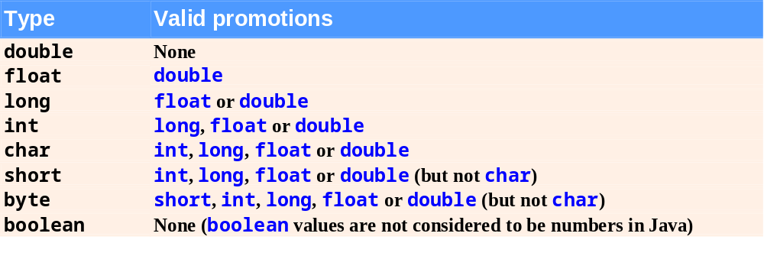
Fig. 6.5 | Promotions allowed for primitive types.

Slide 41
Common Programming Error 6.9
Converting a primitive-type value to another primitive type may change the value if the new type is not a valid promotion. For example, converting a floating-point value to an integral value may introduce truncation errors (loss of the fractional part) into the result.

Slide 42
6.8 Java API Packages
Including the declaration
import java.util.Scanner;
allows the programmer to use Scanner instead of java.util.Scanner
Java API documentation
  java.sun.com/javase/6/docs/api/
Overview of packages in Java SE 6
  java.sun.com/javase/6/docs/api/overview-summary.html

Slide 43
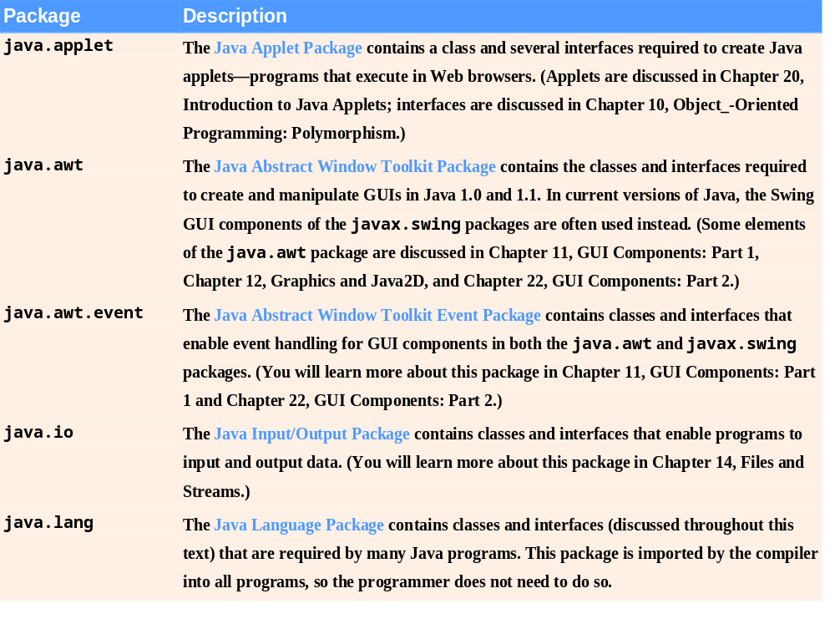
Fig. 6.6 | Java API packages (a subset). (Part 1 of 2)

Slide 44
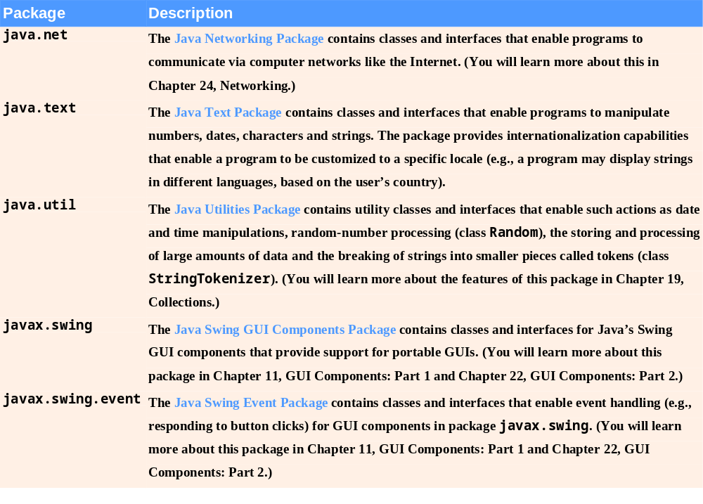
Fig. 6.6 | Java API packages (a subset). (Part 2 of 2)

Slide 45
Good Programming Practice 6.2
The online Java API documentation is easy to search and provides many details about each class. As you learn a class in this book, you should get in the habit of looking at the class in the online documentation for additional information.

Slide 46
6.9 Case Study: Random-Number Generation
Random-number generation
  static method random from class Math
    Returns doubles in the range 0.0 <= x < 1.0
  class Random from package java.util
    Can produce pseudorandom boolean, byte, float, double, int, long and Gaussian values
    Is seeded with the current time of day to generate different sequences of numbers each time the program executes

Slide 47
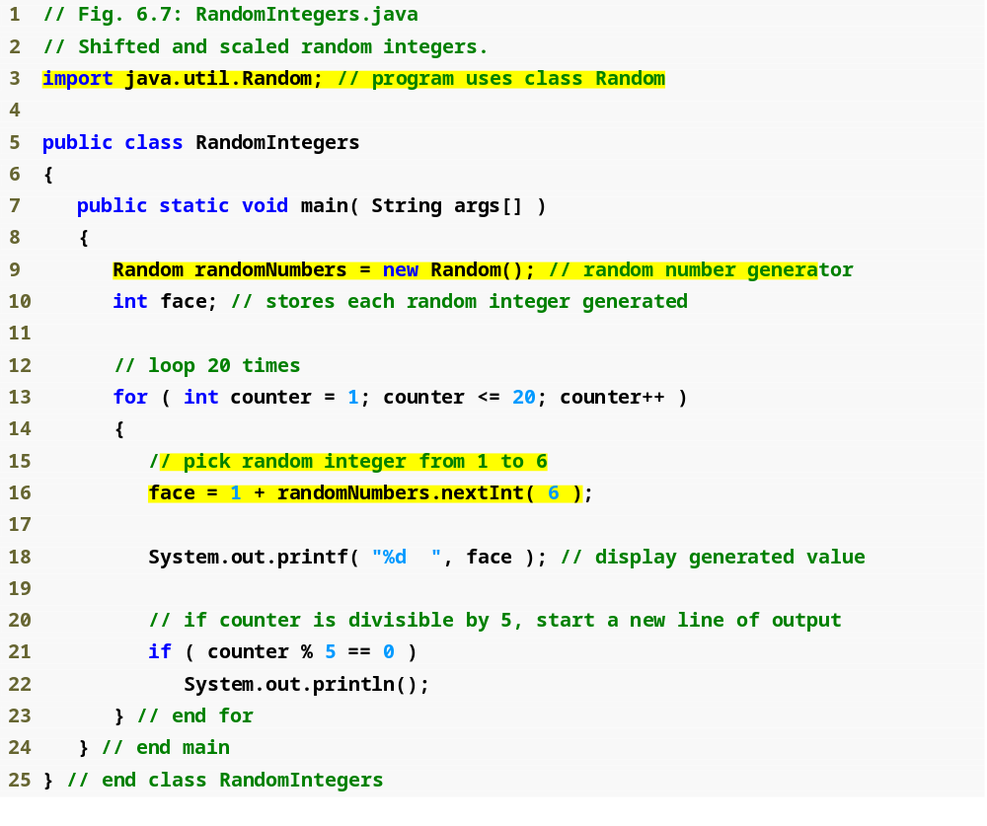
Outline
Import class Random from the java.util package
RandomIntegers
.java
(1 of 2)
Create a Random object
Generate a random die roll

Slide 48

Outline
Two different sets of results containing integers in the range 1-6
RandomIntegers
.java
(2 of 2)

Slide 49
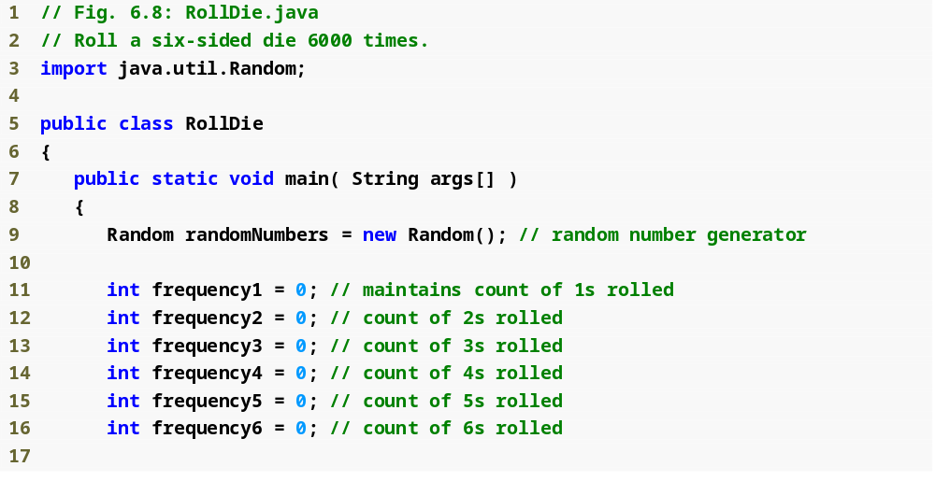
Outline
Import class Random from the java.util package
RollDie.java
(1 of 2)
Create a Random object
Declare frequency counters

Slide 50
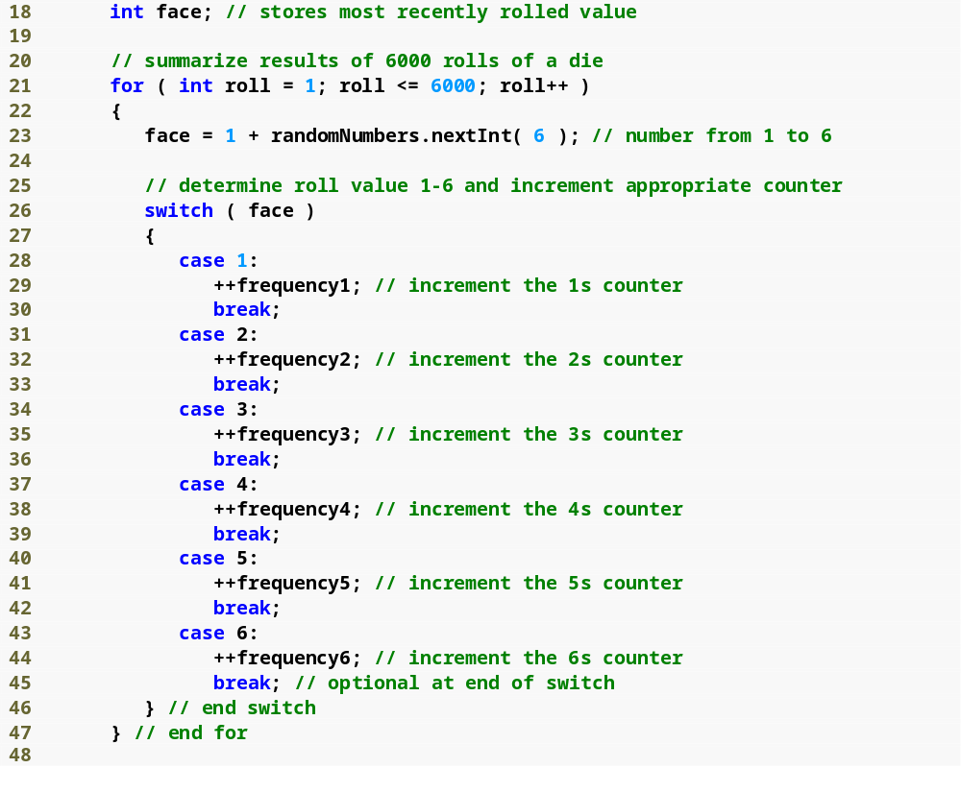
Outline
Iterate 6000 times
RollDie.java
(2 of 2)
Generate a random die roll
switch based on the die roll

Slide 51
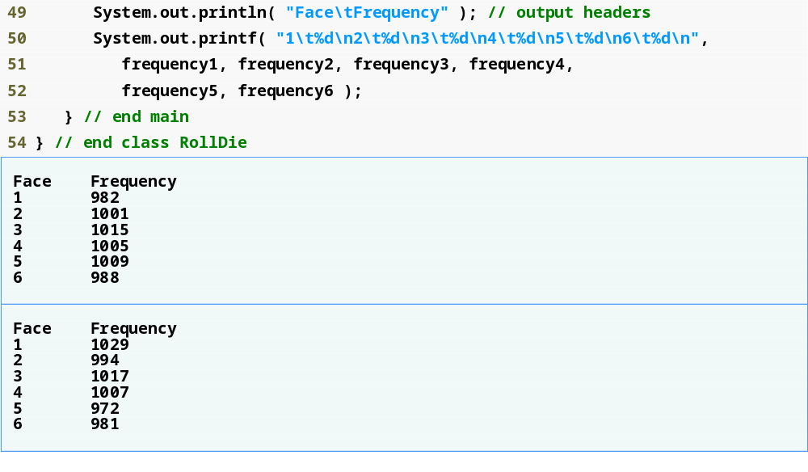
Outline
Display die roll frequencies
RollDie.java
(3 of 3)

Slide 52
6.9.1 Generalized Scaling and Shifting of Random Numbers
To generate a random number in certain sequence or range
  Use the expression
  shiftingValue + differenceBetweenValues * randomNumbers.nextInt( scalingFactor )
  where:
    shiftingValue is the first number in the desired range of values
    differenceBetweenValues represents the difference between consecutive numbers in the sequence
    scalingFactor specifies how many numbers are in the range

Slide 53
6.9.2 Random-Number Repeatability for Testing and Debugging
To get a Random object to generate the same sequence of random numbers every time the program executes, seed it with a certain value
  When creating the Random object:
  Random randomNumbers =
  new Random( seedValue );
  Use the setSeed method:
  randomNumbers.setSeed( seedValue );
  seedValue should be an argument of type long

Slide 54
Error-Prevention Tip 6.2
While a program is under development, create the Random object with a specific seed value to produce a repeatable sequence of random numbers each time the program executes. If a logic error occurs, fix the error and test the program again with the same seed value-this allows you to reconstruct the same sequence of random numbers that caused the error. Once the logic errors have been removed, create the Random object without using a seed value, causing the Random object to generate a new sequence of random numbers each time the program executes.

Slide 55
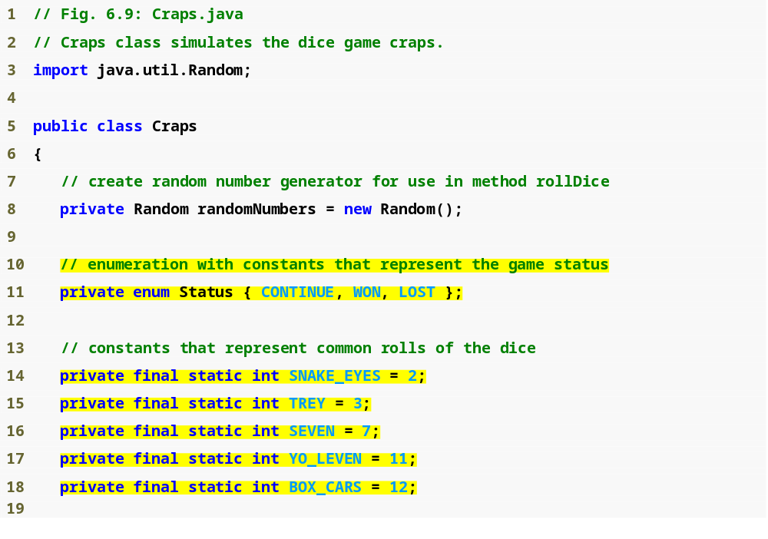
Outline
Import class Random from the java.util package
Craps.java
(1 of 4)
Create a Random object
Declare an enumeration
Declare constants

Slide 56
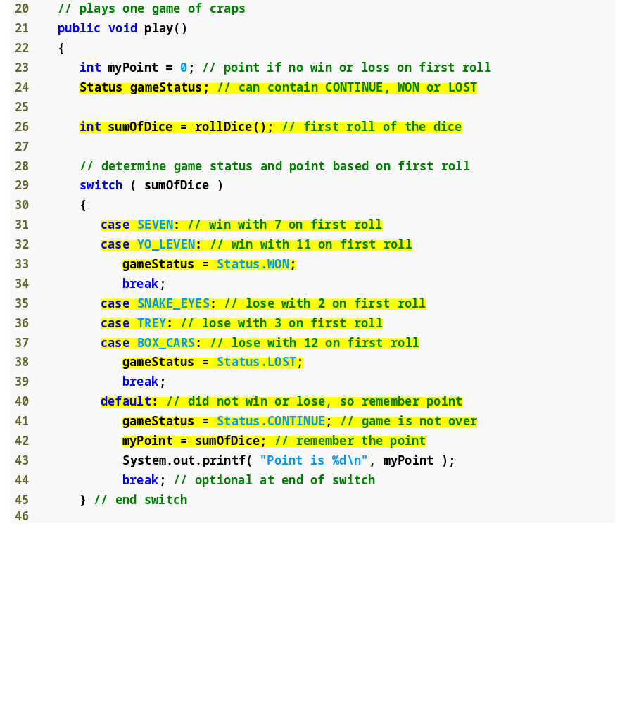
Outline
Call rollDice method
Craps.java
(2 of 4)
Player wins with a roll of 7 or 11
Player loses with a roll of 2, 3 or 12
Set and display the point

Slide 57
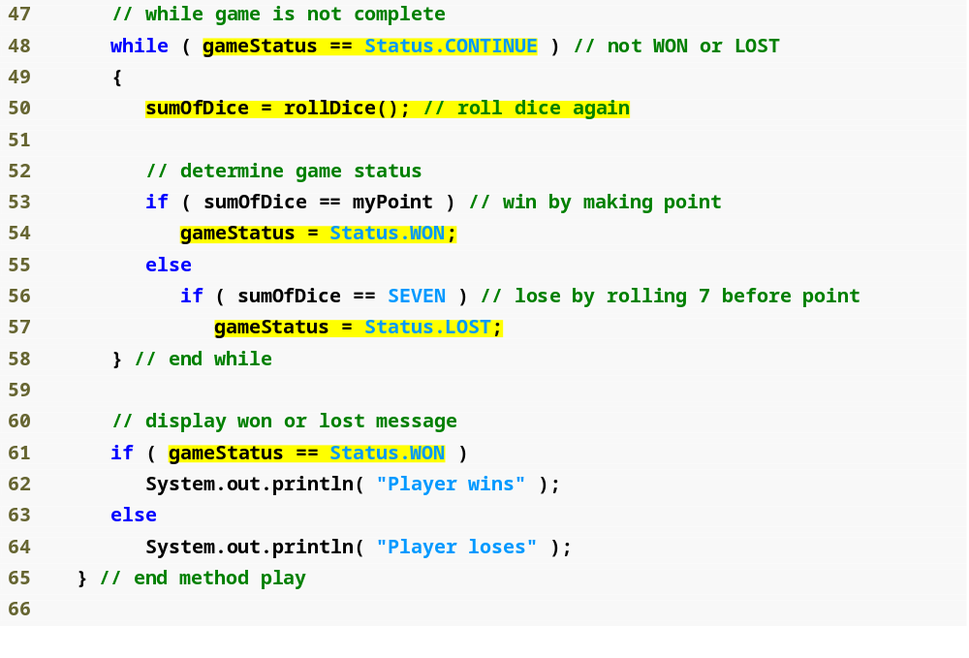
Outline
Call rollDice method
Craps.java
(3 of 4)
Player wins by making the point
Player loses by rolling 7
Display outcome

Slide 58
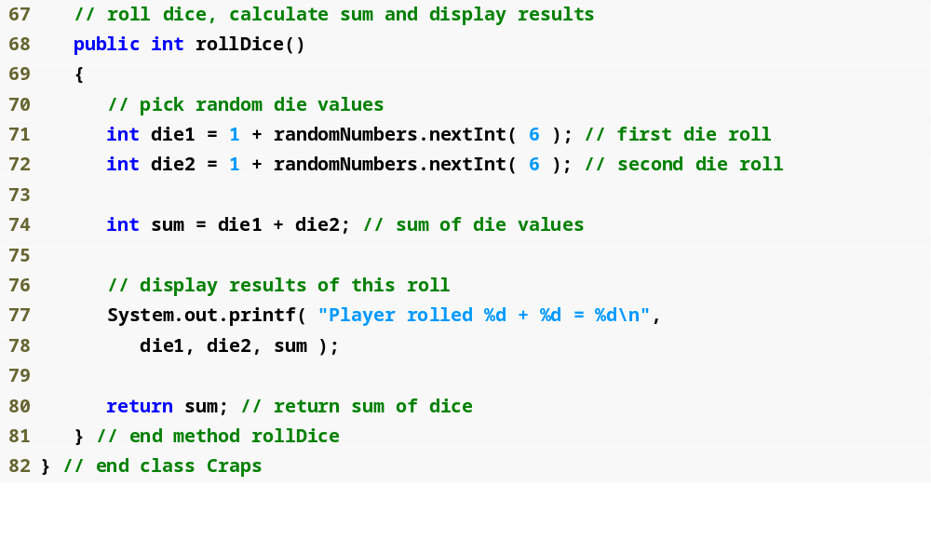
Outline
Declare rollDice method
Craps.java
(4 of 4)
Generate two dice rolls
Display dice rolls and their sum

Slide 59
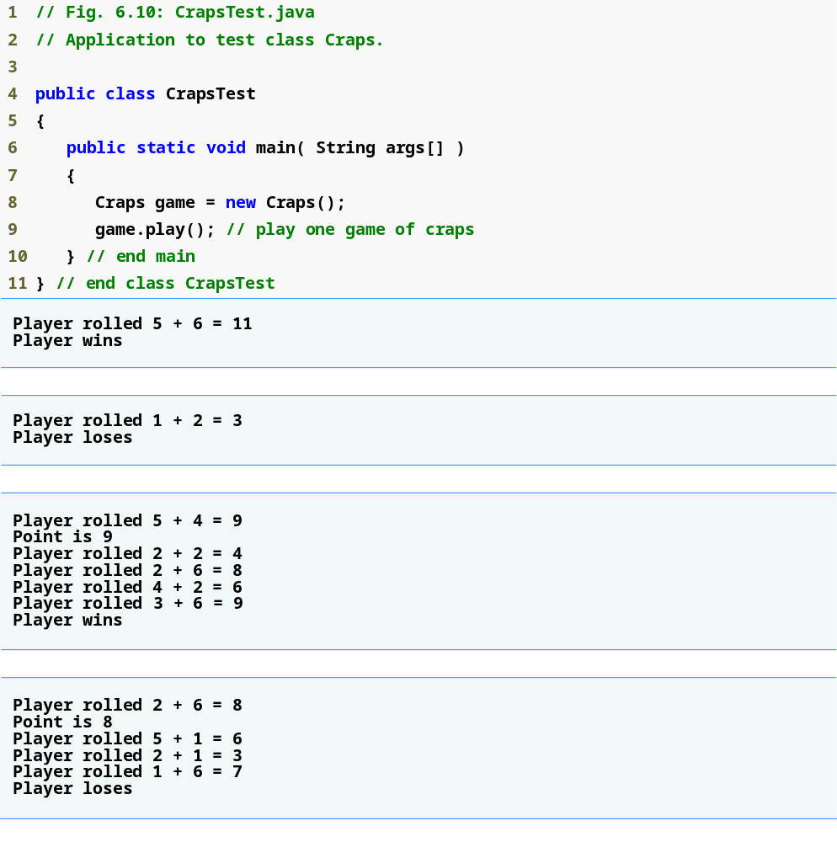
Outline
CrapsTest.java
(1 of 2)

Slide 60
6.10 Case Study: A Game of Chance (Introducing Enumerations)
Enumerations
  Programmer-declared types consisting of sets of constants
  enum keyword
  A type name (e.g. Status)
  Enumeration constants (e.g. WON, LOST and CONTINUE)
    cannot be compared against ints

Slide 61
Good Programming Practice 6.3
Use only uppercase letters in the names of constants. This makes the constants stand out in a program and reminds the programmer that enumeration constants are not variables.

Slide 62
Good Programming Practice 6.4
Using enumeration constants (like Status.WON, Status.LOST and Status.CONTINUE) rather than literal integer values (such as 0, 1 and 2) can make programs easier to read and maintain.

Slide 63
6.11 Scope of Declarations
Basic scope rules
  Scope of a parameter declaration is the body of the method in which appears
  Scope of a local-variable declaration is from the point of declaration to the end of that block
  Scope of a local-variable declaration in the initialization section of a for header is the rest of the for header and the body of the for statement
  Scope of a method or field of a class is the entire body of the class

Slide 64
6.11 Scope of Declarations (Cont.)
Shadowing
  A field is shadowed (or hidden) if a local variable or parameter has the same name as the field
    This lasts until the local variable or parameter goes out of scope

Slide 65
Common Programming Error 6.10
A compilation error occurs when a local variable is declared more than once in a method.

Slide 66
Error-Prevention Tip 6.3
Use different names for fields and local variables to help prevent subtle logic errors that occur when a method is called and a local variable of the method shadows a field of the same name in the class.

Slide 67
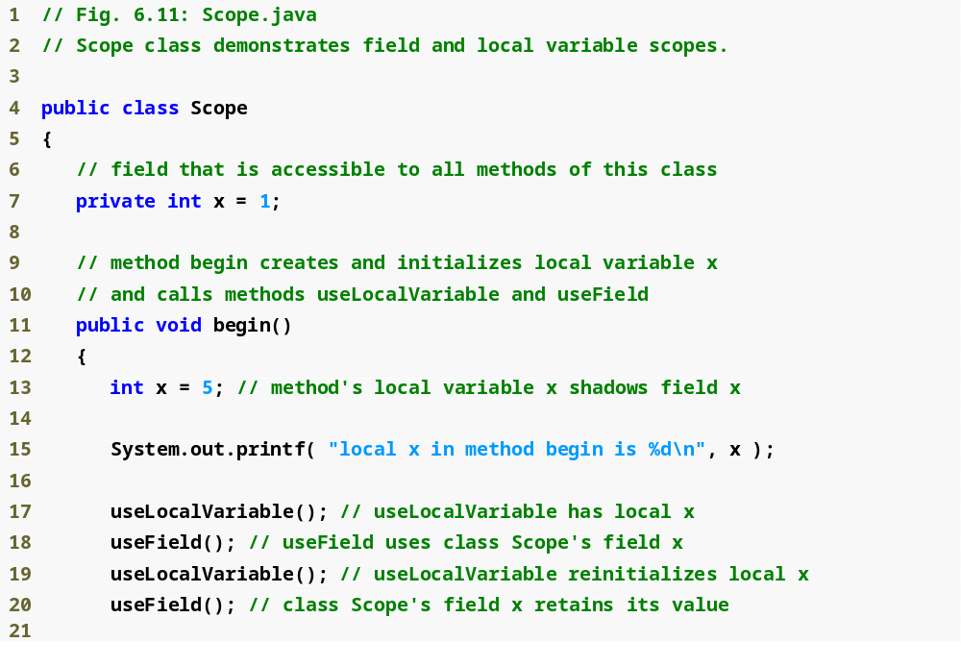
Outline
Scope.java
(1 of 2)
Shadows field x
Display value of local variable x

Slide 68
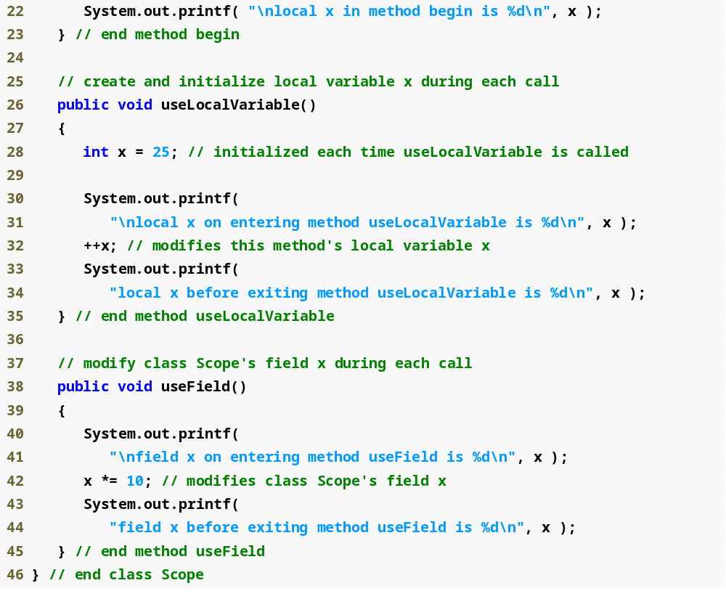
Outline
Shadows field x
Scope.java
(2 of 2)
Display value of local variable x
Display value of field x

Slide 69
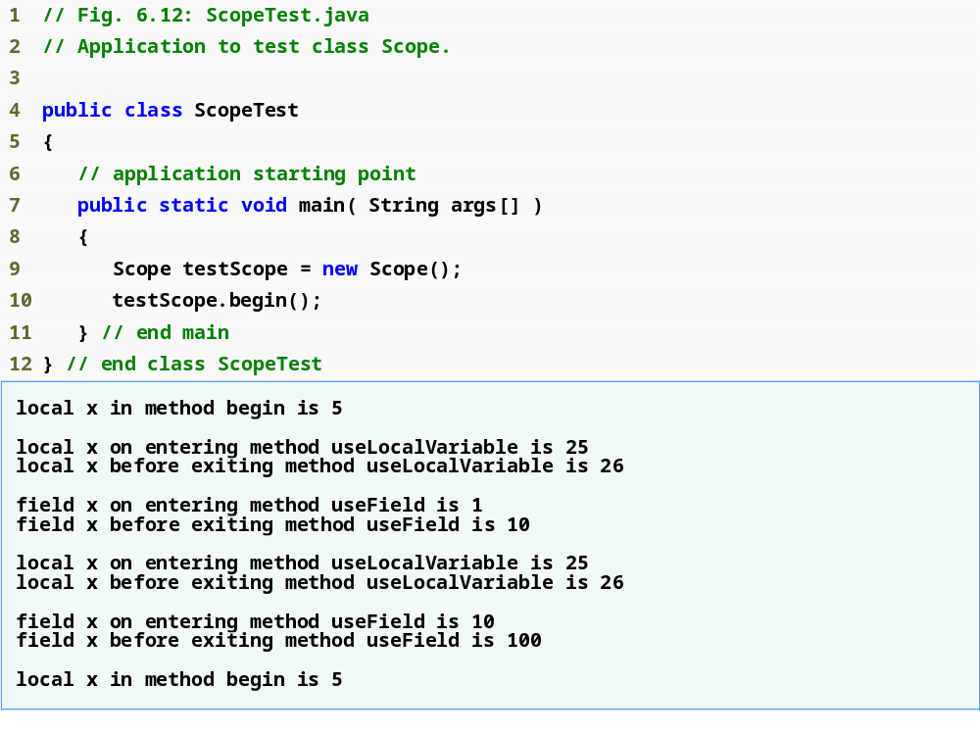
Outline
ScopeTest.java

Slide 70
6.12 Method Overloading
Method overloading
  Multiple methods with the same name, but different types, number or order of parameters in their parameter lists
  Compiler decides which method is being called by matching the method call’s argument list to one of the overloaded methods’ parameter lists
    A method’s name and number, type and order of its parameters form its signature
  Differences in return type are irrelevant in method overloading
    Overloaded methods can have different return types
    Methods with different return types but the same signature cause a compilation error

Slide 71
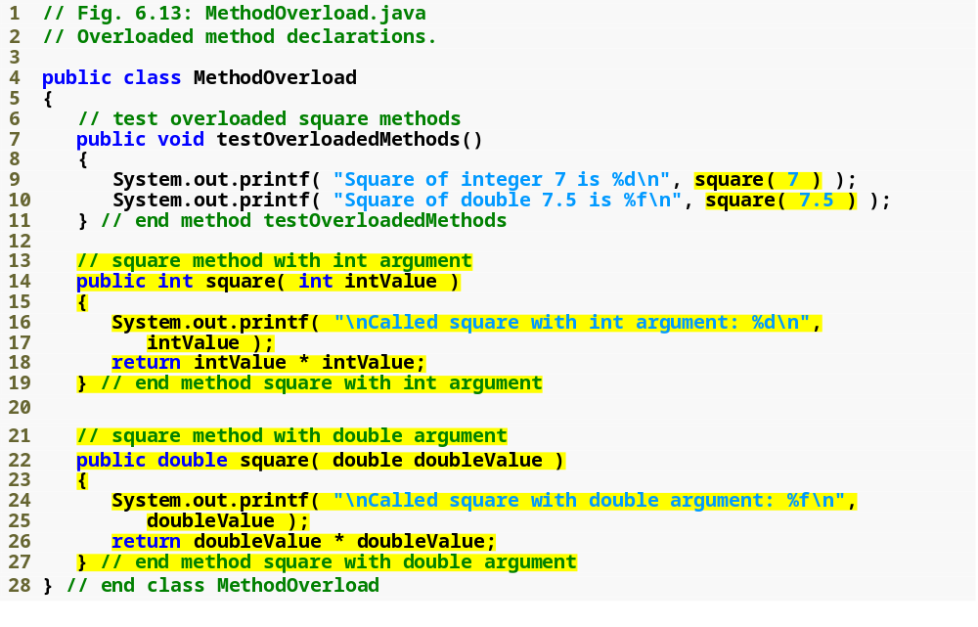
Outline
Correctly calls the “square of int” method
MethodOverload.java
Correctly calls the “square of double” method
Declaring the “square of int” method
Declaring the “square of double” method

Slide 72
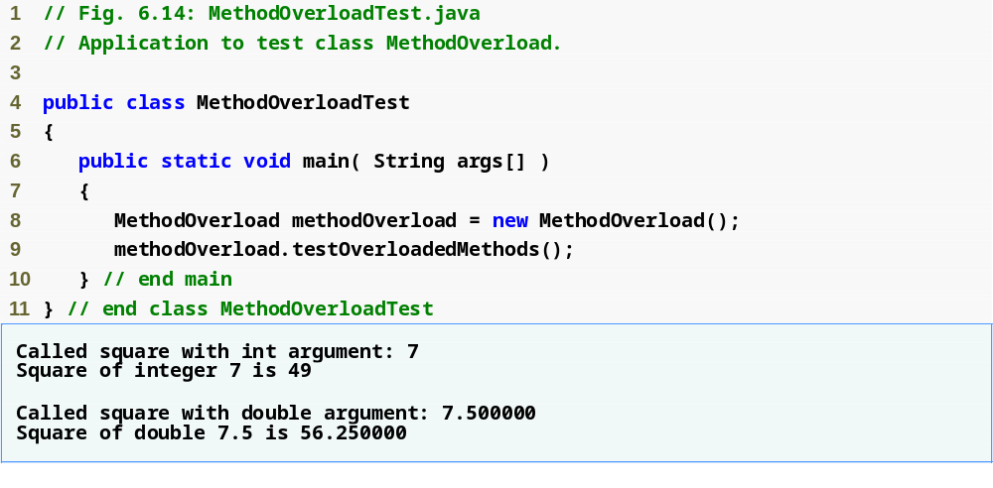
Outline
MethodOverloadTest.java

Slide 73
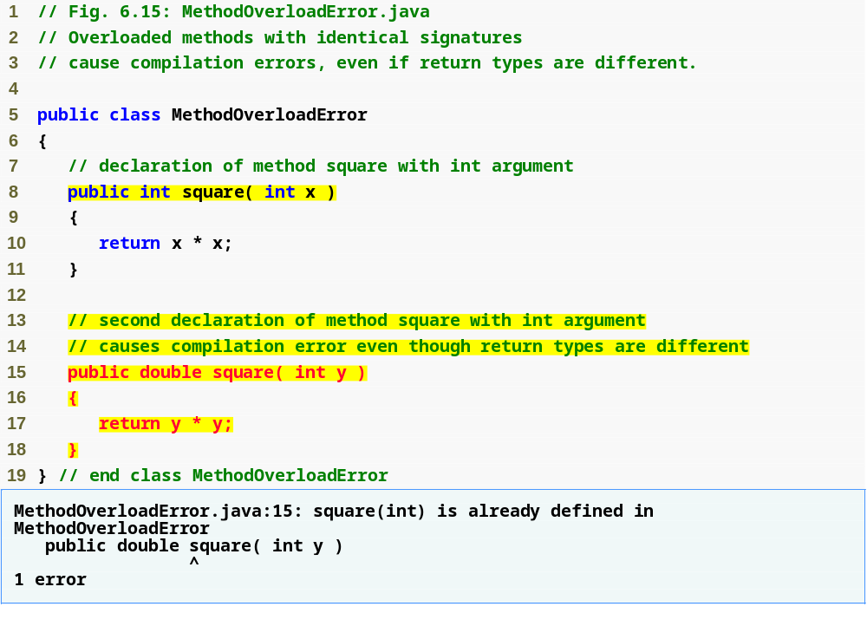
Outline
MethodOverload
Error.java
Same method signature
Compilation error

Slide 74
Common Programming Error 6.11
Declaring overloaded methods with identical parameter lists is a compilation error regardless of whether the return types are different.

Slide 75
6.13 (Optional) GUI and Graphics Case Study: Colors and Filled Shapes
Color class of package java.awt
  Represented as RGB (red, green and blue) values
    Each component has a value from 0 to 255
  13 predefined static Color objects:
    Color.Black, Coor.BLUE, Color.CYAN, Color.DARK_GRAY, Color.GRAY, Color.GREEN, Color.LIGHT_GRAY, Color.MAGENTA, Color.ORANGE, Color.PINK, Color.RED, Color.WHITE and Color.YELLOW

Slide 76
6.13 (Optional) GUI and Graphics Case Study: Colors and Filled Shapes (Cont.)
fillRect and fillOval methods of Graphics class
  Similar to drawRect and drawOval but draw rectangles and ovals filled with color
    First two parameters specify upper-left corner coordinates and second two parameters specify width and height
setColor method of Graphics class
  Set the current drawing color (for filling rectangles and ovals drawn by fillRect and fillOval)

Slide 77
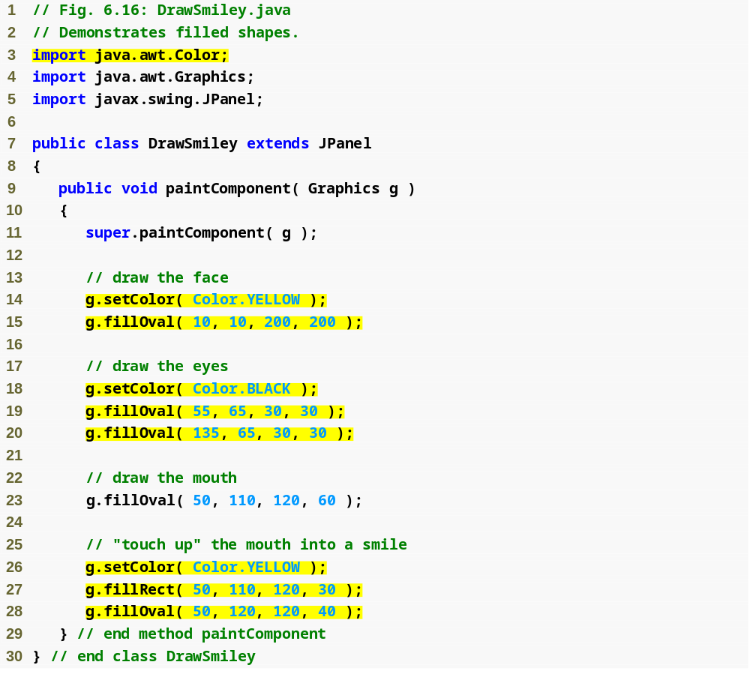
Outline
Import Color class
DrawSmiley.java
Set fill colors
Draw filled shapes

Slide 78
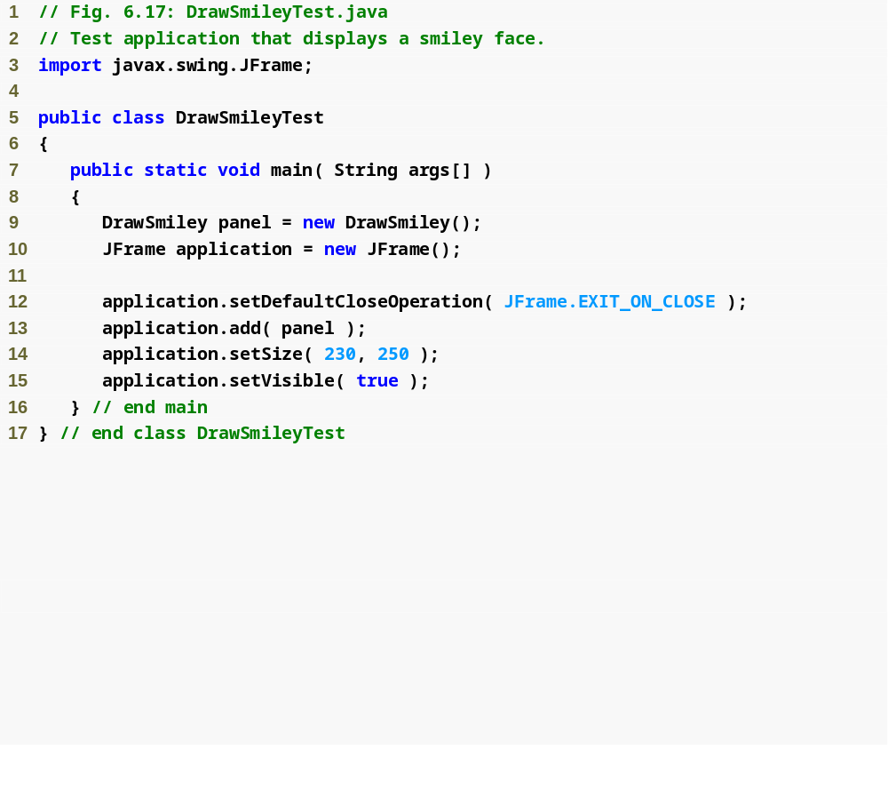

Outline
DrawSmileyTest
.java

Slide 79

Fig. 6.18 | A bull’s-eye with two alternating, random colors.

Slide 80
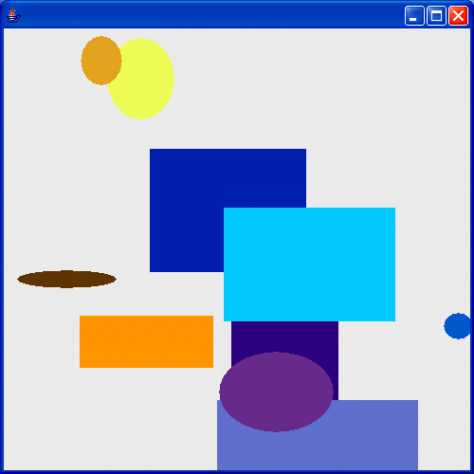
Fig. 6.19 | Randomly generated shapes.

Slide 81
6.14 (Optional) Identifying Class Operations
Identifying operations
  Examine key verbs and verb phrases in the requirements document
Modeling operations in UML
  Each operation is given an operation name, a parameter list and a return type:
    operationName( parameter1, parameter2, …, parameterN ) : return type
    Each parameter has a parameter name and a parameter type
      parameterName : parameterType

Slide 82
6.14 (Optional) Identifying Class Operations (Cont.)
  Some operations may not have return types yet
    Remaining return types will be added as design and implementation proceed
Identifying and modeling operation parameters
  Examine what data the operation requires to perform its assigned task
  Additional parameters may be added later on

Slide 83
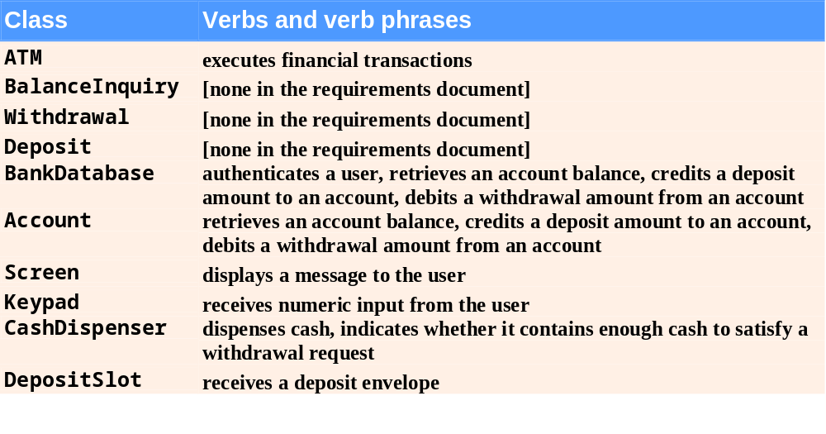
Fig. 6.20 | Verbs and verb phrases for each class in the ATM system.

Slide 84
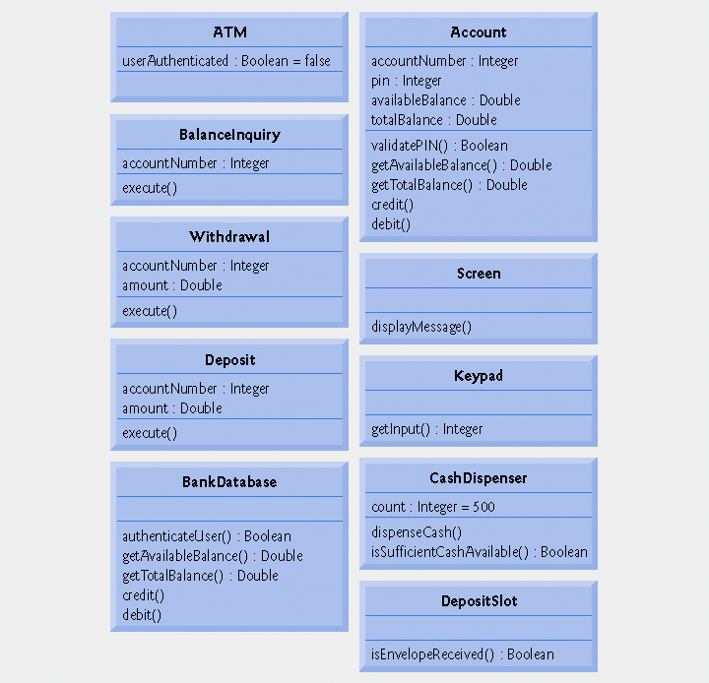
Fig. 6.21 | Classes in the ATM system with attributes and operations.

Slide 85
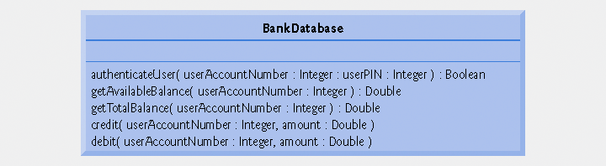
Fig. 6.22 | Class BankDatabase with operation parameters.

Slide 86
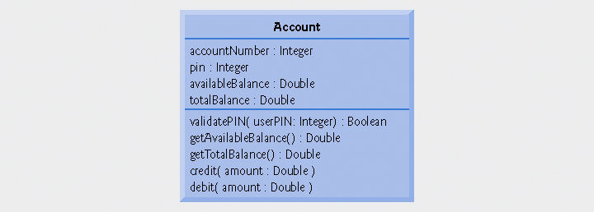
Fig. 6.23 | Class Account with operation parameters.

Slide 87

Fig. 6.24 | Class Screen with operation parameters.

Slide 88

Fig. 6.25 | Class CashDispenser with operation parameters.

