Slide 1
5
Control Statements: Part 2

Slide 2
Not everything that can be counted counts, and not every thing that counts can be counted.
  Albert Einstein
Who can control his fate?
  William Shakespeare
The used key is always bright.
  Benjamin Franklin
Intelligence … is the faculty of making artificial objects, especially tools to make tools.
  Henri Bergson
Every advantage in the past is judged in the light of the final issue.
  Demosthenes

Slide 3
OBJECTIVES
In this chapter you will learn:
The essentials of counter-controlled repetition.
To use the for and do…while repetition statements to execute statements in a program repeatedly.
To understand multiple selection using the switch selection statement.
To use the break and continue program control statements to alter the flow of control.
To use the logical operators to form complex conditional expressions in control statements.

Slide 4
5.1 Introduction
5.2 Essentials of Counter-Controlled Repetition
5.3 for Repetition Statement
5.4 Examples Using the for Statement
5.5 do…while Repetition Statement
5.6 switch Multiple-Selection Statement
5.7 break and continue Statements
5.8 Logical Operators
5.9 Structured Programming Summary
5.10 (Optional) GUI and Graphics Case Study: Drawing Rectangles and Ovals
5.11 (Optional) Software Engineering Case Study: Identifying Objects’ States and Activities
5.12 Wrap-Up

Slide 5
5.1 Introduction
Continue structured-programming discussion
  Introduce Java’s remaining control structures
    for, do…while, switch

Slide 6
5.2 Essentials of Counter-Controlled Repetition
Counter-controlled repetition requires:
  Control variable (loop counter)
  Initial value of the control variable
  Increment/decrement of control variable through each loop
  Loop-continuation condition that tests for the final value of the control variable

Slide 7
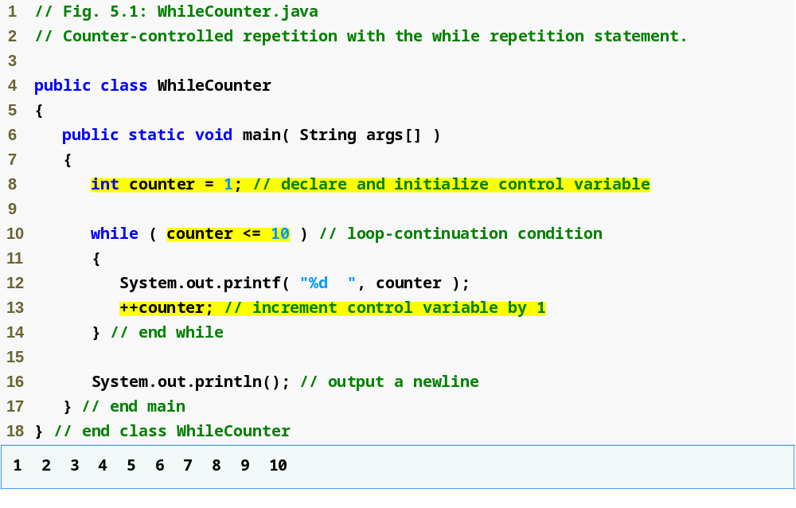
Outline
WhileCounter.java
Control-variable name is counter
Control-variable initial value is 1
Condition tests for counter’s final value
Increment for counter

Slide 8
Common Programming Error 5.1
Because floating-point values may be approximate, controlling loops with floating-point variables may result in imprecise counter values and inaccurate termination tests.

Slide 9
Error-Prevention Tip 5.1
Control counting loops with integers.

Slide 10
Good Programming Practice 5.1
Place blank lines above and below repetition and selection control statements, and indent the statement bodies to enhance readability.

Slide 11
Software Engineering Observation 5.1
“Keep it simple” remains good advice for most of the code you will write.

Slide 12
5.3 for Repetition Statement
Handles counter-controlled-repetition details

Slide 13
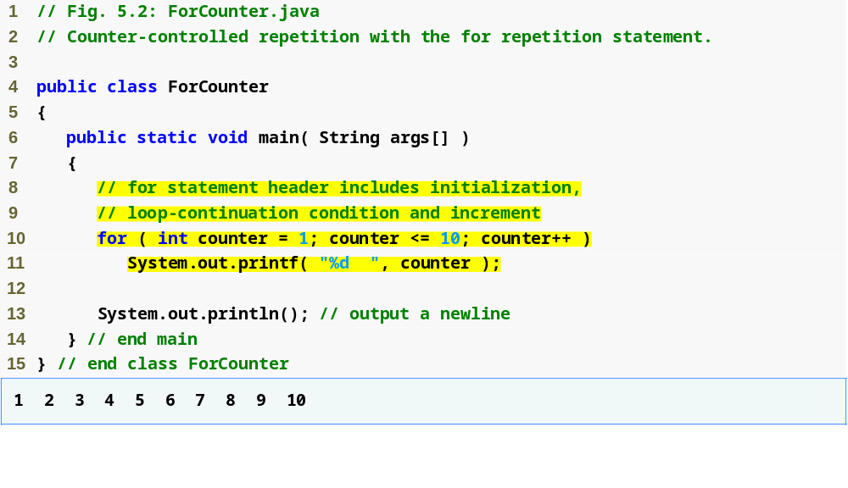
Outline
ForCounter.java
Line 10
int counter = 1;
Line 10
counter <= 10;
Line 10
counter++;
Control-variable name is counter
Control-variable initial value is 1
Increment for counter
Condition tests for counter’s final value

Slide 14
Common Programming Error 5.2
Using an incorrect relational operator or an incorrect final value of a loop counter in the loop-continuation condition of a repetition statement can cause an off-by-one error.

Slide 15
Good Programming Practice 5.2
Using the final value in the condition of a while or for statement and using the <= relational operator helps avoid off-by-one errors. For a loop that prints the values 1 to 10, the loop-continuation condition should be counter <= 10 rather than counter < 10 (which causes an off-by-one error) or counter < 11 (which is correct). Many programmers prefer so-called zero-based counting, in which to count 10 times, counter would be initialized to zero and the loop-continuation test would be counter < 10.

Slide 16
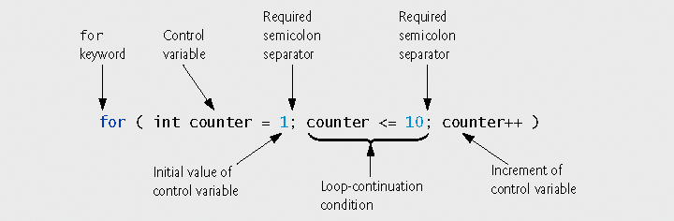
Fig. 5.3 | for statement header components.

Slide 17
5.3 for Repetition Statement (Cont.)
for ( initialization; loopContinuationCondition; increment )
statement;
can usually be rewritten as:
initialization;
while ( loopContinuationCondition )
{
statement;
increment;
}

Slide 18
Common Programming Error 5.3
Using commas instead of the two required semicolons in a for header is a syntax error.

Slide 19
Common Programming Error 5.4
When a for statement’s control variable is declared in the initialization section of the for’s header, using the control variable after the for’s body is a compilation error.

Slide 20
Performance Tip 5.1
There is a slight performance advantage to preincrementinga, but if you choose to postincrement because it seems more natural (as in a for header), optimizing compilers will generate Java bytecode that uses the more efficient form anyway.

Slide 21
Good Programming Practice 5.3
In the most cases, preincrementing and postincrementing are both used to add 1 to a variable in a statement by itself. In these cases, the effect is exactly the same, except that preincrementing has a slight performance advantage. Given that the compiler typically optimizes your code to help you get the best performance, use the idiom with which you feel most comfortable in these situations.

Slide 22
Common Programming Error 5.5
Placing a semicolon immediately to the right of the right parenthesis of a for header makes that for’s body an empty statement. This is normally a logic error.

Slide 23
Error-Prevention Tip 5.2
Infinite loops occur when the loop-continuation condition in a repetition statement never becomes false. To prevent this situation in a counter-controlled loop, ensure that the control variable is incremented (or decremented) during each iteration of the loop. In a sentinel-controlled loop, ensure that the sentinel value is eventually input.

Slide 24
Error-Prevention Tip 5.3
Although the value of the control variable can be changed in the body of a for loop, avoid doing so, because this practice can lead to subtle errors.

Slide 25
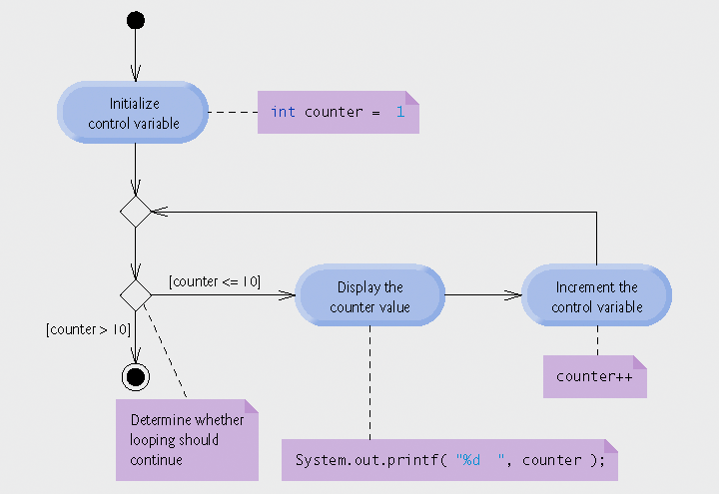
Fig. 5.4 | UML activity diagram for the for statement in Fig. 5.2.

Slide 26
5.4 Examples Using the for Statement
Varying control variable in for statement
  Vary control variable from 1 to 100 in increments of 1
    for ( int i = 1; i <= 100; i++ )
  Vary control variable from 100 to 1 in increments of –1
    for ( int i = 100; i >= 1; i-- )
  Vary control variable from 7 to 77 in increments of 7
    for ( int i = 7; i <= 77; i += 7 )
  Vary control variable from 20 to 2 in decrements of 2
    for ( int i = 20; i >= 2; i -= 2 )
  Vary control variable over the sequence: 2, 5, 8, 11, 14, 17, 20
    for ( int i = 2; i <= 20; i += 3 )
  Vary control variable over the sequence: 99, 88, 77, 66, 55, 44, 33, 22, 11, 0
    for ( int i = 99; i >= 0; i -= 11 )

Slide 27
Common Programming Error 5.6
Not using the proper relational operator in the loop-continuation condition of a loop that counts downward (e.g., using i <= 1 instead of i >= 1 in a loop counting down to 1) is usually a logic error.

Slide 28
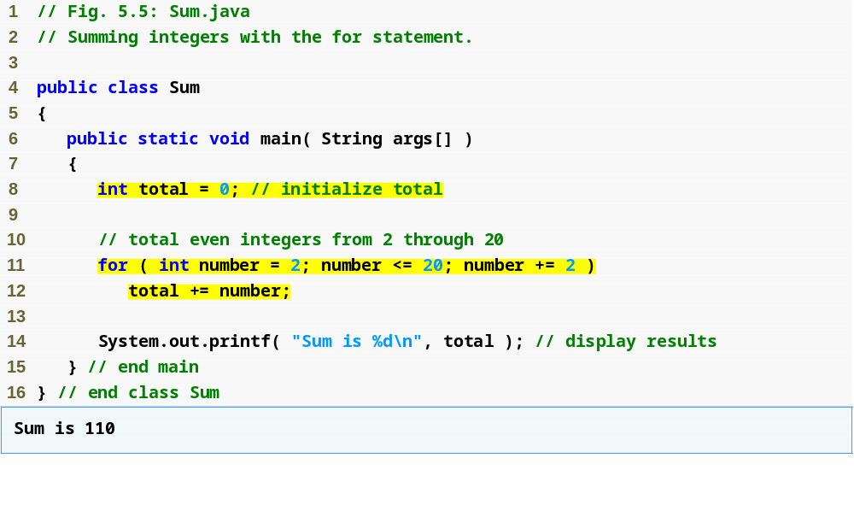
Outline
Sum.java
Line 11
increment number by 2 each iteration

Slide 29
5.4 Examples Using the for Statement (Cont.)
Initialization and increment expression can be comma-separated lists of expressions
  E.g., lines 11-12 of Fig. 5.5 can be rewritten as
  for ( int number = 2; number <= 20; total += number, number += 2 )
  ; // empty statement

Slide 30
Good Programming Practice 5.4
Limit the size of control statement headers to a single line if possible.

Slide 31
Good Programming Practice 5.5
Place only expressions involving the control variables in the initialization and increment sections of a for statement. Manipulations of other variables should appear either before the loop (if they execute only once, like initialization statements) or in the body of the loop (if they execute once per iteration of the loop, like increment or decrement statements).

Slide 32
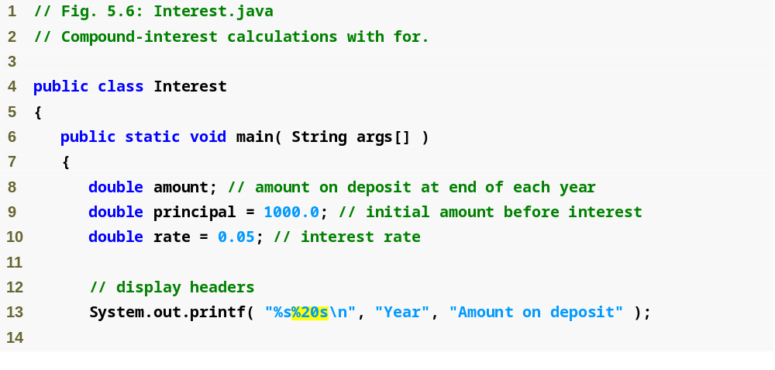
Outline
Java treats literal values with decimal points as type double
Interest.java
(1 of 2)
Line 8
Line 13
Second string is right justified and displayed with a field width of 20

Slide 33
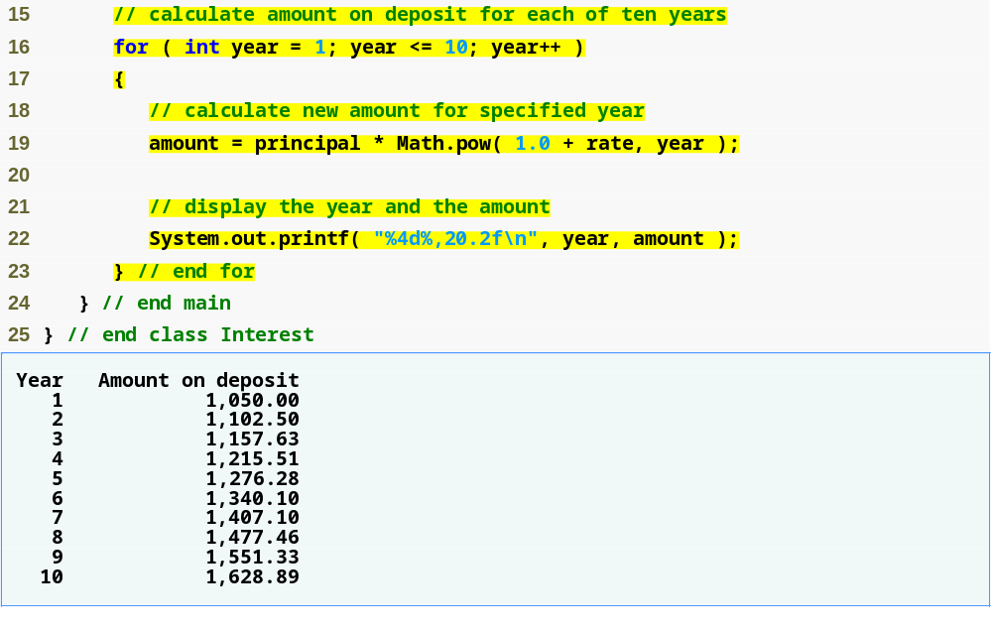
Outline
Calculate amount with for statement
Interest.java
(2 of 2)
Lines 16-23
Line 22
Program output
Use the comma (,) formatting flag to display the amount with a thousands separator

Slide 34
5.4 Examples Using the for Statement (Cont.)
Formatting output
  Field width
  Minus sign (-) formatting flag for left justification
  Comma (,) formatting flag to output numbers with grouping separators
static method
  ClassName.methodName( arguments)

Slide 35
Good Programming Practice 5.6
Do not use variables of type double (or float) to perform precise monetary calculations. The imprecision of floating-point numbers can cause errors that will result in incorrect monetary values. In the exercises, we explore the use of integers to perform monetary calculations. [Note: Some third-party vendors provide for-sale class libraries that perform precise monetary calculations. In addition, the Java API provides class java.math.BigDecimal for performing calculations with arbitrary precision floating-point values.]

Slide 36
Performance Tip 5.2
In loops, avoid calculations for which the result never changes— such calculations should typically be placed before the loop. [Note: Many of today’s sophisticated optimizing compilers will place such calculations outside loops in the compiled code.]

Slide 37
5.5 do…while Repetition Statement
do…while statement
  Similar to while statement
  Tests loop-continuation after performing body of loop
    i.e., loop body always executes at least once

Slide 38
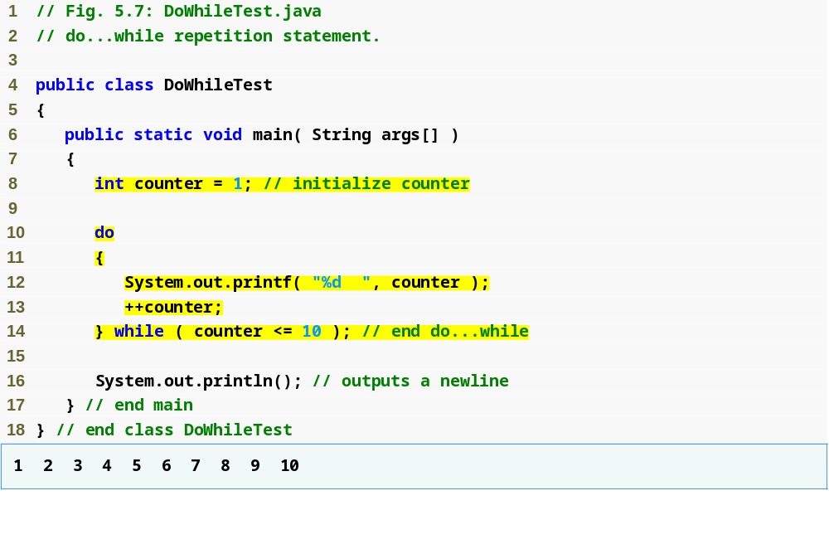
Outline
Declares and initializes control variable counter
DoWhileTest.java
Line 8
Lines 10-14
Program output
Variable counter’s value is displayed before testing counter’s final value

Slide 39
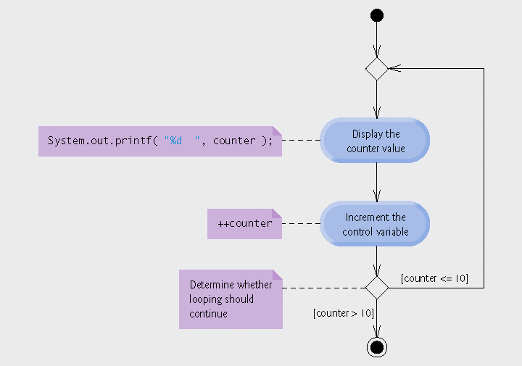
Fig. 5.8 | do...while repetition statement UML activity diagram.

Slide 40
Good Programming Practice 5.7
Always include braces in a do...while statement, even if they are not necessary. This helps eliminate ambiguity between the while statement and a do...while statement containing only one statement.

Slide 41
5.6 switch Multiple-Selection Statement
switch statement
  Used for multiple selections

Slide 42
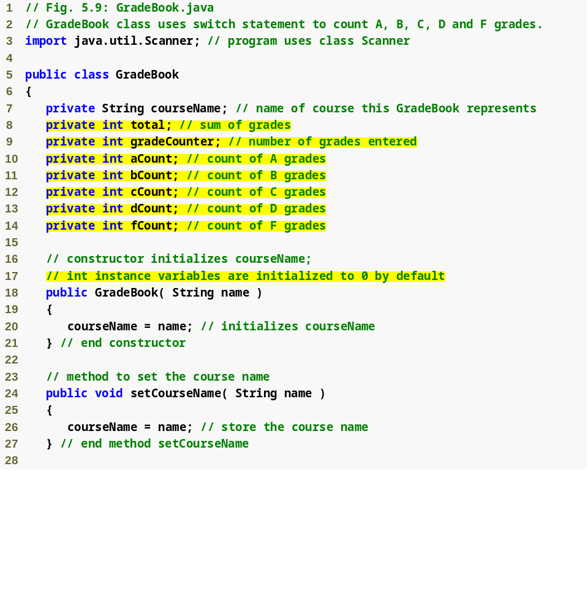
Outline
GradeBook.java
(1 of 5)
Lines 8-14

Slide 43
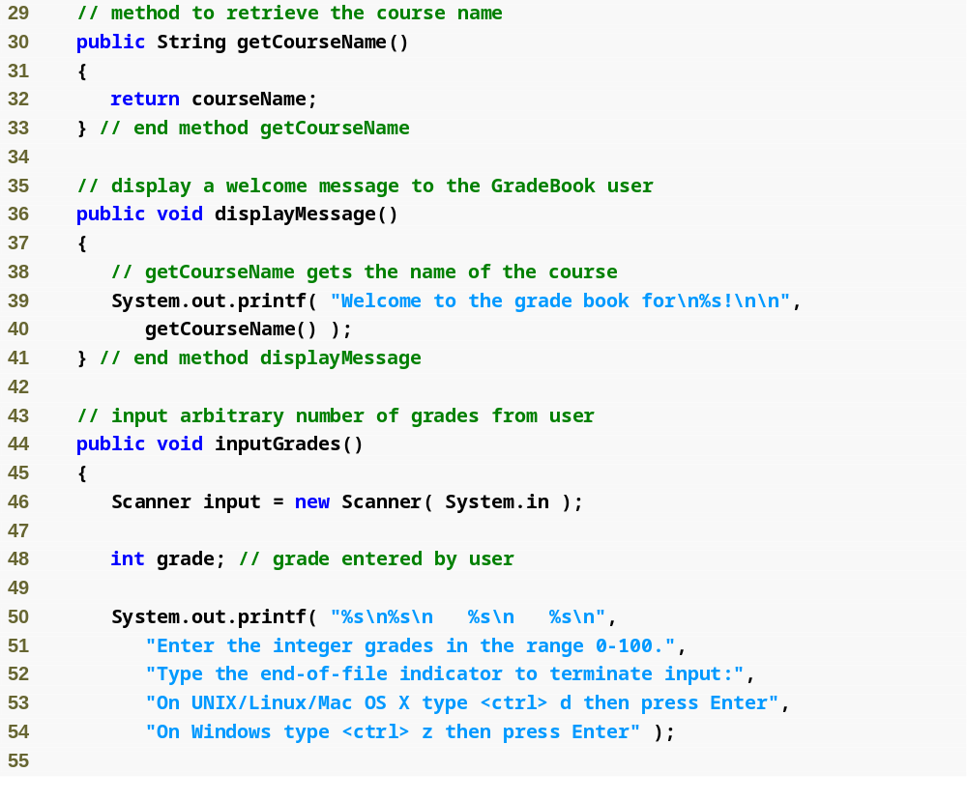
Outline
GradeBook.java
(2 of 5)
Lines 50-54
Display prompt

Slide 44
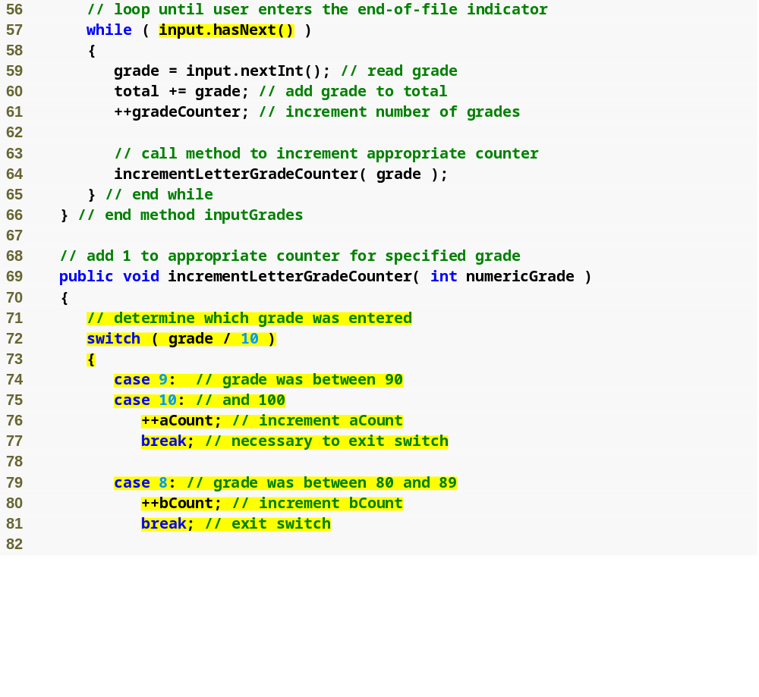
Outline
Loop condition uses method hasNext to determine whether there is more data to input
GradeBook.java
(3 of 5)
Line 57
Line 72 controlling expression
Lines 72-94
(grade / 10 ) is controlling expression
switch statement determines which case label to execute, depending on controlling expression

Slide 45
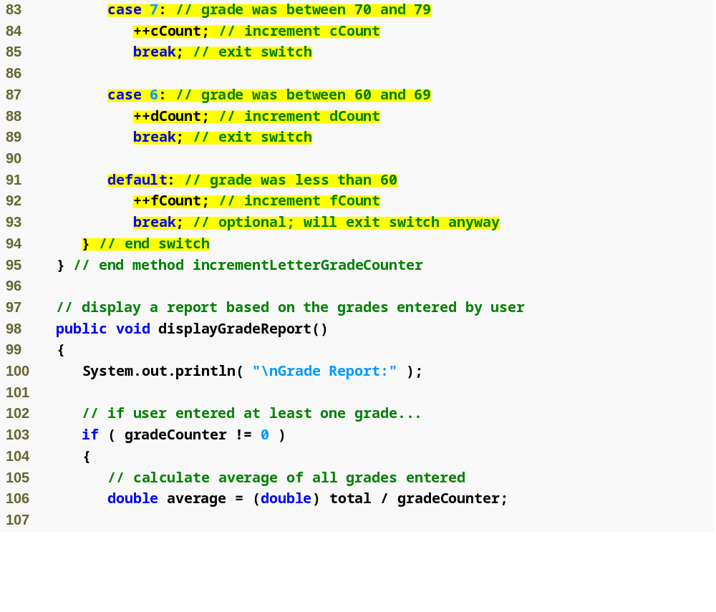
Outline
GradeBook.java
(4 of 5)
Line 91 default case
default case for grade less than 60

Slide 46
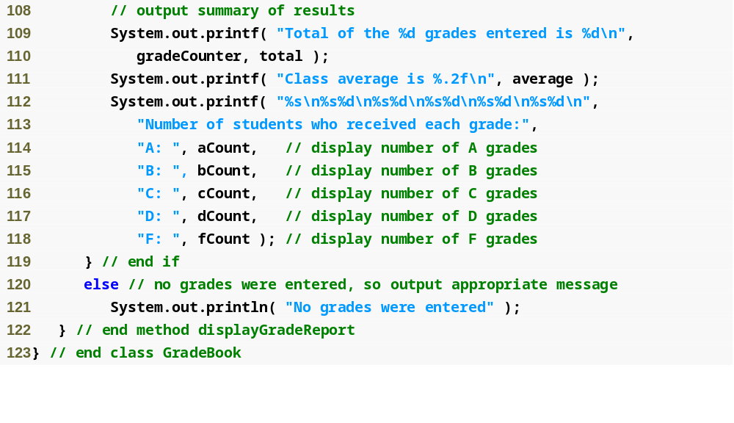
Outline
GradeBook.java
(5 of 5)

Slide 47
Portability Tip 5.1
The keystroke combinations for entering end-of-file are system dependent.

Slide 48
Common Programming Error 5.7
Forgetting a break statement when one is needed in a switch is a logic error.

Slide 49
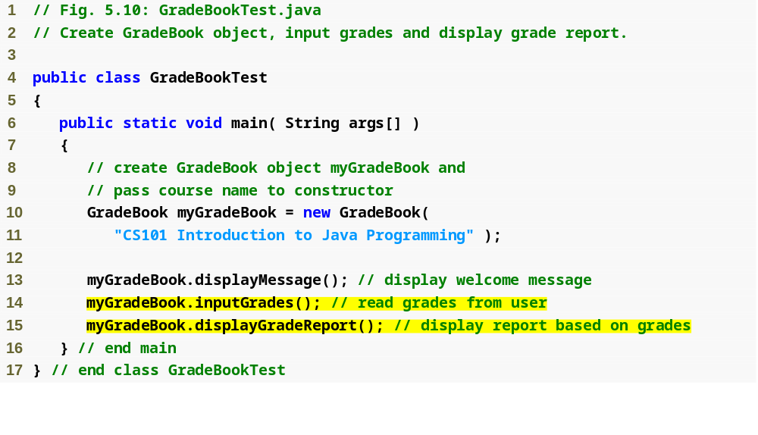
Outline
GradeBookTest.java
(1 of 2)
Lines 13-15
Call GradeBook public methods to count grades

Slide 50
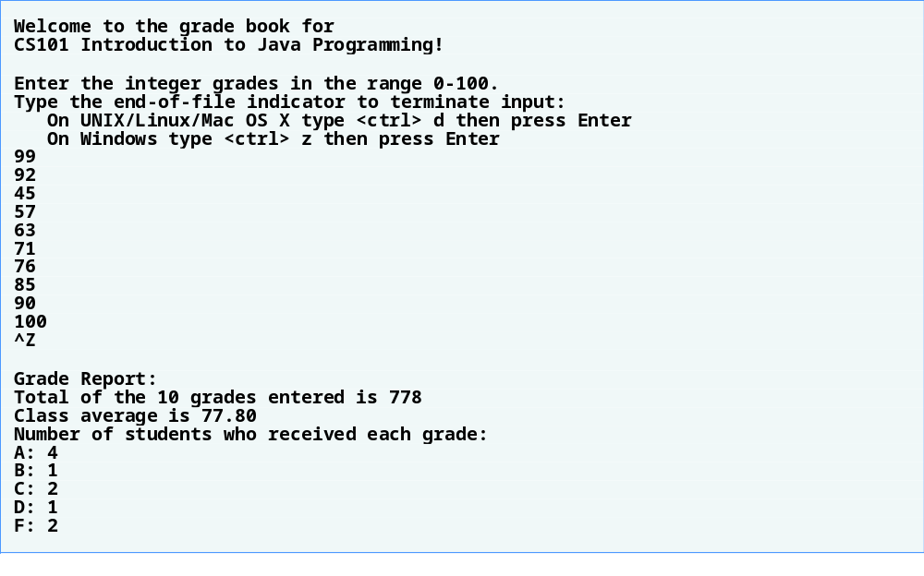
Outline
GradeBookTest.java
(2 of 2)
Program output

Slide 51
Software Engineering Observation 5.2
Provide a default case in switch statements. Including a default case focuses you on the need to process exceptional conditions.

Slide 52
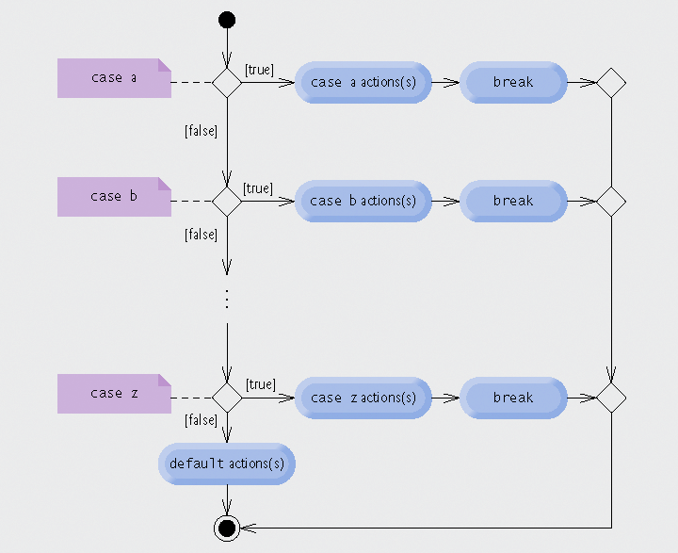
Fig. 5.11 | switch multiple-selection statement UML activity diagram with break statements.

Slide 53
Good Programming Practice 5.8
Although each case and the default case in a switch can occur in any order, place the default case last. When the default case is listed last, the break for that case is not required. Some programmers include this break for clarity and symmetry with other cases.

Slide 54
5.6 switch Multiple-Selection Statement (Cont.)
Expression in each case
  Constant integral expression
    Combination of integer constants that evaluates to a constant integer value
  Character constant
    E.g., ‘A’, ‘7’ or ‘$’
  Constant variable
    Declared with keyword final

Slide 55
5.7 break and continue Statements
break/continue
  Alter flow of control
break statement
  Causes immediate exit from control structure
    Used in while, for, do…while or switch statements
continue statement
  Skips remaining statements in loop body
  Proceeds to next iteration
    Used in while, for or do…while statements

Slide 56
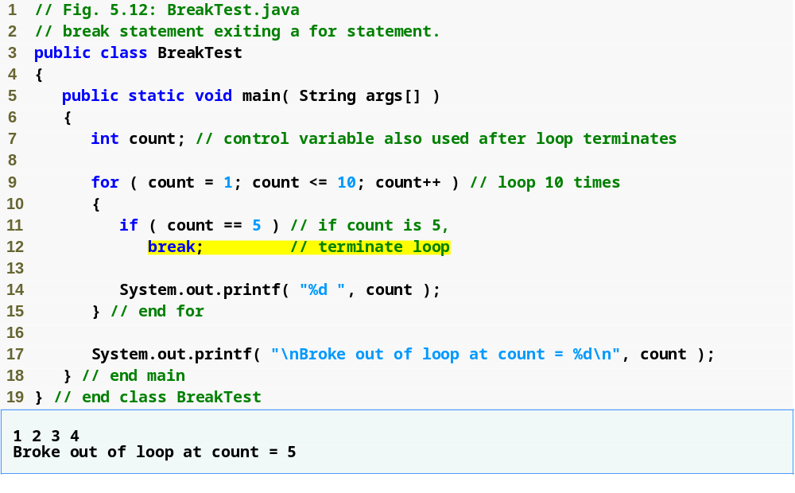
Outline
Loop 10 times
Exit for statement (break) when count equals 5
BreakTest.java
Line 9
Lines 11-12
Program output

Slide 57
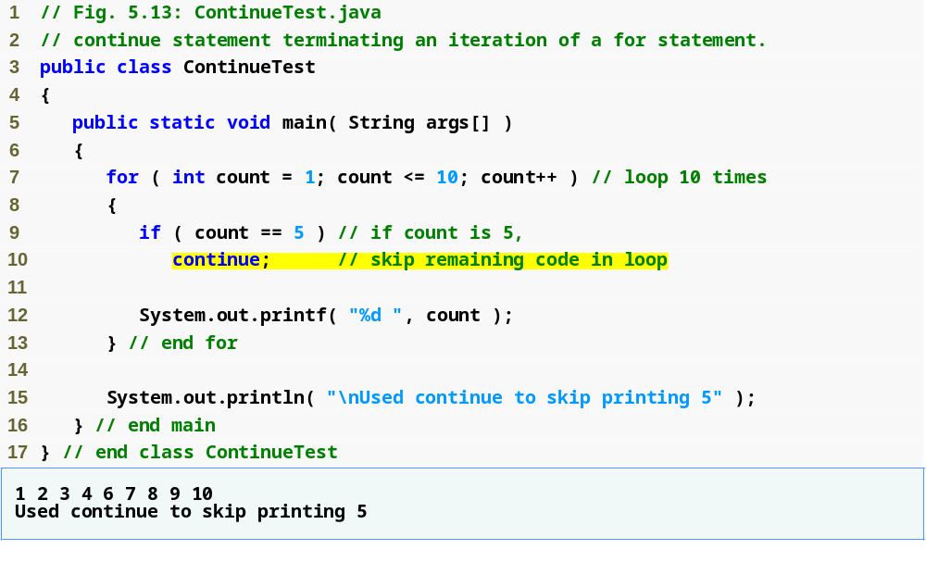
Outline
Loop 10 times
Skip line 12 and proceed to line 7 when count equals 5
ContinueTest.java
Line 7
Lines 9-10
Program output

Slide 58
Software Engineering Observation 5.3
Some programmers feel that break and continue violate structured programming. Since the same effects are achievable with structured programming techniques, these programmers do not use break or continue.

Slide 59
Software Engineering Observation 5.4
There is a tension between achieving quality software engineering and achieving the best-performing software. Often, one of these goals is achieved at the expense of the other. For all but the most performance-intensive situations, apply the following rule of thumb: First, make your code simple and correct; then make it fast and small, but only if necessary.

Slide 60
5.8 Logical Operators
Logical operators
  Allows for forming more complex conditions
  Combines simple conditions
Java logical operators
  && (conditional AND)
  || (conditional OR)
  & (boolean logical AND)
  | (boolean logical inclusive OR)
  ^ (boolean logical exclusive OR)
  ! (logical NOT)

Slide 61
5.8 Logical Operators (Cont.)
Conditional AND (&&) Operator
  Consider the following if statement
    if ( gender == FEMALE && age >= 65 )
    ++seniorFemales;
  Combined condition is true
    if and only if both simple conditions are true
  Combined condition is false
    if either or both of the simple conditions are false

Slide 62
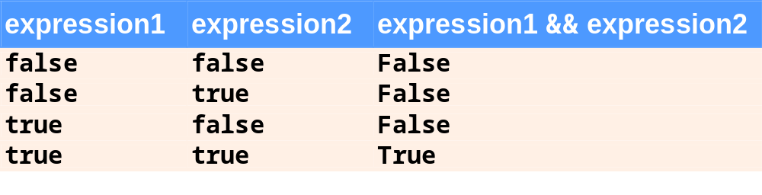
Fig. 5.14 | && (conditional AND) operator truth table.

Slide 63
5.8 Logical Operators (Cont.)
Conditional OR (||) Operator
  Consider the following if statement
    if ( ( semesterAverage >= 90 ) || ( finalExam >= 90 )
    System.out.println( “Student grade is A” );
  Combined condition is true
    if either or both of the simple condition are true
  Combined condition is false
    if both of the simple conditions are false

Slide 64
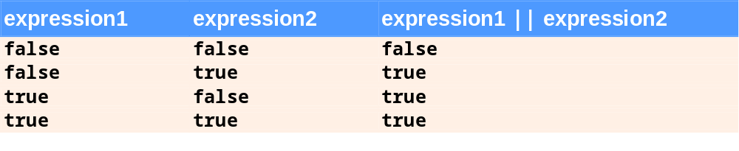
Fig. 5.15 | || (conditional OR) operator truth table.

Slide 65
5.8 Logical Operators (Cont.)
Short-Circuit Evaluation of Complex Conditions
  Parts of an expression containing && or || operators are evaluated only until it is known whether the condition is true or false
  E.g., ( gender == FEMALE ) && ( age >= 65 )
    Stops immediately if gender is not equal to FEMALE

Slide 66
Common Programming Error 5.8
In expressions using operator &&, a condition—we will call this the dependent condition—may require another condition to be true for the evaluation of the dependent condition to be meaningful. In this case, the dependent condition should be placed after the other condition, or an error might occur. For example, in the expression ( i != 0 ) && ( 10 / i == 2 ), the second condition must appear after the first condition, or a divide-by-zero error might occur.

Slide 67
5.8 Logical Operators (Cont.)
Boolean Logical AND (&) Operator
  Works identically to &&
  Except & always evaluate both operands
Boolean Logical OR (|) Operator
  Works identidally to ||
  Except | always evaluate both operands

Slide 68
Error-Prevention Tip 5.4
For clarity, avoid expressions with side effects in conditions. The side effects may look clever, but they can make it harder to understand code and can lead to subtle logic errors.

Slide 69
5.8 Logical Operators (Cont.)
Boolean Logical Exclusive OR (^)
  One of its operands is true and the other is false
    Evaluates to true
  Both operands are true or both are false
    Evaluates to false
Logical Negation (!) Operator
  Unary operator

Slide 70
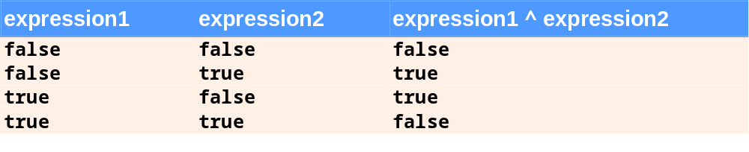
Fig. 5.16 | ^ (boolean logical exclusive OR) operator truth table.

Slide 71
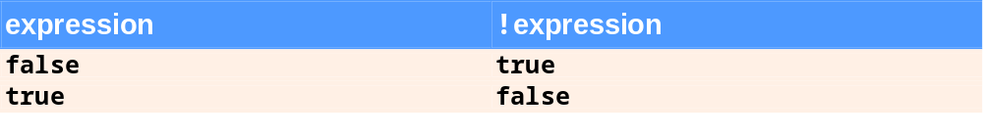
Fig. 5.17 |! (logical negation, or logical NOT) operator truth table.

Slide 72
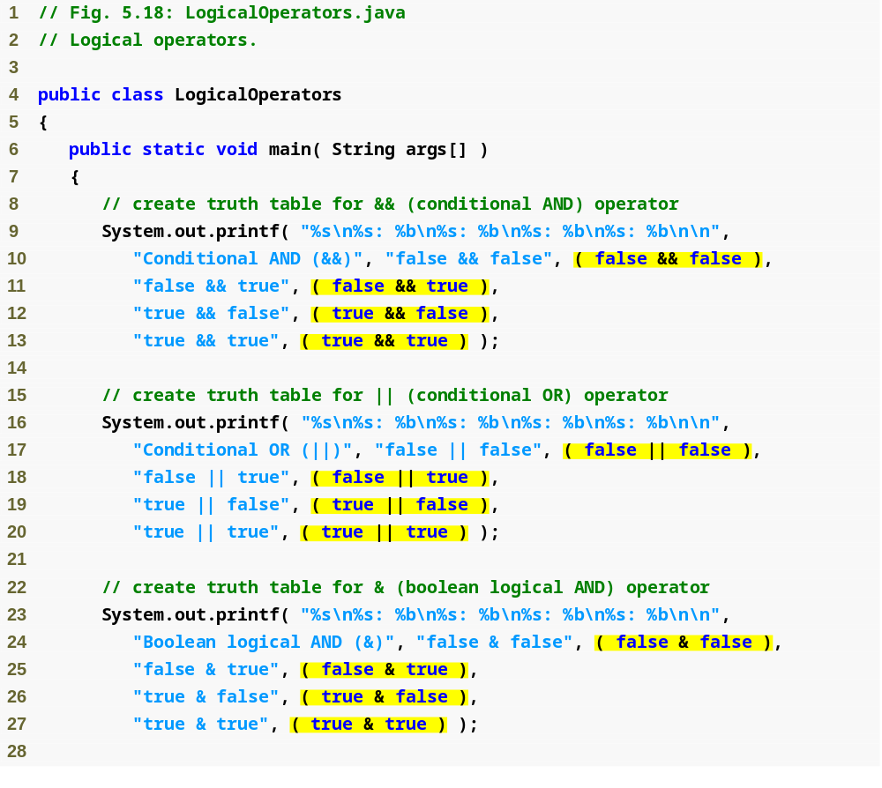
Outline
LogicalOperators. java
(1 of 3)
Lines 9-13
Lines 16-20
Lines 23-27
Conditional AND truth table
Conditional OR truth table
Boolean logical AND truth table

Slide 73
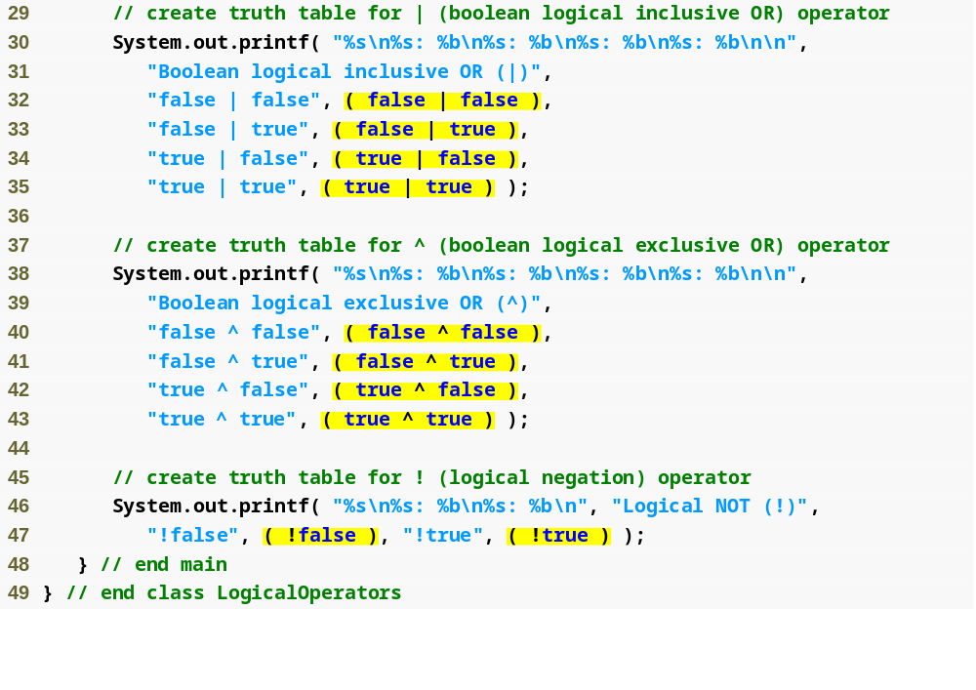
Outline
Boolean logical inclusive OR truth table
LogicalOperators. java
(2 of 3)
Lines 30-35
Lines 38-43
Lines 46-47
Boolean logical exclusive OR truth table
Logical negation truth table

Slide 74
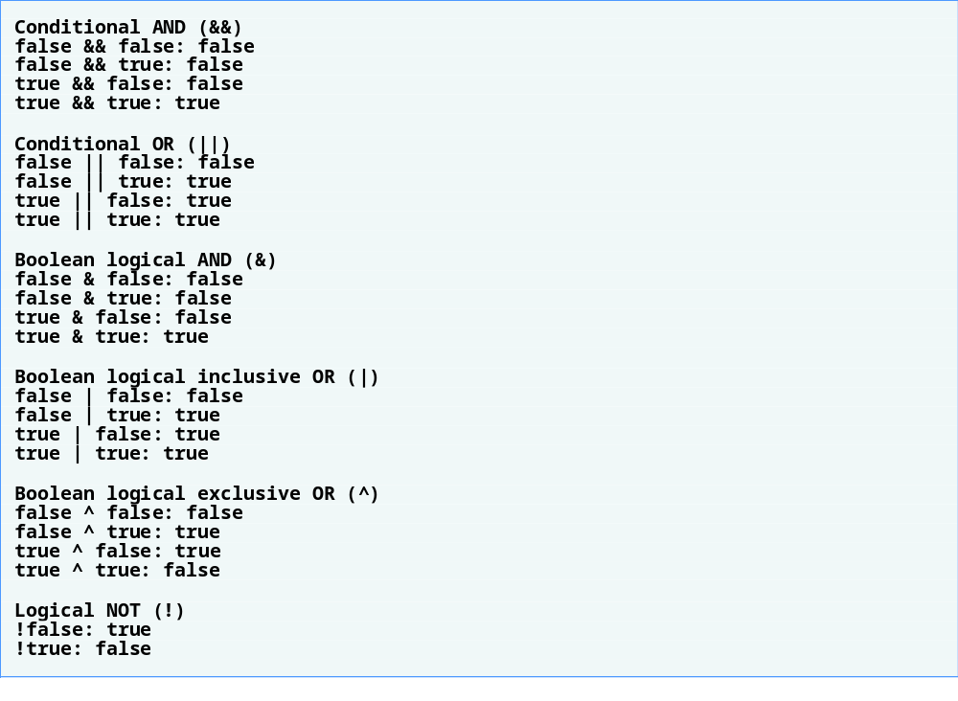
Outline
LogicalOperators. java
(3 of 3)
Program output

Slide 75
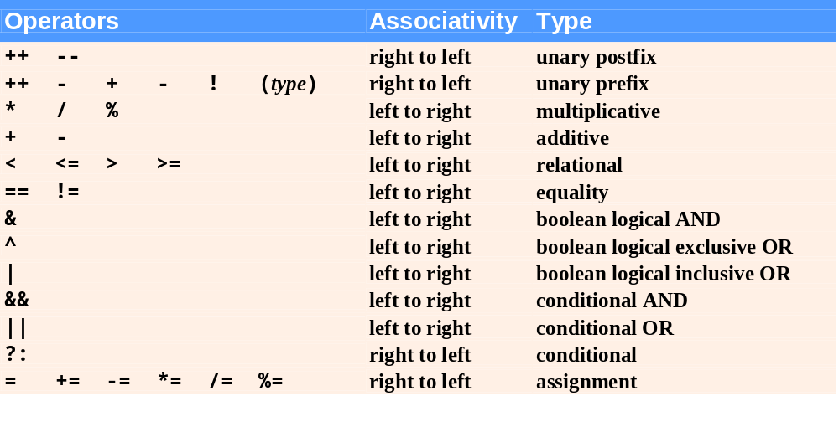
Fig. 5.19 | Precedence/associativity of the operators discussed so far.

Slide 76
5.9 Structured Programming Summary
Sequence structure
  “built-in” to Java
Selection structure
  if, if…else and switch
Repetition structure
  while, do…while and for
ملغي –مش مطلوب

Slide 77
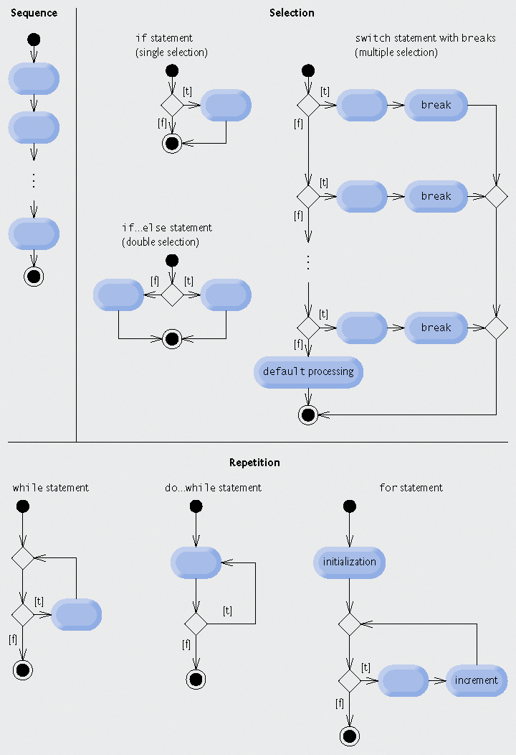
Fig. 5.20 | Java’s single-entry/single-exit sequence, selection and repetition statements.
ملغي –مش مطلوب

Slide 78
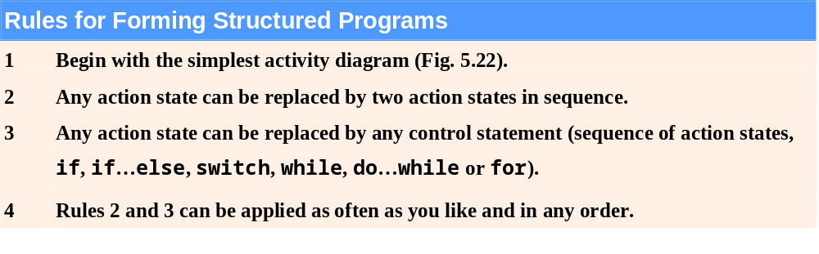
Fig. 5.21 | Rules for forming structured programs.
ملغي –مش مطلوب

Slide 79

Fig. 5.22 | Simplest activity diagram.
ملغي –مش مطلوب

Slide 80
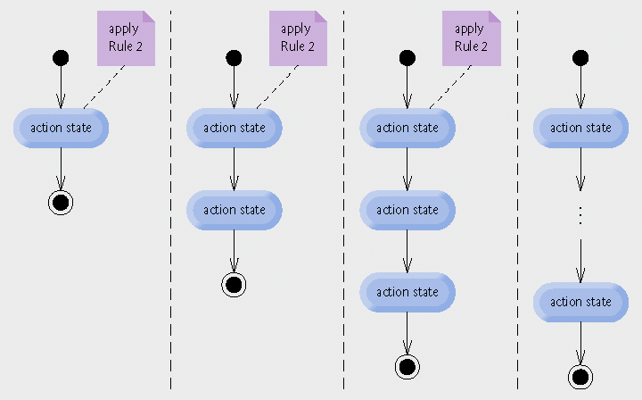
Fig. 5.23 | Repeatedly applying the stacking rule (rule 2) of Fig. 5.21 to the simplest activity diagram.
ملغي –مش مطلوب

Slide 81
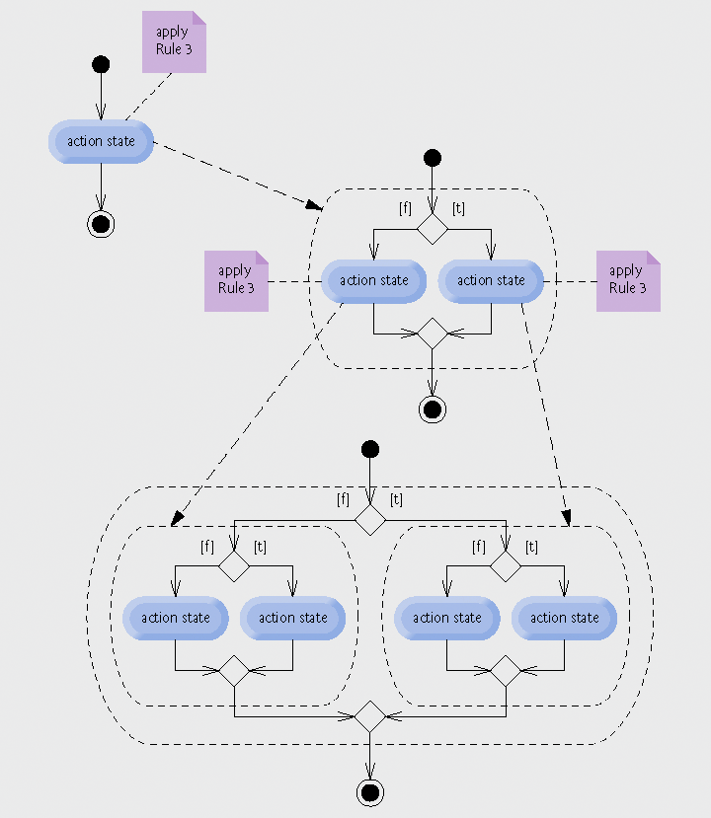
Fig. 5.24 | Repeatedly applying the nesting rule (rule 3) of Fig. 5.21 to the simplest activity diagram.
ملغي –مش مطلوب

Slide 82
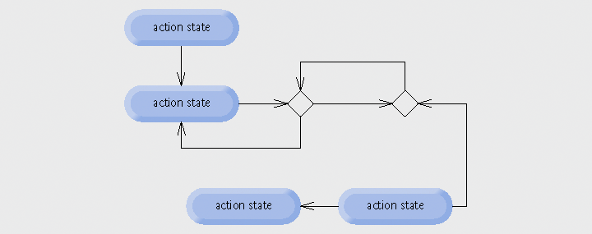
Fig. 5.25 | “Unstructured” activity diagram.
ملغي –مش مطلوب

Slide 83
5.10 (Optional) GUI and Graphics Case Study: Drawing Rectangles and Ovals
Draw rectangles
  Method drawRect of Graphics
Draw ovals
  Method drawOval of Graphics
ملغي –مش مطلوب

Slide 84
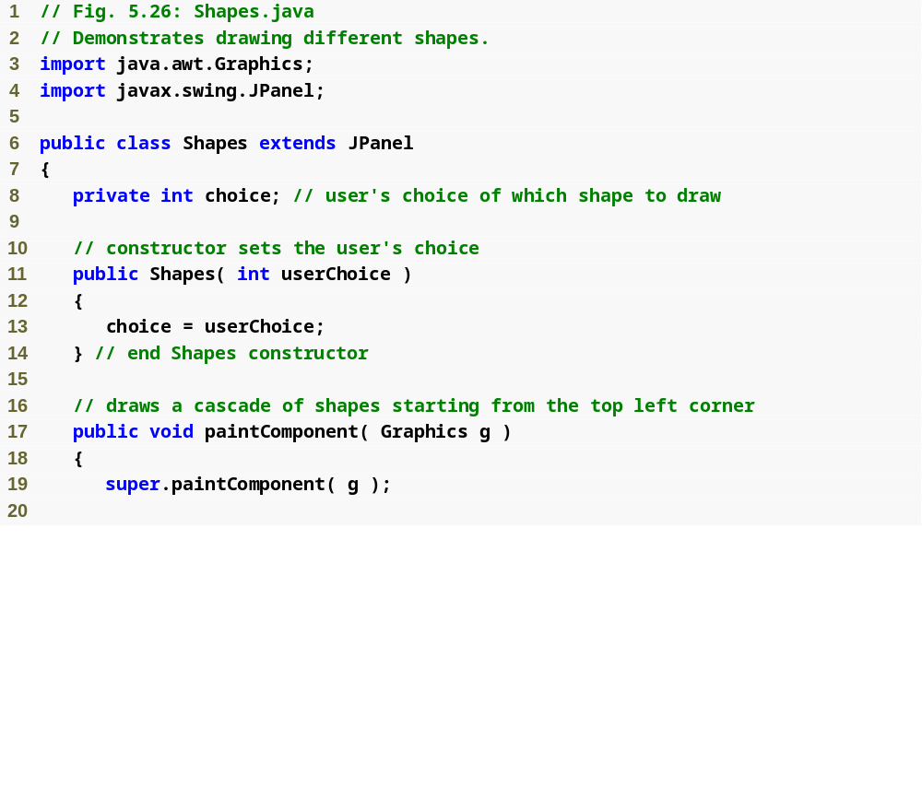
Outline
Shapes.java
(1 of 2)
ملغي –مش مطلوب

Slide 85
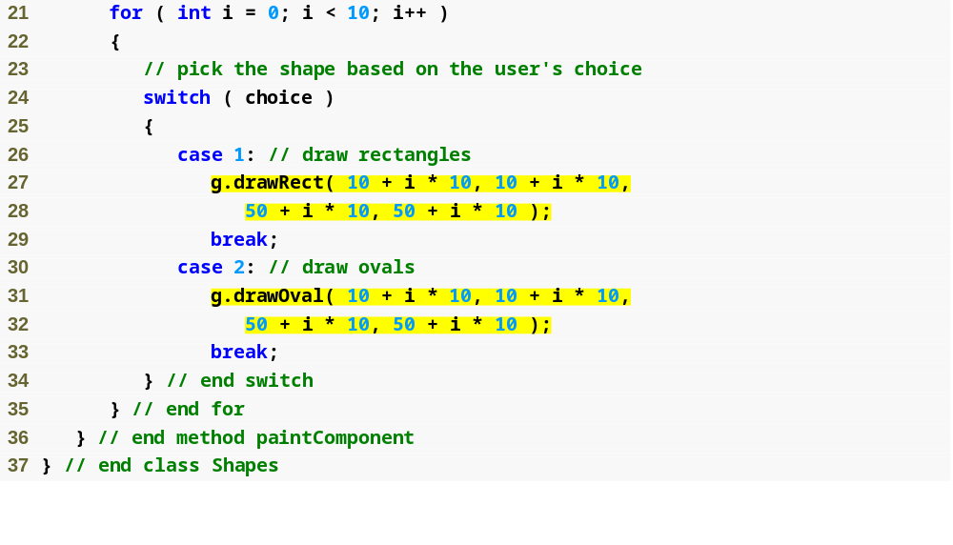
Outline
Shapes.java
(2 of 2)
Lines 27-28
Lines 31-32
Draw rectangles
Draw ovals
ملغي –مش مطلوب

Slide 86
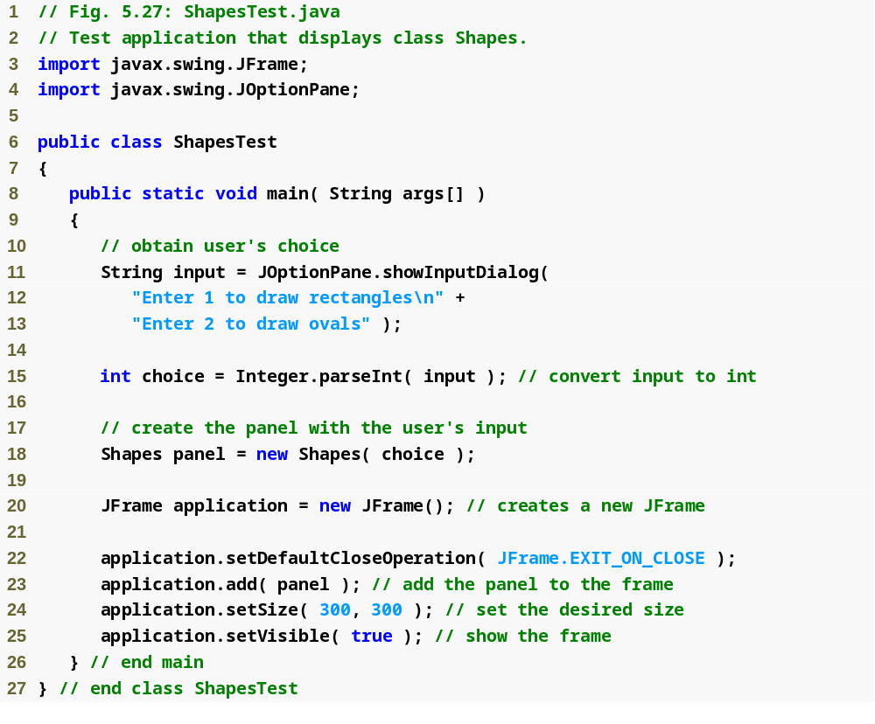
Outline
ShapesTest.java
(1 of 2)
ملغي –مش مطلوب

Slide 87

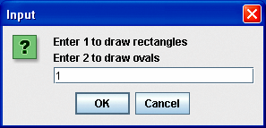
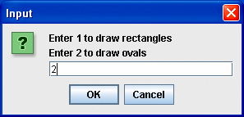
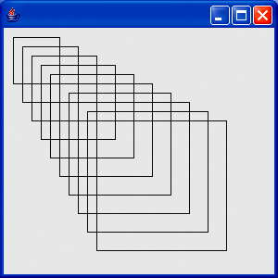
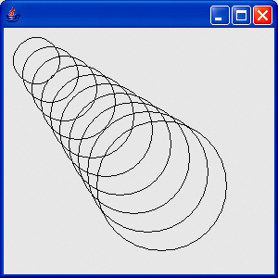
Outline
ShapesTest.java
(2 of 2)
Program output
ملغي –مش مطلوب

Slide 88
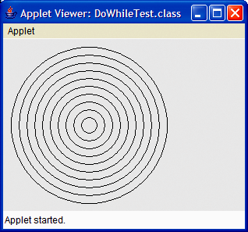
Fig. 5.28 | Drawing concentric circles.
ملغي –مش مطلوب

Slide 89
5.11 (Optional) Software Engineering Case Study: Identifying Object’s State and Activities
State Machine Diagrams
  Commonly called state diagram
  Model several states of an object
  Show under what circumstances the object changes state
  Focus on system behavior
  UML representation
    State
      Rounded rectangle
    Initial state
      Solid circle
    Transitions
      Arrows with stick arrowheads
ملغي –مش مطلوب

Slide 90

Fig. 5.29 | State diagram for the ATM object.
ملغي –مش مطلوب

Slide 91
Software Engineering Observation 5.5
ملغي –مش مطلوب
Software designers do not generally create state diagrams showing every possible state and state transition for all attributes—there are simply too many of them. State diagrams typically show only key states and state transitions.

Slide 92
5.11 (Optional) Software Engineering Case Study (Cont.)
Activity Diagrams
  Focus on system behavior
  Model an object’s workflow during program execution
  Model the actions the object will perform and in what order
  UML representation
    Action state ( rectangle with its left and right sides replaced by arcs curving outwards)
    Action order ( arrow with a stick arrowhead)
    Initial state (solid circle)
    Final state (solid circle enclosed in an open circle)
ملغي –مش مطلوب

Slide 93
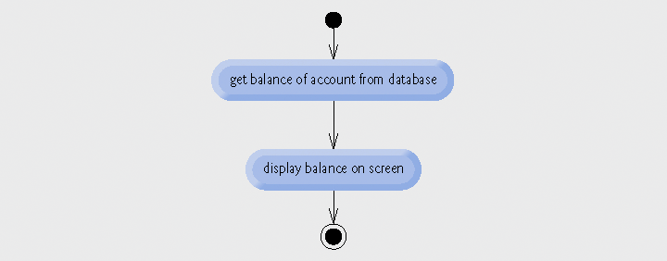
Fig. 5.30 | Activity diagram for a BalanceInquiry object.
ملغي –مش مطلوب

Slide 94
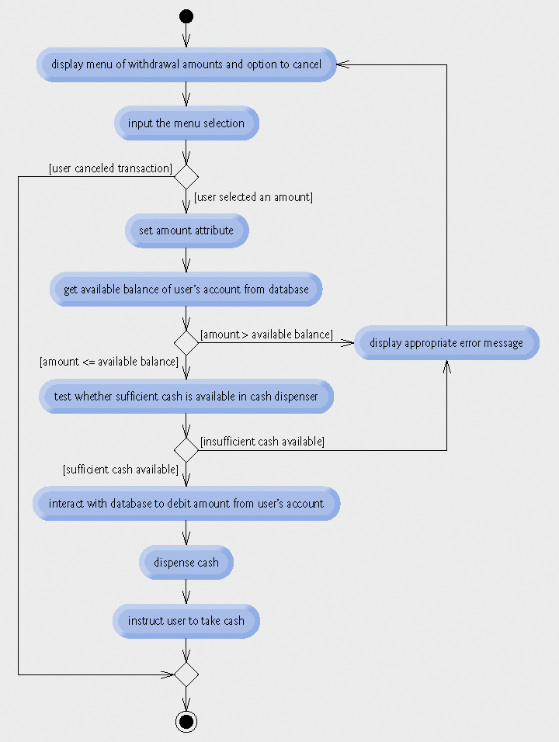
Fig. 5.31 | Activity diagram for a withdrawal transaction.
ملغي –مش مطلوب

Slide 95
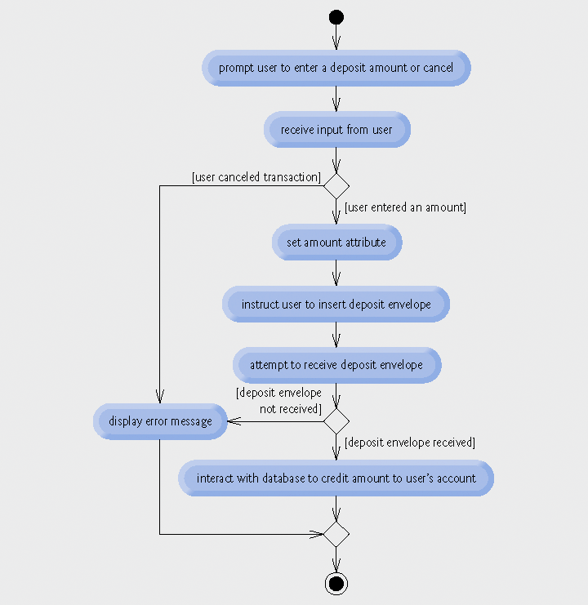
Fig. 5.32 | Activity diagram for a deposit transaction.
ملغي –مش مطلوب

