Slide 1


Title: Informative Data Inspection for Flipkart Mobiles

Slide 2


Introduction
Analyzing the trends of mobile phones in the Flipkart market unveils a dynamic landscape shaped by technological advancements, consumer preferences, and market competition. Over recent years, Flipkart has been a hub for diverse mobile offerings, reflecting a myriad of trends that influence consumer choices and industry innovations.
The trends in Flipkart's mobile market showcase a continual evolution in smartphone technology, with a focus on features such as camera quality, battery life, processing power, and design aesthetics. Additionally, the emergence of 5G technology has propelled a new wave of smartphones catering to enhanced connectivity needs.

Slide 3
CONCEPTS USED
Pandas
Matplotlib
Data visualization
Seaborn
numpy

Slide 4

Implementation
import pandas as pd
import numpy as np
import matplotlib.pyplot as plt
import seaborn as sns
import missingno as msno
df = pd.read_csv('data.csv')
df.shape
df.head()
df.tail()
df.fillna(0).iloc[:3]
df.describe().T
df.dtypes
Problem 2

Slide 5
msno.bar(df,figsize=(6,3),color='magenta')
df['Brand'].groupby(df['Brand']).count().sort_values(ascending=False)
df['Brand'].groupby(df['Memory']).count().sort_values(ascending=False)
sns.set_style("white")
sns.pairplot(df, hue='Brand')
df.keys()
sns.displot(df, x= 'Selling Price',bins=[5000,10000,15000,20000,25000,30000,35000,40000,50000,60000,80000],
aspect=1.2,color='#fd6c9e')
sns.displot(df, x='Original Price',bins=[5000,10000,15000,20000,25000,30000,35000,40000,50000,60000,80000], aspect=1.2,color='#ff8243')
sns.displot(df, x='Selling Price',bins=5, hue='Brand',aspect=1.2)
fig, ax = plt.subplots(figsize=(15,3))
ax=sns.countplot(x="Brand", data=df)
-
Problem 2

Slide 6
fig, ax = plt.subplots(figsize=(15,3))
ax = sns.stripplot(y="Rating", x="Brand", data=df)
fig, ax = plt.subplots(figsize=(15,3))
ax = sns.stripplot(y="Selling Price", x="Brand", data=df)
fig, ax = plt.subplots(figsize=(15,3))
ax = sns.stripplot(y="Original Price", x="Brand", data=df)
fig, ax = plt.subplots(figsize=(15,6))
ax = sns.boxplot(x="Brand", y="Selling Price", data=df)
round(df.groupby('Brand')['Selling Price'].mean(),0).sort_values(ascending=False)
Problem 2

Slide 7
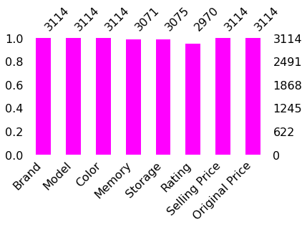
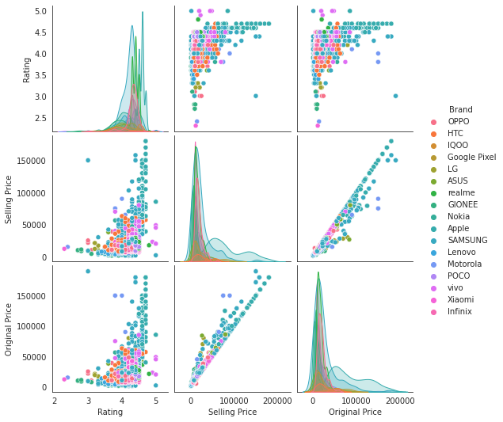

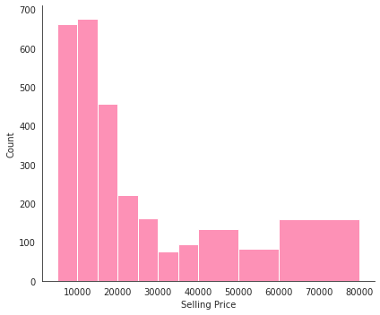

Slide 8
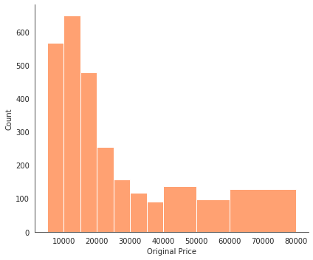
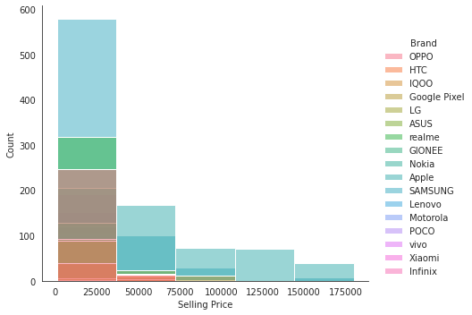
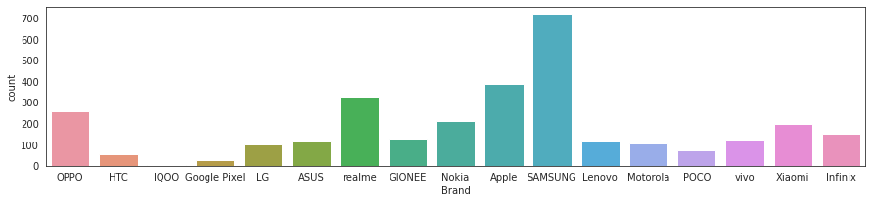

Slide 9
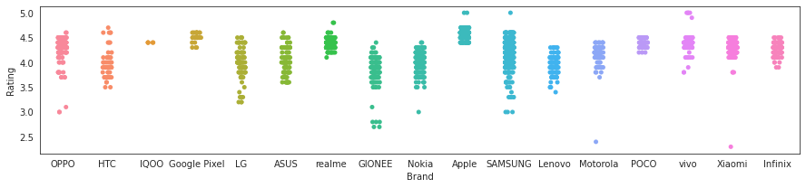
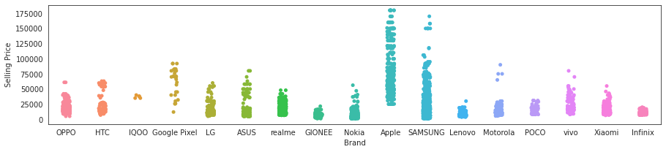

Slide 10
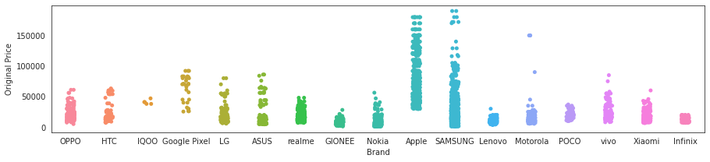
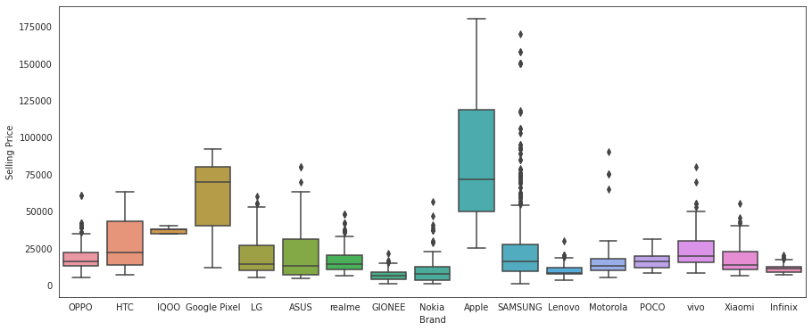

Slide 11
Conclusion
This project reveals the beating heart of consumer preferences and market dynamics within Flipkart by using EDA to untangle the complex web of mobile phone sales trends. The conclusions drawn highlight the transformational potential of data analysis, providing a compass for companies to traverse the ever changing terrain of customer demands and technology advancements. Through the process of deciphering these trends, this exploration not only provides a clear picture of market behaviors, but it also gives stakeholders priceless insight that will help them adapt and prosper in a world where change is driven by consumers and changes quickly.

Slide 12
1.Sana Banu
Strategy 1
2.Sahana Priya G
3.N.Dharsini
Strategy 2
Strategy 3
Presented by::
4.Nitya P Shetty

Slide 13


