Slide 1
DBSE Project Milestone - 3

Slide 2
Data Cleaning (train and test)
Checking Missing Values - df.replace('', np.nan)
df.isnull().sum()
if any null values found, replacing them with mean, median or any other value
Checking duplicate values - df.duplicated().any()- if true, remove those instances

Slide 3
Feature Extraction(train and test)
Hour, HourEnc extracted from trans_date_trans_time
1day, 7day, 30day and last transaction are extracted from cc_num
https://www.kaggle.com/code/kartik2112/credit-card-transactions-fraud-detection-eda/notebook?scriptVersionId=51680535

Slide 4
Feature Selection (train and test)
Correlation Heatmap
Dropped irrelevant features
Selected only 14 features
Category, amt, gender, age,hour, hourenc, 1d, 7d, 30d, timediff
is_fraud is target

Slide 5
Feature Encoding(train and test)
Categorical to Numerical data
Used LabelEncoder (converted to 1,2,3…)
Category and Gender – Features
For association rule mining, features must be one hot encoded (0,1). Got 167 columns when one hot encoded.

Slide 6
Feature Scaling
Scaling all the feature values to same scale
Standardization and Normalization
Usually, we should perform feature scaling after train test split, so as to ensure that test data is not leaked into the training data
we do not do train test split here, Since, we have separate train and test data and we don’t need to split them.
In case of one hot encode, we do not do feature scaling.

Slide 7
Experiments
StandardScaler, rbf
MinMaxScaler, rbf
[[547479 6095]
[ 1944 201]]
precision recall f1-score support
0 1.00 0.99 0.99 553574
1 0.03 0.09 0.05 2145
accuracy 0.99 555719
macro avg 0.51 0.54 0.52 555719
weighted avg 0.99 0.99 0.99 555719
F2_Score 0.06755848346329658
The customized score threshold for 3% of outliers is 168.94
[[537309 16265]
[ 1738 407]]
precision recall f1-score support
0 1.00 0.97 0.98 553574
1 0.02 0.19 0.04 2145
accuracy 0.97 555719
macro avg 0.51 0.58 0.51 555719
weighted avg 0.99 0.97 0.98 555719
F2_Score 0.08058767622366544
Standard scaler seems to work fine with our data since we have high negative and high positive values.
Whereas, minmax scaler scales between 0 and 1.
[[548770 4804]
[ 2113 32]]
precision recall f1-score support
0 1.00 0.99 0.99 553574
1 0.01 0.01 0.01 2145
accuracy 0.99 555719
macro avg 0.50 0.50 0.50 555719
weighted avg 0.99 0.99 0.99 555719
F2_Score 0.011926058437686345
The customized score threshold for 3% of outliers is 6182.65
[[537010 16564]
[ 2037 108]]
precision recall f1-score support
0 1.00 0.97 0.98 553574
1 0.01 0.05 0.01 2145
accuracy 0.97 555719
macro avg 0.50 0.51 0.50 555719
weighted avg 0.99 0.97 0.98 555719
F2_Score 0.021384444796451768
Comparison between standard scaler and min scaler(label encoded). Found standard is good.
Then trained only with majority class(standard and label encoder)(next slide result). All highlighted can be used for comparison.
Model trained with one hot encoding did not give better results.

Slide 8
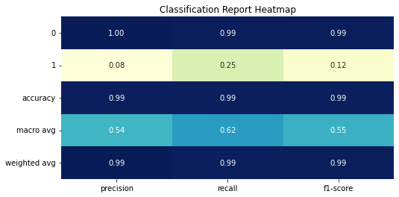
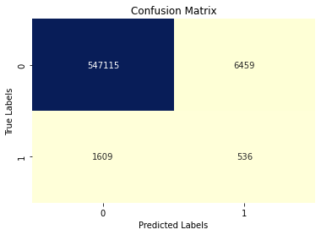
Experiments
Training only with Majority Class(‘0’). Model learns the distance, similarity and density of majority class. Other data when given is considered as anomaly
[[547115 6459]
[ 1609 536]]
precision recall f1-score support
0 1.00 0.99 0.99 553574
1 0.08 0.25 0.12 2145
accuracy 0.99 555719
macro avg 0.54 0.62 0.55 555719
weighted avg 0.99 0.99 0.99 555719
F2_Score 0.17207062600321027
3% threshold
[[537760 15814]
[ 1287 858]]
precision recall f1-score support
0 1.00 0.97 0.98 553574
1 0.05 0.40 0.09 2145
accuracy 0.97 555719
macro avg 0.52 0.69 0.54 555719
weighted avg 0.99 0.97 0.98 555719
F2_Score 0.16988753366070014
Standardscaler and trained on majority class seems to get better recall for anomalous class. Also, the data is labelencoded.
Training time of oneclasssvm is longer (takes 60mins, 120 or more than that)

Slide 9
Experiments
The customized score threshold for 1% of outliers is 151.34
[[548472 5102]
[ 1689 456]]
precision recall f1-score support
0 1.00 0.99 0.99 553574
1 0.08 0.21 0.12 2145
accuracy 0.99 555719
macro avg 0.54 0.60 0.56 555719
weighted avg 0.99 0.99 0.99 555719
F2_Score 0.1612675060121658
The customized score threshold for 2% of outliers is 164.27
[[543171 10403]
[ 1433 712]]
precision recall f1-score support
0 1.00 0.98 0.99 553574
1 0.06 0.33 0.11 2145
accuracy 0.98 555719
macro avg 0.53 0.66 0.55 555719
weighted avg 0.99 0.98 0.99 555719
F2_Score 0.18075653719218074
The customized score threshold for 1.5% of outliers is 158.97
[[545830 7744]
[ 1553 592]]
precision recall f1-score support
0 1.00 0.99 0.99 553574
1 0.07 0.28 0.11 2145
accuracy 0.98 555719
macro avg 0.53 0.63 0.55 555719
weighted avg 0.99 0.98 0.99 555719
F2_Score 0.1749822653109482

Slide 10
Rule Mining
For association rule mining, we need to give data in the form of 0’s and 1’s or true and false. (one-hot encoding)
If the data is continuous, make it discrete using binning or discretization. (used sturge’s logarithmic algorithm to find number of bins)
Category, gender – one hot encode.
Hour, hourenc, 1d, 7d, 30d, timediff, age, amt – discretize 3 methods(selected sturge’s), one hot encode
Remove remaining features
Used apriori algorithm. Association rules were extracted for original dataset (without applying model)

