Slide 1
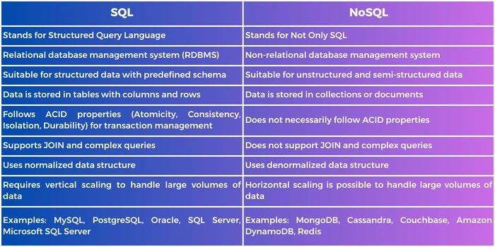
Comparison of SQL vs NoSQL
With a basic understanding of what SQL vs NoSQL is, let's take a look at this quick comparison chart to see what sets the two apart:

Slide 2
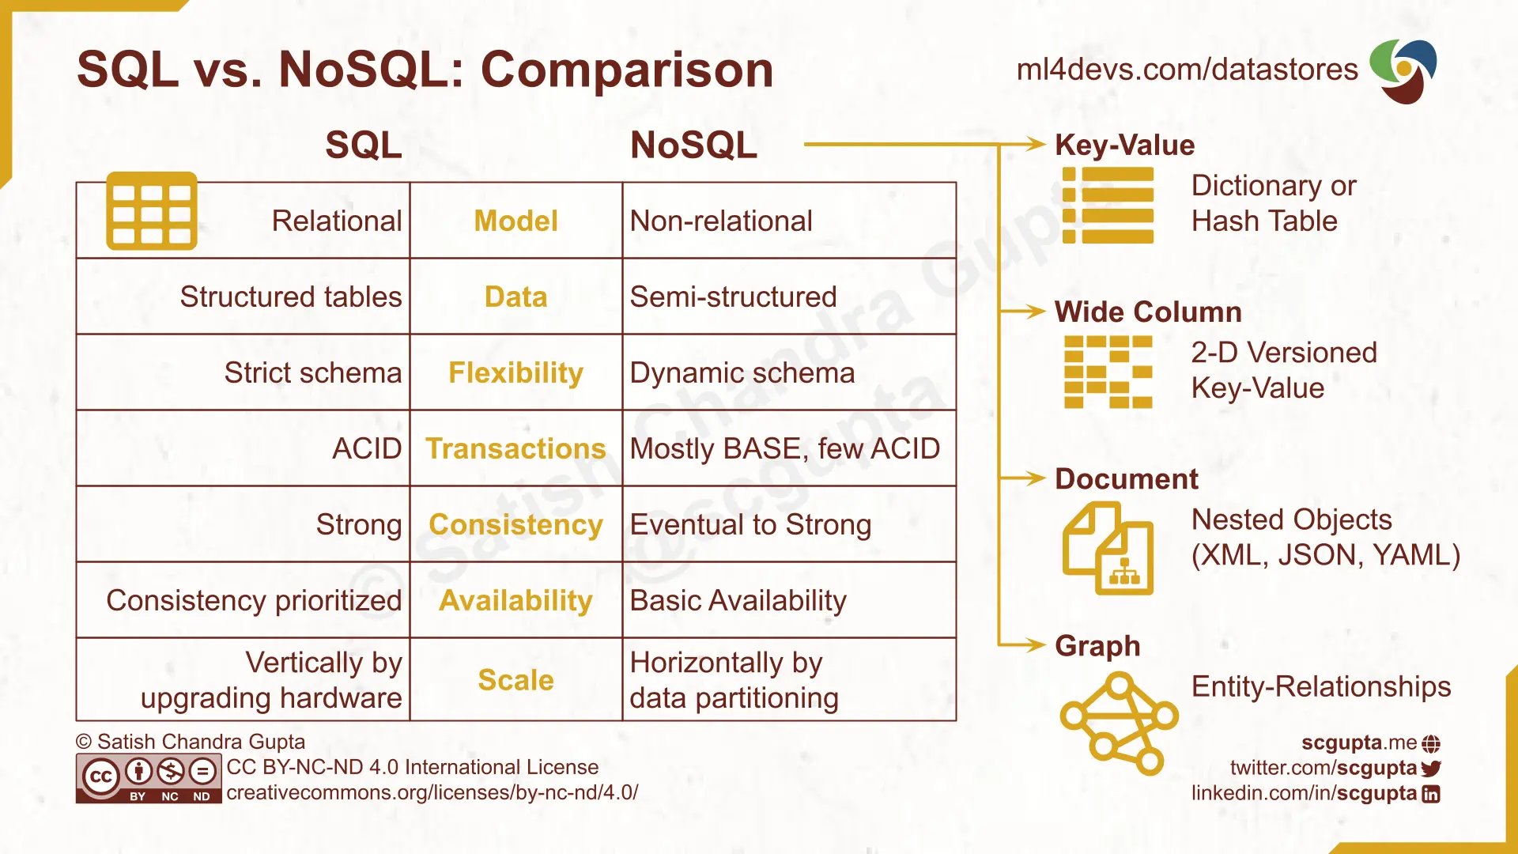

Slide 3
Advantages of SQL
Atomicity: This property ensures that each attempted set of changes to a database is treated as a single, indivisible unit of work. Either the whole unit is committed to the database, or none of them are if any part of the transaction fails.
Consistency: Ensures that a transaction ends with the database in a valid state. The database must satisfy a set of integrity constraints both before and after the transaction.
Isolation: Ensures that simultaneous transactions do not lead to inconsistencies in the database. Each transaction appears to execute in isolation, unaware of other transactions running. Isolation prevents interference between transactions and maintains their integrity.
Durability: Durability guarantees that once a transaction is committed, its effects persist even in the event of a system failure. The changes made by the transaction are permanently stored in the database, and they survive system crashes or power outages.

Slide 4
Common SQL Database Systems
there are three commonly used RDBMS:
MySQL: MySQL is an open-source RDBMS, now owned by Oracle, known for speed, reliability, and ease of use. MySQL is often used in LAMP stack (Linux, Apache, MySQL, PHP/Python/Perl) environments for small to medium-sized web applications.
PostgreSQL: An open-source object-relational database system with advanced features (e.g., support for custom functions and procedures as well as for complex queries, indexing, and transactions). PostgreSQL is best for large-scale applications, data warehousing, and geospatial data.
Microsoft SQL Server: A proprietary RDBMS by Microsoft, which is part of a suite with editions like Express, Standard, and Enterprise. Microsoft SQL Server integrates well with Microsoft's ecosystem and is suitable for diverse applications from small businesses to large enterprises.

Slide 5
Advantages of NoSQL
NoSQL databases offer several advantages, with notable strengths in scalability, flexibility, and performance when dealing with unstructured data.
NoSQL databases offer scalability in the form of horizontal scalability and elasticity. They are designed to scale horizontally, allowing organizations to handle increasing amounts of data by adding more servers to a distributed system. This makes them well-suited for applications with growing or unpredictable workloads.
Many NoSQL databases also provide automatic sharding and load balancing, distributing data across multiple nodes to ensure efficient resource utilization and improved performance. This capability enables systems to scale up or down dynamically based on demand and is known as elasticity.
They also provide schema flexibility. NoSQL databases use dynamic schemas, allowing for flexibility in data representation. This means that fields in a record can vary across different documents, accommodating the diverse and evolving data structures commonly encountered in modern applications.
They also perform well on unstructured and semi-structured data types like JSON and XML. Data today is often unpredictable, especially when user-generated, and NoSQL handles storing this data well.

Slide 6
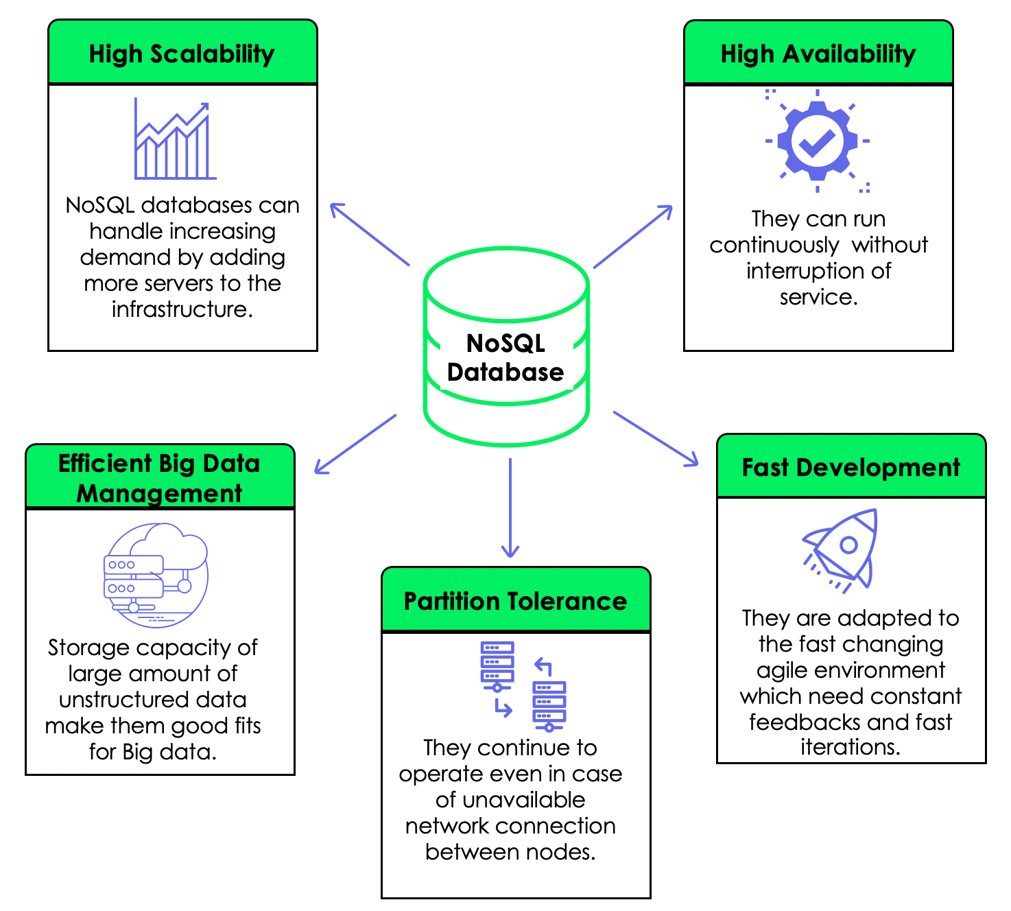

Slide 7
Common NoSQL Database Systems
A few of the most commonly used NoSQL database systems are:
MongoDB: popular document-oriented NoSQL database that stores data in flexible, JSON-like BSON documents, providing scalability and high performance for diverse data types.
Cassandra: A distributed and highly scalable NoSQL database designed for handling large amounts of data across multiple servers with a decentralized architecture, making it suitable for high-speed and high-volume applications.
Redis: An in-memory data structure store known for its speed and versatility, serving as a caching mechanism, message broker, and key-value store, with support for various data structures like strings, hashes, and sets.

