Slide 1
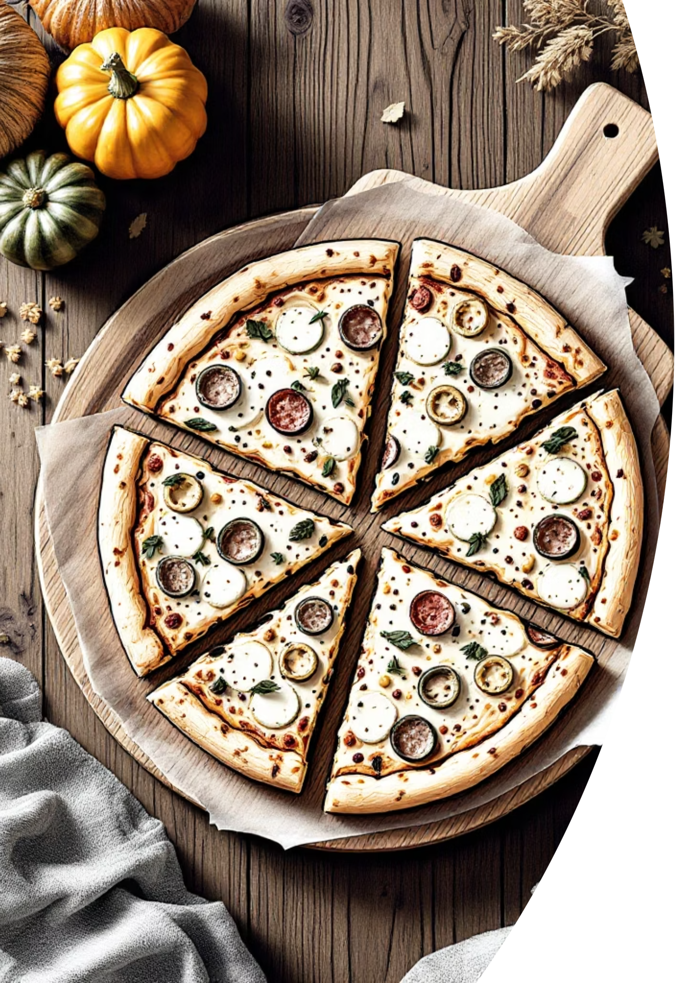
Pizza Sales Analysis Dashboard
SQL & Power BI Project
Name
Tools Used
Sana Gul Niazi
SQL | Power BI
Project
Pizza Sales Analysis

Slide 2

Project Overview
Business Insights
This project focuses on analyzing pizza sales data to generate business insights.
SQL Processing
SQL was used for data cleaning, transformation, and KPI calculation.
Interactive Dashboard
Power BI was used to build an interactive dashboard.
Core Goal
The goal was to understand sales performance and customer preferences.

Slide 3
Objectives
1
2
3
Sales Performance
Top Sellers
Revenue Contribution
Analyze overall sales performance
Identify top-selling pizzas and categories
Understand revenue contribution by category
4
5
Daily Trends
Dashboard
Track daily sales trends
Build an interactive dashboard for decision-making

Slide 4
Dataset & Data Modelling
Original Structure
Data was normalised into 4 tables:
Original dataset contained all data in a single table
Pizza
Pizza_Detail
Outcome
Orders
Order_Detail
Improved data structure and query performance

Slide 5
Data Cleaning Using SQL
Cleaning Steps
SQL Concepts Used
Removed duplicate records
JOINs
CTE (Common Table Expressions)
Subqueries
Handled missing values
Standardised data formats
Ensured data consistency

Slide 6
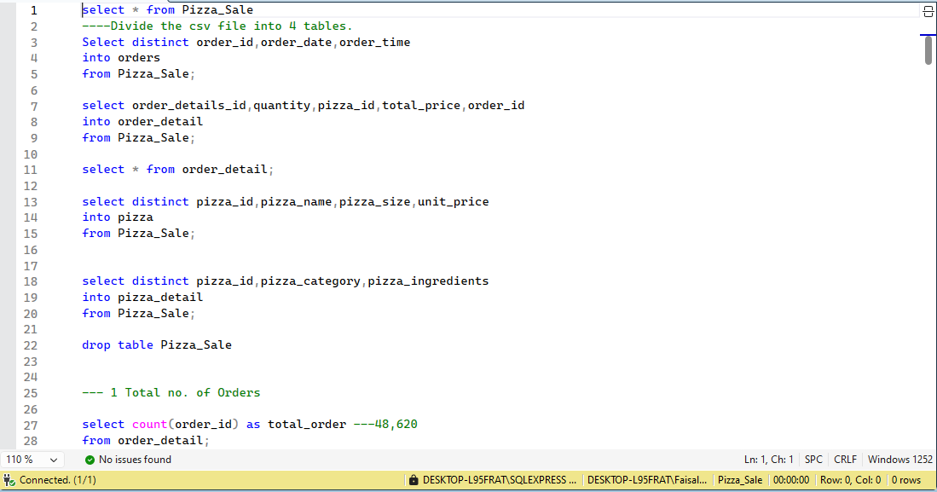
Data Cleaning Using SQL

Slide 7
Key Performance Indicators
817.86K
50K
Total Revenue
Total Pizzas Sold
Average Order Value (AOV)
Revenue by Category
Daily Sales Trends
Tracks the average spend per order across the dataset
Breaks down total revenue across each pizza category
Monitors fluctuations in sales volume day by day

Slide 8
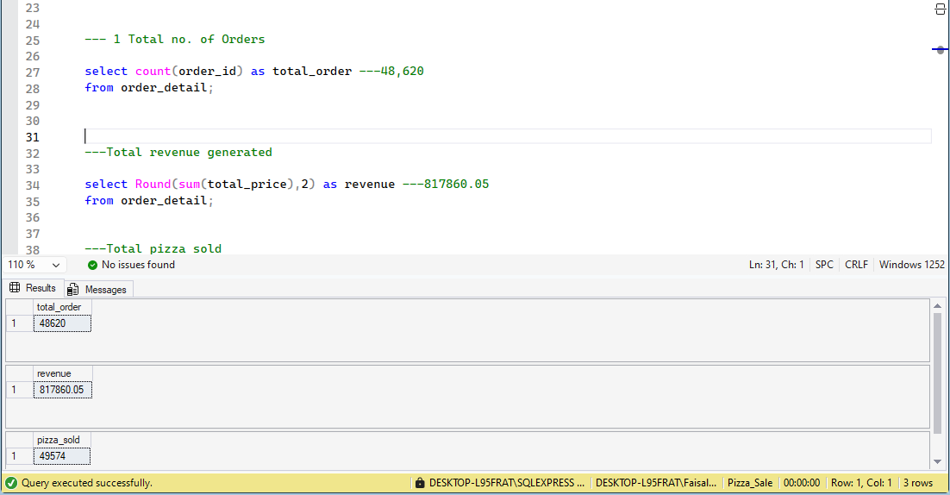
Key Performance Indicators

Slide 9

Revenue Insights
Top Category Identified
Highest revenue-generating pizza category identified
🏆 Top Category: Thai Chicken Pizza
Top category: 👉 Thai Chicken Pizza – 43,434.25
Cross-Category Comparison
Compared revenue across all categories
Segment Performance
Identified high and low-performing segments

Slide 10
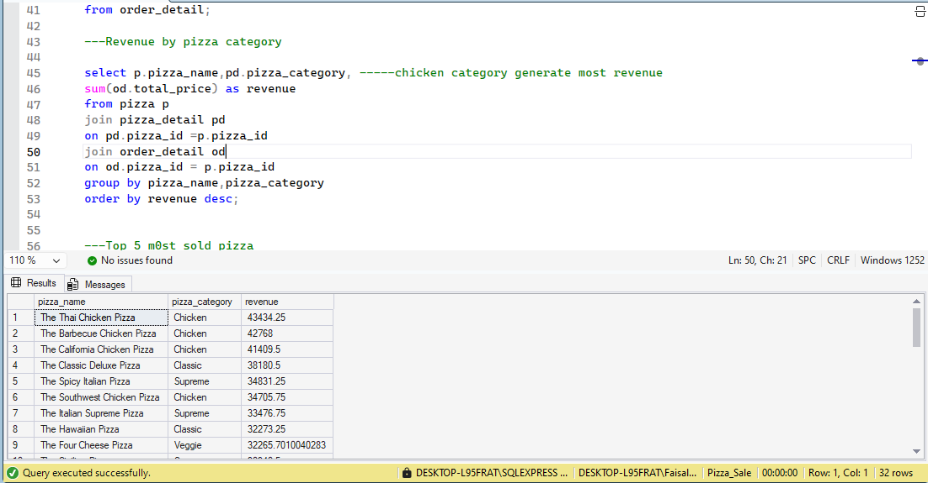
Revenue Insights

Slide 11
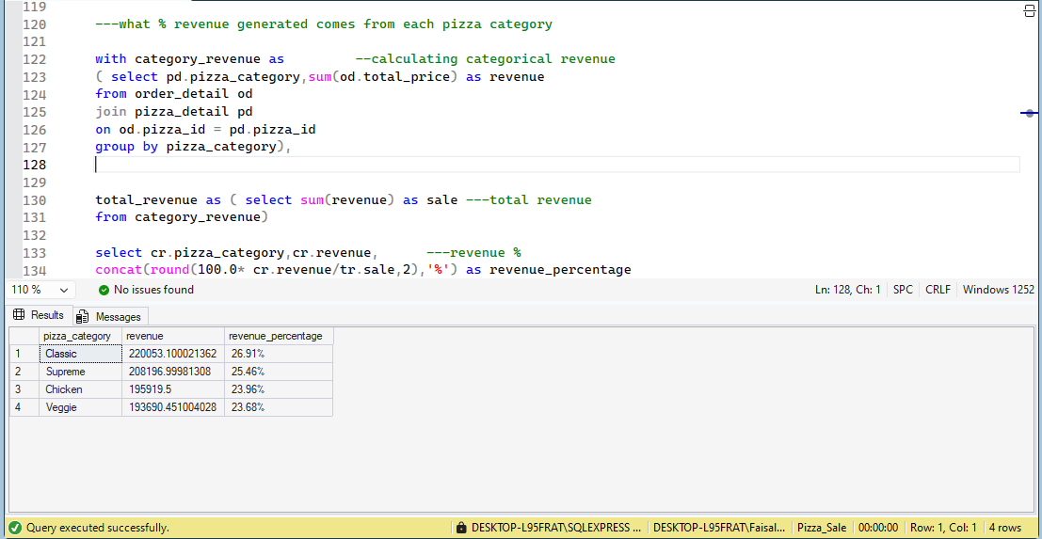
Revenue Insights

Slide 12
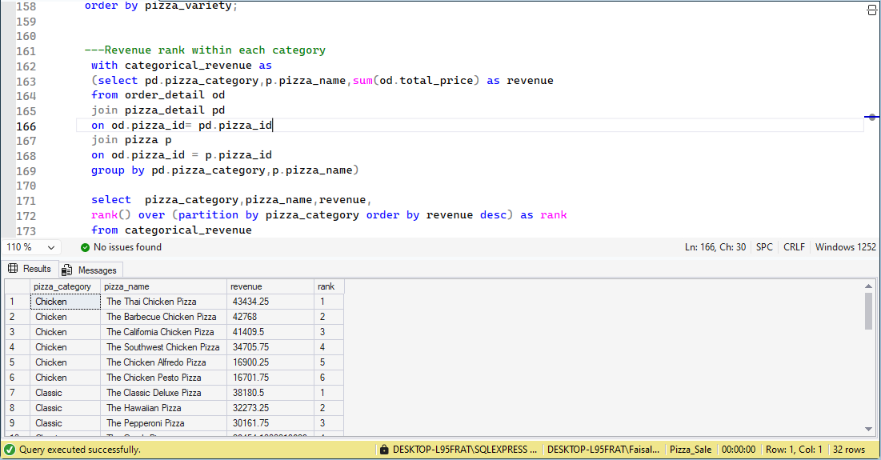
Revenue Insights

Slide 13
Top Performing Pizzas
Top 5 Pizzas by Revenue
Customer Preferences
Top 5 pizzas by revenue
Identified customer preferences
Top 5 Pizzas by Quantity Sold
Best-Selling Products
Top 5 pizzas by quantity sold
Highlighted best-selling products

Slide 14
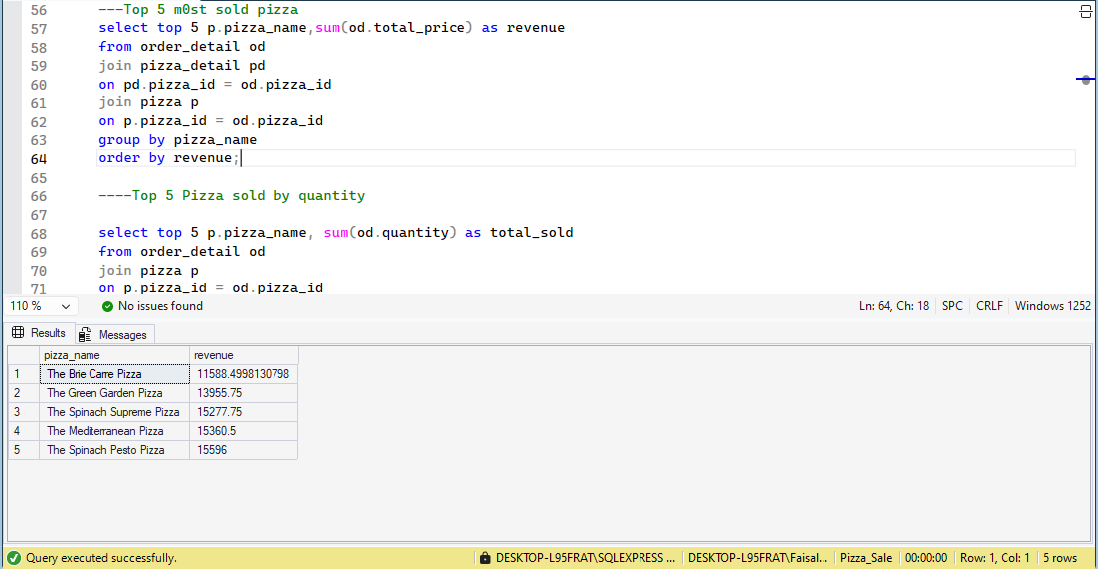
Top Performing Pizzas

Slide 15
Business Problem Solved
01
SQL Concepts Used
Revenue Contribution
Calculated percentage revenue contribution of each category
JOINs
CTE (Common Table Expressions)
Subqueries
02
Revenue Ranking
Created revenue ranking for each category
03
Profitable Segments
Helped in identifying most profitable segments

Slide 16


Power BI Dashboard
Built an interactive dashboard with the following components:
KPI Cards
Sales Trend Charts
Category Analysis
Filters & Slicers
Enabled dynamic data exploration

Slide 17
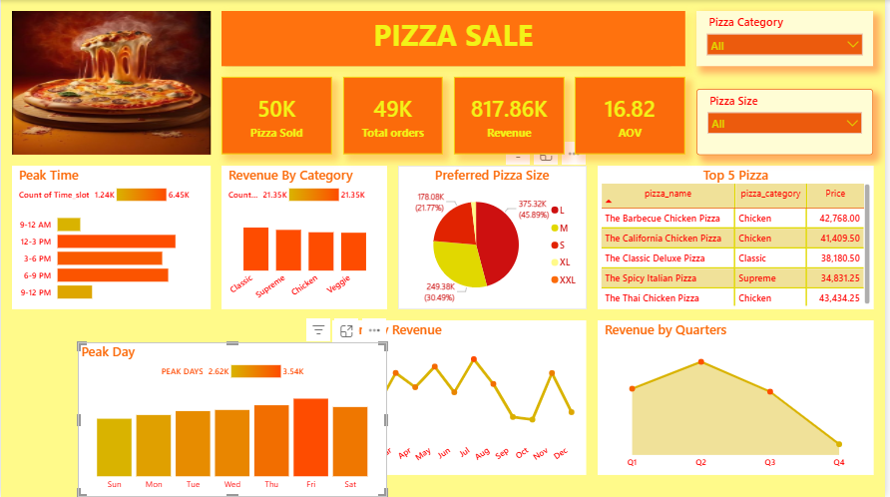
Power BI Dashboard

