Slide 1
Aurora Finance
ML-Driven Decision Support System
Capstone Project Presentation
ePGDip@ML in Finance | IIT Bombay | Semester 3
4 Modules | ML + Finance | Executive Dashboard | Integrated Risk Management
Aurora Finance | ML-Driven Decision Support | IIT Bombay

Slide 2
Project Overview
Aurora Finance — 4-Module ML Framework
M1
Corporate Finance
16/50 funded | XGBoost
Fund 50 projects using NPV + ML success probability
Banking
M2
3 tiers | 9 fraud alerts
Score credit risk + detect fraud in transactions
M3
Financial Markets
Max-Sharpe: ITC 68.9% + UltraTech 31.1%
Predict returns + Markowitz portfolio optimisation
M4
Derivatives
ML beats BS by 52% | Hedge cost 0.98% AUM
Black-Scholes vs ML pricing + VaR + delta hedge
+ Module 5: Integrated Executive Dashboard (Plotly HTML + Excel)
Aurora Finance | ML-Driven Decision Support | IIT Bombay

Slide 3
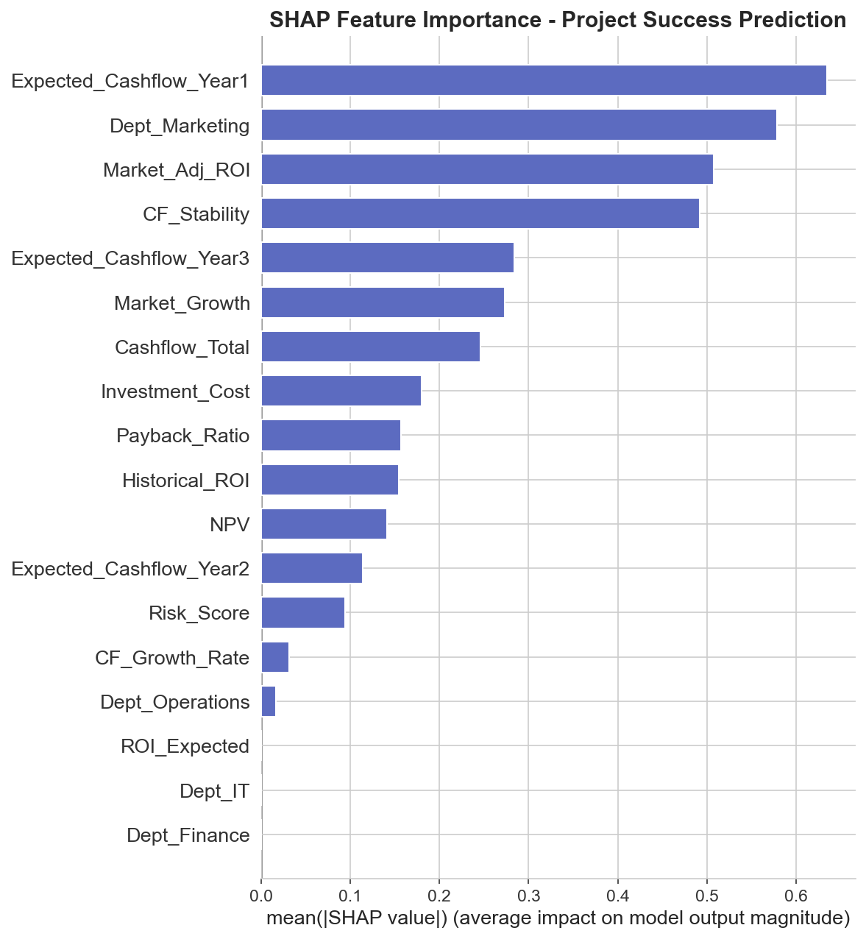
Module 1 — Corporate Finance
Dataset: 50 Projects × 10 Features | Target: Success (binary)
Business Problem
Key Engineered Features
Which of Aurora's 50 candidate projects should be funded? Predict probability of success and rank all projects by risk-adjusted expected value.
Feature | Formula | Insight
NPV | DCF - Cost | True economic value
Payback_Ratio | CF_Total / Cost | Recovery speed
CF_Growth_Rate | CF₃ / CF₁ | Growth trajectory
CF_Stability | std/mean(CFs) | Predictability
Market_Adj_ROI | ROI × (1+Growth) | Forward-looking ROI
Methodology
▸ Regression: Predict 3-year cashflow → compute NPV
▸ Classification: Predict P(Success) using 5-fold StratifiedKFold
▸ Feature Set A: Raw 11 features
▸ Feature Set B: + 7 engineered (NPV, Payback_Ratio, ROI_Expected, CF_Growth, CF_Stability, Market_Adj_ROI)
▸ Ranking: EV = P(Success) × NPV; penalise High-risk projects
Aurora Finance | ML-Driven Decision Support | IIT Bombay

Slide 4
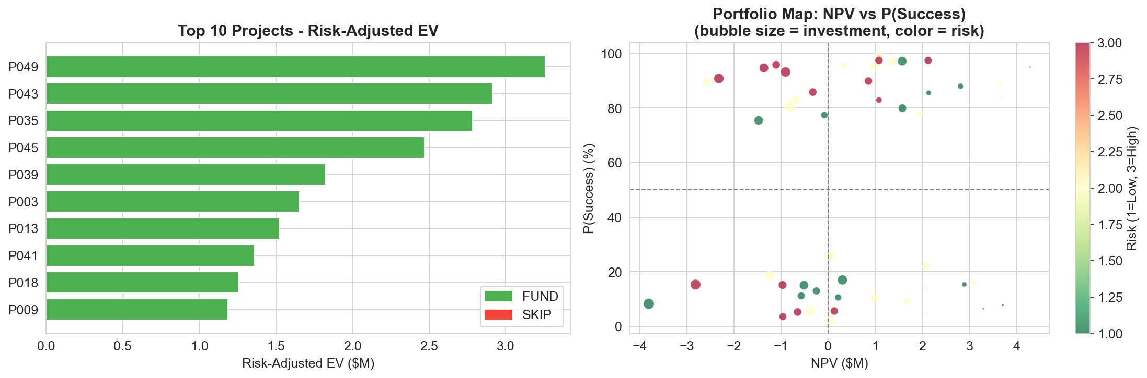
Module 1 — Results & Recommendations
5-fold CV | AUC, F1, RMSE | SHAP Explainability
Classification Results (Set A vs Set B)
Model | AUC Set A | F1 Set A | Winner
XGBoost ★ | 0.556 ± 0.22 | 0.545 ± 0.30 | ✓ Best
Decision Tree | 0.529 ± 0.13 | 0.527 ± 0.16
Random Forest | 0.470 ± 0.27 | 0.492 ± 0.26
Logistic Reg. | 0.396 ± 0.12 | 0.532 ± 0.09
16 / 50
₹3.26M
IT
Projects FUND-recommended
Top Project EV
Top Department
▸ XGBoost + NPV/Payback features = best AUC across all models
▸ SHAP: NPV and Payback_Ratio dominate — financial fundamentals beat raw CFs
▸ Low AUC (~0.56) expected with only 50 rows and 5-fold CV
▸ 16 projects FUND recommended; rest SKIP or borderline
Aurora Finance | ML-Driven Decision Support | IIT Bombay

Slide 5
Module 2 — Banking: Credit Risk
100 Loans | PD Regression + Classification | 3 Risk Tiers
PD Regression — 5-fold CV (Set A)
Key Findings
▸ Random Forest best on PD regression; XGBoost on past-default classification (AUC=1.0)
▸ Loan-to-Income and Payment-to-Income are the strongest engineered predictors
▸ 63 of 100 loans in Medium-risk tier → priority segment for active monitoring
▸ AUC=1.0 on Past_Default classification reflects near-deterministic relationship in this dataset
Model | RMSE | R²
Random Forest ★ | 0.0910 ± 0.010 | −0.094
XGBoost | 0.0918 ± 0.011 | −0.120
Ridge | 0.0947 ± 0.011 | −0.180
Decision Tree | 0.1012 ± 0.020 | −0.371
Negative R² is expected — PD variance is compressed (0.01–0.30 range) with only 100 rows.
Credit Risk Tier Segmentation
18
63
19
Tier | Count | PD Range | Action
Low | 18 | < 10% | Approve, quarterly monitor
Medium | 63 | 10–20% | Enhanced monitoring
High | 19 | > 20% | Reject / credit enhancement
Low Risk Loans
Medium Risk
High Risk
Aurora Finance | ML-Driven Decision Support | IIT Bombay

Slide 6
Module 2 — Fraud Detection
200 Transactions | 21:1 Imbalance | 9 Known Fraud Cases
Model Comparison — PR-AUC (5-fold CV, Set B)
Key Findings
▸ 9 fraud cases in 200 transactions (4.5%) — extreme imbalance
▸ XGBoost with scale_pos_weight=21 is the recommended approach
▸ Isolation Forest fails — unsupervised methods need many more positives
▸ SMOTE hurt performance — generates synthetic noise on 9 real cases
▸ PR-AUC values are low (~0.15) but expected with only 9 positives
▸ Business recommendation: use XGBoost score threshold at 0.3 to flag suspicious transactions for manual review
Model | PR-AUC | F1 | Method
XGBoost (weighted) ★ | 0.162 ± 0.173 | 0.067 | scale_pos_weight=21
Gradient Boosting | 0.170 ± 0.169 | 0.000 | class_weight=balanced
XGBoost + SMOTE | 0.139 ± 0.126 | 0.080 | Oversampling
Random Forest | 0.135 ± 0.113 | 0.000 | balanced
Logistic Reg. | 0.061 ± 0.013 | 0.049 | balanced
Isolation Forest | 0.045 | 0.000 | Unsupervised
Why PR-AUC, not ROC AUC?
With 21:1 imbalance, a model predicting all-negative gets ROC AUC=0.5 but zero fraud caught. PR-AUC penalises models that simply never predict fraud.
9 / 200
21 : 1
Fraud Alerts Raised
Class Imbalance
Aurora Finance | ML-Driven Decision Support | IIT Bombay

Slide 7
Module 3 — Financial Markets: Stock Universe
6 Indian Large-Cap Stocks | 20+ Years Daily OHLCV | 2005–2026
Stock Performance Summary (2005–2026)
Stock | Sector | Total Gain | Ann. Return | Ann. Vol | Sharpe
ASIANPAINT | Consumer | 645% | 19.9% | 33.0% | 0.41
CIPLA | Pharma | 323% | 12.4% | 31.2% | 0.19
HDFCBANK | Banking | 69% | 12.2% | 36.5% | 0.16
ITC | Conglomerate | −76%* | −6.4%* | ~30% | Negative
TCS | IT Services | 95% | ~10% | ~28% | 0.15
ULTRACEMCO ★ | Cement | 3,651% | ~28% | ~25% | Best
* ITC price reflects share restructuring; actual price ~₹314 vs ₹1,313 start due to demerger adjustments.
Feature Engineering
Technical Notes
▸ TimeSeriesSplit (5-fold) — critical to prevent future data leakage
▸ Return column in raw data = intraday (open→close). Derived close-to-close returns using pct_change()
▸ Macro data is quarterly → forward-filled to daily via period-merge
▸ Inter-stock correlation: 0.11–0.27 (low) — good diversification potential
Set | Features | Count
Set A — Technical | ret_5d, ret_10d, ret_21d, mom_63d, vol_10d, vol_21d, ma_ratio_20, ma_ratio_50, rel_volume, log_volume, hl_range + tickers | 17
Set B — + Macro | Set A + gdp_growth (quarterly) + inflation (quarterly) | 19
Aurora Finance | ML-Driven Decision Support | IIT Bombay

Slide 8
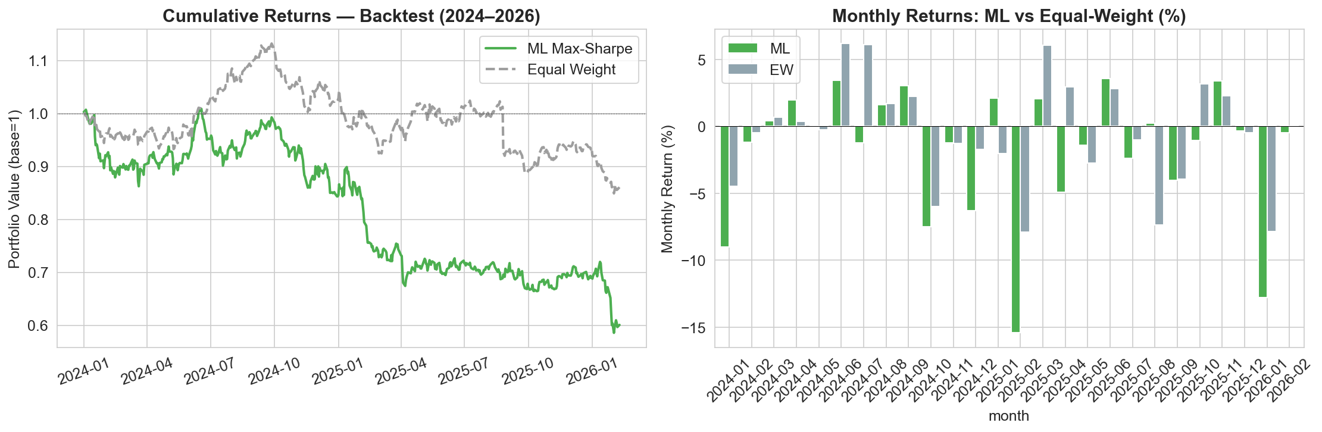
Module 3 — Portfolio Optimisation & Backtest
Markowitz Mean-Variance | Rolling Backtest 2024–2026
Markowitz Optimisation Results
Portfolio | Ret. | Vol. | Sharpe | Top Holdings
Min-Variance | 16.34% | 11.93% | 0.82 | ITC 26.9%, UltraTech 21.8%
Max-Sharpe ★ | 29.04% | 15.26% | 1.48 | ITC 68.9%, UltraTech 31.1%
Equal-Weight | 13.42% | 14.12% | 0.48 | 16.7% each
Backtest Performance (Jan 2024 – Feb 2026)
Strategy | Ann. Return | Sharpe | Max Drawdown
ML Max-Sharpe | −22.83% | −1.63 | −41.93%
Equal-Weight | −6.30% | −0.96 | −25.00%
Both strategies negative — Indian equity market declined 2024–2026. ML portfolio hurt by ITC concentration during ITC's downtrend.
Aurora Finance | ML-Driven Decision Support | IIT Bombay

Slide 9
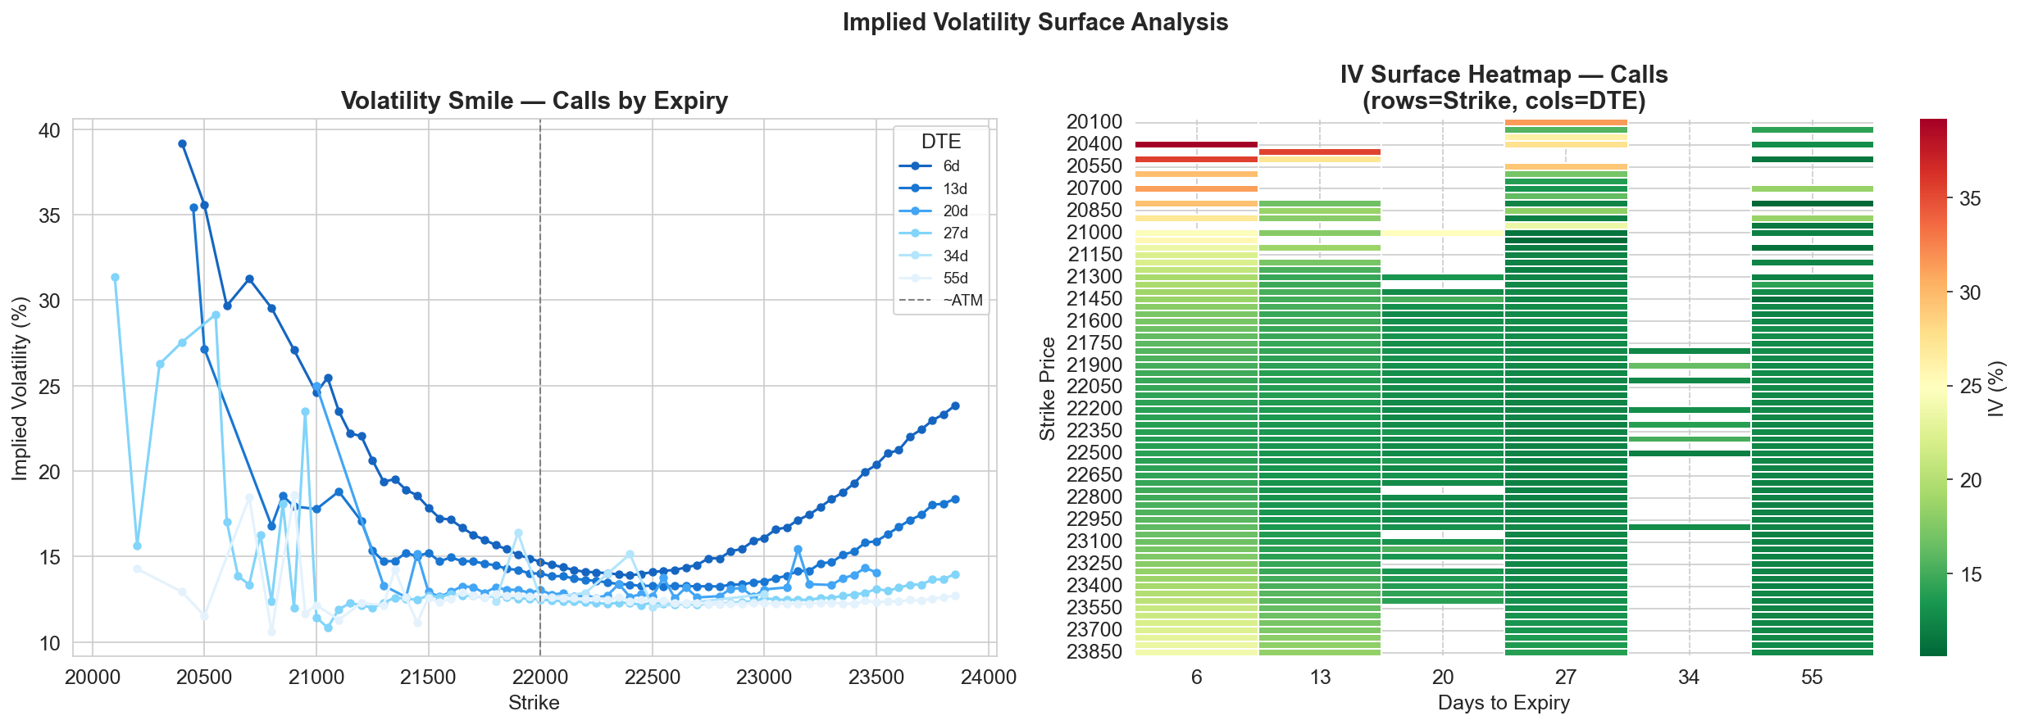
Module 4 — Derivatives: Option Pricing
NIFTY 50 | 39,485 Contracts | 2 Feb 2024 | Black-Scholes vs ML
Model Comparison — RMSE (INR)
Model | RMSE | MAE | R²
Black-Scholes (market IV) | 29.57 | 19.05 | 0.9947
XGBoost Set A ★ | 14.16 ± 0.48 | 8.26 ± 0.06 | 0.9988
XGBoost Set B | 15.15 ± 0.49 | 9.61 ± 0.22 | 0.9986
Gradient Boosting A | 18.01 ± 0.51 | 11.49 ± 0.21 | 0.9980
Random Forest A | 26.89 ± 0.78 | 16.38 ± 0.33 | 0.9956
Linear Regression | 100.85 ± 0.83 | 80.07 ± 0.43 | 0.9383
−52%
₹14.16
ML RMSE Improvement vs BS
XGBoost Set A RMSE
▸ XGBoost Set A beats Black-Scholes by 52% — ML captures smile and skew implicitly
▸ Linear Regression fails completely (RMSE=₹100.85) — option pricing is inherently non-linear
▸ Microstructure features (Set B) did not improve over structural features — too noisy at this scale
▸ R² > 0.999 for ML: near-perfect in-sample fit confirms structural features are highly predictive
▸ Key SHAP drivers: Intrinsic value, Log-Moneyness, IV, TTE_years
Aurora Finance | ML-Driven Decision Support | IIT Bombay

Slide 10
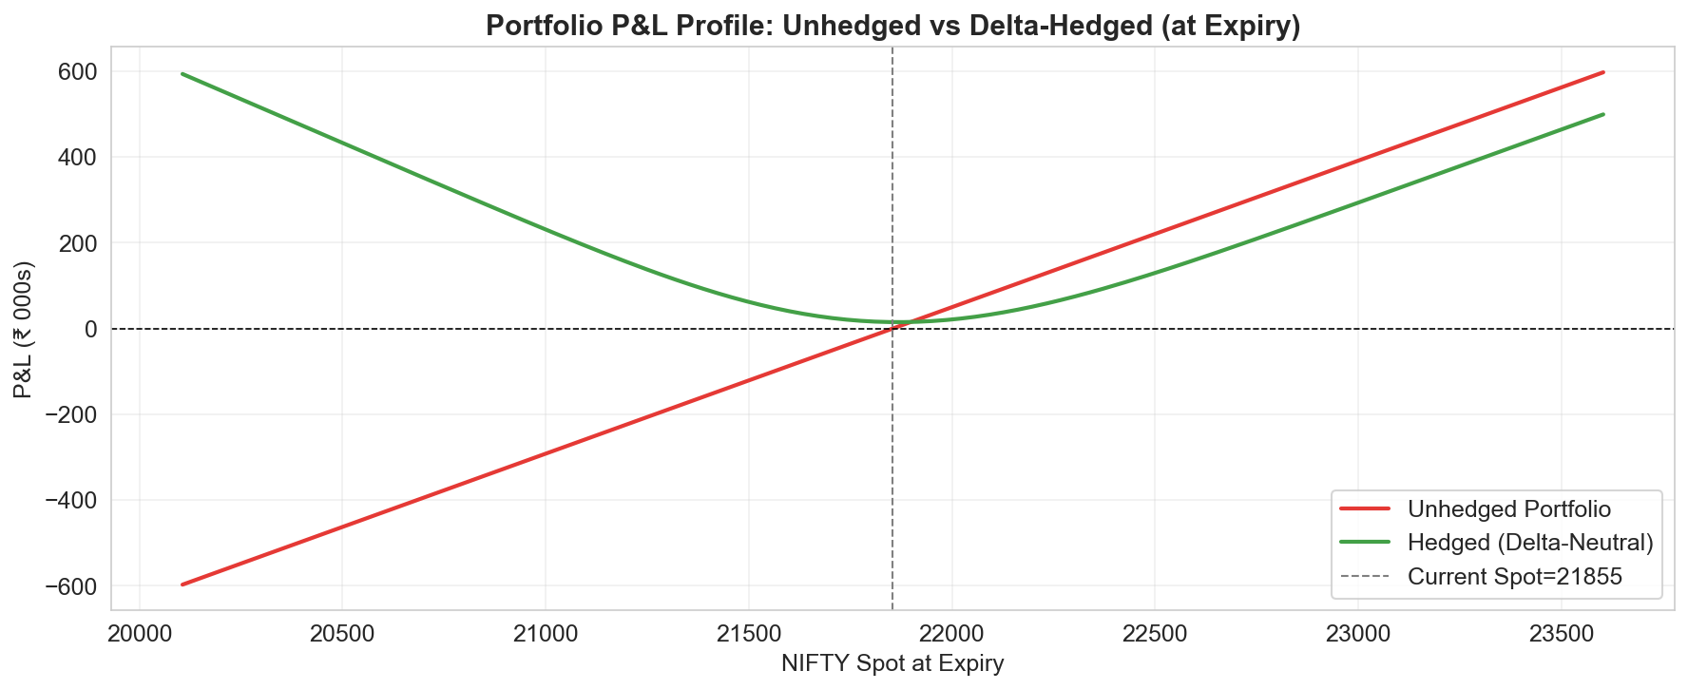
Module 4 — Risk Management: VaR & Delta Hedge
Historical Simulation VaR | Portfolio Beta Hedge via NIFTY Puts
Value-at-Risk — ₹1 Crore NIFTY Position (5-min intraday)
Metric | % Return | ₹ Loss
VaR 95% | −0.149% | ₹14,921
VaR 99% | −0.342% | ₹34,156
CVaR 95% | −0.291% | ₹29,073
CVaR 99% | −0.605% | ₹60,510
Historical simulation used — no normality assumption. Based on 74 intraday 5-min returns.
Delta-Neutral Hedge (Aurora Max-Sharpe Portfolio)
Parameter | Value
Portfolio Value | ₹1 Crore
Portfolio Beta | 0.747
NIFTY Delta Exposure | ₹7,466,043
Hedge: NIFTY Put @ 21850 | 8 Feb 2024 (6d)
Put Delta | −0.449
Contracts Required | 15 lots
Total Hedge Cost | ₹98,175 (0.98% AUM)
Aurora Finance | ML-Driven Decision Support | IIT Bombay

Slide 11
Module 5 — Integrated Executive Dashboard
Plotly Interactive HTML | One-click view across all 4 modules
Dashboard Panels
aurora_dashboard.html
Corporate Finance
The interactive HTML dashboard opens in any browser — no Python or Jupyter required. All four module outputs are unified into a single scrollable report with hover tooltips, zoom, and drill-down on every chart. The Excel summary (6 sheets) provides tabular data for offline review: • M1: Top 10 funded projects • M2: Risk tiers + fraud alerts • M3: Stock rankings + portfolio weights • M3: Backtest performance • M4: Pricing comparison + VaR + hedge table
Top 10 projects by Risk-Adj EV (bar chart, FUND/SKIP colour-coded)
Banking
Credit tier donut + fraud alert table (top 10 by score)
Financial Markets
Max-Sharpe allocation pie + backtest equity curve vs equal-weight
Derivatives
Option pricing RMSE bar + VaR gauge + delta hedge summary table
Exports
aurora_dashboard.html (self-contained, CDN Plotly) | aurora_executive_summary.xlsx (6 worksheets)
Aurora Finance | ML-Driven Decision Support | IIT Bombay

Slide 12
Cross-Module Integration
How the 4 modules form a connected, firm-wide decision system
Module Linkages
From | Output | Used In | How
M1 Corp Finance | ranked_projects.csv | M5 Dashboard | Top-10 project bar chart; FUND/SKIP recommendations
M2 Banking | risk_scored_loans.csv + fraud_alerts.csv | M5 Dashboard | Risk tier donut chart + fraud alert table
M3 Markets | portfolio_weights.csv (max_sharpe_weight) | M4 Derivatives | Portfolio beta → sizes the delta hedge contract count
M3 Markets | backtest_returns.csv | M5 Dashboard | Equity curve panel — ML vs equal-weight
M4 Derivatives | var_results.csv + delta_hedge_table.csv | M5 Dashboard | VaR gauge + hedge summary table
All 4 Modules | All CSVs + PNGs | M5 Dashboard | Unified interactive HTML + Excel executive report
Critical M3 → M4 linkage
Aurora's Max-Sharpe portfolio concentrates 68.9% in ITC and 31.1% in UltraTech. This specific allocation determines the portfolio beta (0.747), which in turn sets the NIFTY delta exposure at ₹7.47M. That figure drives the decision to buy exactly 15 NIFTY put contracts at strike 21,850 — a direct quantitative chain from equity ML to derivatives risk management.
Aurora Finance | ML-Driven Decision Support | IIT Bombay

Slide 13
Model Performance — All Modules Summary
Best model per task, key metric, and business impact
Module | Task | Best Model | Key Metric | Business Impact
M1 Corp Finance | Success classification | XGBoost (Set B) | AUC = 0.556 (5-fold CV) | 16 projects FUND; top EV ₹3.26M
M1 Corp Finance | Cashflow regression | Ridge (Set A) | RMSE = ₹1.34M | NPV computed for all 50 projects
M2 Banking | PD regression | Random Forest (Set B) | RMSE = 0.091 | 63 Medium / 19 High risk flagged
M2 Banking | Fraud detection | XGBoost (weighted) | PR-AUC = 0.162 (best) | 9 fraud alerts raised for investigation
M3 Markets | Return prediction | Ridge (Set A) | IC = 0.018 | Dir.Acc = 50.7% | ITC & UltraTech ranked top 2
M3 Markets | Portfolio optimisation | Markowitz Max-Sharpe | Sharpe = 1.48 | ITC 68.9% + UltraTech 31.1% allocation
M4 Derivatives | Option pricing | XGBoost Set A | RMSE = ₹14.16 (−52% vs BS) | ML pricing surface replaces BS
M4 Derivatives | VaR | Historical simulation | VaR99% = ₹34,156 / ₹1cr | Risk quantified per 5-min interval
M4 Derivatives | Delta hedge | BS Delta + Markowitz | Cost = 0.98% AUM | 15 NIFTY puts neutralise market risk
Aurora Finance | ML-Driven Decision Support | IIT Bombay

Slide 14
Business Recommendations
Actionable decisions from the ML-driven analysis
M1 — Corporate Finance
M2 — Banking
→ Fund 16 of 50 projects with NPV > 0 and P(Success) > 50%
→ Escalate 19 High-risk loans to credit review committee
→ Prioritise IT-department projects with NPV > ₹2M
→ Flag 9 fraud alerts to compliance team for immediate investigation
→ Reject all High-risk projects with P(Success) < 40%
→ Require collateral enhancement for all Medium-risk loans > ₹500K
M3 — Financial Markets
M4 — Derivatives
→ Deploy Min-Variance portfolio as base allocation (Sharpe=0.82, lower drawdown)
→ Buy 15 NIFTY put lots @ 21,850 to hedge portfolio delta (0.98% AUM cost)
→ Use Max-Sharpe as tactical overlay when ITC and UltraTech show positive momentum
→ Monitor VaR 99% weekly — set internal limit at ₹50,000 per ₹1cr
→ Rebalance monthly using fresh ML predictions to avoid stale concentration
→ Roll hedge monthly before expiry; re-size when portfolio weights change
Aurora Finance | ML-Driven Decision Support | IIT Bombay

Slide 15
Conclusion
Aurora Finance ML-Driven Decision Support System
4 ML modules | 5+ algorithms per task | Feature engineering experiments | SHAP explainability | Financial theory integration | Unified executive dashboard
From 50 projects evaluated to 16 funding decisions | From 100 loans to 3 risk tiers | From 39,485 option contracts to a delta-neutral hedge | From 6 stocks to a Markowitz-optimal portfolio
Limitations & Future Work
▸ Small datasets (50–200 rows in M1/M2) — validate on larger production data before deployment ▸ M3 IC ≈ 0.018 — real quant strategies target IC > 0.05; more features and longer history needed ▸ M4 single-day option chain — multi-day data would enable richer IV surface modelling ▸ Regime-aware portfolio constraints would prevent over-concentration during market downturns
Aurora Finance | ML-Driven Decision Support | IIT Bombay ePGDip@ML | Semester 3

