Slide 1
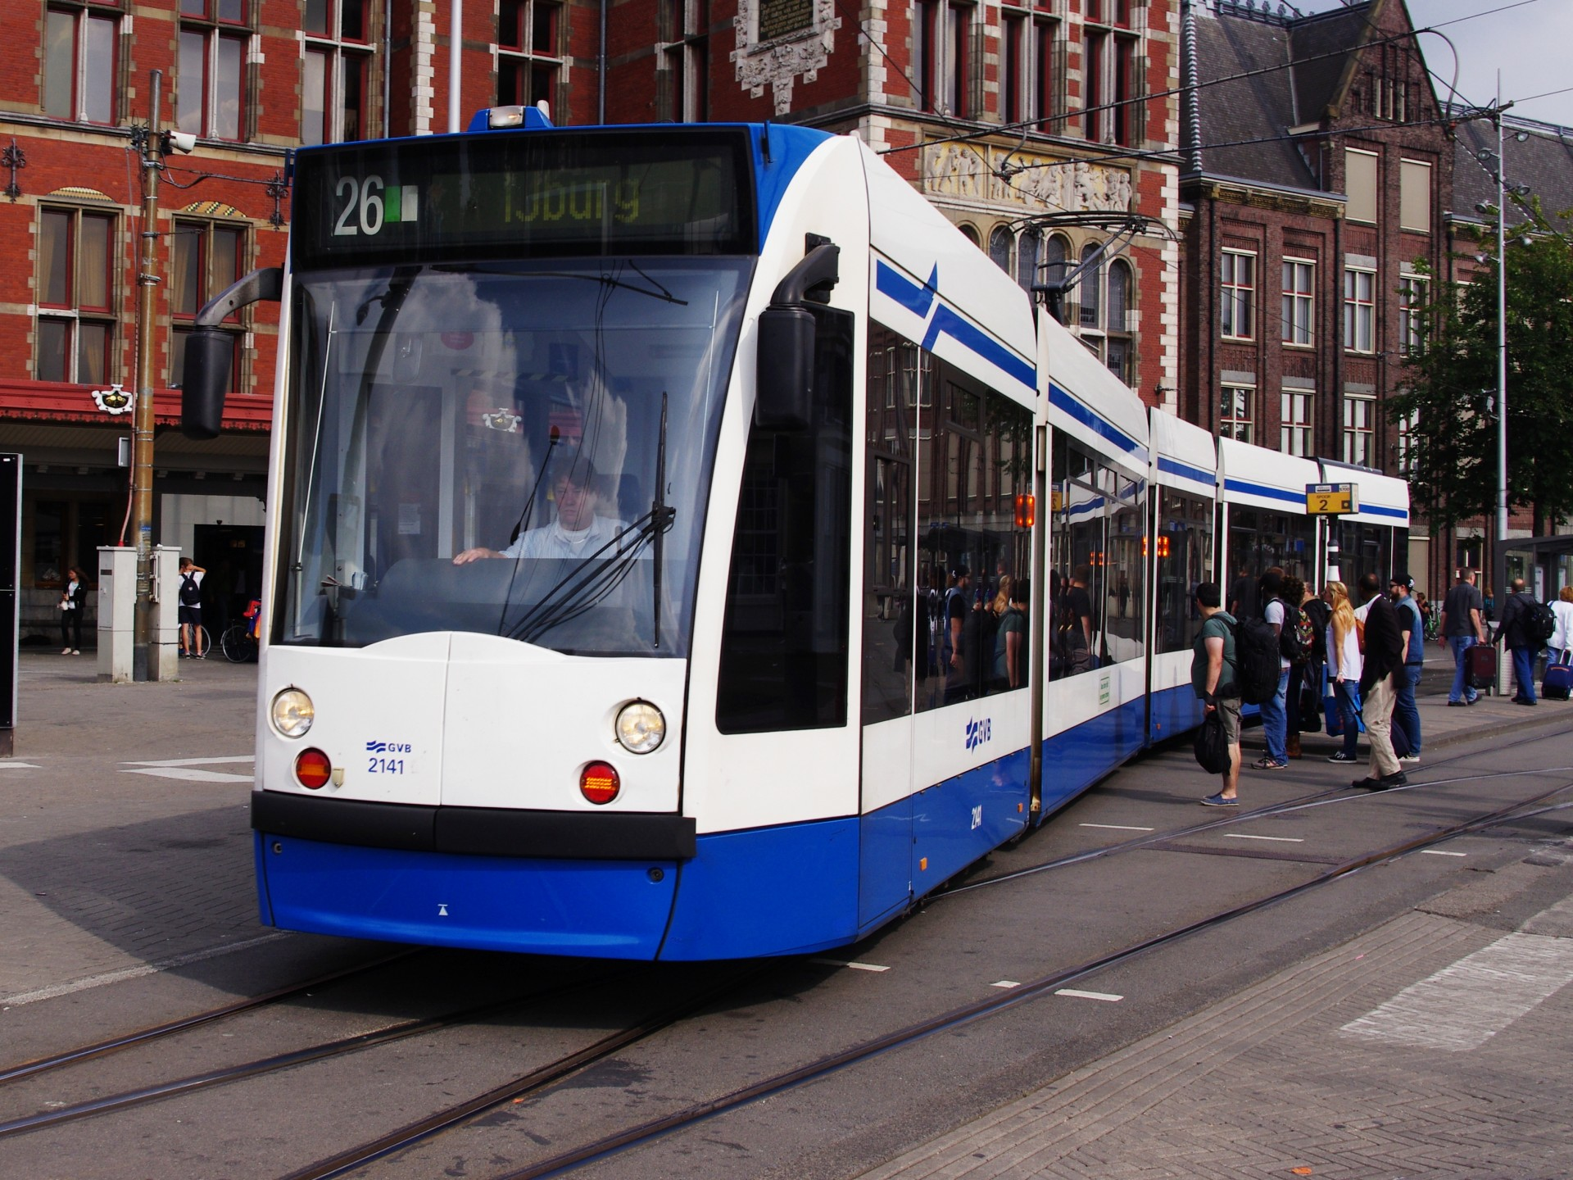

City Tram Conveyance Management System
Contributors :
SANAL PILLAI (002878588)
SIDDHARTH PAWAR (002225020)
SRIRAM VENKATESH (002201501)
RAMY SOLAnki (002816593)
RISHABH PATEL (002844967)
PROFESSOR :
MANUEL MONTROND

Slide 2
About Project
Project Objectives
We have designed a database for a Tram transportation company, to provide a centralized database for storing, managing and analyzing transportation data, including information on Trams, Routes, Drivers, Tickets, Passengers and Schedules information.
Optimizing Transit Operations
Data-Driven Decision Making
Optimize Customer Experience
Cost Conservation
Data Security
Growing the Business

Slide 3
High Level Design
Identification of Requirements
Development of Data
In order to administer the Tram Database, we first had to decide what data needed to be saved, how it would be accessed, and what kinds of reports and analyses would be required.
After creating the ER diagram, we start developing the DDL Commands and DML Insert Statements for our database
Determine Schema
Optimizing Performance & Analytics
We later determine the various entity types such as Trams, Drivers, Routes as well as their relationships co-ordinalities in accordance with the requirements.
To optimize our database we designed indexes, views, procedures, triggers UDFs to ensure that the database is properly tuned for the expected workload.

Slide 4
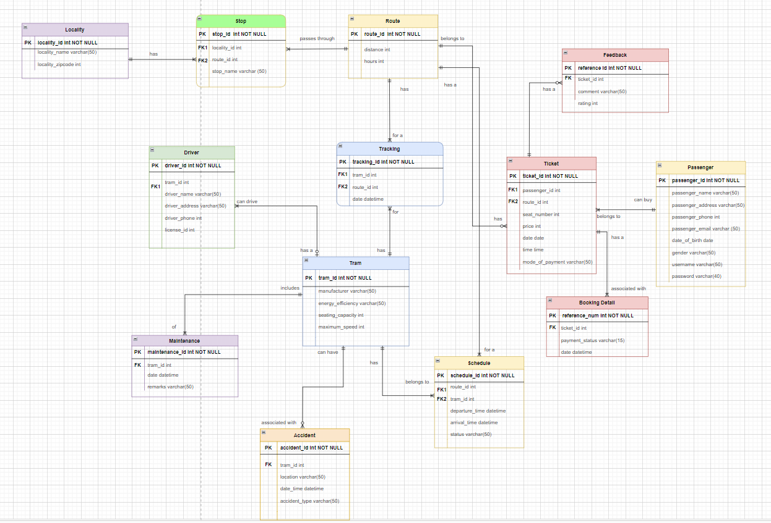
E-R Diagram

Slide 5
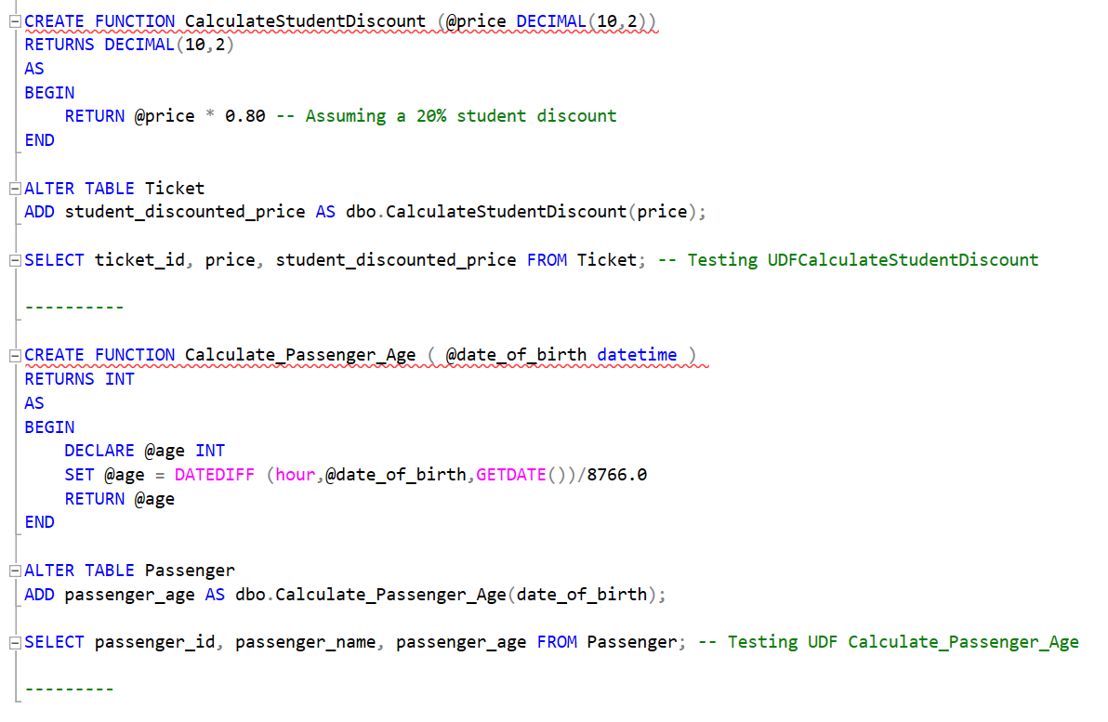
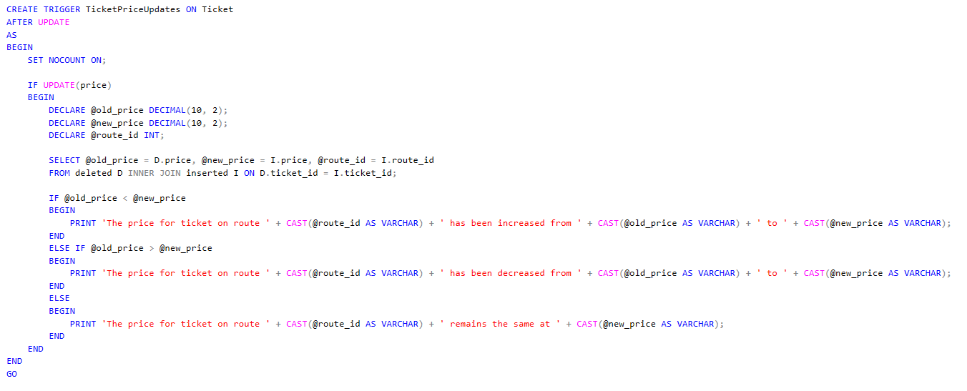
Database Objects
User Defined Functions
Triggers

Slide 6
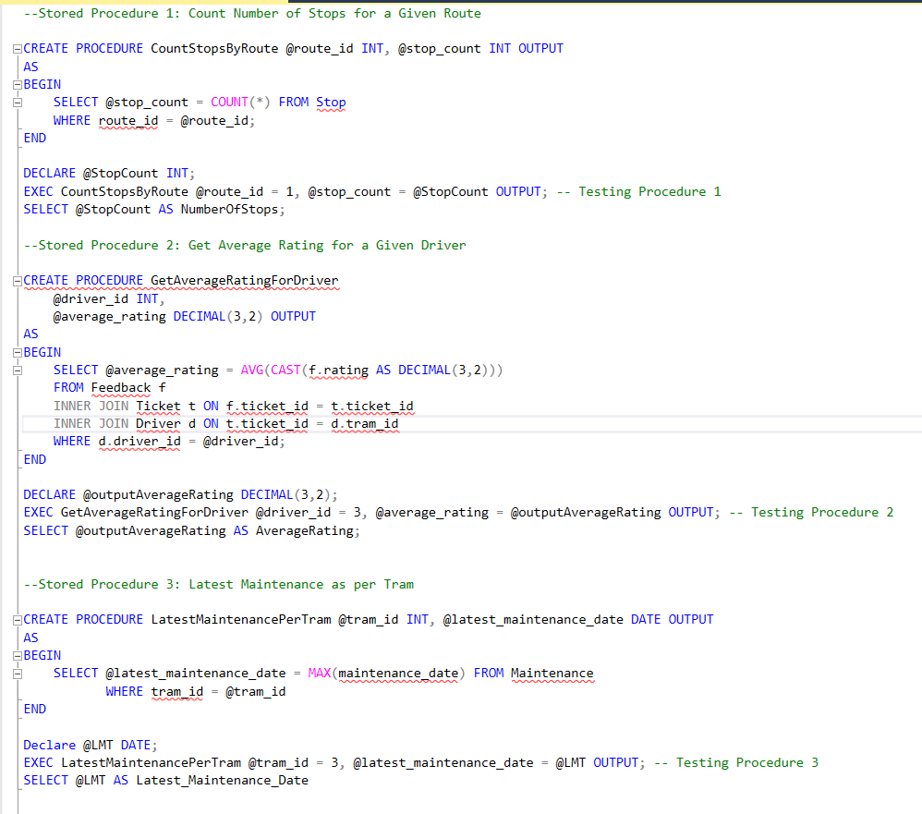
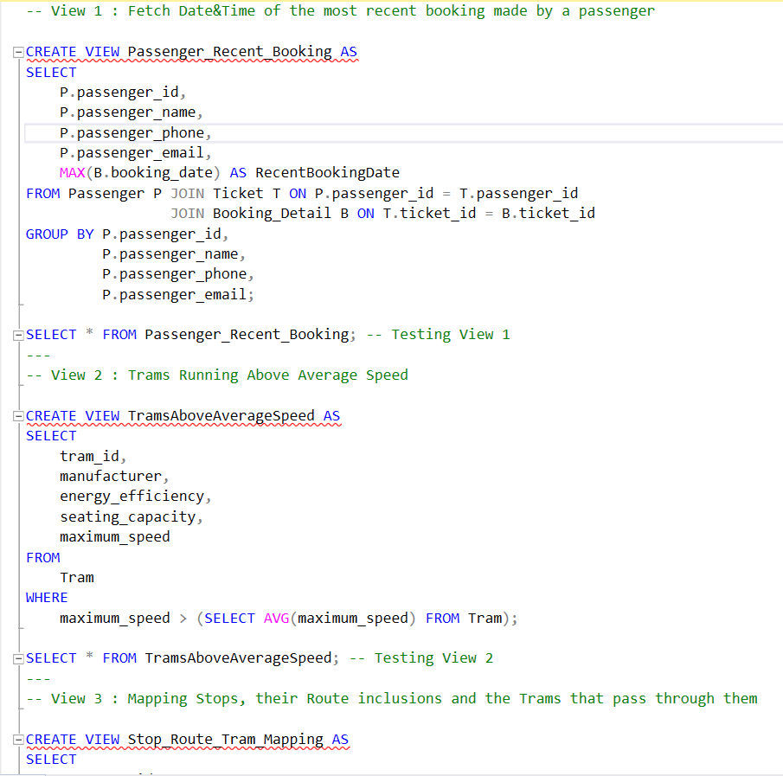
Procedures
Views

Slide 7
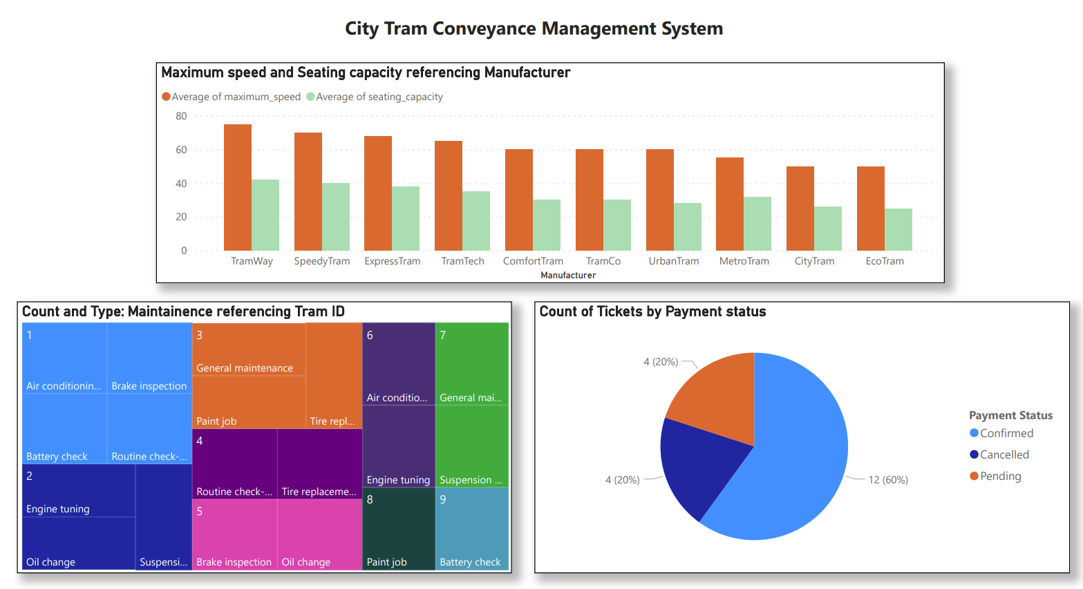
Data
Visualization

Slide 8
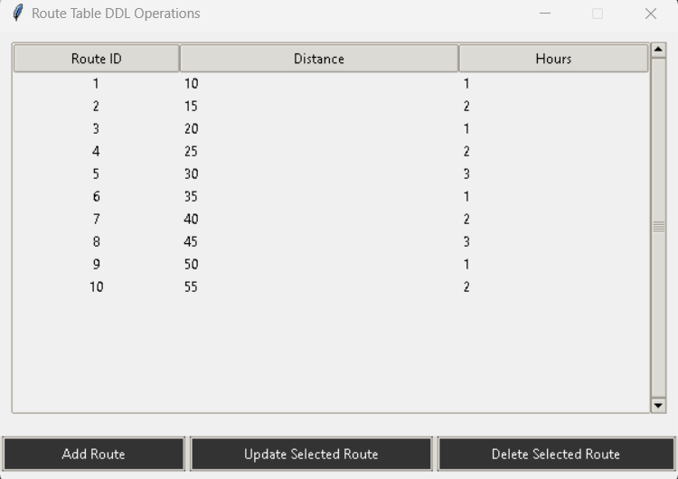
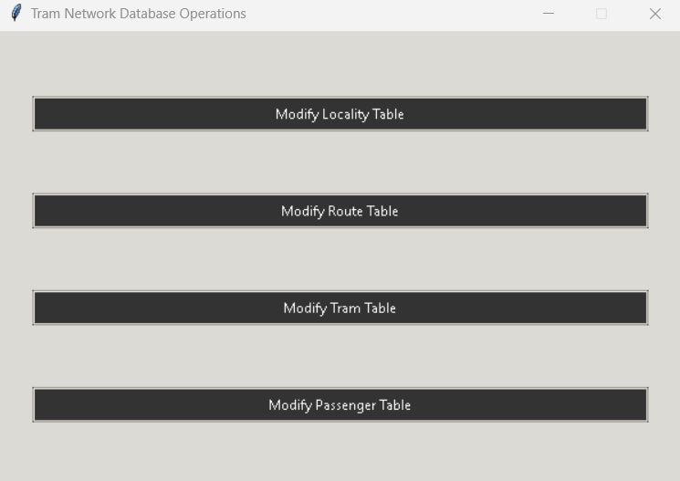
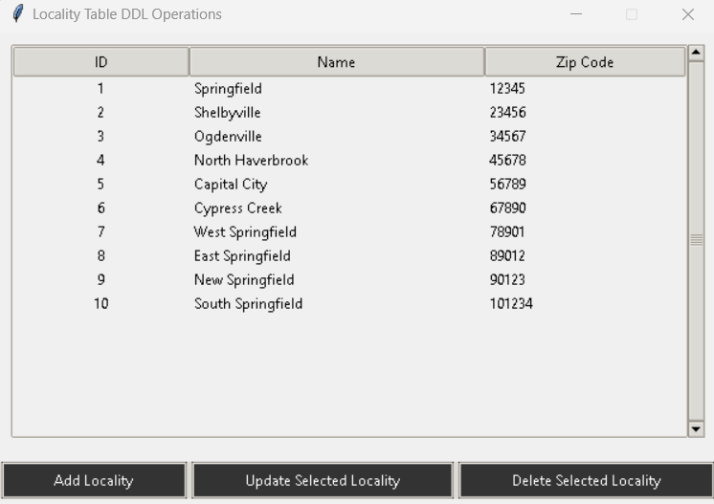
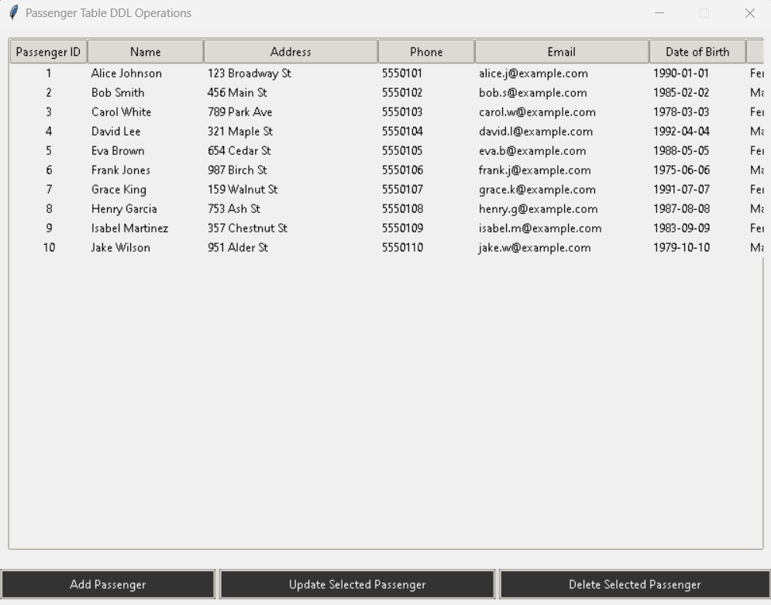
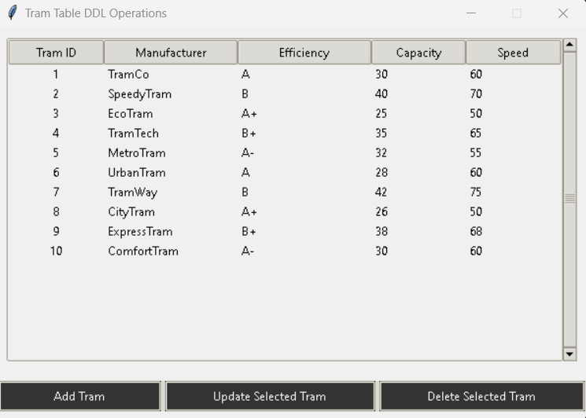
GUI

Slide 9
GitHub : https://github.com/Siddharth-Dattaram-Pawar/DMDD_Project
THANK YOU!
PROFESSOR MANUEL
ALISHA RAFIQ AHMED KHAN
MOIN SOORYA
SEONA RODRIGUES

