Slide 1


GitTorrent
The decentralized information manager from hell
Manas Pratim Biswas
Roll - 002011001025 UG - IV
Information Technology
Jadavpur University

Slide 2

Introduction

Slide 3
Looking Back

Slide 4
Federated Internet

Slide 5
Federated Internet
File sharing — FTP, HTTP
Chats — IRC, XMPP
Messaging — Email, Fidonet

Slide 6
Centralized Internet
File sharing — Dropbox, Google Drive
Chats — Slack, Discord
Messaging — Facebook, WhatsApp
Payments — PayPal
Code — GitHub, GitLab, BitBucket

Slide 7
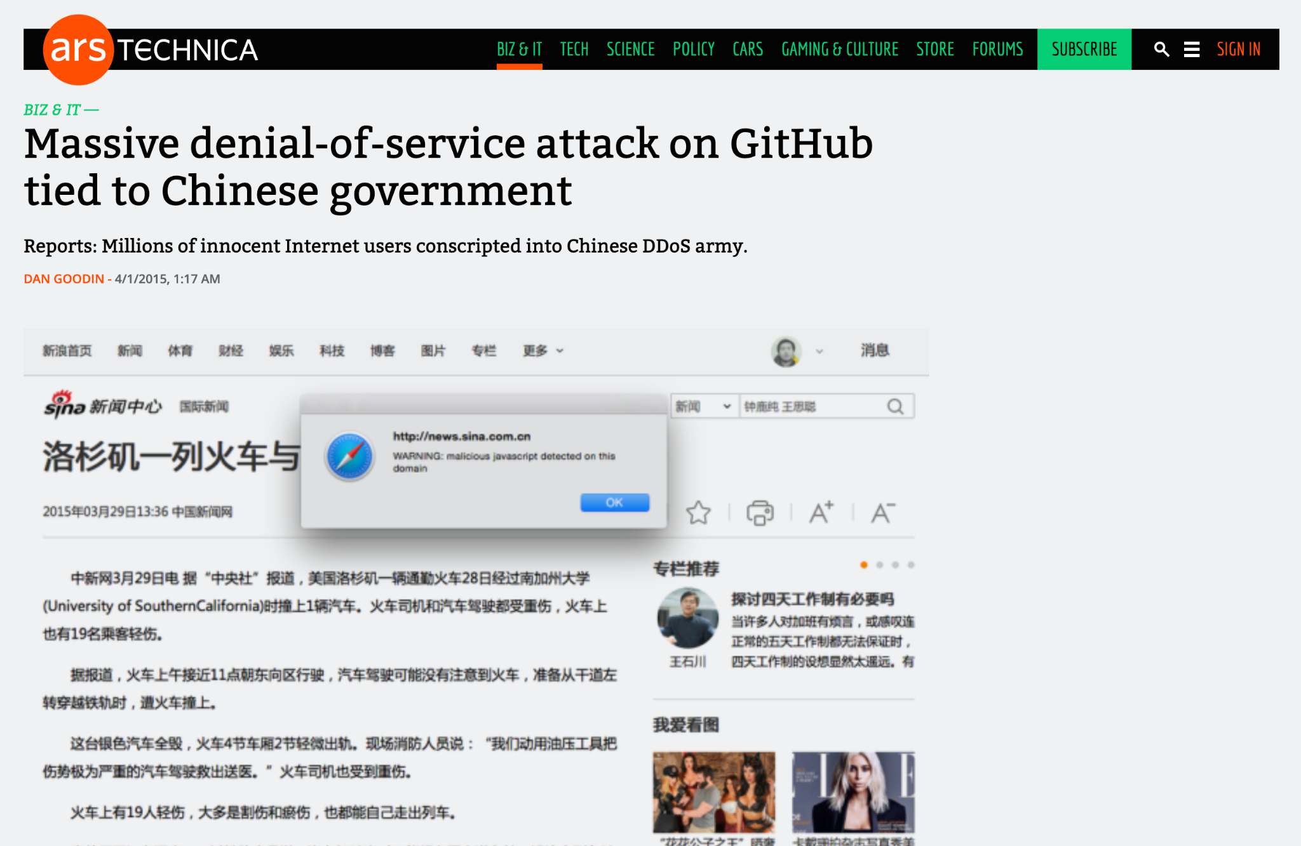
Demerits of Centralization
Data Leaks Censorship
Resilience and Availability Government Surveillance
https://arstechnica.com/information-technology/2015/03/massive-denial-of-service-attack-on-github-tied-to-chinese-government/

Slide 8

A New Hope

Slide 9
Peer-To-Peer
Distributed Network

Slide 10
Fundamentals
Peer-To-Peer communication
Decentralization of Control
High Resilience and Low Redundancy
Maintain a Distributed Ledger

Slide 11
Re-Decentralization
File sharing — BitTorrent, IPFS
Chats — Matrix
Messaging — GNU Ring, Tox
Payments — BitCoin, Ethereum
Code — Distributed Git => GitTorrent

Slide 12
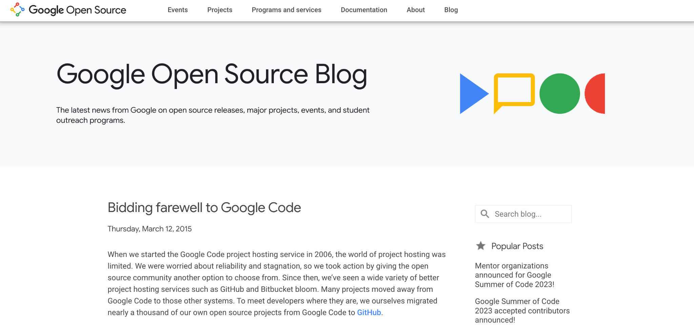
Why GitTorrent ?
https://opensource.googleblog.com/2015/03/farewell-to-google-code.html

Slide 13
Why GitTorrent ?
Practical Reasons
GitHub’s vulnerabilities and potential hacks/ DDoS threats
GitHub’s centralized control over open-source collaboration
https://mako.cc/writing/hill-free_tools.html

Slide 14
Why GitTorrent ?
Philosophical Reasons
Free softwares dependency on proprietary tools
Lack of control and modification options for users
https://mako.cc/writing/hill-free_tools.html

Slide 15
Why GitTorrent ?
Ironical Reason
Shifting from centralized protocols (CVS, Subversion) running on multiple servers to decentralized protocols (DVCS, Git) running on a centralized GitHub server
https://mako.cc/writing/hill-free_tools.html

Slide 16
Isn’t Git already Decentralized ?
Comparing Git to FTP, the lack of an index and the inability to turn clients into servers hinder the true decentralization of Git.
Unlike peer-to-peer protocols like BitTorrent, Git doesn't inherently provide visibility into where repositories are stored or enable direct communication between clients.

Slide 17
Isn’t Git already Decentralized ?
GitTorrent aims to address this limitation by introducing a decentralized approach, allowing users to locate and clone repositories without relying on a central server.

Slide 18
GitTorrenting a repository hosted on BitTorrent
1 git clone gittorrent://github.com/cjb/recursers
2 Cloning into 'recursers'...
3
4 Okay, we want to get: 5fbfea8de70ddc686dafdd24b690893f98eb9475
5
6 Adding swarm peer: 192.34.86.36:30000
7
8 Downloading git pack with infohash:
9d98510a9fee5d3f603e08dcb565f0675bd4b6a2
9
10 Receiving objects: 100% (47/47), 11.47 KiB | 0 bytes/s, done.
11 Resolving deltas: 100% (10/10), done.
12 Checking connectivity... done.

Slide 19

find the latest revision/commit
GitTorrenting a repository hosted on BitTorrent
run gittorrent protocol
git clone
git-remote-gittorrent
GitHub
commit: 5fbfea8de...
packfile of git repository
peer-to-peer network

Slide 20
GitTorrenting a repository hosted on BitTorrent
get_nodes('5fbfea8de70ddc686dafdd24b690893f98eb9475') = [192.34.86.36:30000, ...]
list of all peers or the peer set that
can seed that particular commit

Slide 21
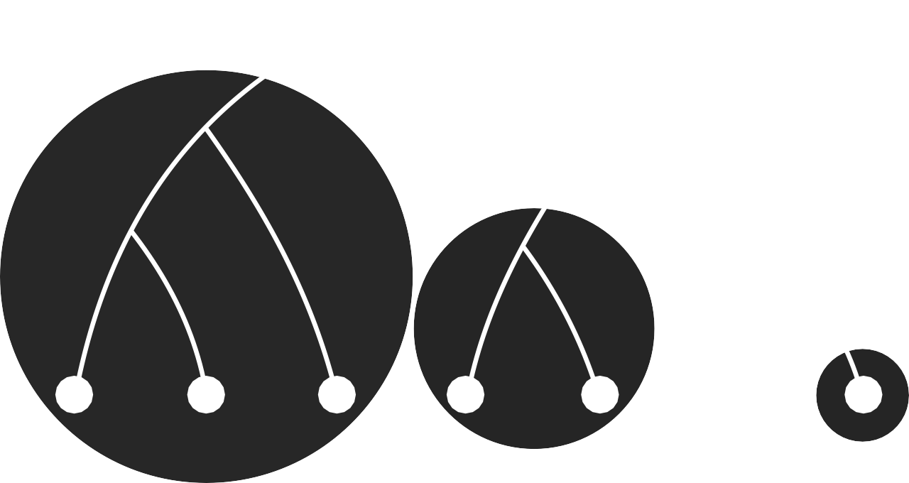
Kademlia Distributed Hash Table
1
1
10
0
10
0
10
0
1
000 001 010 100 101 110 111

Slide 22
Removing the GitHub Centralised Dependency
// Immutable key put hash(value) = put({ value: 'some data' }) // Mutable key put hash(key) = put({ value: 'some data', key: key, seq: n }) // Get value = get(hash)
each node maintains a
network-wide key-value store

Slide 23
GitTorrenting a new revision or commit
new commit as
a signed update
with a new seq no
update and redistribute the new commit
verify public key with
the hash table key

Slide 24
GitTorrenting a repository hosted on BitTorrent
run gittorrent client with a hex number that is the hash of author’s public key which is used as a mutable key on the distributed hash table
hash: 81e24205d4bac8496d3e13282c90ead5045f09ea
git-remote-gittorrent
peer-to-peer network
packfile of git repository

Slide 25
1 git clone gittorrent://81e24205d4bac8496d3e13282c90ead5045f09ea/recursers 2 3 Cloning into 'recursers'... 4 5 Mutable key 81e24205d4bac8496d3e13282c90ead5045f09ea returned: 6 name: Chris Ball 7 email: chris@printf.net 8 repositories: 9 recursers: 10 master: 5fbfea8de70ddc686dafdd24b690893f98eb9475 11 12 Okay, we want to get: 5fbfea8de70ddc686dafdd24b690893f98eb9475 13 14 Adding swarm peer: 192.34.86.36:30000 15 16 Downloading git pack with infohash: 9d98510a9fee5d3f603e08dcb565f0675bd4b6a2 17 18 Receiving objects: 100% (47/47), 11.47 KiB | 0 bytes/s, done. 19 Resolving deltas: 100% (10/10), done. 20 Checking connectivity... done.

Slide 26
Conclusion

Slide 27
A global BitTorrent swarm of Git objects
git clone https://github.com/cjb/foo
git clone gittorrent://github.com/cjb/foo
git clone gittorrent://81e24205d4bac8496d3e13282c90ead5045f09ea/foo

Slide 28
GitTorrent Limitations
Doesn’t implement GitHub Comments, Issues, Discussions
Doesn’t implement Pull Request and collaborative workflow
Seeders should be rewarded for being a part of network
DHTs support is limited

Slide 29
GitTorrent Future Work
Distributed revision control systems for bug tracking - Bugs Everywhere
Use IPFS (InterPlanetary File System) instead of BitTorrent swarm
https://ipfs.tech/
https://bugseverywhere.org/

Slide 30
References
https://blog.printf.net/articles/2015/05/29/announcing-gittorrent-a-decentralized-github/
https://github.com/cjb/GitTorrent
https://lwn.net/Articles/646628/
https://news.ycombinator.com/item?id=9625840

Slide 31
Thank you
https://github.com/sanam2405/seminar
Manas Pratim Biswas (@sanam2405)
Roll - 002011001025 UG - IV
Information Technology
Jadavpur University

Slide 32
Questions ?

