Slide 1
Mobile Application Development
AutoComplete
Menu
Shapes

Slide 2
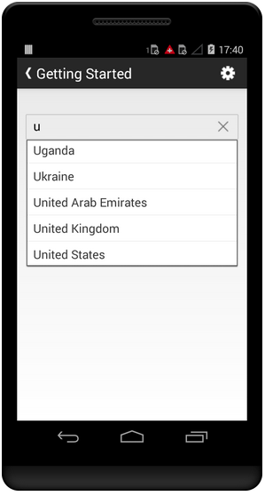
AutoComplete
shows completion suggestions automatically while the user is typing
suggestions is displayed in a drop down menu
DataSource
  private static final String[] Title1 = new String[] { "United States", "Wales", "New York", “United Kingdom”}
Threshold
  Option to be displayed on typing text

Slide 3
Auto Complete
<AutoCompleteTextView
android:id="@+id/autoCompleteTextView"
android:layout_width="wrap_content"
android:layout_height="wrap_content"
/>

Slide 4
Auto Complete
AutoCompleteTextView autoCompleteTv;
String[] countries = getResources().getStringArray(R.array.list_of_countries);
ArrayAdapter<String> adapter = new ArrayAdapter<String> (this,android.R.layout.simple_list_item_1,countries);
autoCompleteTv.setAdapter(adapter);

Slide 5

Custom Shape
Shape
  Oval
  Rectange
  Ring
Stroke (outline)
Solid (inner color)

Slide 6
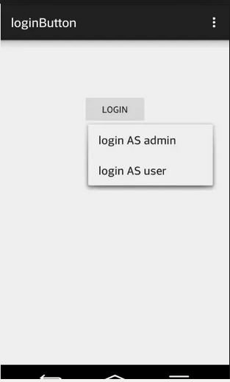
Menus
Options Menu
Context Menu
Popup Menu

Slide 7
Options Menu
Android:id
A resource ID that's unique to the item, which allows the application to recognize the item when the user selects it.
Android:icon
A reference to a drawable to use as the item's icon.
Android:title
A reference to a string to use as the item's title.
android:showAsAction
Specifies when and how this item should appear as an action item in the app bar.

Slide 8
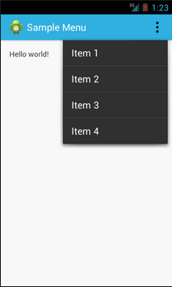
Option Menu
<menu>
<item>
</item>
<item>
</item>
</menu>

Slide 9
Option Menu
<?xml version="1.0" encoding="utf-8"?>
<menu xmlns:android="http://schemas.android.com/apk/res/android">
<item android:id="@+id/new_game"
android:icon="@drawable/ic_new_game"
android:title="@string/new_game"
android:showAsAction="ifRoom"/>
<item android:id="@+id/help"
android:icon="@drawable/ic_help"
android:title="@string/help" />
</menu>

Slide 10
PopUp Menu
public void showMenu(View v) {
PopupMenu popup = new PopupMenu(this, v);
// This activity implements OnMenuItemClickListener
popup.setOnMenuItemClickListener(this);
popup.inflate(R.menu.actions);
popup.show();
}
PopupMenu.OnMenuItemClickListener

Slide 11
Handling Click Events
@Override
public boolean onMenuItemClick(MenuItem item) {
switch (item.getItemId()) {
case R.id.archive:
archive(item);
return true;
case R.id.delete:
delete(item);
return true;
default:
return false;
}}

