Slide 1
Mobile Application Development
JSON,
GSON,
Picasso,
Glide

Slide 2
What is JSON?
Stands for JavaScript Object Notation
Lightweight format for storing and transportation of data
Easy to understand
Used when data is sent from server to web page

Slide 3
JSON Rules
Data is in name/value pairs
Data is separated by commas
Curly bracket holds the object
Square bracket holds the array

Slide 4
JSON Objects
JSON Objects are written in curly braces
Objects can hold multiple name/value pairs
{
“firstName”: “Jack”,
“lastName”: “John”,
“age”: “20”
}

Slide 5
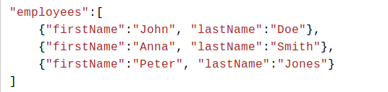
JSON Array
JSON Arrays are written inside square brackets
Array can contain objects

Slide 6
GSON
Gson is a Java Library
Used to convert Java Objects into their JSON representation
Used to convert a JSON string to an equivalent Java object

Slide 7
Gradle Dependencies
Dependencies
{
implementation 'com.google.code.gson:gson:2.8.5'
}

Slide 8
Image Loading Libraries
Picasso
Glide

Slide 9
Picasso
ImageView imageView = (ImageView) findViewById(R.id.my_image_view);
Picasso.get().load("http://i.imgur.com/DvpvklR.png").into(imageView);
implementation 'com.squareup.picasso:picasso:2.71828'

Slide 10
Glide
repositories {
mavenCentral()
google()
}
dependencies {
implementation 'com.github.bumptech.glide:glide:4.9.0'
annotationProcessor 'com.github.bumptech.glide:compiler:4.9.0'
}

Slide 11
Glide
ImageView imageView = (ImageView) findViewById(R.id.my_image_view);
Glide.with(this).load("http://goo.gl/gEgYUd").into(imageView);

Slide 12
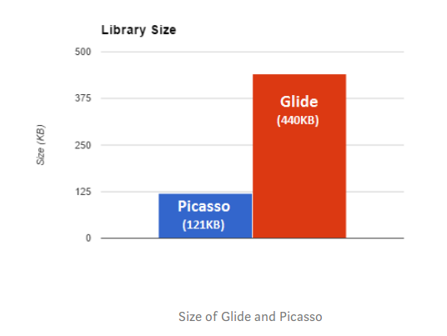
Picasso Vs Glide

Slide 13
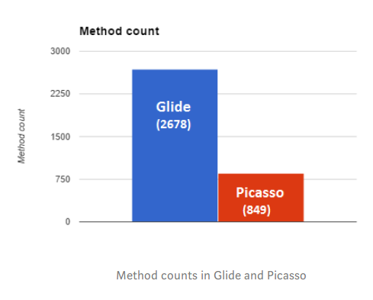
Picasso Vs Glide

Slide 14
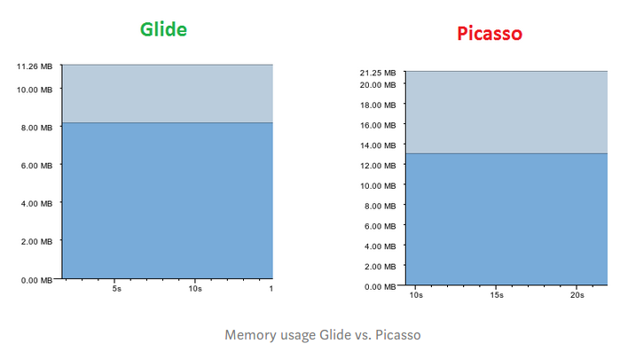
Picasso Vs Glide

