Slide 1
Mobile Application Development - Day 13
Spinner,
Multi-Language

Slide 2
Spinner
Provide a quick way to select one value from a set
In the default state, a spinner shows its currently selected value
Displays a dropdown menu with all other available values, from which the user can select a new one

Slide 3
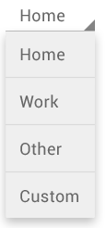
Spinner
Array of data
  Home
  Work
  Other
  Custom

Slide 4
Spinner -XML
<Spinner
android:id="@+id/planets_spinner"
android:layout_width="fill_parent"
android:layout_height="wrap_content" />

Slide 5
Spinner - Data Source
<?xml version="1.0" encoding="utf-8"?>
<resources>
<string-array name="planets_array">
<item>Mercury</item>
<item>Venus</item>
<item>Earth</item>
<item>Mars</item>
<item>Jupiter</item>
<item>Saturn</item>
<item>Uranus</item>
<item>Neptune</item>
</string-array>
</resources>

Slide 6
Spinner - Populating spinner
Spinner spinner = (Spinner) findViewById(R.id.spinner);
// Create an ArrayAdapter using the string array and a default spinner layout
ArrayAdapter<CharSequence> adapter = ArrayAdapter.createFromResource(this,
R.array.planets_array, android.R.layout.simple_spinner_item);
// Specify the layout to use when the list of choices appears
adapter.setDropDownViewResource(android.R.layout.simple_spinner_dropdown_item);
// Apply the adapter to the spinner
spinner.setAdapter(adapter);

Slide 7
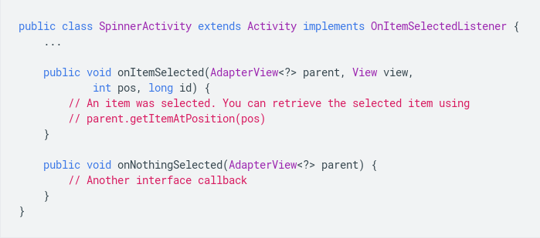
Spinner - Responding to User Selections

Slide 8
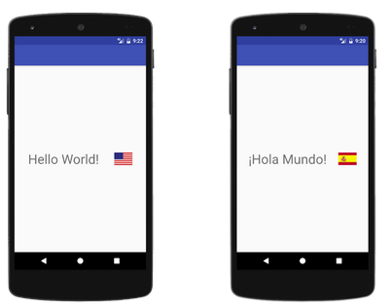
Multi-Language

