Slide 1
MGMT 571 Data Mining Final Project
Neural Nomads
Satish | Sana Majeed | Iscel Manalo

Slide 2
CONTENTS
Model Summary
Data Preprocessing
AutoGluon
Validation
Project Insights

Slide 3
Model Summary
Final Score
0.9231
AutoGluon
Step 1
Step 2
Step 3
Step 4
Step 5
Preprocess Training Data
5-Fold Split (Repeated 20 times)
Run Base Models (LightBGM, RF, NN, etc.)
Create Meta-Model Using OOF Predictions
Final Weighted Ensemble

Slide 4
Data Preprocessing
Handling Infinite Values
Selecting Financial Attributes
Reducing Skewness with the arcsinh Transformation
To avoid errors during model training, all positive and negative infinite values in both the training and test data were replaced with NaN (missing values)
By explicitly defining the attribute list, the model focuses on the relevant financial indicators and ignores any non-predictive columns such as IDs or other metadata that might be present
To reduce skewness and stabilize variance, the inverse hyperbolic sine (arcsinh) transformation was applied
Several preprocessing steps were applied to clean and transform the data to ensure that the model can learn effectively and that issues such as extreme values and skewness are handled appropriately.

Slide 5
Why AutoGluon?
AutoGluon automates the running of different algorithms and hyperparameters.
It can train multiple models such as gradient-boosted trees (LightGBM, CatBoost, XGBoost), random forests, neural networks, and others, and then intelligently ensemble the best ones.
More information: https://github.com/autogluon/autogluon
AutoGluon typically leads to strong performance with much less manual effort.

Slide 6
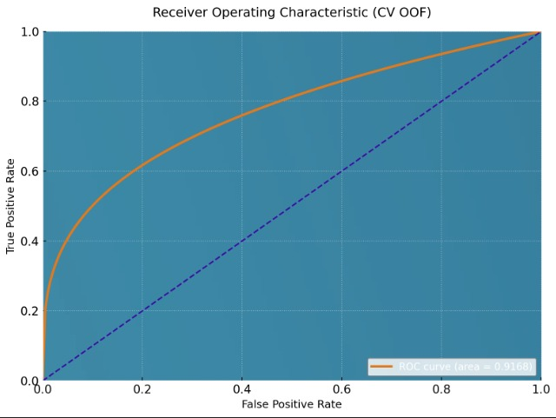
Validation
The high ROC AUC value indicates that the model is effective at ranking bankrupt firms above non-bankrupt firms in terms of predicted risk.

Slide 7
Project Insights
Financial-risk data behaves in a very non-linear way, meaning there isn't just one obvious pattern pointing toward bankruptcy.
Tuning the model with extended time is beneficial accuracy.
Simpler models were fast but missed important signals, while very complex models sometimes overfit unless controlled carefully.
Letting AutoGluon automate model selection, tuning, and ensembling saved a huge amount of manual effort and ultimately produced a model that was both accurate and dependable.
Datasets with many correlated variables and subtle patterns an automated multi-model approach performs far better than choosing one algorithm by intuition alone.

Slide 8
THANK YOU

