Slide 1
MGMT 590 · Big Data Analytics & MLOps · Spring 2026
Flight Delay
Prediction
Using Apache Spark · Hive · MLlib on Databricks
US Flights 2019–2023 · 3 Million Records

Slide 2
00
Agenda
01
Data Selection & Problem Definition
02
Data Ingestion & Preprocessing
03
Exploratory Data Analysis (EDA)
04
Predictive Modeling with Spark MLlib
05
MLOps Practices
06
Insights & Business Recommendations

Slide 3
SECTION
01
Data Selection &
Problem Definition
Dataset · Business problem · Target variable

Slide 4
01
Data at a Glance
3M
2.9M
Flight Records
Modeling Dataset
flights_sample_3m.csv · 2019–2023
After filtering cancelled flights
17.6%
82.4%
Delayed Flights
On-Time
DEP_DELAY > 15 min (FAA standard)
Within 15 min of scheduled departure

Slide 5
01
Business Problem
✈
Can we predict if a flight will be delayed
before it departs?
🎯
Target: Binary — Delayed (>15 min) vs On-Time
💼
Use case: Airlines, airports, travelers — proactive planning
⚠
Challenge: Real-time factors (weather, ATC) drive many delays

Slide 6
SECTION
02
Data Ingestion &
Preprocessing
Databricks DBFS · Spark · Cleaning · Feature engineering

Slide 7
02
Data Ingestion & Preprocessing
1
2
3
4
Upload
Read with Spark
Clean
Feature Engineering
flights_sample_3m.csv → Databricks
/Volumes/workspace/default/bigdataproject/
→
spark.read.csv(..., header=True, inferSchema=True)
→
Remove duplicates · Filter cancelled flights · Handle nulls
→
MONTH · DAY_OF_WEEK · DEP_HOUR from FL_DATE & CRS_DEP_TIME

Slide 8
SECTION
03
Exploratory Data
Analysis
Delay breakdown · Airline comparison · Temporal patterns · Visualizations

Slide 9
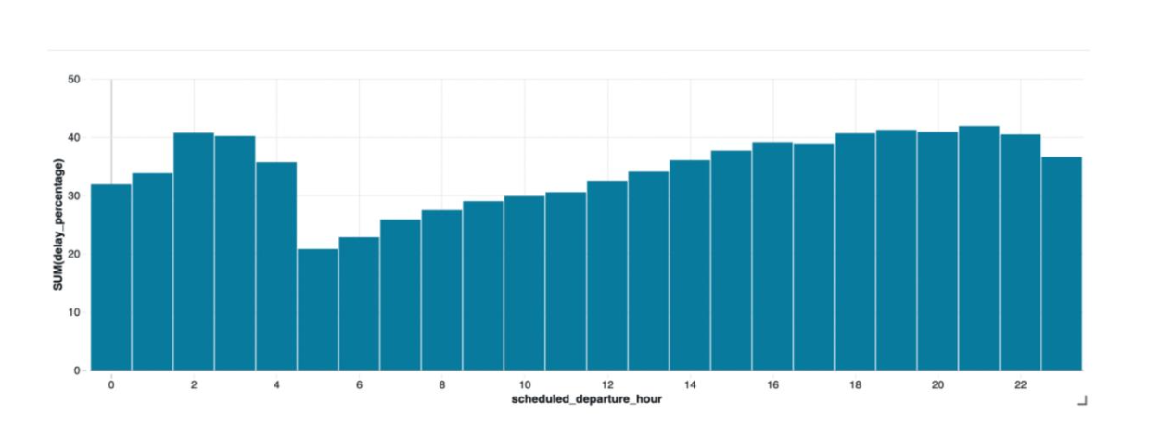
03
Delay Frequency
33.1%
72.5%
5
Evening
Delayed Flights
Arrival Delays also had a Departure Delay
Delay Causes
Riskiest- 40% delay rate
ARR_DELAY > 0 min
Carrier · Weather · NAS · Security · Late Aircraft
Cascading delays pile up through the day
Confirms cascading delay effect in airline operations.
•
Delay causes cascade — carrier and late aircraft delays dominate
•
Certain airlines and origin airports show significantly higher delay rates
•
Monthly trends: Summer and winter show higher delay rates

Slide 10
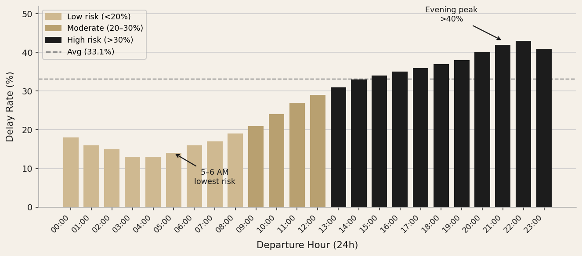
03
EDA — Delay Rate by Departure Hour
Cascade accumulation drives evening risk
KEY INSIGHTS
▸ 5–6 AM departures have the lowest delay risk (~14%)
▸ Delay probability rises steadily — exceeding 40% for flights departing after 8 PM
▸ Cascade effect: each delayed inbound flight reduces the probability the next departure leaves on time
▸ DEP_HOUR is the single strongest predictor in the ML model (27.7% feature importance)

Slide 11
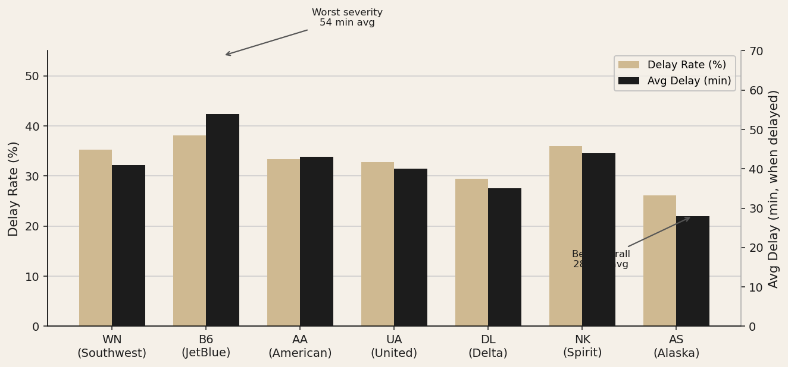
03
EDA — Airline Performance Comparison
Delay rate vs. average delay severity
KEY INSIGHTS
▸ JetBlue worst for severity: 54 min avg delay — 26 min worse than Alaska
▸ Southwest highest volume of delays (201,632) — reflects scale, not necessarily poor performance
▸ Alaska best overall: lowest rate (26.1%) and shortest delays (28.3 min)
▸ Spirit elevated delay rate (36%) suggests structural scheduling challenges

Slide 12
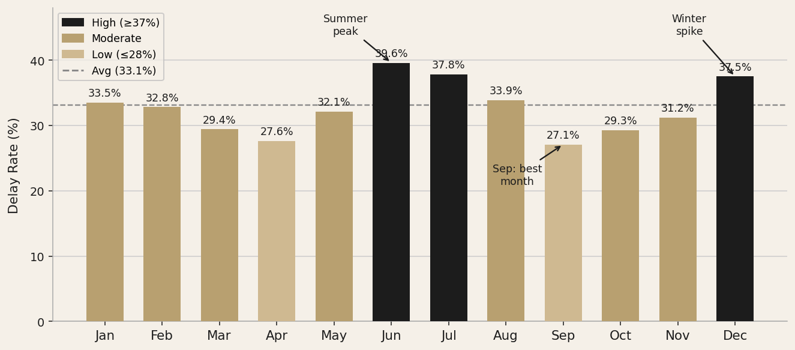
03
EDA — Monthly Delay Rate Pattern
Summer and winter peaks bracket a September trough
KEY INSIGHTS
▸ June (39.6%) and July (37.8%) are the riskiest months — summer travel demand + convective weather
▸ December spike (37.5%) driven by winter storms and holiday traffic concentration
▸ September is the safest month at 27.1% — post-summer lull, pre-winter
▸ MONTH is the 3rd strongest feature in the RF model (5.8% importance)

Slide 13
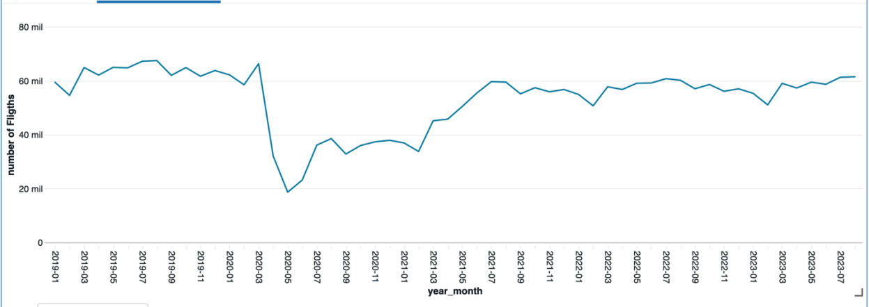
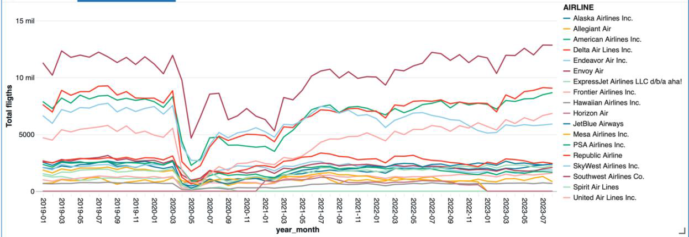
03
EDA — Flight Volume & Temporal Trends
Seasonal patterns and COVID-19 impact (Fig. 17)
KEY INSIGHTS
▸ COVID-19 caused a 70% traffic collapse (Mar–Apr 2020); full recovery by mid-2022
▸ Seasonal peaks: June (39.6%) and July (37.8%) — summer demand + convective weather
▸ December spike (37.5%) — winter storms + holiday concentration
▸ September is the cleanest month at 27.1% — post-summer lull

Slide 14
SECTION
04
Predictive Modeling
with Spark MLlib
Classification · Feature engineering · 3 models · Evaluation

Slide 15
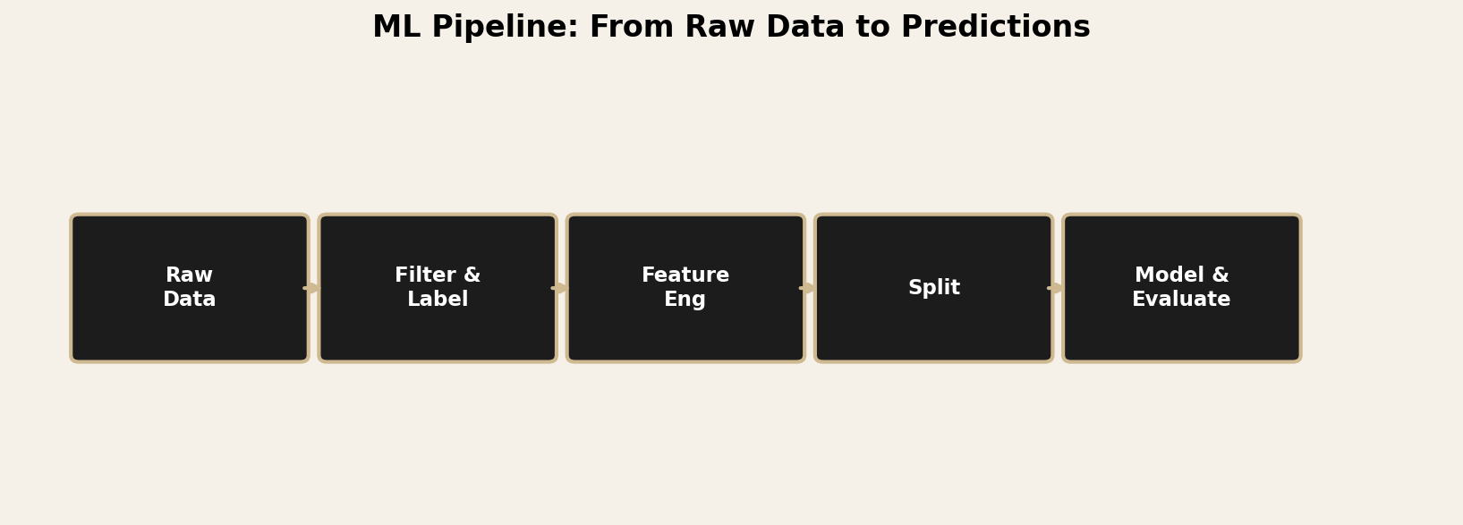
04
ML Pipeline — From Raw Data to Predictions

Slide 16
04
Features Used for Prediction
FEATURE
TYPE
DESCRIPTION
TARGET LABEL
AIRLINE
Categorical
Encoded via StringIndexer + OHE
1
ORIGIN
Categorical
Departure airport code
DELAYED
DEST
Categorical
Arrival airport code
DEP_DELAY > 15 min
MONTH
Numeric
Month of year (1–12)
0 = On-Time
1 = Delayed (>15 min)
DAY_OF_WEEK
Numeric
1=Sunday … 7=Saturday
⚠ No leakage: DEP_DELAY, ARR_DELAY,
and DELAY_DUE_* not used as features
DEP_HOUR
Numeric
Scheduled departure hour (0–23)
DISTANCE
Numeric
Flight distance in miles

Slide 17
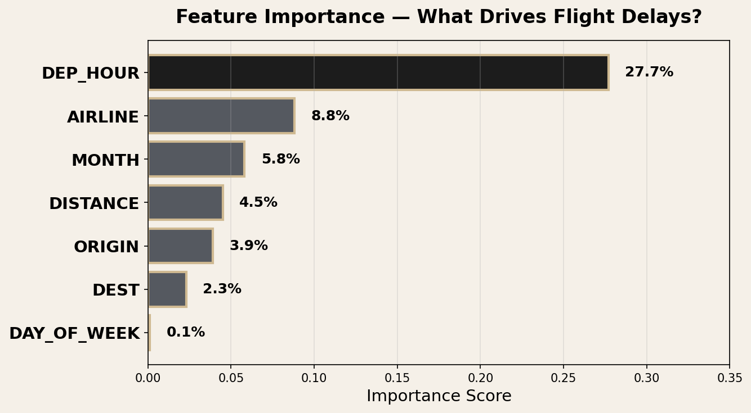
04
Feature Importance — What Drives Delays?

Slide 18
04
Model Comparison — Results
Model
AUC
Accuracy
Precision
Recall
F1
Logistic Regression
0.6514
0.8239
0.7525
0.8239
0.7448
Random Forest
0.6476
0.8240
0.6789
0.8240
0.7444
Tuned Random Forest ★
0.6525
0.8240
0.6789
0.8240
0.7444
★ Best model: Tuned RF (numTrees=200, maxDepth=15) · ~0.65 AUC reflects the inherent limit of pre-departure features

Slide 19
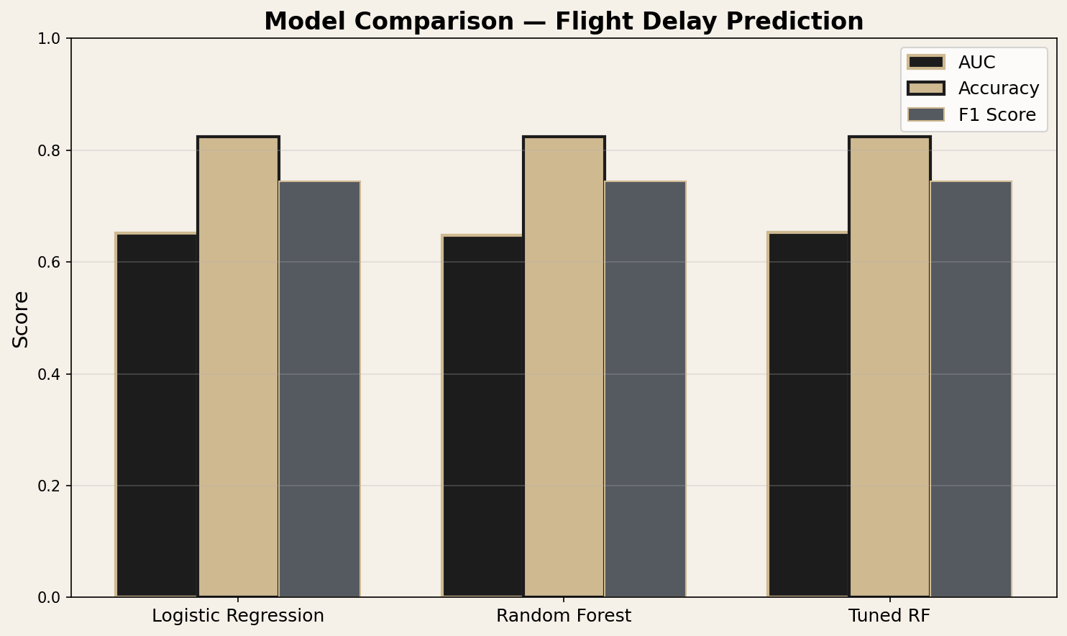
04
Model Comparison — AUC · Accuracy · F1 Score

Slide 20
04
Interpretation
~0.65 AUC
DEP_HOUR 27.7%
Moderate predictive power
Top predictor
All 3 models perform similarly — pre-departure features have a ceiling
Evening flights delay more — cascading effect from earlier flights
82% On-Time
Consistent
Class imbalance
Tuned RF wins
Models tend to predict majority class — class weights would help
Marginal improvement from hyperparameter tuning; more data or features needed

Slide 21
SECTION
05
MLOps Practices
Spark Pipelines · MLflow · Experiment tracking · Reproducibility

Slide 22
05
Automated Spark Pipeline + MLflow Tracking
SPARK PIPELINE
MLFLOW EXPERIMENT TRACKING
1
StringIndexer
Logistic Regression
AUC 0.6514
F1 0.7448
↓
2
OneHotEncoder
Random Forest
AUC 0.6476
F1 0.7444
↓
3
VectorAssembler
Tuned RF ★
AUC 0.6525
F1 0.7444
↓
4
RandomForestClassifier
Parameters, metrics, and models logged per run.
Accessible via Databricks Experiments sidebar.

Slide 23
SECTION
06
Insights & Business
Recommendations
Key findings · Actionable recommendations · Future work

Slide 24
06
Key Insights & Business Recommendations
KEY INSIGHTS
RECOMMENDATIONS
Time of day matters most
1
Flag high-risk flights (evening, certain airlines/routes) for proactive alerts to passengers
DEP_HOUR drives 27.7% of predictive power. Evening = risky.
2
Prioritize airport staffing and gates during peak delay hours (4–8pm)
Airline matters
Some carriers delay significantly more — AIRLINE is 2nd most important feature.
3
Integrate real-time weather + air traffic feeds in production to lift AUC beyond 0.65
Seasonal patterns
MONTH contributes 5.8% — winter storms and summer demand spikes.
FUTURE WORK
Pre-departure ceiling
→ Class balancing (SMOTE) for imbalanced dataset
All models top out at ~0.65 AUC — real-time data needed to go higher.
→ Add weather & FAA ATC delay feeds as features

Slide 25
Thank You
Questions?
MGMT 590 · Big Data Analytics & MLOps · Spring 2026

