Slide 1

SMARTER
CALLING
44%
How predictive targeting increased bank campaign profit by 11% —
while cutting call volume by 44%.
THE RESULT
$99,740
Net profit
1,523
Calls made
Sana Majeed· Portuguese Bank Telemarketing Dataset
90%
Sensitivity

Slide 2


Key Variables
What each row contains — one customer, one contact attempt
THE
DATASET
Customer
age, job, marital, education, housing, loan, default
Campaign
Portuguese Bank
Telemarketing Campaign
contact type, month, day of week, previous contacts
Economic
emp.var.rate, cons.price.idx, cons.conf.idx, euribor3m
41,188 customer records (raw)
~5,466 after cleaning
History
18 input variables per customer
pdays (days since last contact), poutcome (prior result)
Target: subscribed yes/no
Revenue: $200 per subscription
Target ✦
Cost: $20 per call made
y — Did the customer subscribe? (yes / no)

Slide 3





Assumptions & Methodology
What we assumed before building — and how we built it.
ASSUMPTIONS
METHODOLOGY FLOW
01
Fixed economics
Derive Profit Cutoff
$200 revenue per sub, $20 cost per call — constant, no exceptions.
Establish p* = 0.10 from cost/revenue before any modelling
02
Clean Data
Binary outcome
Remove invalid records — illiterate, defaulted, unknowns
A customer subscribes or doesn't. No partial conversions modelled.
Encode & Split
03
Log-odds linearity
One-hot encode categoricals · 50/50 train-test split
Logistic regression assumes a linear relationship in log-odds space.
Logistic Regression
04
Cleaned sample representative
Fit model on training set · extract significant variables
Removing illiterate, defaulted & unknown-status records leaves a reliable population.
Evaluate Model
Sensitivity, specificity, precision, F1, confusion matrix
05
50/50 random split
Compare Profit
Train/test split with fixed seed (random_state=1) for reproducibility.
Targeted vs. mass calling — quantify the business gain

Slide 4
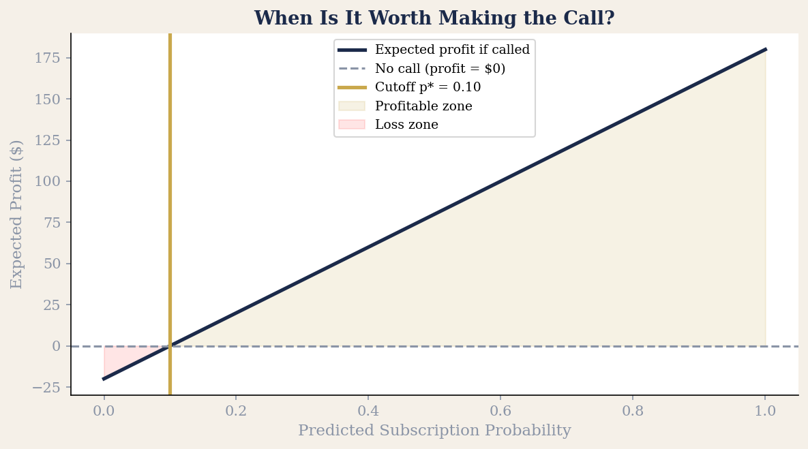
The Decision Rule: When Is It Worth Calling?
We derived the optimal cutoff mathematically before touching the model.
THE MATH
E[Profit | call]
= $200p − $20
E[Profit | no call]
= $0
Call when:
p > 20/200
= 0.10
Optimal cutoff: 10%

Slide 5
What Drives Subscription? — Most Influential Variables
Logistic regression on training set — variables significant at 5% confidence, ranked by effect size.
INCREASES SUBSCRIPTION LIKELIHOOD
DECREASES SUBSCRIPTION LIKELIHOOD
▲
cons.price.idx
▼
emp.var.rate
Higher consumer price index = more economic confidence = more savings appetite
Rising employment variation signals economic uncertainty — people avoid locking up savings
▲
poutcome_success
▼
pdays
If they said yes in a previous campaign, they're far more likely to say yes again
The longer since last contact, the colder the lead — recency matters
▲
age
▼
euribor3m
Older customers are slightly more inclined to open a term deposit
Higher interest rates elsewhere reduce relative appeal of the bank's term deposit

Slide 6
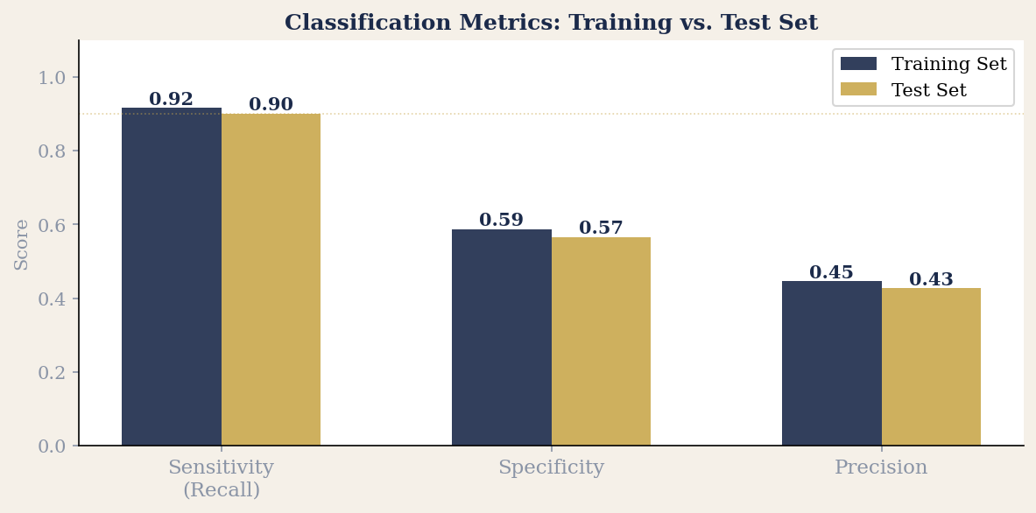
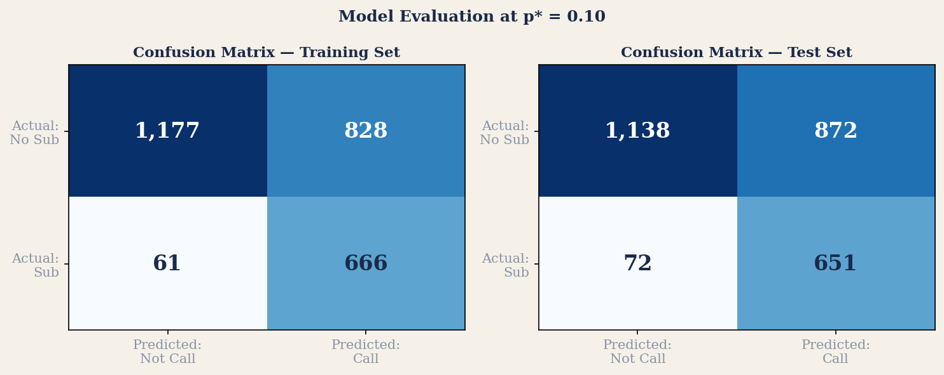
Model Evaluation — How Well Does It Classify?
Classifier assessed at p* = 0.10 on both training and test sets.
90%
Sensitivity / Recall
Of all customers who WOULD subscribe, we correctly identified 90% and called them.
57%
Specificity
Of customers who would NOT subscribe, we correctly skipped 57%. Some unnecessary calls remain — by design.
43%
Precision
Of customers we chose to call, 43% actually subscribed. Low but economically rational given the 10× revenue/cost ratio.
Why this tradeoff?
The cutoff (10%) is intentionally low. Missing a subscriber costs $200. Making an unnecessary call costs only $20. Sensitivity wins.

Slide 7
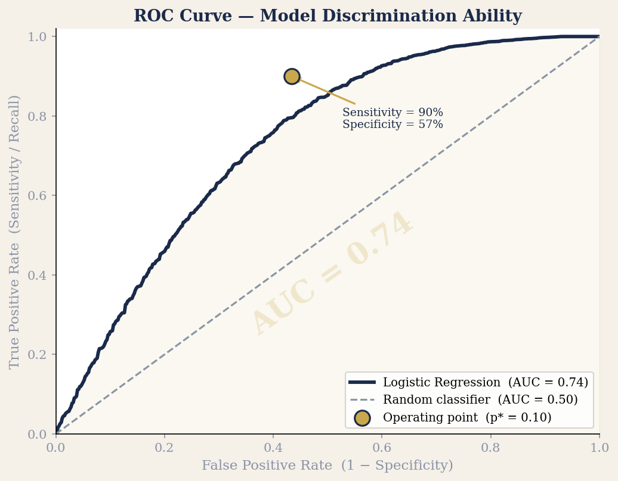
ROC Curve — Is the Model Better Than Guessing?
AUC measures overall discrimination ability across all possible cutoffs — not just at p* = 0.10.
0.74
AUC Score
Area Under the Curve — ranges from 0.5 (random) to 1.0 (perfect). Our model at 0.74 is meaningfully better than chance.
0.50
Random baseline
A model that randomly assigns probabilities would follow the diagonal dashed line — AUC = 0.50. Ours is well above it.
p*=0.10
Our operating point
The gold dot marks where we operate: 90% sensitivity, 57% specificity. We chose this point based on the profit rule, not the curve.
Why AUC matters
AUC is threshold-independent. It proves the model has genuine predictive skill — regardless of which cutoff you choose. This is your credibility check.

Slide 8
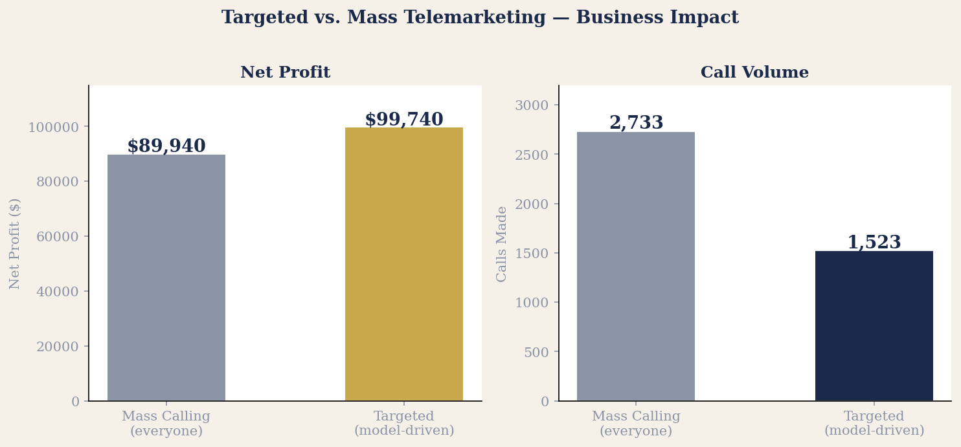
The Business Case — Targeted vs. Mass Calling
Less activity. Smarter allocation. Better outcome.
Metric
Mass
Target
Δ
Customers called
2,733
1,523
−44%
Subscribers reached
723
651
−10%
Revenue earned
$144,600
$130,200
−10%
Calling cost
$54,660
$30,460
−44%
Net profit
$89,940
$99,740
+11%

Slide 9





Strategic Takeaways
THE
NUMBERS
FOR ACCOUNT MANAGERS · BRAND TEAMS · CAMPAIGN PLANNERS
Not every customer is worth the same call
Fewer calls, more profit — that's the counterintuitive win
+11%
A predictive model lets you concentrate sales effort where the expected return justifies the cost — before you pick up the phone.
Cutting call volume by 44% while growing profit by 11% proves that activity and effectiveness are not the same thing.
Profit gain
−44%
Economic context predicts willingness to commit
Prior campaign success is your strongest predictor
Fewer calls
Consumer price index and employment variation rate were top drivers — external signals matter as much as demographics.
Customers who subscribed before are far more likely to subscribe again. Past behaviour is the most reliable signal.
90%
Sensitivity

Slide 10
The model doesn't
replace the call.
It makes every
call count.
Sana Majeed · Purdue University
$9,800
1,210
90%
additional profit
unnecessary calls avoided
of subscribers reached

