Slide 1

$3.4M
THE $3.4M
RETENTION
DECISION
1,312
Properties evaluated
355
Gifts recommended
9.6×
Predicting which Airbnb hosts to retain — and what it's worth to keep them.
Return on spend
Sana Majeed · Purdue University

Slide 2



The Business Problem
THE SCALE
Every Airbnb host that leaves takes their revenue with them — permanently.
5,247
Airbnb earns 15% of every booking. If a host leaves, that revenue stream disappears.
Given 1,312 new-market properties, which ones should receive a $1,000 retaining gift
to maximise net profit — not just save the most hosts?
Training properties
1,312
New properties to decide
$201
Who is at risk of leaving?
Avg daily rate
Predict attrition probability per property
15%
What is each property worth?
Airbnb's margin
Quantify annual profit contribution to Airbnb
$1,000
When does the gift pay for itself?
Find the property-specific break-even threshold
Gift cost per property

Slide 3

Dataset & Assumptions
What we worked with and what we assumed before modelling.
abb.csv — Training Data
abb_new.csv — Prediction Data
5,247
Properties with known attrition outcomes.
Used to train and cross-validate both models.
1,312
New market properties — no labels.
Gift decision generated for each one.
KEY VARIABLES
ASSUMPTIONS
Property
bedrooms, bathrooms, latitude, longitude
01
15% margin is fixed
Airbnb earns exactly 15% of each property's gross revenue.
Pricing
averagedailyrateusd (avg nightly rate)
02
Gift guarantees retention
If we gift a property, we assume it stays the full year.
Ratings
rating_overall + 6 component ratings
03
Training data representative
Activity
reservationdays1-12 (monthly booking days)
5,247 training properties reflect the same population as new ones.
04
Revenue is predictable
Tenure
nmon (months on Airbnb platform)
Historical reservation days proxy for next year's activity.
Target
attrition — did host leave? (training only)
05
Model selected on profit only
Cross-validated expected dollar profit — not AUC or F1.

Slide 4







Methodology & Process
Eight steps from raw data to a profitable, actionable gift list.
01
02
03
04
Load Data
Feature Engineering
EDA
Model Training
5,247 training + 1,312 prediction properties
Revenue, profit, composite rating — 3 new features
Distributions, attrition rates, segment analysis
Random Forest vs Gradient Boosting comparison
05
06
07
08
Profit CV
Model Selection
Decision Rule
Output
5-fold cross-validated expected $ profit — not AUC
RF selected: $21.73M vs GBM $21.70M
Property-specific p* = $1,000 / annual_profit
355 gifts recommended, $3.41M net profit

Slide 5
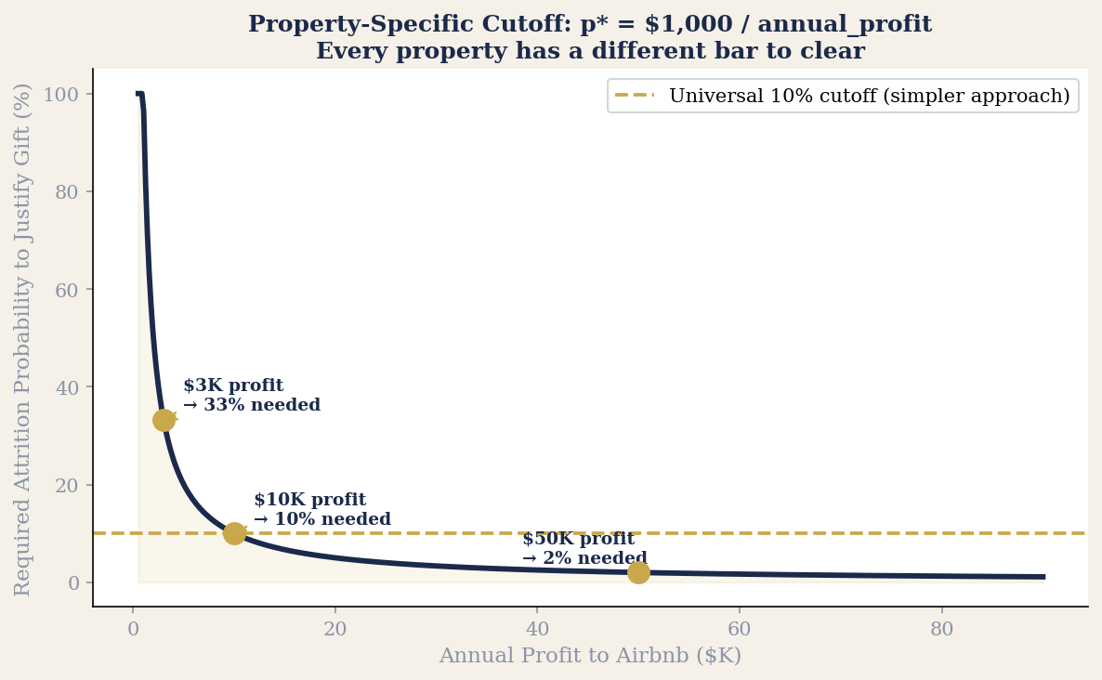
The Key Innovation: Property-Specific Decision Rule
Not one cutoff for every property — a different bar for each one, based on what they're worth.
OPTIMAL DECISION RULE
Give Gift if:
P(attritionᵢ) > pᵢ*
where pᵢ* = $1,000 / πᵢ (annual profit)
$3K profit
$10K profit
$50K profit
33%
10%
2%
needed
needed
needed
Rarely justified
Moderate bar
Almost automatic

Slide 6
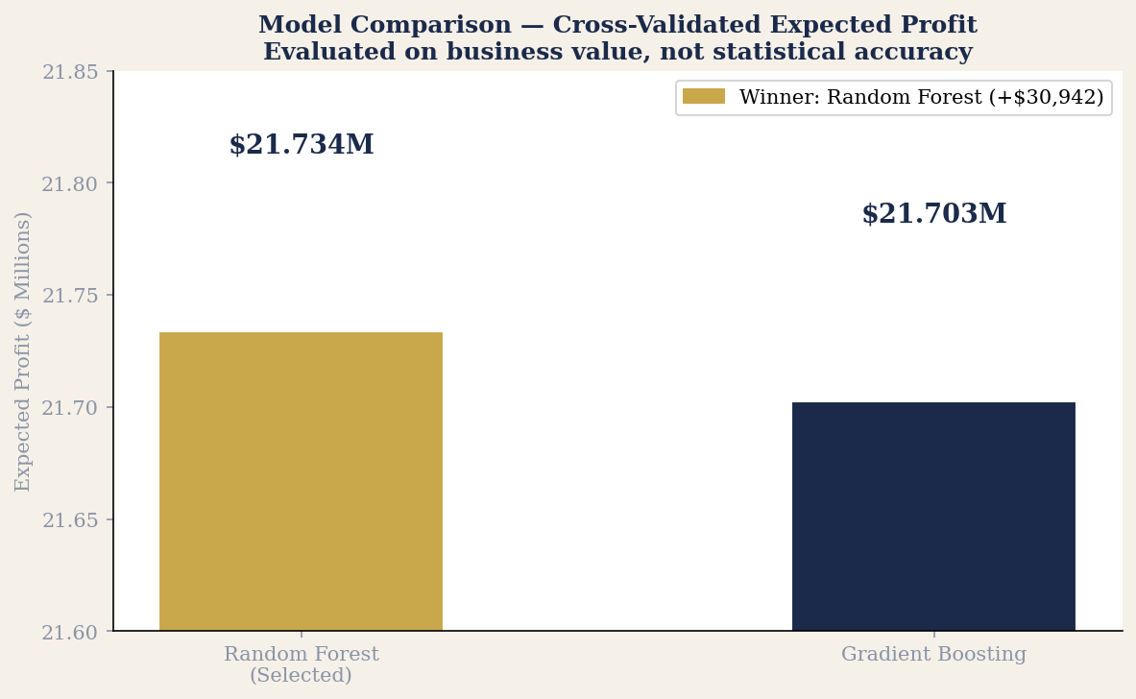
Model Comparison: RF vs. Gradient Boosting
Selected by cross-validated profit — not accuracy, not AUC. The only metric that matters here is money.
$21.73M
Random Forest
Ensemble of 400 decision trees. Handles non-linear relationships between ratings, rates, and geography.
$21.70M
Gradient Boosting
Sequential boosting method. Strong baseline but marginally outperformed by RF on this dataset.
Why profit-based CV?
Standard metrics (AUC, F1) optimise classification — not profit. A model that correctly identifies low-value attritors but misses high-value ones is useless for this problem.
+$30,942
RF advantage
Small in absolute terms, but this is the correct selection criterion. Both models are strong — RF wins on the margin that matters.

Slide 7
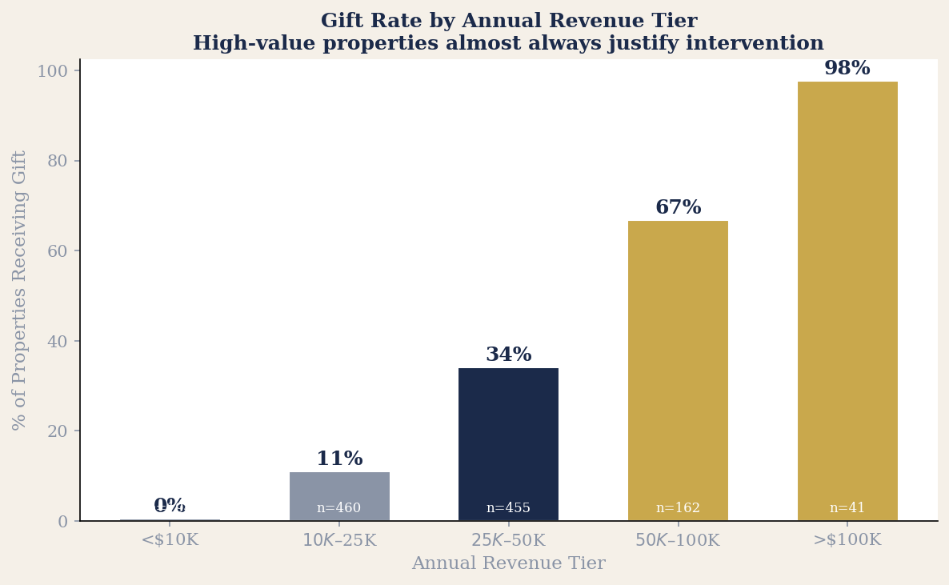
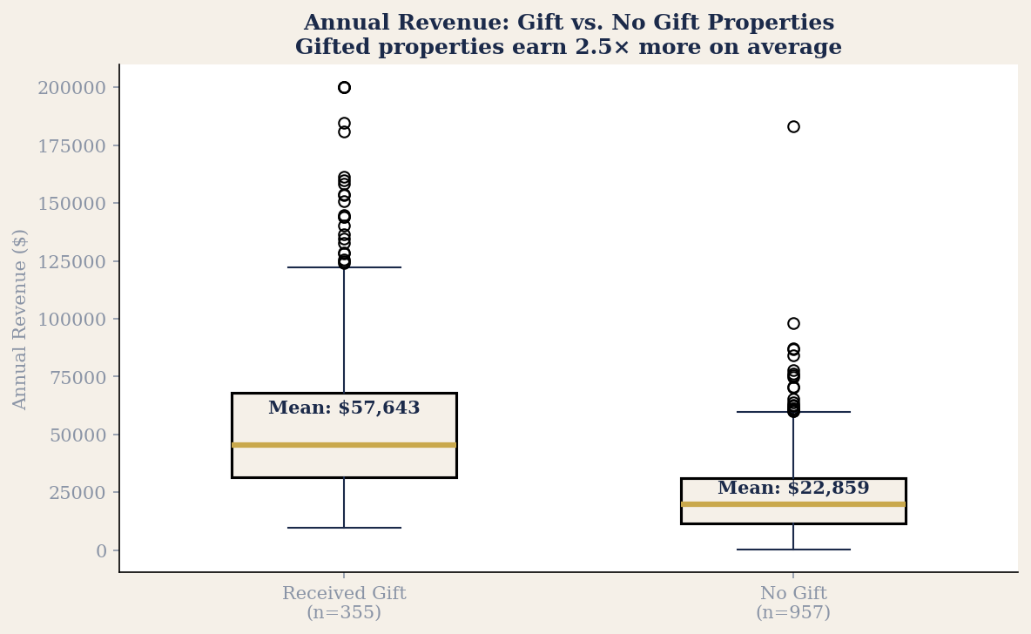
Gift Decision Results — 1,312 Properties
Higher-value properties justify intervention much more readily — 97.6% of >$100K revenue properties received a gift.
355
Properties gifted
27% of all 1,312
957
No gift needed
73% — not cost-effective
$367
Avg daily rate (gifted)
vs $139 for non-gifted
2.5×
Revenue advantage
Gifted props earn 2.5× more

Slide 8
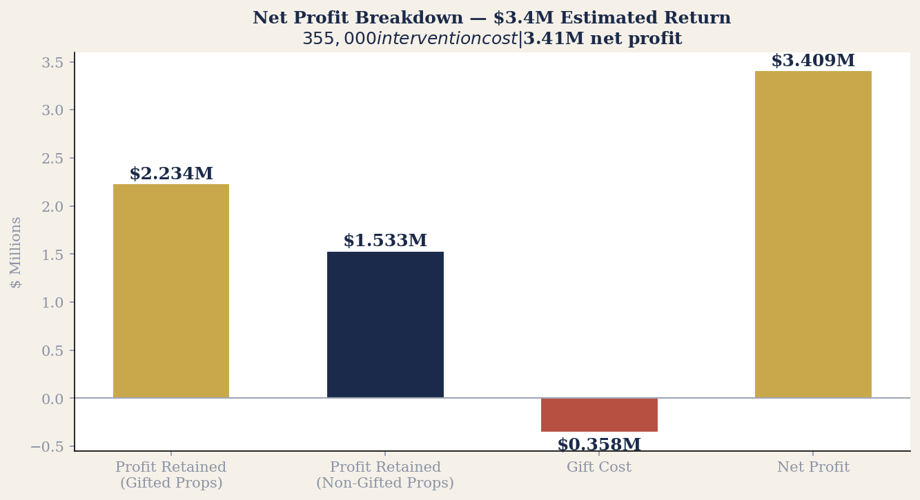
The $3.4M Return — Net Profit Breakdown
$355,000 invested in retention gifts generates an estimated $3,409,576 net profit.
PROFIT DETAIL
Gifted properties
355
Profit from gifted
$2,234,706
Profit from non-gifted
$1,532,870
Total retained
$3,767,576
Total gift cost
($355,000)
NET PROFIT
$3,409,576
9.6× return on $355K investment

Slide 9





Who Is This Project Useful For?
The question this project answers is universal — which customers are worth how much effort?
Account Management / Strategy
Client Success & Retention Roles
Airbnb, Uber, DoorDash, Booking.com, any two-sided marketplace
SaaS, subscription, membership businesses
Any platform managing a supply side — hosts, drivers, restaurants — faces this exact problem. Who is at risk of leaving, what are they worth, and does the retention cost pay off?
Which accounts warrant a dedicated call? Which ones get a discount offer? Which ones do you let churn? This project builds a systematic answer rather than relying on gut feel.
Media & Performance Agencies
CRM & Loyalty Strategy Advisors
Holding companies, independent agencies
Consulting, brand teams, marketing analytics
When a client asks 'where should we focus our retention budget?' — this is the analytical framework. Not 'keep everyone,' but 'intervene only where the expected return justifies the spend.'
Segment by value, predict risk, intervene where the math says to. The same decision logic applies to hotel guests, retail customers, loyalty members — any repeat-revenue context.

Slide 10

How This Is Applied in Industry Practice
This framework — predict risk, quantify value, intervene selectively — runs inside most major platform businesses today.
Platform Marketplaces
SaaS & Subscriptions
Financial Services & Retail
Airbnb — host retention (this project)
Salesforce — customer health scores
Banks — account closure prediction
Uber — driver churn prediction
HubSpot — churn risk dashboards
Credit cards — spend lapse models
DoorDash — restaurant partner retention
Netflix — cancel propensity models
Retail — loyalty programme attrition
Etsy / eBay — seller attrition modelling
Spotify — premium subscription retention
Insurance — policy non-renewal risk
HOW IT WORKS
HOW IT WORKS
HOW IT WORKS
Same model: predict who's at risk, calculate what they're worth, decide whether intervention ROI is positive.
Propensity-to-churn scores power automated outreach, discount triggers, and CSM prioritisation queues.
Same math, different intervention: a call, a fee waiver, a personalised offer — calibrated to expected lifetime value.

Slide 11
Not every customer
is worth the same
effort.
Data tells you which
ones are.
Sana Majeed · Purdue University
$3.41M
355
9.6×
estimated net profit
properties gifted of 1,312
return on investment

