Slide 1
TEXT
NLP
What Customers
Say —
6,166
reviews
And What It
Actually Means
3 methods
Mining 6,166 restaurant reviews to discover what language,
topics, and themes actually predict customer satisfaction.
Sana Majeed · Purdue University

Slide 2

THE
QUESTION
The Dataset
6,166
restaurant reviews from we8there.com
What makes a restaurant
successful — and can we
learn it from customer reviews?
2,640
unique bigrams (two-word phrases)
5
rating dimensions: Food, Service, Value, Atmosphere, Overall
01
Descriptive Analysis
Top bigrams by rating
02
LASSO Regression
1–5
Text as predictive input
rating scale (0 also appears for missing values)
03
Topic Modeling (LDA)
Discover hidden themes
Source: we8there.com · Reviews matched to 5-dimension rating scores

Slide 3

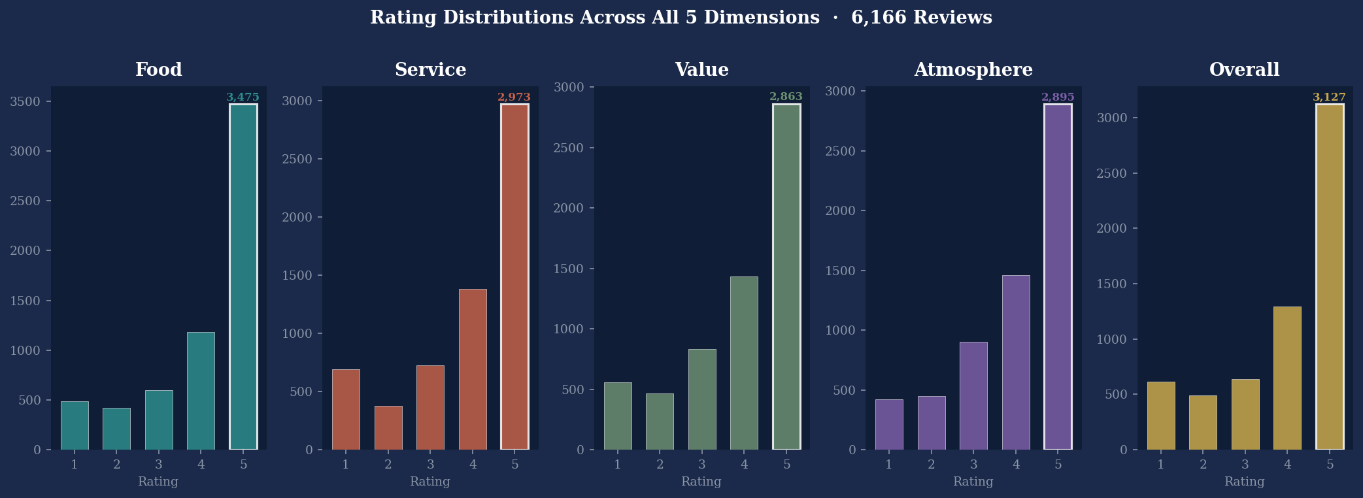
Part 1 — Descriptive Analysis
How Are Restaurants Rated?
Distribution of ratings across all 5 dimensions · 6,166 reviews
KEY FINDING: 56% of Food ratings are 5-star. When both Food AND Service = 5, Overall is also 5 in 95.9% of cases.

Slide 4
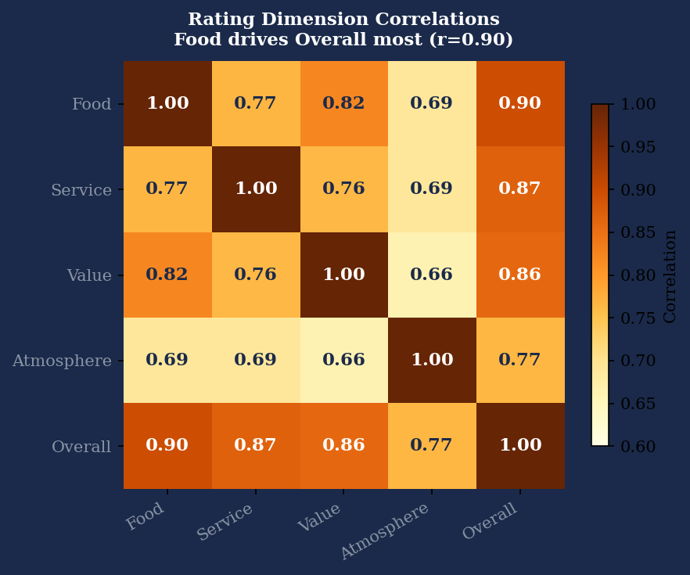
PART 1 · DESCRIPTIVE ANALYSIS
What Drives the Overall Rating?
r = 0.90
Food → Overall
Strongest driver of the Overall score by far
r = 0.87
Service → Overall
Second strongest — service quality is critical
r = 0.86
Value → Overall
Price perception matters nearly as much as service
r = 0.77
Atmosphere → Overall
Weakest link — ambiance alone won't save a bad meal
Food quality is the most critical investment a restaurant can make.

Slide 5

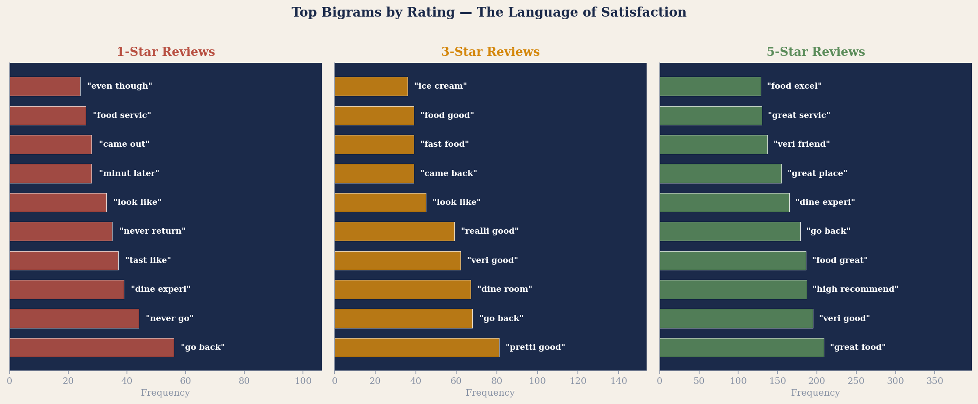
PART 1 · THE LANGUAGE OF REVIEWS
1-Star vs. 5-Star: Two Completely Different Vocabularies
Service failure language dominates 1-star reviews — not food quality alone
5-star reviews consistently use enthusiastic food + service language together

Slide 6

PART 2 · LASSO TEXT REGRESSION
Teaching a Machine to Read Reviews
LASSO logistic regression: 2,640 bigrams as input → predict rating. The model selects only the most informative phrases.
2,640
→
LASSO
→
5
→
CV
Bigram
features
Penalty
shrinks noise
Rating
classes
5-fold cross
validation
Extreme ratings are most predictable
Service failures dominate negative signal
1-star and 5-star reviews have clear, consistent language patterns. The model identifies them most confidently.
Phrases like 'never return', 'very rude', 'service terrible' have the highest negative coefficients — stronger than food-quality complaints.
Mid-range ratings are linguistically ambiguous
Enthusiasm drives positive signal
2–4 star reviews lack a consistent vocabulary. Customers who are 'fine' with a restaurant don't have a standard way to express it.
Top positive bigrams are enthusiastic superlatives: 'great food', 'highly recommend', 'food excellent'. Lukewarm praise has weak predictive power.

Slide 7
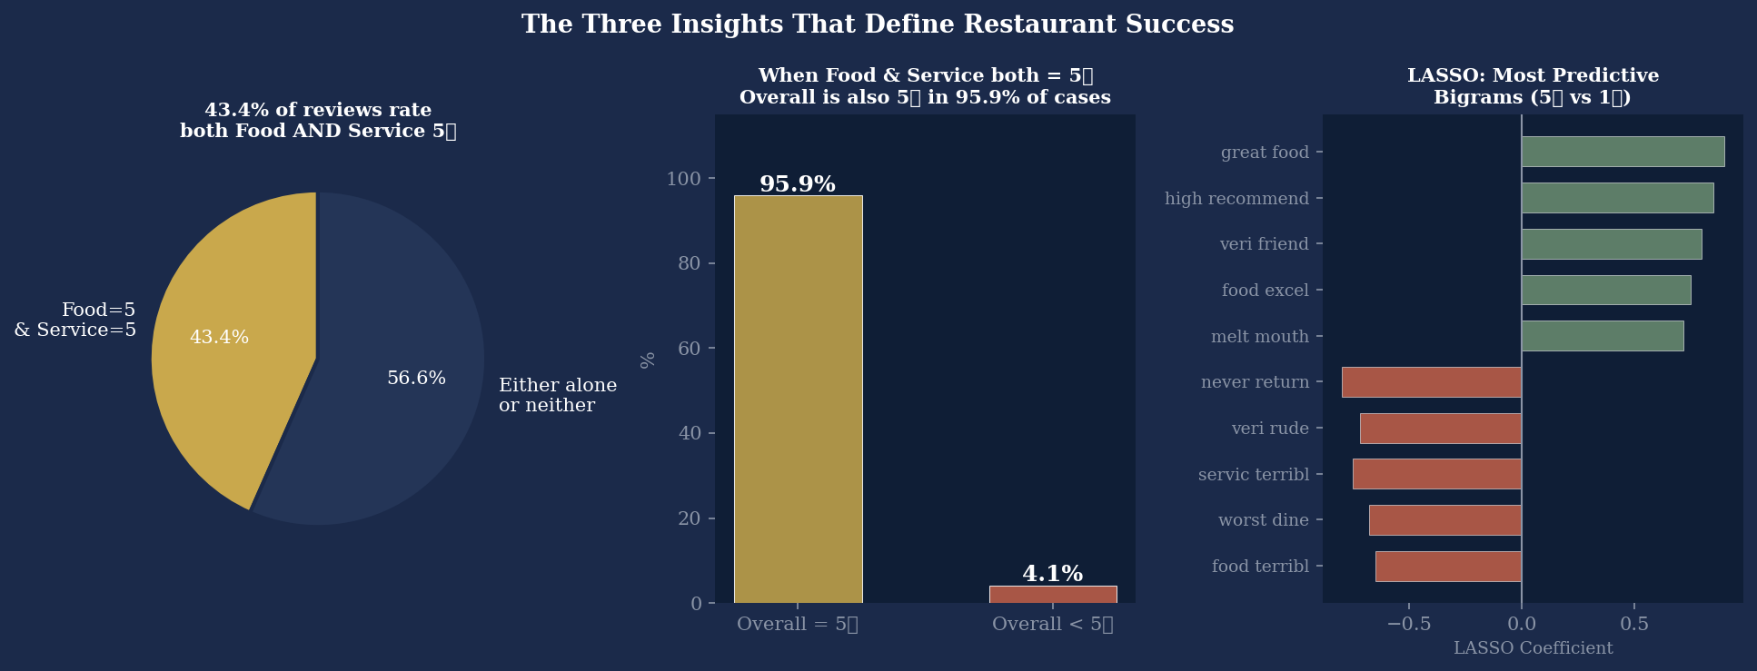
PART 2 · LASSO RESULTS
The Most Predictive Phrases — Positive vs. Negative Signal
When Food AND Service both receive 5-star ratings, the Overall score follows suit in 95.9% of cases — near certainty.

Slide 8

PART 3 · TOPIC MODELING (LDA)
Discovering Hidden Themes in 6,166 Reviews
T1
T2
T3
T4
T5
Wait Time
& Logistics
Strong
Recommendations
Specific
Food Items
Mixed Past
Experiences
Friendly
Staff
Mixed
Positive
Neutral
Negative
Positive
wait minut · half hour
high recommend · best food
pull pork · cole slaw
year ago · last time
veri friend · wait staff
T6
T7
T8
T9
T10
Menu &
Timing
Great Food,
Service & Atm.
Generally
Good
Food Quality
Issues
Dining Room
Impressions
Neutral
Positive
Moderate
Negative
Neutral
ice cream · main cours
food great · excel servic
veri good · good food
tast like · over cook
dine room · look like

Slide 9
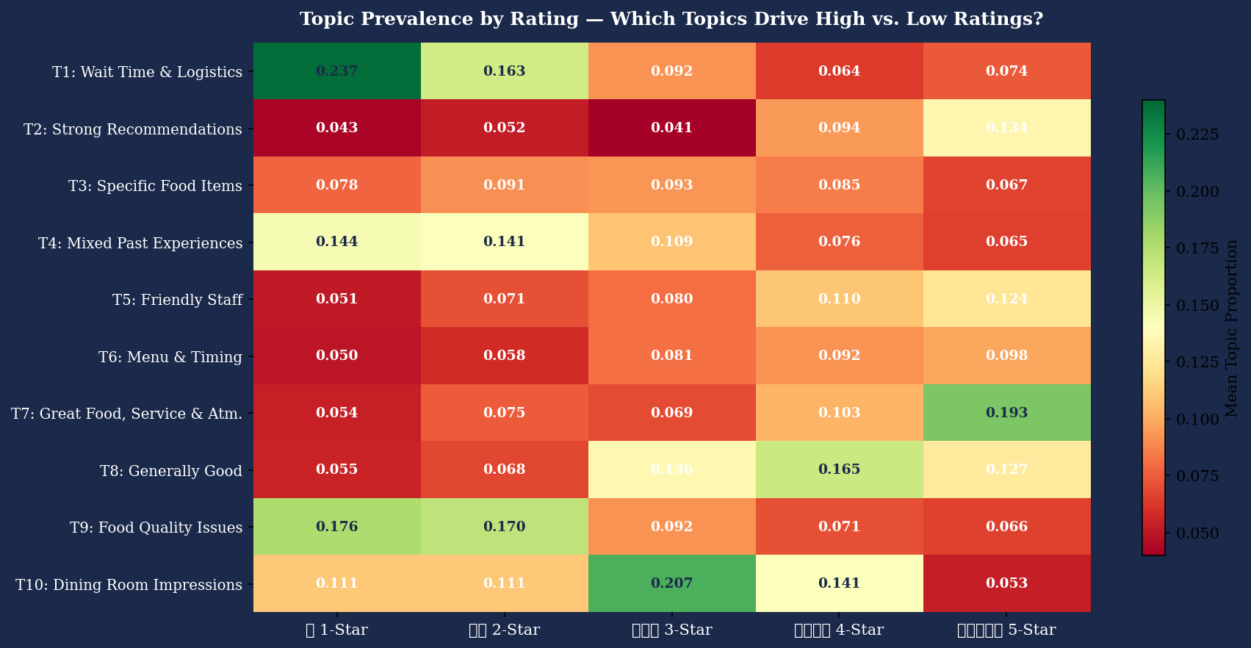
PART 3 · TOPIC PREVALENCE BY RATING
Which Topics Appear Most in High vs. Low-Rated Reviews?
Green = topic heavily present · Red = topic rarely appears
T1 (Wait Time) & T9 (Food Issues) dominate 1-star reviews
T7 (Excellence) & T2 (Recommendations) drive 5-star reviews

Slide 10
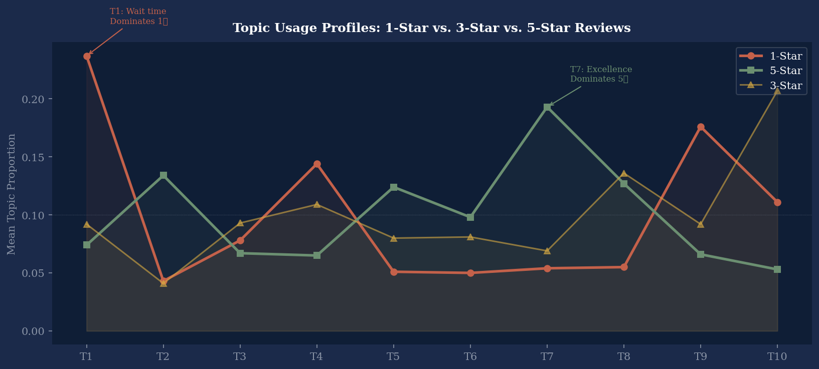
PART 3 · TOPIC PROFILES COMPARED
The Divergence Between 1-Star and 5-Star Review DNA
T1: Wait Time
1-Star: 23.7%
5-Star: 7.4%
Wait time mentions are 3× more common in 1-star reviews. Operational efficiency is a make-or-break signal.
T7: Excellence
5-Star: 19.3%
1-Star: 5.4%
'Great food, service, atmosphere' language is 3.6× more common in 5-star reviews. Excellence needs to be total — all three dimensions.
T9: Food Issues
1-Star: 17.6%
5-Star: 6.6%
Food quality complaints appear 2.7× more in 1-star reviews. Inconsistency in food quality is a primary driver of poor ratings.

Slide 11





INDUSTRY APPLICATION
Who Needs This — and Why It Matters
Any organisation sitting on unstructured text data — reviews, surveys, tickets, social — has this exact problem.
Restaurant Groups & Hospitality
CRM & Loyalty Strategy
Operations teams, brand managers, CMOs
Account managers, customer success, agency planners
Which locations are underperforming and why? Are service failures or food quality issues driving negative reviews? This framework answers both — without reading every review manually.
When a client asks 'why are our ratings dropping?' — this is how you answer it with evidence, not assumptions. Topic shifts in review language can be leading indicators before ratings visibly decline.
Brand & Market Research
Product & Experience Design
Consumer insights teams, strategy consultants
UX teams, product managers, operations
Voice-of-customer analysis at scale. Instead of focus groups, model what customers actually say and weight it by what predicts satisfaction. Far cheaper, far faster, far more scalable.
Identify the specific dimensions — service speed, food consistency, atmosphere — where improvement would have the highest rating impact, based on actual customer language.

Slide 12
STRATEGIC TAKEAWAYS
What Restaurants Should Actually Focus On
01
Food quality is the foundation — but service determines the ceiling
02
Operational failures kill ratings faster than mediocre food
Food has the highest correlation with Overall ratings (r=0.90). But 5-star reviews are characterised by service language just as much as food praise. You need both.
'Never return', 'very rude', 'service terrible' — the strongest negative LASSO coefficients are all service-failure phrases. A bad service experience drives 1-star reviews more than bad food alone.
03
The middle of the scale is your blind spot
04
Excellence needs to be total — food, service, atmosphere together
2–4 star reviews lack consistent language. Customers who are 'fine' don't have a standard vocabulary. This makes the middle hard to improve — you can't optimise what you can't measure.
When Food=5 and Service=5, the Overall rating is also 5 in 95.9% of cases. Topic 7 (great food, service, atmosphere combined) is the strongest predictor of 5-star reviews.

Slide 13
METHOD
1
Customers tell you
everything.
You just need to
know how to listen.
METHOD
2
METHOD
3
Three methods. 6,166 reviews. One consistent answer:
food quality + service excellence = the only recipe that matters.
Sana Majeed · Purdue University

