Slide 1
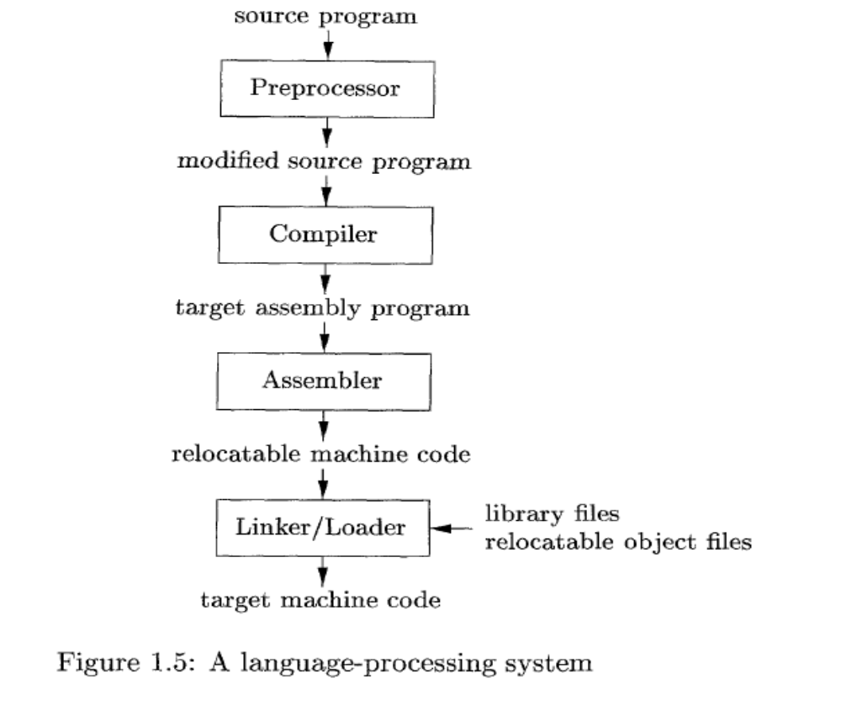
Language Processing System
Compiler Construction

Slide 2
Cousins of Compilers
- Preprocessors: A program may be divided into modules stored under separate files. Preprocessor combines all such files.
- preprocessor also expands short hands(macros)
Compiler : converts high level language into assembly or machine code.
Assemblers :
  Compiler may produce assembly code instead of generating relocatable machine code directly.
Compiler Construction

Slide 3
Loaders and Linkers
  Large programs are often compiled in pieces, so the relocatable machine code may have to be linked together with other relocatable object files and library files
  Linker resolves external memory addresses, where the code in one file may refer to a location in another file.
  The loader puts together all of the executable object files into memory for execution.
Compiler Construction

Slide 4
Language Processors.
A translator inputs and then converts a source program into an object or target program.
Source program is written in a source language
Object program belongs to an object language
A translators could be: Assembler, Compiler, Interpreter
  Assembler:
  source program object program
  (in assembly language) (in machine language)
Assembler
Compiler Construction

Slide 5
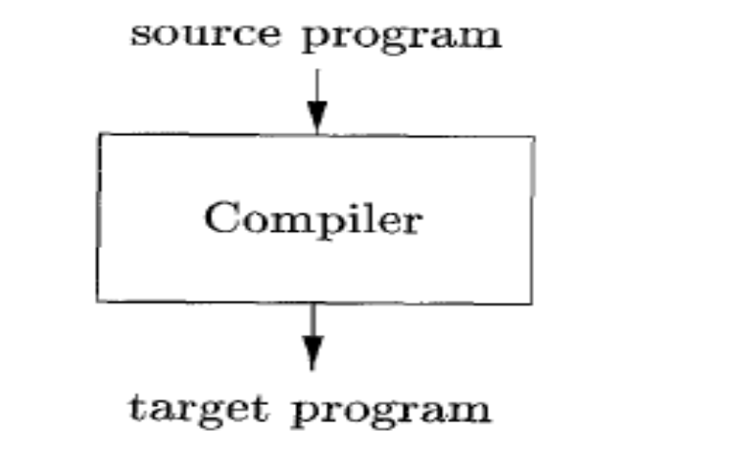
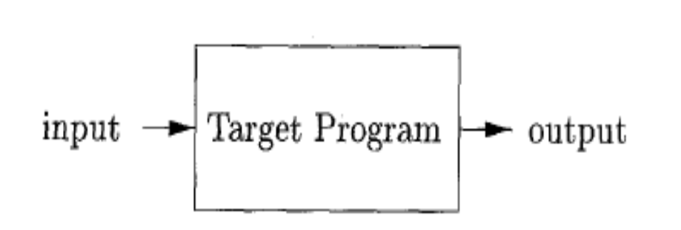
Language Processors.
a compiler is a program that can read a program in one language the source language - and translate it into an equivalent program in another language - the target language;
Compiler Construction

Slide 6
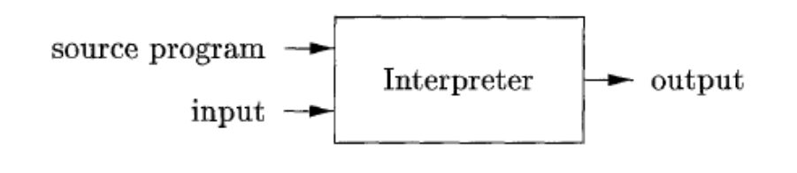
Interpreter
An interpreter is another common kind of language processor. Instead of producing a target program as a translation, an interpreter appears to directly execute the operations specified in the source program on inputs supplied by the user
Compiler Construction

Slide 7
The machine-language target program produced by a compiler is usually much faster than an interpreter at mapping inputs to outputs .
An interpreter, however, can usually give better error diagnostics than a compiler, because it executes the source program statement by statement.
Compiler Construction

Slide 8
Overview of Compilers
  - Compiler: translates a source program written in a High-Level Language (HLL) such as Pascal, C++ into computer’s machine language (Low-Level Language (LLL)).
  * The time of conversion from source program into
  object program is called compile time
  * The object program is executed at run time
  - Interpreter: processes the source program and data at the same time (at run time).
Compiler Construction

Slide 9
Compilers and Interpreters
  Why Interpretation
  Dynamic execution: modification or addition to user programs as execution proceeds.
  Dynamic data type: type of object may change at runtime
  Better diagnostics
Compiler Construction

Slide 10
Overview of Compilers
  Compilation Process:
  Interpretion Process:
Data
Source
program
Object
program
Results
Compiler
Executing
Computer
Compile time
run time
Data
Source
program
Interpreter
Result
Compiler Construction

Slide 11
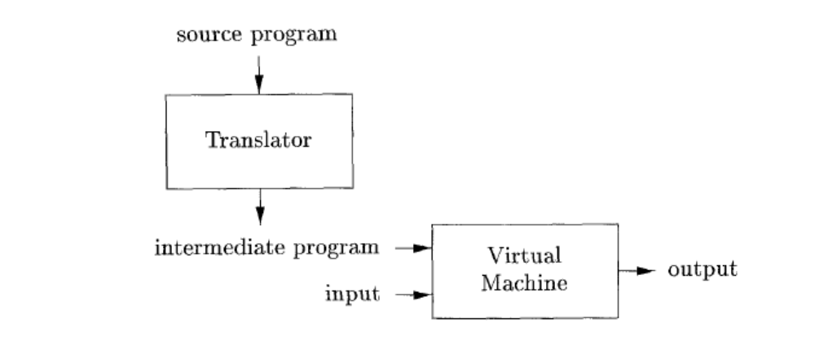
Example Of Combining Both Interpreter and Compiler
Java language processors combine
compilation and interpretation,
A Java source program may first be compiled into an intermediate form called bytecodes.
The bytecodes are then interpreted by a virtual machine. A benefit of this arrangement is that bytecodes compiled on one machine can be interpreted on another machine, perhaps across a network.
Compiler Construction

Slide 12
Model of A Compiler
A compiler must perform two tasks:
- analysis of source program: The analysis part breaks up the source program into constituent pieces and imposes a grammatical structure on them. It then uses this structure to create an intermediate representation of the source program.
- synthesis of its corresponding program: constructs the desired target program from the intermediate representation and the information in the symbol table.
The analysis part is often called the front end of the compiler; the synthesis part is the back end.
Compiler Construction

Slide 13
Grouping of Compiler Phases
Front end
  Consist of those phases that depend on the source language but largely independent of the target machine.
Back end
  Consist of those phases that are usually target machine dependent such as optimization and code generation.
Compiler Construction

Slide 14
source program object program
Analysis
Lexical Syntactic Semantic
Analysis Analysis Analysis
Synthesis
Code Code
Generator optimizer
Tables
Compiler Construction

Slide 15
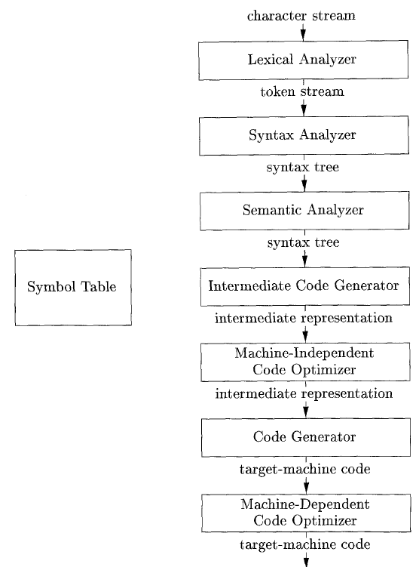
Tasks of Compilation Process and Its Output
Error handler
Compiler phases
Compiler Construction

Slide 16
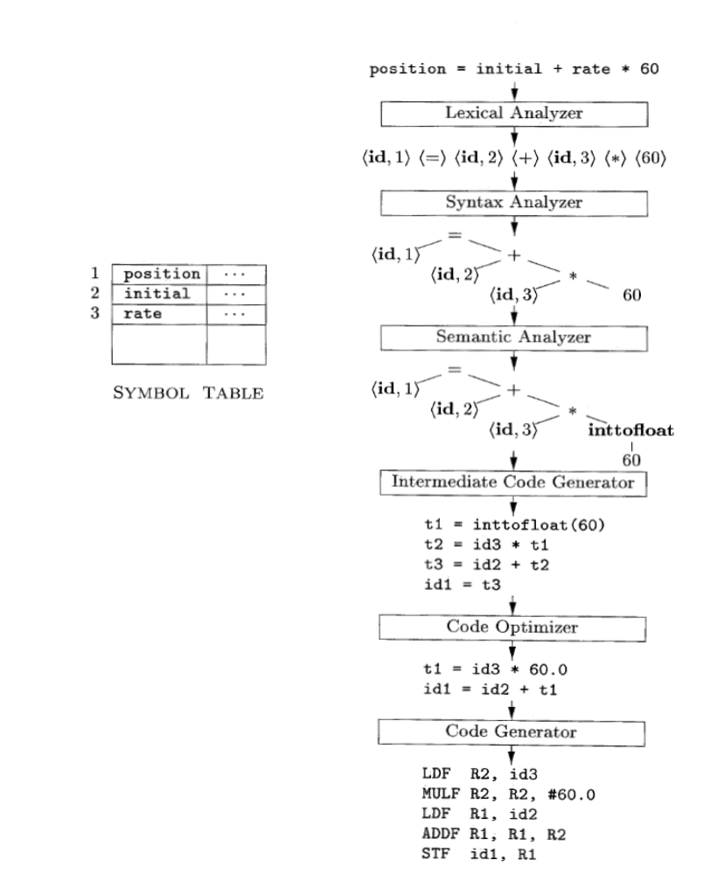
Translation of an assignment statement
Compiler Construction

Slide 17
Lexical Analysis (scanner): The first phase of a compiler
Lexical analyzer reads the stream of characters making up the source program and groups the characters into meaningful sequences called lexeme
For each lexeme, the lexical analyzer produces a token of the form that it passes on to the subsequent phase, syntax analysis
(token-name, attribute-value)
Token-name: an abstract symbol is used during syntax analysis, an
attribute-value: points to an entry in the symbol table for this token.
Compiler Construction

Slide 18
Example: position =initial + rate * 60
1.”position” is a lexeme mapped into a token (id, 1), where id is an abstract symbol standing for identifier and 1 points to the symbol table entry for position. The symbol-table entry for an identifier holds information about the identifier, such as its name and type.
2. = is a lexeme that is mapped into the token (=). Since this token needs no attribute-value, we have omitted the second component. For notational convenience, the lexeme itself is used as the name of the abstract symbol.
3. “initial” is a lexeme that is mapped into the token (id, 2), where 2 points to the symbol-table entry for initial.
4. + is a lexeme that is mapped into the token (+).
5. “rate” is a lexeme mapped into the token (id, 3), where 3 points to the symbol-table entry for rate.
6. * is a lexeme that is mapped into the token (*) .
7. 60 is a lexeme that is mapped into the token (60)
Blanks separating the lexemes would be discarded by the lexical analyzer.
Compiler Construction

Slide 19

Syntax Analysis (parser) : The second phase of the compiler
The parser uses the tokens produced by the lexical analyzer to create a tree-like intermediate representation that depicts the grammatical structure of the token stream.
A typical representation is a syntax tree in which each interior node represents an operation and the children of the node represent the arguments of the operation
Compiler Construction

Slide 20
Semantic Analysis: Third phase of the compiler
The semantic analyzer uses the syntax tree and the information in the symbol table to check the source program for semantic consistency with the language definition.
Gathers type information and saves it in either the syntax tree or the symbol table, for subsequent use during intermediate-code generation.
An important part of semantic analysis is type checking, where the compiler checks that each operator has matching operands. For example, the compiler reports an error if a floating-point number is used to index an array.
The language specification may permit some type conversions
Compiler Construction

Slide 21
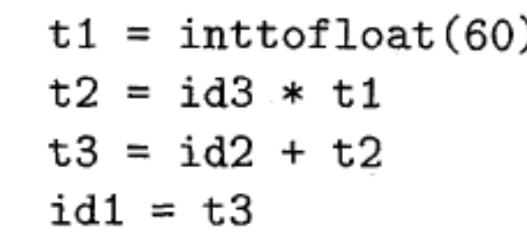
Intermediate Code Generation: three-address code
After syntax and semantic analysis of the source program, many compilers generate an explicit low-level or machine-like intermediate representation (a program for an abstract machine). This intermediate representation should have two important properties:
  it should be easy to produce and
  it should be easy to translate into the target machine.
for ex called three-address code, which consists of a sequence of assembly-like instructions with three operands per instruction.
Compiler Construction

Slide 22
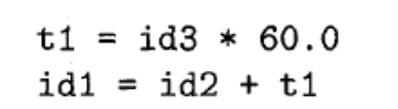
Code Optimization: to generate better target code
The machine-independent code-optimization phase attempts to improve the intermediate code so that better target code will result.
Usually better means:
  faster, shorter code, or target code that consumes less power.
The optimizer can deduce that the conversion of 60 from integer to floating point can be done once and for all at compile time, so the int to float operation can be eliminated by replacing the integer 60 by the floating-point number 60.0. Moreover, t3 is used only once
There are simple optimizations that significantly improve the running time of the target program without slowing down compilation too much.
Compiler Construction

Slide 23
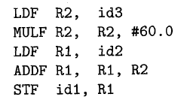
Code Generation: takes as input an intermediate representation of the source program and maps it into the target language
If the target language is machine code, registers or memory locations are selected for each of the variables used by the program.
Then, the intermediate instructions are translated into sequences of machine instructions that perform the same task.
A crucial aspect of code generation is the judicious assignment of registers to hold variables.
Compiler Construction

Slide 24
Symbol-Table Management:
The symbol table is a data structure containing a record for each variable name, with fields for the attributes of the name.
.
Compiler Construction

