Slide 1
Training a Small-Scale BERT Model on an NLP Question Answering Task
Sana Moin & Nur Atiqah Zakiah Abdul Khaliq
Advisor: Kyra Ahrens

Slide 2
Outline
Motivation and Question
Basics and Definition
Approach
Results
Discussion and Conclusion

Slide 3
Outline
Motivation and Question
Basics and Definition
Approach
Results
Discussion and Conclusion

Slide 4

NLP & QA Tasks
Natural Language Processing (NLP):
explores how computers can understand, interpret and manipulate human language
Question Answering (QA) Models:
creating models that can automatically answer questions posed in natural language
good models also avoid answering a question if it is not possible to answer a question that it is not able to answer
[3]
Notes:
NLP and QA tasks-
Natural Language Processing (NLP) is a branch of Artificial
Intelligence that studies how machines understand human language.
Its goal is to build systems that can make sense of text and
perform tasks like translation, grammar checking, topic
classification, question answering and so on.
Talking about question answering, this task requires us humans to
interpret the question being asked and then respond accordingly.
Some kinds of questions require a simple yes or no. Some of them
require specific details, like the questions which begin with how,
when, what, where, etc. Apart from that, there are other questions
which even require some analytical analysis of the questions. And
these questions require some thinking, which we humans are good
at. We can understand the relations between the segments of the
question and interpret with all the information we have from our
past experience or from deducing the details provided.
Machines are still far from this understanding part.
Modern systems can figure out the parts of questions, their focus
and even what is asked. But they can find out the answers from
the information they have, without acquiring the analytical
abilities.

Slide 5
Motivation and Question
How one can train mobileBERT^{[1]} to answer QA tasks from the bAbI dataset?
What are the optimal hyperparameters for mobileBERT?
Can mobileBERT perform as well as BERT^{[2]} like how researchers have claimed?
Notes:
With that, our motivation is to understand
how well can machines perform on
question answering task which are usually easy for humans due
to the analytical abilities and how much can the modern systems
acquire this ability.
We will see how mobileBERT performs on such a dataset of qa, babi.
We would train and try to find out the optimal hyperparameters and
also try to see if mobileBERT actually performs as good as BERT,
a model it is based on.

Slide 6
Outline
Motivation and Question
Basics and Definition
Approach
Results
Discussion and Conclusion

Slide 7
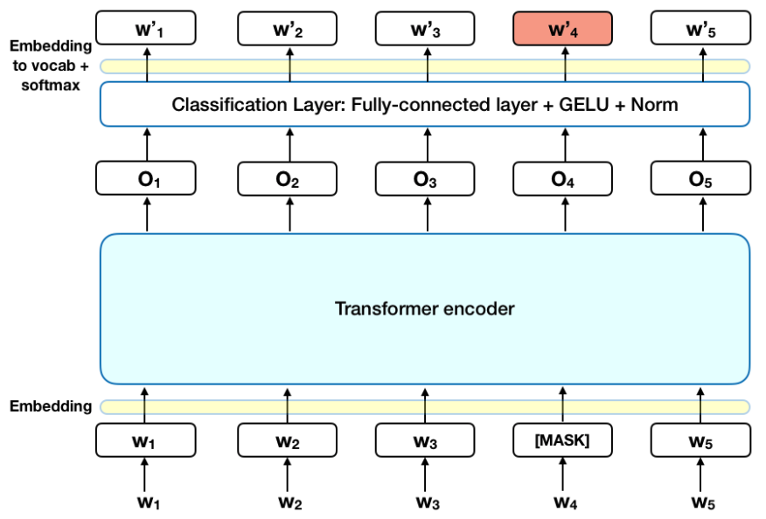
Basics and Definition: BERT
BERT
Bidirectional, Encoder, Representations from Transformers
Bidirectional → context understanding
Transformer → utilizes multi-head attention
uses (1) Masked Language Modelling and (2) Next Sentence Prediction to ‘understand’ language
can be applied to many downstream tasks simply by adding a single layer
state of art performance on many NLP tasks

Slide 8
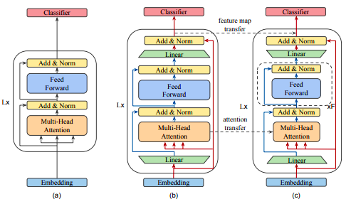
Basics and Definition: mobileBERT
mobileBERT
Thin version of BERT, 4.3x smaller than 5.5x faster
Comparable performance
Takes advantage of bottleneck structures
Significantly lower number of parameters for each layer due to carefully designed balance between self-attention and feed-forward network
(a) BERT, (b) mobileBERT with inverted bottleneck structures which is used to teach (c) mobileBERT
Notes:
bottleneck structures: map from smaller nodes when receiving input from the feedforward module to larger number of nodes before the classifier.

Slide 9
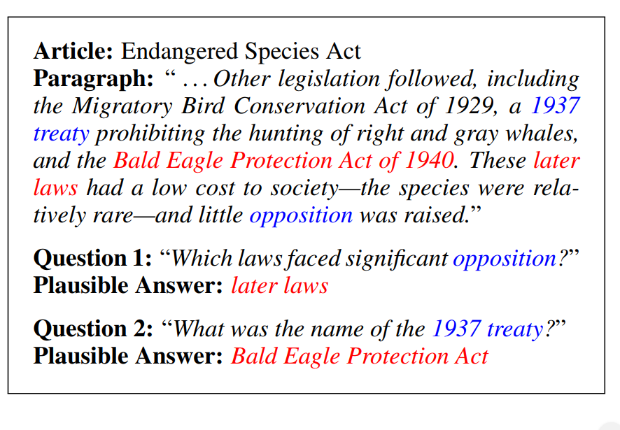
Basics and Definition: SQuAD Dataset
Stanford Question Answering Dataset (SQuAD)
Reading comprehension dataset
Questions posed by crowdworkers on a set of Wikipedia articles
The answer to every question is a segment of text, or span, from the corresponding reading passage, or the question might be unanswerable.
Trained on both BERT and mobileBERT
[4]
Notes:
This SQUAD dataset was what the authors of mobilebert had trained their model on. The model is given a paragraph called the context and then asked several questions, all the answers to the questions is can be found from the context.

Slide 10
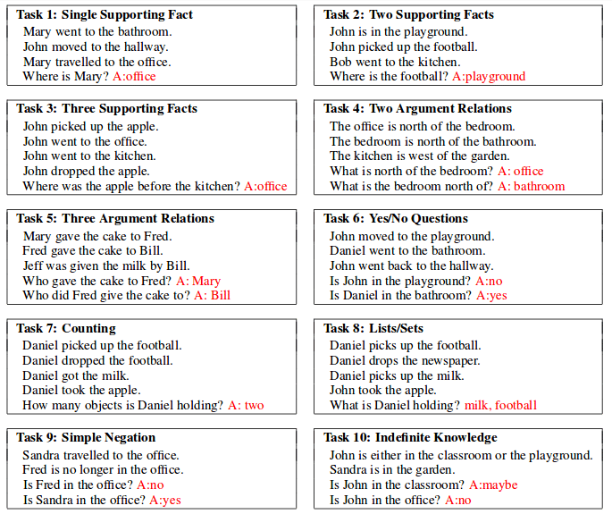
Basics and Definition: bAbI Tasks
Provided by Facebook for AI QA task
20 different natural and easy to human tasks
Noiseless
Each task is different from other tasks
Available in English, Hindi and shuffled english words
[5]
Notes:
Here, i introduce the bAbi dataset which is what we were mostly interested in. So it is provided by facebook and has 20 different tasks with different difficulties. Some tasks require one word answers, some required yes or no answers some require semantic knowledge about directions or about math. But all of them require reasoning about the sentences, and its not possible to do simple pattern matching.

Slide 11
Outline
Motivation and Question
Basics and Definition
Approach
Results
Discussion and Conclusion

Slide 12
Tasks chosen for training model
Task 1
Single Supporting Fact
1| John travelled to the hallway.
2| Mary journeyed to the bathroom.
3| Where is John? hallway 1
4| Daniel went back to the bathroom.
5| John moved to the bedroom.
6| Where is Mary? bathroom 2
Task 4
Two Argument Relation
1| The office is north of the kitchen.
2| The garden is south of the kitchen.
3| What is north of the kitchen? office 1
1| The kitchen is west of the garden.
2| The hallway is west of the kitchen.
3| What is the garden east of? kitchen 1
Task 12
Conjunction
1| John and Mary travelled to the hallway.
2| Sandra and Mary journeyed to the bedroom.
3| Where is Mary? bedroom 2
4| Mary and Daniel travelled to the bathroom.
5| Daniel and Sandra journeyed to the office.
6| Where is Mary? bathroom 4
Notes:
We wanted to start with tasks requiring one word answers, and these were the tasks that met this criteria. They have different levels of difficulty.

Slide 13
Expected Performance
Task 1
Single Supporting Fact
No world knowledge required
Task 1
Single Supporting Fact
1| John travelled to the hallway.
2| Mary journeyed to the bathroom.
3| Where is John? hallway 1
4| Daniel went back to the bathroom.
5| John moved to the bedroom.
6| Where is Mary? bathroom 2
Task 4
Two Argument Relation
Task 4
Two Argument Relation
1| The office is north of the kitchen.
2| The garden is south of the kitchen.
3| What is north of the kitchen? office 1
1| The kitchen is west of the garden.
2| The hallway is west of the kitchen.
3| What is the garden east of? kitchen 1
Task 12
Conjunction
Task 12
Conjunction
1| John and Mary travelled to the hallway.
2| Sandra and Mary journeyed to the bedroom.
3| Where is Mary? bedroom 2
4| Mary and Daniel travelled to the bathroom.
5| Daniel and Sandra journeyed to the office.
6| Where is Mary? bathroom 4
No world knowledge required
More difficult than simple word matching
Worse performance than on SQUAD
World knowledge REQUIRED
North, South, East, West relations
Worse performance than TASK 1
No world knowledge required
Simple extension from Task 1
Similar performance to Task 1

Slide 14
Environment and Set-Up
Environment
several python 3 (upto 3.7) Google Colab Notebooks
Tensorflow 1.15
Dataset: bAbI as obtained from https://research.fb.com/downloads/babi
1000 questions in training and testing datasets for each task
run_babi to execute

Slide 15
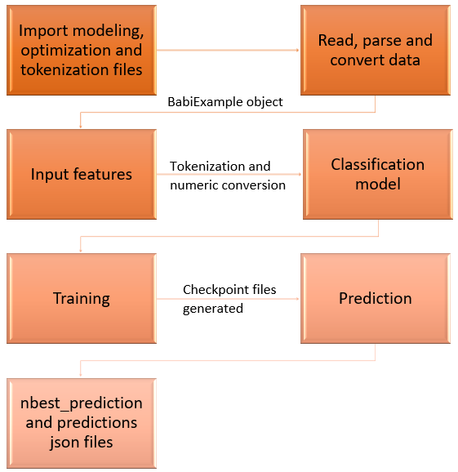
mobileBERT Execution Pipeline

Slide 16
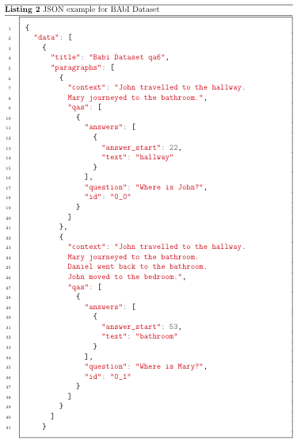
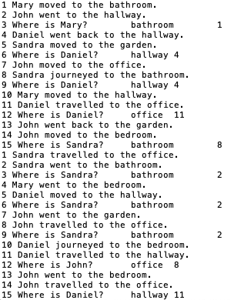
bAbI Pre-processing

Slide 17
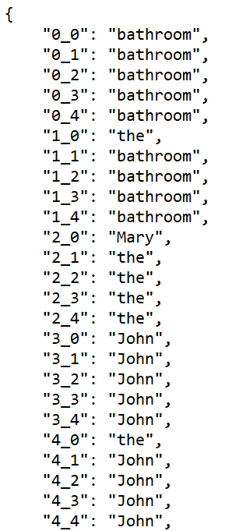
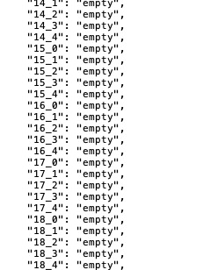
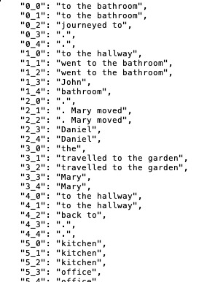
Pilot Experiments on local machine

Slide 18
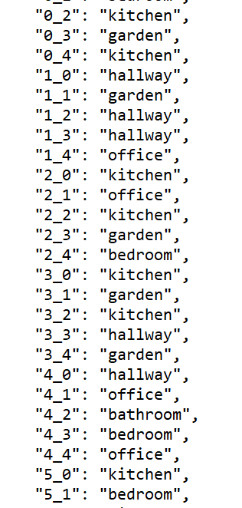
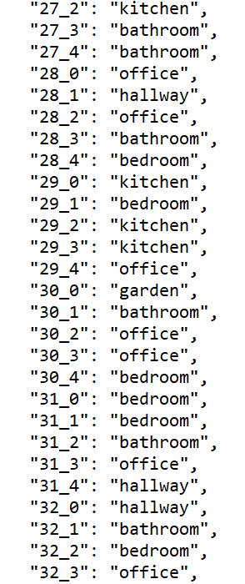
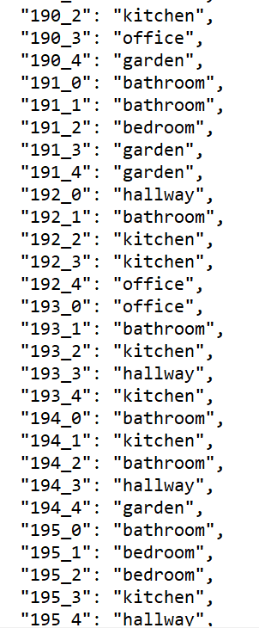
Pilot Experiments on Google Colab

Slide 19
Experiment Design
Manipulation of 3 hyperparameters
# Epochs
Learning Rate
Training Batch Size
MobileBERT and BERT
BERT as a control to check if indeed bAbI tasks are harder than SQuAD
bare versions of both models used
Example format of the experiments performed
Test | Num Epochs | Learning Rate | Batch Size | mobileBERT Accuracy | BERT Accuracy
test 1 | 2 | 4.00E-05 | 8
test 2 | 3 | 4.00E-05 | 8
test 3 | 3 | 2.00E-05 | 8
test 4 | 3 | 4.00E-06 | 8
test 5 | 3 | 4.00E-07 | 8
test 6 | 3 | 4.00E-04 | 8
test 7 | 3 | 4.00E-05 | 16
test 8 | 3 | 4.00E-05 | 32
test 9 | 5 | 4.00E-05 | 8

Slide 20
Outline
Motivation and Question
Basics and Definition
Approach
Results
Discussion and Conclusion

Slide 21
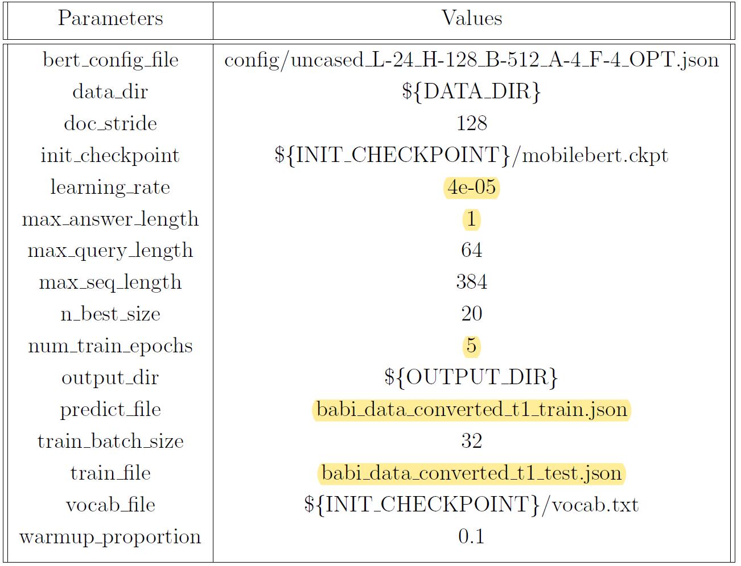
Tests Performed
Example of Parameter Set Used
Number of Tests for each Task
Task | mobileBERT | BERT
1 | 20 | 10
4 | 13 | 10
12 | 31 | 10
A total of 64 tests on mobileBERT with different configuration of hyperparameters
Similar tests, a total of 30, on BERT, wherever supported
count of reported results for tests
Notes:
We started off with the default parameters, or the parameters the mobileBERT authors recommended did a total of 64 tests on mobileBERT across all the tasks. We only did 30 for BERT because we were only interested in the scores would be comparable, and so we can attribute the difference in our results to the difficulty of the dataset and not because mobileBERT was a bad model.

Slide 22
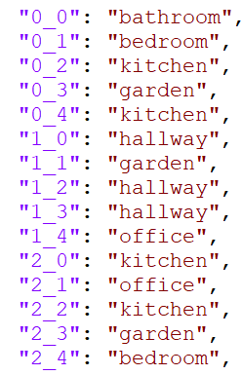
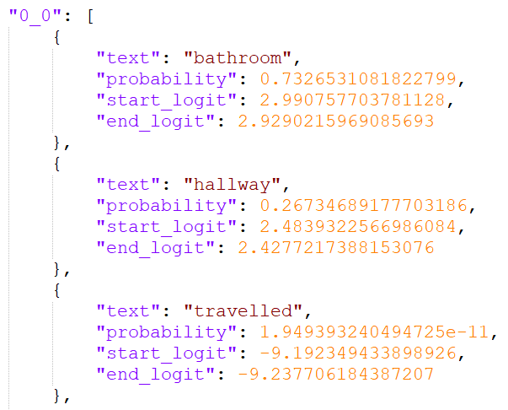
Results: Predictions
Context: "Mary moved to the bathroom. John went to the hallway.”
Question: Where is Mary?
ID: 0_0
predictions.json
nbest_predictions.json
Notes:
This is a sample result for one of the questions from our training dataset. You see the final predictions on the left, but this was derived from the best prediction and we select the one with the highest probability. Then we calculated the accuracy using predictions.json file and the ground truth value we had for the validation dataset, i.e. we see how often mobielBERT got the correct answers.
Then we inspected how this accuracies changed when we manipulated the hyperparameters.

Slide 23
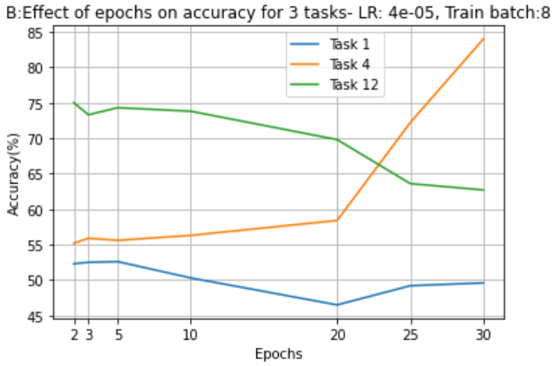
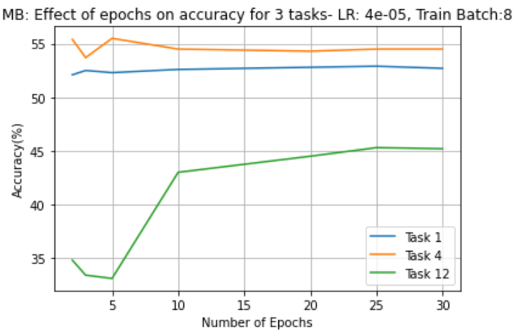
Results: Performance
The number of epochs did not influence the accuracy on Task 1 and Task 4 much, but it did for Task 12
mobileBERT & BERT performances are comparable for task 1 & 4 at least at lower epoch values
Notes:
Left: graph for mobileBERT, Right: graph for BERT
on the left graph, we see that epochs did not influence the accuracies for Task 1 and 4 very much, but for task 12 the accuracy really started to take off after 5 epochs and peaked at 25
when we compare these two graphs, we saw that at least at lower epoch values mobileBERT and BERT performed similarly hovering at around 53-55%

Slide 24
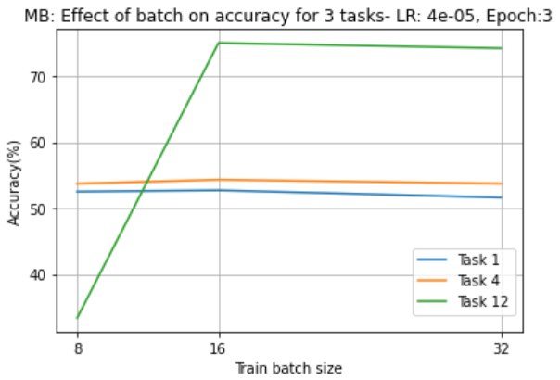
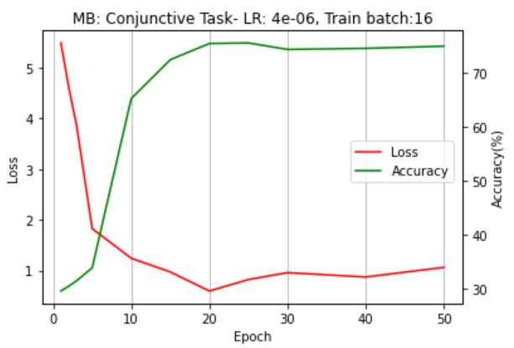
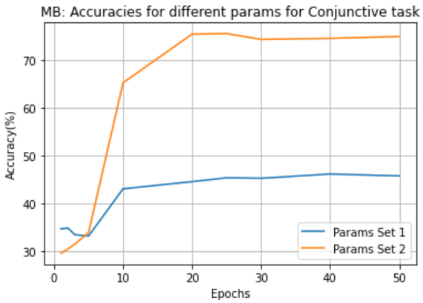
Results
Accuracy almost doubles for Task 12 when batch size was increased
For Task 12, using a smaller learning rate boosted the accuracy and reduced the loss
Accuracy almost doubles for Task 12 with smaller learning rate and bigger batch size of 16 (Blue: lr=4E-05, Orange: lr=4E-06)
Notes:
As we see the graph on the left, when we altered the batch size, the accuracy almost doubled for Task 12.
Moreover, when you changed both the batch size and the learning rate,as you can see on the right most graph, the results were much better than before (represented by the orange line).
Also as we see in the center graph, the loss converged at epoch 20 as the accuracy improved and there was no significant difference in the values of both loss and accuracy beyond that epoch value.

Slide 25
Outline
Motivation and Question
Basics and Definition
Approach
Results
Discussion and Conclusion

Slide 26
Discussion
Results of mobileBERT and BERT
Task | Model | Epoch | Learning Rate | Training batch size | Accuracy | Loss
1 | mobileBERT | 5 | 4E-05 | 8 | 52.3 | 1.23
 | BERT | 5 | 4E-05 | 8 | 52.6 | 1.45
4 | mobileBERT | 10 | 4E-05 | 8 | 55.8 | 0.72
 | BERT | 10 | 4E-05 | 8 | 56.3 | 0.70
12 | mobileBERT | 20 | 4E-06 | 16 | 75.4 | 0.59
 | BERT | 20 | 4E-05 | 8 | 69.8 | 0.55
MobileBERT can be trained for bAbI tasks
Hyperparameters should be optimized for each task individually
Accuracy for task 12 doubled with a smaller learning rate, but this was not the case for task 1 and 4
Notes:
Here, we did not report BERT’s best performance because we were more interested if the performances of mobileBERT for the same set of parameters could be comparable.
For mobileBERT specifically, the accuracies for both task 1 and 4 were the best for the given parameter set, in the range of 50-60
But for task 12, we found a new set of hyperparameter which yielded us the best results, with the accuracy of mobileBERT being 75.4%.
We expected task 1 and 12 to perform in a similar way but the results were quite different. We also expected that task 12 would be more difficult than task 1 because it involved 2 people, but still task 12 outperformed all the other tasks. We are not sure why the results were this way because we tried the same set of hyperparameters for task 1 as well but in no case the accuracies went beyond what we reported.

Slide 27
Discussion
Results of mobileBERT and BERT
Task | Model | Epoch | Learning Rate | Training batch size | Accuracy | Loss
1 | mobileBERT | 5 | 4E-05 | 8 | 52.3 | 1.23
 | BERT | 5 | 4E-05 | 8 | 52.6 | 1.45
4 | mobileBERT | 10 | 4E-05 | 8 | 55.8 | 0.72
 | BERT | 10 | 4E-05 | 8 | 56.3 | 0.70
12 | mobileBERT | 20 | 4E-06 | 16 | 75.4 | 0.59
 | BERT | 20 | 4E-05 | 8 | 69.8 | 0.55
Actual vs Expected Performance
bAbI tasks are indeed harder than SQuAD as seen by comparable performance by BERT
Worse than expected performance on Task 1
Performance on Task 4 > Task 1
Performance on Task 12 > Task 1
Notes:
The accuracies of mobileBERT and BERT are comparable for the given parameter set.

Slide 28
Conclusion
Adapting the mobileBERT model to solve tasks from bAbI dataset
Pre-processing bAbI datasets to give as input into mobileBERT
Optimizing Hyperparameters
MobileBERT performed worse on bAbI tasks than on SQuAD
As expected
However, bAbI performed worst on one of the easiest task and better on task requiring world knowledge
Notes:
We were able to adapt mobileBERT to solve tasks of babi dataset by optimizing the hyperparamteres.
We also saw that mobilebert was not able to perform well enough on babi as it did for squad. This can be understood because babi required more of world and analytical understanding.

Slide 29
Conclusion
MobileBERT capable of solving bAbI tasks
performed comparable to BERT
→ due to difficulty in the bAbI dataset and not because mobileBERT is a poor model
Future Work
all tasks from bAbI
pre-trained versions of mobileBERT for transfer learning
Notes:
We can also conclude that mobileBERT, a lighter version of BERT, can solve babi tasks and it indeed is comparable to bert. The results we see are due to babi being difficult and not because mobileBERT is a poor model.
For future work, we can try and work on all the 20 tasks of babi to analyze how well these transformer models can answer such questions. we can also try and use pretrained versions of mobileBERT and perform transfer learning, and hence we might even get to see better results.

Slide 30
References
Zhiqing Sun et al. “Mobilebert: a compact task-agnostic bert for resource-limited devices”. In:arXiv preprint arXiv:2004.02984 (2020)
Devlin, Jacob, Ming-Wei Chang, Kenton Lee, and Kristina Toutanova. "Bert: Pre-training of deep bidirectional transformers for language understanding." (2018).
Image retrieved from https://miro.medium.com/max/ 700/1*qUFgGhSERoWAa08MV6AVCQ.jpeg
Image retrieved from https://miro.medium.com/max/886/1*Tqibs5z0zCntcK6kCpziaA.png
Image retrieved from https://www.researchgate.net/profile/Sagar_Dhungel2/publication/336637712/figure/fig2/AS:815162017730561@1571361178811/bAbi-tasks-1-to-10-3.ppm

Slide 31
The End
Thank you for your attention.
Any question?

Slide 32
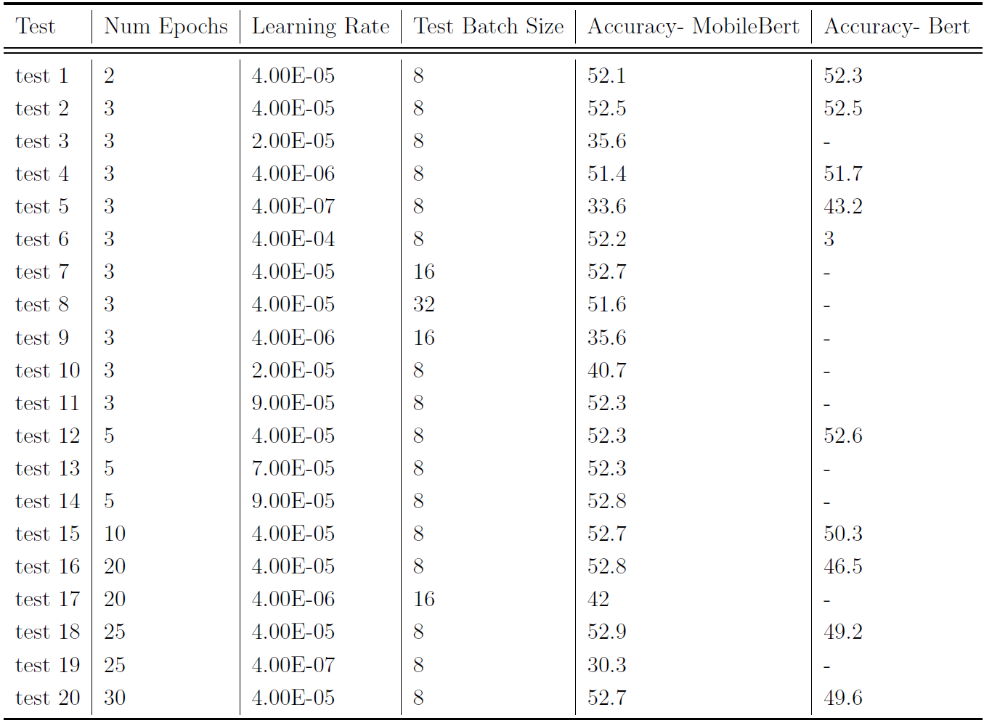
Appendix
Test results Task 1

Slide 33
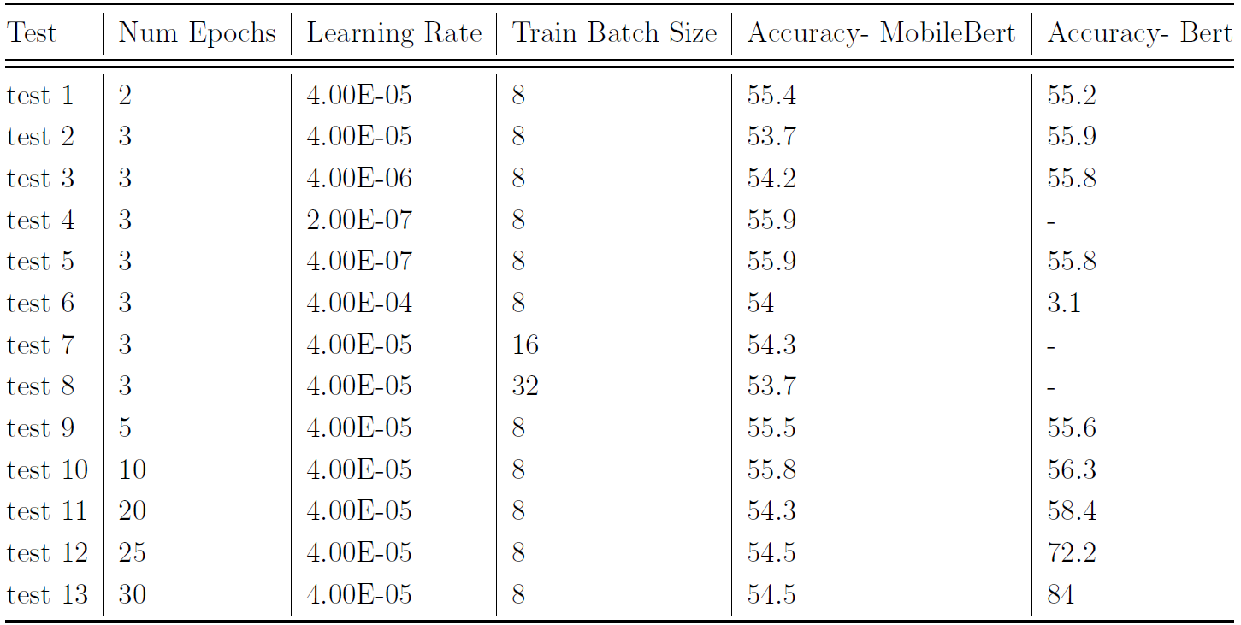
Appendix
Test results Task 4

Slide 34
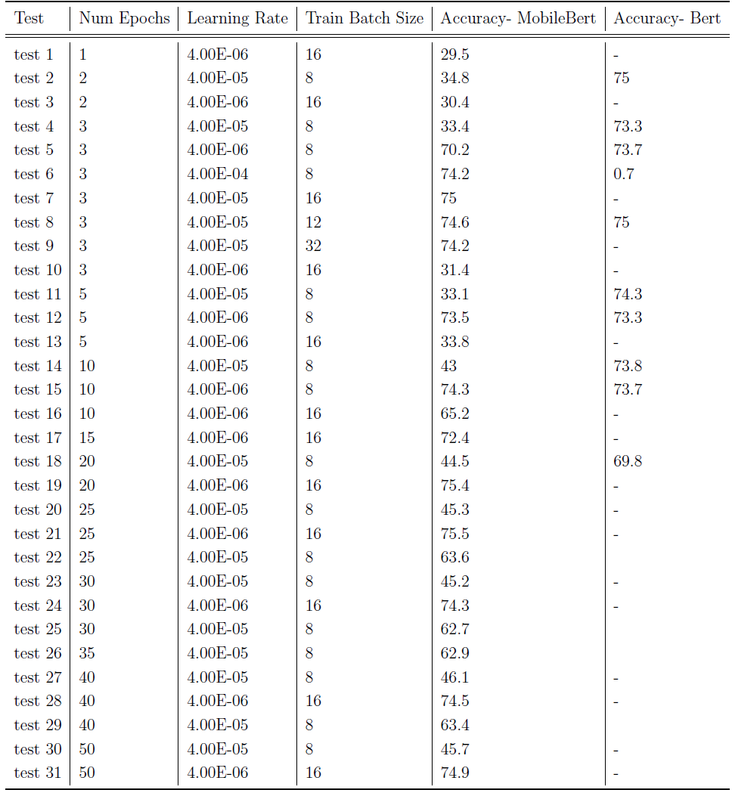
Appendix
Test results Task 12

