Slide 1
Model-Based Reinforcement Learning: MuZero
Navneet Singh Arora & Sana Moin

Slide 2

Outline
Introduction
Prior Work
MuZero Algorithm
Experimental Setup
Results
Discussion and Conclusion

Slide 3
Outline
Introduction
Prior Work
MuZero Algorithm
Experimental Setup
Results
Discussion and Conclusion

Slide 4
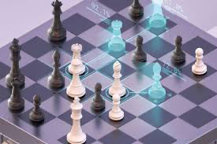
Introduction
Model-Free Reinforcement Learning
Actor-Critic based approach
Task based approach
Pre-defined environment
Rely on environment states and rewards
Model-Based Reinforcement Learning
Dynamic behavior
Generalized approach
Environment is learnt
Rely on environment state and reward predictions
Fig. 1
[1]
[1] https://en.chessbase.com/post/muzero-figures-out-chess-rules-and-all

Slide 5
Outline
Introduction
Prior Work
MuZero Algorithm
Experimental Setup
Results
Discussion and Conclusion

Slide 6
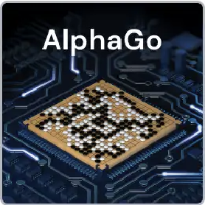

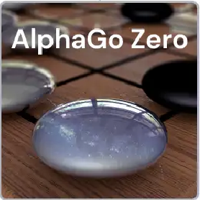
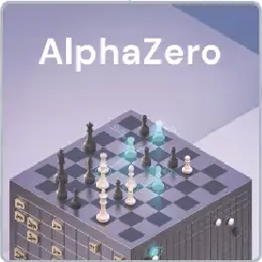
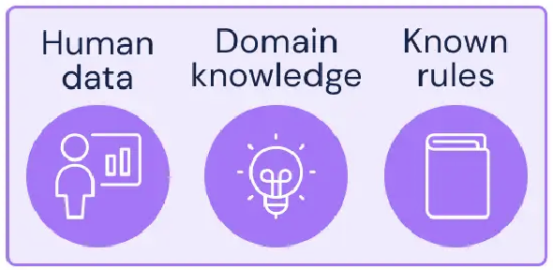
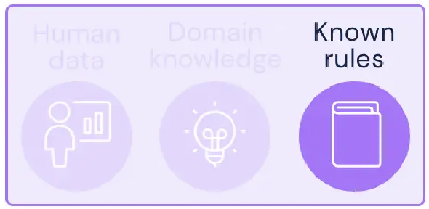
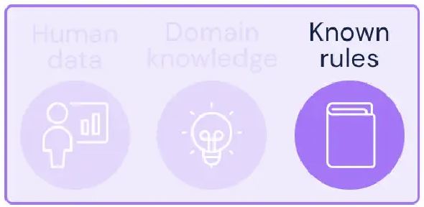
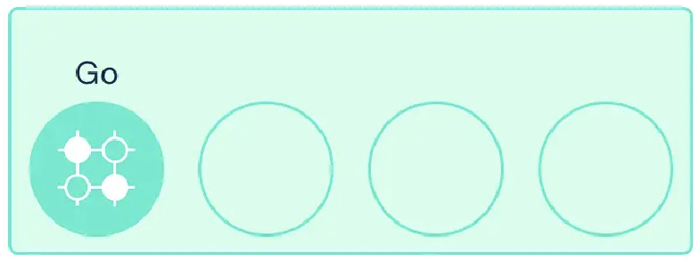
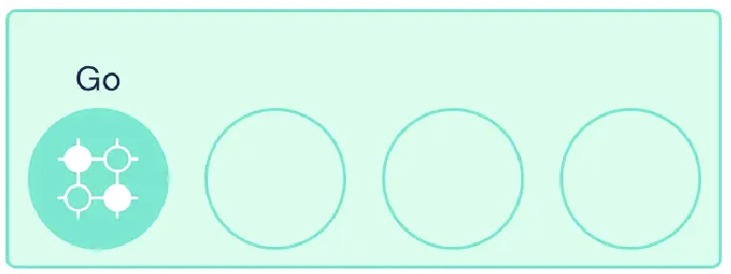
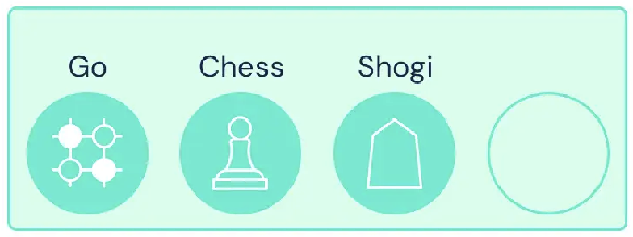
Prior Work
[1]
Fig. 2
[1] https://deepmind.com/blog/article/muzero-mastering-go-chess-shogi-and-atari-without-rules

Slide 7
Outline
Introduction
Prior Work
MuZero Algorithm
Experimental Setup
Results
Discussion and Conclusion

Slide 8
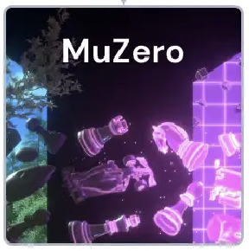
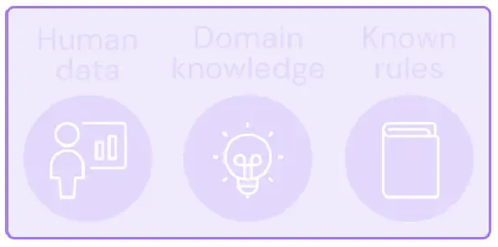
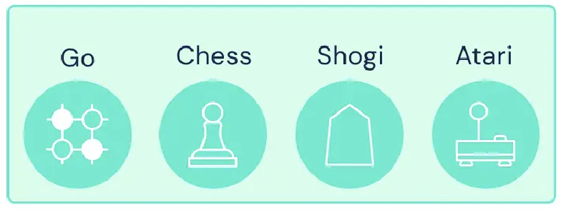
MuZero
Fig. 3
[1]
[1] https://deepmind.com/blog/article/muzero-mastering-go-chess-shogi-and-atari-without-rules

Slide 9
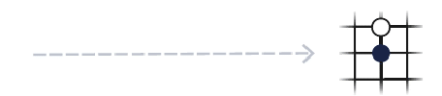
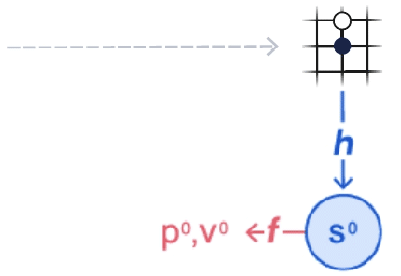
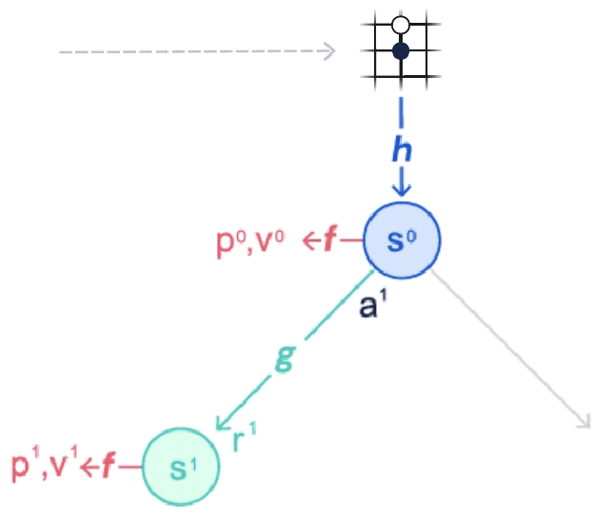
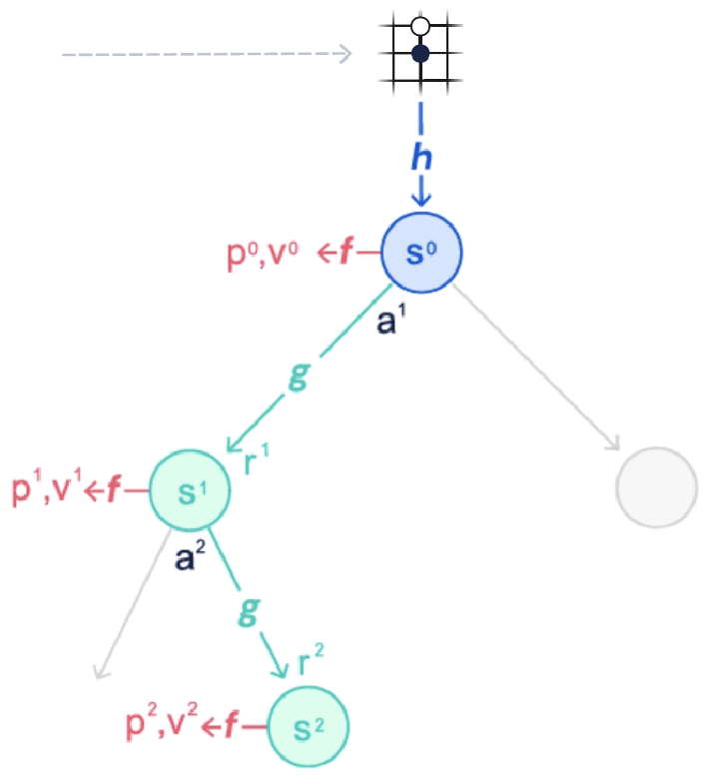
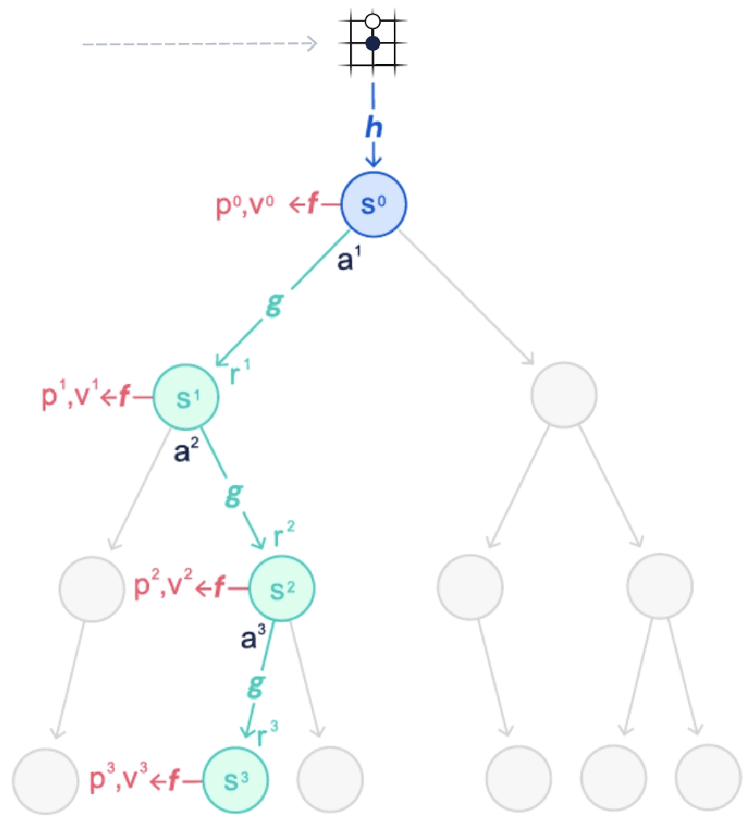
MuZero
[1]
Environment’s Current Position
Representation Function to map observation to an embedding
Dynamics Function computes future states
Prediction Function computes policy and value predictions for subsequent actions
Using these representations, possible future sequences are predicted and best one is chosen using
Monte Carlo Tree Search
Fig. 4
[1] https://deepmind.com/blog/article/muzero-mastering-go-chess-shogi-and-atari-without-rules

Slide 10
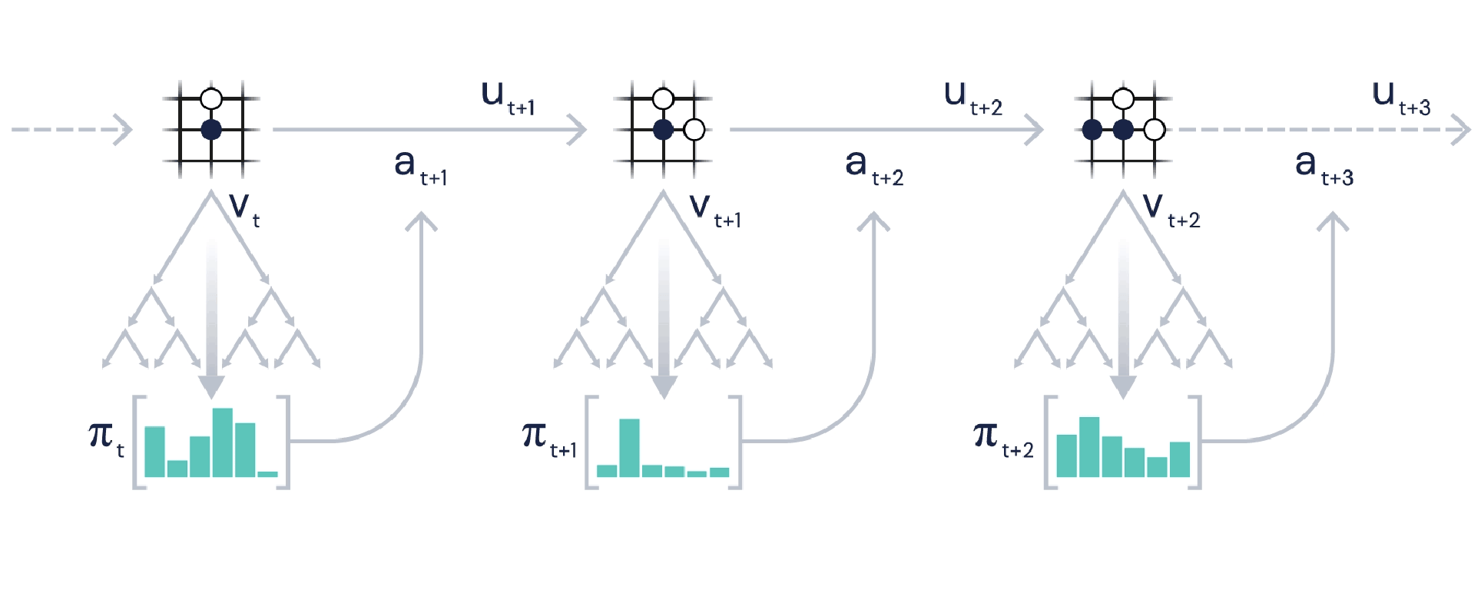
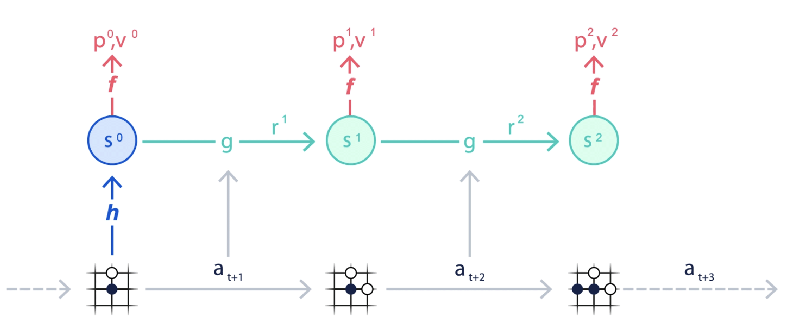
MuZero
[1] a
[1] b
Fig. 5
[1] https://deepmind.com/blog/article/muzero-mastering-go-chess-shogi-and-atari-without-rules

Slide 11
Outline
Introduction
Prior Work
MuZero Algorithm
Experimental Setup
Results
Discussion and Conclusion

Slide 12

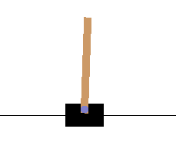
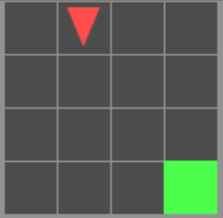
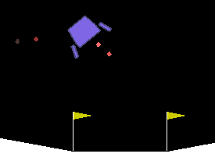


Games Trained
Grid Based Games:
Simple Grid
Gridworld
Tic-tac-toe
Non-Grid Based Games:
Cartpole: Inverted pendulum
Lunarlander: Land the vessel
Twenty-One: Blackjack
Fig. 6-11

Slide 13
Outline
Introduction
Prior Work
MuZero Algorithm
Experimental Setup
Results
Discussion and Conclusion

Slide 14
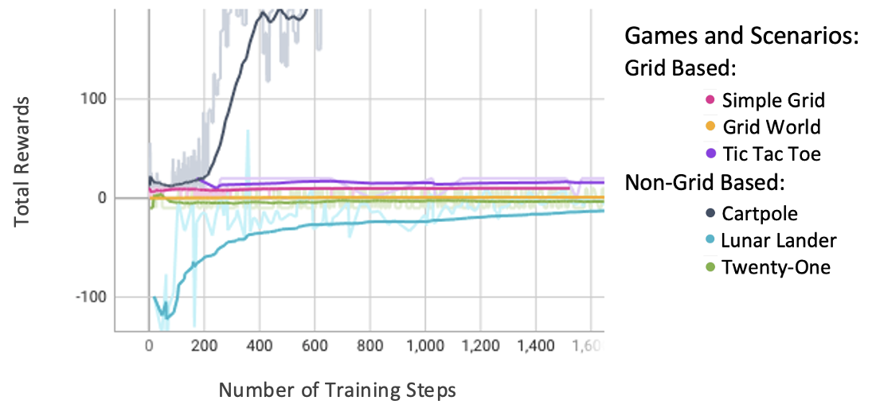
Results
Grid Based:
Simple Grid and Grid World and TicTacToe:
Consistent
Non-Grid Based:
Cartpole:
Sharp increase
Twenty-One:
Consistent reward
Lunarlander:
Small incline
Total rewards per training step
Fig. 12

Slide 15
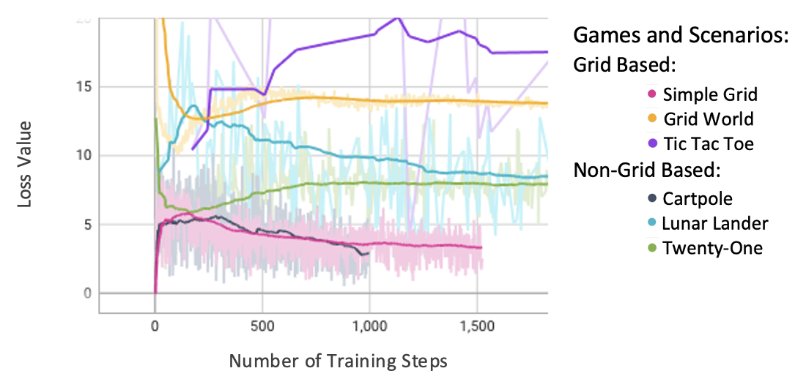
Results
Independent of the type of game
TicTacToe:
Fluctuates
GridWorld and Twenty-One:
Decreases and then consistent
Simple Grid, Lunarlander and Cartpole:
Increases and then decreases
Total weighted loss per training step
Fig. 13

Slide 16
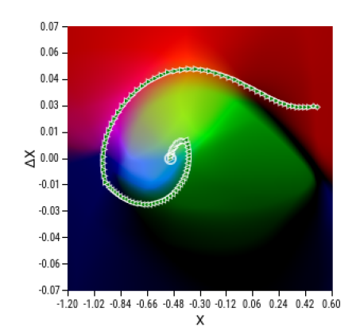
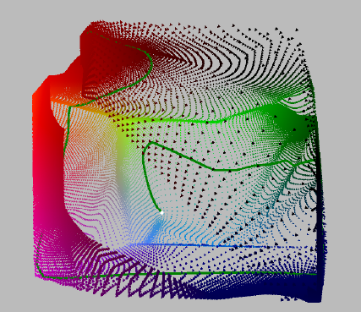
Latent Space Representation
Mountain Car game
Visualize latent space representation of embeddings after Principal Component Analysis
Agent covers the entire latent space
Dynamically close states grouped
Fig.14 Value estimate plot Fig. 15: 4D latent space representation

Slide 17
Outline
Introduction
Prior Work
MuZero Algorithm
Experiment Setup
Results
Discussion and Conclusion

Slide 18
Discussion
Multiple aspects of a game involved in learning
Grid type
Complexity
Draw in a game
Latent space representation and interpretability can aid in future research and development

Slide 19
Discussion: Strengths
The MuZero algorithm: state-of-the-art performance with less information
Intermediary information computed through the hidden states.
Past observations utilized to improve hidden state, policy, and value computation before action
Better generalization than predecessor algorithms

Slide 20
Discussion: Weaknesses
Real-time weight updates:
Computationally expensive
Non-intuitive to understand how environment learns
Hidden states computation is a black-box

Slide 21
Conclusion
Properties of MuZero algorithm and predecessor algorithms
Analyzed games and their execution results
Visual representation of latent space
Analyzed the strengths and weaknesses of Muzero
Future work: multiple outcome possibility, possibility of application on non-game scenarios

Slide 22
References
[1] https://en.chessbase.com/post/muzero-figures-out-chess-rules-and-all
[2] Joery A. de Vries, Ken S. Voskuil, Thomas M. Moerland, and AskePlaat. Visualizing muzero models. CoRR, abs/2102.12924, 2021.
[3] Julian Schrittwieser, Ioannis Antonoglou, Thomas Hubert, Karen Simonyan, Laurent Sifre, Simon Schmitt, Arthur Guez, Edward Lockhart,Demis Hassabis, Thore Graepel, et al. Mastering atari, go, chess and shogi by planning with a learned model. Nature, 588(7839):604–609, 2020.
[4] David Silver, Aja Huang, Chris J Maddison, Arthur Guez, Laurent Sifre, George Van Den Driessche, Julian Schrittwieser, Ioannis Antonoglou, Veda Panneershelvam, Marc Lanctot, et al. Mastering the game of go with deep neural networks and tree search. nature, 529(7587):484–489, 2016.
[5] David Silver, Thomas Hubert, Julian Schrittwieser, Ioannis Antonoglou, Matthew Lai, Arthur Guez, Marc Lanctot, Laurent Sifre, Dharshan Kumaran, Thore Graepel, et al. A general reinforcement learning algorithm that masters chess, shogi, and go through self-play. Science, 362(6419):1140–1144, 2018.
[6] David Silver, Julian Schrittwieser, Karen Simonyan, Ioannis Antonoglou, Aja Huang, Arthur Guez, Thomas Hubert, Lucas Baker, Matthew Lai, Adrian Bolton, et al. Mastering the game of go without human knowledge. nature, 550(7676):354–359, 2017
[7] Greg Brockman, Vicki Cheung, Ludwig Pettersson, Jonas Schneider, John Schulman, Jie Tang, and Wojciech Zaremba. Openai gym, 2016.

Slide 23
The End
Thank you for your attention.
Any questions?

Slide 24
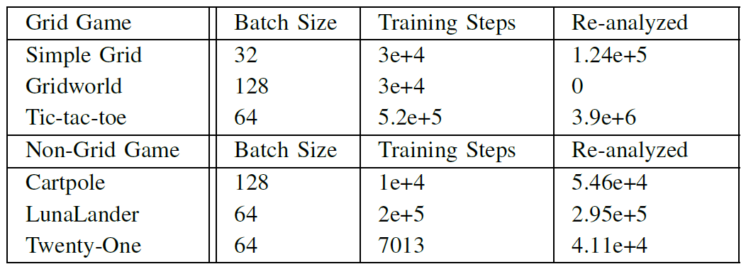
Appendix
Hyperparameters

