Slide 1
Multi-Modal Deep Reinforcement Learning for Robot Control
Sana Moin & Nur Atiqah Zakiah Abdul Khaliq
Advisor: Dr. Muhammad Burhan Hafez
Notes:
Good morning everyone :-)
Myself, Atiqah Khaliq, and my partner Sana Moin will present our literature survey on multi-modal deep reinforcement learning for robot contro. First, I would like to thank our supervisor Dr Muhammad Burhan Hafez.

Slide 2
Outline
Motivation and Question
Basics and Definition
Approach
Discussion
Future Work
Notes:
Here is the outline of our presentation.

Slide 3
Outline
Motivation and Question
Basics and Definition
Approach
Discussion
Future Work
Notes:
We will start with the Motivation and Research Question

Slide 4

Motivation: Humans Vs Robots
Humans use multi-sensory experience for many tasks
Robots use only one sense, usually ignorant to sound in the environment
Multi-modal deep reinforcement learning to integrate multi-sensory information in robots
Source
Notes:
We know that humans use multiple senses to help us complete out tasks, for example when the doorbell rings and we open the door we use our eyes and ears to know that someone is there. However, robots typically only rely on vision and they tend to be ignorant to sound in the environment. Integrating information from multiple modalities is a challenge.

Slide 5
Motivation and Question
Aim of Survey: Overview of the state-of-the-art Multi-Modal Deep Reinforcement learning (MMDRL) Approaches
Task: Indoor robot navigation
Summary of approaches
Advantages and challenges faced in implementing MMDRL in robot control
Recommendations
Notes:
Thus, the aim of our survey is to get an overview of current multi modal deep reinforcement learning.
We narrowed the scope down to indoor navigation, we will summarise several approaches that we have reviewed
And discusses the pros and cons of multi modal deep reinforcement learning approaches
We will also give recommendations for future work

Slide 6
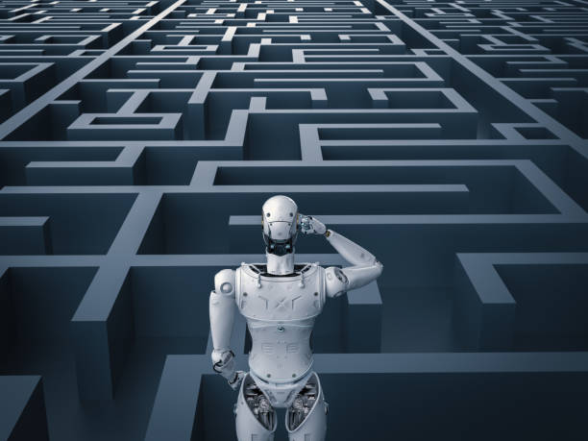
Indoor Robot Navigation
Used in households, warehouses, stores
Limited space and often dynamic elements
Navigation is crucial component, from start to goal location
Subtasks - Path Planning, Collision Prevention, Search Algorithm, and Map Building
Understand environment by using sight, sound, and textual instructions
Source
Notes:
Before we go into the details, we should discuss the task we chose to focus our survey on.
Indoor Robot Navigation is used in households, warehouses, shops etc. These spaces tend to be dense and contain dynamic elements such as people walking. This navigation is crucial, and robots should take advantage of multiple modalities such as sight, sound, text etc to understand their environments.

Slide 7
Outline
Motivation and Question
Basics and Definition
Multi-modality
Reinforcement Learning
Approach
Discussion
Future Work
Notes:
Now we will go through some basic definitions

Slide 8
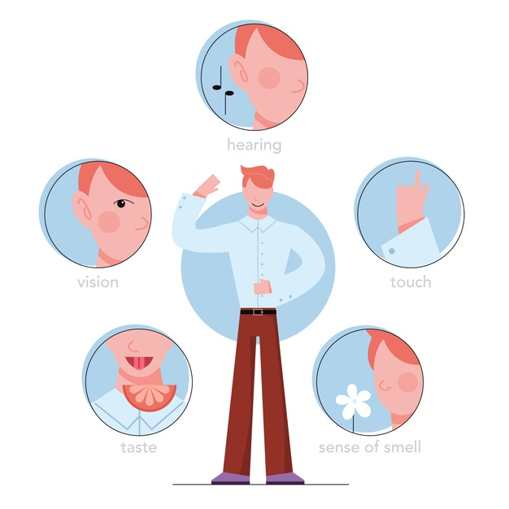
Multi-modality
Modality | Raw format | Format for DL
Vision | Images / Videos | Matrix of pixels, typically representing colour as RGB triplet
Audio | Speech, music, animal sounds, external sounds | Sound waves as spectrograms
Textual | Series of characters | Word embeddings
Notes:
So Multi-modality is the use of information from more than one modality. Modalities that humans use are typically sight, smell, tactile, audio, taste. Most robots rely on vision and the principal modality.

Slide 9
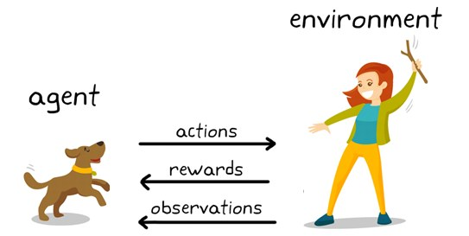
Reinforcement Learning
How agents can learn in an interactive environment using feedback from its actions and experiences
Reward functions: how well agent is doing
Policies: actions the agent should take in a given state
Source
Notes:
I will now give a very brief idea of reinforcement learning - it is how agents can learn in an interactive environment using feedback from its actions and experiences. All approaches require a reward function so that the agent has feedback on how well it is doing. From there, the agent learns a policy which is a mapping of what action to take in a given state.

Slide 10
Outline
Motivation and Question
Basics and Definition
Approaches
Discussion
Future Work
Notes:
So now, we dive into the various approaches we came across in our survey.

Slide 11
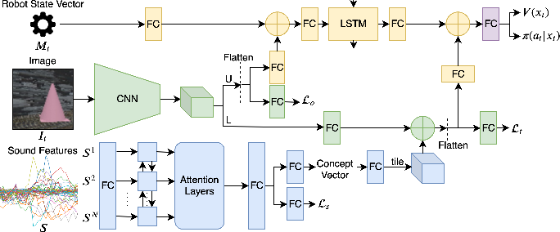
Chang’s Speech Vision MMDRL: Architecture
Notes:
This is the first one, from Chang and colleagues. The architecture of their proposed system is an end-to-end architecture that receives sound features and images from each time step to output an action policy. The sound signals are processed in a biLSTM, the images are processed in a CNN and the state vector simply in a dense layer. The CNN output is split into two parts, one is fused with the sound concept and one is fused with the state vector, then these parts are concatenated and passed to a reinforcement learning component to generate action and value functions. It uses several task specific losses, Ls for associating sound to target, Lo for object recognition and Lt for target recognition.
In the purple part: Proximal Policy Optimization (PPO) from OpenAI Baselines, model-free, is used to train the policy and value function when given the fused sound-image and image-state vectors

Slide 12
Chang’s Speech Vision MMDRL: Experiments
Experiments
Types of Sound
experiment with single-word speech signals, environmental sounds, and single-tone signals.
Multiple Sound Types
identify if network could map different sounds to a single object
Dynamic Interpretation of Sound
show that sound concept can evolve dynamically in the network
Notes:
The authors focussed on the sound concepts and how it can be fused with vision. They experimented with three things, whether their architecture is robust to different types of sound, whether it can learn to map multiple sound types to one object and they wanted to show that sound concepts can evolve.

Slide 13
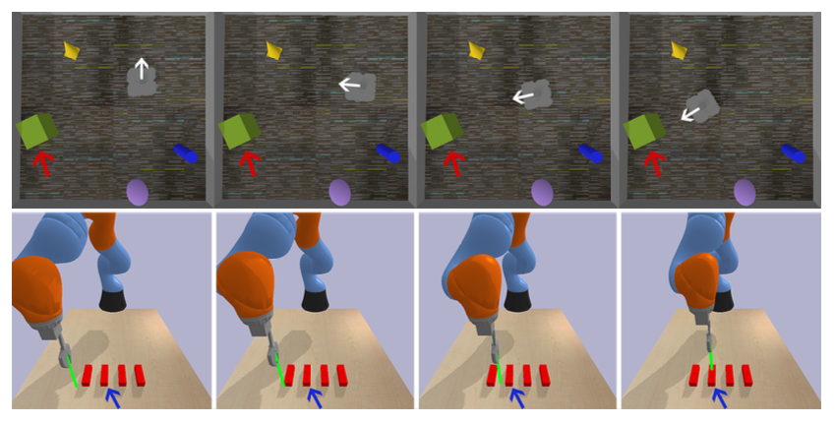
Chang’s Speech Vision MMDRL: Experiments
Kuka 2D
reward is highest when the gripper is at the centre of the target block in the XY-plane
Turtlebot 3D
reward increases as it approaches the target while maintaining a safe distance
Notes:
They simulated two environments, a 2d and a 3d one. In the 2d world, the agent had to move the gripper above the target block and in the 3d world the agent had to move towards and stay near the target.

Slide 14
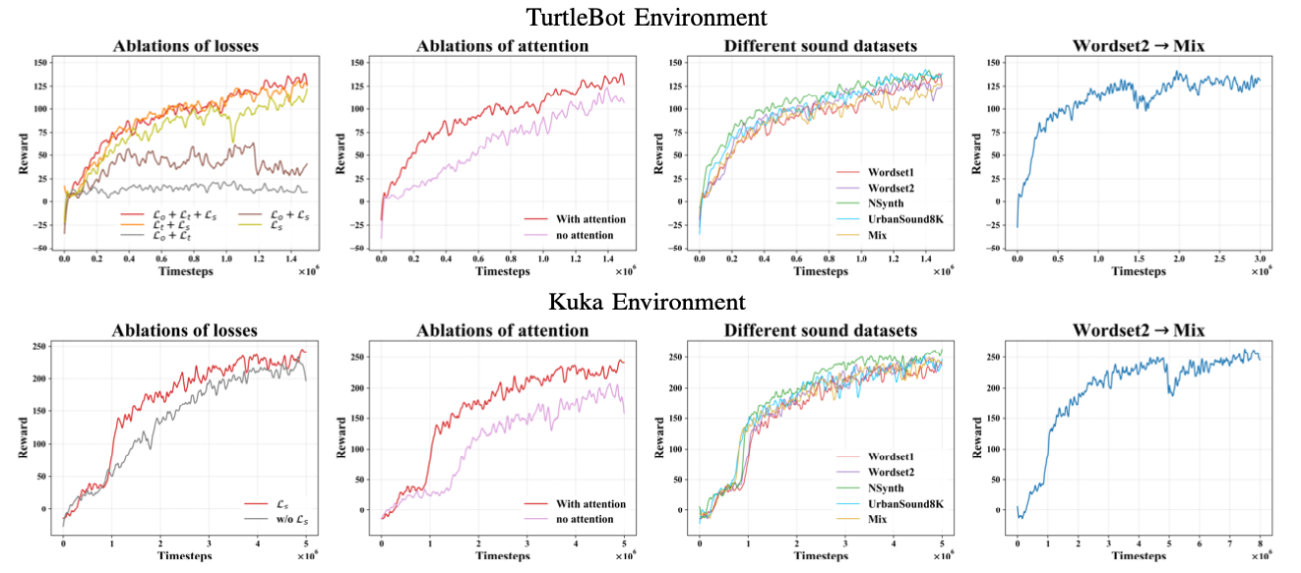
Chang’s Speech Vision MMDRL: Results
Notes:
First Graph LOSS Functions: researchers removed one loss function at a time to identify its importance in the model
They found that loss function for sound provides guidance for sound interpretation, which facilitates policy learning. On the other hand, we did not see a big impact of loss function of object or target identification during training. But without these loss functions, the agent performs badly in new situations - it could not identify the correct target ad often went for the first object it saw. As such, the researchers deemed it necessary to have all three auxiliary losses for any agent in the dynamic Turtlebot environment.
Results; There are two rows, but this is because the authors tested their network on two virtual simulation environments.
SOUND:
Third Graph: Network performed similarly for the different types of sounds (wordsets contain word utterances, nsynth contained pure tones and urbahnsound8k contains environmental sounds), this suggests that all types of sound could be processed by the network and potentially be used if relevant to a robot’s task
Third Graph (MIX label) in orange, where the dataset contained multiple sound types associated to the same visual object: network can associate the utterance ”dog” and the sounds of a dog barking in the same visual object
Fourth Graph: Dynamic interpretation: From Figure 4 in the graph of using only word utterances and slater adding different sound types, we see that the reward dips slightly, corresponding to the addition of two new types of sound signals associated to the same visual object, but it quickly increases and achieves a similar reward and success rate as on the other sound datasets.
WordSet 2 only includes word utterances and Mix dataset combines word utterances with environmental sounds - what happened here was the network was trained only with words utterances and after several timesteps environmental sounds were used to refer to the same object was introduced. There was a dip in average reward, but it quickly bounced back suggesting that the sound concept can evolve and the model can map two types of sound to a single visual object.

Slide 15
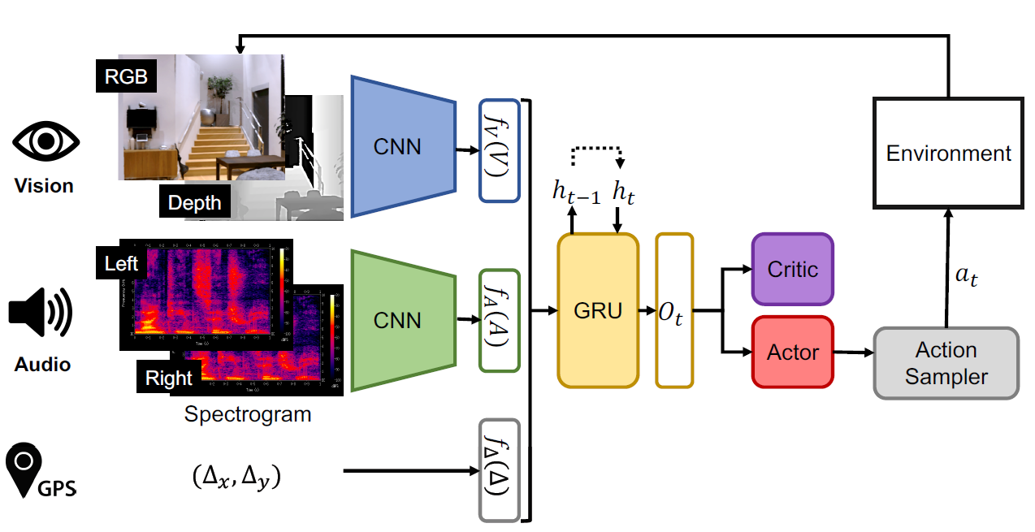
Chen’s Speech Vision MMDRL: Architecture
Notes:
In this approach, three types of input are considered. Audio signals are first pre-processed into spectrograms. Visual signals are given as RGB(D) image. Moreover, a relative displacement vector of the agent to the goal in 2D space is provided by the third input, GPS.
Both audio and visual inputs are processed using CNNs.The outputs of the CNNs are concatenated together along with the relative displacement vector.
This concatenated result is given as input to GRU that operates on the current step's input and the accumulated history of states.
Finally, through Proximal Policy Optimization, the value of the state are estimated using the critic and actor heads of the model, which are both linear layers. The reward depends upon the action correctness and the distance from the goal location.

Slide 16
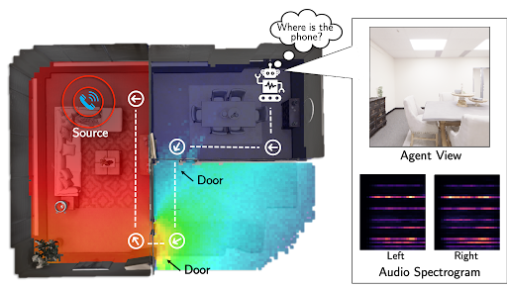
Chen’s Speech Vision MMDRL (SoundSpaces)
Audio visual embodied navigation for 2 visually realistic 3D environments: Replica and Matterport3D
Audio simulator, Habitat, produces realistic audio rendering based on the room geometry, materials and sound source location.
 | # scenes | Avg. Area | # training epochs
Replica | 18 | 47.24 m² | 0.1M
Matterport3D | 85 | 517.34 m² | 2M
Table 1. Summary of dataset statistics
Notes:
For training and validating this model, 2 visually realistic environments are used.
Replica: It is a dataset of 18 apartments, hotels, oces, and room scenes with 3D meshes.
Matterport3D: These are the realworld homes and other indoor environments with 3D meshes and image scans,
These two are hosted within Habitat which is an open-source platform.

Slide 17
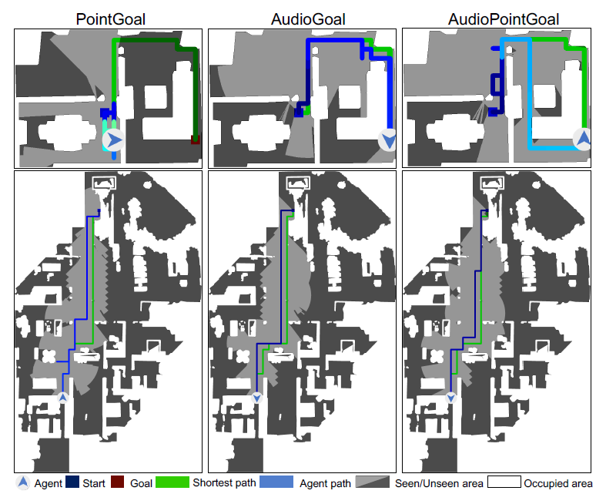
Chen’s Speech Vision MMDRL: Experiments and Results
Audio visual navigation tasks:
PointGoal: displacement vector pointing towards the goal
AudioGoal: an audio signal
AudioPointGoal: both displacement vector and audio signal
Notes:
For the navigation tasks,there are three variants that are considered.
1. PointGoal: The target is identified by a GPS cue.
2. AudioGoal: The target is identified by the sound it emits by audio hint, even when it is not in the visual space.
3. AudioPointGoal: The target is identified by the sound it emits and a GPS cue. The agent gets both audio and directional hints.
The image on the right shows the top down map of the room of replica. Green path indicates the shortest path. The top three shows for Replica where for the PointGoal, the agent bumps into the wall several times. In contrast, the AudioGoal and AudioPointGoal agents get a better sense of the target: the sound travels through the door and the agent leaves the starting room immediately.
In the Bottom for Matterport, the AudioGoal agent best again avoids backtracking to efficiently reach the target in a large multi-room home.

Slide 18
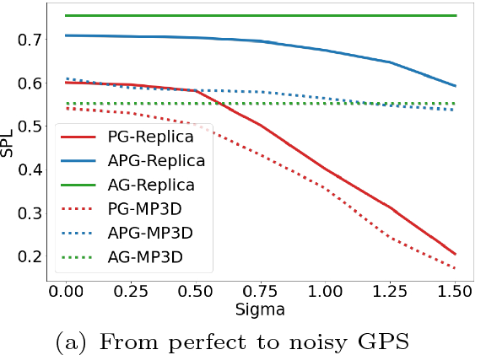
Chen’s Speech Vision MMDRL: Experiments and Results
AudioGoal is immune to GPS noise and robust to microphone noise
Audio signal gives similar or even better spatial cues than the PointGoal displacements
Notes:
The graph shows the Navigation accuracy with increasing GPS noise for different tasks. Unlike existing PointGoal agents, the AudioGoal agent does not rely on GPS,
and hence is immune to GPS noise.

Slide 19
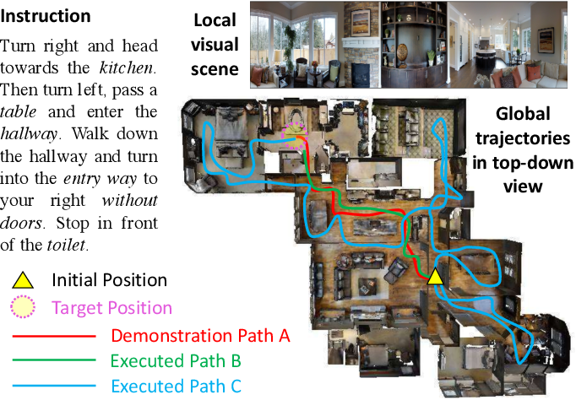
Wang’s Speech Vision MMDRL
Instruction provided to robot
Difficult when in a new environment
Issues addressed:
Cross-Modal Grounding
Ill-posed feedback
Generalization
Approaches: Cross Modal Matching, Self-supervised imitation learning
Dataset: Room-to-Room - panoramic view images of rooms
Training | Seen validation | Unseen validation | Test
14,025 | 1,020 | 2,349 | 4,173
Table 2: Dataset partition
Notes:
This task becomes even more dicult when it comes to the robot being in a new environment. In this approach, the authors try to address three different issues in such a robot navigation system in a 3D environment: (1) Cross-Model Grounding, (2) Ill-posed feedback, which means that a feedback that can deviate the agent from optimal policy learning and (3) Generalization.
So to address them, the authors came up with two approaches, cross modal matching and self supervised imitation learning, that I will describe in just a moment.
Room-to-Room (R2R) dataset, which consists of panoramic view images of rooms

Slide 20
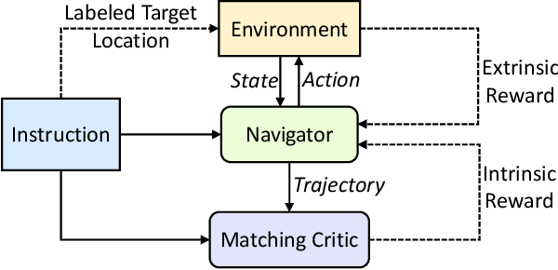
Wang’s Speech Vision MMDRL: Architecture
Cross Modal Matching (CRM)
Two modules:
Reasoning navigator
Matching critic
Two reward functions are used:
Extrinsic reward : by environment , measures success signal and the navigation error
Intrinsic reward: from matching critic, measures the alignment between the language instruction and the navigator’s trajectory
LSTM for both modules
Notes:
We first look at Reinforced Cross-modal Matching(RCM) model proposed.
This model comprises two modules: 1) a reasoning navigator , 2) a matching critic V.
The Reasoning Navigator module is responsible for interpreting the text
instructions into a sequence of actions by incorporating both text instructions
with the panoramic view and a historical context. The reasoning navigator takes as input the trajectory history, textual and visual context to predict an output. For policy learning, the extrinsic reward function is used that measures the success signal and the navigation error of each action.
Matching Critic- in this case, The intrinsic reward function from the matching critic
is introduced. It computes how well the actions generated from the reasoning
navigator matches the textual instructions. It is helpful if the robot had followed a different path to reach the correct destination, hence penalizing the deviation from the path.

Slide 21
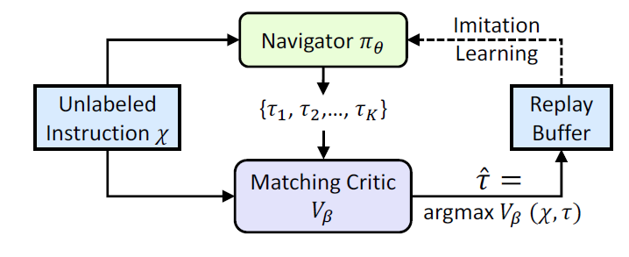
Wang’s Speech Vision MMDRL: Architecture
Self Supervised Imitation Learning (SIL)
Adapt by itself in unseen environments
Uses trajectories that matching critic had evaluated
Good trajectories reused from the replay buffer
Generalizability improves
Notes:
The robots may perform well when they learn from an already seen environment, but it is challenging for them to perform well in unseen environments. This new approach, SIL, which can explore and adapt by itself in unseen environments. It takes advantage of the trajectories that the matching critic had evaluated. In the image, where given an instruction, the navigator produces a set of possible trajectories. The matching critic determines the best trajectory, ^ , and that is stored in the Replay Buffer. The agent optimizes itself by self-supervision by reusing these good trajectories from the replay buffer.

Slide 22
Wang’s Speech Vision MMDRL: Experiments and Results
Evaluation metrics:
Success rate weighted by inverse Path Length (SPL)
Train in seen environments, test on previously unseen environments in a zero-shot fashion (RCM and SIL)
RCM outperforms the existing methods
SIL was able to imitate the RCM agent’s behaviors and generate efficient policies.
Ablation study: Success Rate for unseen environments dropped when the intrinsic/extrinsic reward was removed
Generalizable model
Notes:
Success rate weighted by inverse Path Length (SPL) because it considers both effectiveness and efficiency.
The standard testing scenario of the task is to train the agent in seen environments and then test it in previously unseen environments in a zero-shot fashion.
The RCM outperforms the existing methods and SIL was able to imitate the RCM agent's behaviors and generate efficient policies.
It was observed by the ablation study that the Success Rate for unseen environments dropped when the intrinsic reward was removed, indicating its importance for exploration of such environment. Similar as when extrinsic rewards were not used.

Slide 23
Outline
Motivation and Question
Basics and Definition
Approach
Discussion
Future Work

Slide 24
Discussion: Generalizability
Indoor environments are dynamic, so robots should be able to localize themselves with time
Reinforcement learning helps robot learn continuously
Sounds can be used to navigate in an unknown environment
Self-supervised imitation learning
Robots responsive to other sound-emitting objects in the environment
Notes:
The indoor environments are dynamic. The robots should be designed in a way that they can localize themselves with time and perform well. Reinforcement learning has helped with this aspect, as it enables the robot to learn continuously.
We saw how sounds can be used to navigate in an unknown environments. We also saw how generalizability can be enhanced through self-supervised imitation learning. Additionally, we see that in first and second approach, the proposed models were able to handle different types of sound signals, beyond speech.

Slide 25
Discussion: Architecture
Different components handle each modality, further connected to reinforcement learning component
Architectures :
Same CNN for both audio and visual signals
LSTM for audio and a CNN for vision
LSTM for textual and CNN for vision
Depends upon what the network has to learn:
Feature extraction
Generating mapping between input and a concept
Notes:
Most of the approaches had architectures that were easy to understand because
they could be broken down into smaller components. We observed in most of the approaches that there are always components that handle each modality, and they are connected downstream to a
reinforcement learning component which is responsible for deciding which action
to take next.
These decisions depend on what the researchers wish the network to learn, some
may want to extract features while others may want to create a mapping between
input and a concept.

Slide 26
Discussion: Architecture
Adaptability of MMDRL
Passing Information Downstream
Simple concatenation of the outputs of the modal-specific components
GRU components to accumulate information from several time steps
Training the model End-to-End
RL handles the integration of the various modalities and maps it into an action policy
Training the model as a whole overcomes the fusion problem
Notes:
There are different ways to pass the information downstream. Most architectures concatenate the outputs from the different modal-specific components. However, some may utilize a Gated Recurrent Unit to accumulate information from several time steps.
\\ \\
As such, an end-to-end network provide a means to overcome the fusion of data from different modality. The reinforcement learning components essentially act as the integrator to address this problem. As long as the outputs of each modal-specific component can be represented in the same way, i.e., in a tensor, the MMDRL architecture can be trained as a whole.

Slide 27
Discussion: Advantages
Robustness of object concept
Multi-modality helps infer spatial information from several types of information and sensors
Notes:
First advantage, Robustness of object concept
When the modalities are combined, the agent has a more robust concept of an object i.e. a ringing phone and ‘telephone’ refer to the same visual scene.
Multi-modality helps infer spatial information from several types of information and sensors - this is because MMDRL helps with cross-grounding by integrating different modalities.
Think of the McGurk Effect.
An example we saw earlier, Audio signals boost the robot’s spatial awareness even when GPS signals are noisy

Slide 28
Discussion: Advantages
MMDRL can be trained in virtually
Little or no expense
Less wear-and-tear on robots
Transferrable to real-world applications
End-to-end trained architectures:
Identifies relevant features itself
No additional rules or handwritten features required
Notes:
These networks are also easily trained in virtual simulations
And because they can be trained end2end, the network can identify for itself which features of the text/sound/visual information is relevant. This means less reliance on domain knowledge or handwritten features.

Slide 29
Discussion: Challenges
Generalizability of the models
Error accumulation can lead to bad decisions in complex tasks
Multitasking robot - need for the future, expensive as of now
Suitable RL algorithm to integrate different modalities for the respective task
Notes:
A challenge is still the generalizability of the models, they are trained only one one specific task at a time.
Error can accumulate and can lead to bad action policies in complex tasks.
As such, more work needs to be done before multi-tasking robots can be trained with such an architecture.
Additionally, the RL algorithms needs to be suitable for the respective task.

Slide 30
Outline
Motivation and Question
Basics and Definition
Approach
Discussion
Future Work

Slide 31
Future Work
General Architecture
Stick to the overall MMDRL architecture
Loss function for training
Use one for every component/subtask in the network
Notes:
Researchers should stick to the general architecture of MMDRL - with components for each modality
that is fused together in the reinforcement learning component.
More thought can be placed into selecting the best sub-architectures for each component,
how these components should be connected, loss functions, and reward functions.
best if loss functions are used in every component in the network,. This would facilitate the learning in each component.

Slide 32
Future Work
Reward function
Prioritized and assigned based on the relevance to agent’s progress
Specificity & Generalizability Balance
MMDRL can support different tasks without significant changes in architecture, but more computation with more features necessary which may slow the robot down
Notes:
Furthermore, the reward functions should be prioritized and assigned based on
their relevance to the agent’s progress
MMDRL networks are great because they can be used to meet different
aims without significant changes to the architecture.
However, the researcher would also have to take into consideration the aim of
the robot. There is a trade-off between the amount of computation
and generalizability.
A multi-tasking MMDRL agent would be beneficial in a household, but, several action policies would be necessary
for the robot to learn leading to more computation, and the agent would have to learn when to switch between policies.

Slide 33
References
Peixin Chang et al. “Robot Sound Interpretation: Combining Sight and Sound in Learning-Based Control”. In:2020 IEEE/RSJ International Conference on Intelligent Robots and Systems (IROS). 2020, pp. 5580–5587.doi:10.1109/IROS45743.2020.9341196
Changan Chen et al. “Soundspaces: Audio-visual navigation in 3d environments”. In:Proceedings of the European Conference on Computer Vision(ECCV). Springer. 2020
Xin Wang et al. “Vision-Language Navigation Policy Learning and Adapta-tion”. In:IEEE Transactions on Pattern Analysis and Machine Intelligence(2020), pp. 1–1.doi:10.1109/TPAMI.2020.2972281
Image retrieved from https://miro.medium.com/max/ 700/1*qUFgGhSERoWAa08MV6AVCQ.jpeg
Image retrieved from https://miro.medium.com/max/886/1*Tqibs5z0zCntcK6kCpziaA.png
Image retrieved from https://www.researchgate.net/profile/Sagar_Dhungel2/publication/336637712/figure/fig2/AS:815162017730561@1571361178811/bAbi-tasks-1-to-10-3.ppm

Slide 34
The End
Thank you for your attention.
Any question?

