Slide 1
Cryptography and Network Security
Traditional Symmetric-key Ciphers

Slide 2
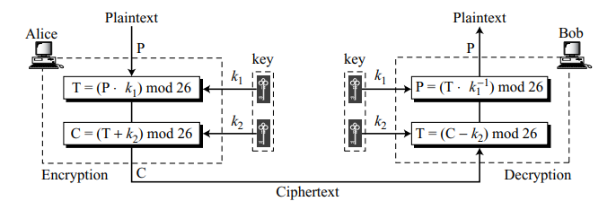
Affine Cipher
The additive and multiplicative ciphers are combined to get the affine cipher – a combination of both ciphers with a pair of keys.
The first key is used with the multiplicative cipher; the second key is used with the additive cipher.

Slide 3
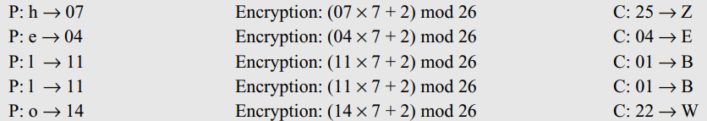
Affine Cipher
Use an affine cipher to encrypt the message “hello” with the key pair (7, 2).
Solution: We use 7 for the multiplicative key and 2 for the additive key. We get “ZEBBW”.

Slide 4
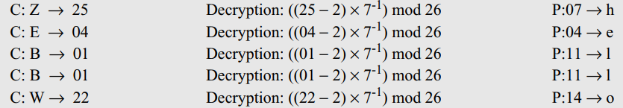
Affine Cipher
Use the affine cipher to decrypt the message “ZEBBW” with the key pair (7, 2) in modulus 26.
Solution: Add the additive inverse of − 2 ≡ 24 (mod 26) to the received ciphertext. Then multiply the result by the multiplicative inverse of 7⁻¹ ≡ 15 (mod 26) to find the plaintext characters.

Slide 5
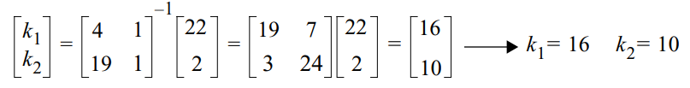
Cryptanalysis of Affine Cipher
Assume that Eve intercepts the following ciphertext:
Eve also very briefly obtains access to Alice’s computer and has only enough time to type a two-letter plaintext: “et”.
These two congruence equations can be solved and the values of k₁ and k₂ can be found. However, this answer is not acceptable because k₁ = 16 cannot be the first part of the key. Its value, 16, does not have a multiplicative inverse in Z_{26*}. Or gcd(16, 26) ≠ 1

Slide 6
Cryptanalysis of Affine Cipher
Eve now tries another way.
The square matrix and its inverse are the same. Now she has k1 = 11 and k2 = 4. This pair is acceptable because k1 has a multiplicative inverse in Z_{26∗}. She tries the pair of keys (19, 22), which are the inverse of the pair (11, 4), to decipher the message. The plaintext is

Slide 7
Transposition Cipher
A transposition cipher does not substitute one symbol for another, instead it changes the location of the symbols.
A symbol in the first position of the plaintext may appear in the tenth position of the ciphertext.
Keyless Transposition Ciphers –
There are two methods for permutation of characters.
In the first method, the text is written into a table column by column and then transmitted row by row.
In the second method, the text is written into the table row by row and then transmitted column by column.

Slide 8
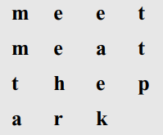
Transposition Cipher
Alice and Bob can agree on the number of columns and use the second method.
Alice writes the same plaintext, row by row, in a table of four columns.
She then creates the ciphertext “MMTAEEHREAEKTTP” by transmitting the characters column by column.
Bob receives the ciphertext and follows the reverse process.

Slide 9

Transposition Cipher
Keyed Transposition Ciphers –
The plaintext is divided into groups of predetermined size, called blocks, and then use a key to permute the characters in each block separately.
Alice needs to send the message “Enemy attacks tonight” to Bob. Alice and Bob have agreed to divide the text into groups of five characters and then permute the characters in each group. The following shows the grouping after adding a bogus character at the end to make the last group the same size as the others.
The key used for encryption and decryption is a permutation key, which shows how the character are permuted. For this message, assume that Alice and Bob used the following key:

Slide 10
Transposition Cipher
The third character in the plaintext block becomes the first character in the ciphertext block; the first character in the plaintext block becomes the second character in the ciphertext block; and so on. The permutation yields
Alice sends the ciphertext “EEMYNTAACTTKONSHITZG” to Bob.
Bob divides the ciphertext into 5-character groups and, using the key in the reverse order, finds the plaintext.

Slide 11
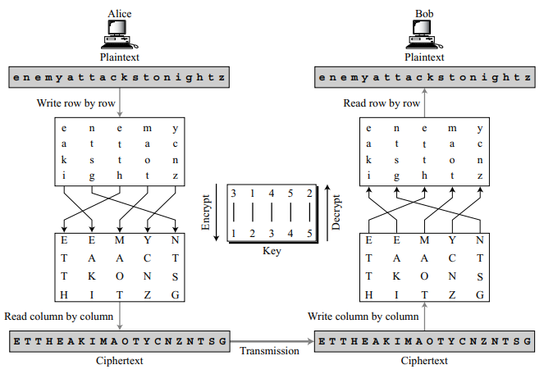
Combining Two Approaches

Slide 12
Cryptanalysis of Transposition Ciphers
Statistical Attack –
This method can be useful if the length of the ciphertext is long enough.
Transposition ciphers do not preserve the frequency of digrams and trigrams. This means that Eve cannot use these tools.
Brute-Force Attack –
Eve can try all possible keys to decrypt the message. However, the number of keys can be huge (1! + 2! + 3! + . . . + L!), where L is the length of the ciphertext.
A better approach is to guess the number of columns. Eve knows that the number of columns divides L. For example, if the length of the cipher is 20 characters, then 20 = 1 × 2 × 2 × 5. This means the number of columns can be a combination of these factors (1, 2, 4, 5, 10, 20).

Slide 13
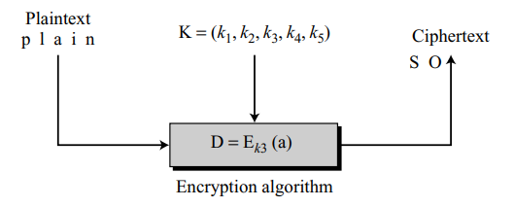

Stream Cipher
In a stream cipher, encryption and decryption are done one symbol (such as a character or a bit) at a time. We have a plaintext stream, a ciphertext stream, and a key stream.
We call the plaintext stream P, the ciphertext stream C, and the key stream K.
Characters in the plaintext are fed into the encryption algorithm, one at a time; the ciphertext characters are also created one at a time.
The key stream is a stream of predetermined values created using an algorithm.

Slide 14
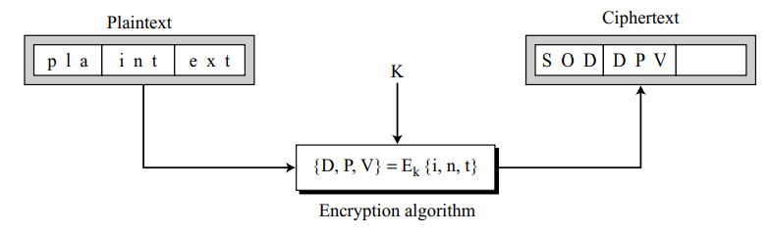
Block Cipher
In a block cipher, a group of plaintext symbols of size m (m > 1) are encrypted together creating a group of ciphertext of the same size.
Based on the definition, in a block cipher, a single key is used to encrypt the whole block even if the key is made of multiple values.
In a block cipher, a ciphertext block depends on the whole plaintext block.

